Slide 1
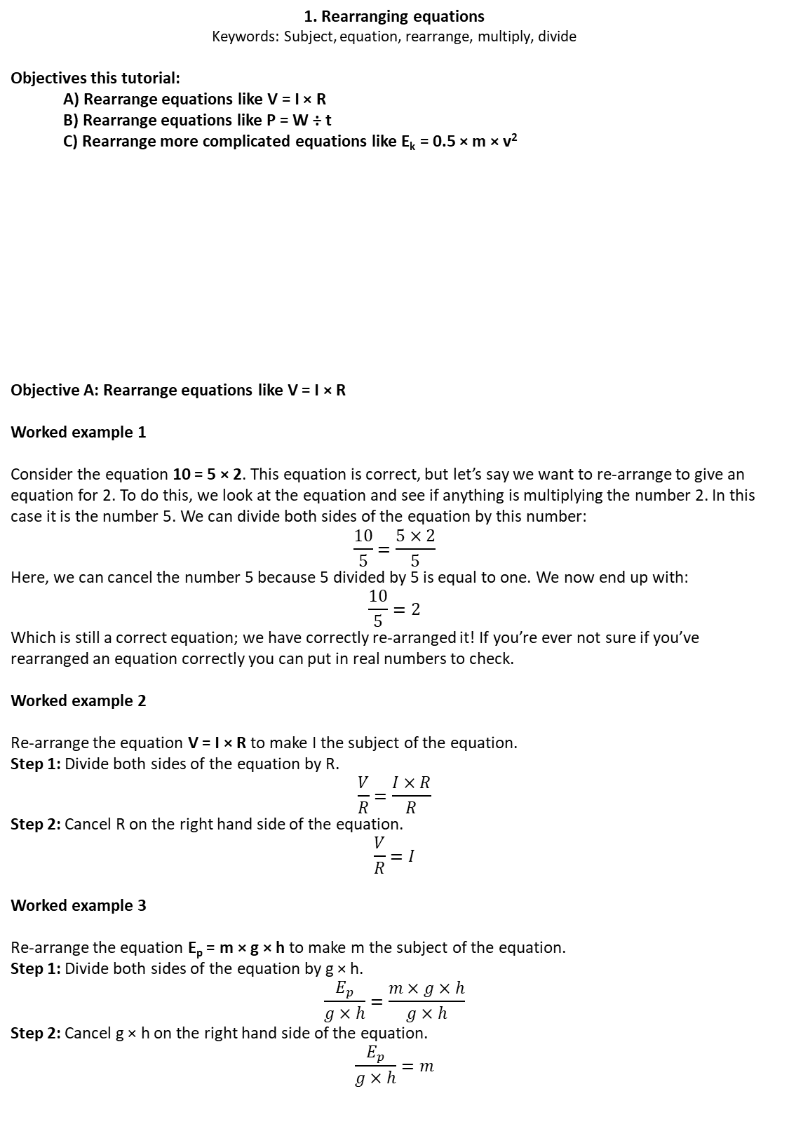
1. Rearranging equations
Keywords: Subject, equation, rearrange, multiply, divide
Objectives this tutorial:
  A) Rearrange equations like V = I × R
  B) Rearrange equations like P = W ÷ t
  C) Rearrange more complicated equations like E_{k} = 0.5 × m × v²
Objective A: Rearrange equations like V = I × R
Worked example 1
Consider the equation 10 = 5 × 2. This equation is correct, but let’s say we want to re-arrange to give an equation for 2. To do this, we look at the equation and see if anything is multiplying the number 2. In this case it is the number 5. We can divide both sides of the equation by this number:
$$\frac{10}{5}=\frac{5×2}{5}$$
Here, we can cancel the number 5 because 5 divided by 5 is equal to one. We now end up with:
$$\frac{10}{5}=2$$
Which is still a correct equation; we have correctly re-arranged it! If you’re ever not sure if you’ve rearranged an equation correctly you can put in real numbers to check.
Worked example 2
Re-arrange the equation V = I × R to make I the subject of the equation.
Step 1: Divide both sides of the equation by R.
$$\frac{V}{R}=\frac{I×R}{R}$$
Step 2: Cancel R on the right hand side of the equation.
$$\frac{V}{R}=I$$
Worked example 3
Re-arrange the equation E_{p} = m × g × h to make m the subject of the equation.
Step 1: Divide both sides of the equation by g × h.
$$\frac{E_{p}}{g×h}=\frac{m×g×h}{g×h}$$
Step 2: Cancel g × h on the right hand side of the equation.
$$\frac{E_{p}}{g×h}=m$$
Do now: Write down as many symbols and units as you can for:
Power
Energy
Charge
Voltage
Mass
Resistance
Speed
Height
i) Work done
j) Current
k) Time
l) Gravitational field strength
m) Density
n) Volume

Slide 2
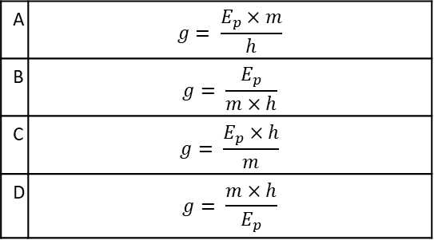
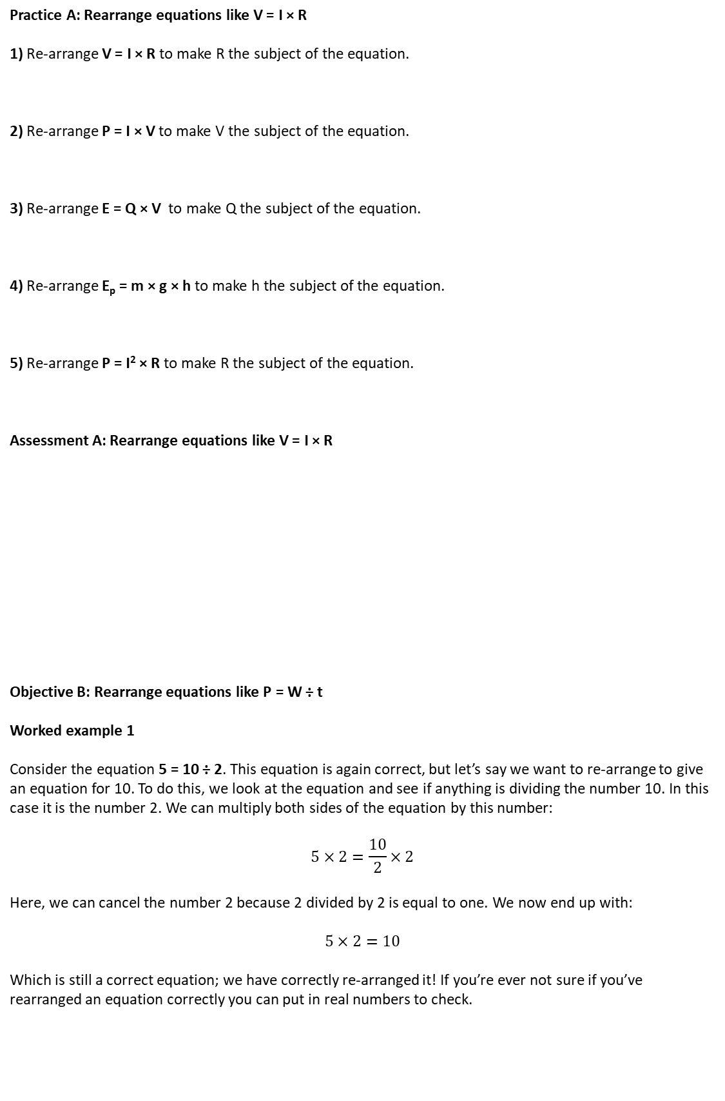
Practice A: Rearrange equations like V = I × R
1) Re-arrange V = I × R to make R the subject of the equation.
2) Re-arrange P = I × V to make V the subject of the equation.
3) Re-arrange E = Q × V to make Q the subject of the equation.
4) Re-arrange E_{p} = m × g × h to make h the subject of the equation.
5) Re-arrange P = I² × R to make R the subject of the equation.
Assessment A: Rearrange equations like V = I × R
Objective B: Rearrange equations like P = W ÷ t
Worked example 1
Consider the equation 5 = 10 ÷ 2. This equation is again correct, but let’s say we want to re-arrange to give an equation for 10. To do this, we look at the equation and see if anything is dividing the number 10. In this case it is the number 2. We can multiply both sides of the equation by this number:
$$5×2=\frac{10}{2}×2$$
Here, we can cancel the number 2 because 2 divided by 2 is equal to one. We now end up with:
$$5×2=10$$
Which is still a correct equation; we have correctly re-arranged it! If you’re ever not sure if you’ve rearranged an equation correctly you can put in real numbers to check.
A | $$g= \frac{E_{p}×m}{h}$$
B | $$g= \frac{E_{p}}{m×h}$$
C | $$g= \frac{E_{p}×h}{m}$$
D | $$g= \frac{m×h}{E_{p}}$$
Which statement is correct?
Re-arrange E_{p} = m × g × h to make g the subject of the equation.

Slide 3
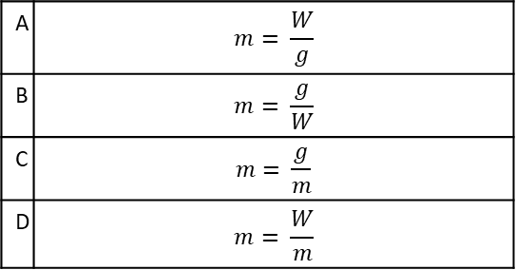
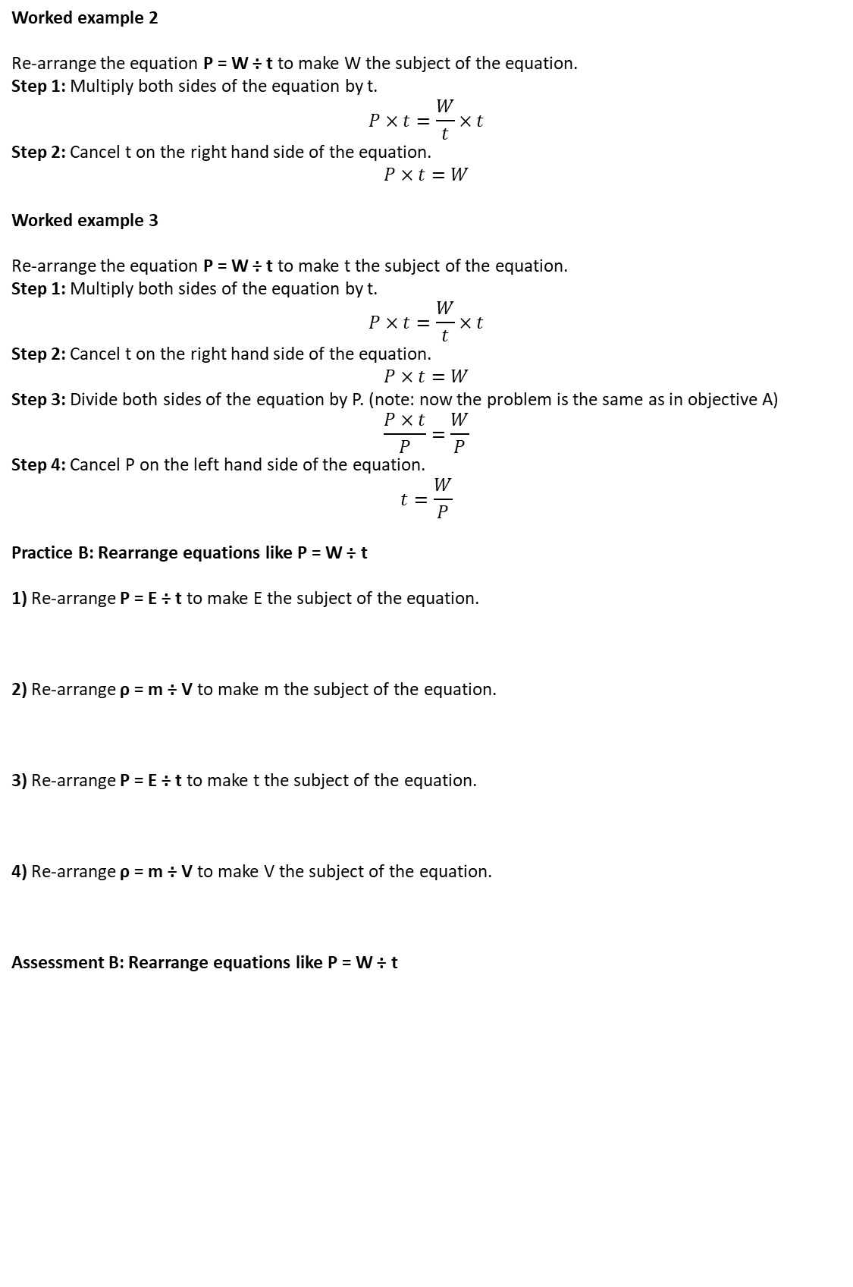
Worked example 2
Re-arrange the equation P = W ÷ t to make W the subject of the equation.
Step 1: Multiply both sides of the equation by t.
$$P×t=\frac{W}{t}×t$$
Step 2: Cancel t on the right hand side of the equation.
$$P×t=W$$
Worked example 3
Re-arrange the equation P = W ÷ t to make t the subject of the equation.
Step 1: Multiply both sides of the equation by t.
$$P×t=\frac{W}{t}×t$$
Step 2: Cancel t on the right hand side of the equation.
$$P×t=W$$
Step 3: Divide both sides of the equation by P. (note: now the problem is the same as in objective A)
$$\frac{P×t}{P}=\frac{W}{P}$$
Step 4: Cancel P on the left hand side of the equation.
$$t=\frac{W}{P}$$
Practice B: Rearrange equations like P = W ÷ t
1) Re-arrange P = E ÷ t to make E the subject of the equation.
2) Re-arrange ρ = m ÷ V to make m the subject of the equation.
3) Re-arrange P = E ÷ t to make t the subject of the equation.
4) Re-arrange ρ = m ÷ V to make V the subject of the equation.
Assessment B: Rearrange equations like P = W ÷ t
A | $$m= \frac{W}{g}$$
B | $$m= \frac{g}{W}$$
C | $$m= \frac{g}{m}$$
D | $$m= \frac{W}{m}$$
Which statement is correct?
Re-arrange g = W ÷ m to make m the subject of the equation.

Slide 4
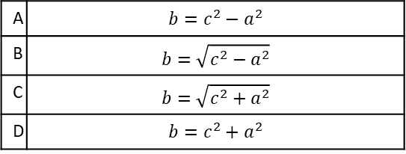
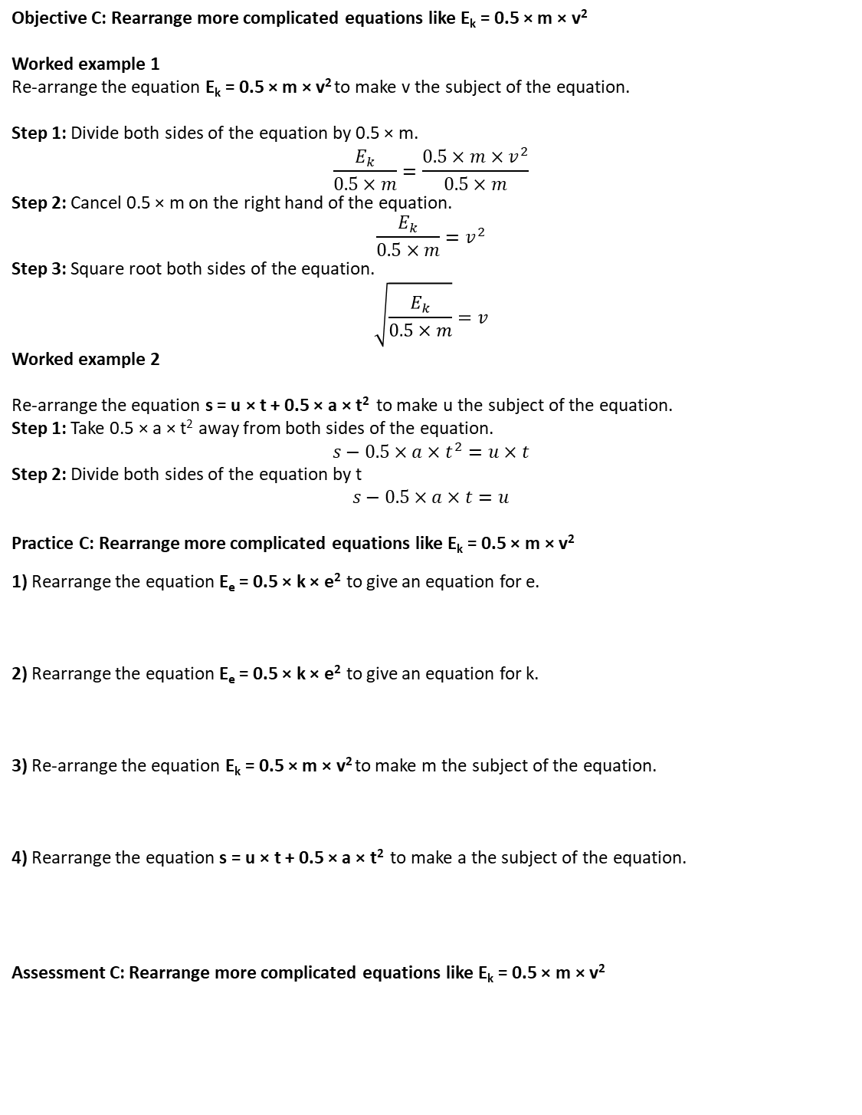
Objective C: Rearrange more complicated equations like E_{k} = 0.5 × m × v²
Worked example 1
Re-arrange the equation E_{k} = 0.5 × m × v² to make v the subject of the equation.
Step 1: Divide both sides of the equation by 0.5 × m.
$$\frac{E_{k}}{0.5×m}=\frac{0.5×m×v^{2}}{0.5×m}$$
Step 2: Cancel 0.5 × m on the right hand of the equation.
$$\frac{E_{k}}{0.5×m}=v^{2}$$
Step 3: Square root both sides of the equation.
$$\sqrt{\frac{E_{k}}{0.5×m}}=v$$
Worked example 2
Re-arrange the equation s = u × t + 0.5 × a × t² to make u the subject of the equation.
Step 1: Take 0.5 × a × t² away from both sides of the equation.
$$s−0.5×a×t^{2}=u×t$$
Step 2: Divide both sides of the equation by t
$$s−0.5×a×t=u$$
Practice C: Rearrange more complicated equations like E_{k} = 0.5 × m × v²
1) Rearrange the equation E_{e} = 0.5 × k × e² to give an equation for e.
2) Rearrange the equation E_{e} = 0.5 × k × e² to give an equation for k.
3) Re-arrange the equation E_{k} = 0.5 × m × v² to make m the subject of the equation.
4) Rearrange the equation s = u × t + 0.5 × a × t² to make a the subject of the equation.
Assessment C: Rearrange more complicated equations like E_{k} = 0.5 × m × v²
Which statement is correct?
Re-arrange a² + b² = c² to give an equation for b.
A | $$b=c^{2}−a^{2}$$
B | $$b=\sqrt{c^{2}−a^{2}}$$
C | $$b=\sqrt{c^{2}+a^{2}}$$
D | $$b=c^{2}+a^{2}$$

