Slide 1
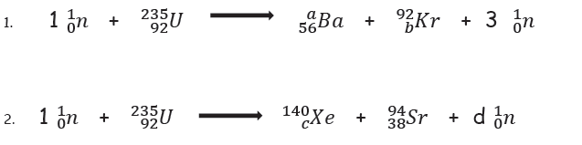
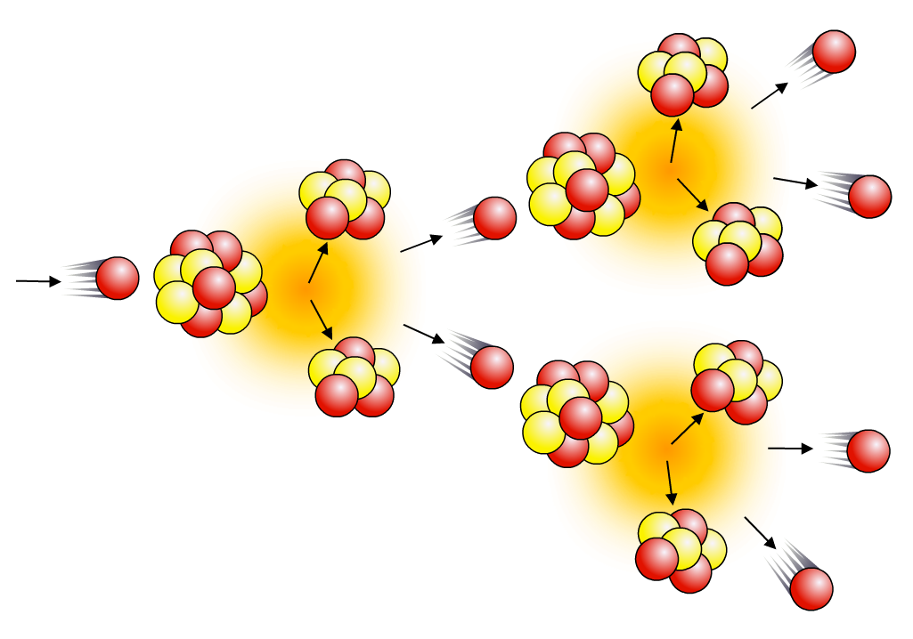
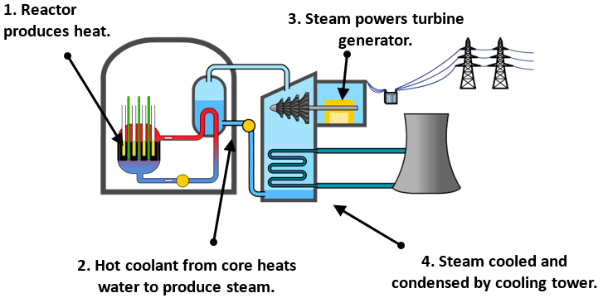
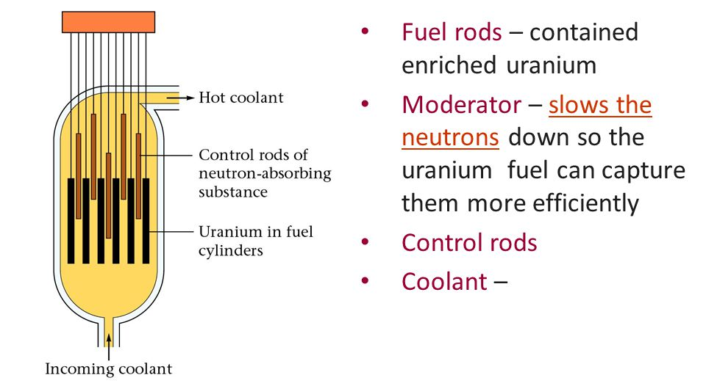
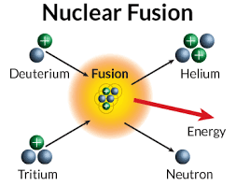

Paper 1 – Separate Physics
Topics: Fusion, fission, static charge, pressure in gases, thermal conductivity
Nuclear fission and fusion
The energy released in nuclear power plants comes from nuclear fission. Large, unstable nuclei such as uranium-235 or plutonium-239 break into smaller fragments, releasing energy as they do so:
²³⁵U + neutron → fission fragments + neutrons + energy
When a uranium-235 nucleus undergoes induced fission after
collision with a neutron, it breaks up into two smaller nuclei and
two/three neutrons. These are called fission neutrons.
Do Now: Balance the following nuclear equations by calculating the missing numbers (letters a, b, c and d)
The fission neutrons can go on to cause further fission events, which will produce further neutrons, and so on, causing a chain reaction.
Uncontrolled chain reactions are used in atomic bombs.
A nuclear reactor uses a controlled chain reaction to produce heat to produce steam for a generator. Apart from the source of heat, it works in the same way as a coal-fired power station. The reactor itself consists of fuel rods, control rods, coolant and a moderator.
Whereas nuclear fission involves very large nuclei splitting into smaller nuclei, fusion involves small nuclei joining together to form larger ones. The energy emitted by a star, such as the Sun, comes from nuclear fusion. In order for this to happen, the core temperature has to be extremely high – in excess of 10 million degrees. Nuclear fusion in a star like the Sun involves the combination of lighter isotopes of hydrogen to form helium, and the release of energy:

Slide 2
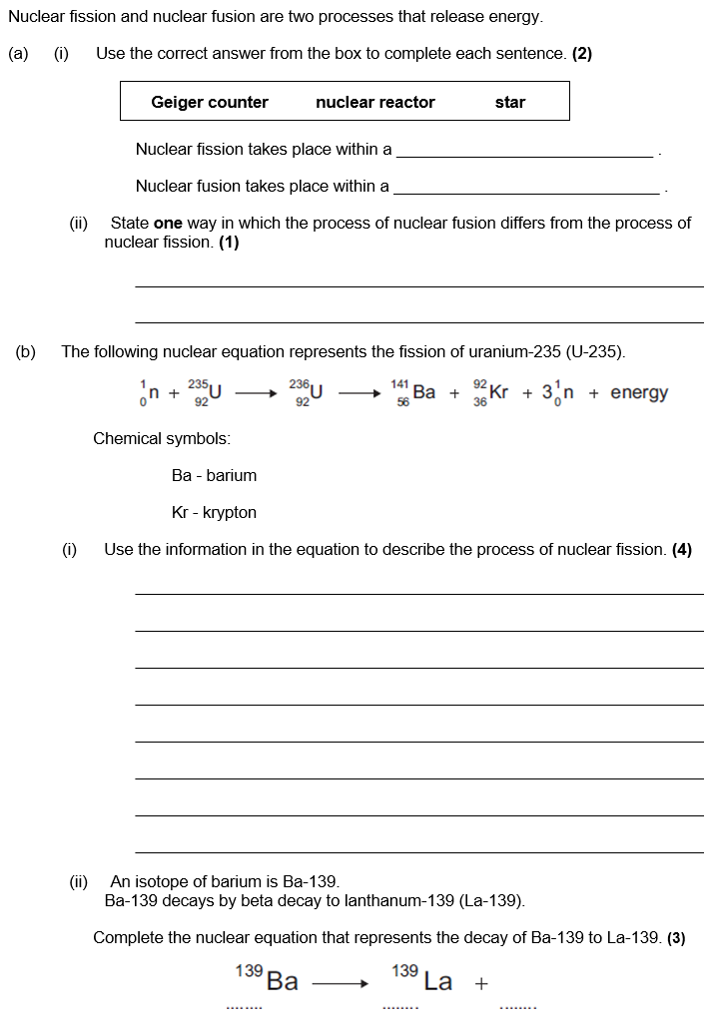

Slide 3
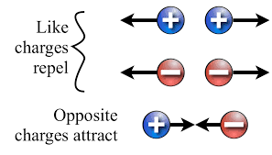
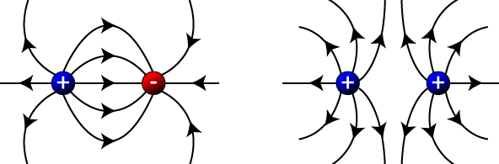
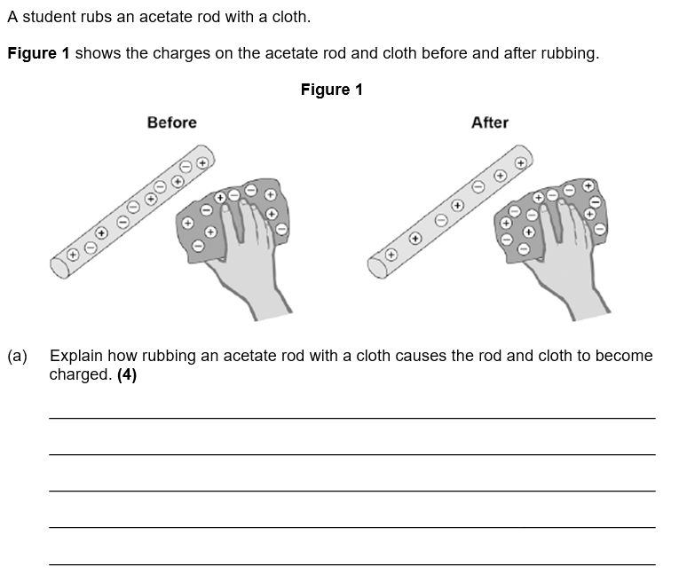
Static electricity
Friction causes static charge. If you rub a balloon (very attractive to other atoms’ electrons) together with a woollen jumper. It will remove some of the electrons and leave the jumper positively charged. The balloon will then become negatively charged.
Two static electricity rules:
Opposite charges attract.
Like charges repel.
A force field is caused by non-contact forces. These forces do not need to be in physical contact (touching) for an interaction of forces to take place. Attraction/repulsion of static charges is an example of a non-contact forces.
Electric field lines flow away from positive charges and towards negative charges. The arrows show the direction a positive charge would move in the field.
The closer together the field lines are, the stronger the field. The strength of the field depends on two things:
The size of the charge.
The distance away from the charge.

Slide 4
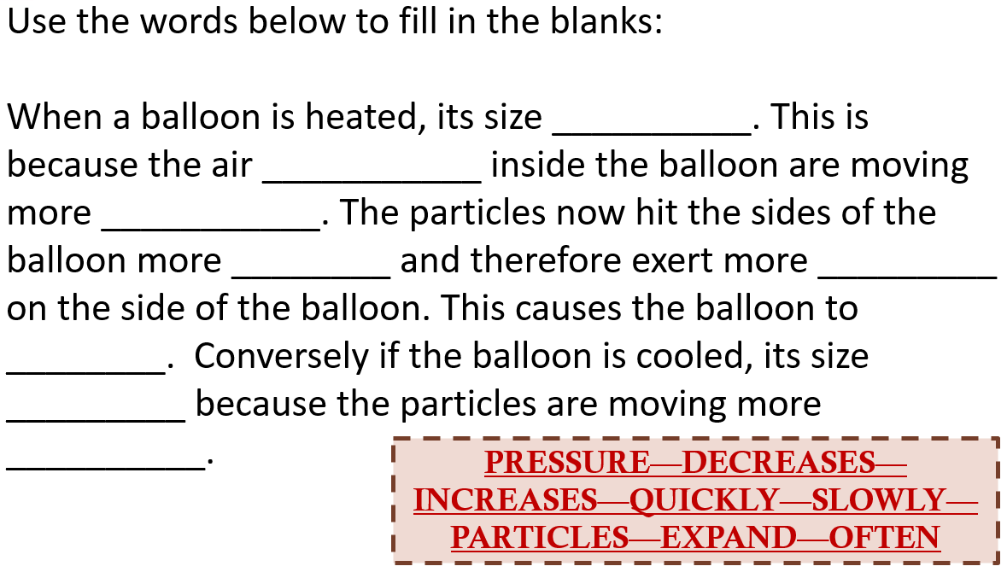
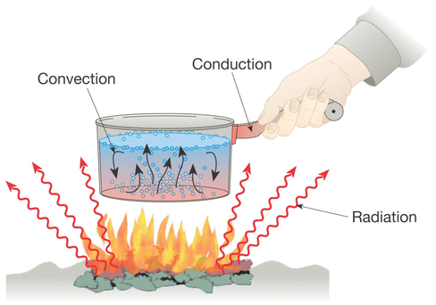
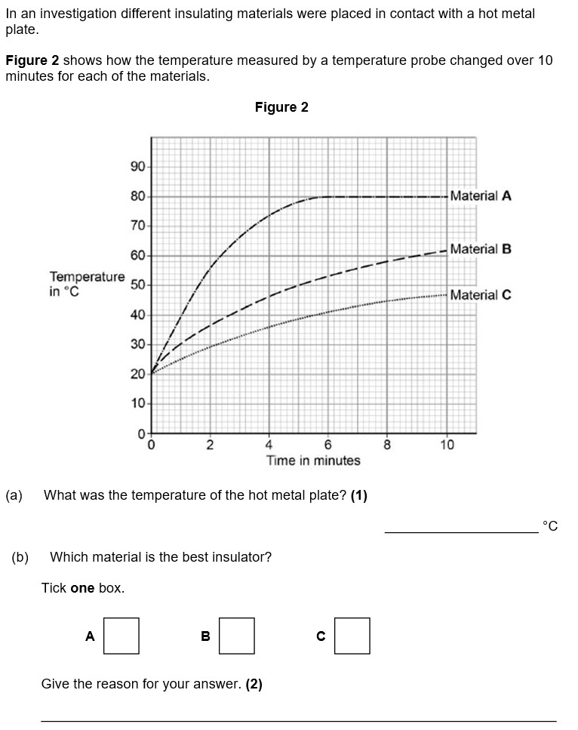
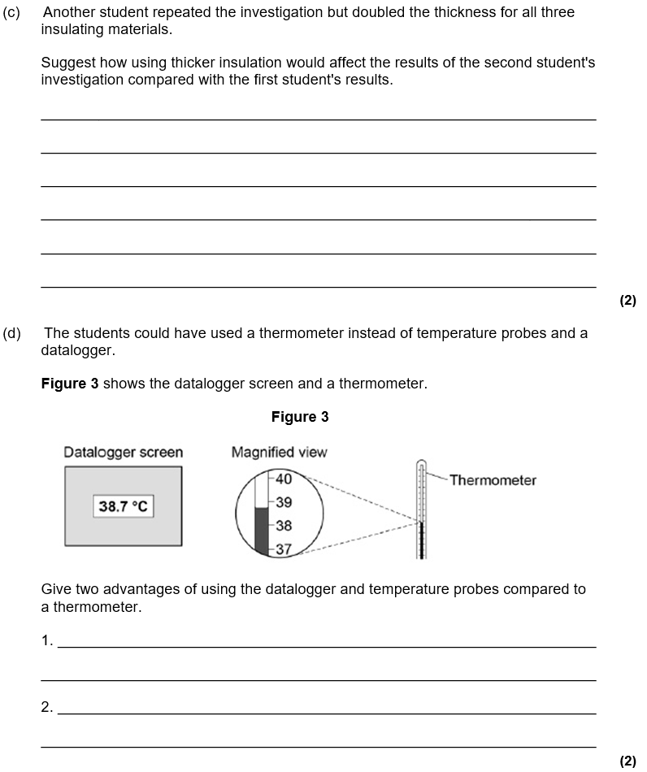
Pressure in gases
Provided that the number of particles and the temperature of a gas are kept constant, then:
P x V = constant
Where:
P is pressure in pascals (Pa)
V is volume in metres cubed (m³)
constant is a number in Pa m³
Thermal conductivity
Heat can be transferred (moved) by three main processes; conduction, convection and radiation.
Thermal conductivity (in units of W/m°C) tells you how well a material conducts heat.
The higher the thermal conductivity of a material the higher the rate of energy transfer by conduction across the material.

