Slide 1

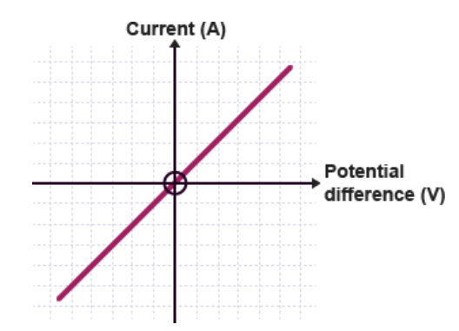

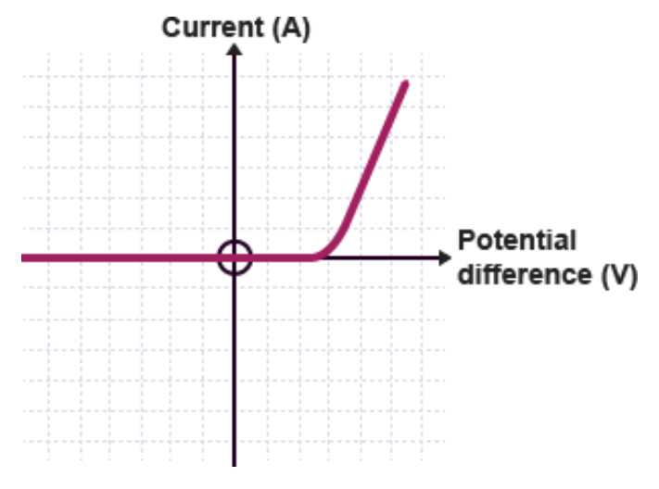
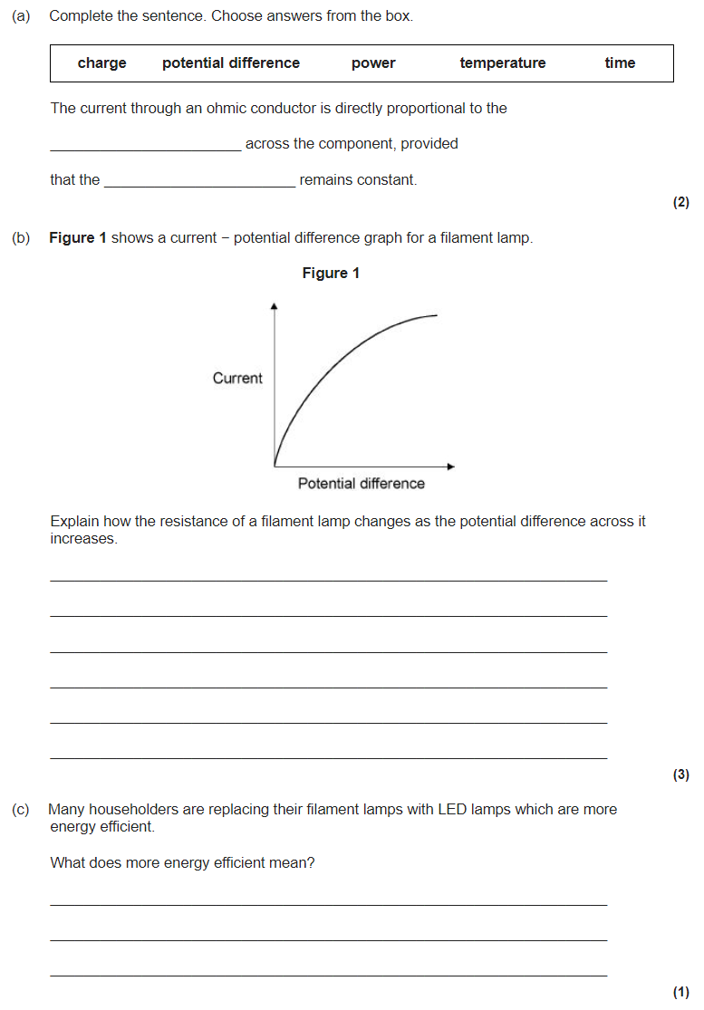
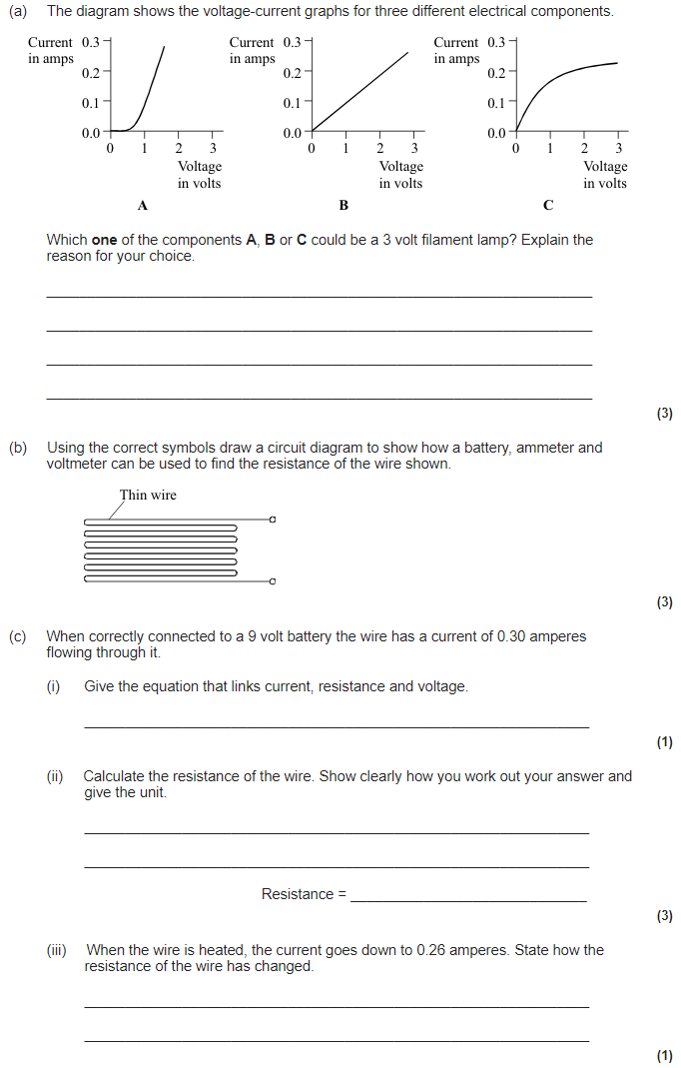
Energy revision
Keywords: Store, system, kinetic, gravitational, kinetic, elastic, heat capacity
Do Now: What are the units of
-Resistance
-Charge
-Time
-Energy
-Power
-Voltage
-Current
Symbols, charge, current and Ohm’s law
Current is the flow of charged particles (electrons). The equation that links charge, current and time is:
Q = I x t
Charge (C) = Current (A) × time (s)
Ohm’s law says that for an Ohmic conductor, the potential difference is directly proportional to the current.
V = I x R
Potential difference (V) = Current (I) × Resistance (Ω).
I-V graph for a resistor. A resistor is Ohmic
I-V graph for a lamp. A lamp is non-Ohmic (resistance increases as it heats)
I-V graph for a diode. A diode is non-Ohmic (only lets current flow one way)

Slide 2

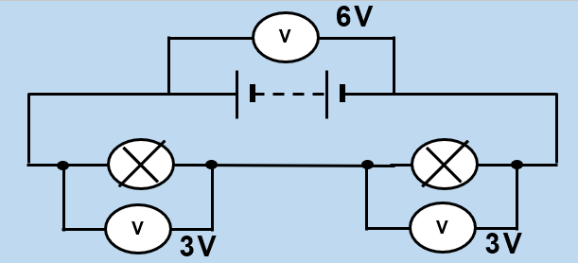
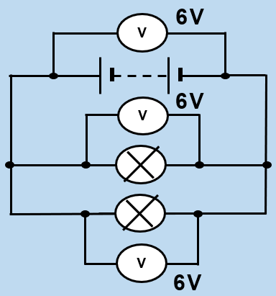

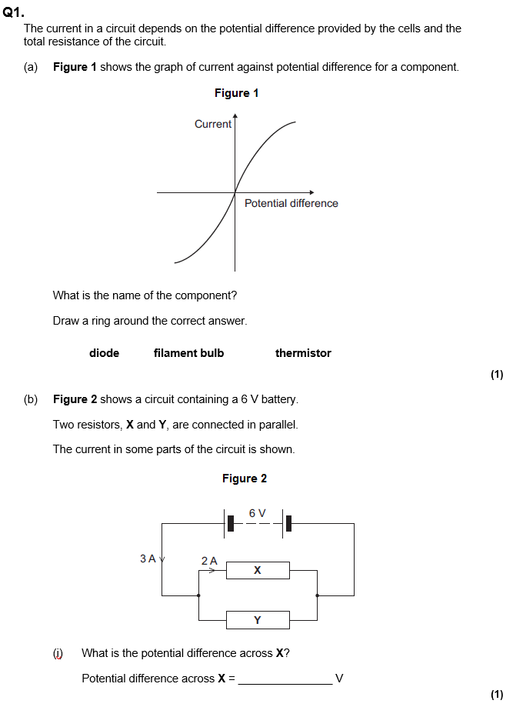
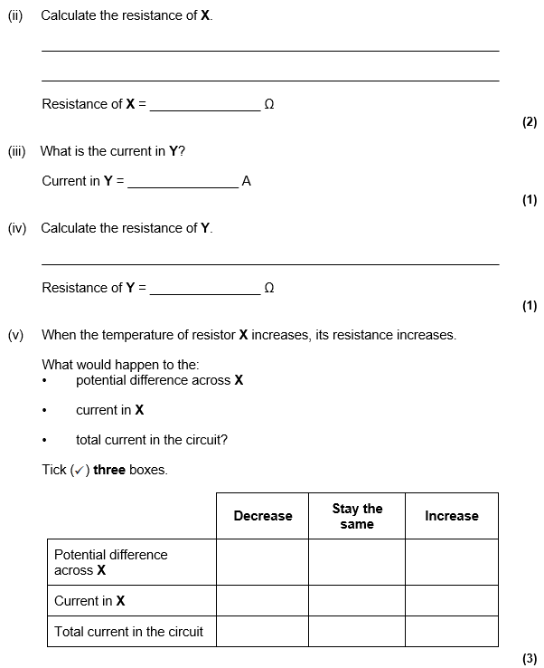
Series and parallel circuits
A series circuit only has one path, a parallel circuit has more than one path.
Current is the same everywhere in a series circuit, but splits on each path of a parallel circuit. Voltage is the same on each path of a parallel circuit, but splits across components in a series circuit.
Ammeters are used to measure current and go in series. Voltmeters are used to measure potential difference and go in parallel across the component you want the voltage across.
Resistance is added together when two resistors are in series:
R_{TOT} = R₁ + R₂ (all in Ω)

Slide 3




Mains electricity and the National Grid
AC current (eg. mains electricity) changes direction, but DC does not (eg. batteries). Mains electricity has a voltage of 230V and a frequency of 50 Hz.
Plugs have three wires. The live wire carries the AC and is brown. The neutral wire completes the circuit and is blue. The earth wire is for safety and is green/yellow.
The national grid is made up of transformers and transmission cables. Directly after a power station is a step-up transformer. This increases the voltage but decreases the current. This reduces the energy lost to heating in the cables.
The cables are also low resistance to reduce energy lost to heating. Before electricity is delivered to consumers it goes to a step down transformer which reduces the voltage to a safe level for consumers.
The fuse is also for safety and melts if the current is too large. The cable grip prevents the cables from coming out of the plug.
Potential difference is how much energy each charge has:
E = Q x V
Energy (J) = Charge (C) × Voltage (V)
Two equations for power:
P = I x V
Power (W) = Current (I) × Voltage (V)
P = I² x R
Power (W) = Current² (A) × Resistance (Ω).

Slide 4
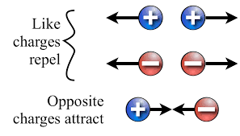
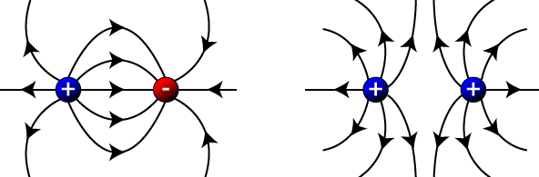
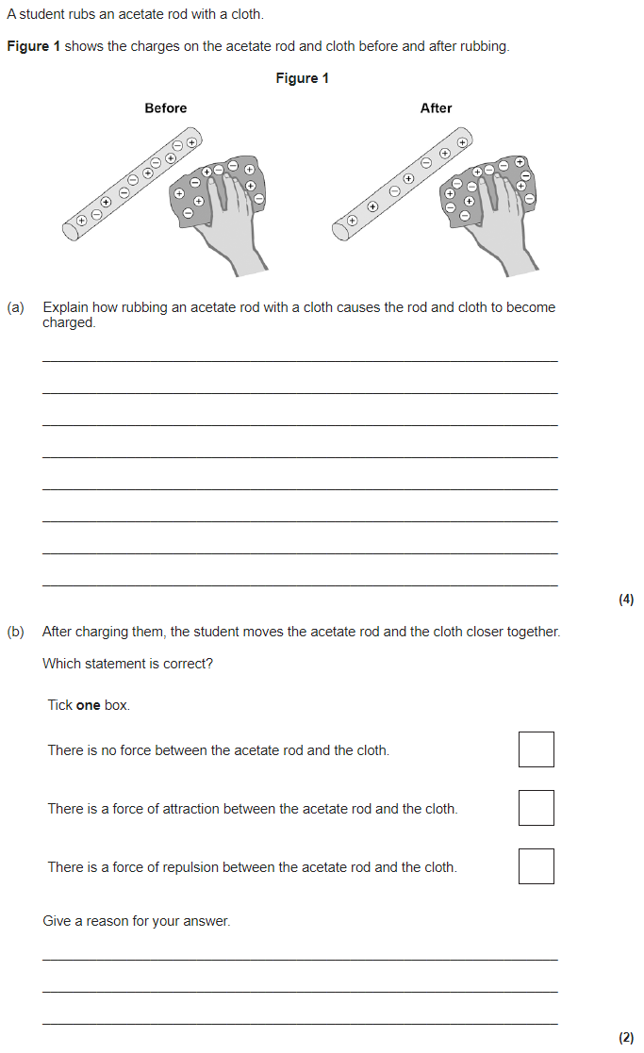
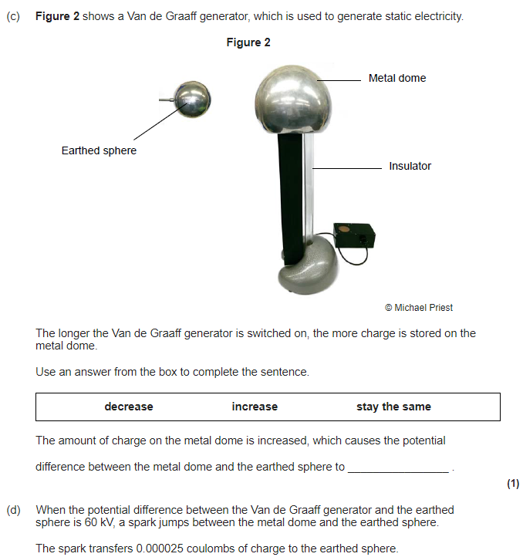
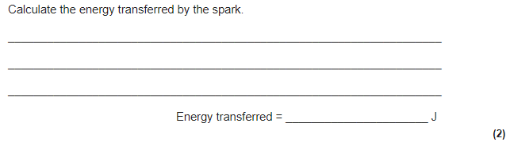
Static electricity
Friction causes static charge. If you rub a balloon (very attractive to other atoms’ electrons) together with a woollen jumper. It will remove some of the electrons and leave the jumper positively charged. The balloon will then become negatively charged.
Two static electricity rules:
Opposite charges attract.
Like charges repel.
A force field is caused by non-contact forces. These forces do not need to be in physical contact (touching) for an interaction of forces to take place. Attraction/repulsion of static charges is an example of a non-contact forces.
Electric field lines flow away from positive charges and towards negative charges. The arrows show the direction a positive charge would move in the field.
The closer together the field lines are, the stronger the field. The strength of the field depends on two things:
The size of the charge.
The distance away from the charge.

