Slide 1

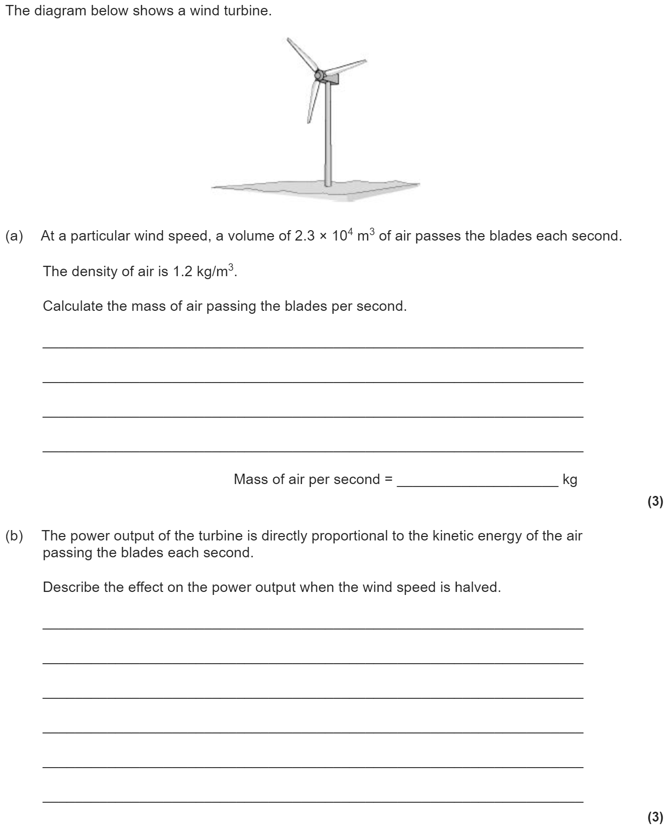
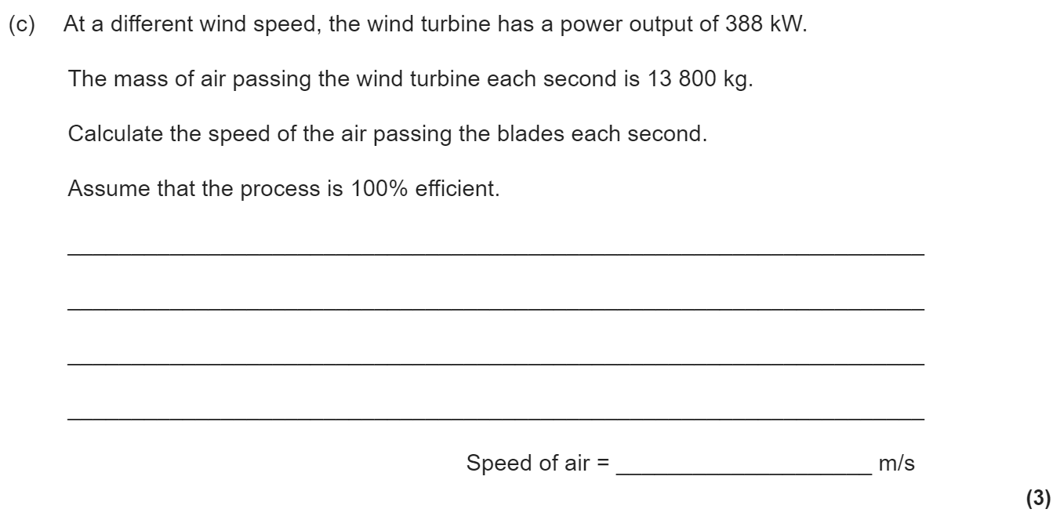
Particle model of matter revision
Keywords: States, solid, liquid, gas, density, internal energy, heat capacity, latent heat
Do Now: What are the units of
-Volume
-Density
-Specific Heat capacity
-Latent Heat
-Mass
-Energy
States of matter
State changes:
Melting: Solid → Liquid
Evaporation: Liquid → Gas
Condensation: Gas → Liquid
Freezing: Liquid → Solid
Sublimation: Solid → Gas
or Gas → Solid
The amount of mass per unit volume is called the density:
ρ = m ÷ V
Density (kg/m³) = mass (kg) ÷ volume (m³)

Slide 2
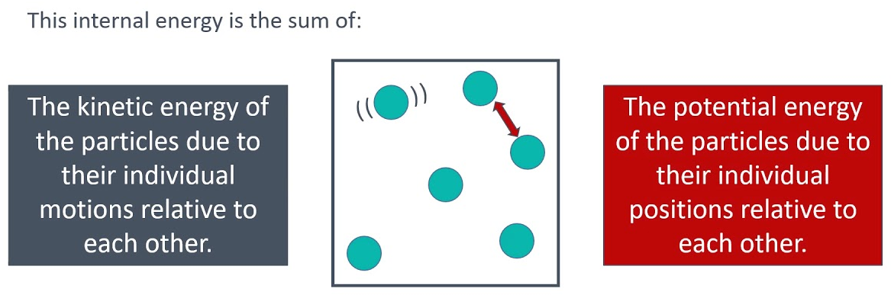

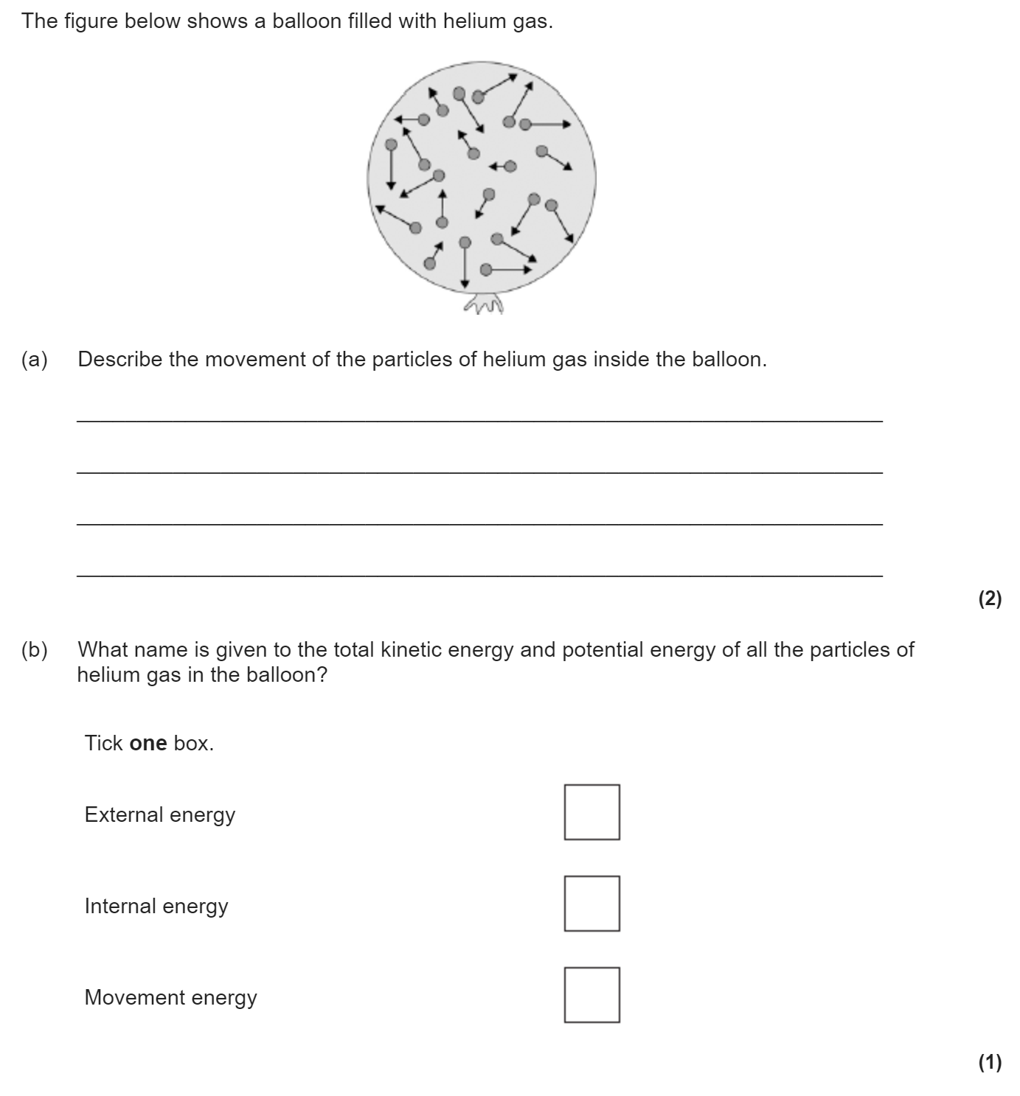
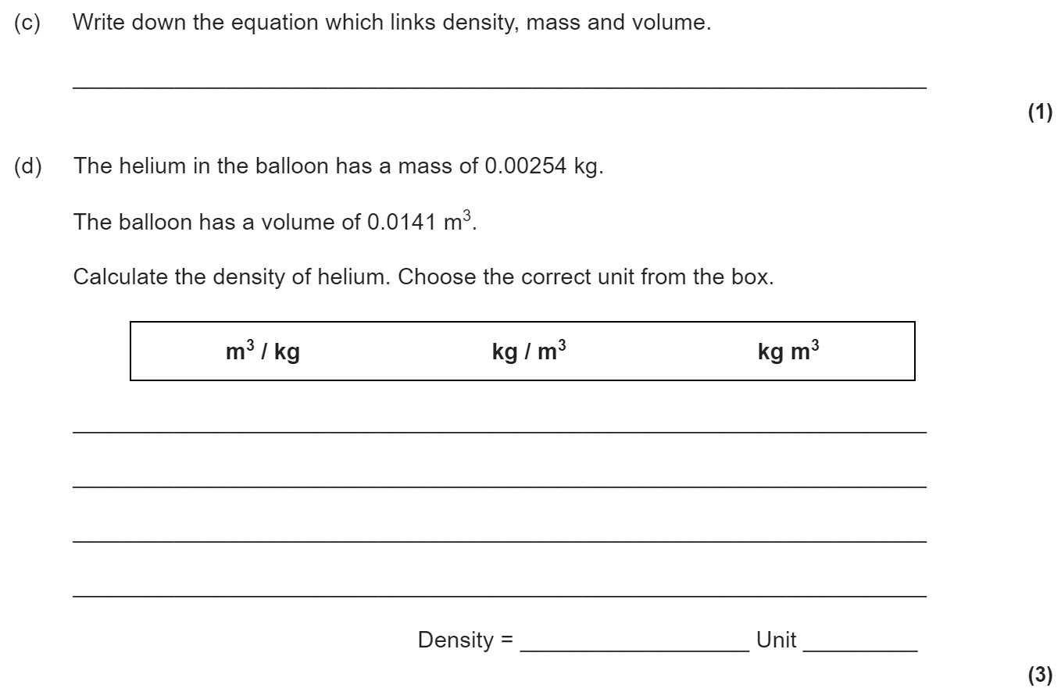
Internal energy & particle motion
Internal energy is the total kinetic energy and potential energy of all the
particles (atoms and molecules) that make up a system.
Heating a system increases the energy of the particles. This either raises the
temperature of the system or produces a change of state.
Gas particles move randomly in all directions at different speeds. As a gas heats, it gains energy and the speed of the particles increases.
The reason balloons get bigger when you blow them us is because more air means more particles. More particles means more collisions and a larger force on the walls of the balloon. This means a higher pressure.
Similarly, if we heat the gas inside a balloon the particles move more quickly. This means more collisions with the wall of the balloon and therefore a higher force on the walls. This leads again to a higher pressure.

Slide 3

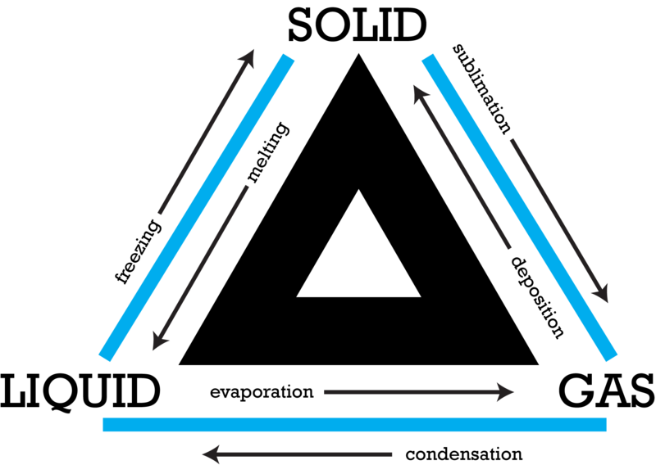
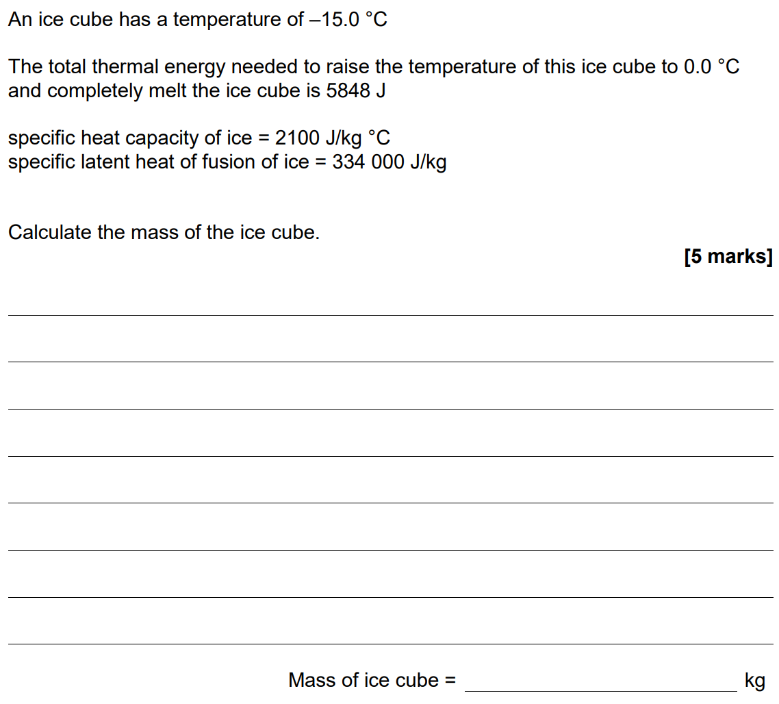
Specific and latent heat
When a substance is changing temperature, the energy change can be calculated by using ΔE= m x c x Δϑ. The specific heat capacity is the energy needed to heat up 1 kg of a substance by 1 degree.
ΔE= m x c x Δϑ
Change in energy (J) = mass (kg) × specific heat (J/kg°C) × change in temp (°C)
When a substance is changing state, energy goes into breaking the bonds instead of increasing the temperature of the substance. The energy needed to change state can be calculated by E = m x L. The latent heat is the energy needed to change state of 1 kg of a substance.
E = m x L
Energy (J) = mass (kg) × latent heat (J/kg)

Slide 4
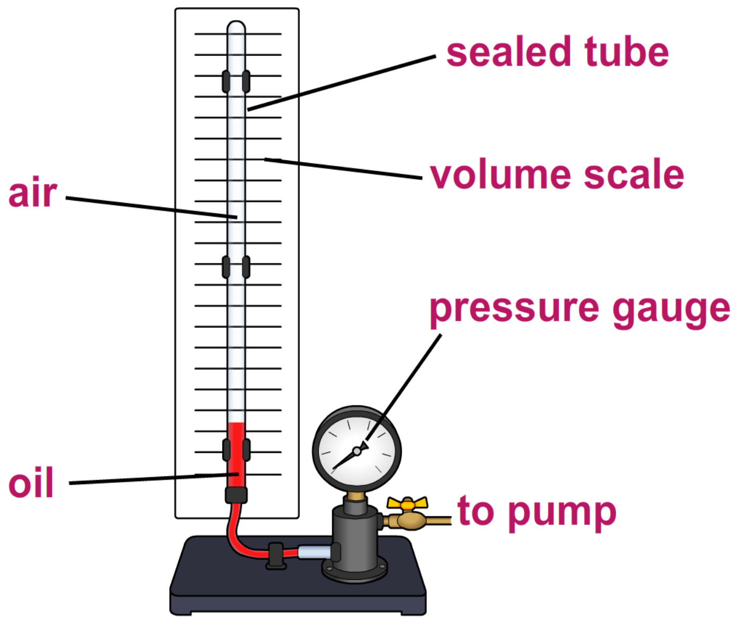
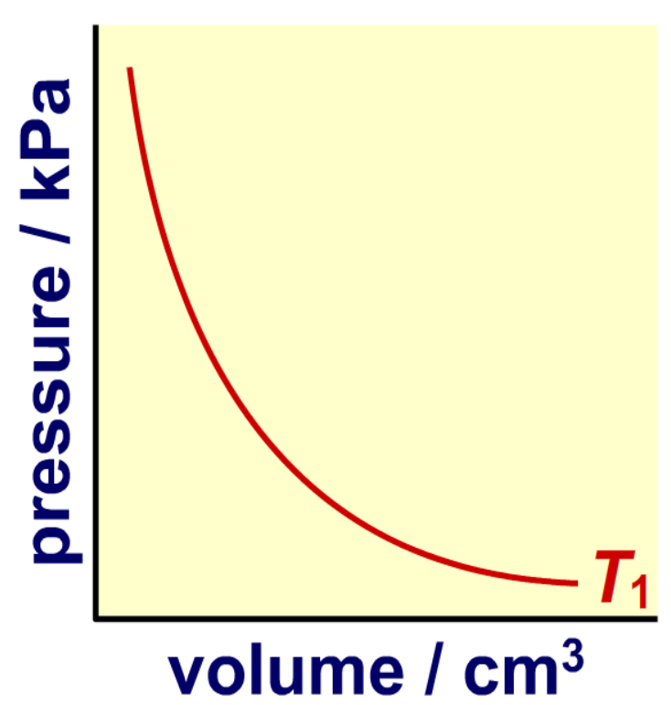
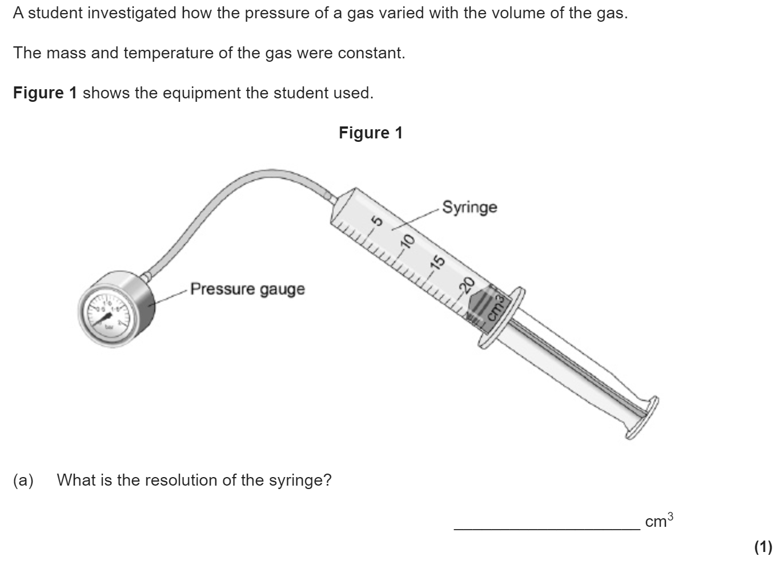
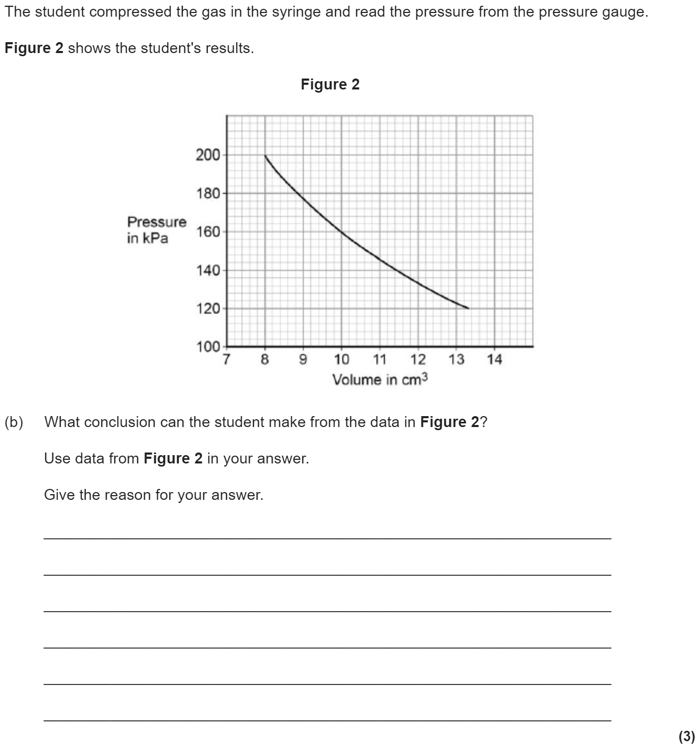
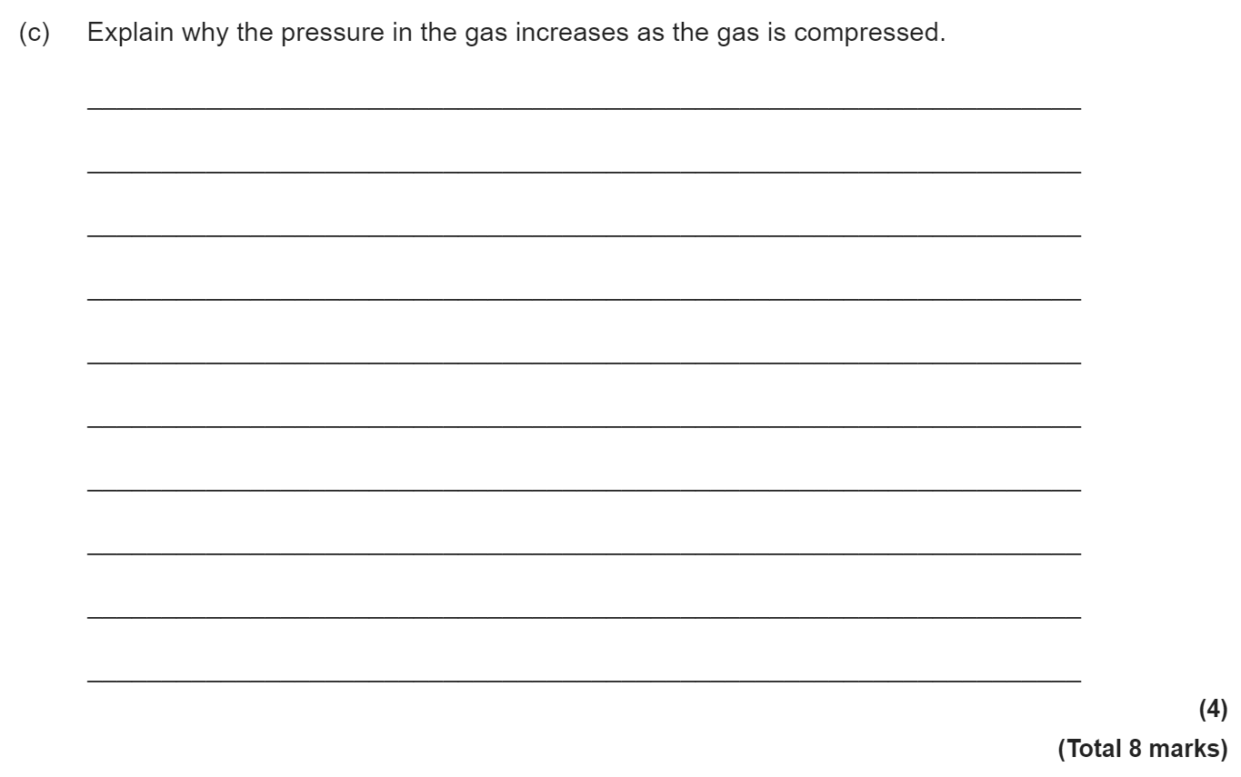
Pressure in gases
Provided that the number of particles and the temperature of a gas are kept constant, then:
P x V = constant
Where:
P is pressure in pascals (Pa)
V is volume in metres cubed (m³)
constant is a number in Pa m³
The graph of pressure against volume is inversely proportional.

