Slide 1
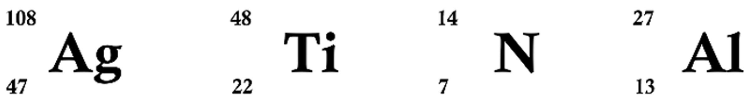
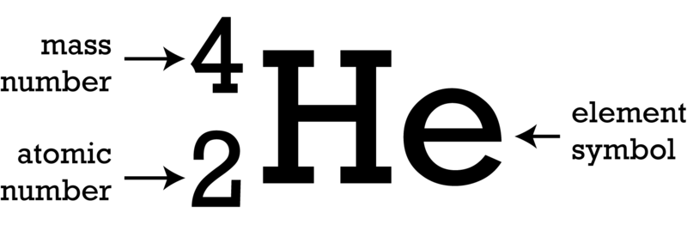


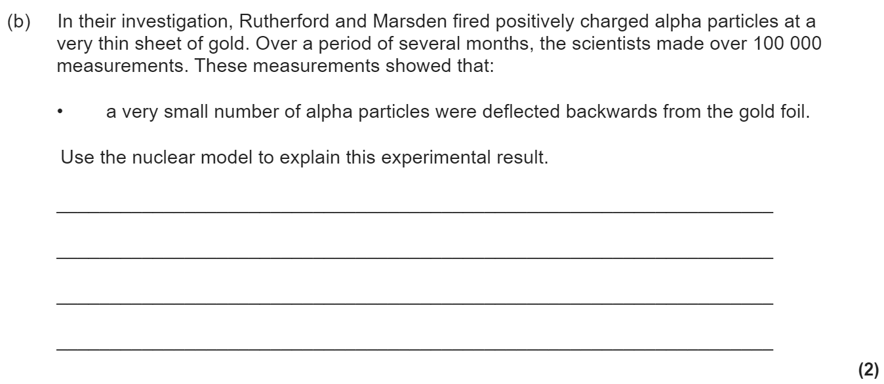
Atomic structure revision
Keywords: Nucleus, electron, proton, neutron, alpha, beta, gamma, radiation, half life, ionising, penetrating
Do Now: How many protons, neutrons and electrons are there in
Atomic structure & development of the model of the atom.
Isotopes are elements with the same atomic number (no. of protons) and different mass numbers (no of protons + neutrons). This means they have different numbers of neutrons.
Before the discovery of the electron, atoms were thought to be tiny spheres that could not be divided. The discovery of the electron led to the plum pudding model of the atom. The plum pudding model suggested that the atom is a ball of positive charge with negative electrons embedded in it.
The results from the alpha particle scattering experiment led to the conclusion that the mass of an atom was concentrated at the centre (nucleus) and that the nucleus was charged. This nuclear model replaced the plum pudding model.

Slide 2


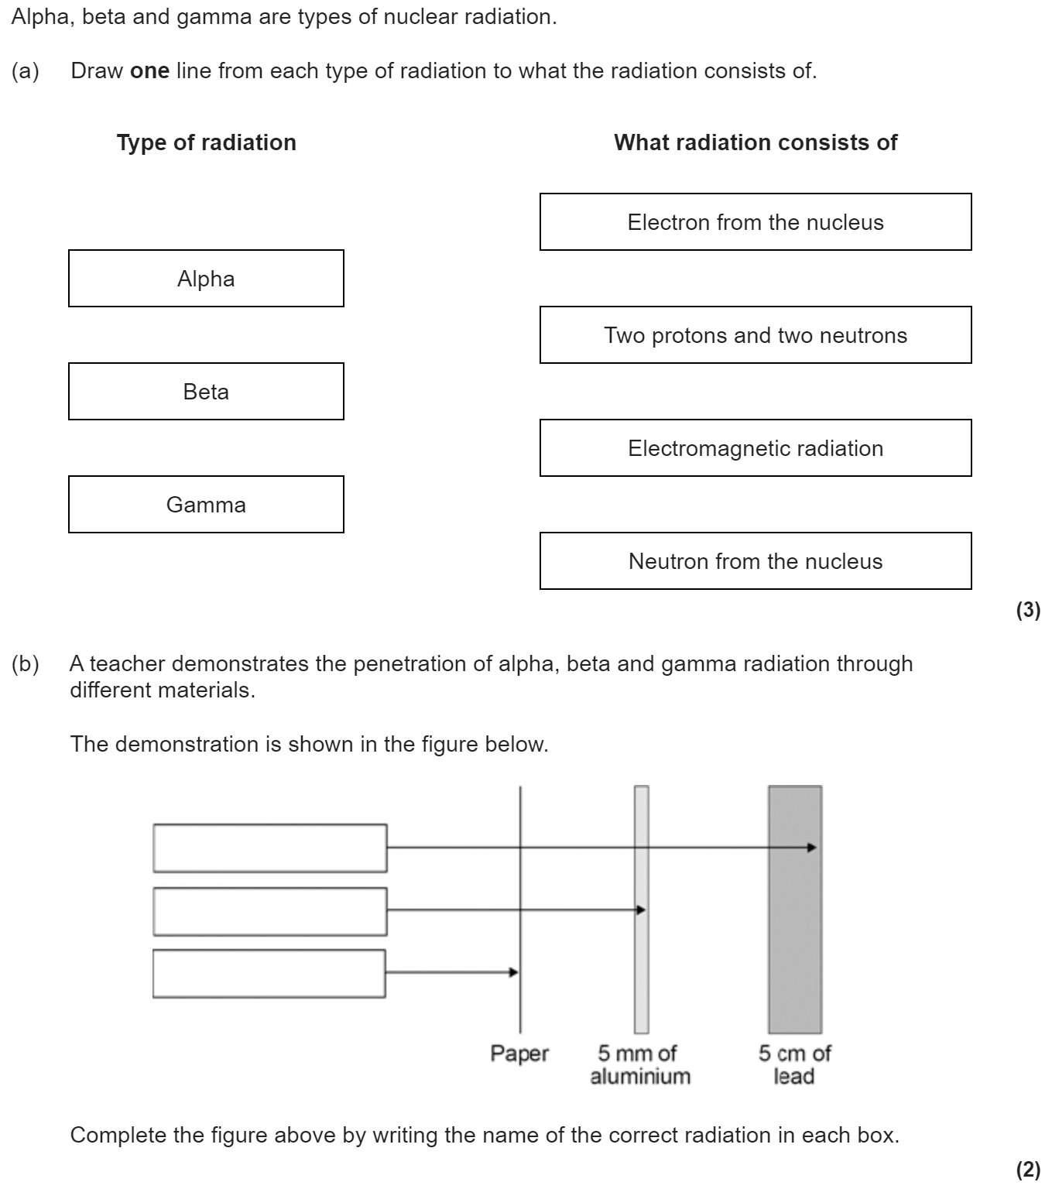
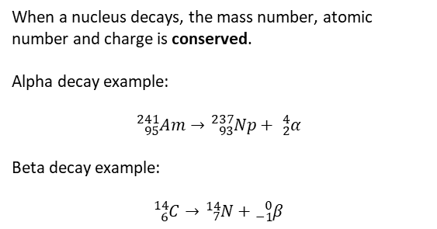
Types of radiation
Alpha particles are the most massive (as they are made of 2 protons and 2 neutrons) and so they bump into other matter more often. When they do this they ionise matter (making it lose an electron). Alpha radiation is the most ionising but the least penetrating (it can be stopped by paper). Gamma radiation is the least ionising but the most penetrating (taking thick lead to stop it).
When a nucleus decays, the mass number, atomic number and charge is conserved.
Alpha decay example:
$${}_{95}^{241}{Am}→{}_{93}^{237}{Np}+ {}_{2}^{4}α$$
Beta decay example:
$${}_{6}^{14}{C→}{}_{7}^{14}N+{}_{−1}^{0}β$$
When alpha/beta decay happens, the nucleus transmutes into another element. When gamma decay happens the nucleus emits some energy but keeps the same atomic and mass numbers.

Slide 3

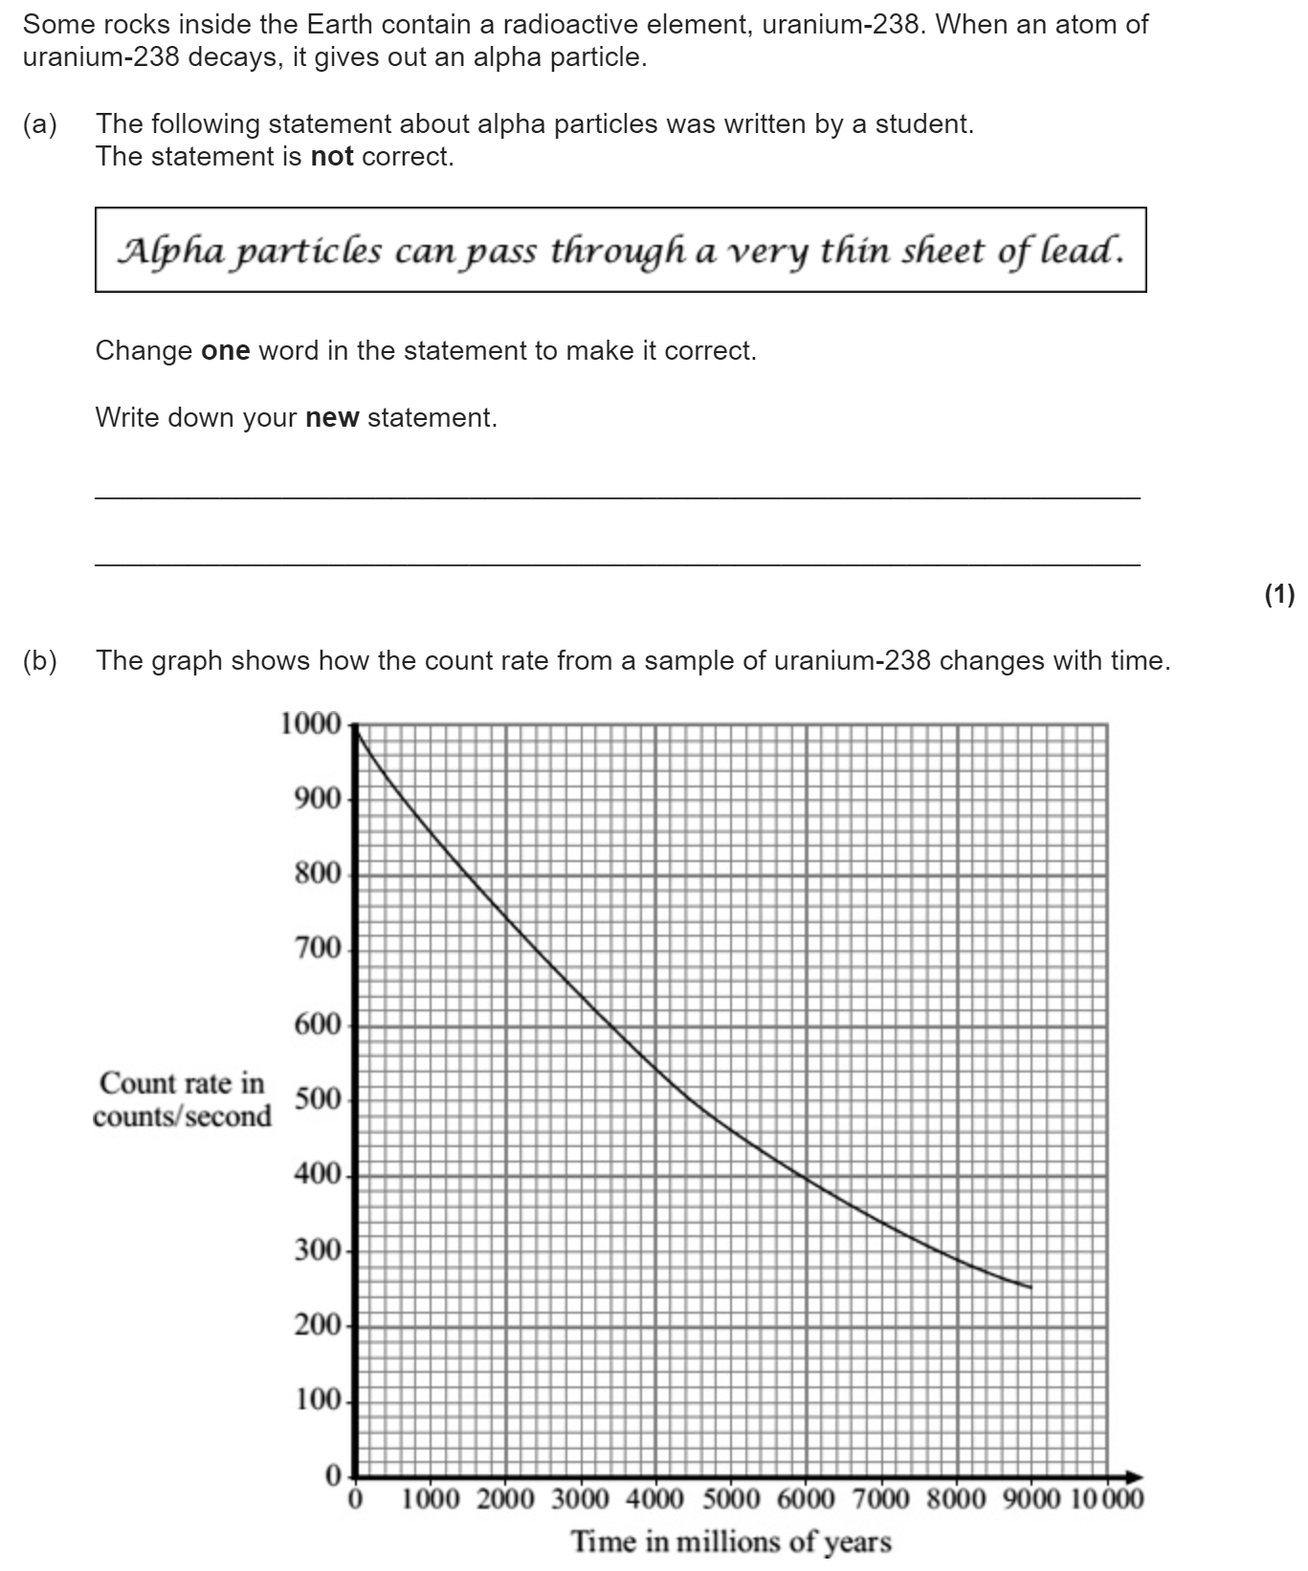

Half life
Half-life is the time taken for the count rate (measured in Becquerel) to halve. We can calculate this using the tree method or from a graph.
Radioactivity is dangerous because our cells can be ionised. This can kill cells or lead to mutations and potentially cancer. If some radioactive particles are in contact with an object, we say the object is contaminated.
All types of radiation are dangerous but alpha particles are most dangerous inside the body as they are most ionising and can’t escape the body. Beta particles are dangerous up to the mid-range and gamma radiation is dangerous up to the long-range.

Slide 4
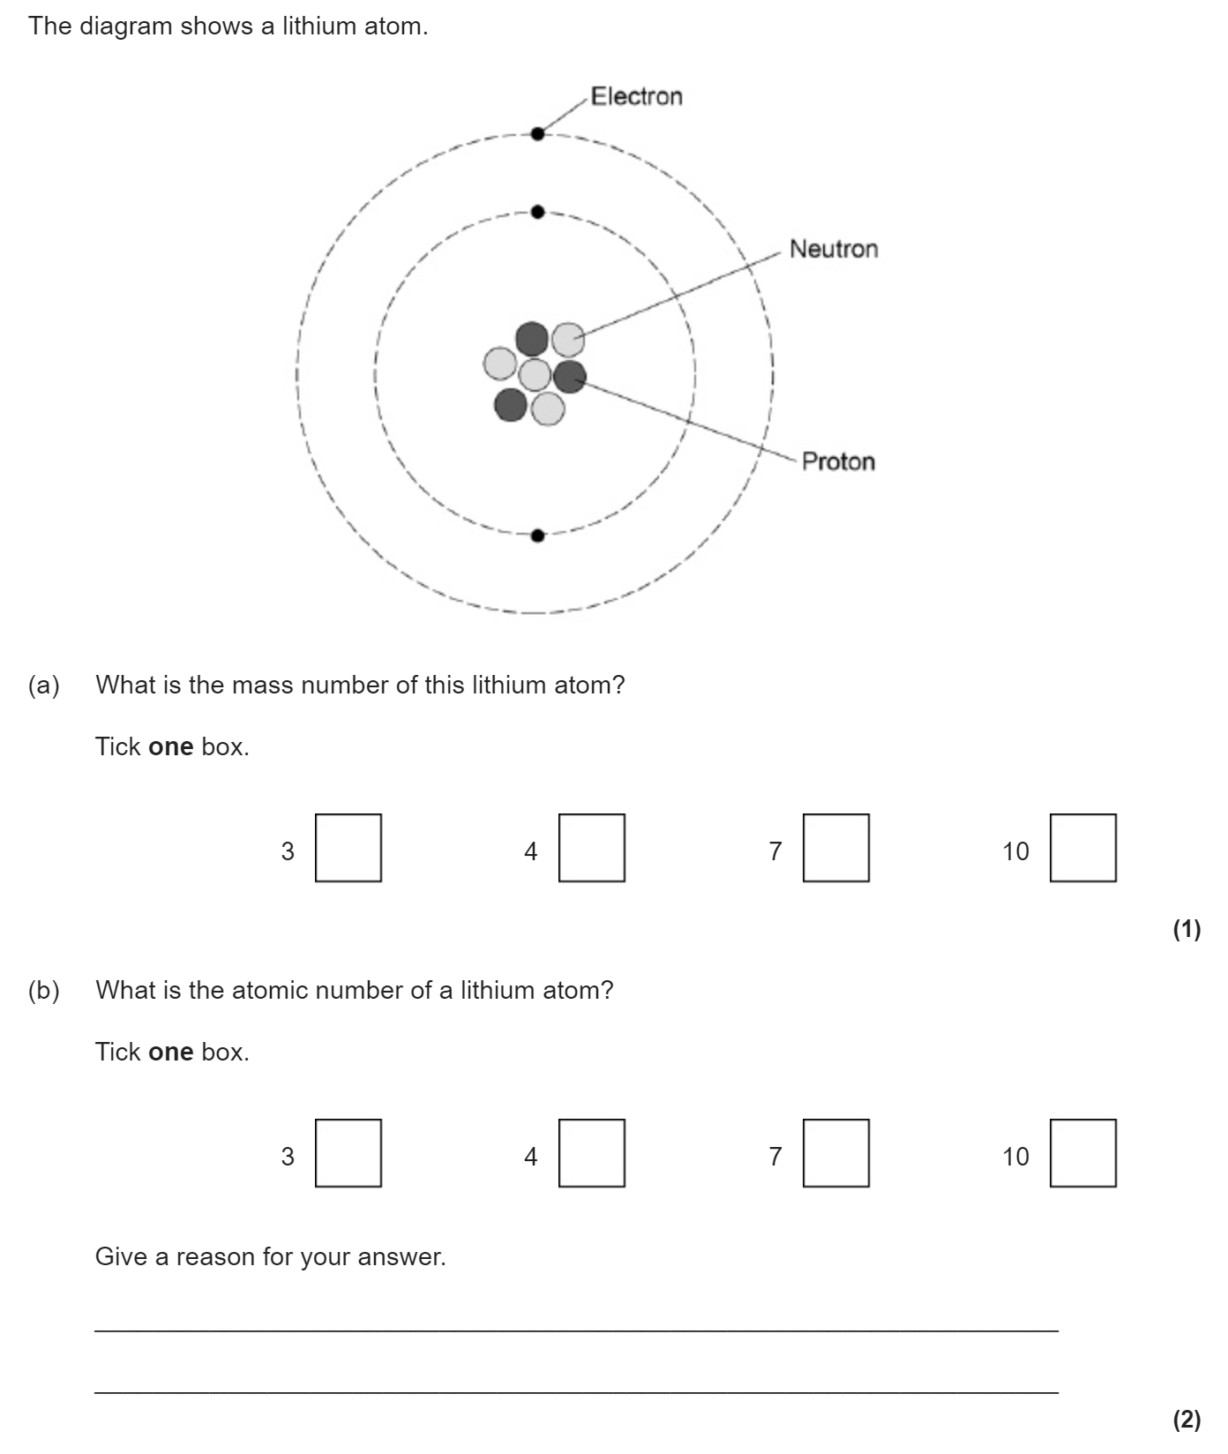
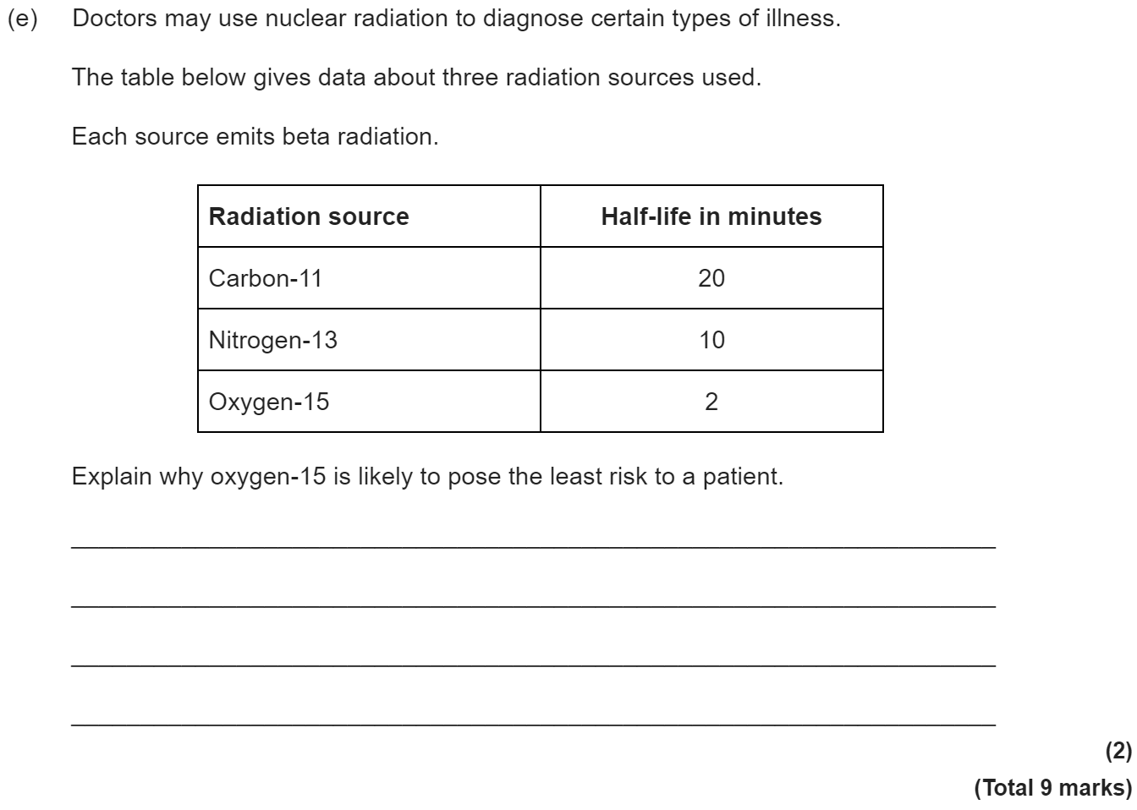
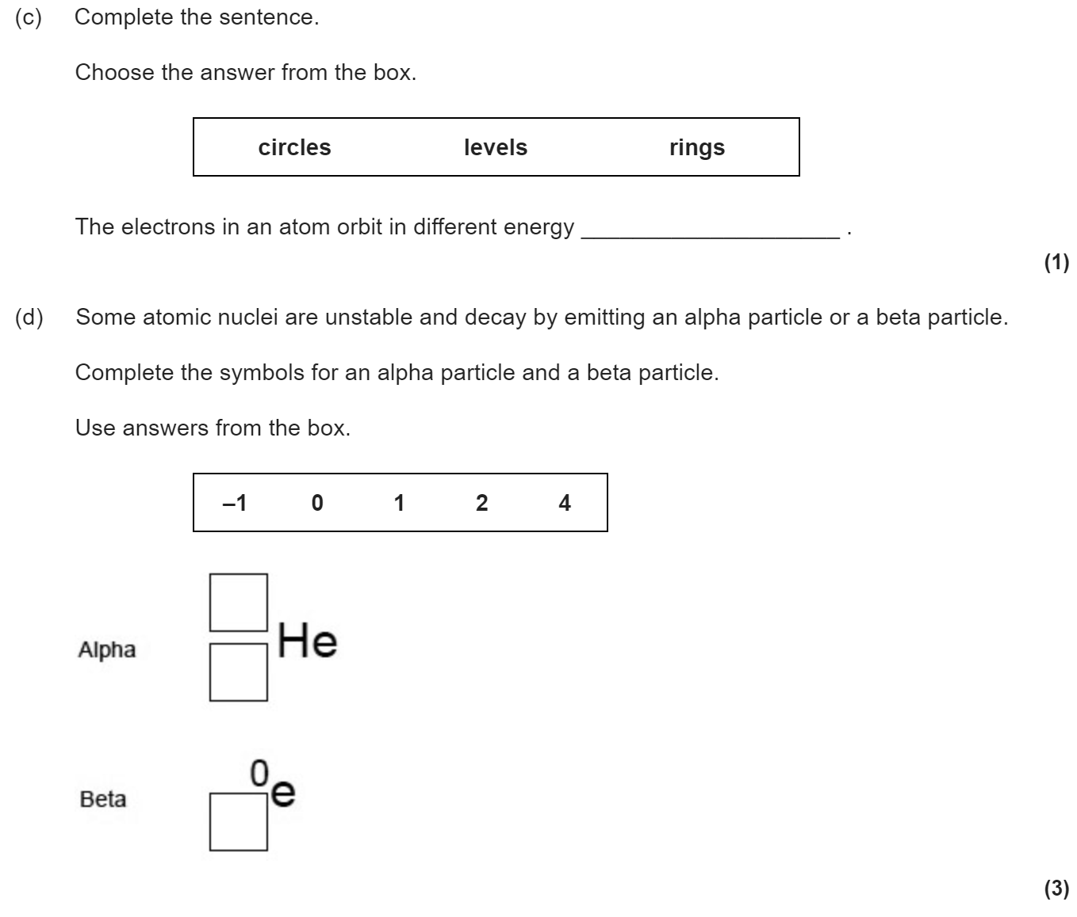
Summary question

