Slide 1
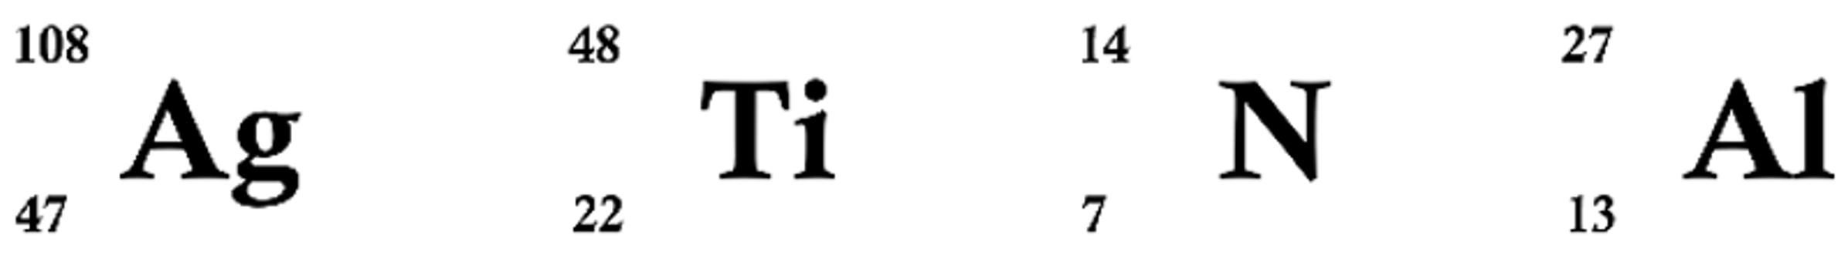
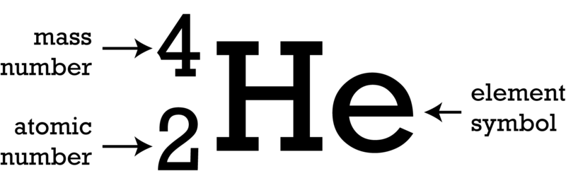

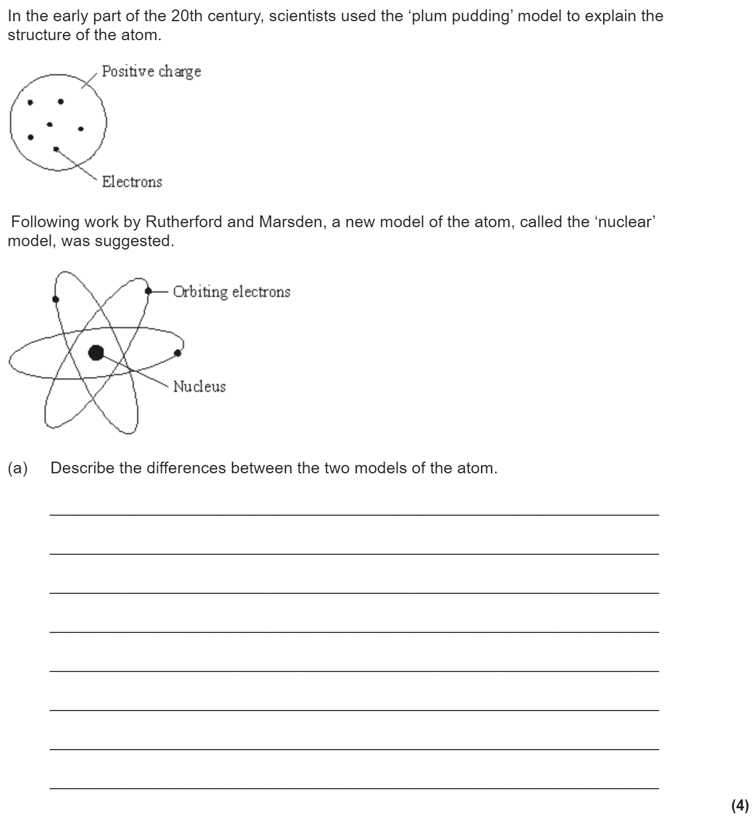
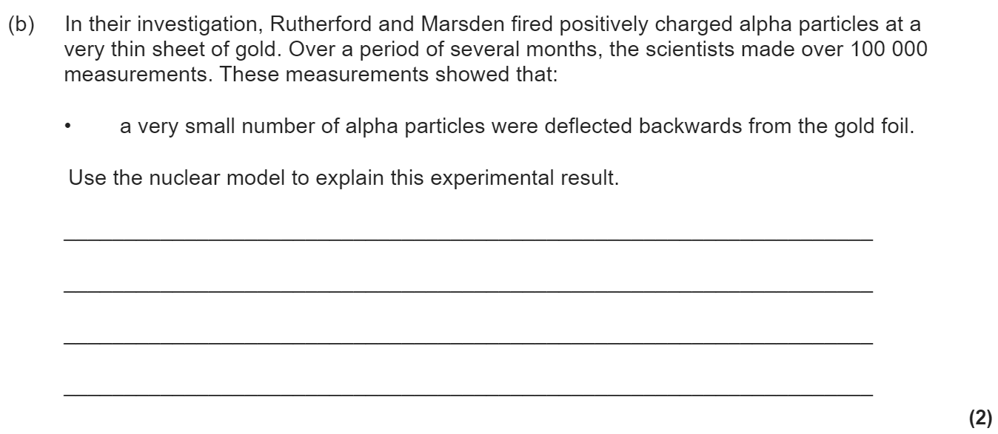
Atomic structure revision
Keywords: Nucleus, electron, proton, neutron, alpha, beta, gamma, radiation, half life, ionising, penetrating
Do Now: How many protons, neutrons and electrons are there in
Atomic structure & development of the model of the atom.
Isotopes are elements with the same atomic number (no. of protons) and different mass numbers (no of protons + neutrons). This means they have different numbers of neutrons.
Before the discovery of the electron, atoms were thought to be tiny spheres that could not be divided. The discovery of the electron led to the plum pudding model of the atom. The plum pudding model suggested that the atom is a ball of positive charge with negative electrons embedded in it.
The results from the alpha particle scattering experiment led to the conclusion that the mass of an atom was concentrated at the centre (nucleus) and that the nucleus was charged. This nuclear model replaced the plum pudding model.

Slide 2


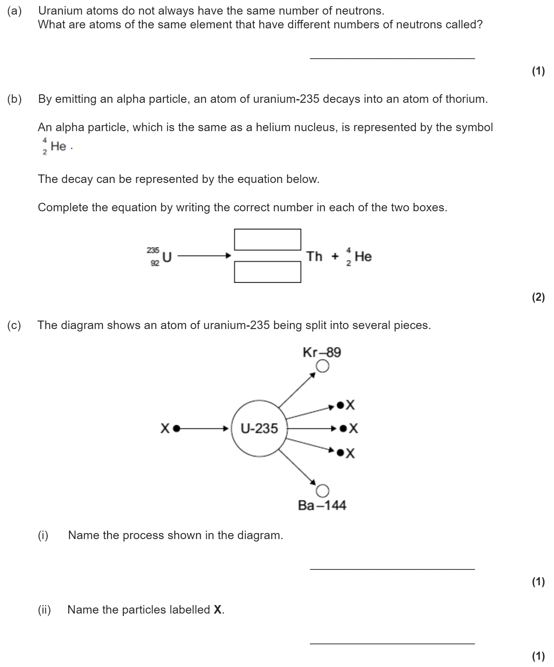
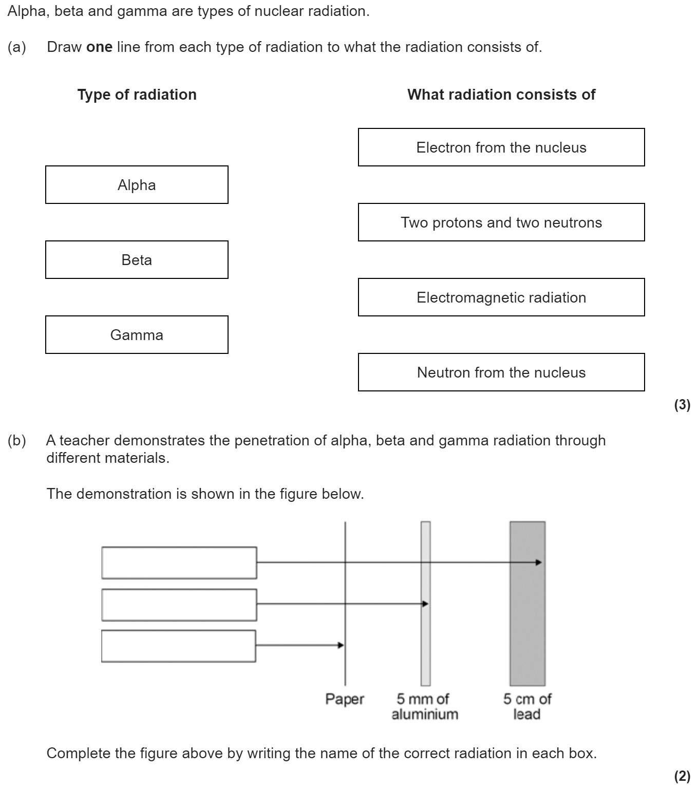
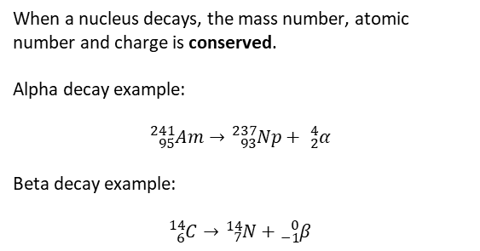
Types of radiation
Alpha particles are the most massive (as they are made of 2 protons and 2 neutrons) and so they bump into other matter more often. When they do this they ionise matter (making it lose an electron). Alpha radiation is the most ionising but the least penetrating (it can be stopped by paper). Gamma radiation is the least ionising but the most penetrating (taking thick lead to stop it).
When a nucleus decays, the mass number, atomic number and charge is conserved.
Alpha decay example:
$${}_{95}^{241}{Am}→{}_{93}^{237}{Np}+ {}_{2}^{4}α$$
Beta decay example:
$${}_{6}^{14}{C→}{}_{7}^{14}N+{}_{−1}^{0}β$$
When alpha/beta decay happens, the nucleus transmutes into another element. When gamma decay happens the nucleus emits some energy but keeps the same atomic and mass numbers.

Slide 3

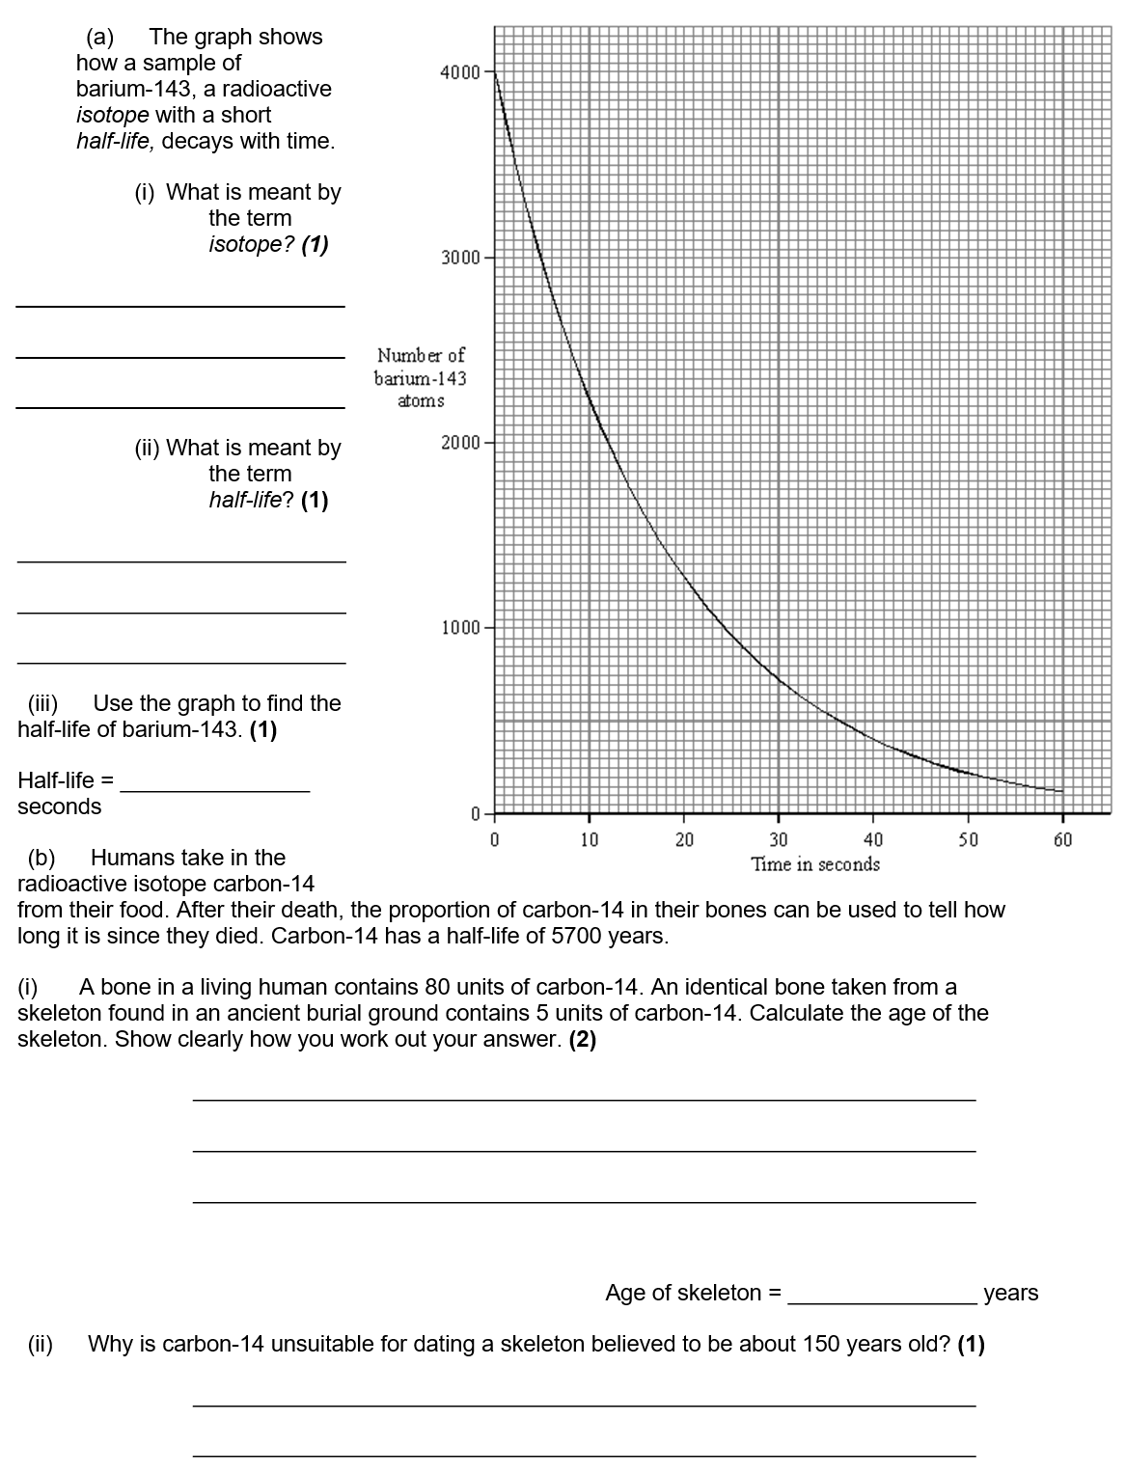
Half life
Half-life is the time taken for the count rate (measured in Becquerel) to halve. We can calculate this using the tree method or from a graph.
Radioactivity is dangerous because our cells can be ionised. This can kill cells or lead to mutations and potentially cancer. If some radioactive particles are in contact with an object, we say the object is contaminated.
All types of radiation are dangerous but alpha particles are most dangerous inside the body as they are most ionising and can’t escape the body. Beta particles are dangerous up to the mid-range and gamma radiation is dangerous up to the long-range.

Slide 4
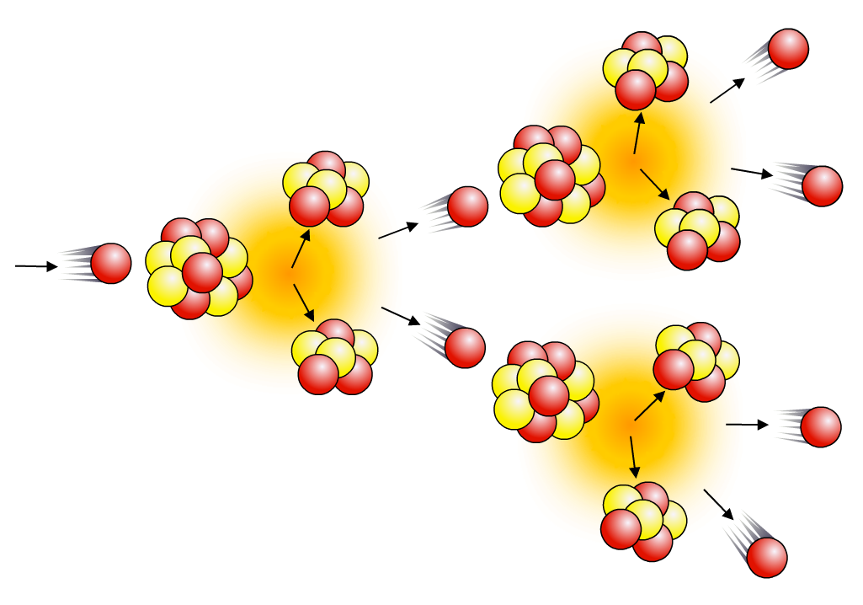
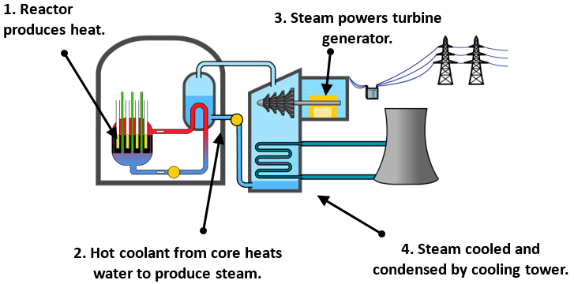
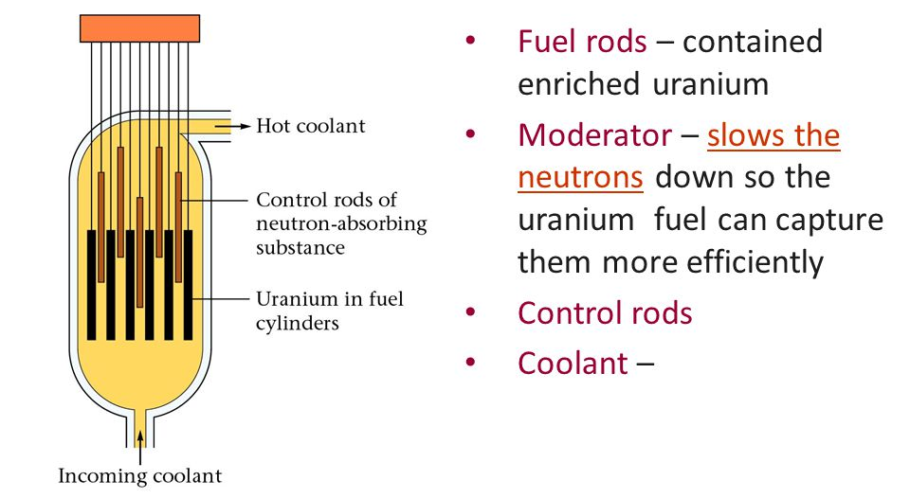

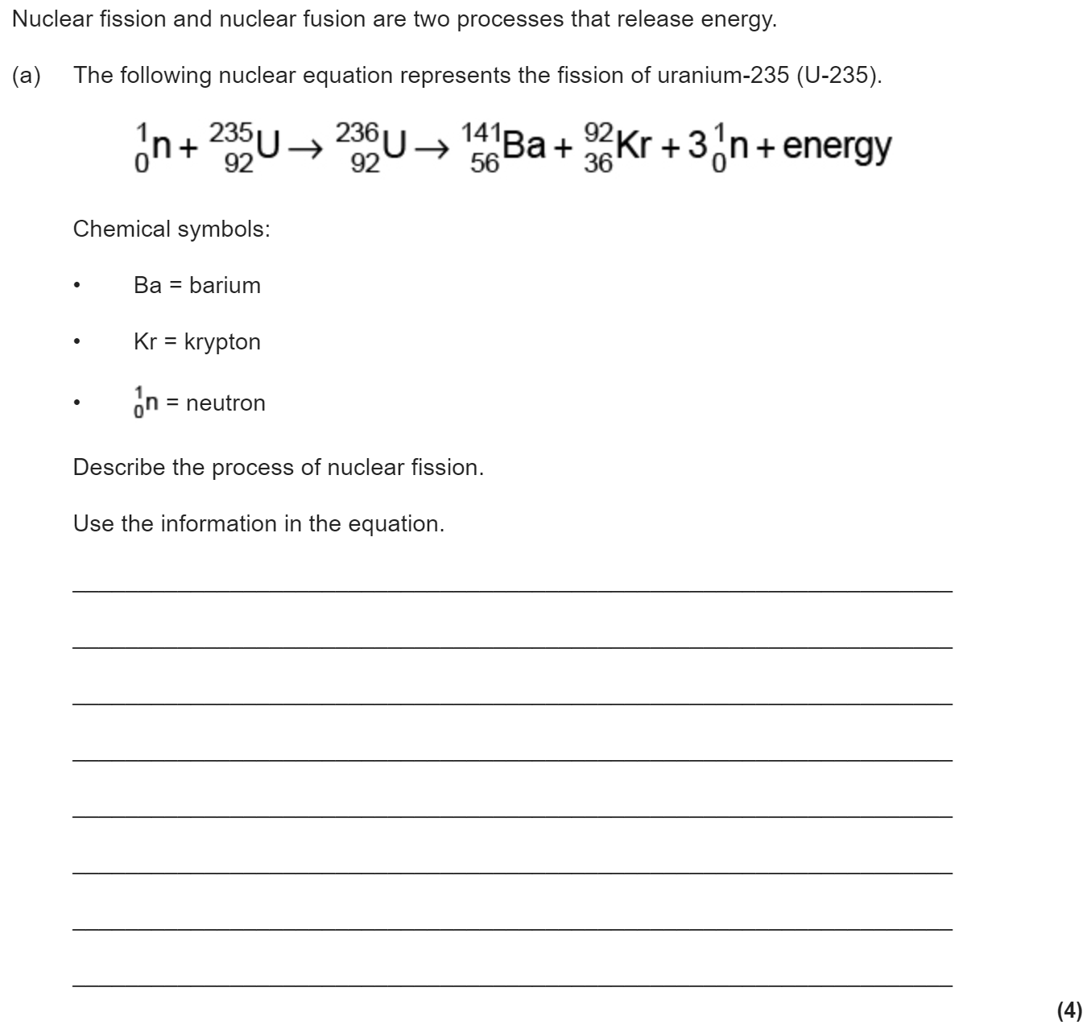

Nuclear fission & fusion
The energy released in nuclear power plants comes from nuclear fission. Large, unstable nuclei such as uranium-235 or plutonium-239 break into smaller fragments, releasing energy as they do so:
²³⁵U + neutron → fission fragments + neutrons + energy
When a uranium-235 nucleus undergoes induced fission after
collision with a neutron, it breaks up into two smaller nuclei and
two/three neutrons. These are called fission neutrons.
The fission neutrons can go on to cause further fission events, which will produce further neutrons, and so on, causing a chain reaction.
Uncontrolled chain reactions are used in atomic bombs.
A nuclear reactor uses a controlled chain reaction to produce heat to produce steam for a generator. Apart from the source of heat, it works in the same way as a coal-fired power station. The reactor itself consists of fuel rods, control rods, coolant and a moderator.
Whereas nuclear fission involves very large nuclei splitting into smaller nuclei, fusion involves small nuclei joining together to form larger ones. The energy emitted by a star, such as the Sun, comes from nuclear fusion. In order for this to happen, the core temperature has to be extremely high – in excess of 10 million degrees. Nuclear fusion in a star like the Sun involves the combination of lighter isotopes of hydrogen to form helium, and the release of energy.

