Slide 1
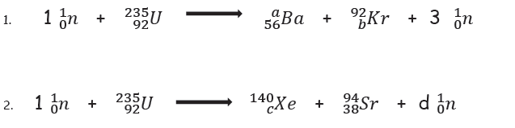
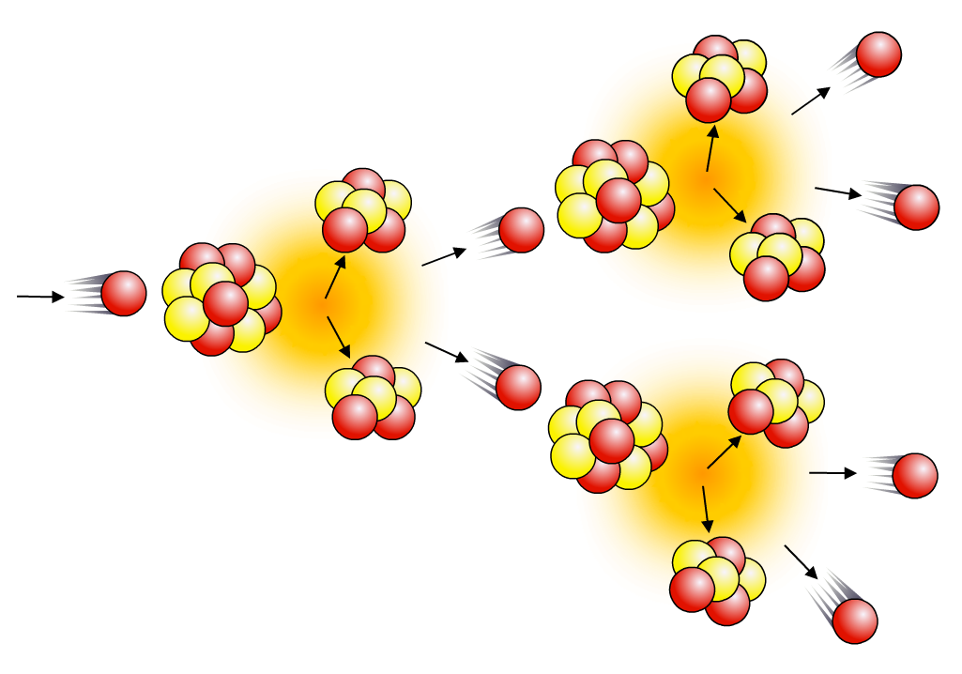
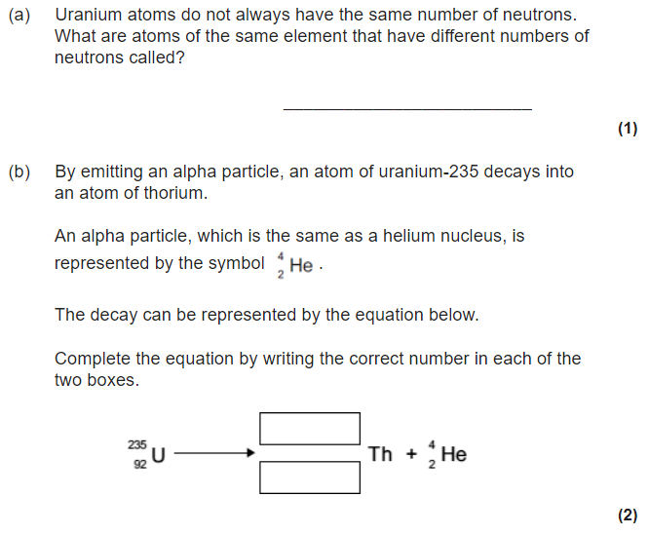
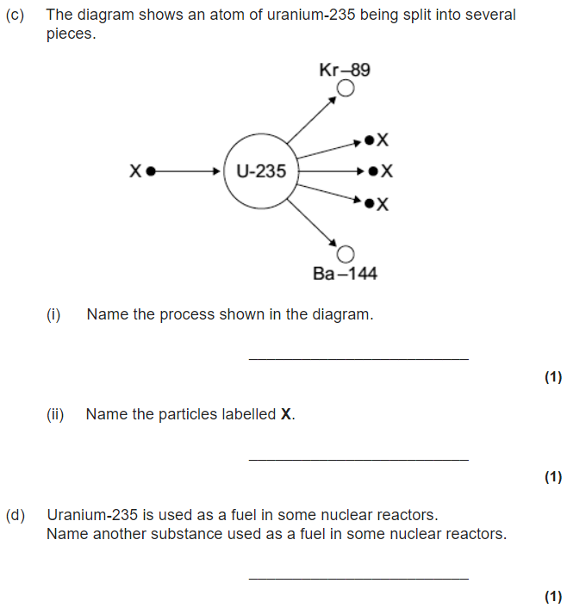
Paper 1 – Fusion & fission
Nuclear fission
The energy released in nuclear power plants comes from nuclear fission. Large, unstable nuclei such as uranium-235 or plutonium-239 break into smaller nuclei, releasing energy as they do so:
²³⁵U + neutron → smaller nuclei + neutrons + energy
When a uranium-235 nucleus undergoes induced fission after
collision with a neutron, it breaks up into two smaller nuclei and
two/three neutrons. These are called fission neutrons.
Do Now: Balance the following nuclear equations by calculating the missing numbers (letters a, b, c and d)
The fission neutrons can go on to cause further fission events, which will produce further neutrons, and so on, causing a chain reaction.
Uncontrolled chain reactions are used in atomic bombs.

Slide 2
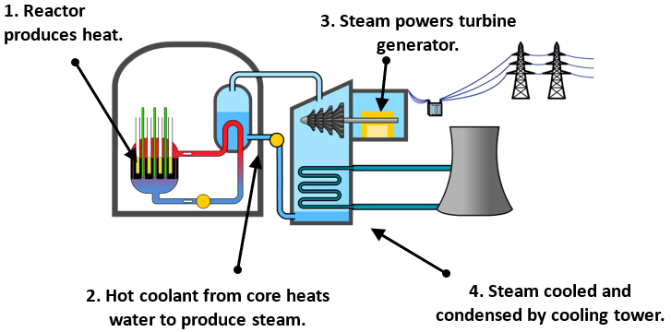
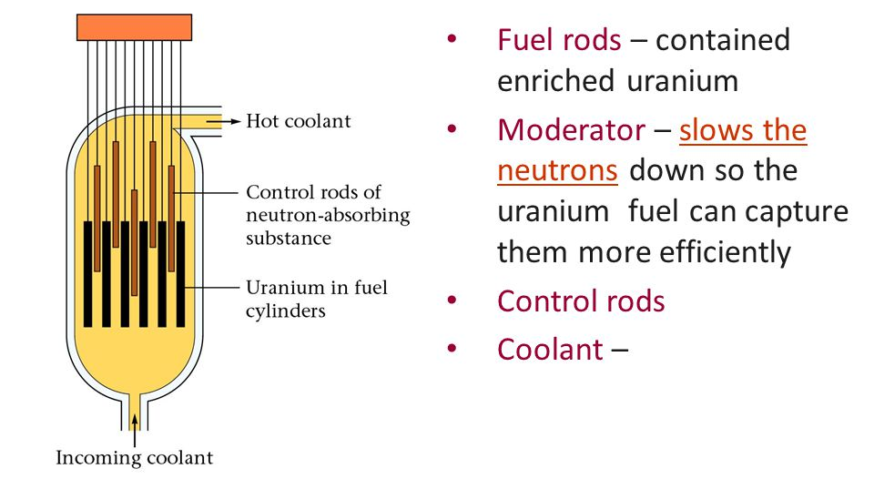
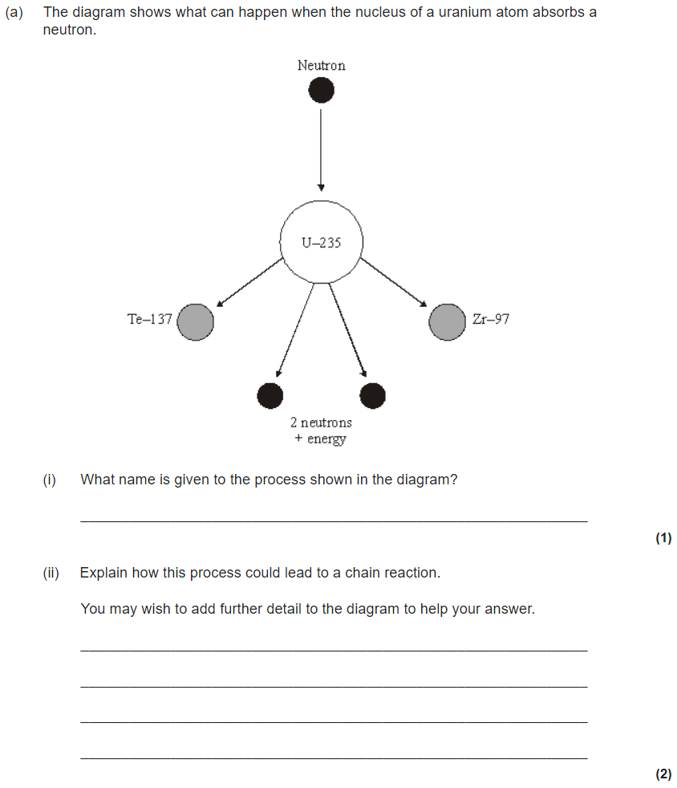
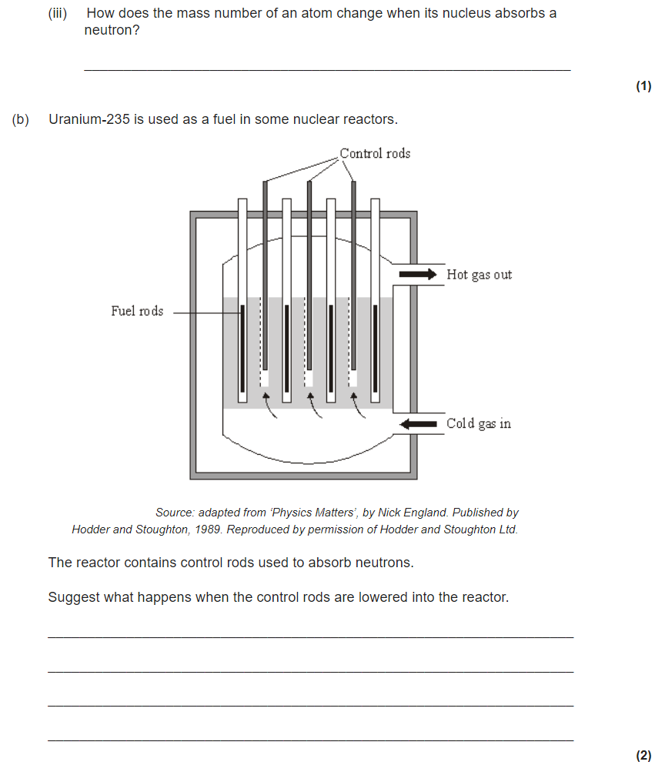
Nuclear power plants
A nuclear reactor uses a controlled chain reaction to produce heat to produce steam for a generator. Apart from the source of heat, it works in the same way as a coal-fired power station. The reactor itself consists of fuel rods, control rods, coolant and a moderator.

Slide 3
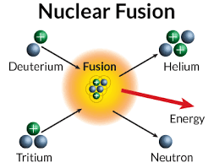

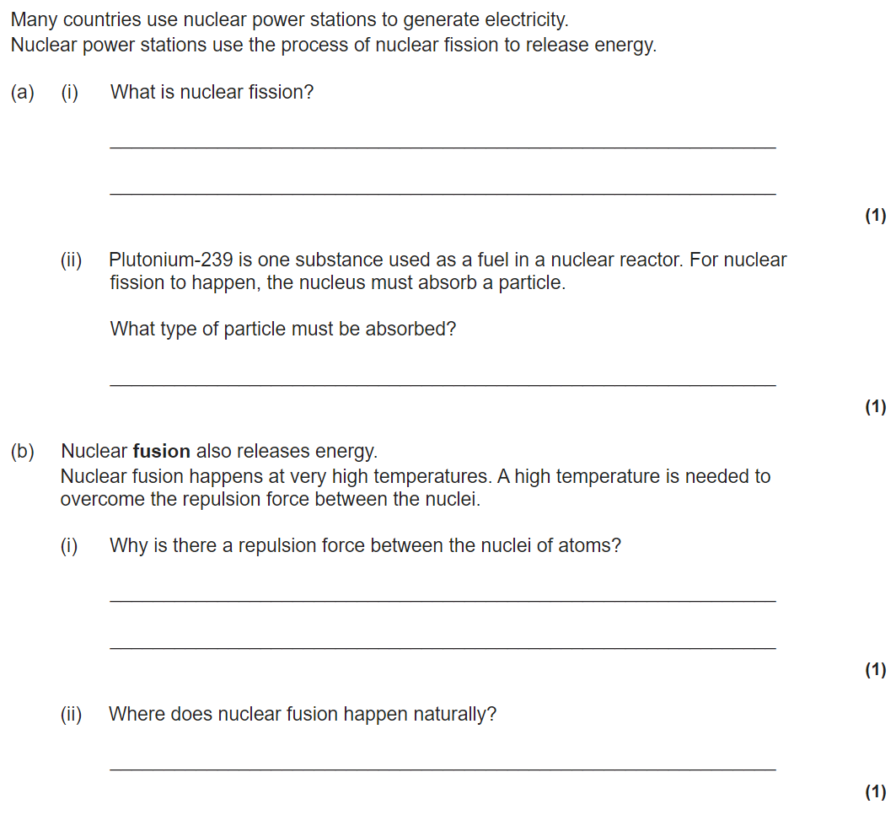
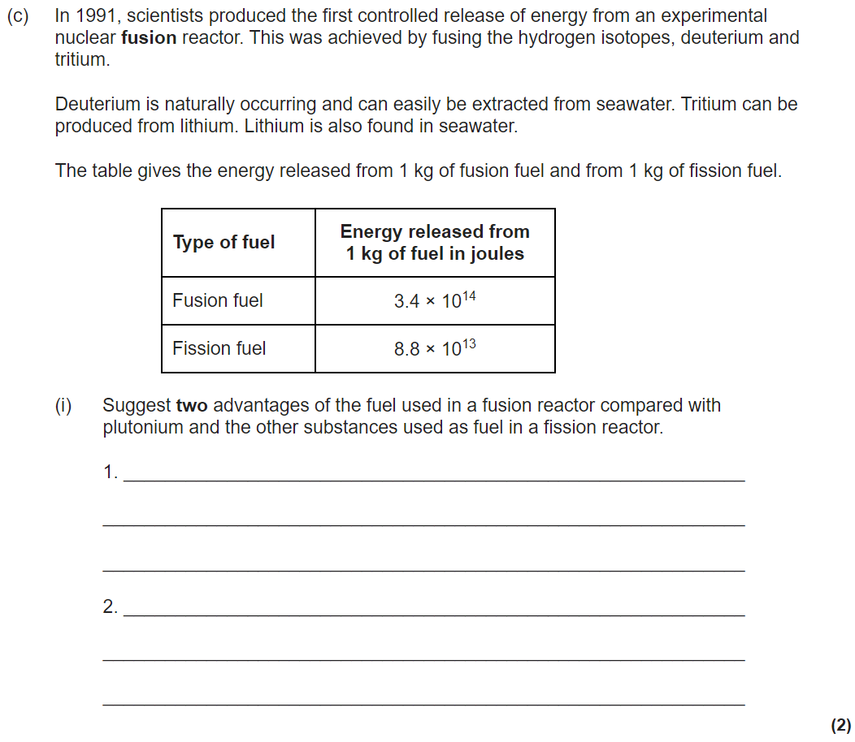
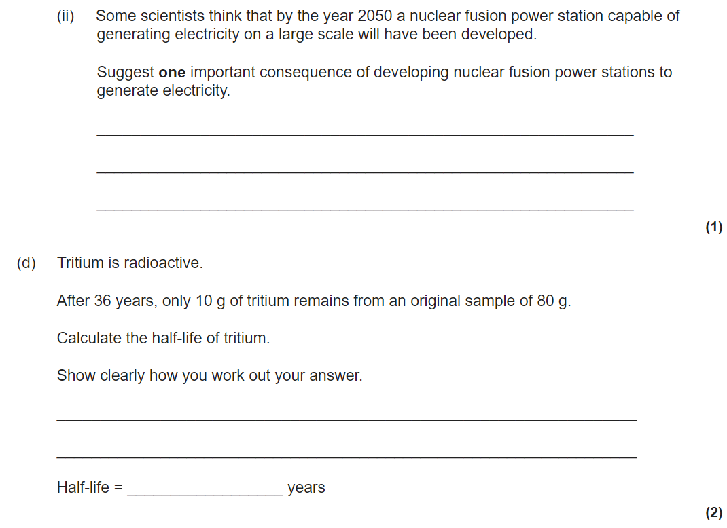
Nuclear Fusion
Whereas nuclear fission involves very large nuclei splitting into smaller nuclei, fusion involves small nuclei joining together to form larger ones. The energy emitted by a star, such as the Sun, comes from nuclear fusion. In order for this to happen, the core temperature has to be extremely high – in excess of 10 million degrees. Nuclear fusion in a star like the Sun involves the combination of lighter isotopes of hydrogen to form helium, and the release of energy:

Slide 4
