Slide 1
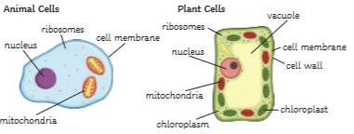
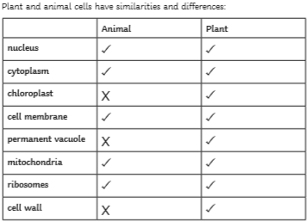
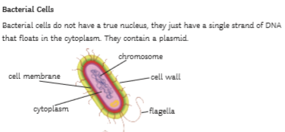
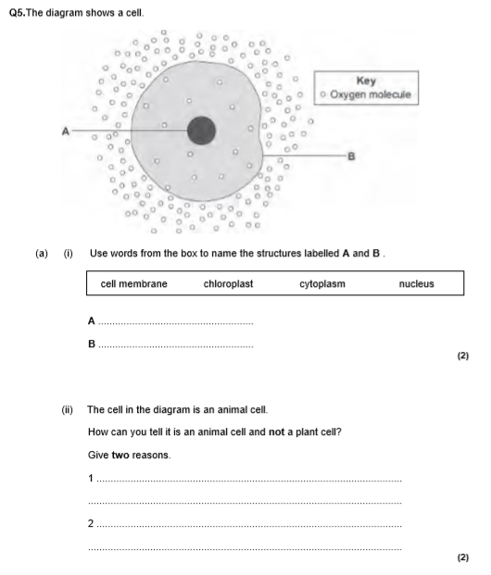
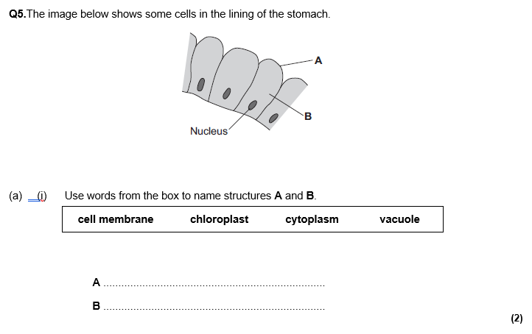
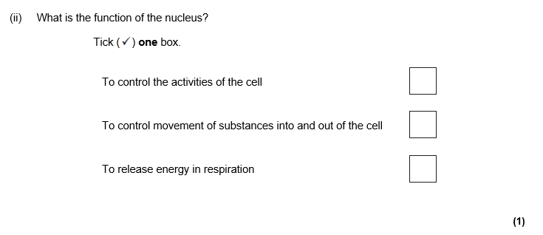
cell biology revision
Keywords: organelle, diffusion , osmosis, mitosis, stem cells, eukaryotes, prokaryotes
Do Now: What are the jobs/ functions of
-cell membrane
-cytoplasm
-chloroplast
-cell wall
-vacuole
-ribosomes
-mitochondria
-nucleus
Eukaryotes vs prokaryotes
Prokaryotes are single celled organisms that have no organelles(parts) that are surrounded by a membrane. They are very small in size and need electron microscopes to be seen. Example : Bacteria
Eukaryotes are multi cellular(lots of cells) organisms with organelles that are surrounded by membranes. You can usually see these cells using light microscopes. Examples: Plant and animal cells

Slide 2
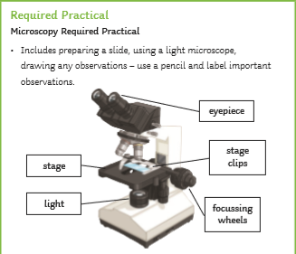
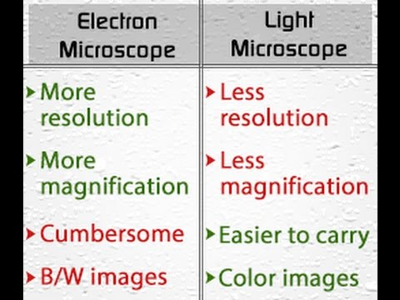
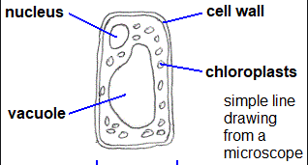
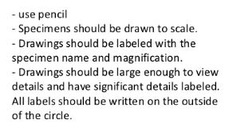
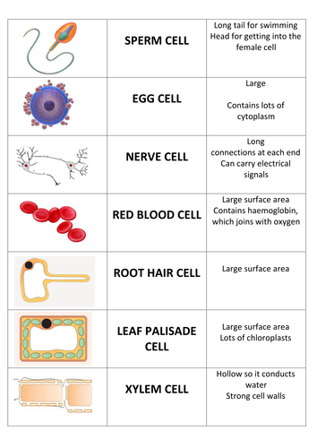
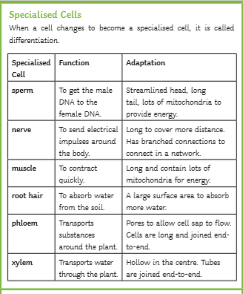
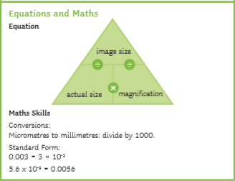
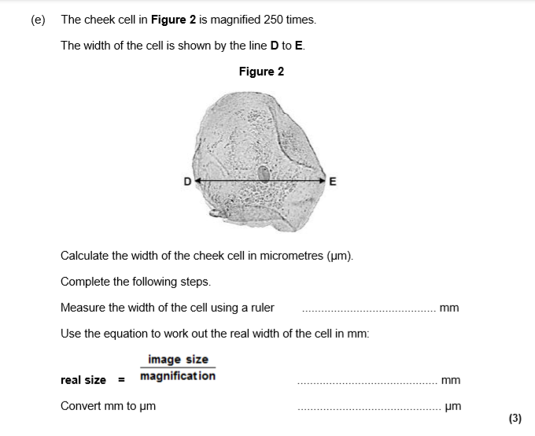
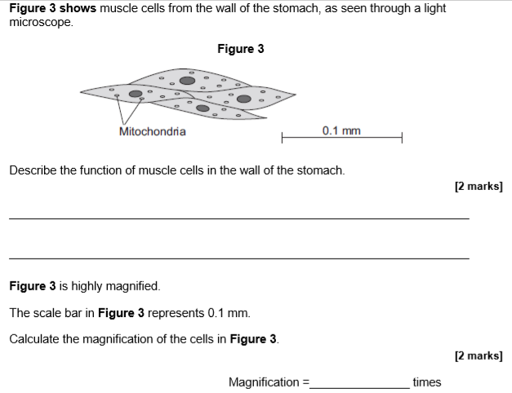
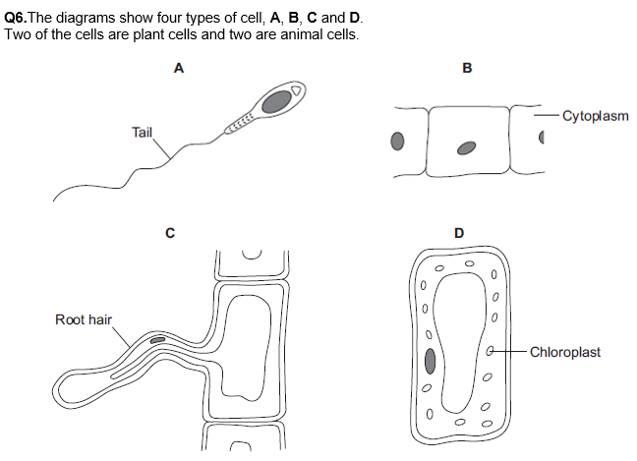
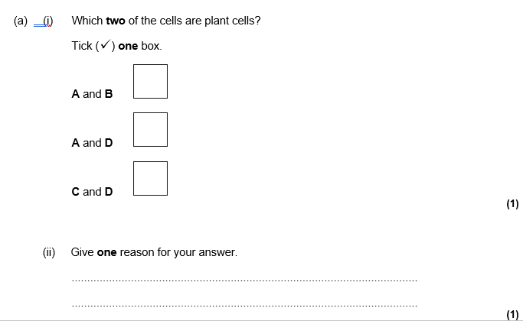
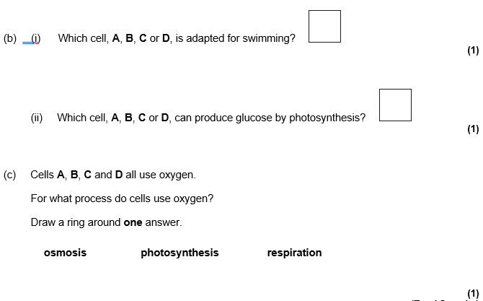
Microscopes, microscopy required practical and magnification and specialised cells
Drawing images from a microscopes

Slide 3
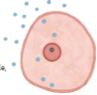
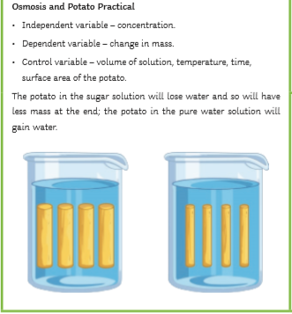
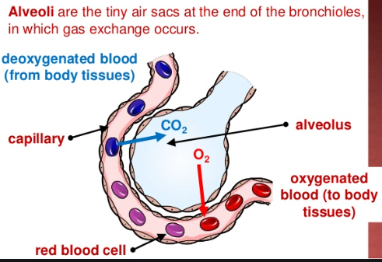
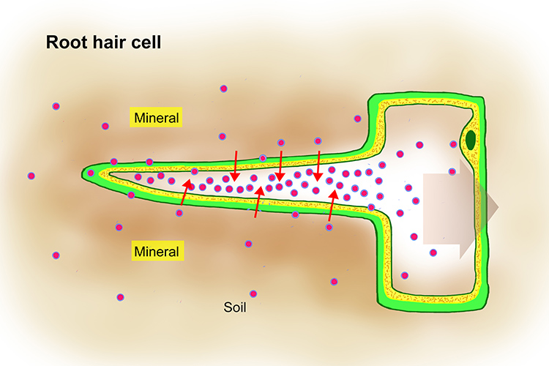
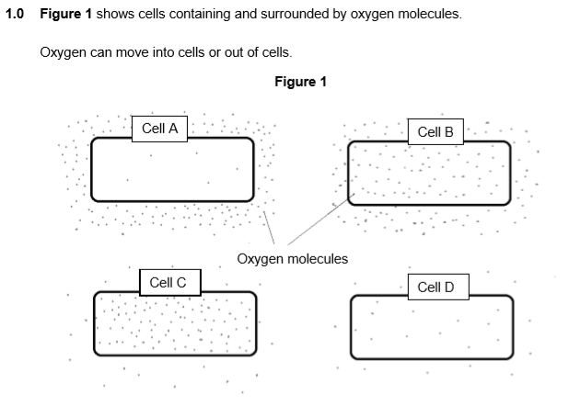
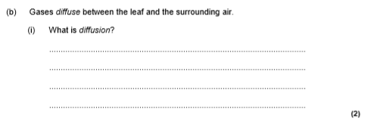
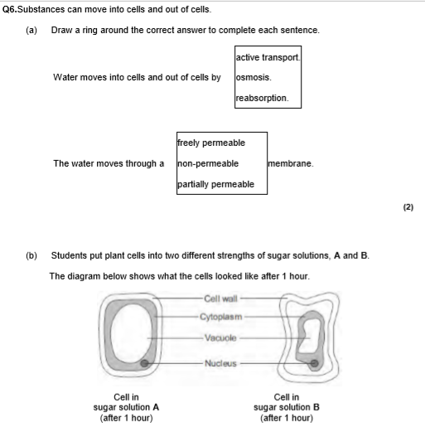
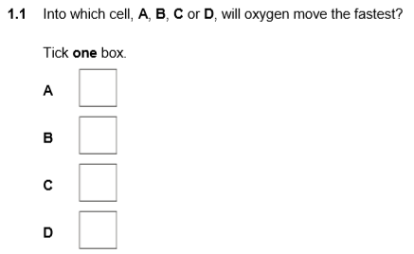
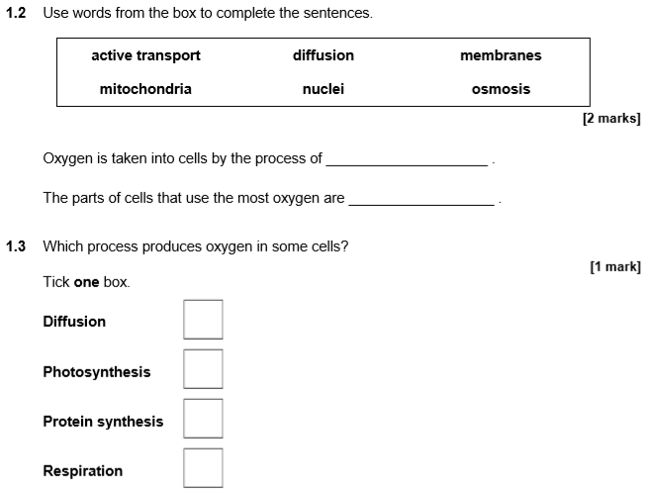
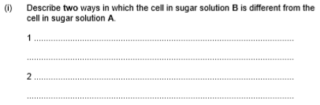
Osmosis diffusion and active transport
Diffusion is the movement of particles from an area of high concentration to an area of low concentration. Diffusion happens in alveoli in the lungs, the villi of the small intestines. In plants, diffusion happens in the leaf and the root hair cells
Osmosis is the movement of water from an area of high concentration to an area of low concentration.
Osmosis happens in the root hair cells and xylem cells in plants and happens in the large intestine in animals
Active transport is the movement of particles from an area of low concentration to an area of high concentration.
Active transport happens in the root hair cells in plants during the transport of mineral ions and happens in the villi of the small intestine in animals

Slide 4
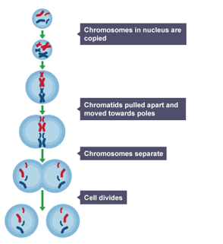
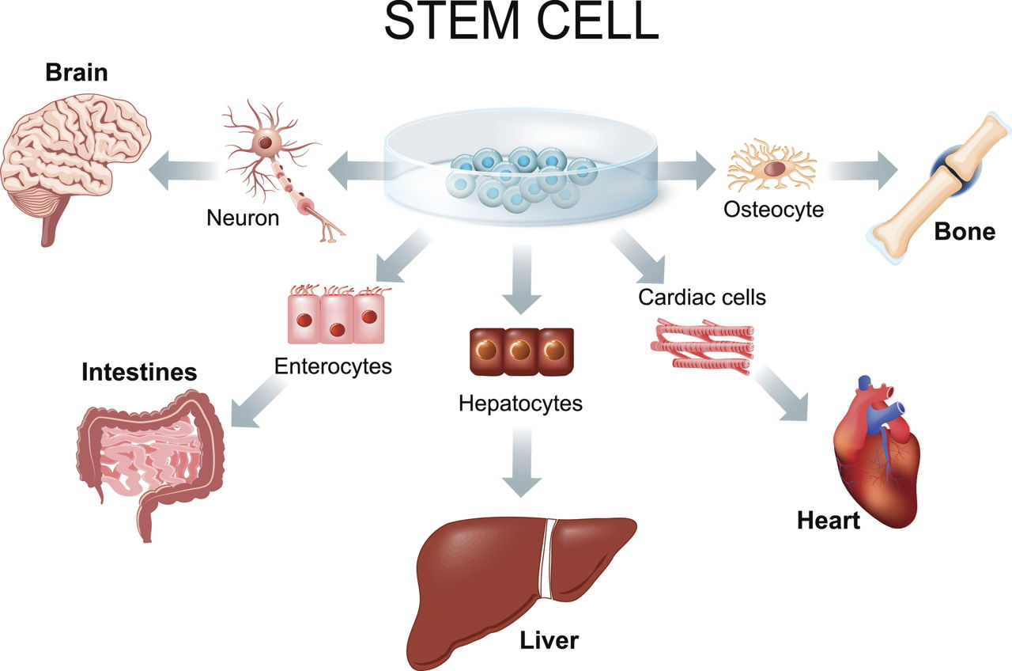
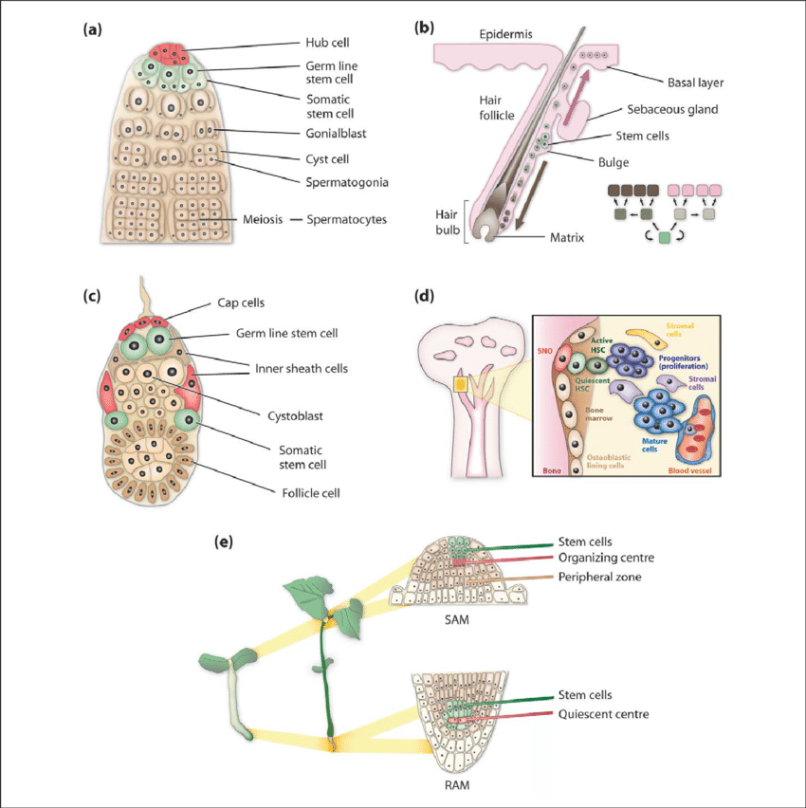
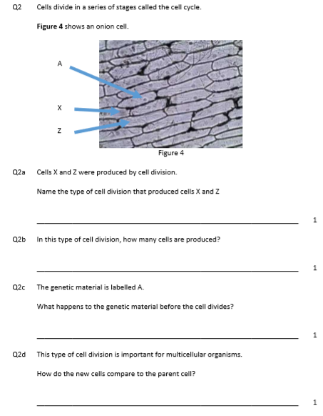
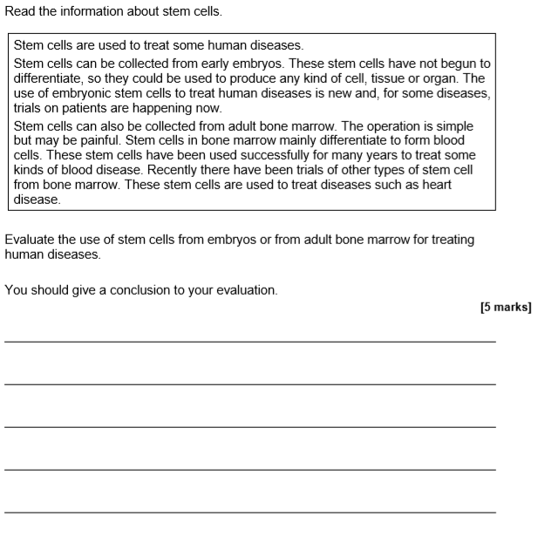
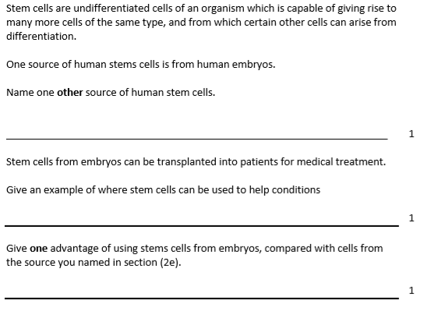
Mitosis and Stem cells
Mitosis is the process by which organisms make new cells. The new cells are exact copies /clones of the original cells. Mitosis is very important for growth and repair
The main stages of mitosis are shown in the diagram below:
Stem cells are cells that have not become specialised. There are three types of stem cells:
Adult stem cells: these are made in the bone marrows and can become blood cells. They are important for research into blood diseases
Embryonic stem cells: These cells come from embryos just after fertilisation has happened. They have the potential to become any specialised cell and so are very useful for scientists to research a range of diseases such as Parkinson’s, diabetes and Alzheimer’s
There are issues with using embryonic stem cells as some people believe that embryos are still babies so it is unethical as they have not given consent. Some scientists may also use embryos left over from IVF for research without getting permission.
Meristem cells: These are stem cells from the tip of a shoot or tip of roots in plants. They divide very quickly and can become any tissue needed by the plant

Slide 5
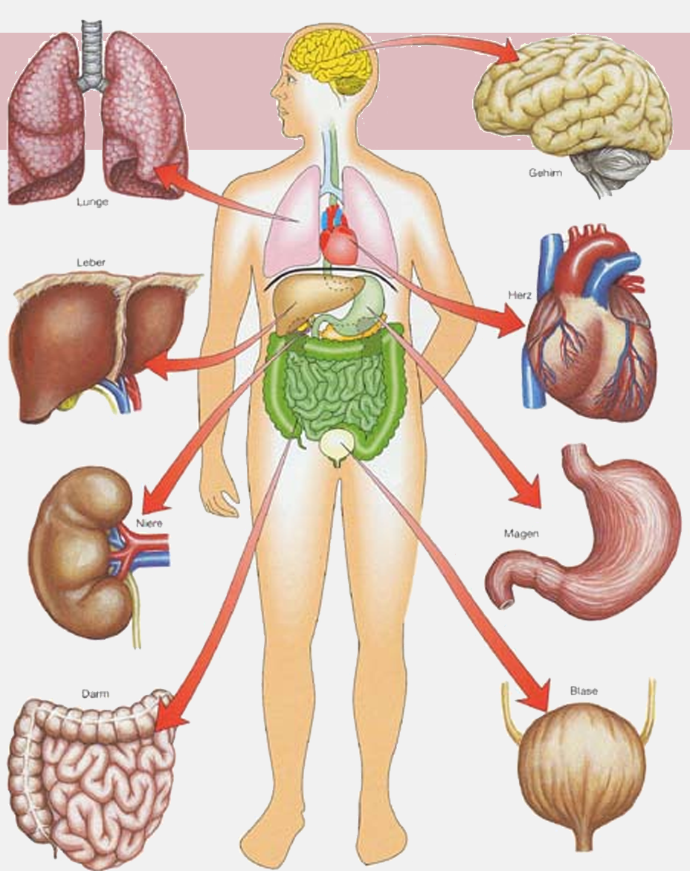
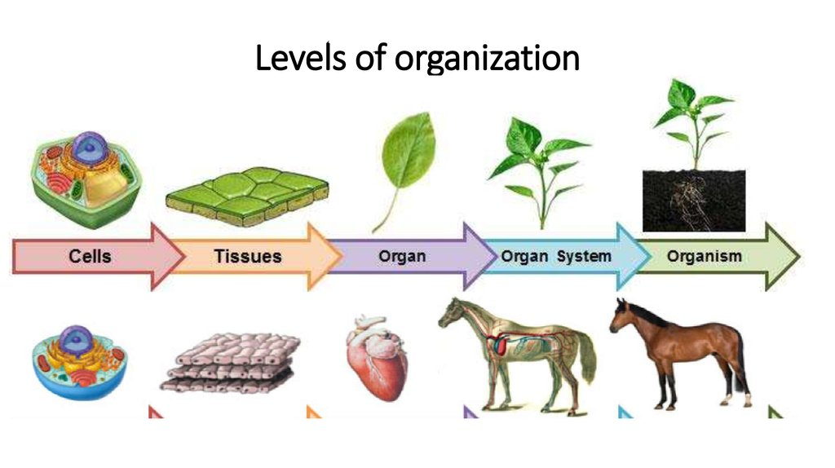
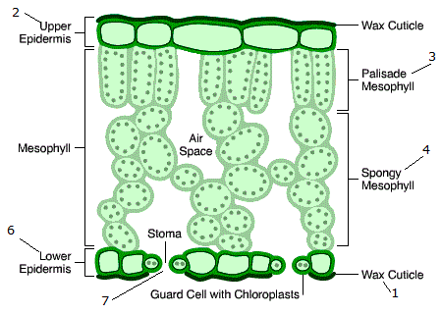
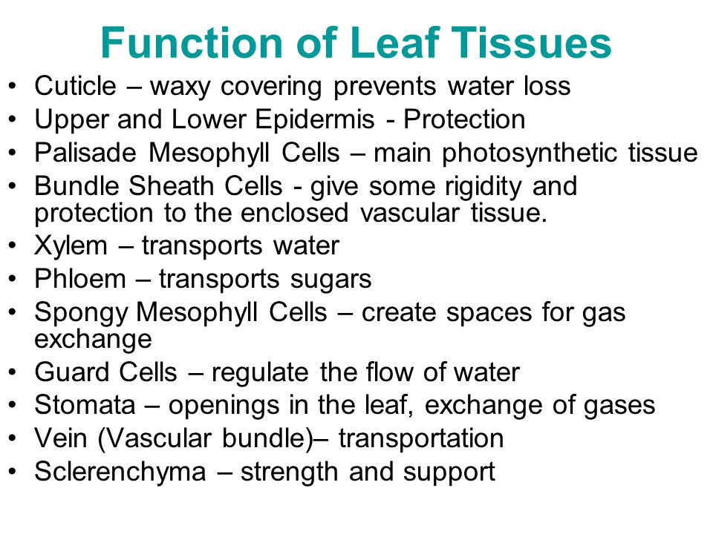
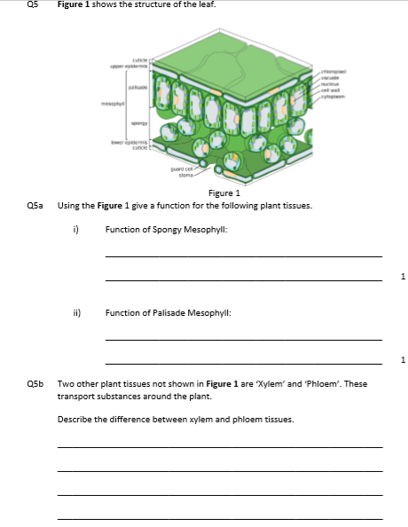
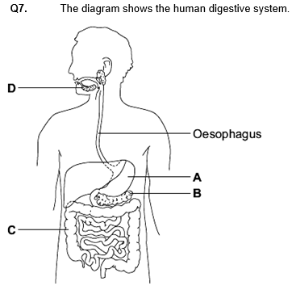
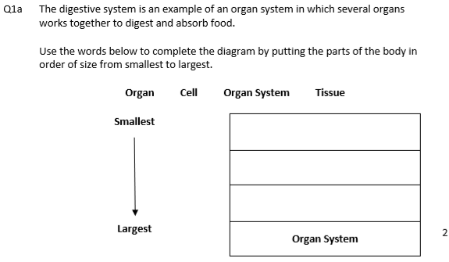
Organisation revision
Keywords: Enzyme, optimum, amylase, protease, lumen, ventricles, atria, valves, lipase, bile, Benedicts, biurets, sudan III, fatty acids glycerol
Do Now: What are the jobs/ functions of
-bile
-amylase
-atria
-ventricles
-valves
-alveoli
-lipase
-protease
Plant and animal organisation
Plant and animals are eukaryotes and so have levels of organisation. Tissues are groups of cells performing the same job e.g nerve cells form nerve tissue. Organs are groups of tissues performing he same job e.g. the heart is an organ made up of muscular and nerve tissue working together. Organ systems are groups of organs working together to perform the same job e.g. the heart, lungs and blood vessels form the circulatory system
Label organs A-D

Slide 6
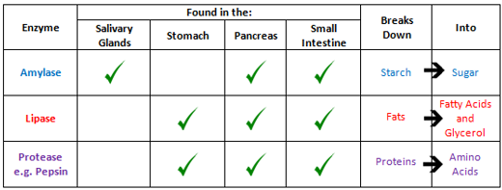
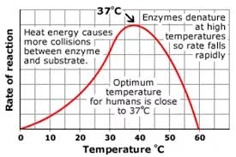
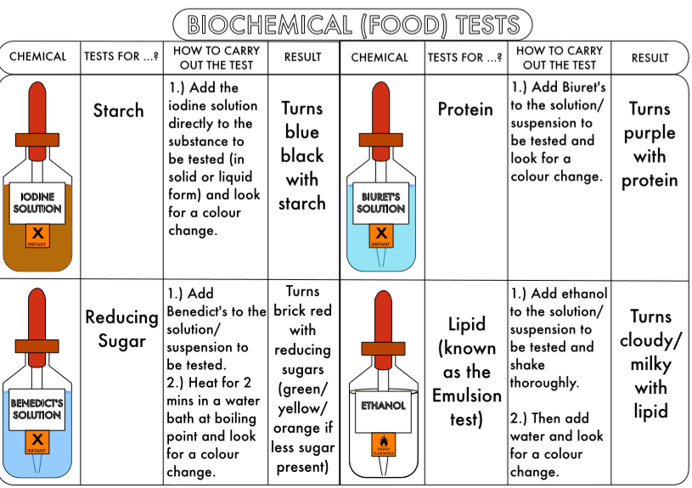
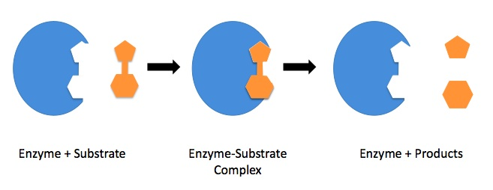
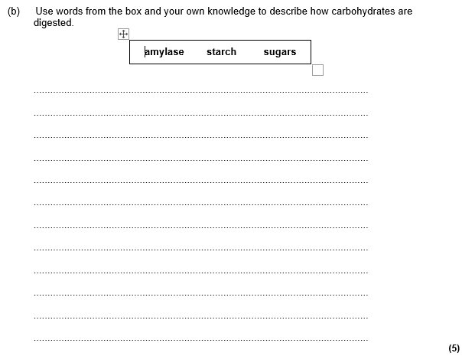
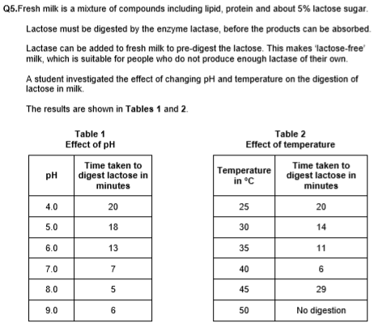
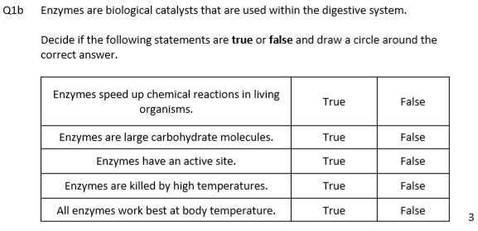
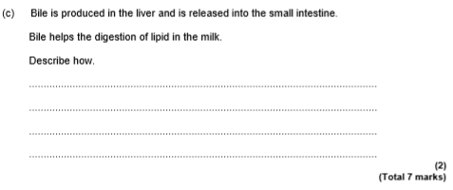
Enzymes and food test required practicals
Enzymes are chemicals that speed up the rate of reactions in organisms. They are also known as biological catalysts. They speed up reactions by lowering the activation energy of reactions. Activation energy is the smallest amount of energy needed for reactions to happen.
There are 4 main enzymes in the digestive system as shown in the table.
Enzymes have very specific shapes and the molecule they are breaking down or making is called the substrate.
Enzymes work in very specific temperature and pH. They denature if they are exposed to very high temperatures or the wrong pH
Other important organs for digestion are:
Organ | Function
Liver | Makes bile. Bile neutralises stomach acid and breaks down fats into lipid so lipase can work
Pancreas | Gland that releases all enzymes needed for digestion
1. a) Explain how you would find out if a food sample had glucose or protein it. You name the chemicals used and results if food group is present
----------------------------------------------------------------------------------------------------------------------------------------------------------------------------------------------------
What pH is best for lactase to work?---------
What temperature is best for lactase to work? -----------------------
Explain why there was no digestion happening at 50 degrees. You must refer to temperature in your answer
---------------------------------------------------------------------------------------------------------------------------------------------------------------------------------------------------------

Slide 7
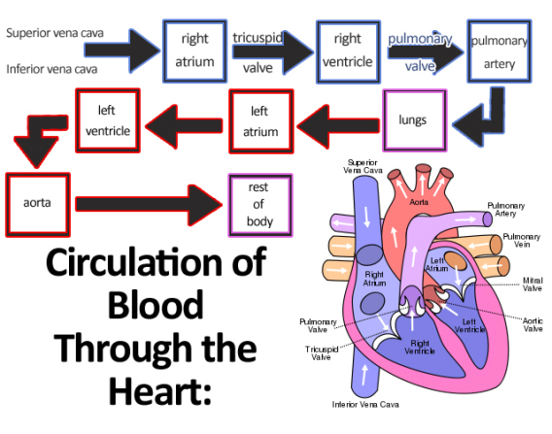







The heart and blood vessels
The heart is made up of 4 chambers:
Left and right atria
Left and right ventricles
Blood goes through the heart twice so we call this a double circulation.
Valve inside the heart help build up pressure and prevent backflow of blood
Journey of blood:
Blood from the body enters the RIGHT ATRIUM from the VENA CAVA. This blood has lots of carbon dioxide
Then blood is then pushed into the RIGHT VENTRICLES through valves. When the right ventricle is full, blood is forced out into the PULMONARY ARTERY towards the lungs.
Once at the lungs, carbon dioxide diffuses out f the blood and oxygen diffuses in. This blood then leaves the lungs via the PULMONARY VEIN back to the heart
The blood enters the heart through the LEFT ATRIUM and then passes into the LEFT VENTRICLE through the valves. When the left ventricle is full, pressure builds up and blood is pushed out of the heart and into the AORTA. The AORTA carries the blood to the rest of the body to deliver the oxygen to tissues and organs that need it for respiration. THE CYCLE STARTS AGAIN
Blood vessels:
There 3 types of blood vessels
Arteries: Carry blood AWAY from the heart to the lungs/body
Veins: carry blood IN to the heart from the lungs or body
Capillaries: are found in organs and this is where diffusion of substances occurs
Valves: Found in veins and the heart. They stop blood from flowing backwards.

Slide 8









Breathing system , risk factors and cardiovascular disease
The breathing system is made up of organs that are well adapted for gas exchange. We inhale air that has a higher percentage oxygen and exhale air that has a higher percentage of carbon dioxide.
Describe how each of the following increases gas exchange:
Good ventilation?
________________________________________________________________________________________
Good circulation?
________________________________________________________________________________________
A large surface area?
________________________________________________________________________________________
Moist surface?
_____________________________________________________________________________________
Short diffusion distance?
________________________________________________________________________________________
Parts of the breathing system
Inhaling vs exhaling
Cardiovascular Diseases and Coronary Heart Disease
Cardiovascular diseases are diseases that affect blood vessels in the circulatory system. These can be:
Build up of cholesterol in arteries
Faulty valves
Build up of cholesterol causes arteries to get blocked and the blood pressure to increase. This can lead to the artery tearing and blood clots forming. Blood clots can then travel to other parts f the body such as the brain and lead to strokes.
Faulty valves can mean than back flow occurs in veins which would affect circulation
Coronary Heart disease (CHD)
CHD affects the coronary arteries that supply the heart with blood rich in oxygen and nutrients. If these arteries are blocked that section of the heart cannot get the nutrients and oxygen needed for respiration and s it will stop working. This is a heart attack
Risk factors
Risk factors are things that increase the chances of you developing CVD/CHD. These include:
Smoking, obesity, alcohol, High salt diet etc
If the heart or valves are damaged sometimes a transplant is needed, Stents can also be used to unclog arteries
Name parts C and D
Using letter A and B explain what happens during gas exchange

Slide 9






Infection and response revision
Keywords: pathogen, microorganism, white blood cells, antibody, antitoxin, physical barriers, vaccines, TMV, crown gall, rose black spot, gonorrhoea, measles, HIV, salmonella, malaria, protist, mosquito, athletes foot, engulf, phagocytosis, pain killers
Do Now: Define the following:
-toxin
-medicine
-vector
-microorganism
-prokaryote
-enzyme
-pathogen
-antibody
Physical and chemical barriers to pathogens
Pathogens are microorganisms that cause disease and the body has to main ways from protecting us from them:
Physical and chemical barriers that prevent pathogens entering the body
Action of white blood cells which helps destroy pathogens their effects
How pathogens spread

Slide 10










Plant and animal diseases
Plant Diseases
Plants can also get infected by viruses, bacteria and fungi and these diseases will show certain symptoms the plant diseases you need to know are shown in the table below:
Plant diseases can be treated by using herbicides for each disease e.g.
Fungicides are used for fungal diseases
Bactericides are used for diseases caused by bacteria and
Viricides are used for diseases caused by viruses
Disease | Pathogen | symptoms | picture
TMW | Virus | Mosaic pattern on leaves
Crown Gall | Bacteria | Tumours on trunks or stems
Rose black spot | Fungi | Black spots on leaves
Parts of the breathing system
Inhaling vs exhaling
Animal diseases
The animal diseases you need to know are shown in the table below
Disease | Pathogen | Symptoms | Transmitted by
HIV Measles | Virus | Flu like symptoms Spots and fever | Fluids, injections Airborne through coughing
Salmonella Gonorrhoea | Bacteria | Stomach upset Yellow discharge and pain when urinating | Under cooked poultry Fluids, sex
Athletes foot Malaria | Fungi Protist | Flaky skin between toes/fingers Fever, nausea | Contact Mosquitoes are vectors and pass into blood when they bite
We can reduce pathogens spreading and infecting us by washing hands, using protection during sex, cooking food properly, vaccines and using mosquito repellents/nets

Slide 11






Secondary defence by white blood cells and treating disease
White blood cells are specialised cells that help us fight infection. They do this in 3 ways:
By engulfing(eating) the pathogen. This is called phagocytosis
Producing anti toxins which neutralise the toxins released by pathogens
Producing antibodies. Antibodies are molecules that attach to the pathogens and make them clump together. Once clumped together the pathogens can be engulfed and digested
Treating disease.
There are several drugs that are used to treat diseases depending on what pathogen causes the disease
Antibiotics:
There are used to treat all diseases caused by bacteria. They work by recognising and destroying part of the structure of the bacteria and preventing reproduction.
Antibiotics cannot kill viruses because viruses live inside cells
The first antibiotic discovered by Alexander Fleming was penicillin. However, bacteria can become resistant to antibiotics by mutating and the drug stops working. Overusing antibiotics can make pathogens become resistant quicker. MRSA is a bacterial infection that is resistant to multiple antibiotics so is very difficult to treat
2. Antivirals:
Antivirals are used treat viral infections such as HIV and colds. They are very expensive to develop and only work on viruses.
3. Antifungals:
Antifungals are used to treat fungal infections such as athletes foot. They are normally creams you apply.
Vaccines:
Vaccines are weak or dead pathogens that are given to you to help you develop immunity against pathogens. They work by making your body produce antibodies to kill the pathogen. When the body is infected by the same pathogen again, it recognises the pathogen very quickly and makes antibodies faster preventing the pathogen from multiplying and causing disease.
The most common vaccine is MMR which stands for Mumps, Measles and Rubella
Some people do not vaccinate their children which means less people are immune and this can lead to outbreaks
Painkillers: Pain killers are drugs used to treat symptoms of disease. They cannot treat the disease. E.g. Paracetamol reduces the pain/fever caused by toxins building up when we are infected.

Slide 12








Non communicable diseases and Developing drugs
Non Communicable Diseases
These are diseases that cannot be passed on form one person to another unless through genes
Examples:
Diabetes
Cancer
CVD and CHD(see revision sheet in organisation topic)
Cancer
Cancer is a disease that develops because of cells dividing controllably. This leads to lumps of cells called tumours forming. There are two types of tumours:
  Malignant tumours- these tumours can spread via the blood stream to other parts of the body. They are difficult to treat
  Benign tumours- these tumours do not spread so are easier to treat as they can just be removed.
Risk factors for cancer
Genetics
Exposure to carcinogens (chemicals which can cause cells to divide uncontrollably)
Lifestyle e.g smokers are more likely to get lung cancer and obese people are more likely to get diabetes.
Developing Drugs
Drugs can either be recreational or used as medicine. They take several years to develop and are very expensive. The flow chart shows the main stages in drug development

Slide 13











Bioenergetics revision
Keywords: respiration, photosynthesis, lactic acid, oxygen debt, light intensity, glucose, mitochondria, ethanol, carbon dioxide, heart rate, breathing rate, muscle, temperature
Do Now: What is the function/purpose of the following:
-stomata
-Arteries
-alveoli
-veins
-benedicts solution
-iodine solution
-mitochondria
-ribosomes
Photosynthesis
Photosynthesis is the process by which plants make glucose from carbon dioxide and water using energy from sunlight
Photosynthesis happens in the chloroplasts of leaf cells.
Factors affecting the rate of photosynthesis
Required practical: investigating effect of light intensity on rate of photosynthesis
Equipment: LED lamp, metre ruler, pondweed, beaker, stopwatch, sodium hydrogen carbonate and pond water
Method
Set up the experiment as shown
Add carbonate tablets to beaker to ensure the plant has enough CO2
Measure the distance the lamp is from the beaker
Leave for a set time and count how many oxygen bubbles are produced
Move the beaker along the ruler every 10cm and repeat step 3
6. Repeat the experiment 3 times and calculate average number of bubbles for each distance
7. Work out light intensity by using 1/distance squared
8. Plot a graph of light intensity vs number of bubbles
What happens to the glucose made by plants?
The glucose made by plants can be used for the following:
It can be converted to starch and stored. We can carry out a starch test to see is a plant has carried out photosynthesis
It can be used in respiration
It can be used to make proteins
It can be used to make seeds
It can be used to make fats and oils.

Slide 14








Respiration, exercise and metabolism
Aerobic vs anaerobic respiration
Aerobic respiration is respiration that uses oxygen to release energy from glucose. It happens in the mitochondria
Anaerobic respiration is respiration without oxygen. In animals anaerobic respiration produces lactic acid and in yeast anaerobic respiration produces ethanol ad carbon dioxide which is useful in the brewing industry.
Respiration and exercise
During exercise, the body uses up a lot of energy. This means the rate of respiration increases to supply muscles with the energy they need to contract.
The following changes occur when exercising:
Heart rate increases as the heart is pumping more blood to and from muscles
Breathing rate increases as the body need to take in more oxygen for aerobic respiration and release carbon dioxide made by cells when they respire.
Blood vessels dilate( widen) so that they can deliver more blood to the muscles and the surface of the skin in order for heat to be conducted away
Oxygen debt
Oxygen debt is the amount of oxygen needed to completely break down lactic acid into carbon dioxide and water. After exercise your breathing rate stays high so that you can take in extra oxygen. Lactic acid is toxic to the body and destroys muscles
Metabolism
Metabolism is the rate at which chemical reactions happen in cells.

