Slide 1


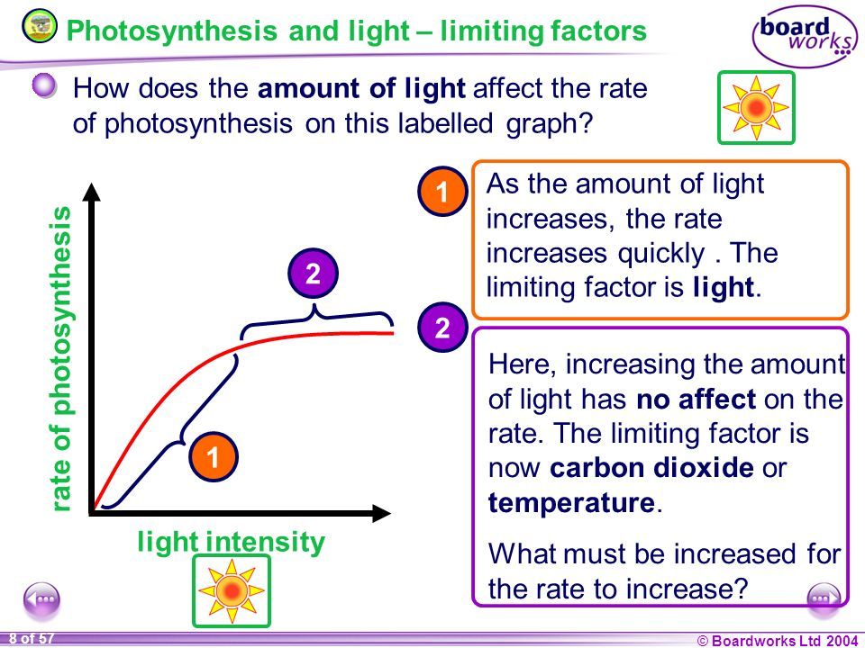
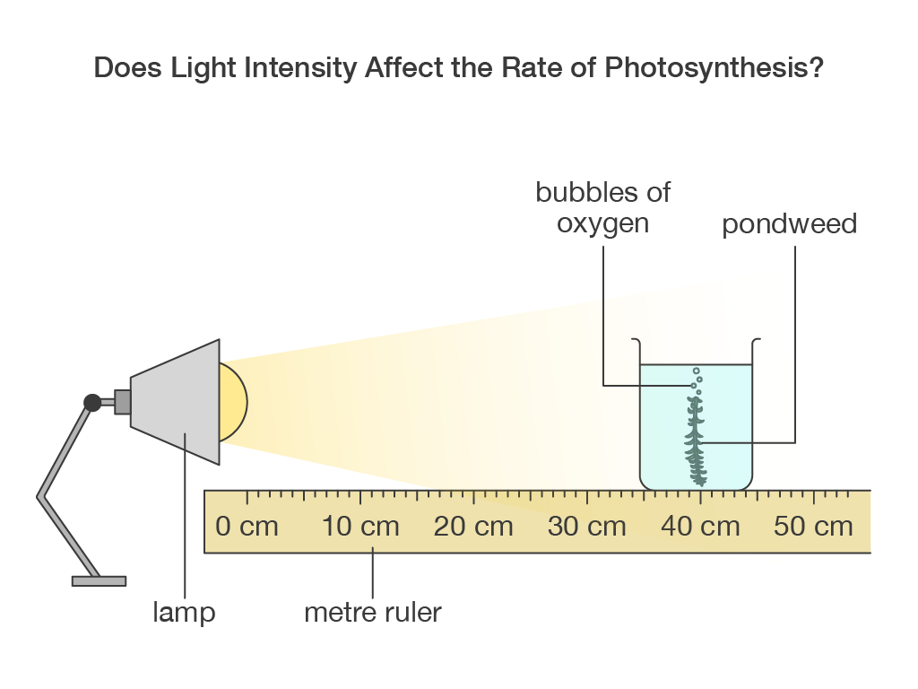
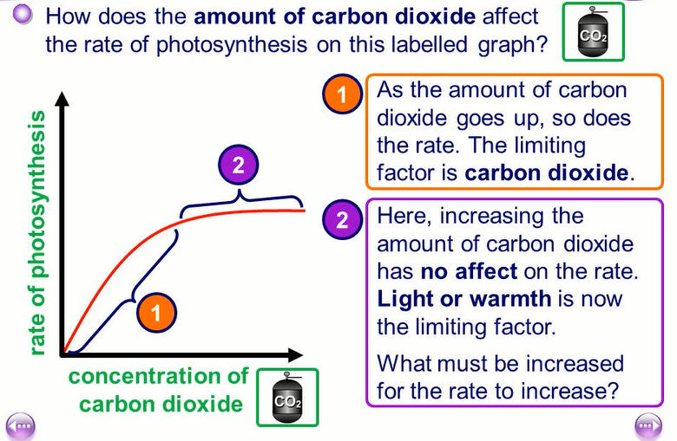
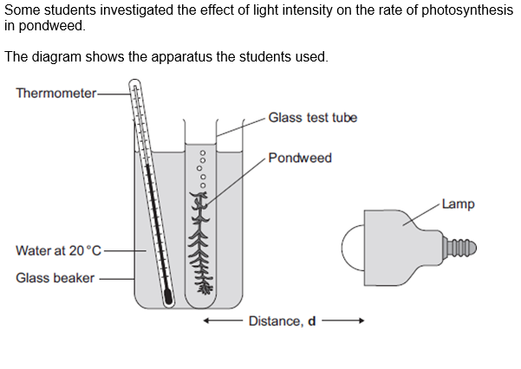
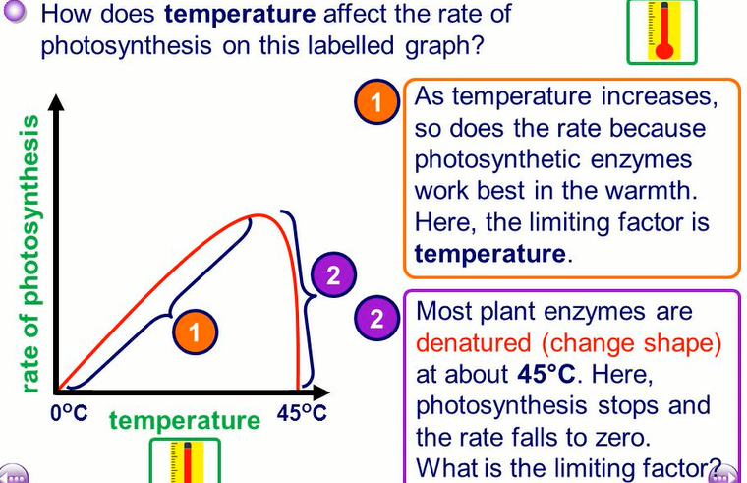
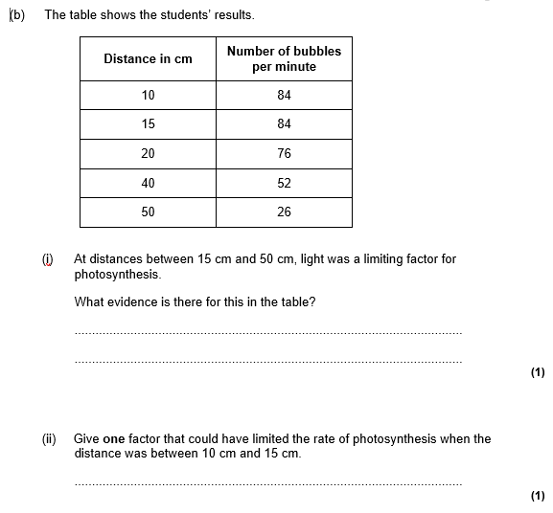
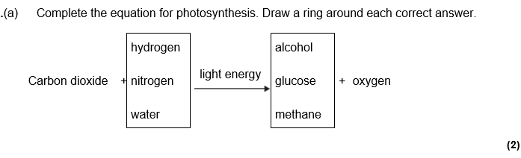
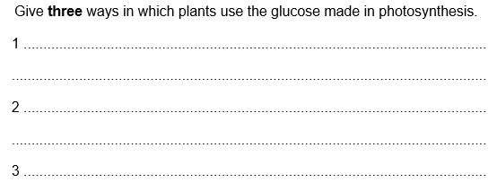
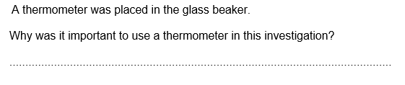
Bioenergetics revision
Keywords: respiration, photosynthesis, lactic acid, oxygen debt, light intensity, glucose, mitochondria, ethanol, carbon dioxide, heart rate, breathing rate, muscle, temperature
Do Now: What is the function/purpose of the following:
-stomata
-Arteries
-alveoli
-veins
-benedicts solution
-iodine solution
-mitochondria
-ribosomes
Photosynthesis
Photosynthesis is the process by which plants make glucose from carbon dioxide and water using energy from sunlight
Photosynthesis happens in the chloroplasts of leaf cells.
Factors affecting the rate of photosynthesis
Required practical: investigating effect of light intensity on rate of photosynthesis
Equipment: LED lamp, metre ruler, pondweed, beaker, stopwatch, sodium hydrogen carbonate and pond water
Method
Set up the experiment as shown
Add carbonate tablets to beaker to ensure the plant has enough CO2
Measure the distance the lamp is from the beaker
Leave for a set time and count how many oxygen bubbles are produced
Move the beaker along the ruler every 10cm and repeat step 3
6. Repeat the experiment 3 times and calculate average number of bubbles for each distance
7. Work out light intensity by using 1/distance squared
8. Plot a graph of light intensity vs number of bubbles
What happens to the glucose made by plants?
The glucose made by plants can be used for the following:
It can be converted to starch and stored. We can carry out a starch test to see is a plant has carried out photosynthesis
It can be used in respiration
It can be used to make proteins
It can be used to make seeds
It can be used to make fats and oils.

Slide 2
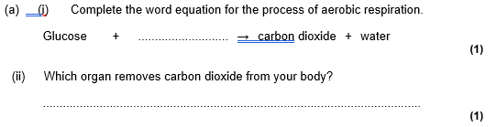

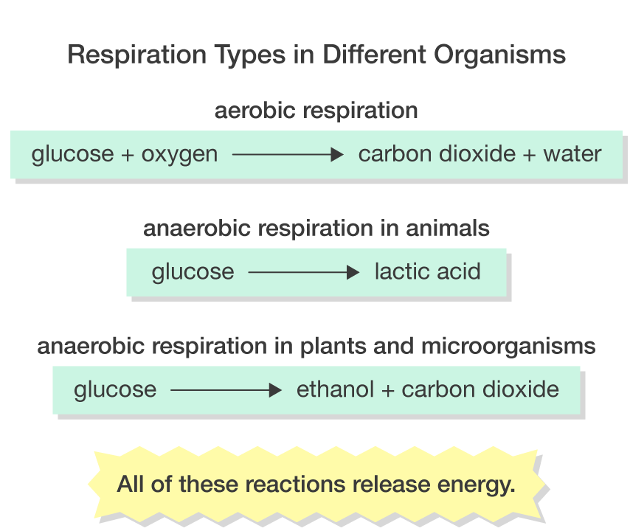
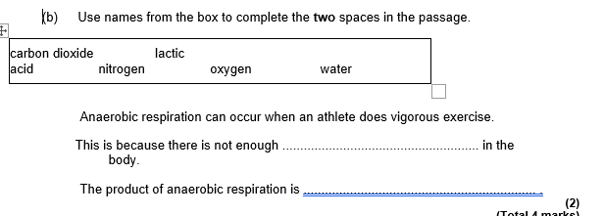
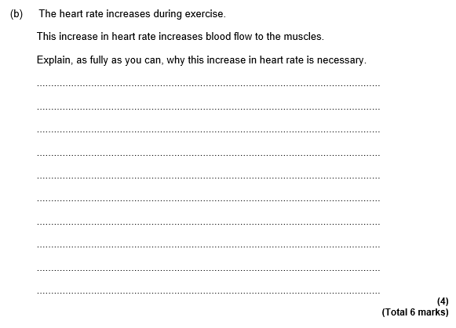
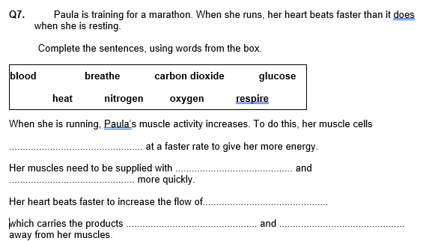
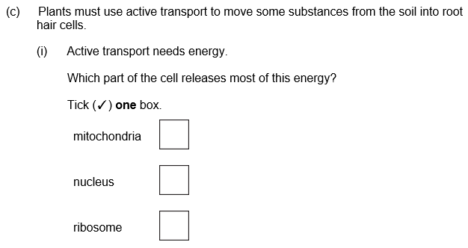
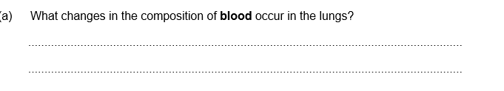
Respiration, exercise and metabolism
Aerobic vs anaerobic respiration
Aerobic respiration is respiration that uses oxygen to release energy from glucose. It happens in the mitochondria
Anaerobic respiration is respiration without oxygen. In animals anaerobic respiration produces lactic acid and in yeast anaerobic respiration produces ethanol ad carbon dioxide which is useful in the brewing industry.
Respiration and exercise
During exercise, the body uses up a lot of energy. This means the rate of respiration increases to supply muscles with the energy they need to contract.
The following changes occur when exercising:
Heart rate increases as the heart is pumping more blood to and from muscles
Breathing rate increases as the body need to take in more oxygen for aerobic respiration and release carbon dioxide made by cells when they respire.
Blood vessels dilate( widen) so that they can deliver more blood to the muscles and the surface of the skin in order for heat to be conducted away
Oxygen debt
Oxygen debt is the amount of oxygen needed to completely break down lactic acid into carbon dioxide and water. After exercise your breathing rate stays high so that you can take in extra oxygen. Lactic acid is toxic to the body and destroys muscles
Metabolism
Metabolism is the rate at which chemical reactions happen in cells.

