Slide 1
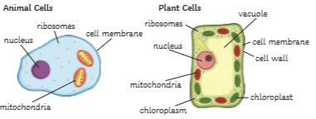
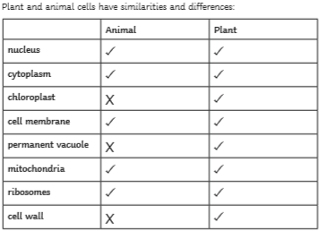
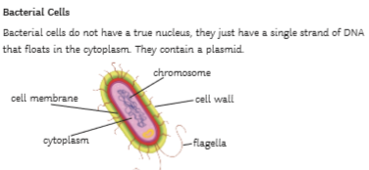
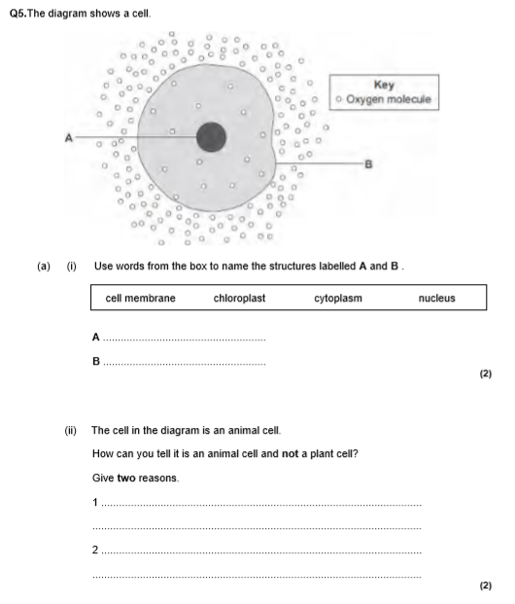
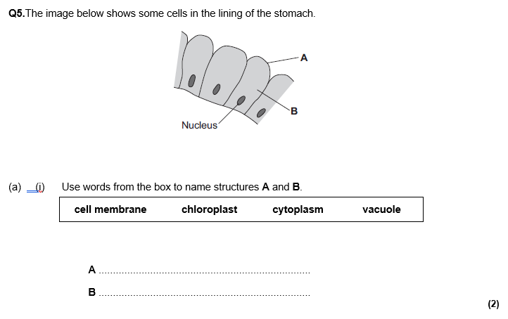
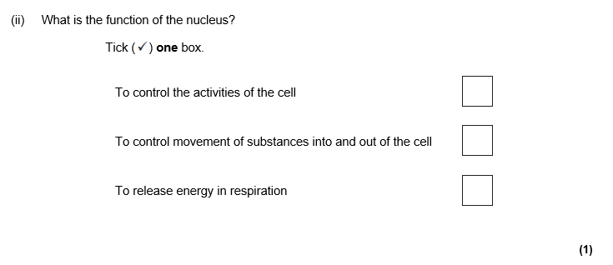
cell biology revision
Keywords: organelle, diffusion , osmosis, mitosis, stem cells, eukaryotes, prokaryotes
Do Now: What are the jobs/ functions of
-cell membrane
-cytoplasm
-chloroplast
-cell wall
-vacuole
-ribosomes
-mitochondria
-nucleus
Eukaryotes vs prokaryotes
Prokaryotes are single celled organisms that have no organelles(parts) that are surrounded by a membrane. They are very small in size and need electron microscopes to be seen. Example : Bacteria
Eukaryotes are multi cellular(lots of cells) organisms with organelles that are surrounded by membranes. You can usually see these cells using light microscopes. Examples: Plant and animal cells

Slide 2
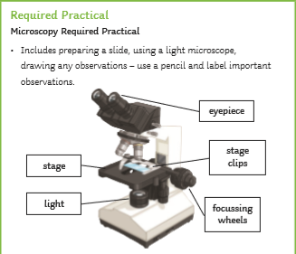
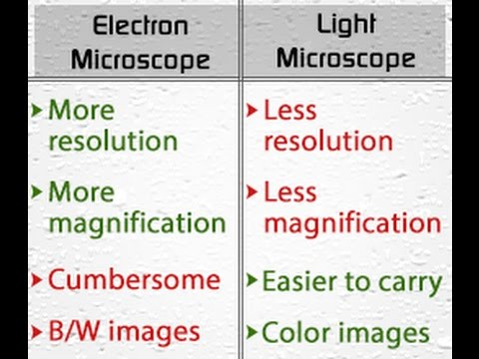
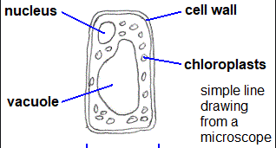
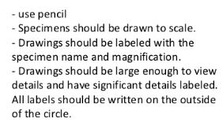
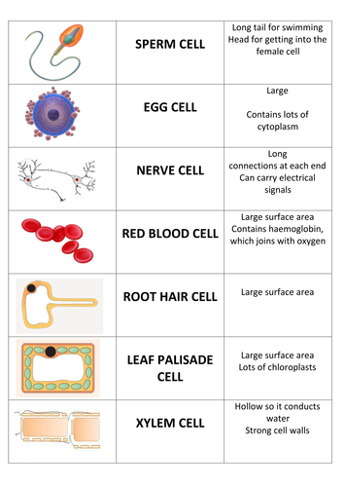
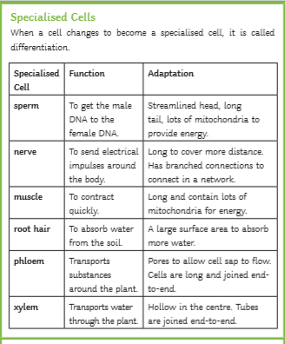
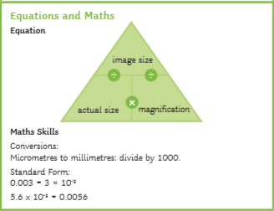
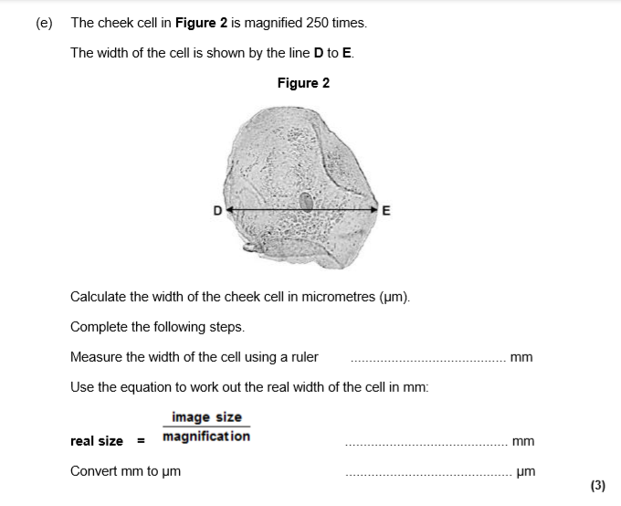
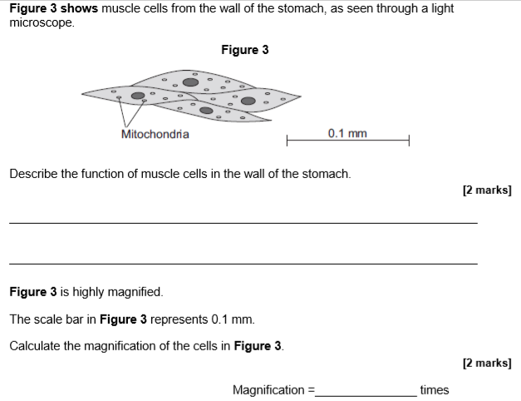
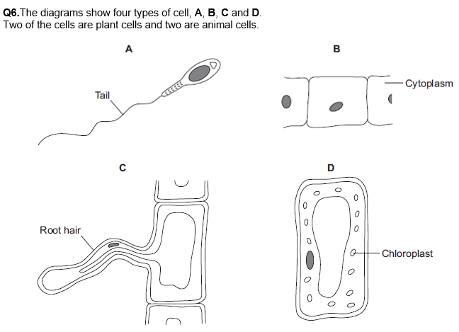
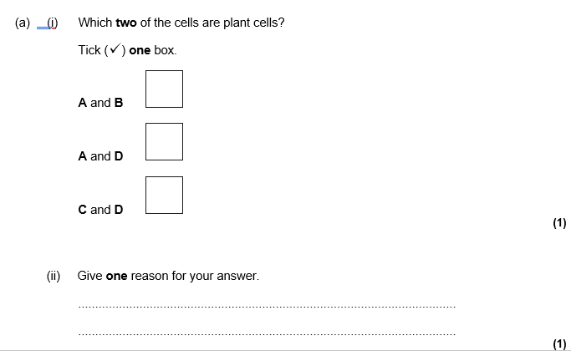
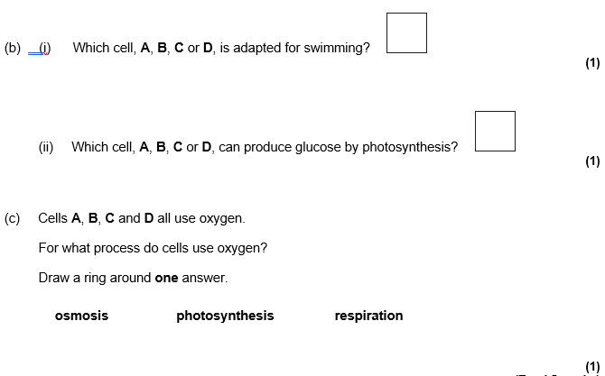
Microscopes, microscopy required practical and magnification and specialised cells
Drawing images from a microscopes

Slide 3
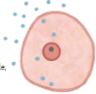
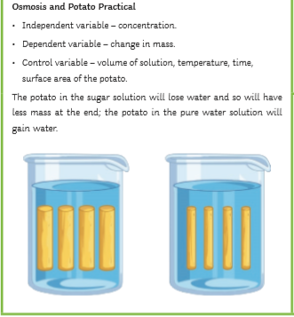
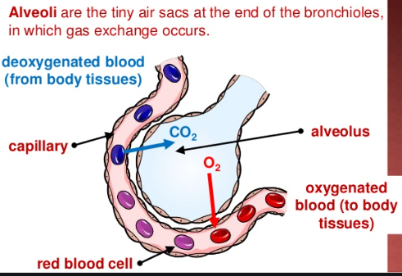
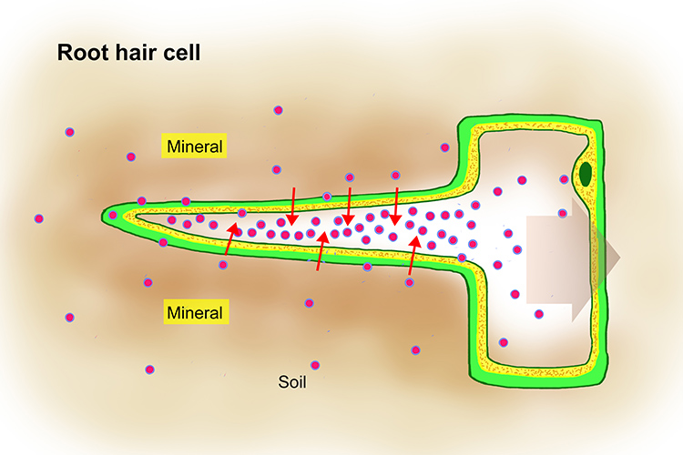
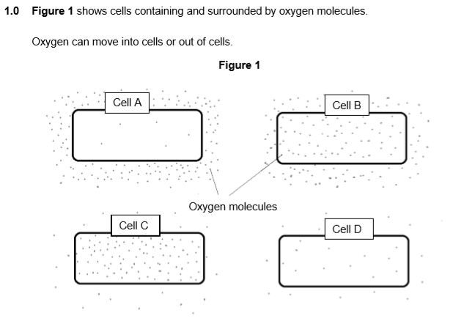
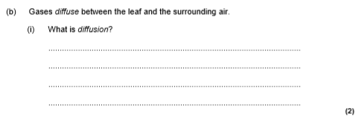
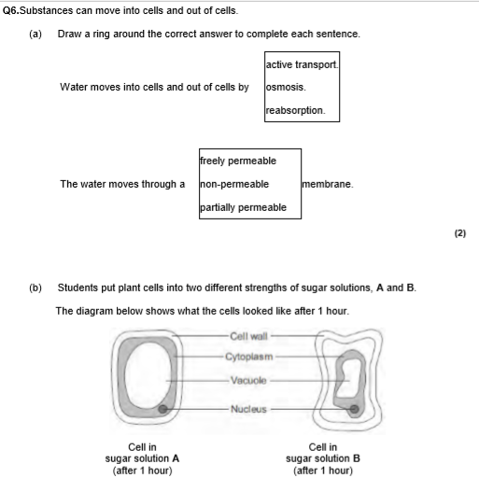
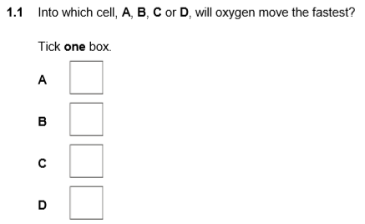
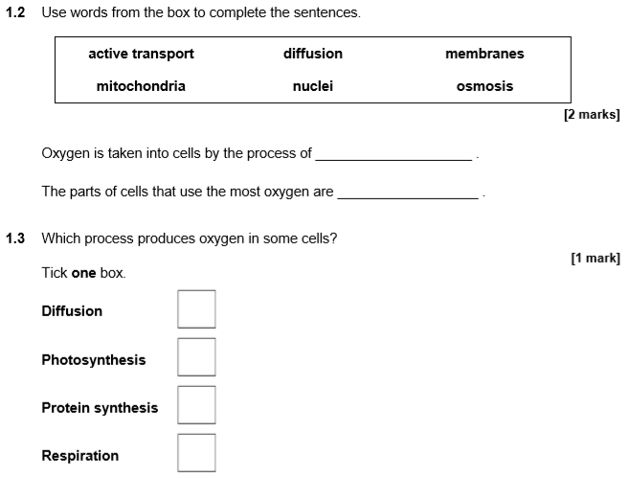
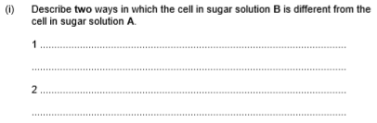
Osmosis diffusion and active transport
Diffusion is the movement of particles from an area of high concentration to an area of low concentration. Diffusion happens in alveoli in the lungs, the villi of the small intestines. In plants, diffusion happens in the leaf and the root hair cells
Osmosis is the movement of water from an area of high concentration to an area of low concentration.
Osmosis happens in the root hair cells and xylem cells in plants and happens in the large intestine in animals
Active transport is the movement of particles from an area of low concentration to an area of high concentration.
Active transport happens in the root hair cells in plants during the transport of mineral ions and happens in the villi of the small intestine in animals

Slide 4
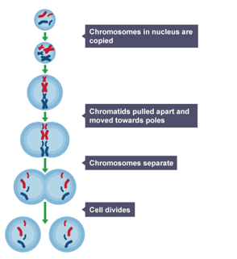
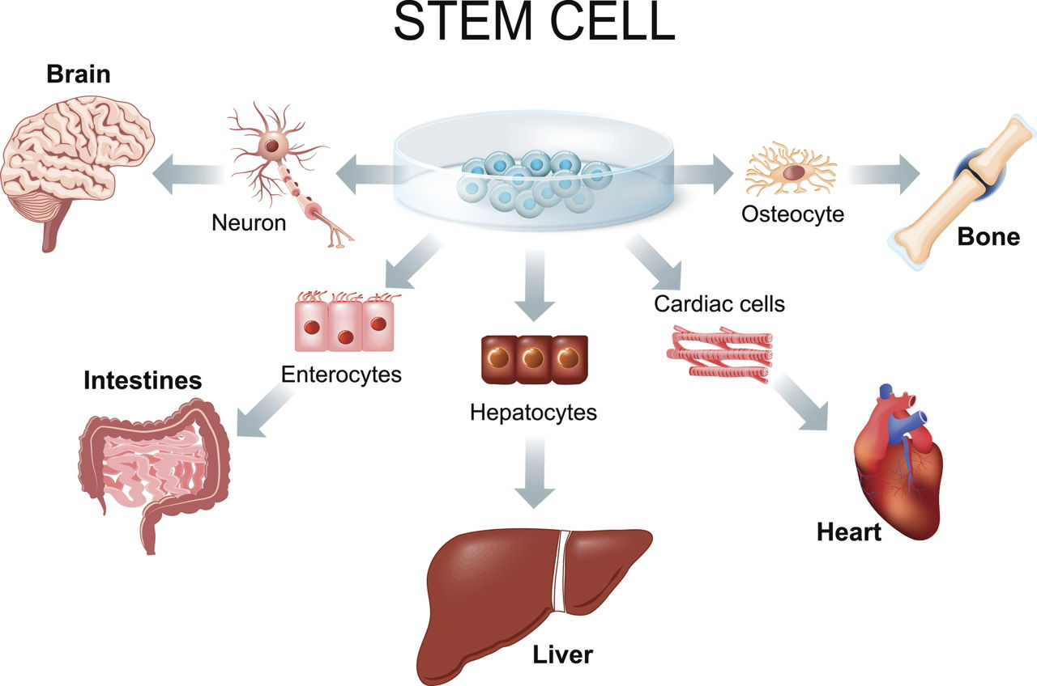
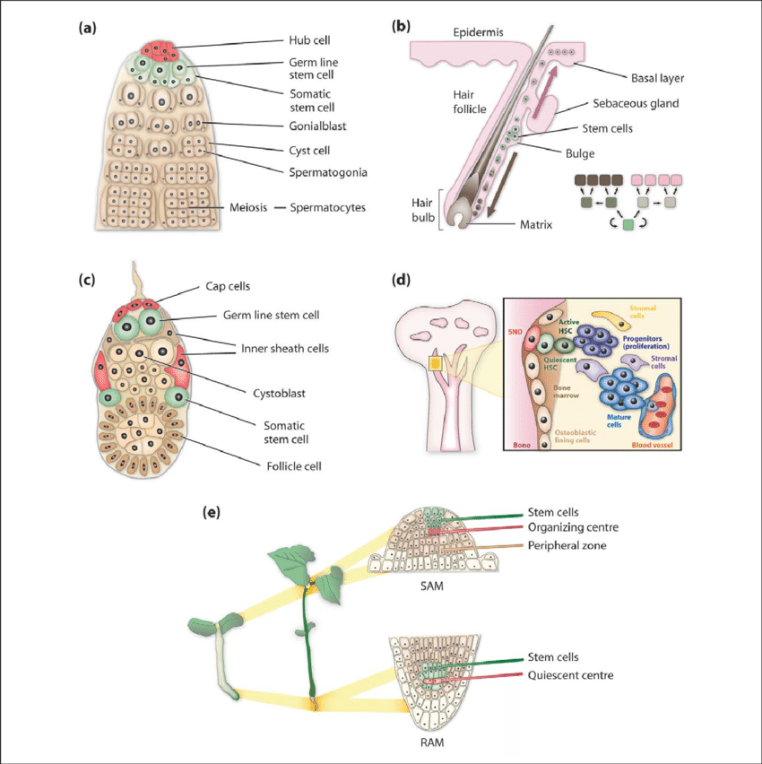
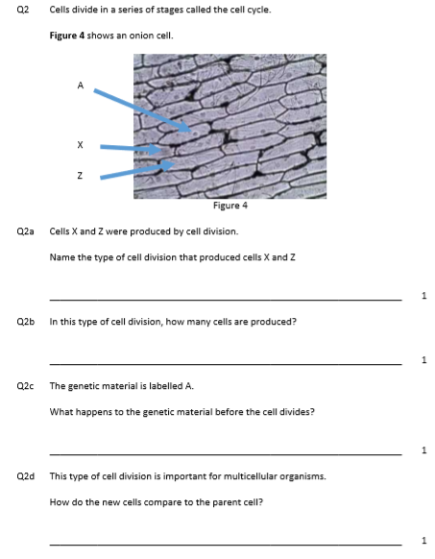
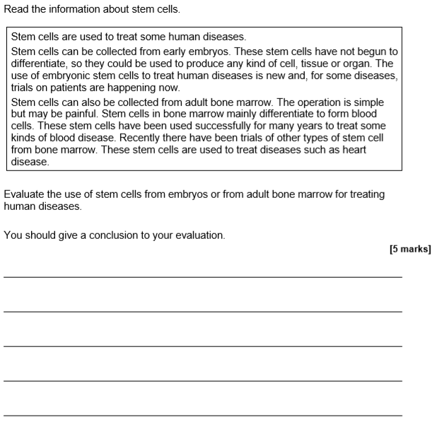
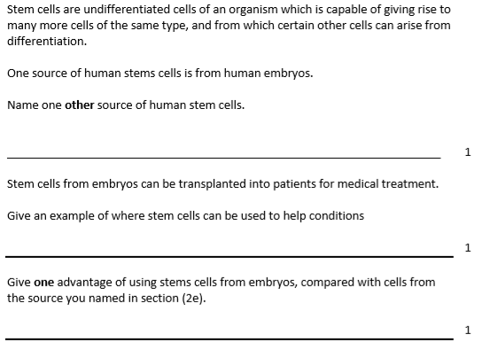
Mitosis and Stem cells
Mitosis is the process by which organisms make new cells. The new cells are exact copies /clones of the original cells. Mitosis is very important for growth and repair
The main stages of mitosis are shown in the diagram below:
Stem cells are cells that have not become specialised. There are three types of stem cells:
Adult stem cells: these are made in the bone marrows and can become blood cells. They are important for research into blood diseases
Embryonic stem cells: These cells come from embryos just after fertilisation has happened. They have the potential to become any specialised cell and so are very useful for scientists to research a range of diseases such as Parkinson’s, diabetes and Alzheimer’s
There are issues with using embryonic stem cells as some people believe that embryos are still babies so it is unethical as they have not given consent. Some scientists may also use embryos left over from IVF for research without getting permission.
Meristem cells: These are stem cells from the tip of a shoot or tip of roots in plants. They divide very quickly and can become any tissue needed by the plant

