Slide 1
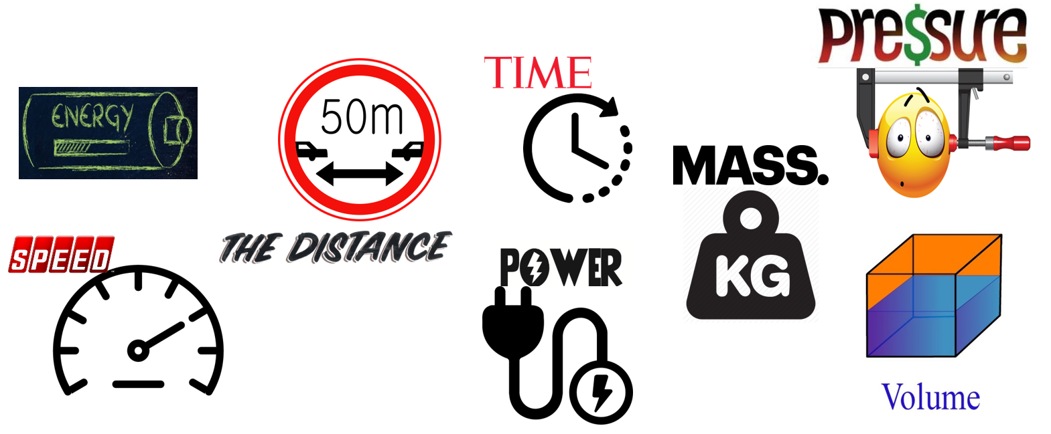
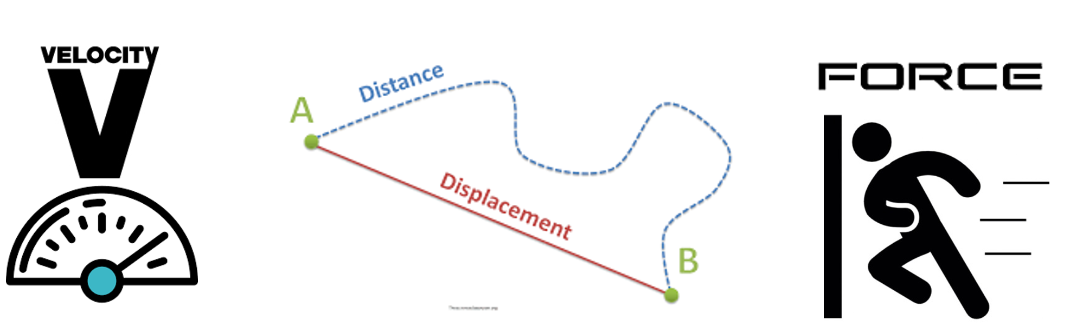
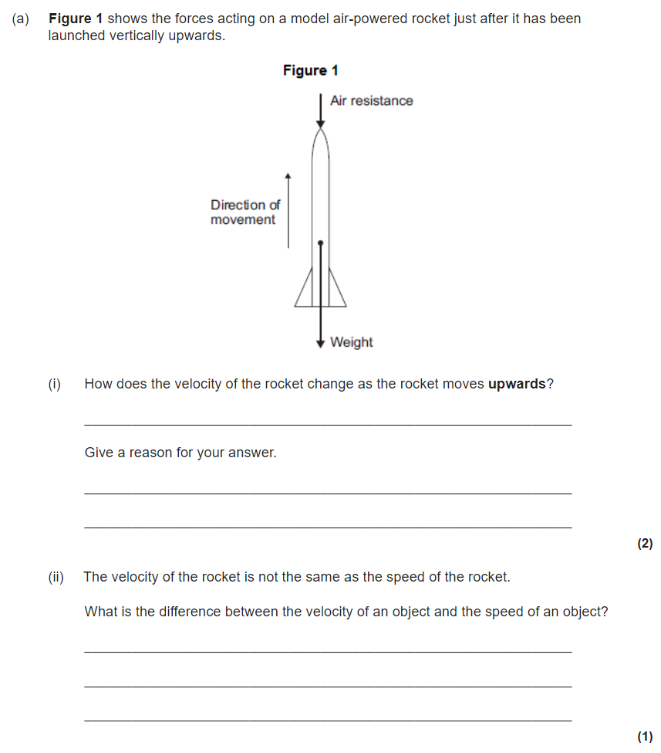
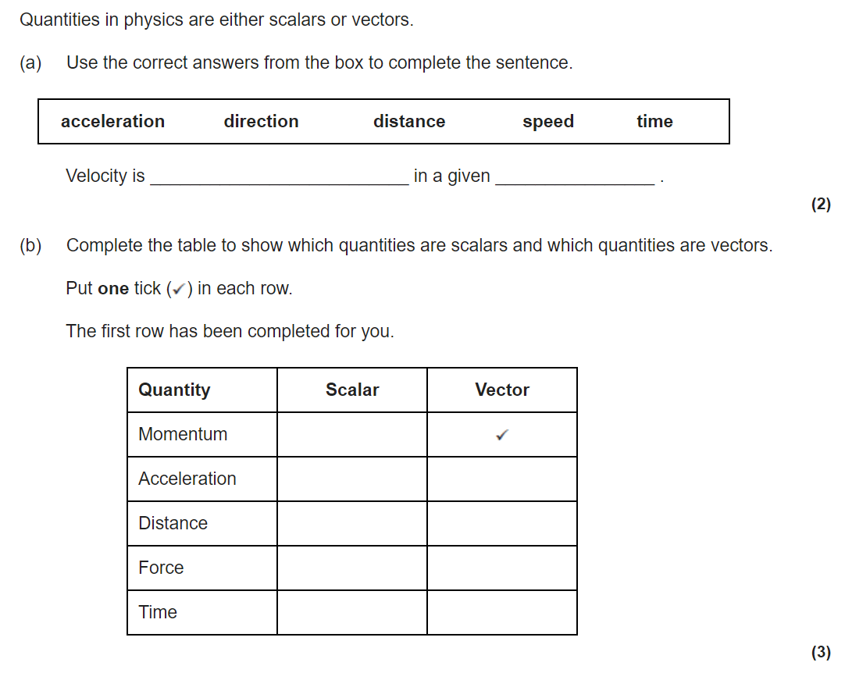
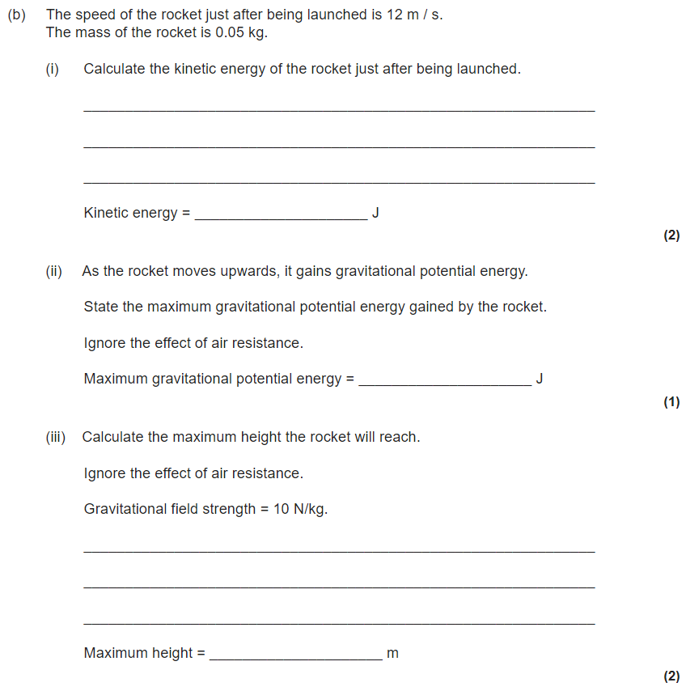
Forces revision
Keywords: Contact, newton, scalar, vector, mass, weight, gravitational field strength, work done, spring constant
What is a contact force? Give two examples
What is a non-contact force? Give two examples.
Do Now:
What is a force?
What are the units of a force?
What do we use to measure a force?
Scalars and vectors
Scalar quantities have size (“magnitude”) only and no direction. An example of a scalar quantity is mass.
Scalar quantities can be added up normally
Example: 36 kg + 14 Kg = 50 kg
Vectors have both size and direction. A vector quantity may be represented by an arrow. The length of the arrow represents the magnitude, and the direction of the arrow the direction of the vector quantity.

Slide 2
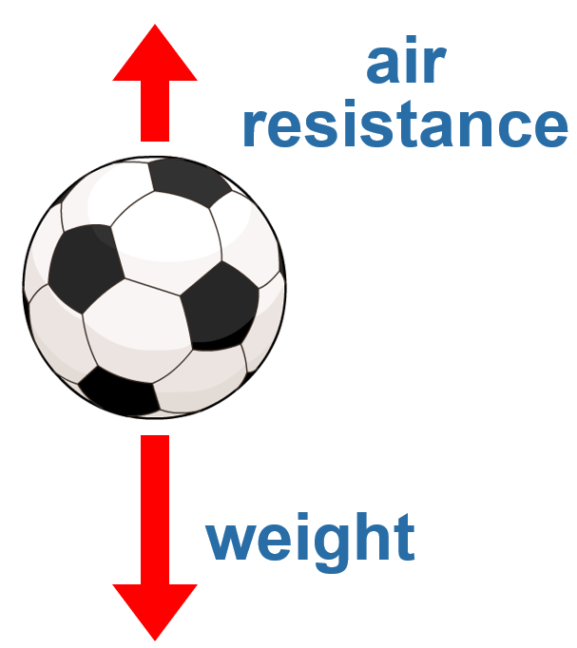
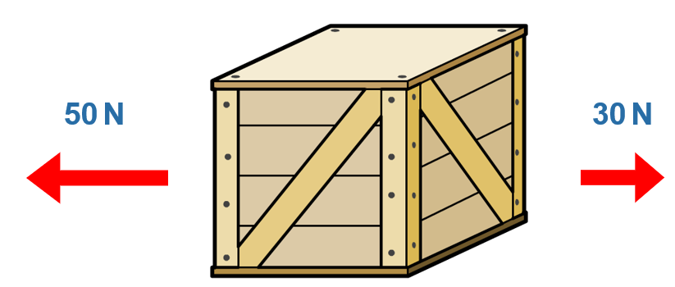
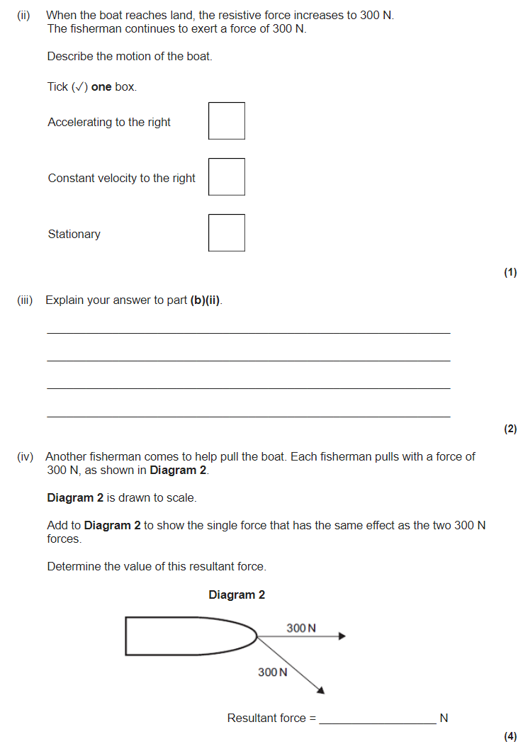
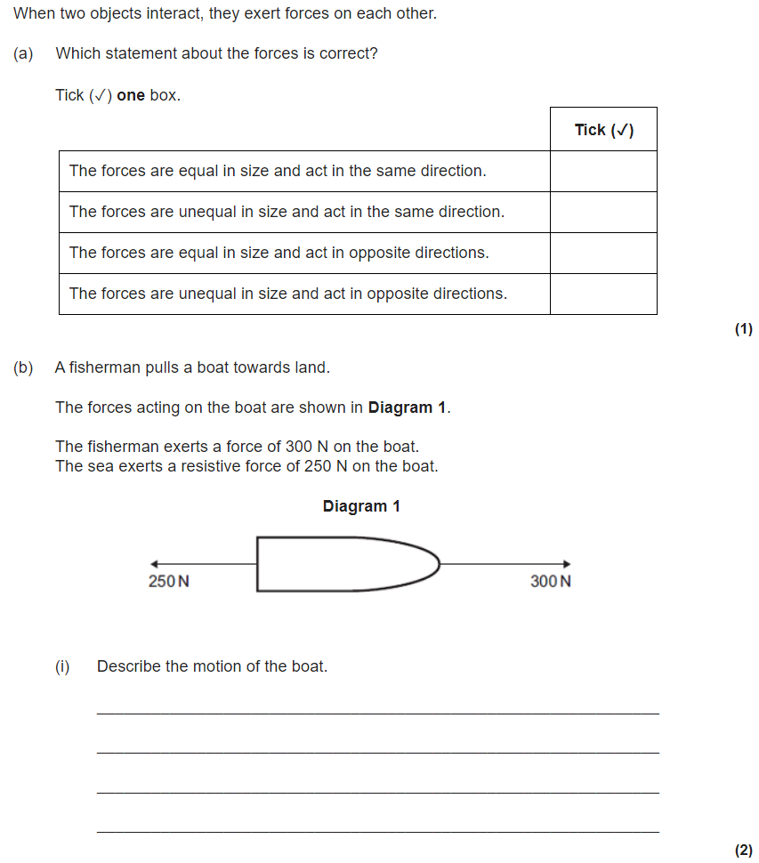
Resultant forces
The forces acting on any object can be shown using a force diagram. A force diagram uses labelled arrows to show all the forces acting on the object.
The direction of each arrow shows the direction of each force.
The length of each arrow is proportional to the size of the force.
Resultant force on the crate = 50 N – 30 N = 20 N to the left
The motion of the object will depend on the resultant force. This is calculated by adding all the forces together, taking their direction into account. When more than one force acts on an object, the forces COMBINE to form a RESULTANT FORCE
If more than one force is on an object, you can simplify the diagram by drawing just the resultant force.
This is a single force that has the same effect as the other forces put together.

Slide 3

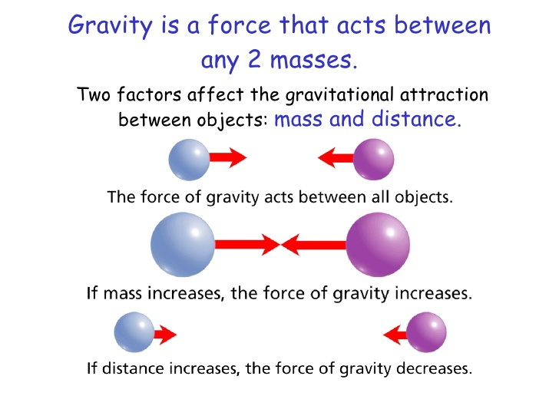
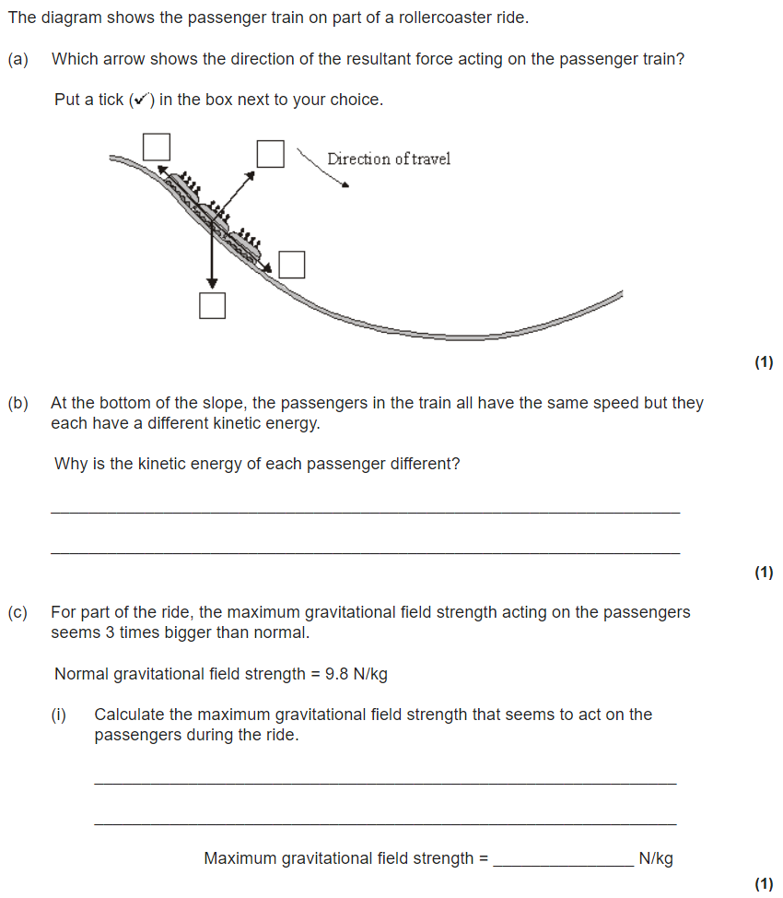
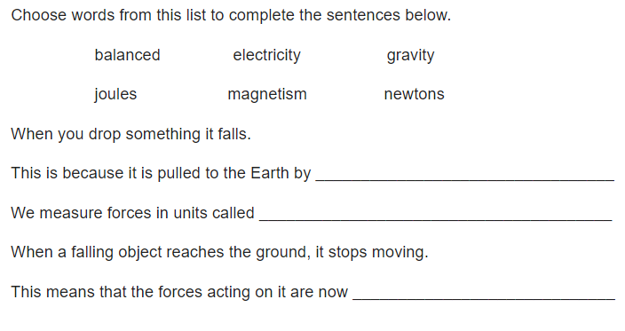
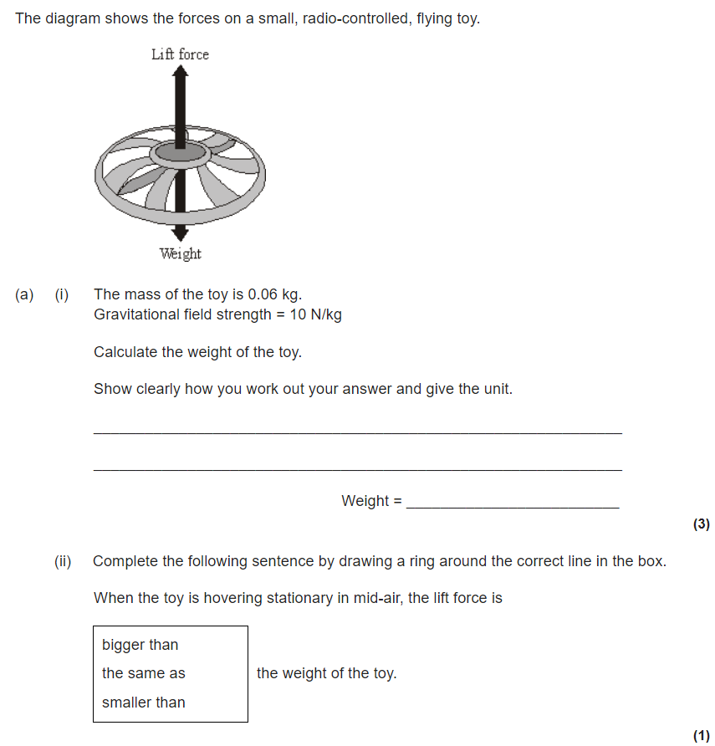
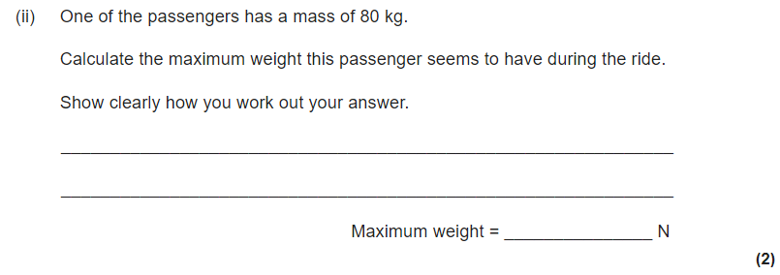
Mass, Weight and Gravity
All objects have a force that attracts them towards each other. This force is due to gravity.
Even you attract other objects to you because of gravity, but you have too little mass for the force to be very strong.
The strength of gravity at the surface of a planet is determined by its mass. g is a measurement of the gravitational field strength
The gravitational field strength on the surface of the earth is 9.8 N/kg.
The mass of an object is the amount of matter it contains.
The mass of an object stays the same wherever it is, but its weight can change depending on the gravitational field strength.
Weight is the force caused by gravity. The weight of an object can be calculated using the formula:
weight = mass x gravitational field strength.
[ W = m x g ]

Slide 4
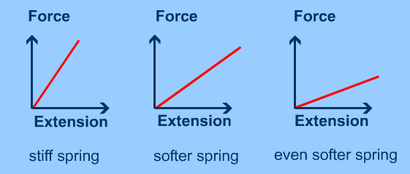
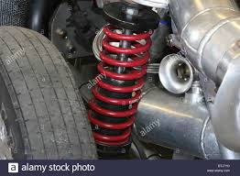
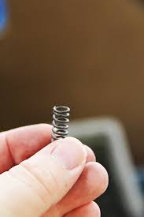
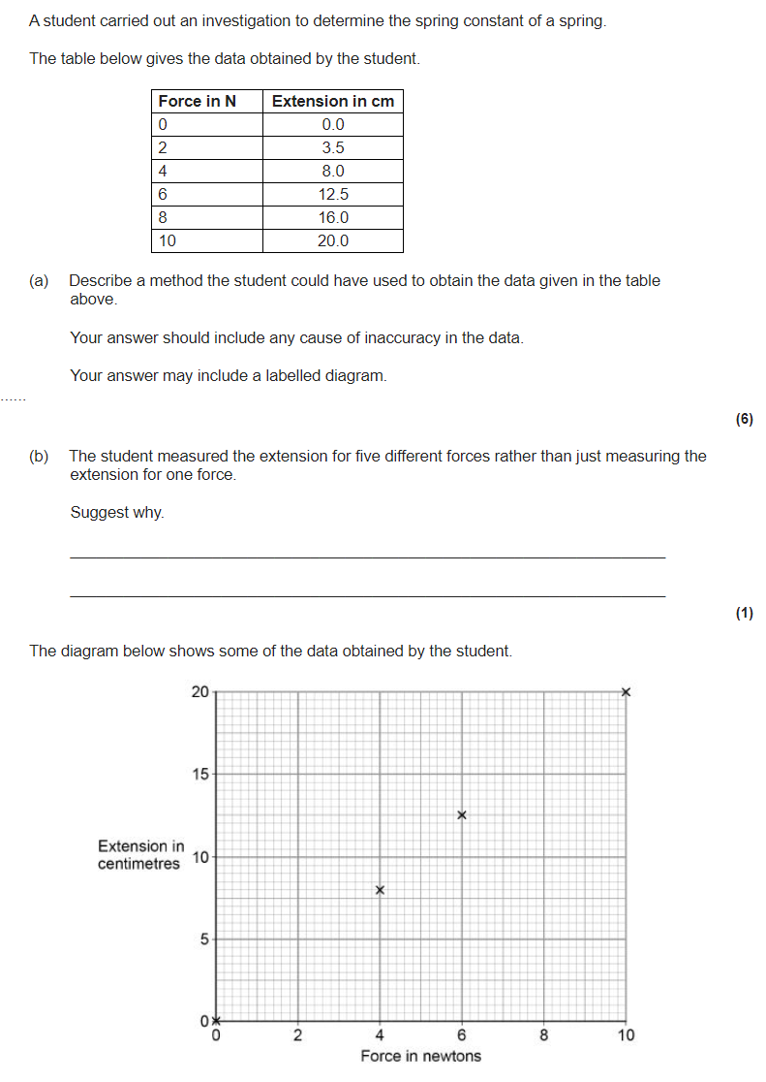
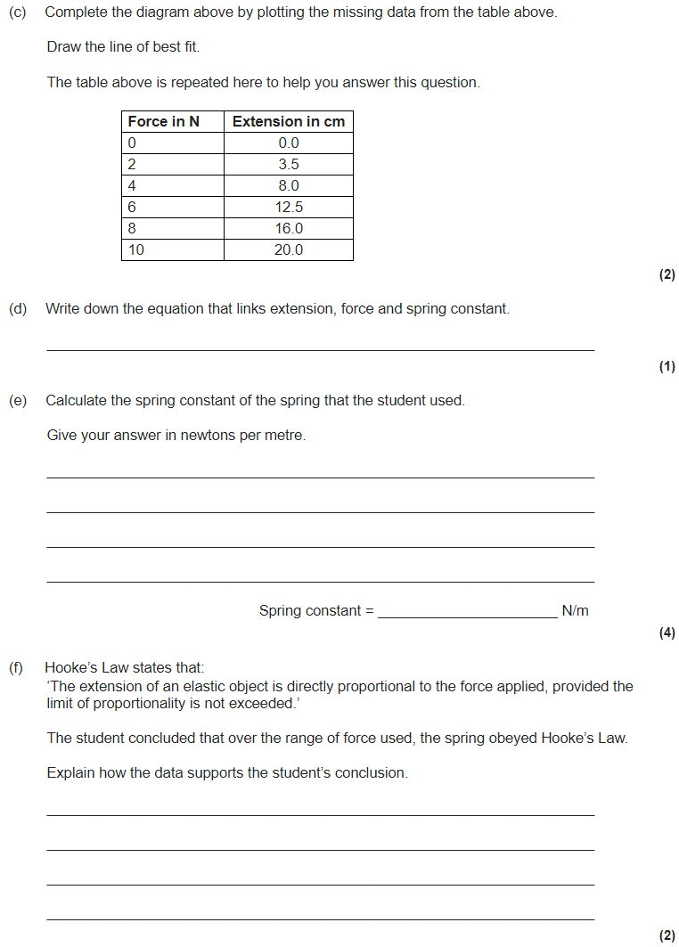
Work done and elasticity
work done = energy transferred
This means the units for work are the same as the units for energy – joules.
work done = force x distance moved (W = F x s)
Force is measured in newtons (N).
Distance moved is measured in metres (m).
Hooke’s law says that the amount a spring stretches is proportional to the amount of force applied to it.
F = k × e
Where:
F is the applied force (in newtons, N),
e is the extension (in metres, m) and
k is the spring constant (in N/m).
The spring constant measures how difficult it is to compress or stretch a spring.
The larger the spring constant the more difficult is to compress or stretch.
E_{e} = ½ x k x e²
EPE (J) = 0.5 × spring constant (N/m) × extension² (m)

