Slide 1
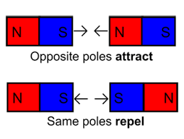
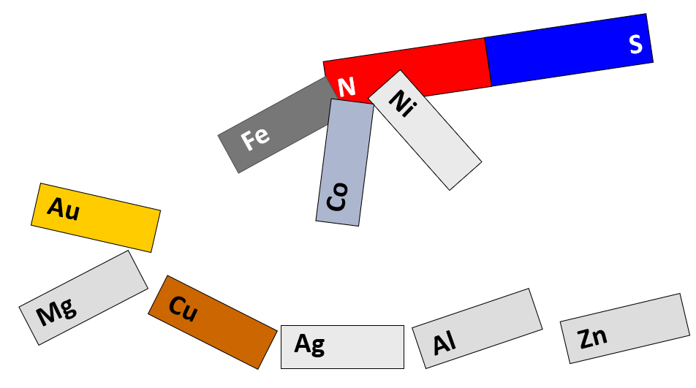
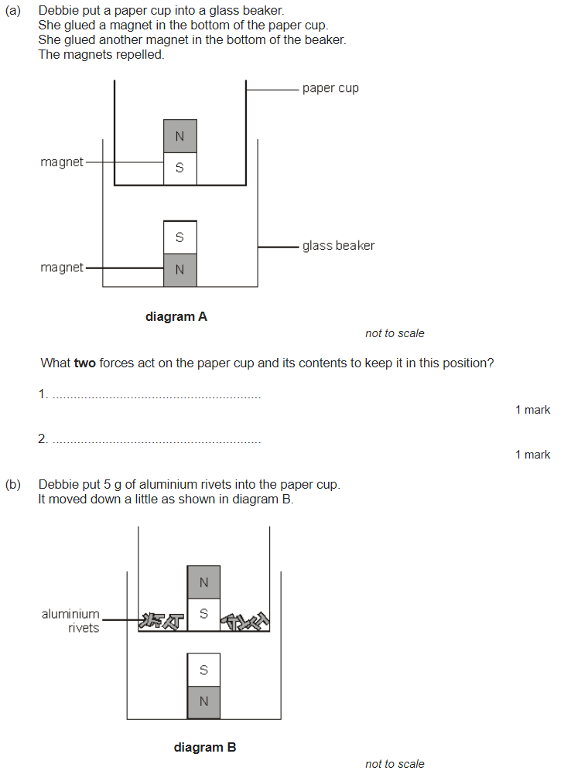
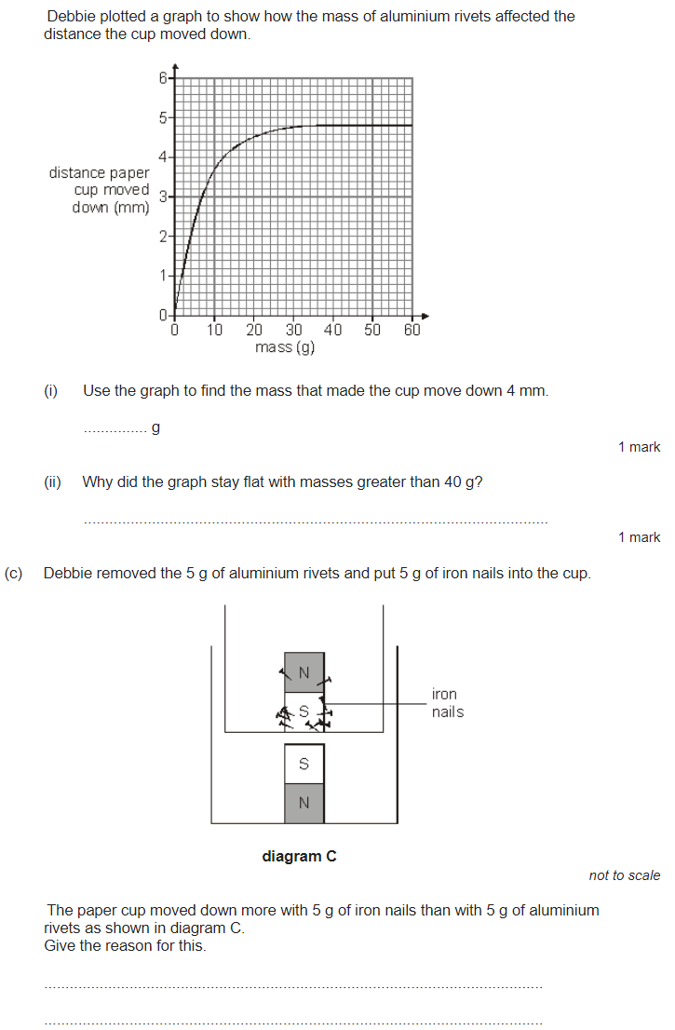
Magnetism revision
Keywords: Non-contact, permanent, induced, poles, field, attract, repel, compass, electromagnet, solenoid
Do Now:
What are the units of a force?
What do we use to measure a force?
3. What is a contact force?
4. What is a non-contact force?
5. Is force a scalar or a vector? Why?
Magnetism
Bar magnets have a north and a south pole. Like poles repel, unlike poles attract.
Magnets can also attract (but not repel) certain metals (iron, cobalt, nickel and steel but no others).
A permanent magnet produces its own magnetic field.
An induced magnet is a material that becomes a magnet when it is placed in a magnetic field.

Slide 2
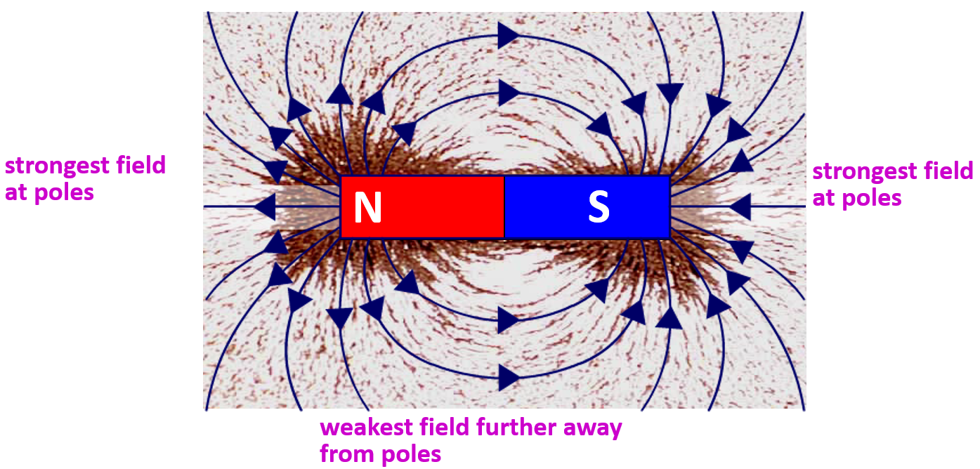
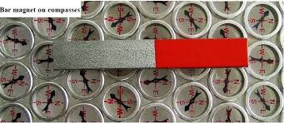
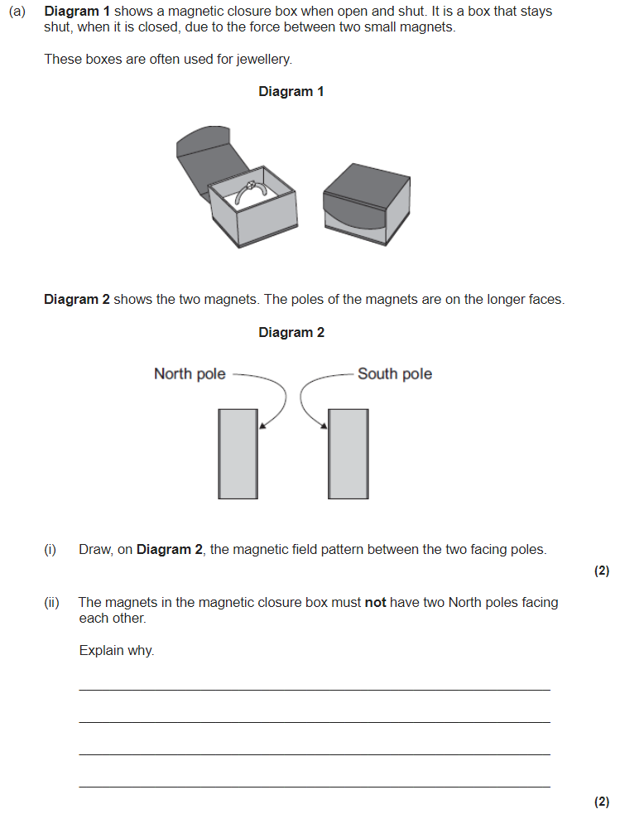
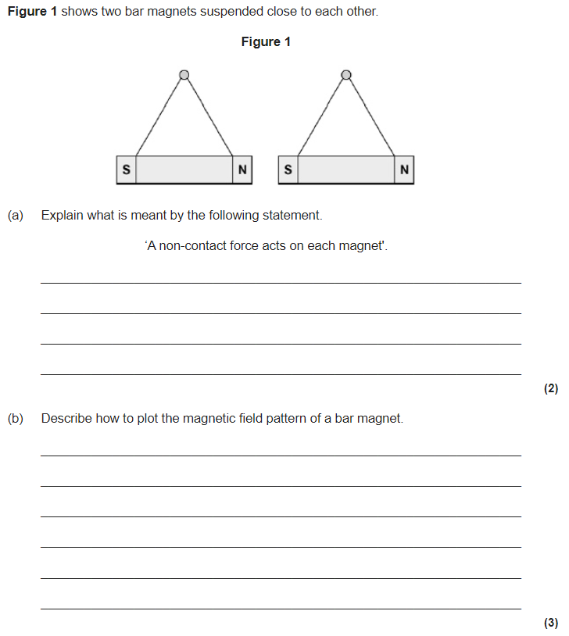
Magnetic Fields
The region around a magnet where a force acts on another magnet or on a magnetic material (iron, steel, cobalt and nickel) is called the magnetic field.
The magnetic field flows from the North Pole to the South Pole. It is strongest neat the poles.
A compass contains a small bar magnet. It always points towards the south pole of a magnet.
The Earth has a magnetic field caused by molten (liquid) iron in the Earth’s outer core. The Earth is like a big bar magnet.
The north pole of the Earth is actually magnetic south. Compasses point north.

Slide 3
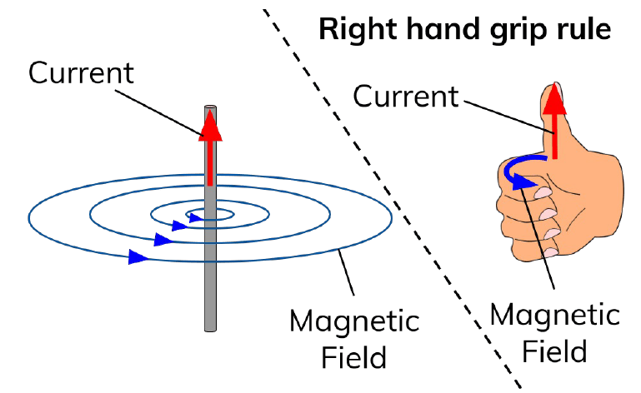
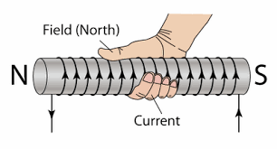
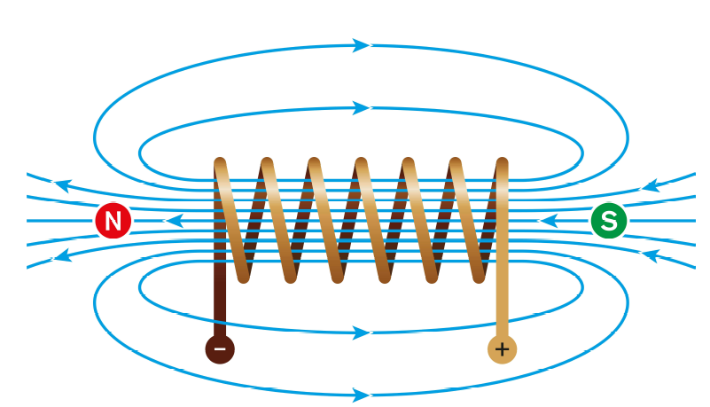
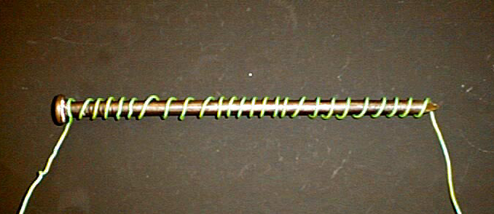
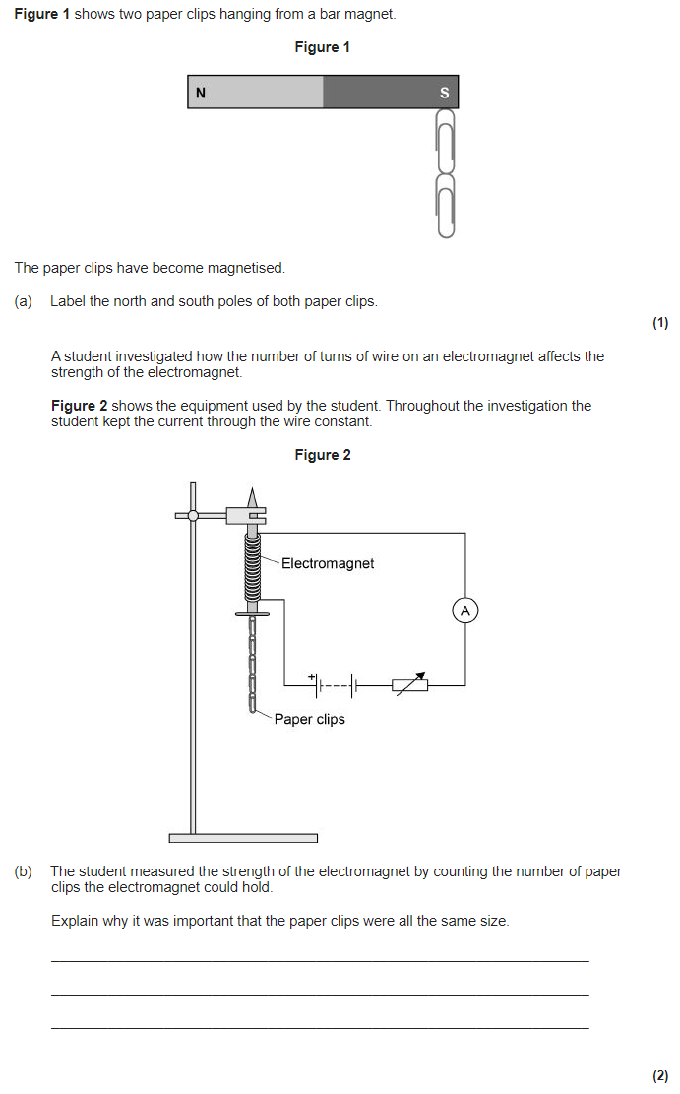
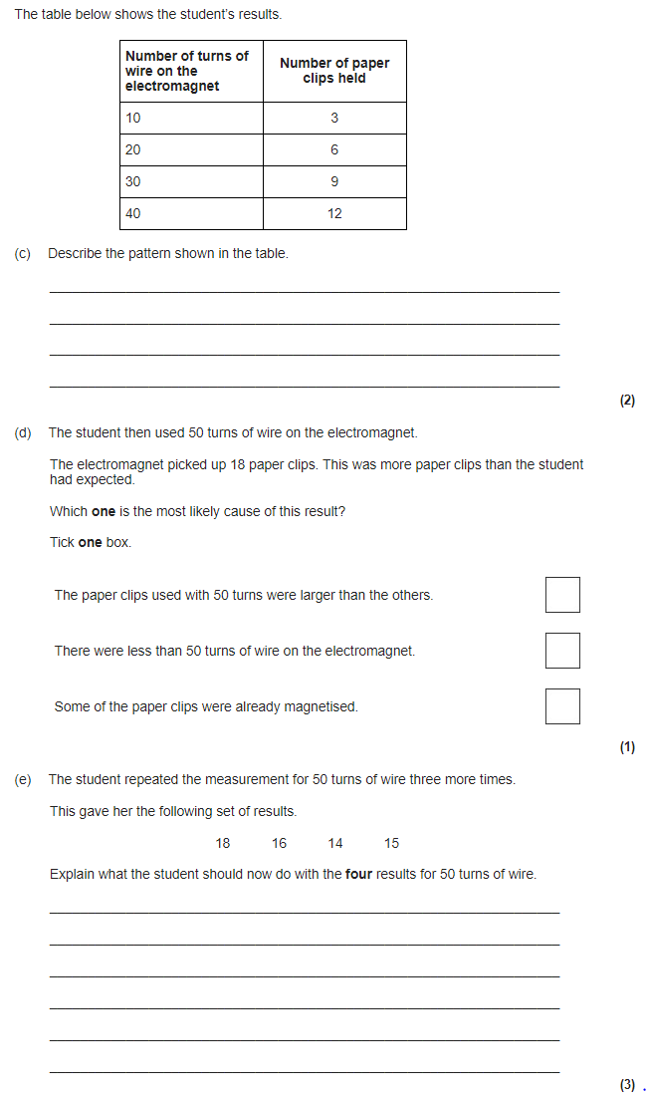
Electromagnetism
Any current flowing through a wire creates a magnetic field. This is called an electro-magnet. Grip the wire with your right hand; thumb gives direction of the current.
Your fingers curled around the wire will point in the direction of the magnetic field.
A solenoid creates a field like a bar magnet.
The field is strongest inside the solenoid.
You can also use the right hand grip rule for a solenoid.
To increase strength of electromagnet:
Wind the wire so it has more loops.
Increase the current in the wire.
Add an “iron core” to the centre of the loops of wire.

Slide 4
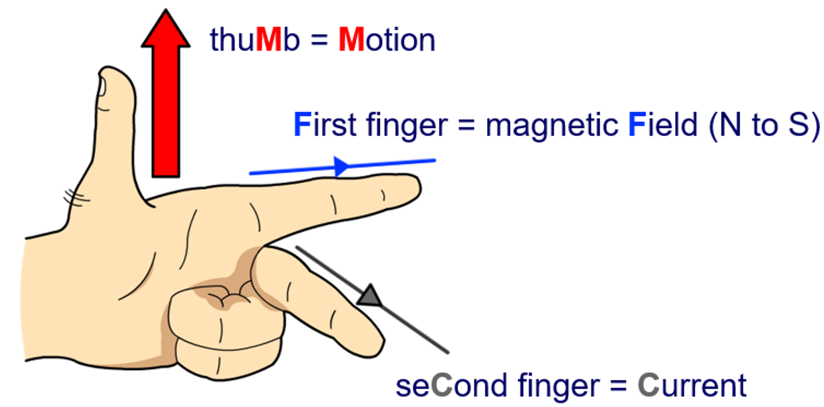
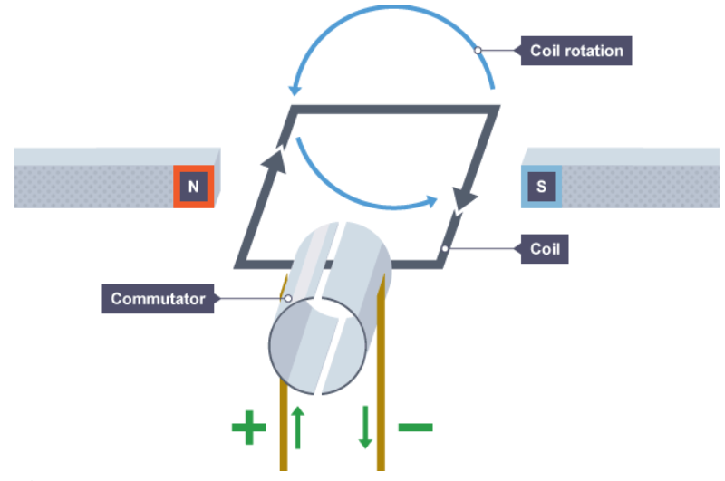
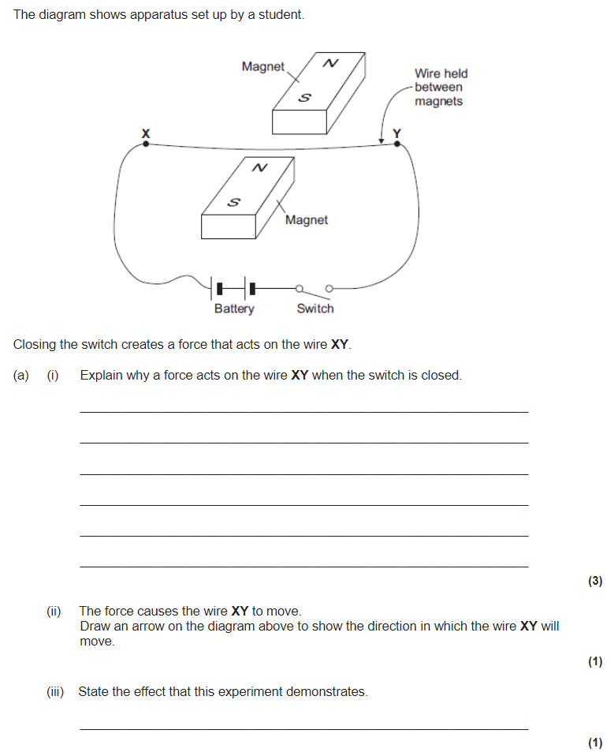
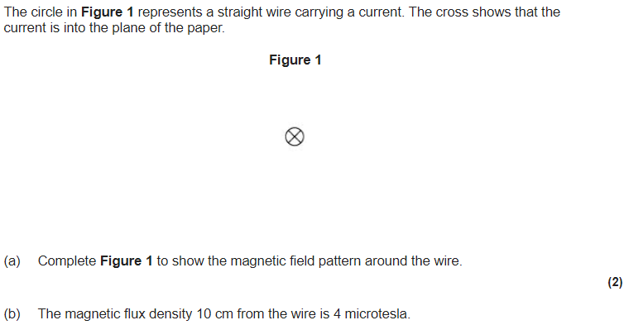
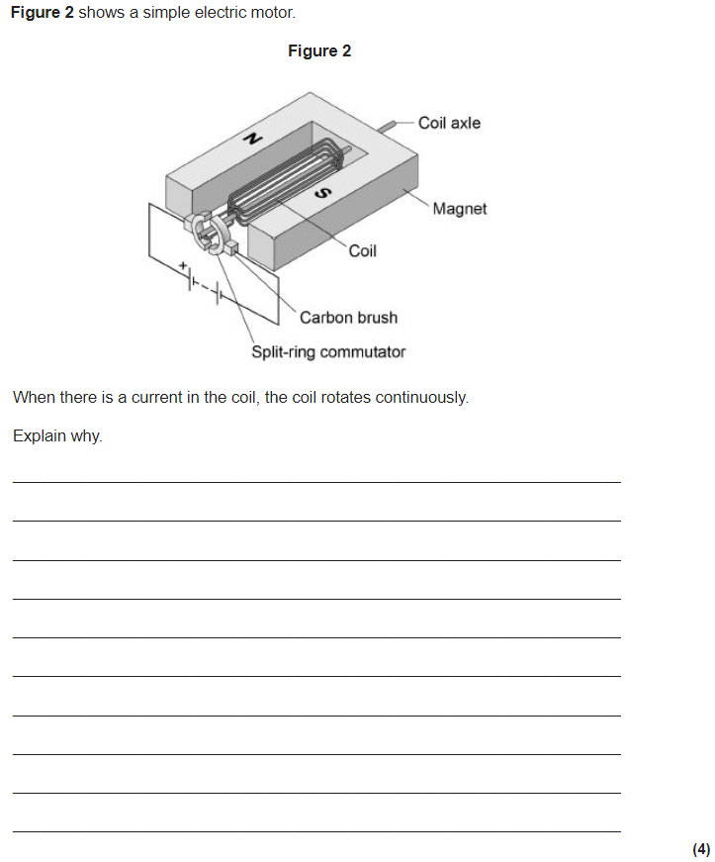
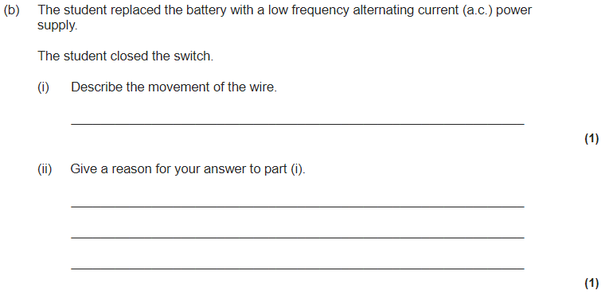
Fleming’s left hand rule & force on a current carrying wire
When a conductor carrying a current is placed in a magnetic field the magnet producing the field and the conductor exert a force on each other. This is called the motor effect.
Fleming’s left hand rule can help us identify which direction the force/field/current will be in.
The force on a current carrying wire can be calculated using F = B × I × l
Where F is force in N
B is magnetic flux density in T
I is current in A
l is length of wire in m
This effect is used in an electric motor. A coil of wire carrying a current in a magnetic field experiences a force that makes it rotate. A split ring commutator changes the current direction every half turn.

