Slide 1

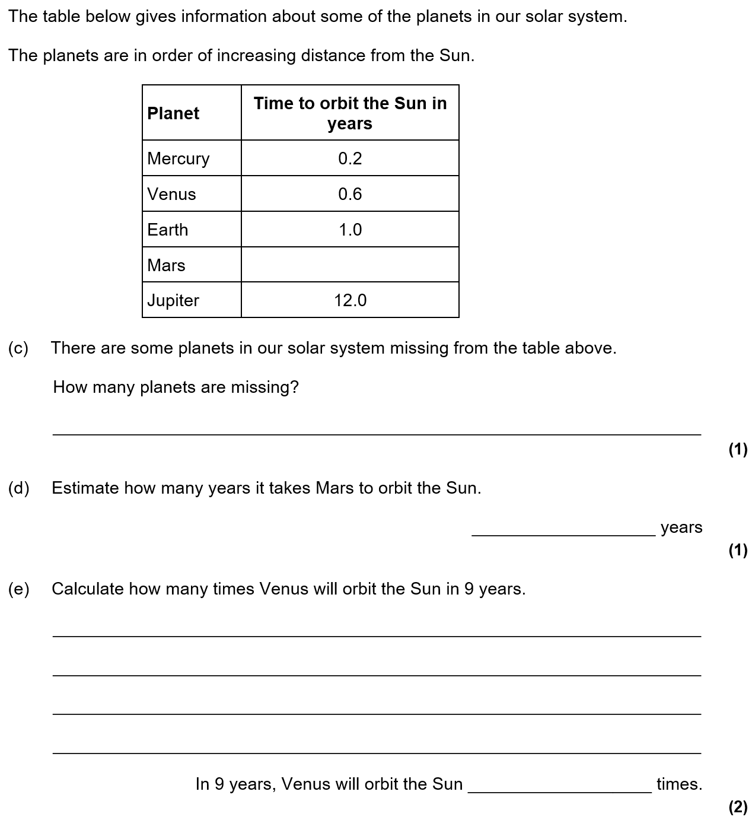

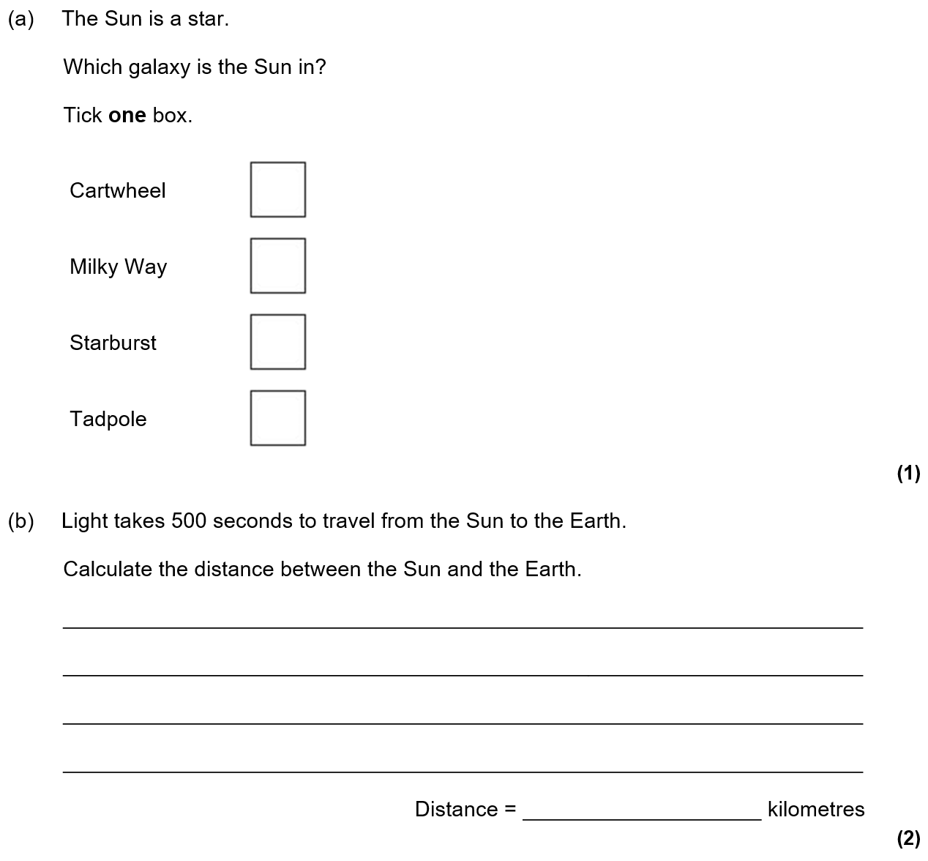
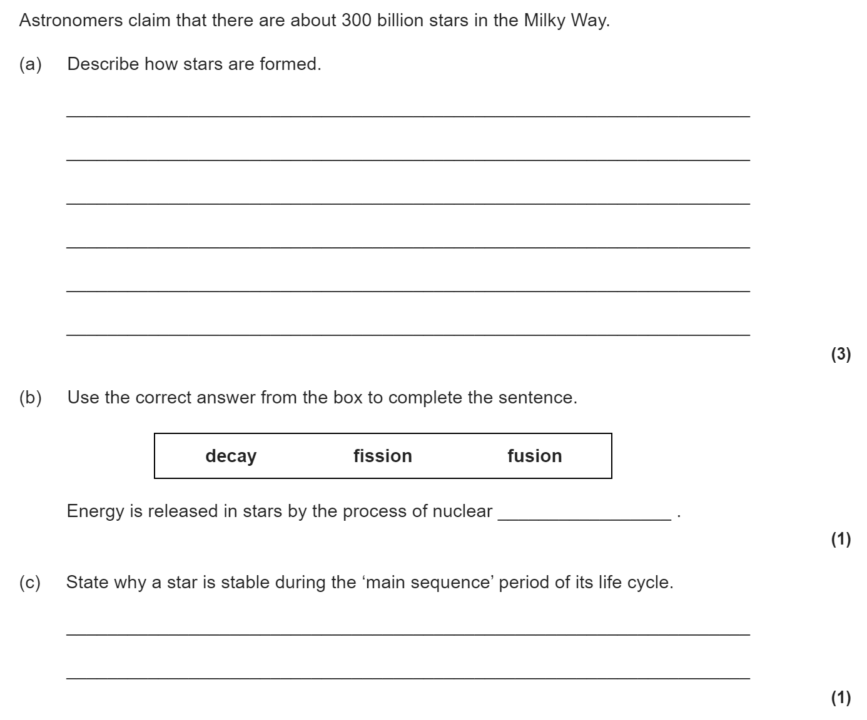
Space revision
Keywords: solar system, nebula, nuclear fusion, red giant, supernova, black hole, neutron star, satellite, red shift
Do Now:
What is nuclear fission? What is nuclear fusion?
The solar system and formation of a star
Our solar system is made of one star (the Sun) plus eight planets that orbit around the Sun. Pluto is known as a dwarf planet. The solar system is a small part of the Milky Way galaxy.
How a star is formed:
A nebula is a cloud of dust and gas (helium and hydrogen). This gets pulled together under gravity.
Friction heats the gases until the nebula is hot enough for nuclear fusion to happen.
The energy emitted by a star, such as the Sun, comes from nuclear fusion. In order for this to happen, the core temperature has to be extremely high – in excess of 10 million degrees.
Nuclear fusion in a star like the Sun involves the combination of lighter isotopes of hydrogen to form helium, and the release of energy:

Slide 2
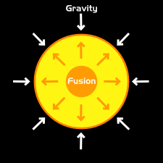
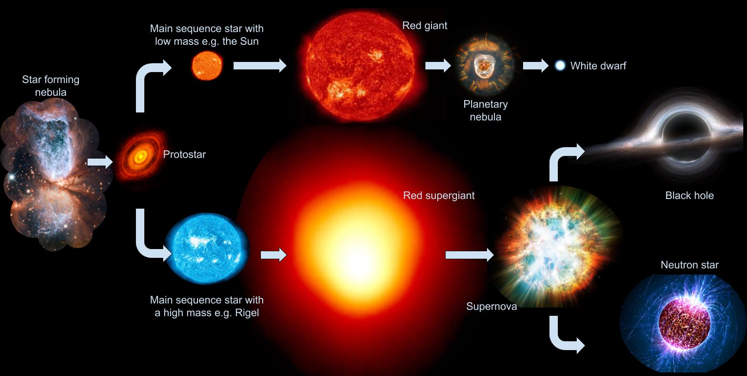
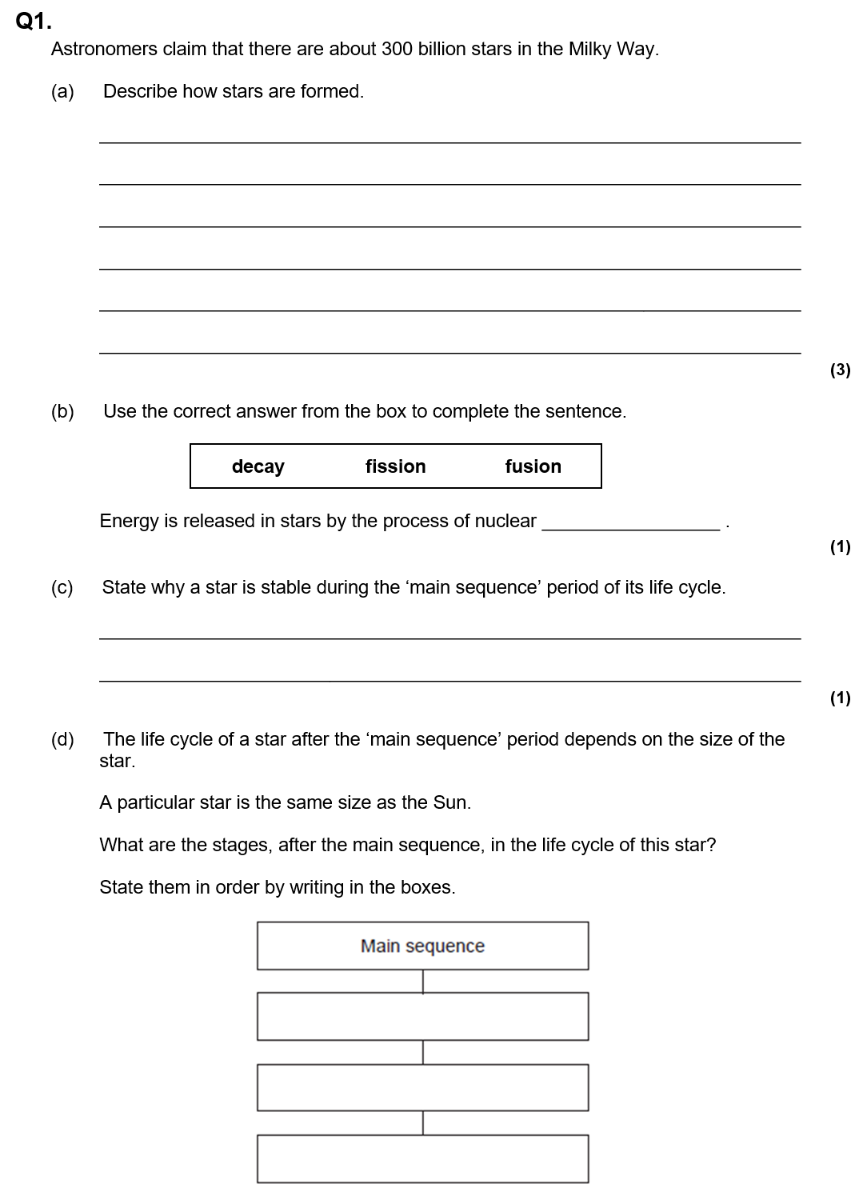
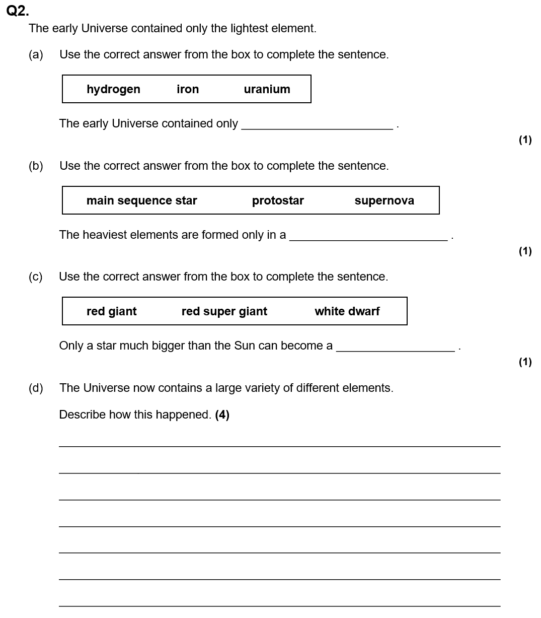
Life cycle of a star
When a star is formed it is stable because the forces within it are balanced.
Gravity acts inwards. This is balanced by the outward force of the radiation from nuclear fusion trying to make the star expand.
Elements heavier than iron are produced in a supernova.
The explosion of a massive star (supernova) spreads out these elements throughout the universe.

Slide 3
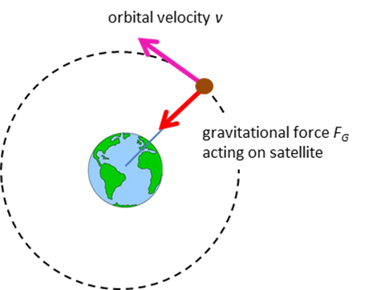
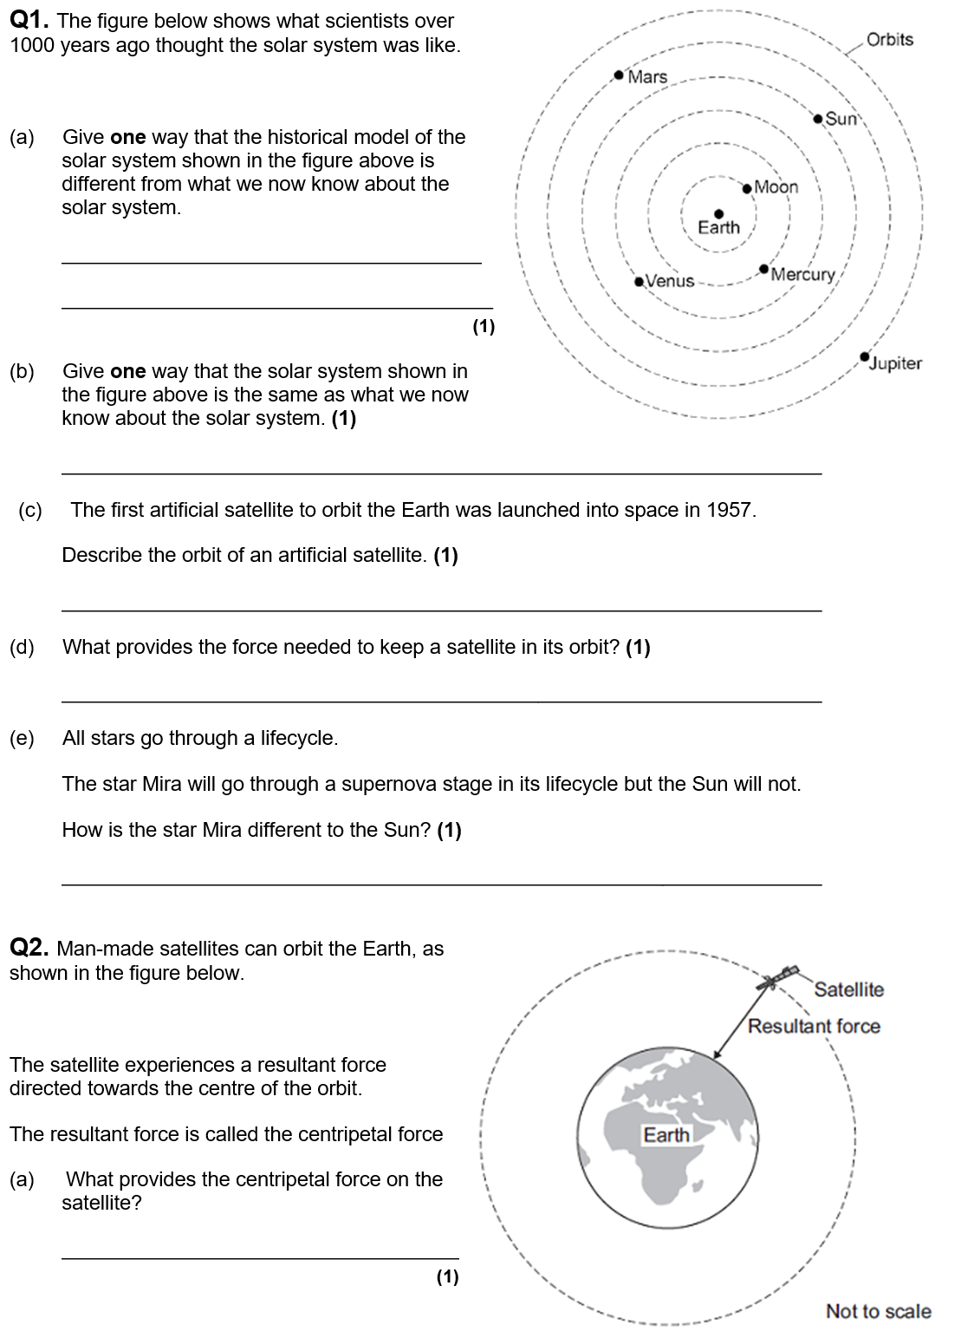
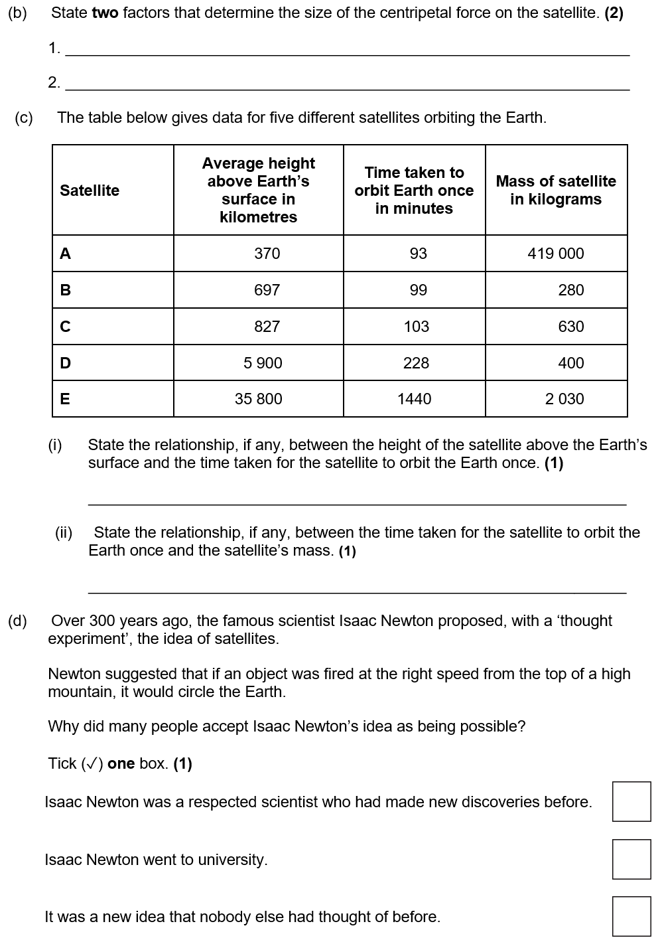
Satellites
A satellite is something in orbit around a planet. Gravity provides the force that allows planets and satellites to maintain their circular orbits. For circular orbits, the force of gravity can lead to changing velocity but unchanged speed. This is because velocity is a vector and speed is a scalar. We can calculate the distance travelled by the circumference of the orbit.
A satellite can be natural (like the Moon) or artificial (like communications or weather satellites).
Geostationary satellites orbit the Earth once every 24 hours. They are used for communications.
Monitoring satellites (for weather) are lower and orbit every 2-3 hours.

Slide 4
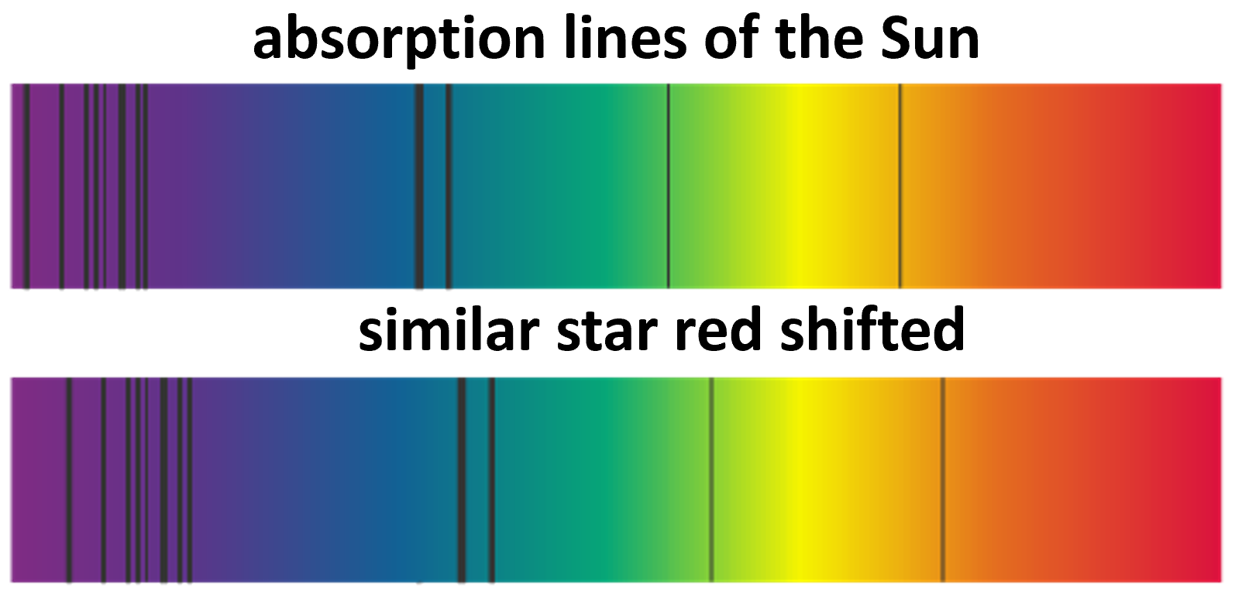
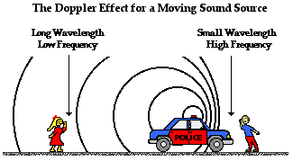
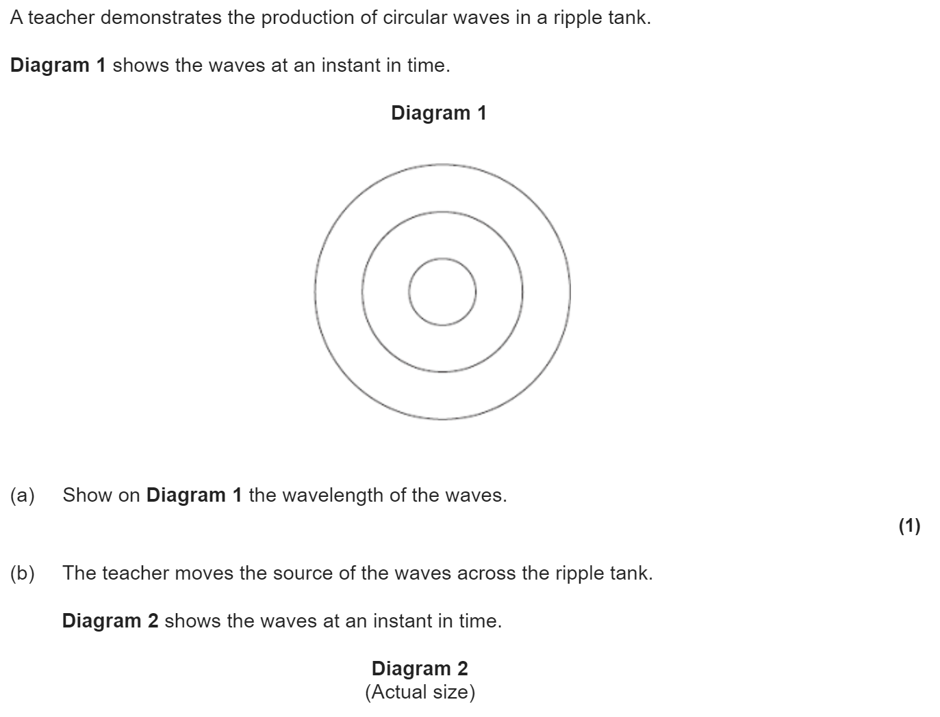
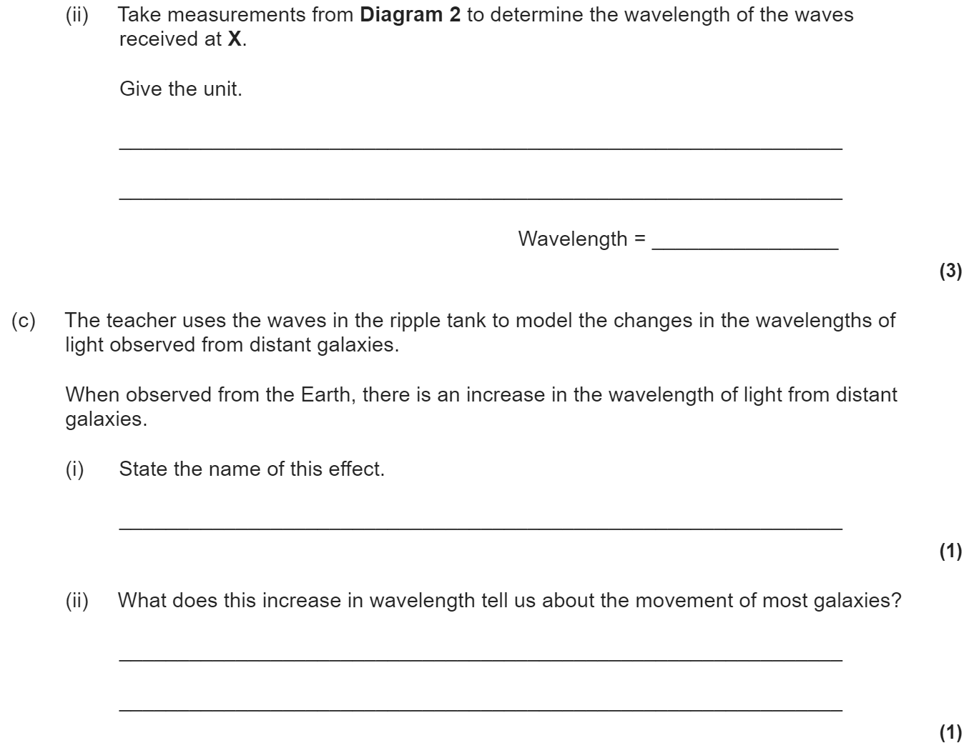
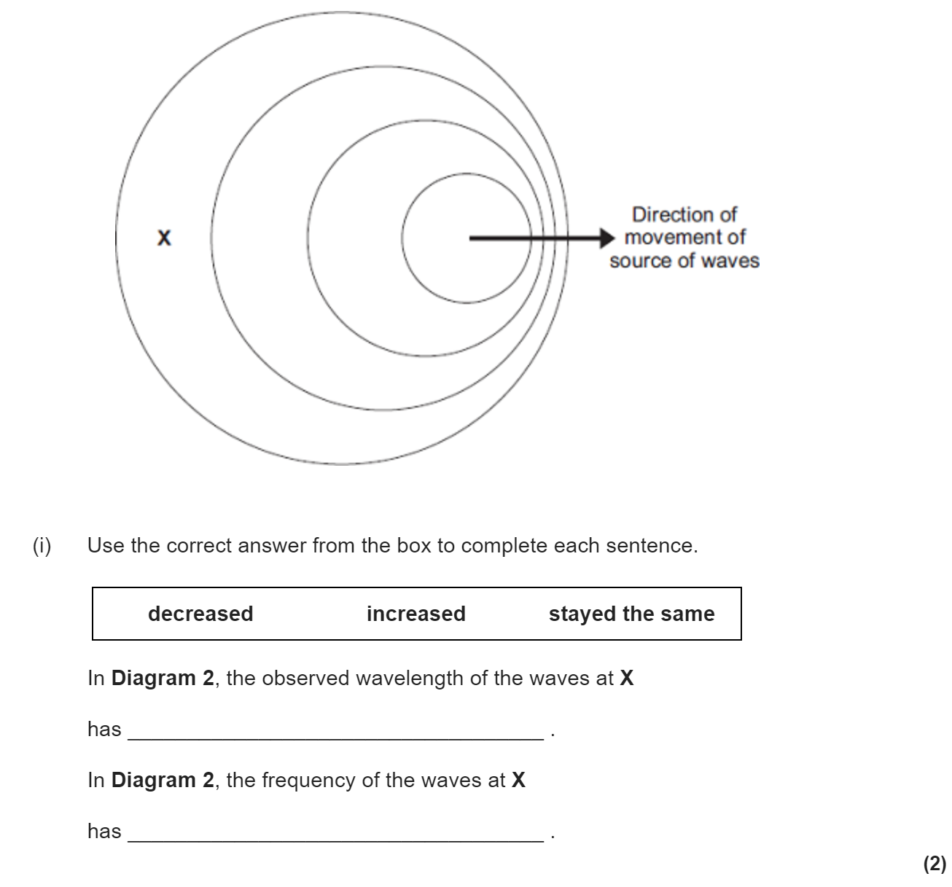
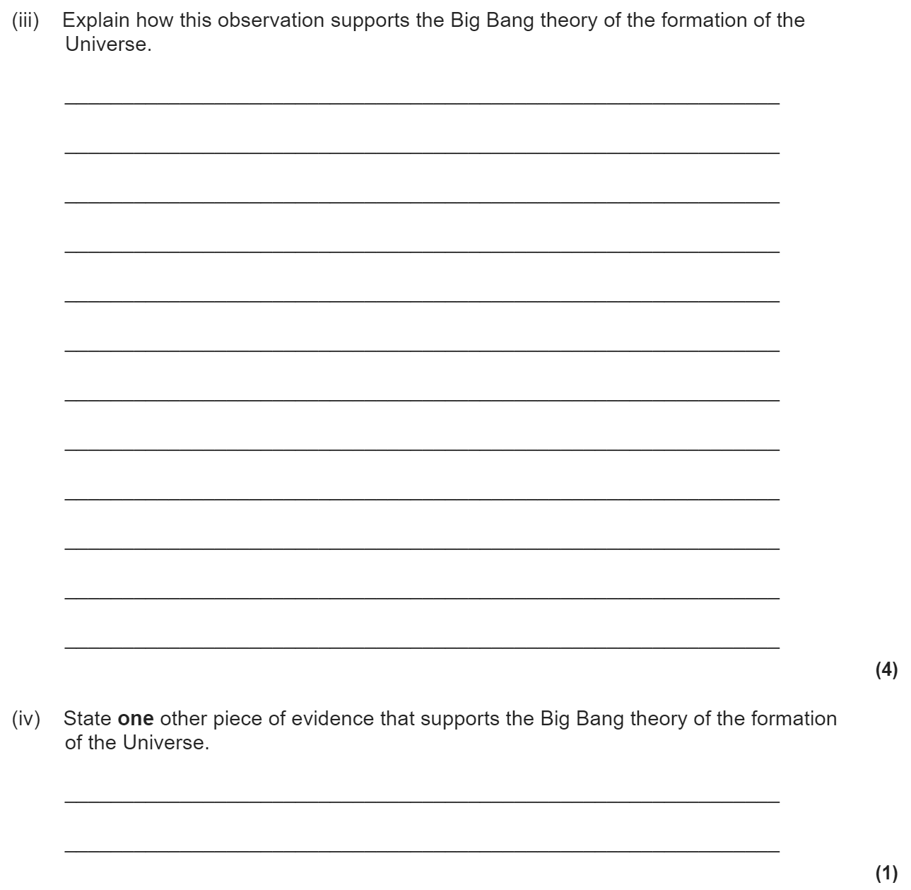
The big bang
The Big Bang theory suggests that the universe began from a very small region that was very hot and dense. It then exploded outwards to form the Universe.
When an ambulance drives past you, its siren sounds higher pitched as it approaches, and lower pitched as it moves away.
This is the Doppler effect. The same thing happens to the light emitted by very fast moving objects, such as distant stars, and can be seen in their spectra. This is red shift.
The wavelength of light from the most far away galaxies is increased. This is called the red-shift and is the main evidence for the Big Bang as it shows the Universe is expanding.

