Slide 1
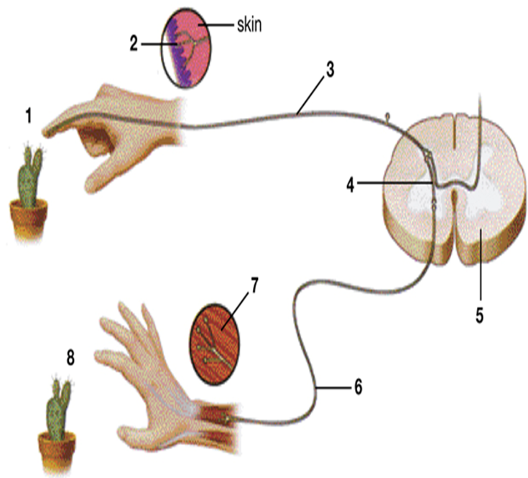
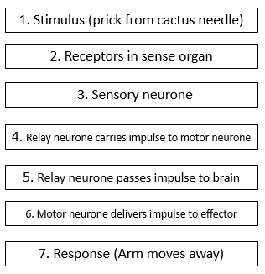
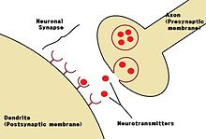
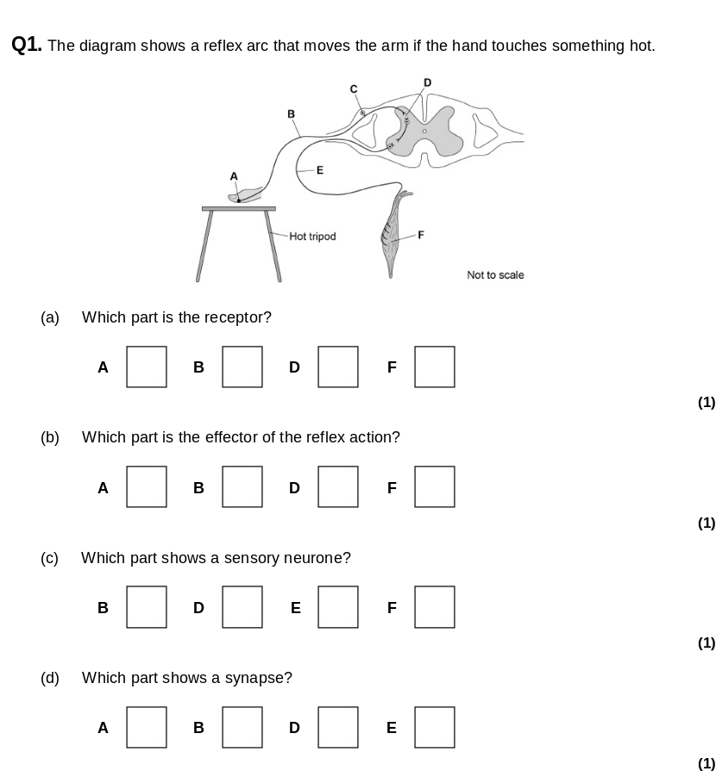
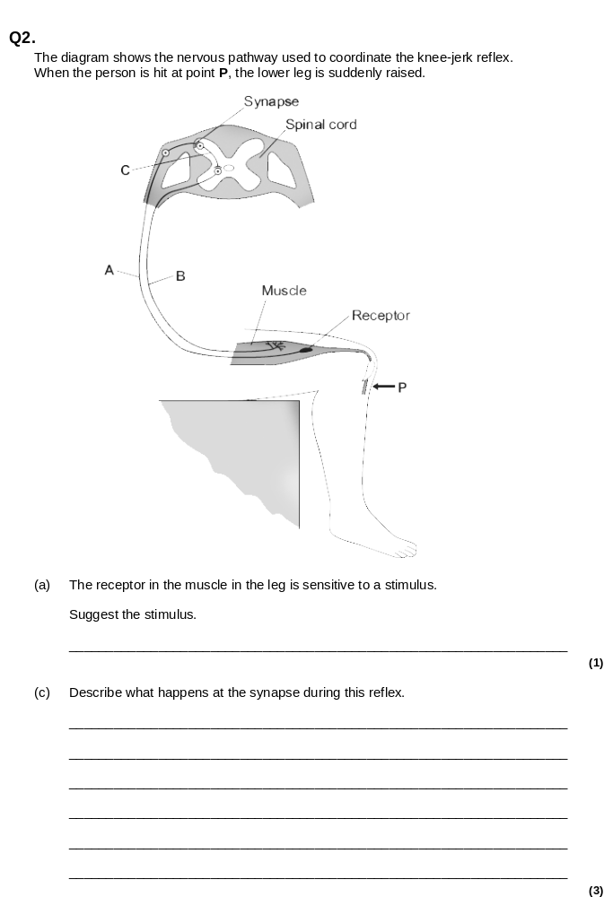
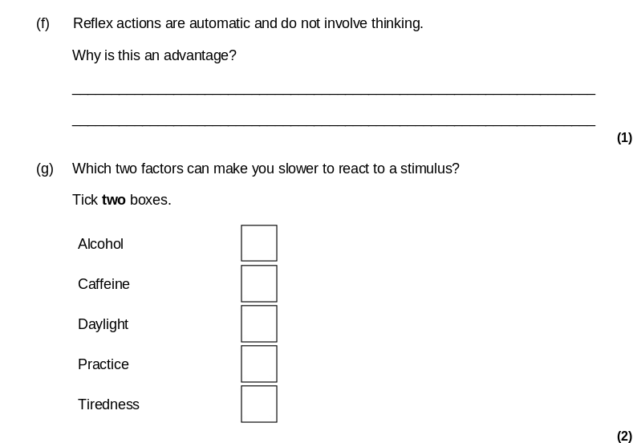
Homeostasis revision
Do Now: Define these terms
-effector
-receptor
-stimulus
-response
-neurone
-hormone
-synapse
-gland
The Nervous System
Receptor: senses change in environment e.g temperature, taste, sound
Coordinators: Brain, CNS, and glands around the body control the response
Effectors: Muscles will contract or relax and glands will release hormones
Reflexes are needed to protect the body.
Reflexes:
Are automatic and fast
do not involve the brain
only involve three neurones – sensory, relay and motor neurones
When an electrical impulse arrives at the end of a neurone a chemical is released. It diffuses across the synapse and attaches to next neurone causing an impulse.

Slide 2
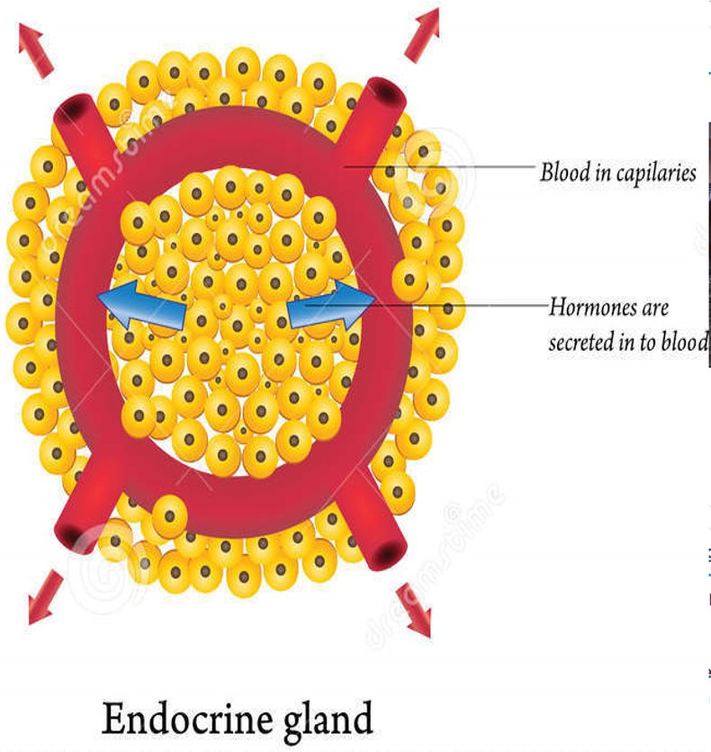
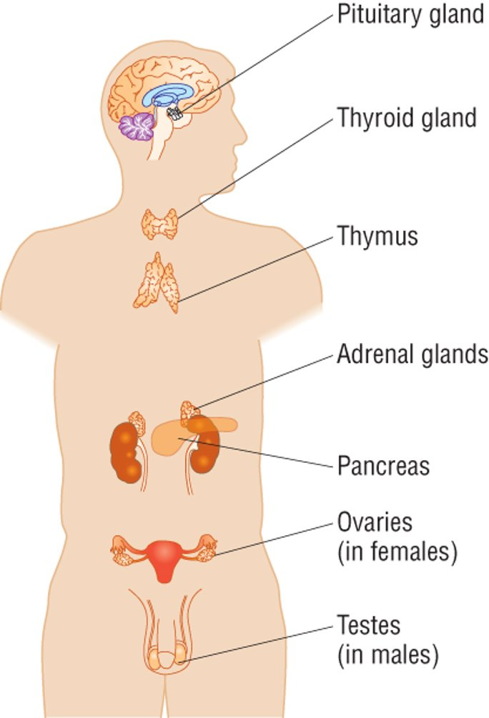
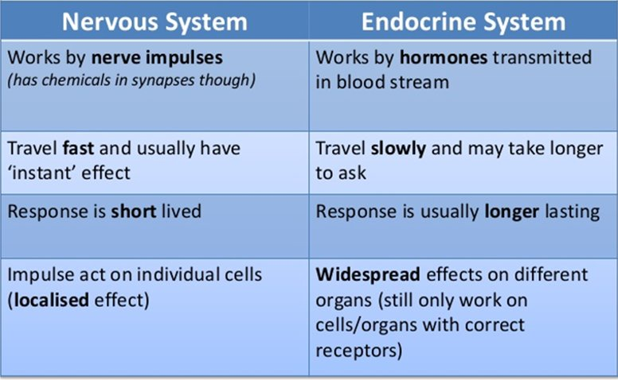
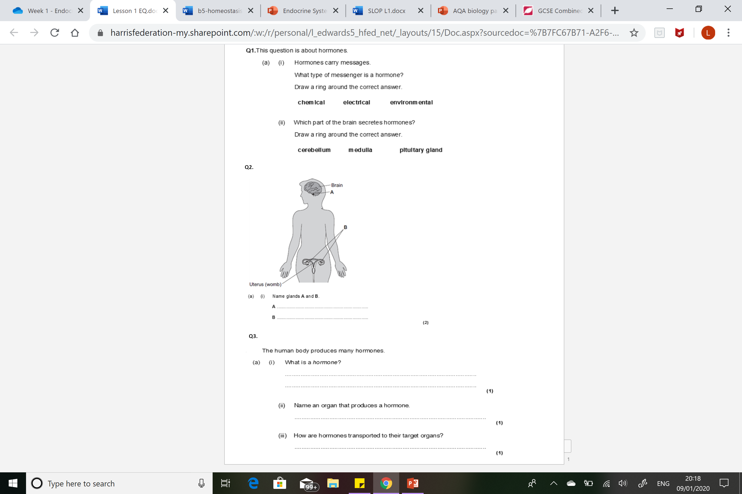
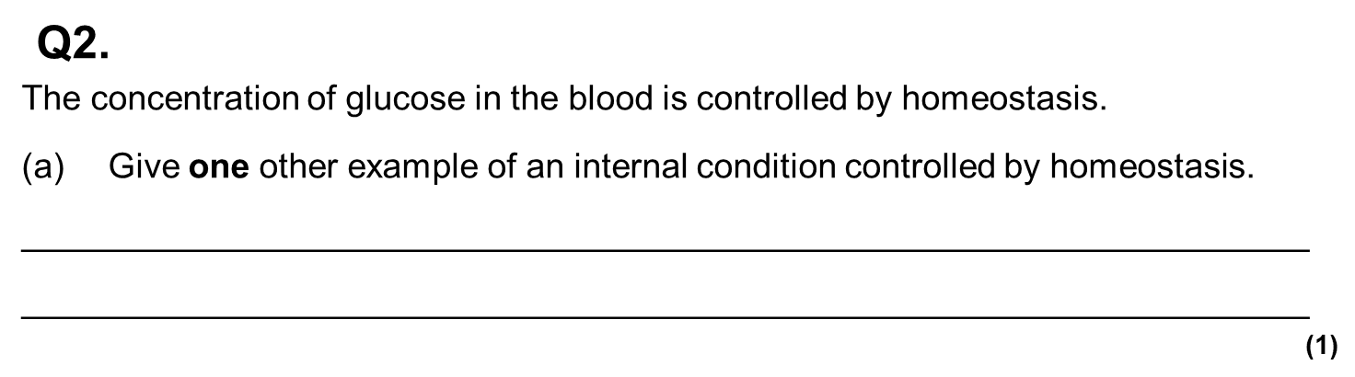
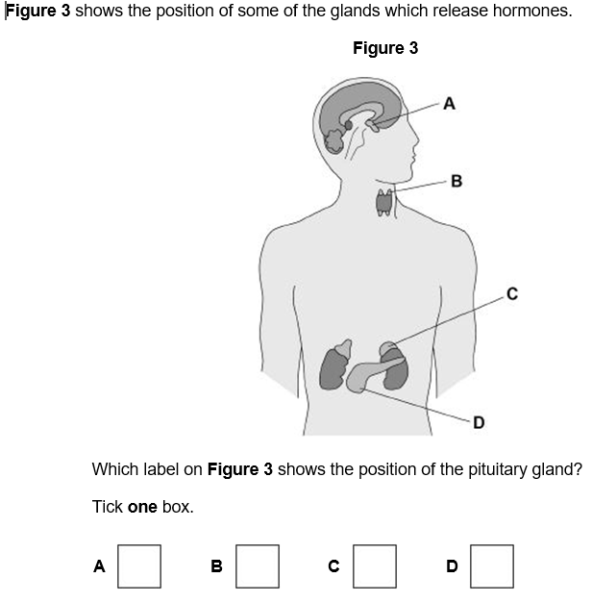
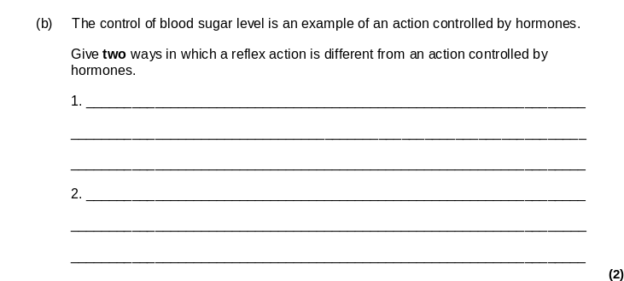
The Endocrine System and Hormonal Control
Humans, like all mammals need to maintain a constant internal environment. If our core body temperature, blood glucose levels, or water levels change too much we can get very ill or even die because changes in conditions can cause enzymes to denature. Enzymes are the main reason for homeostasis. Homeostasis is the regulation of the internal conditions of a cell or organism to maintain optimum conditions for function in response to internal and external changes.
Hormones are chemical messages secreted by the glands of the endocrine system​
​Hormones are released directly into the blood stream by endocrine glands. ​

Slide 3
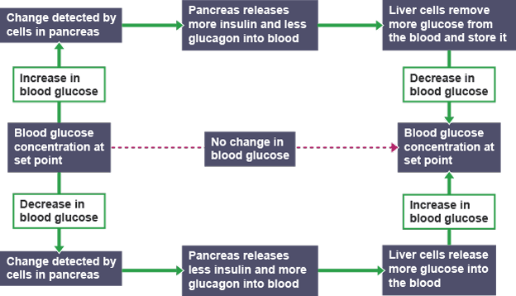
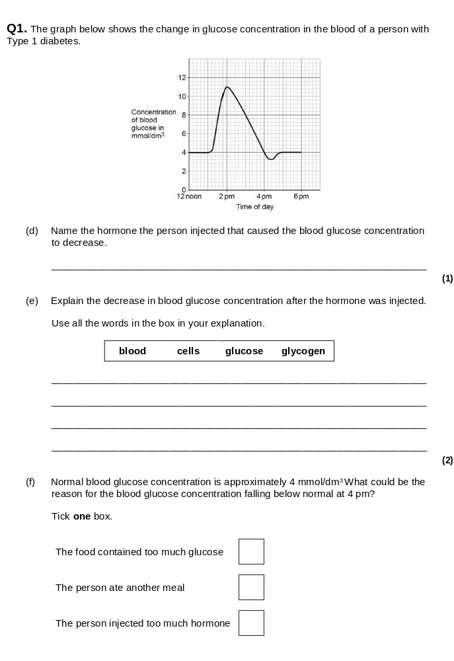
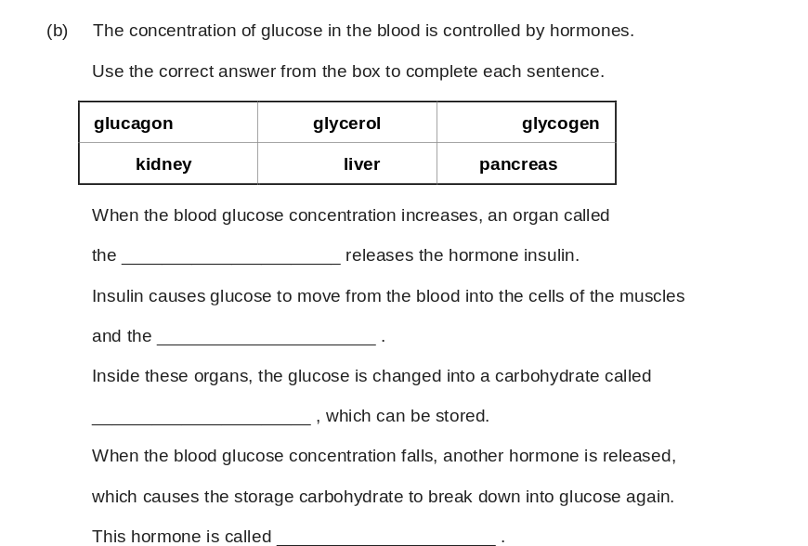
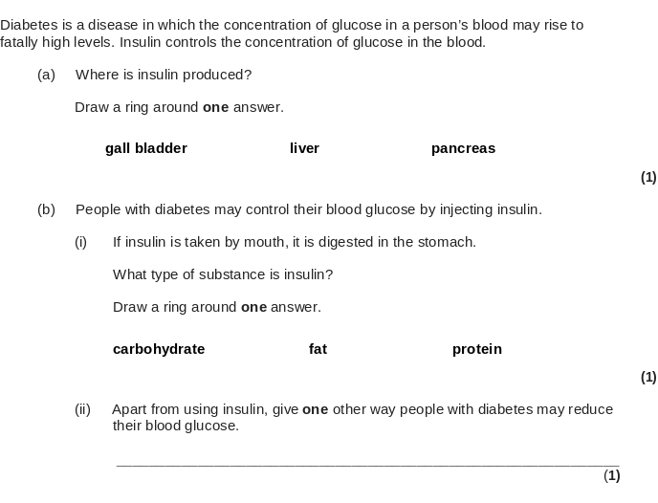
Regulation of Blood Glucose
Insulin – a hormone which decreases blood glucose by storing it as glycogen in the liver.
Glucagon – a hormone that increases blood glucose (by breaking down glycogen in the liver.
Glucose can be stored as glycogen in the liver.
Diabetes:
Type 1 – genetic disorder where pancreas does not produce insulin correctly. Treatment: Injecting insulin.
Type 2 – caused by fat around pancreas, obesity and poor diet. Treatment: diet and exercise.

Slide 4
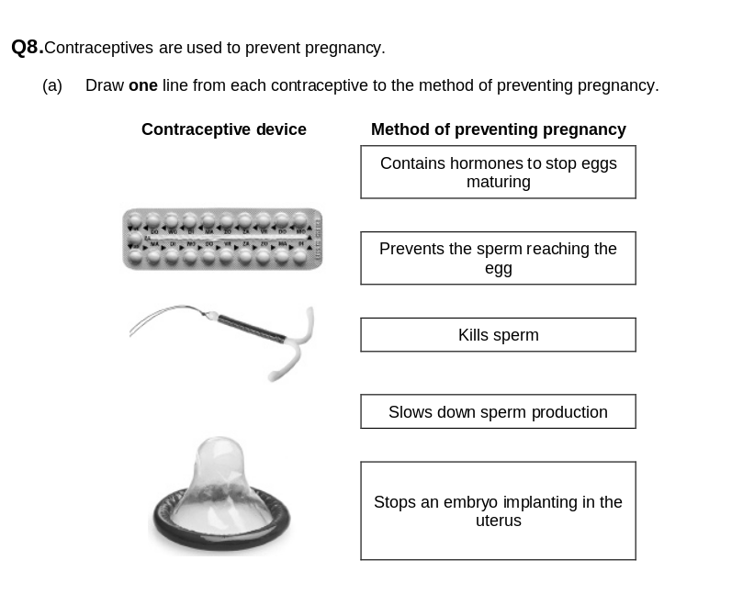
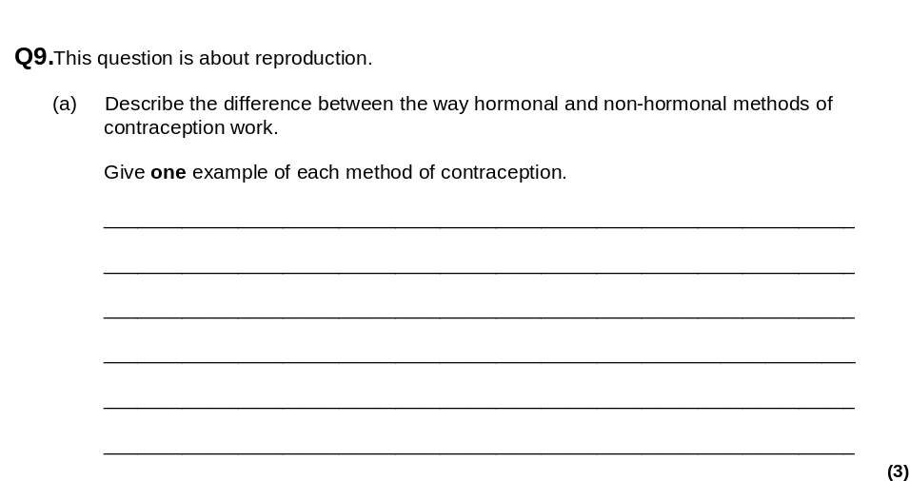
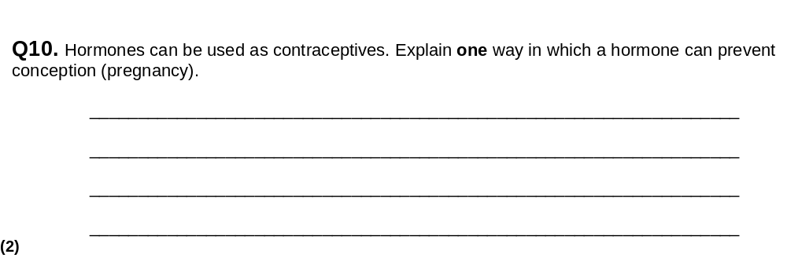
Contraception and Reproductive Hormones
Contraception: Any technology that prevents pregnancy.
Non-hormonal | Hormonal
Barrier methods – e.g condoms or diaphragm: Both of these provide a physical barrier that prevents sperm entering the uterus. | Oral contraceptive pill - Contains oestrogen and progesterone to inhibit FSH. Prevents an egg maturing.
IUD/Coil: prevent uterus lining building up
Spermicidal cream – kills sperm | Implant - Contains a slow release version of progesterone. Ensures that an egg is not released from the ovary.
Surgical Sterilisation – prevents person from releasing sperm or eggs permanently.
Male Hormones: Testosterone – produces sperm and develops secondary sexual characteristics
Female Hormones:
Follicle stimulating hormone (FSH): This causes an egg cell to mature in the ovaries
Luteinising hormone (LH): Stimulates the ovary to release the egg
Progesterone and Oestrogen: These maintain the uterus lining so a fertilised egg can be implanted and develop into an embryo.
(c) Progesterone is used in some contraceptives.
Suggest one advantage of using a progesterone patch rather than a progesterone oral contraceptive.
______________________________________________________________
____________________________________________________________(1)

Slide 5
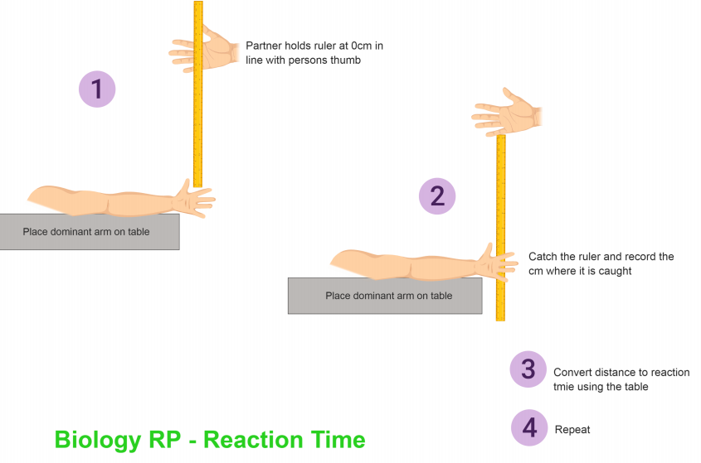
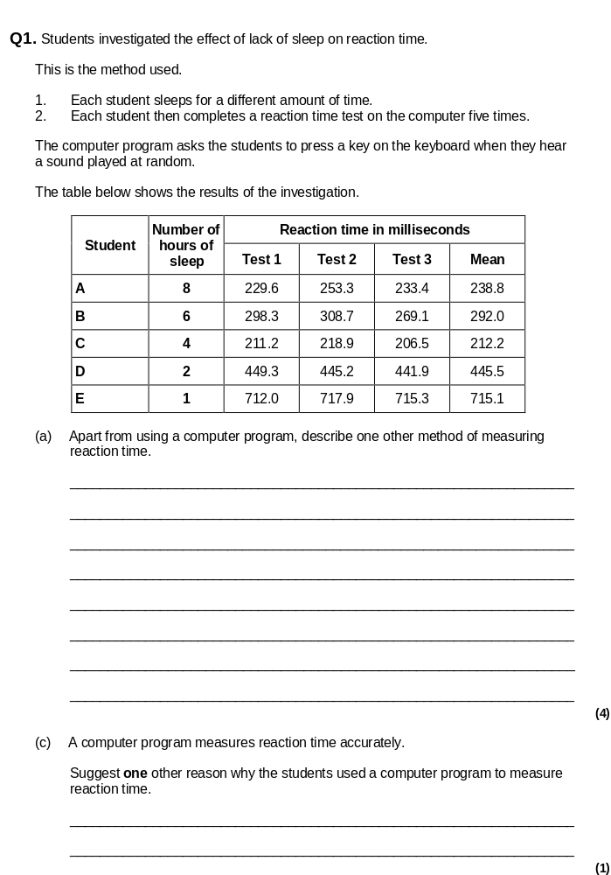
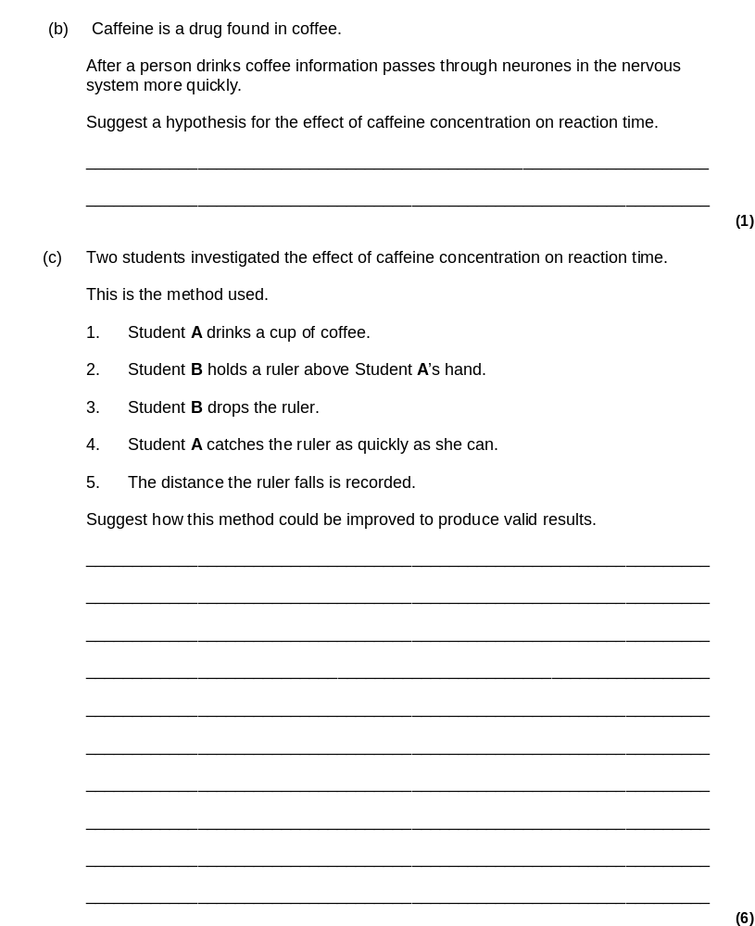
Required Practical – Reaction Times
Method:
Factors that can affect reaction time:
Practice​
Age​
Gender​
Stimulant/drug intake​
Tiredness​
Things to consider:
Does the method test what you want it to test?
Have you removed practice as a factor – e.g use left/non-dominant hand?
Ruler method or computer is more accurate than a stopwatch because then the subjects reaction time is measured not the person using the stopwatch.

Slide 6
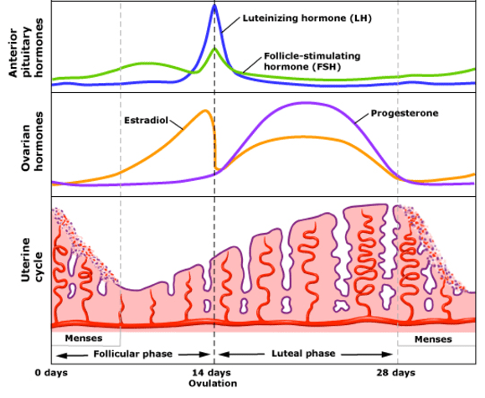
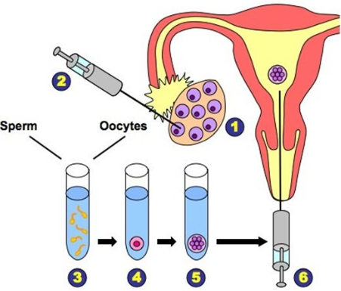
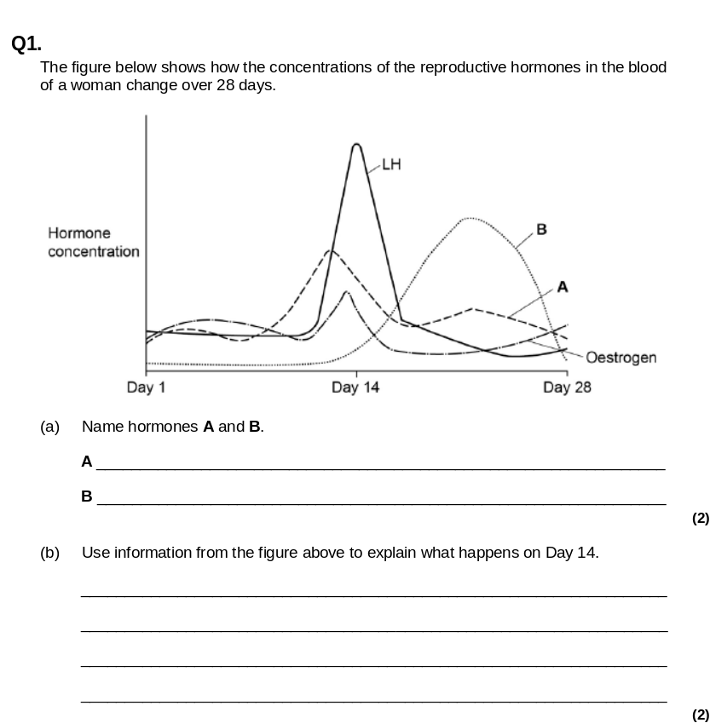
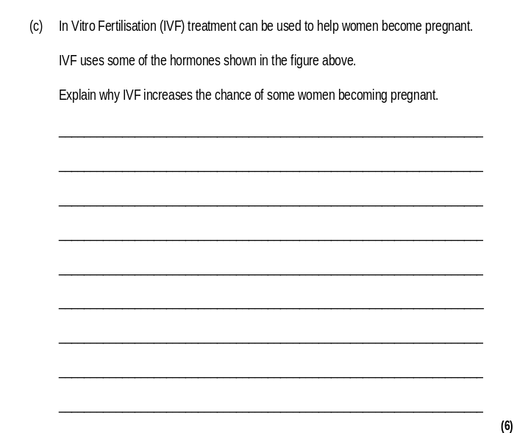
Menstrual cycle and IVF HIGHER ONLY
0 days - oestrogen and progesterone levels are low.
FSH begins to rise slightly, triggering a new egg cell to begin developing. FSH stimulates oestrogen levels begin to rise and the lining of the uterus begins to re-grow.
Before ovulation the levels of oestrogen, LH and FSH all reach their maximum but after ovulation they drop.
Progesterone and oestrogen rise to maintain the lining of the uterus.
If the egg is fertilised it will embed in the lining and progesterone and oestrogen will remain high.
If the egg is not fertilised then progesterone drops and menstruation happens. The cycle repeats.
IVF: In-Vitro Fertilisation is a sophisticated process that can help a couple conceive.
The woman is given a large dose of FSH and LH so she matures and releases many eggs
The eggs are collected
Sperm is collected from the father or donor.
Eggs are fertilised with the sperm. This is done ‘in vitro’ which means ‘outside of the body’.
The embryos develop in the lab.
When the embryos are a ball of cells they are implanted into the mother to be carried to term like a normal pregnancy.

