Slide 1
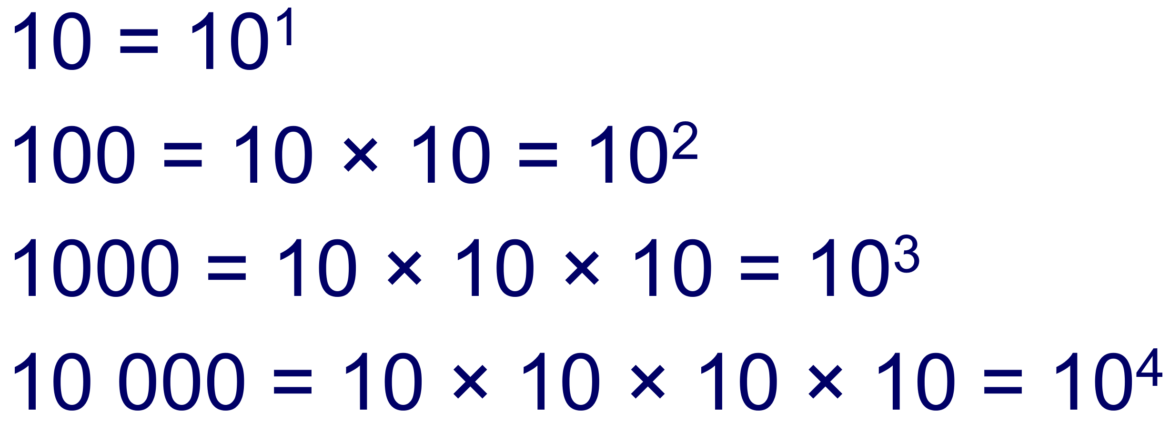
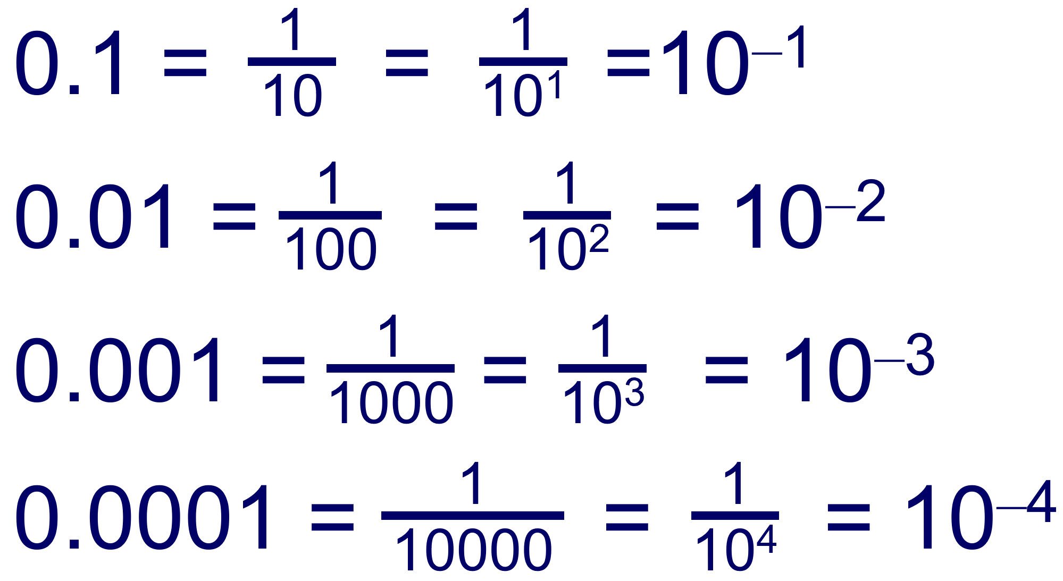
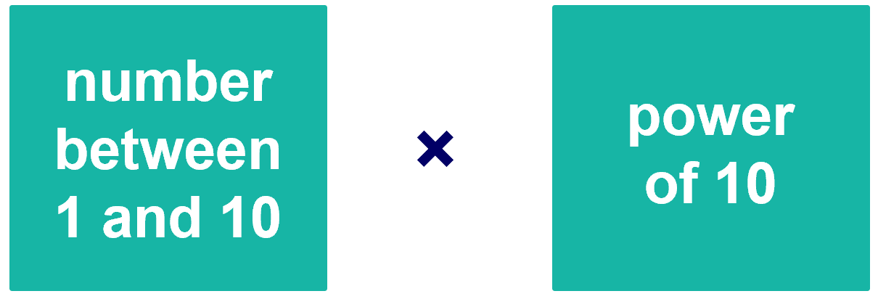

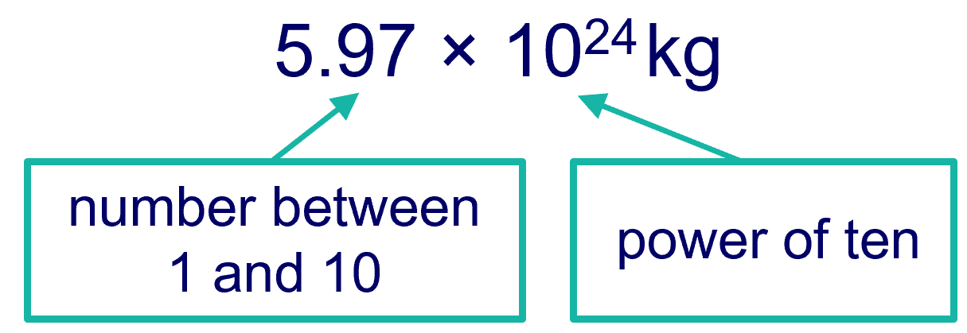
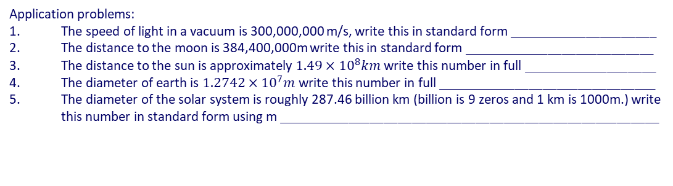
Maths in Physics
Standard form, percentages & graphs.
Do Now: Fill in the equations below
E_{k} = 0.5 x __ x __²
E_{p} = __ × __ × __
P = E ÷ __
P = W ÷ __
V = __ x __
P = __ x __
P = __² x __
E = __ × __
P = E ÷ __
R_{TOT} = __₁ + __₂
ρ = __ ÷ __
Q = __ x __
Standard form
Powers of ten are written using index notation.
Any number raised to the power of 0 is 1, so 10⁰ = 1. Decimals can be written using negative powers of ten.
2 × 10¹⁵ and 1.5 × 10^{–12} are examples of numbers written
in standard form. Numbers written in standard form have two parts:
This way of writing a number is also called scientific notation. Any number can be written using standard form, however it is usually used to write very large or very small numbers. For example, the mass of the planet earth is about 5 970 000 000 000 000 000 000 000 kg. We can write this in standard form as a number between 1 and 10 multiplied by a power of 10.
Write the following numbers in standard form:
100 = _____________
750 = _____________
3300 = ____________
9200 = ____________
58400 = ___________
4720 = ____________
0.02 = _____________
0.0035 = ___________
0.19 = _____________
0.00042 = __________
Convert the following into normal numbers:
2 × 10² = _______________
7 × 10³ = _______________
1.5 × 10⁵ = ______________
5.1 × 10¹ = ______________
6.2 × 10⁸ = ______________
1.2 × 10⁻¹ = ______________
6.5 × 10⁻³ = ______________
5.001 × 10⁻² = ____________
2.74 × 10⁻⁵ = _____________
4.3 × 10⁰ = ______________
Application problems:
The speed of light in a vacuum is 300,000,000 m/s, write this in standard form _____________________
The distance to the moon is 384,400,000m write this in standard form ___________________________
The distance to the sun is approximately $1.49×{10}^{8}km$write this number in full ___________________
The diameter of earth is $1.2742×{10}^{7}m$write this number in full _______________________________
The diameter of the solar system is roughly 287.46 billion km (billion is 9 zeros and 1 km is 1000m.) write this number in standard form using m ______________________________________________________

Slide 2
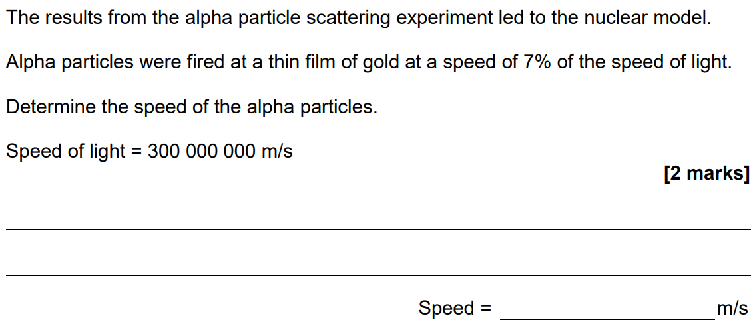
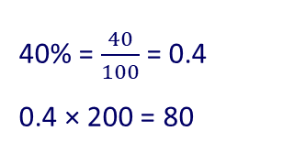

Percentages
Percent means “per one hundred”, so to convert a percent to a decimal divide it by 100.
To calculate the percentage of a number multiply the decimal by the number.
Example question:
What is 40% of 200?
60% = $\frac{60}{100}$ = 0.6
40% = $\frac{40}{100}$ = 0.4
0.4 × 200 = 80
Calculate the percentage of each number:
What is 50% of 36? _________________________
What is 50% of 584? ________________________
What is 20% of 895? ________________________
What is 62% of 250? ________________________
What is 65% of 720? ________________________
What is 30% of 540? ________________________
What is 25% of 936? ________________________
What is 50% of 1316? _______________________
What is 75% of 1476? _______________________
What is 66% of 650? ________________________

Slide 3
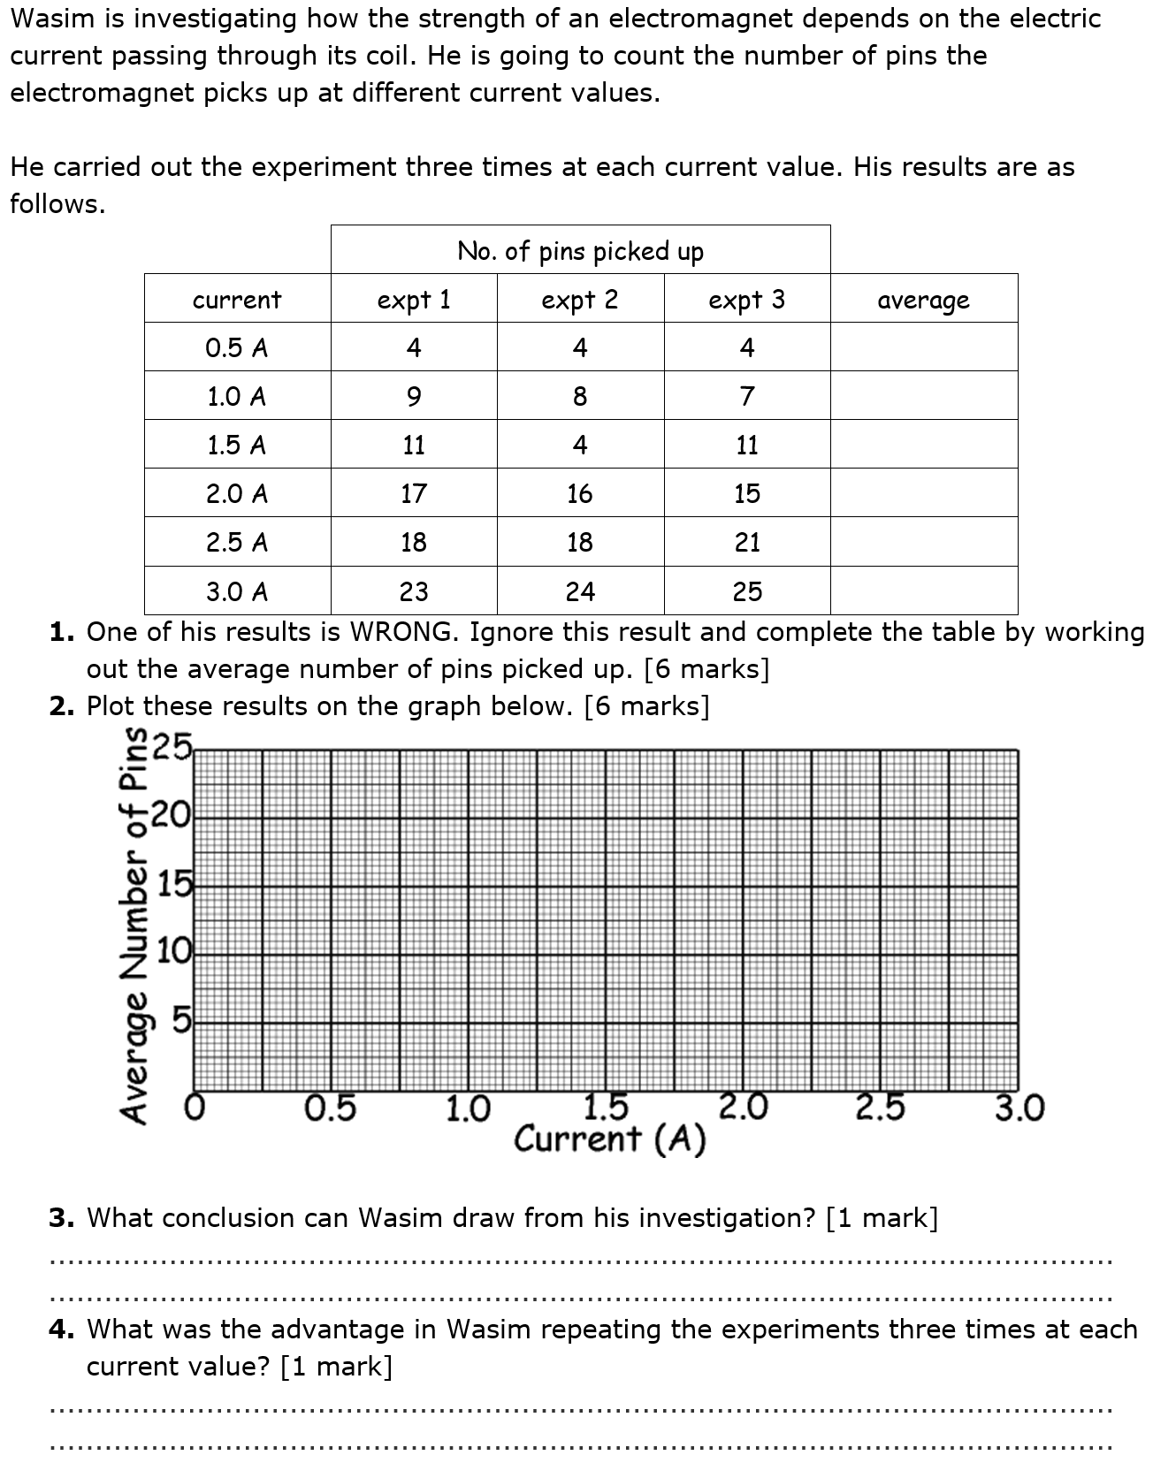
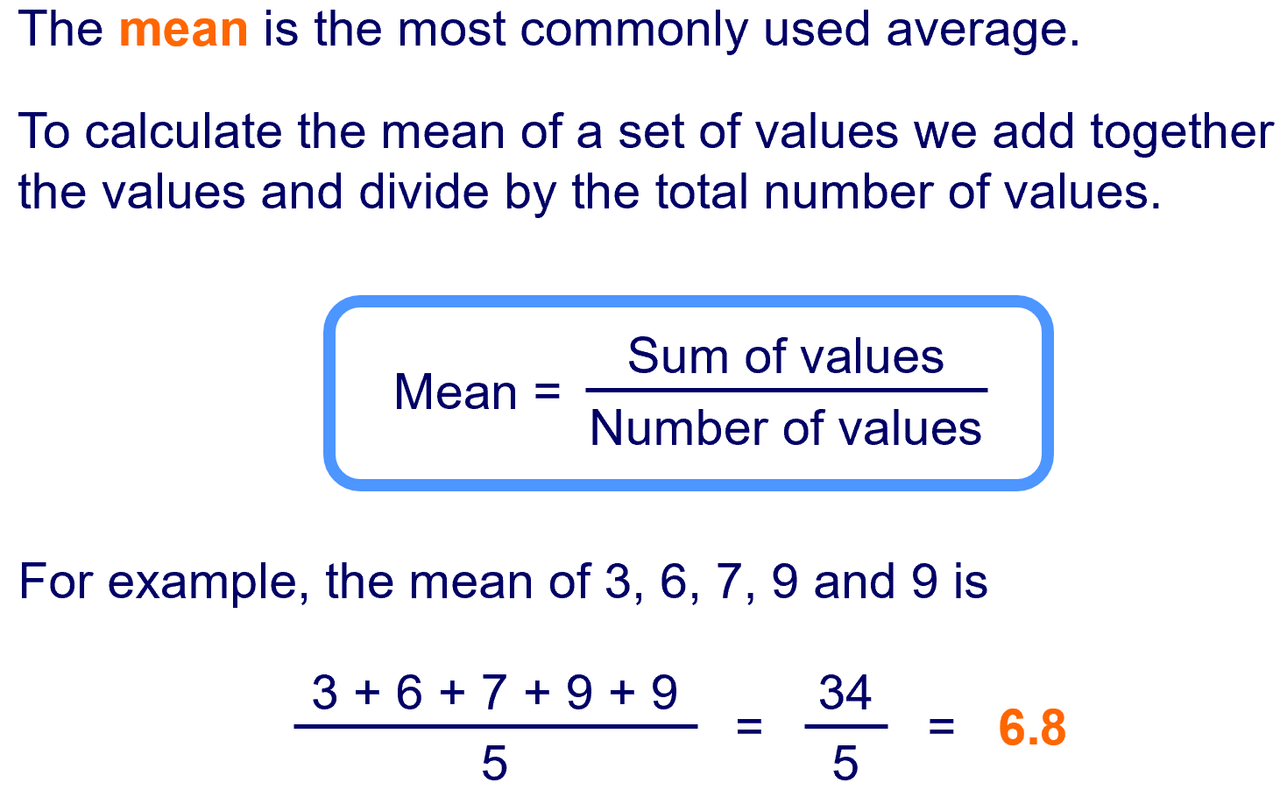
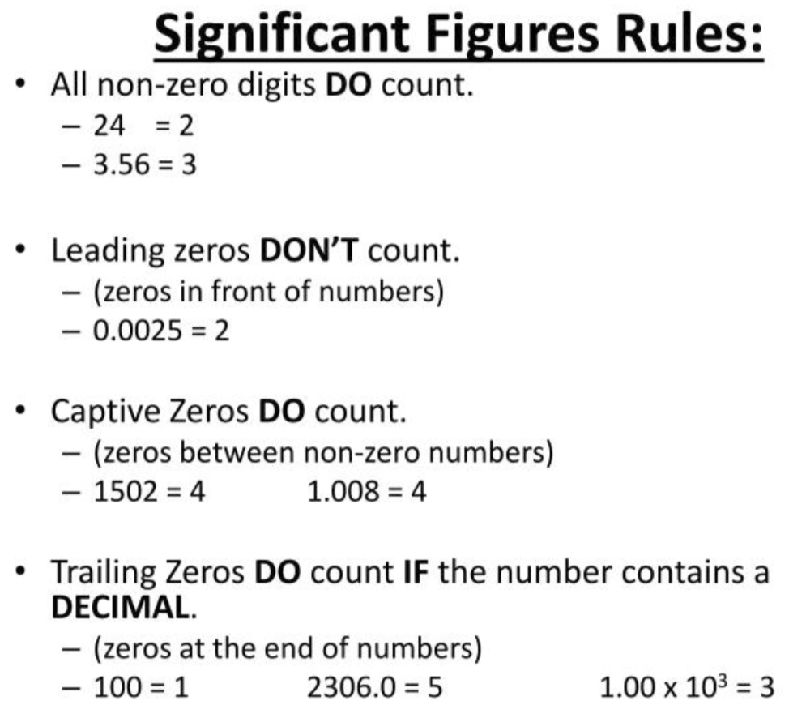
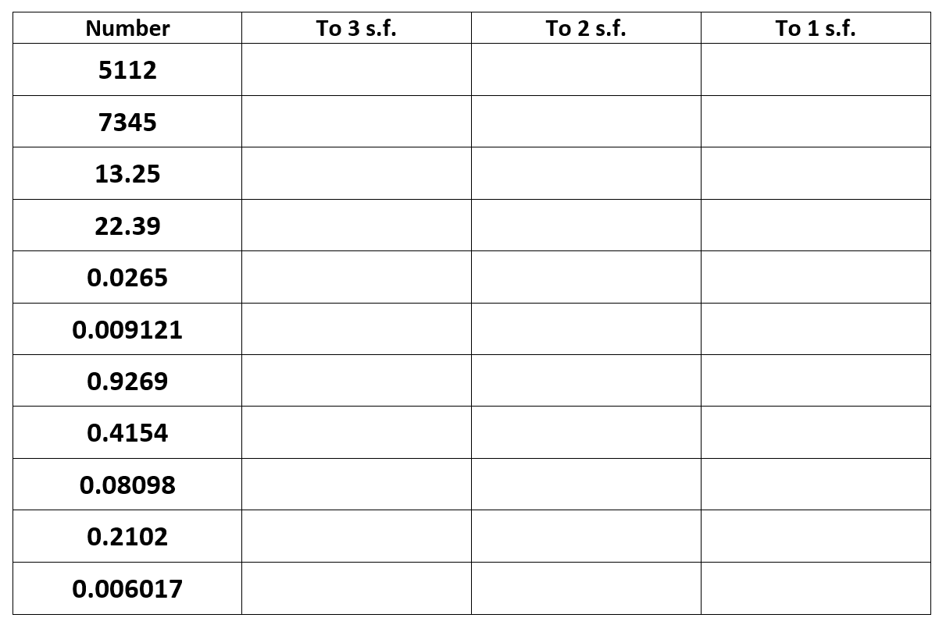
Mean and plotting graphs
Significant figures

Slide 4
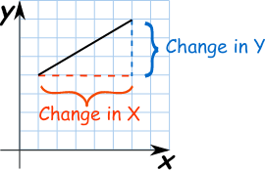
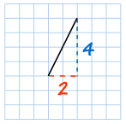
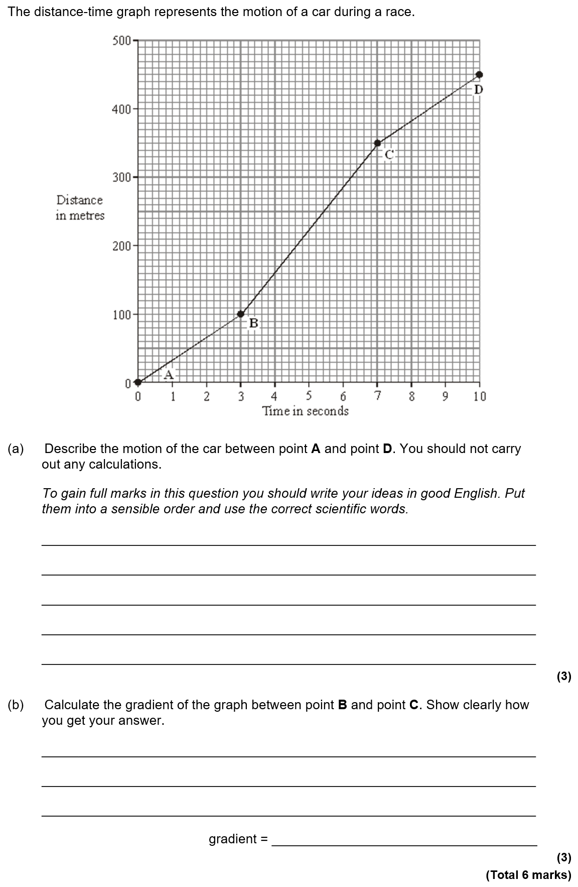
Gradient
The gradient of a graph can be found by using: gradient = Δy ÷ Δx
For example in the graph to the left:
Gradient = 4 ÷ 2 = 2

