Slide 1



Paper 1 – Physics
Topics: Energy, electricity, particle model of matter, atomic structure.
Do Now: Fill in the equations below
E_{k} = 0.5 x __ x __²
E_{p} = __ × __ × __
P = E ÷ __
P = W ÷ __
V = __ x __
P = __ x __
P = __² x __
E = __ × __
P = E ÷ __
R_{TOT} = __₁ + __₂
ρ = __ ÷ __
Q = __ x __
Energy
There are ten different types of energy, and eight energy stores (the underlined energies): “Most Kids Hate Learning GCSE Energy Names”. The first letters stand for Magnetic, Kinetic, Heat (thermal), Light, Gravitational, Chemical, Sound, Electrical, Elastic, Nuclear.
Renewable energy resources are renewed. They do not run out. Examples include; tidal, wave, geothermal, wind and solar.
Non-renewable energy resources do run out. They are fossil fuels (coal, oil and gas) and nuclear. Non-renewables generally work by heating water in a boiler until it turns to steam. This steam is highly pressurised and turns the blades of a turbine. This turbine then turns a generator which converts kinetic energy into electrical energy.
Each method of generating electricity has advantages and disadvantages. Burning fossil fuels creates carbon dioxide which leads to global warming; but they generate electricity reliably. Wind and solar power are unreliable but do not generate carbon dioxide and once built are cheap to run.

Slide 2





Electricity
A series circuit only has one path, a parallel circuit has more than one path. Current is the same everywhere in a series circuit, but splits on each path of a parallel circuit. Voltage is the same on each path of a parallel circuit, but splits across components in a series circuit.
Ammeters are used to measure current and go in series. Voltmeters are used to measure potential difference and go in parallel across the component you want the voltage across.
Ohmic conductors follow Ohm’s law (eg a resistor), but non-Ohmic conductors do not (eg a lamp/diode).
AC current (eg. mains electricity) changes direction, but DC does not (eg. batteries). Mains electricity has a voltage of 230V and a frequency of 50 Hz.
Plugs have three wires. The live wire carries the AC and is brown. The neutral wire completes the circuit and is blue. The earth wire is for safety and is green/yellow.
The national grid is made up of transformers and transmission cables. Directly after a power station is a step-up transformer. This increases the voltage but decreases the current. This reduces the energy lost to heating in the cables.
The cables are also low resistance to reduce energy lost to heating. Before electricity is delivered to consumers it goes to a step down transformer which reduces the voltage to a safe level for consumers.
The fuse is also for safety and melts if the current is too large. The cable grip prevents the cables from coming out of the plug.

Slide 3


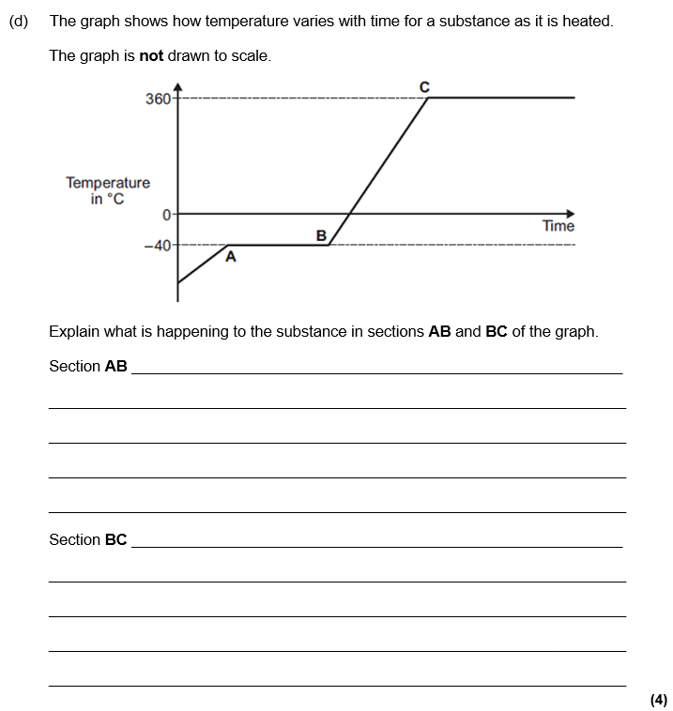
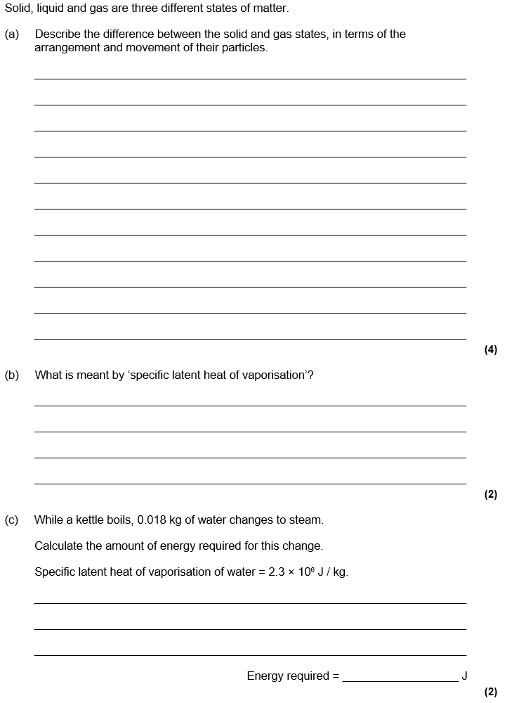
Particle model of matter
State changes:
Melting: Solid → Liquid
Evaporation: Liquid → Gas
Condensation: Gas → Liquid
Freezing: Liquid → Solid
Sublimation: Solid → Gas
or Gas → Solid
The amount of mass per unit volume is called the density.
When a substance is changing temperature, the energy change can be calculated by using ΔE= m x c x Δϑ. The specific heat capacity is the energy needed to heat up 1 kg of a substance by 1 degree.
When a substance is changing state, energy goes into breaking the bonds instead of increasing the temperature of the substance. The energy needed to change state can be calculated by E = m x L. The latent heat is the energy needed to change state of 1 kg of a substance.

Slide 4




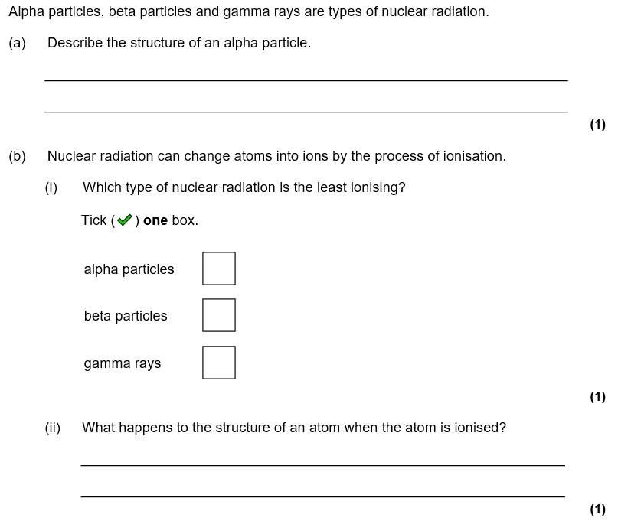
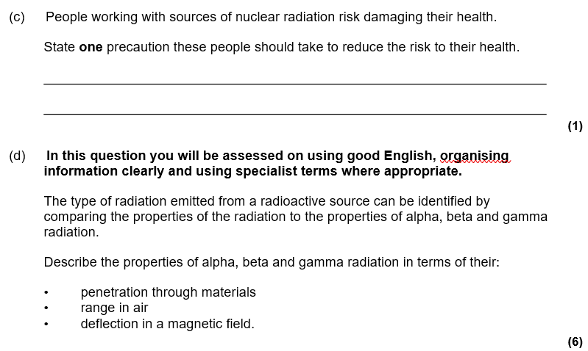
Atomic Structure
Isotopes are elements with the same atomic number (no. of protons) and different mass numbers. This means they have different numbers of neutrons.
Before the discovery of the electron, atoms were thought to be tiny spheres that could not be divided. The discovery of the electron led to the plum pudding model of the atom. The plum pudding model suggested that the atom is a ball of positive charge with negative electrons embedded in it.
The results from the alpha particle scattering experiment led to the conclusion that the mass of an atom was concentrated at the centre (nucleus) and that the nucleus was charged. This nuclear model replaced the plum pudding model.
Half-life is the time taken for the count rate (measured in Becquerel) to halve. We can calculate this using the tree method or from a graph.
Radioactivity is dangerous because our cells can be ionised. This can kill cells or lead to mutations and potentially cancer. If some radioactive particles are in contact with an object, we say the object is contaminated.
All types of radiation are dangerous but alpha particles are most dangerous inside the body as they are most ionising and can’t escape the body. Beta particles are dangerous up to the mid-range and gamma radiation is dangerous up to the long-range.

