Slide 1
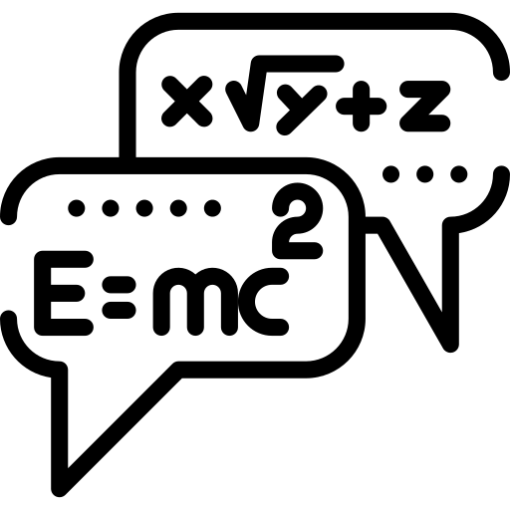

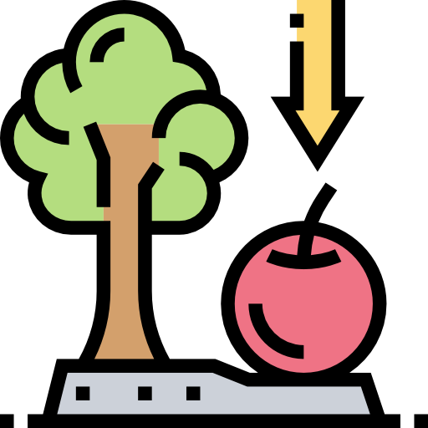





Physics Paper 2 revision booklet (F tier)
Exam date: 12th June 2020 (am)
Contents:
Equations fact sheet
Forces fact sheet.
Forces notes and exam questions.
Forces and motion fact sheet.
Forces and motion notes and exam questions.
Waves fact sheet.
Waves notes and exam questions.
Magnetism fact sheet.
Magnetism notes and exam questions.
Specification
How to use:
Quiz yourself on the questions on the fact sheets (or get a family member/friend) to quiz you.
Answer the questions on the exam questions. Once answered, cover up the answers & check that you can do again.
Revising effectively does not simply involve reading over notes or making new notes – you have to practice answering questions & practice remembering information. To learn physics you have to do physics.
Good luck – although if you revise hard you won’t need it!
Dr. Edmunds

Slide 2
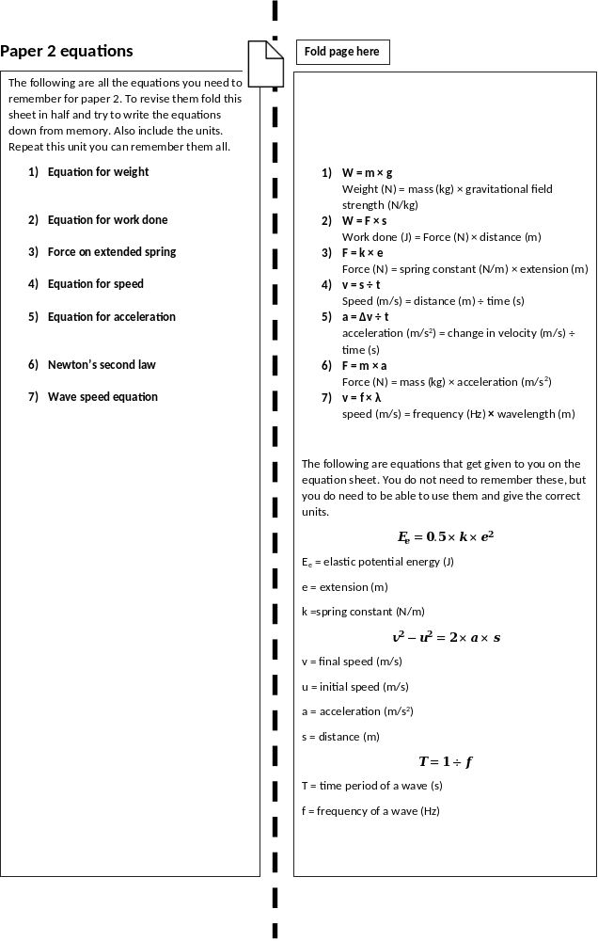

Slide 3
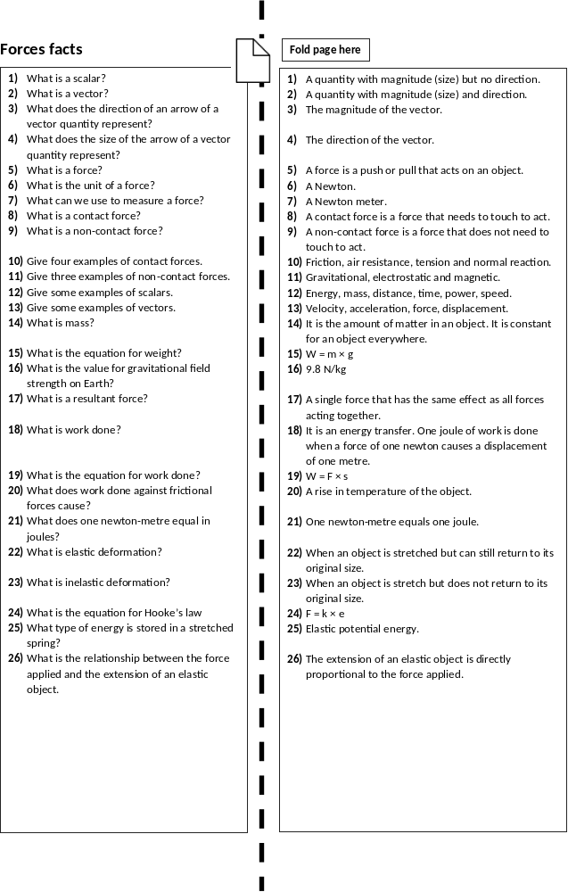

Slide 4
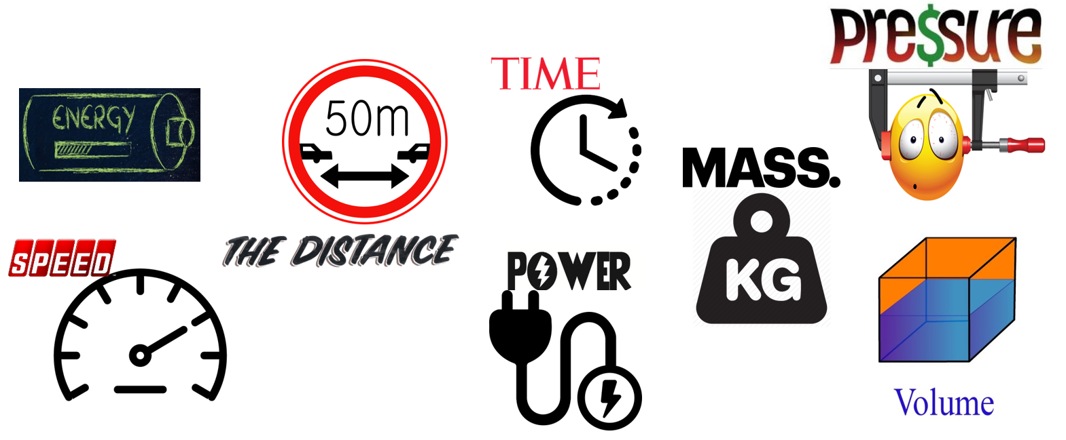
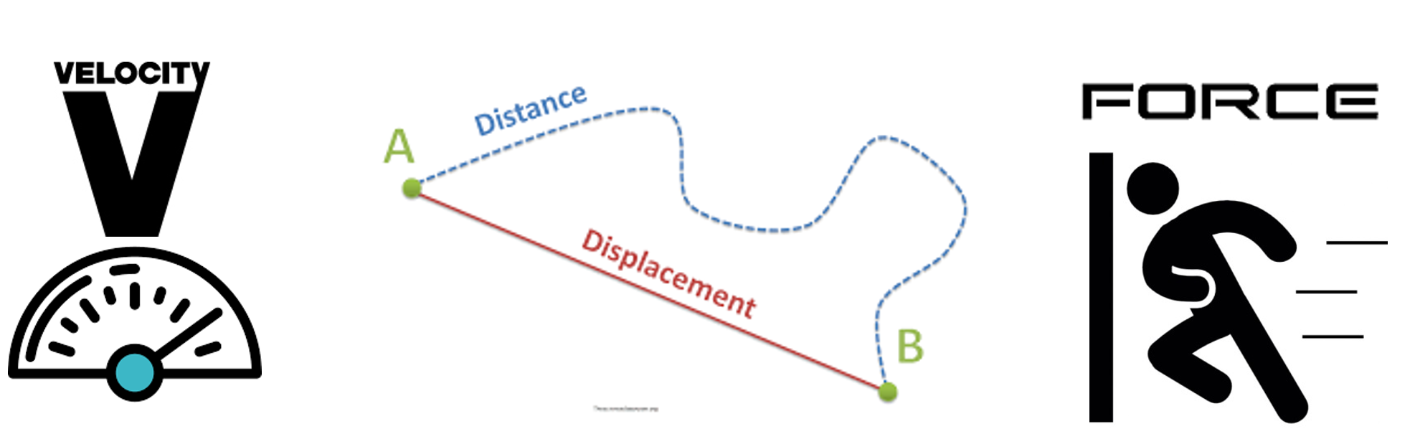
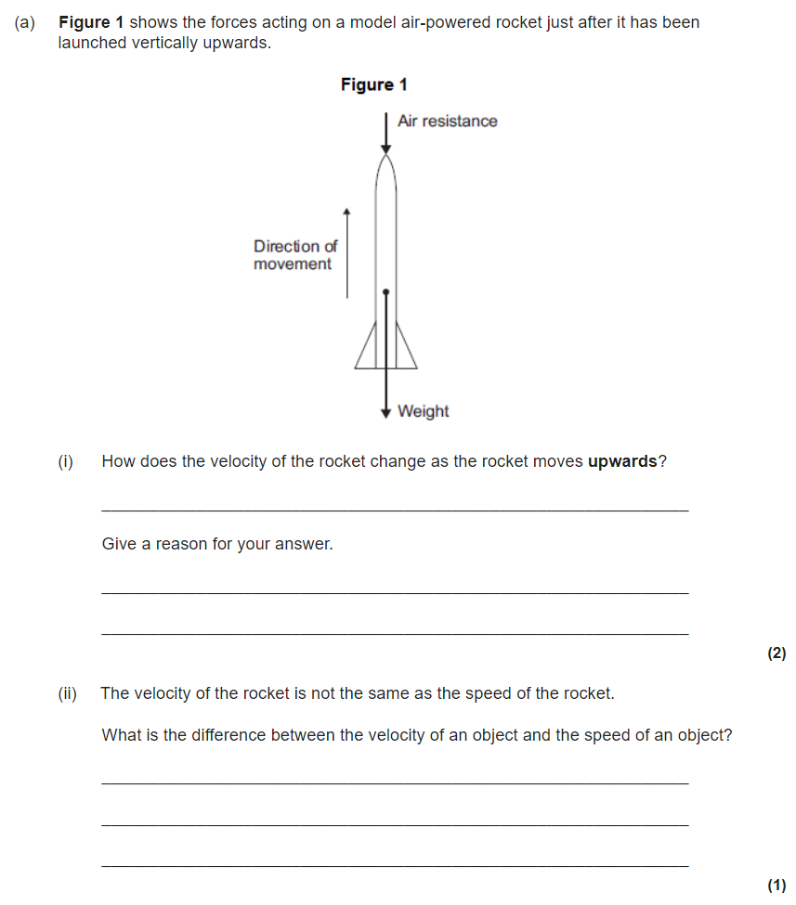
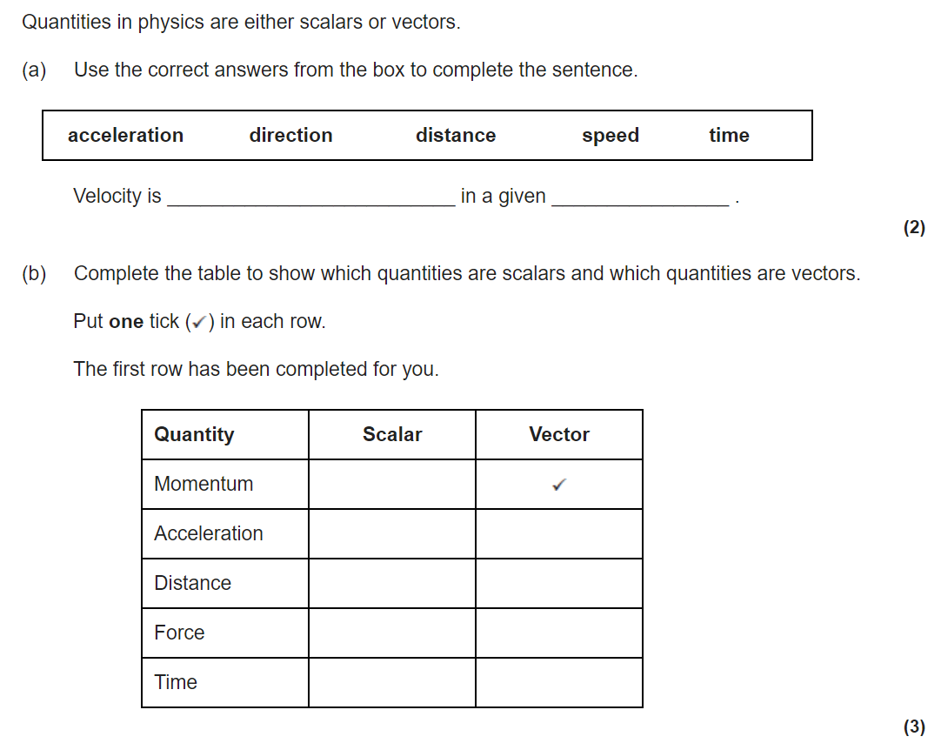
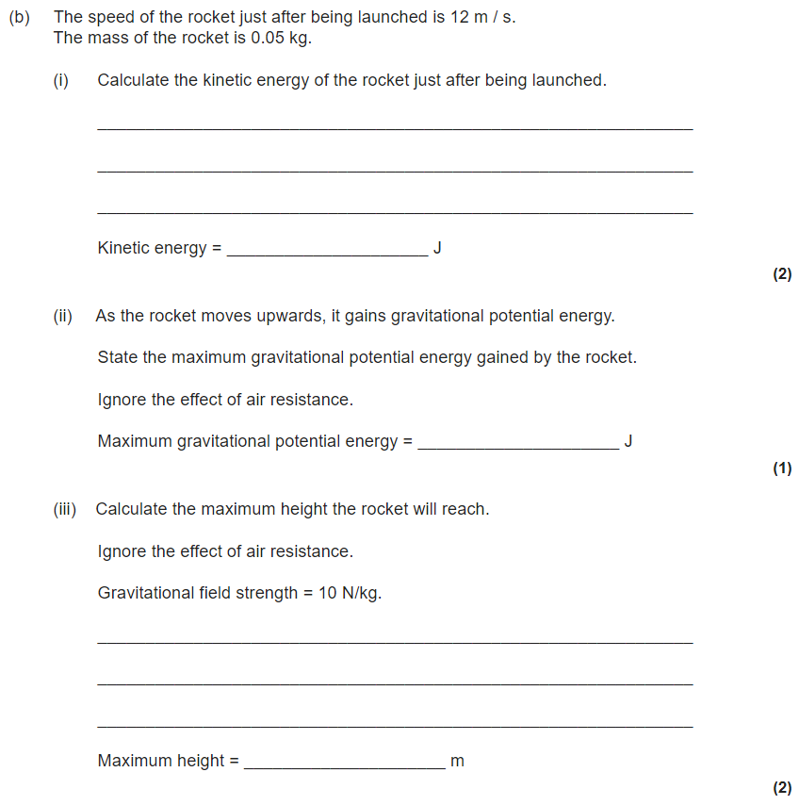
Forces revision
Keywords: Contact, newton, scalar, vector, mass, weight, gravitational field strength, work done, spring constant
What is a contact force? Give two examples
What is a non-contact force? Give two examples.
Do Now:
What is a force?
What are the units of a force?
What do we use to measure a force?
Scalars and vectors
Scalar quantities have size (“magnitude”) only and no direction. An example of a scalar quantity is mass.
Scalar quantities can be added up normally
Example: 36 kg + 14 Kg = 50 kg
Vectors have both size and direction. A vector quantity may be represented by an arrow. The length of the arrow represents the magnitude, and the direction of the arrow the direction of the vector quantity.

Slide 5
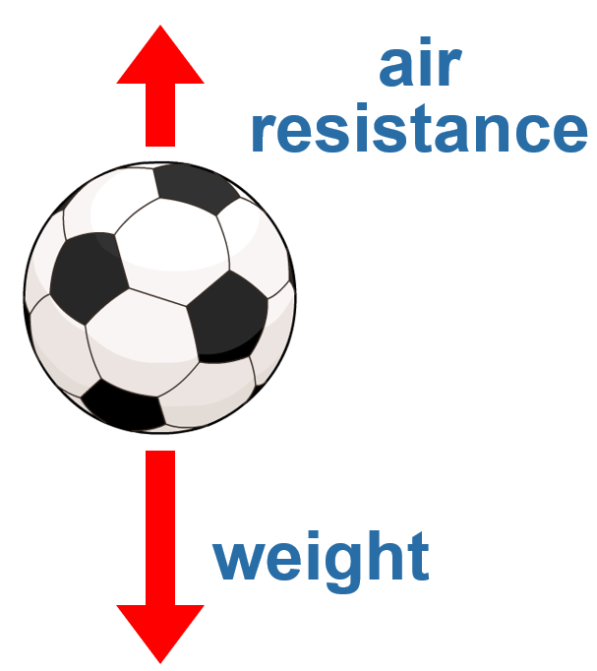
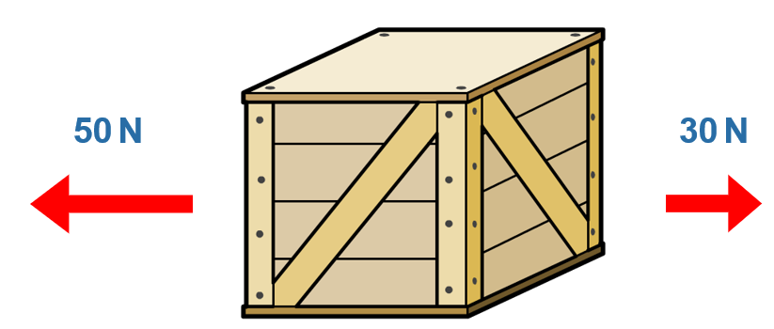
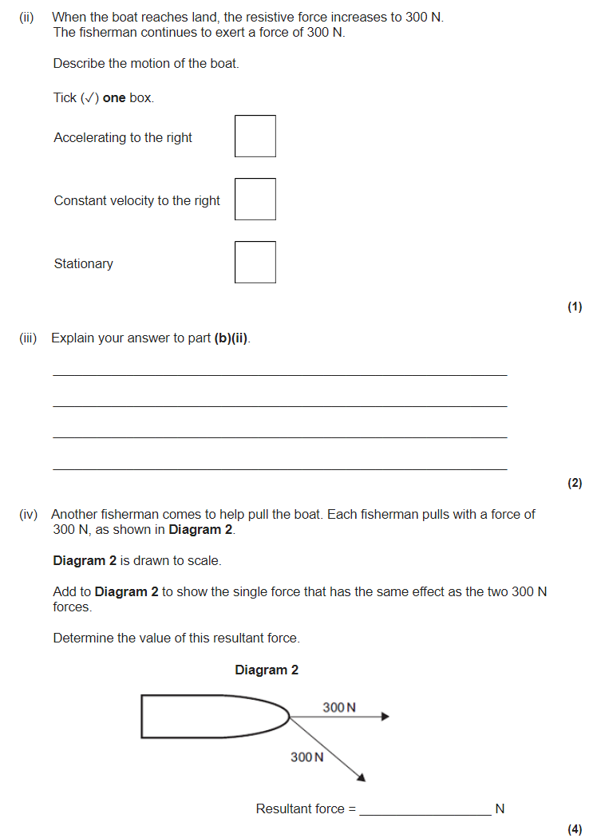
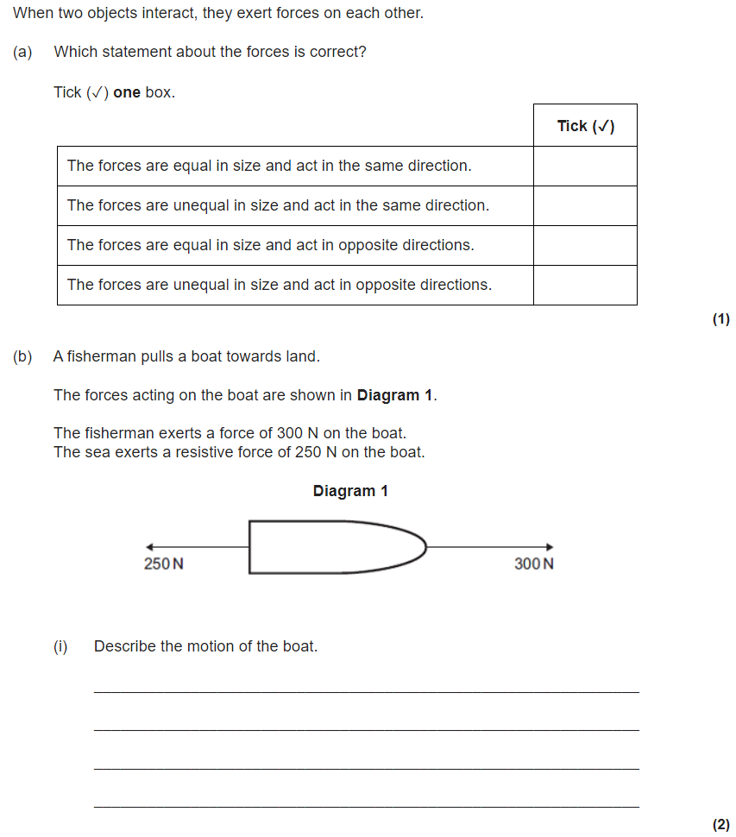
Resultant forces
The forces acting on any object can be shown using a force diagram. A force diagram uses labelled arrows to show all the forces acting on the object.
The direction of each arrow shows the direction of each force.
The length of each arrow is proportional to the size of the force.
Resultant force on the crate = 50 N – 30 N = 20 N to the left
The motion of the object will depend on the resultant force. This is calculated by adding all the forces together, taking their direction into account. When more than one force acts on an object, the forces COMBINE to form a RESULTANT FORCE
If more than one force is on an object, you can simplify the diagram by drawing just the resultant force.
This is a single force that has the same effect as the other forces put together.

Slide 6

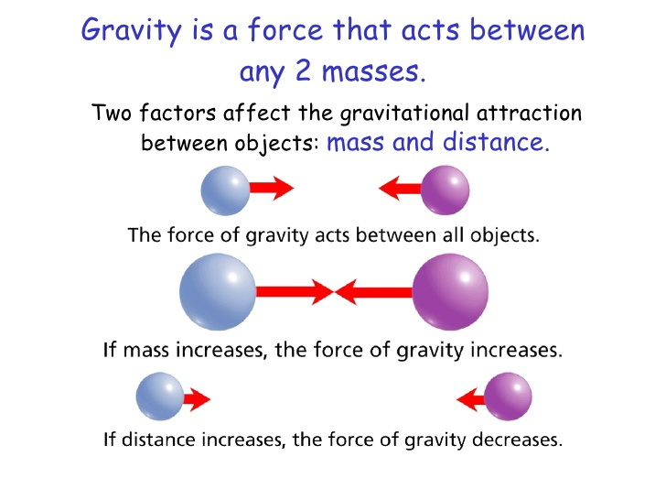
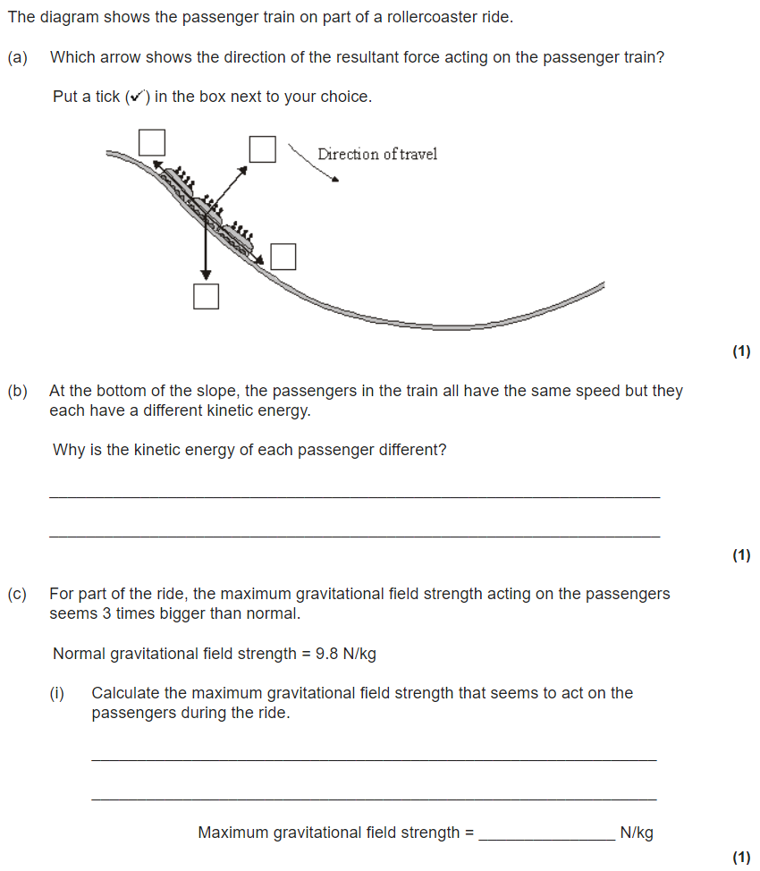
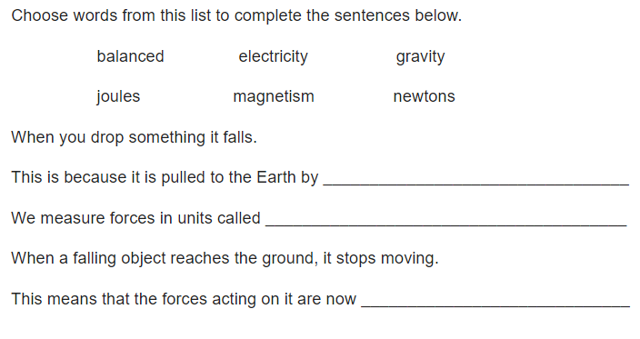
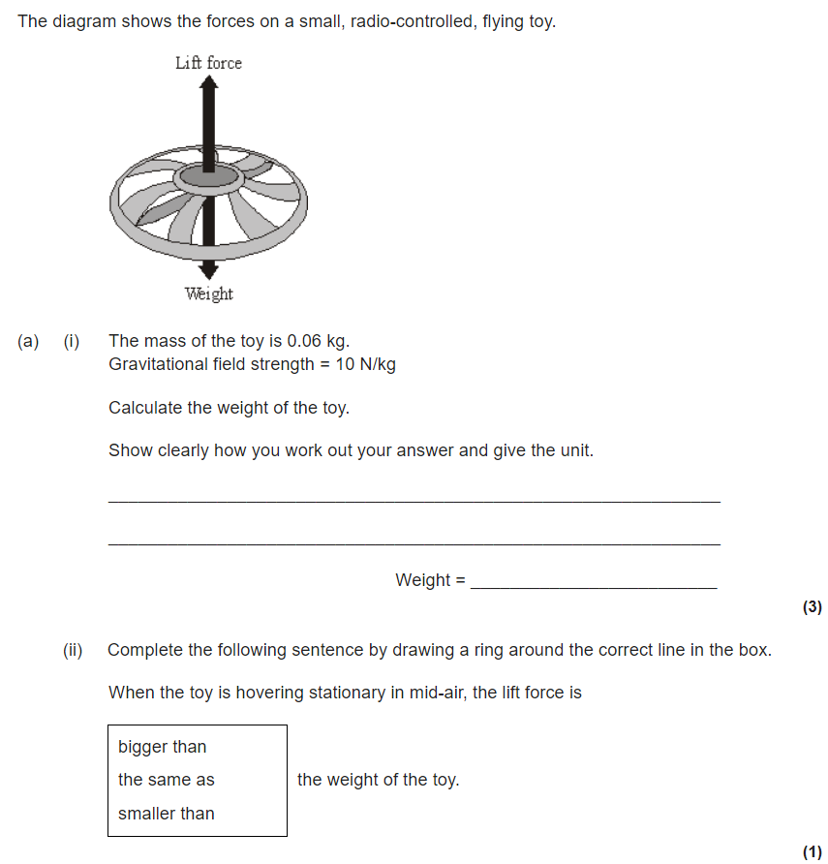
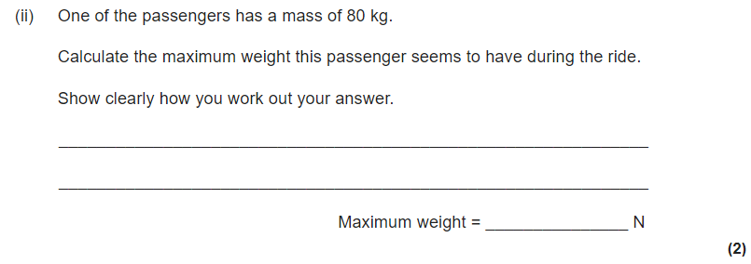
Mass, Weight and Gravity
All objects have a force that attracts them towards each other. This force is due to gravity.
Even you attract other objects to you because of gravity, but you have too little mass for the force to be very strong.
The strength of gravity at the surface of a planet is determined by its mass. g is a measurement of the gravitational field strength
The gravitational field strength on the surface of the earth is 9.8 N/kg.
The mass of an object is the amount of matter it contains.
The mass of an object stays the same wherever it is, but its weight can change depending on the gravitational field strength.
Weight is the force caused by gravity. The weight of an object can be calculated using the formula:
weight = mass x gravitational field strength.
[ W = m x g ]

Slide 7
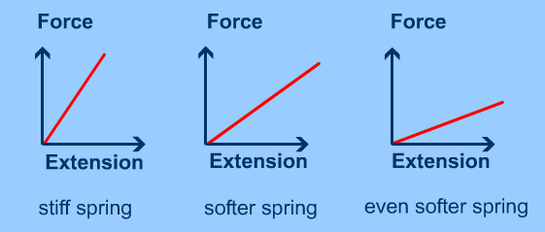
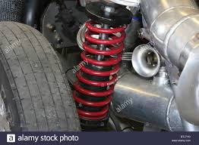
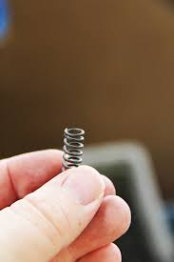
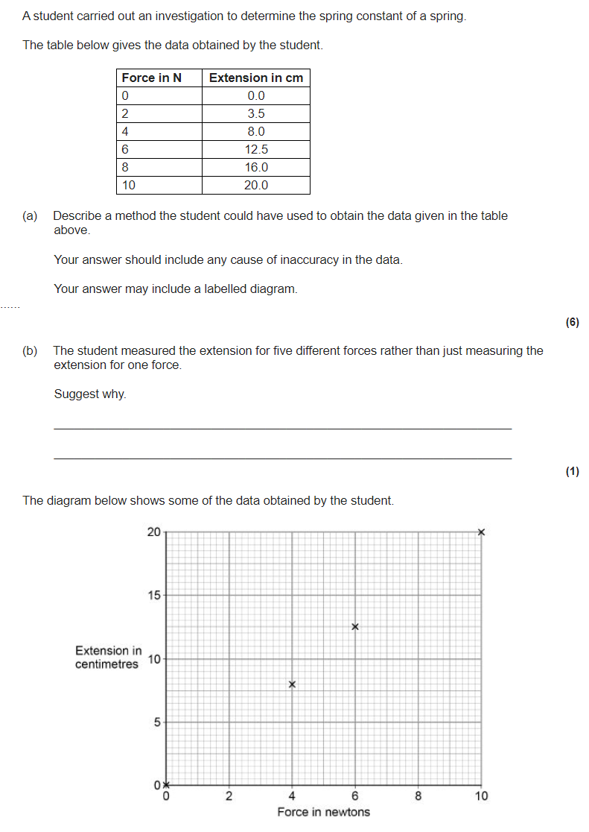
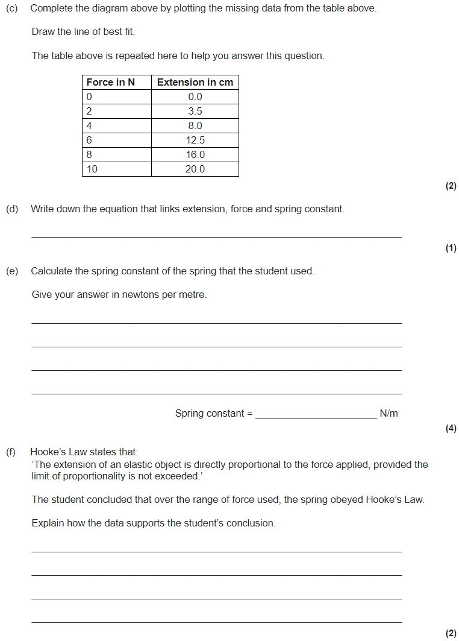
Work done and elasticity
work done = energy transferred
This means the units for work are the same as the units for energy – joules.
work done = force x distance moved (W = F x s)
Force is measured in newtons (N).
Distance moved is measured in metres (m).
Hooke’s law says that the amount a spring stretches is proportional to the amount of force applied to it.
F = k × e
Where:
F is the applied force (in newtons, N),
e is the extension (in metres, m) and
k is the spring constant (in N/m).
The spring constant measures how difficult it is to compress or stretch a spring.
The larger the spring constant the more difficult is to compress or stretch.
E_{e} = ½ x k x e²
EPE (J) = 0.5 × spring constant (N/m) × extension² (m)

Slide 8
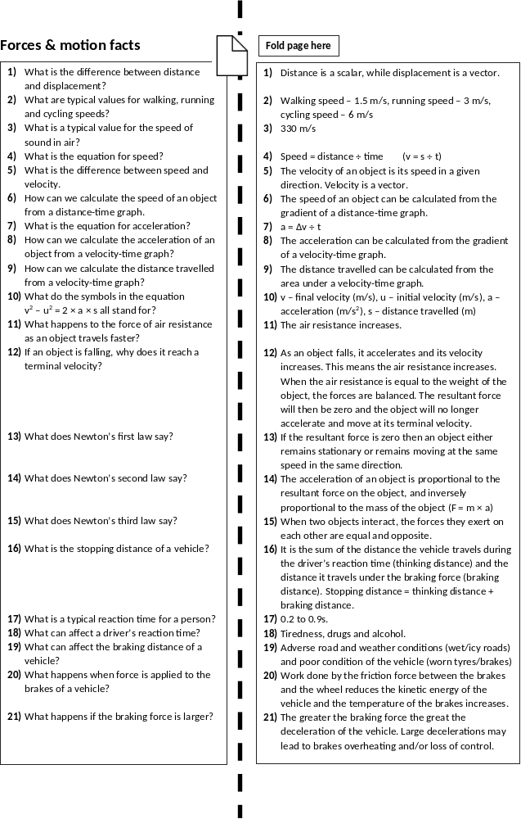

Slide 9
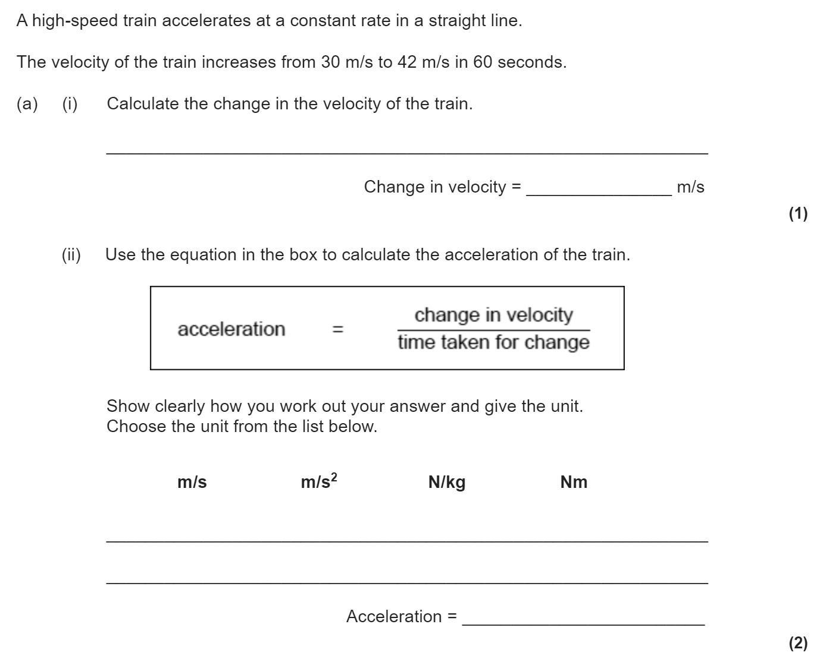
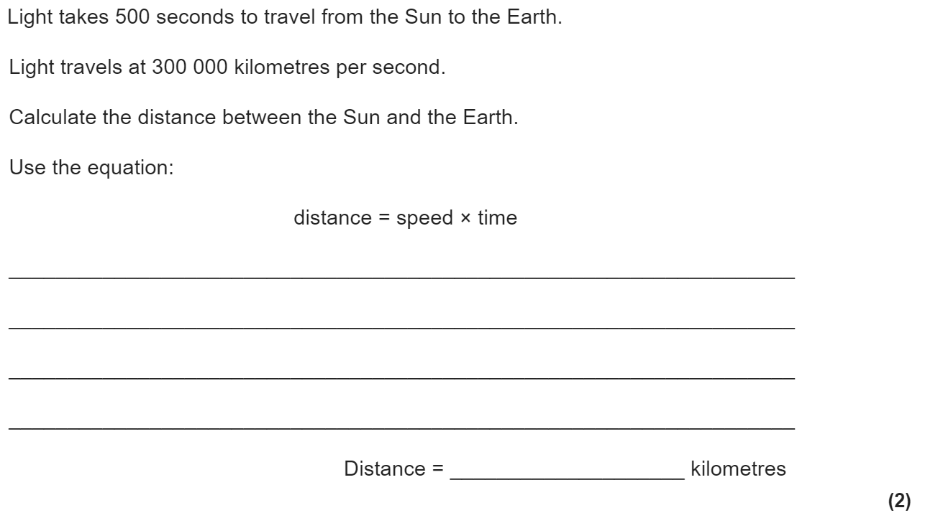
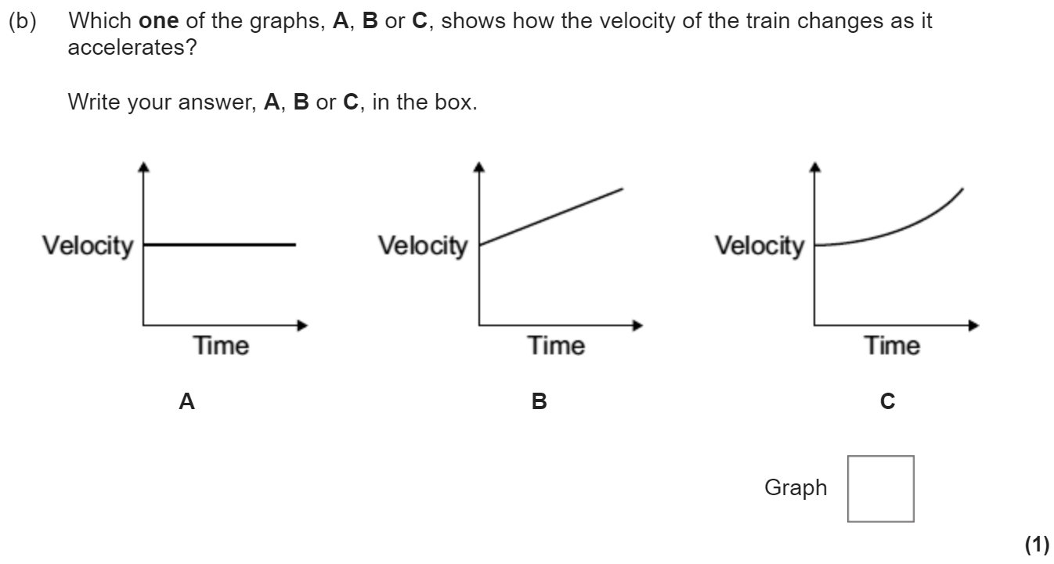
Forces and motion revision
Keywords: Speed, velocity, acceleration, Newton, thinking distance, braking distance, stopping distance
Do Now:
Usain Bolt’s 100m world record is run in a time of 9.58s. Calculate his average speed during the race.
Calculate his average kinetic energy during this race (his mass is 94 kg).
Speed, velocity and acceleration
Acceleration is a vector and is the rate of change of velocity.
Acceleration = Change in velocity ÷ Time taken (a = Δv ÷ t)
Acceleration has units of m/s²
v² - u² = 2 × a × s
where v = final velocity (in m/s)
u = initial velocity (in m/s)
a = acceleration (in m/s²)
s = distance (in m)
Speed is a scalar, while velocity is a vector. They both can be calculated using the equation v = s ÷ t
v is the velocity or speed (in m/s)
s is the distance (in m)
t is the time (is s)
The average person walks at a speed of 1.5 m/s, runs at a speed of 3 m/s and cycles at a speed of 6 m/s. The speed of sound in air is 330 m/s.

Slide 10
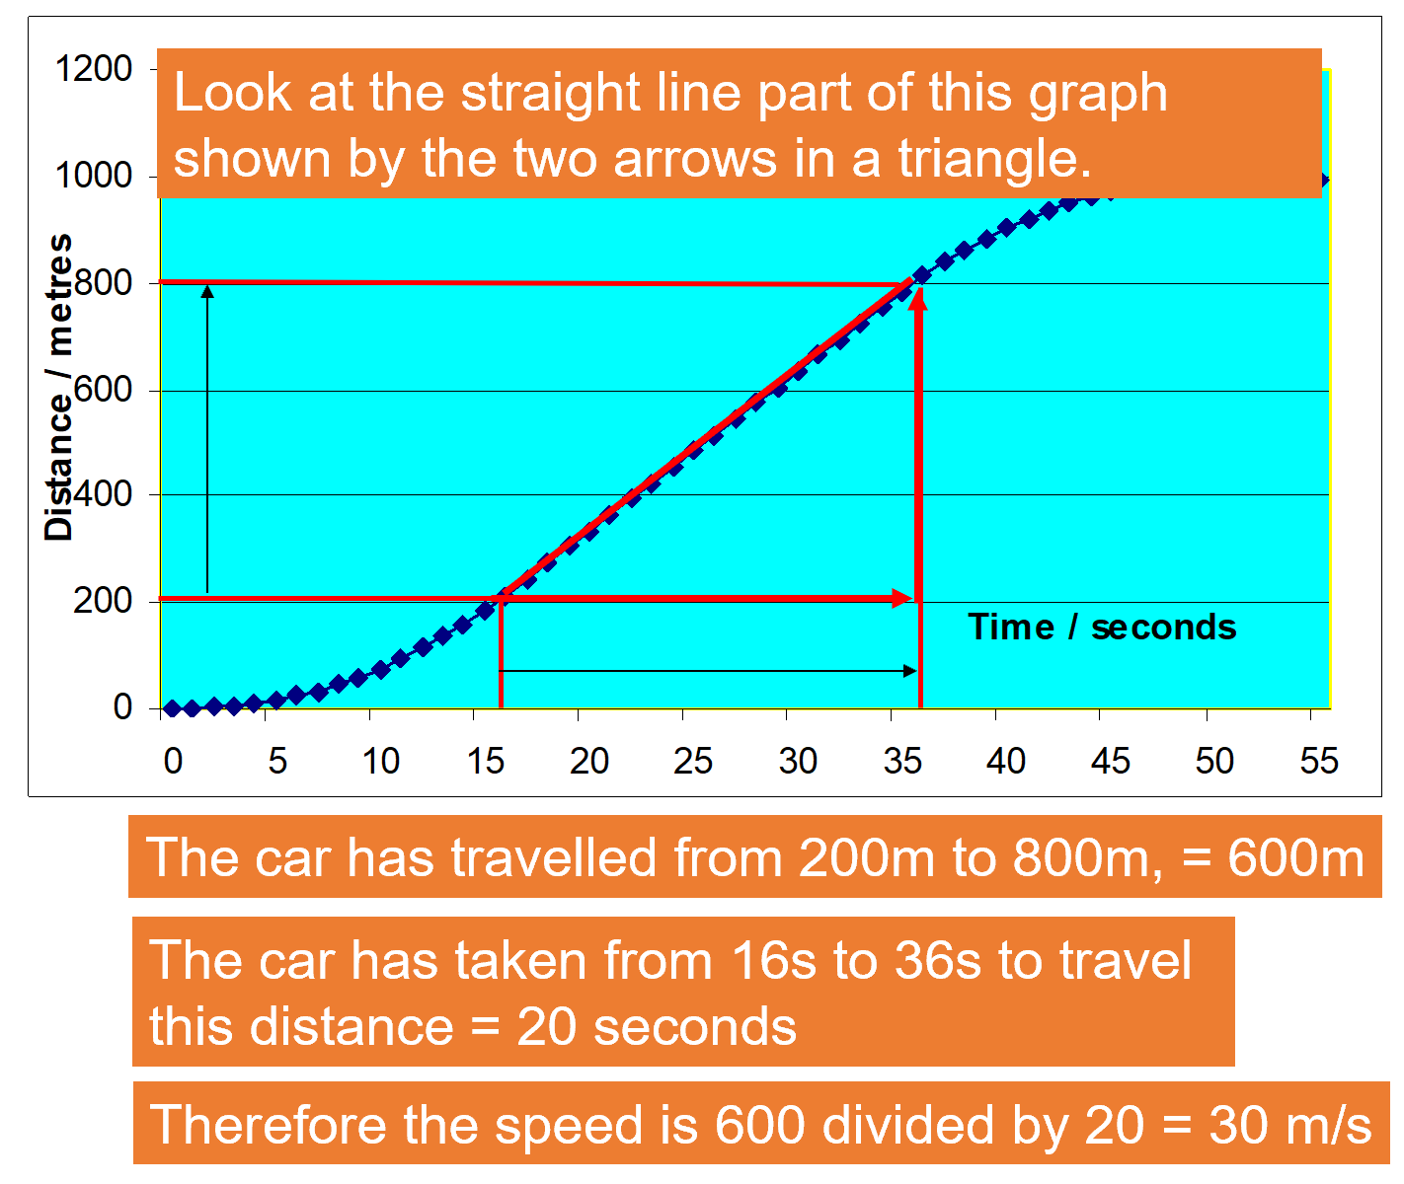
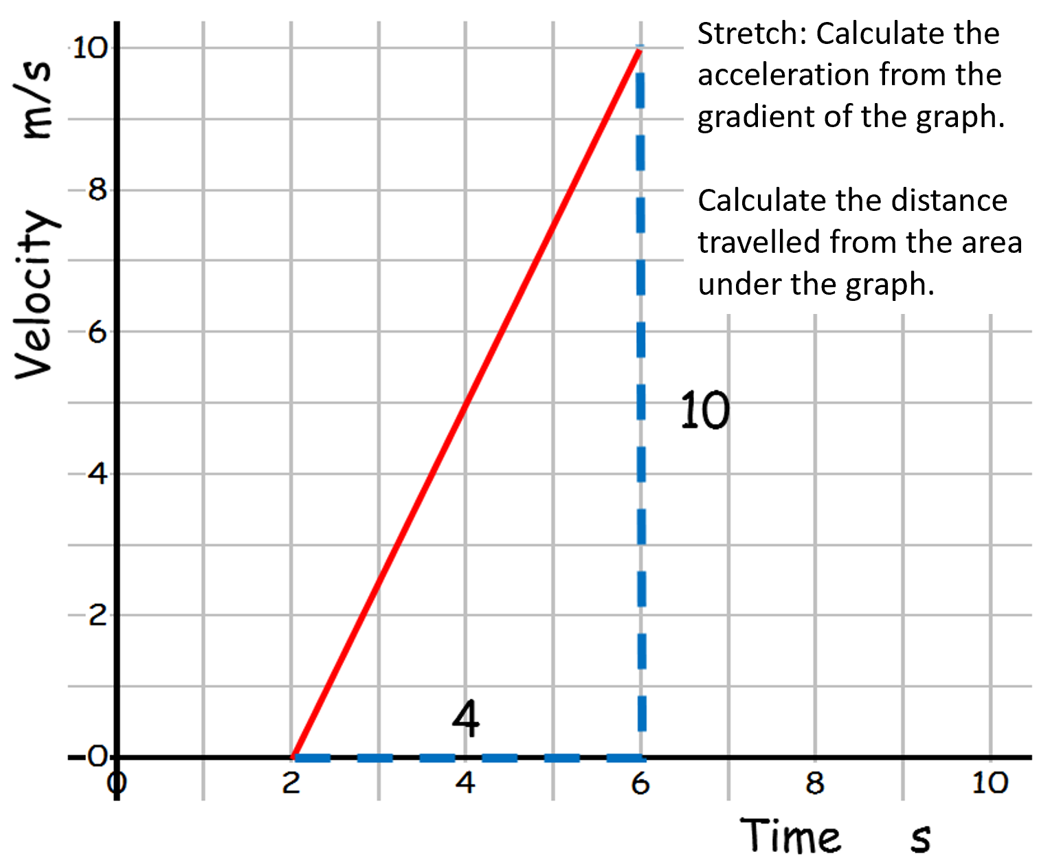
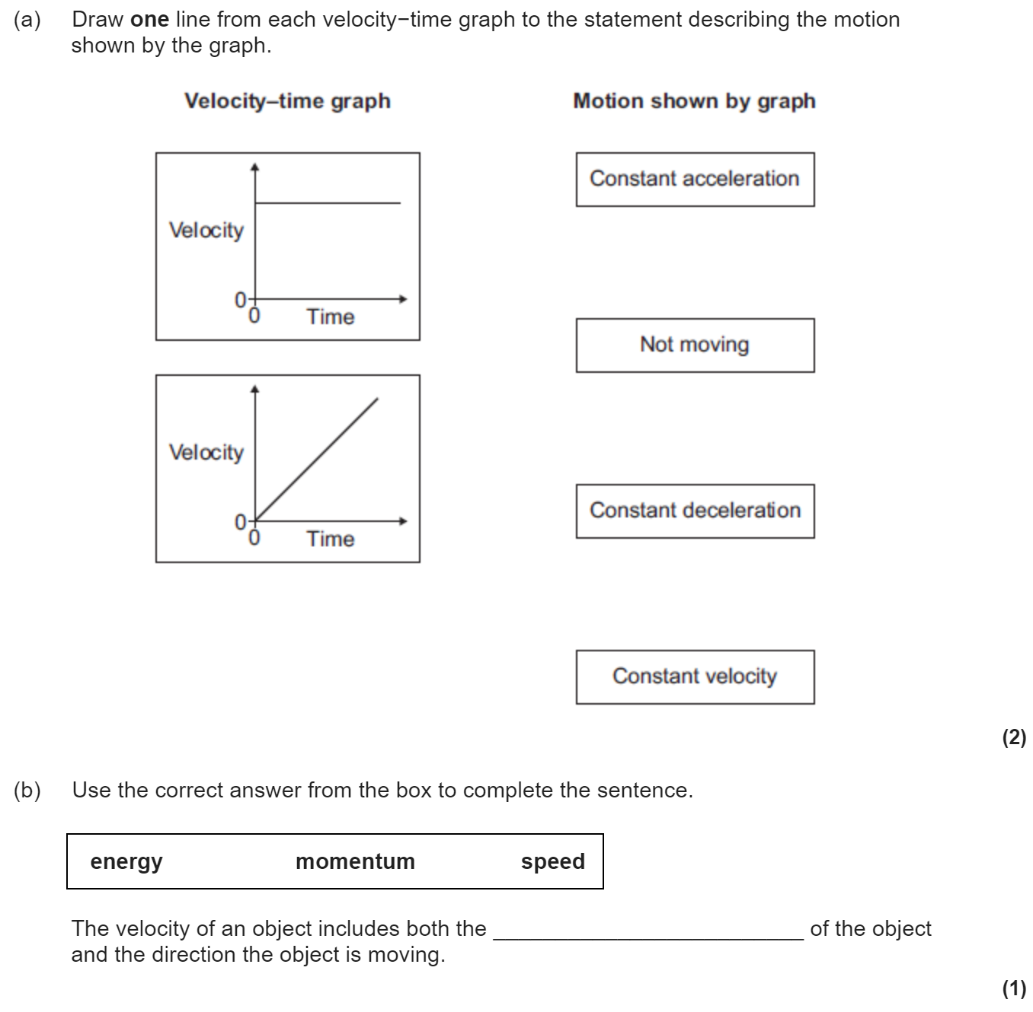
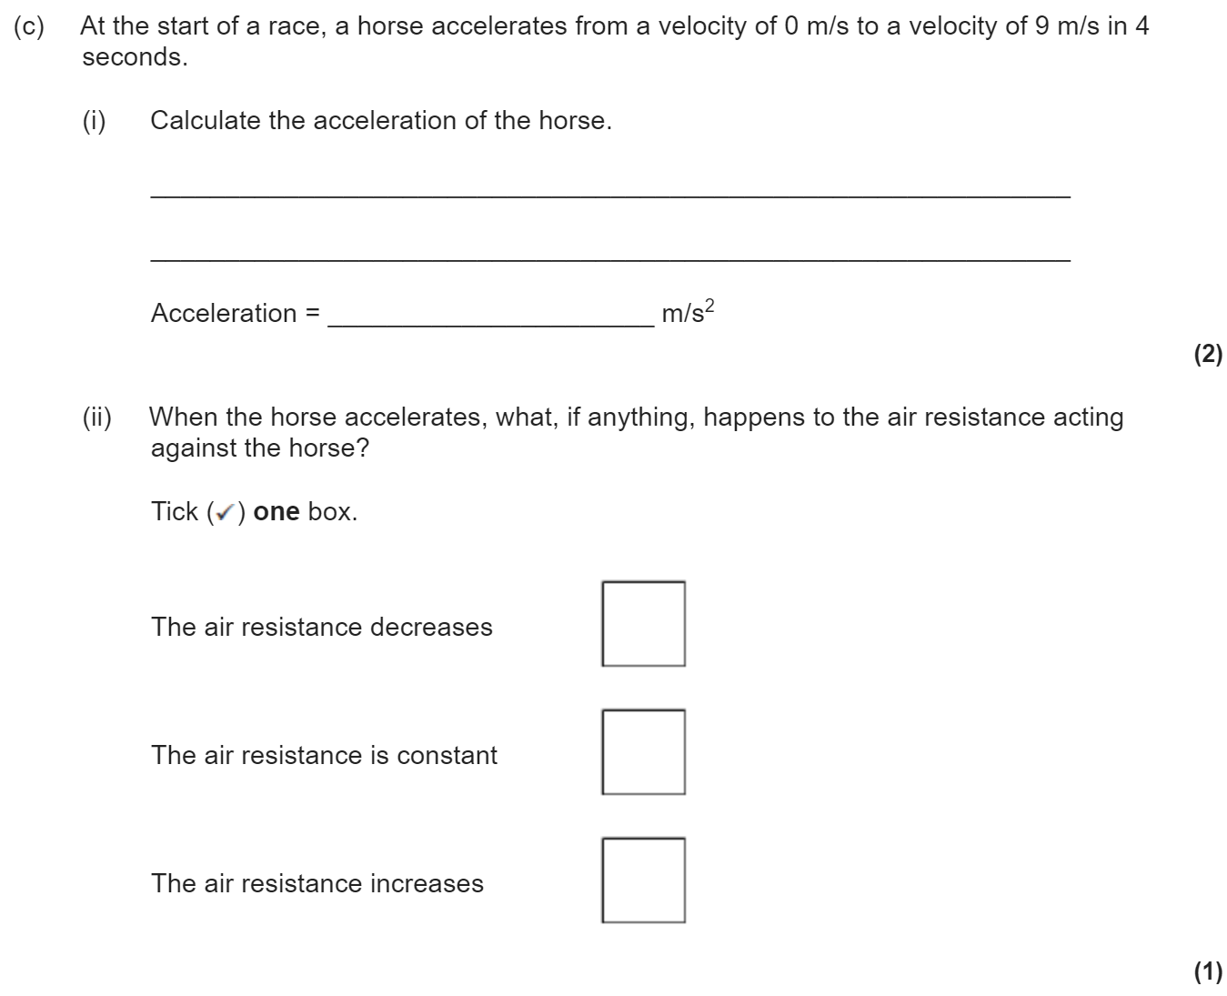
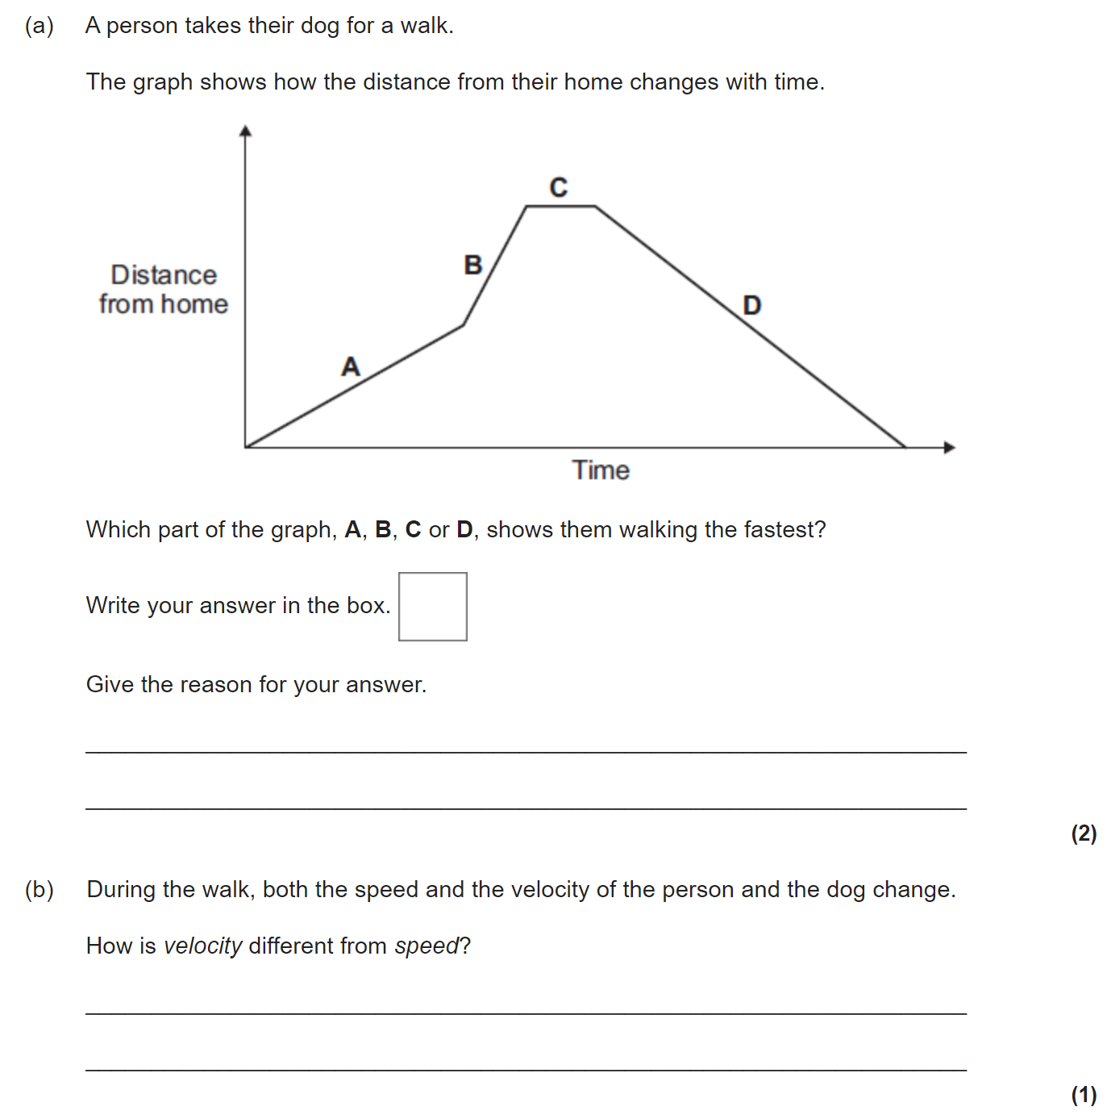
Distance-time and velocity-time graphs
A distance-time graph can be used to see when an object is stationary or travelling at a constant speed.
The steeper the slope, the faster the speed.
The speed of the car can be calculated by looking at the gradient of the distance-time graph. (i.e. change in y divided by change in x)
A velocity-time graph shows how the velocity of an object changes.
Diagonally Up Constant Acceleration
Horizontal Constant speed
Diagonally Down Constant Deceleration
Gradient This is the acceleration of the object.
Area under graph This is the distance travelled by the object.

Slide 11
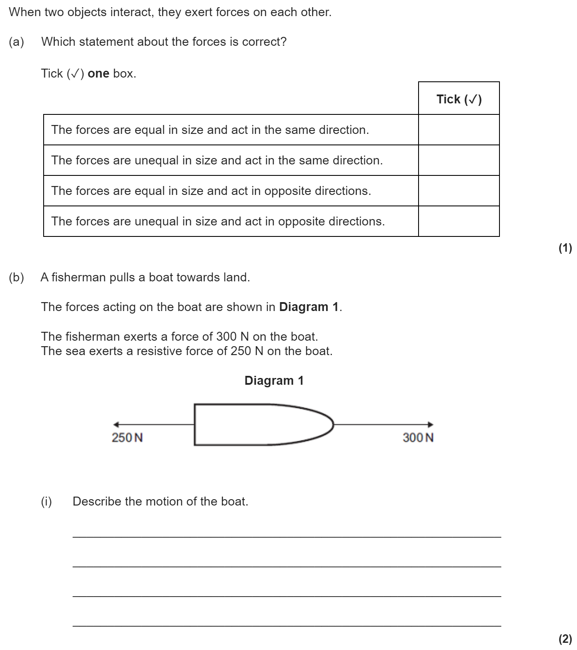
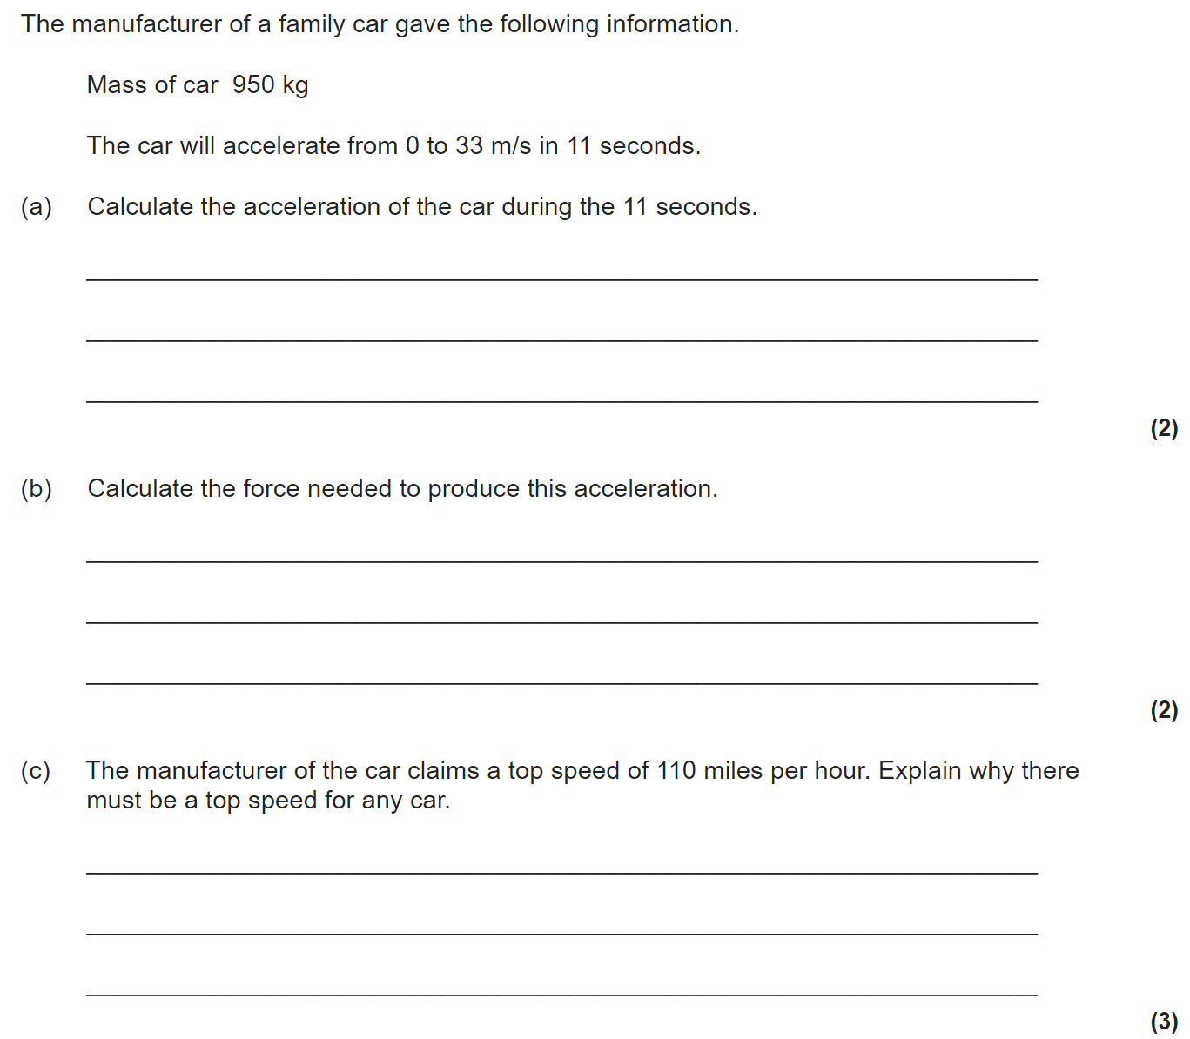
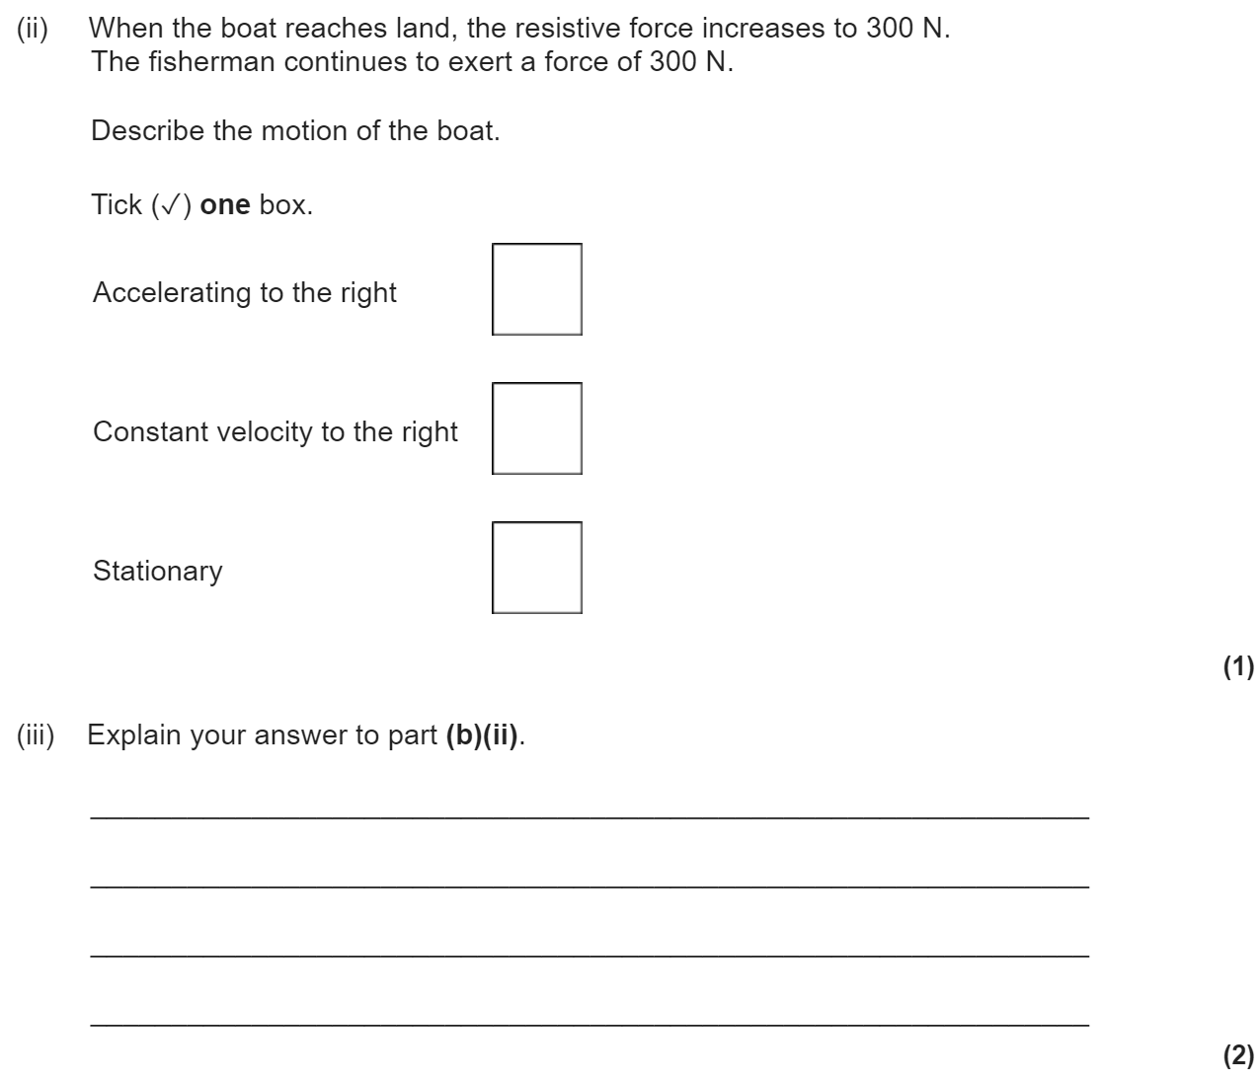
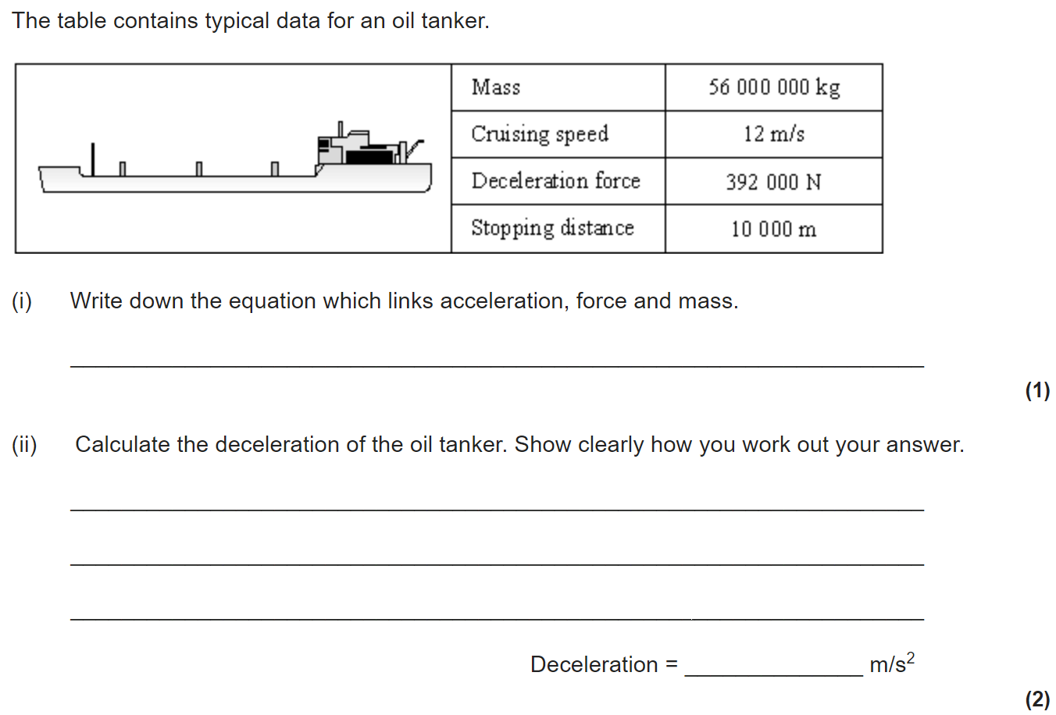
Newton’s laws
Newton’s First Law:
If the resultant force acting on an object is zero and:
The object is stationary, the object remains stationary
The object is moving, the object continues to move at the same speed and in the same direction. So the object continues to move at the same velocity.
So, when a vehicle travels at a steady speed the resistive forces balance the driving force.
So, the velocity (speed and/or direction) of an object will only change if a resultant force is acting on the object.
Newton’s Second Law:
The acceleration of an object is proportional to the resultant force acting on the object, and inversely proportional to the mass of the
object.
Force = mass x acceleration
F = m × a
Newton’s Third Law:
Whenever two objects interact, the forces they exert on each other are
equal and opposite.

Slide 12
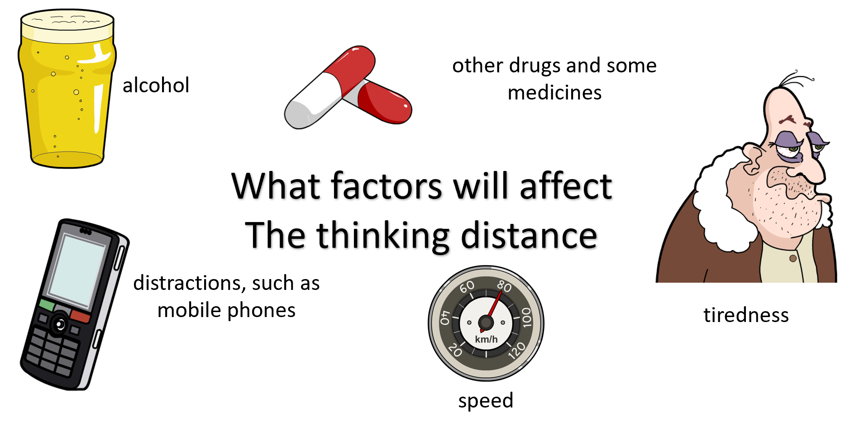
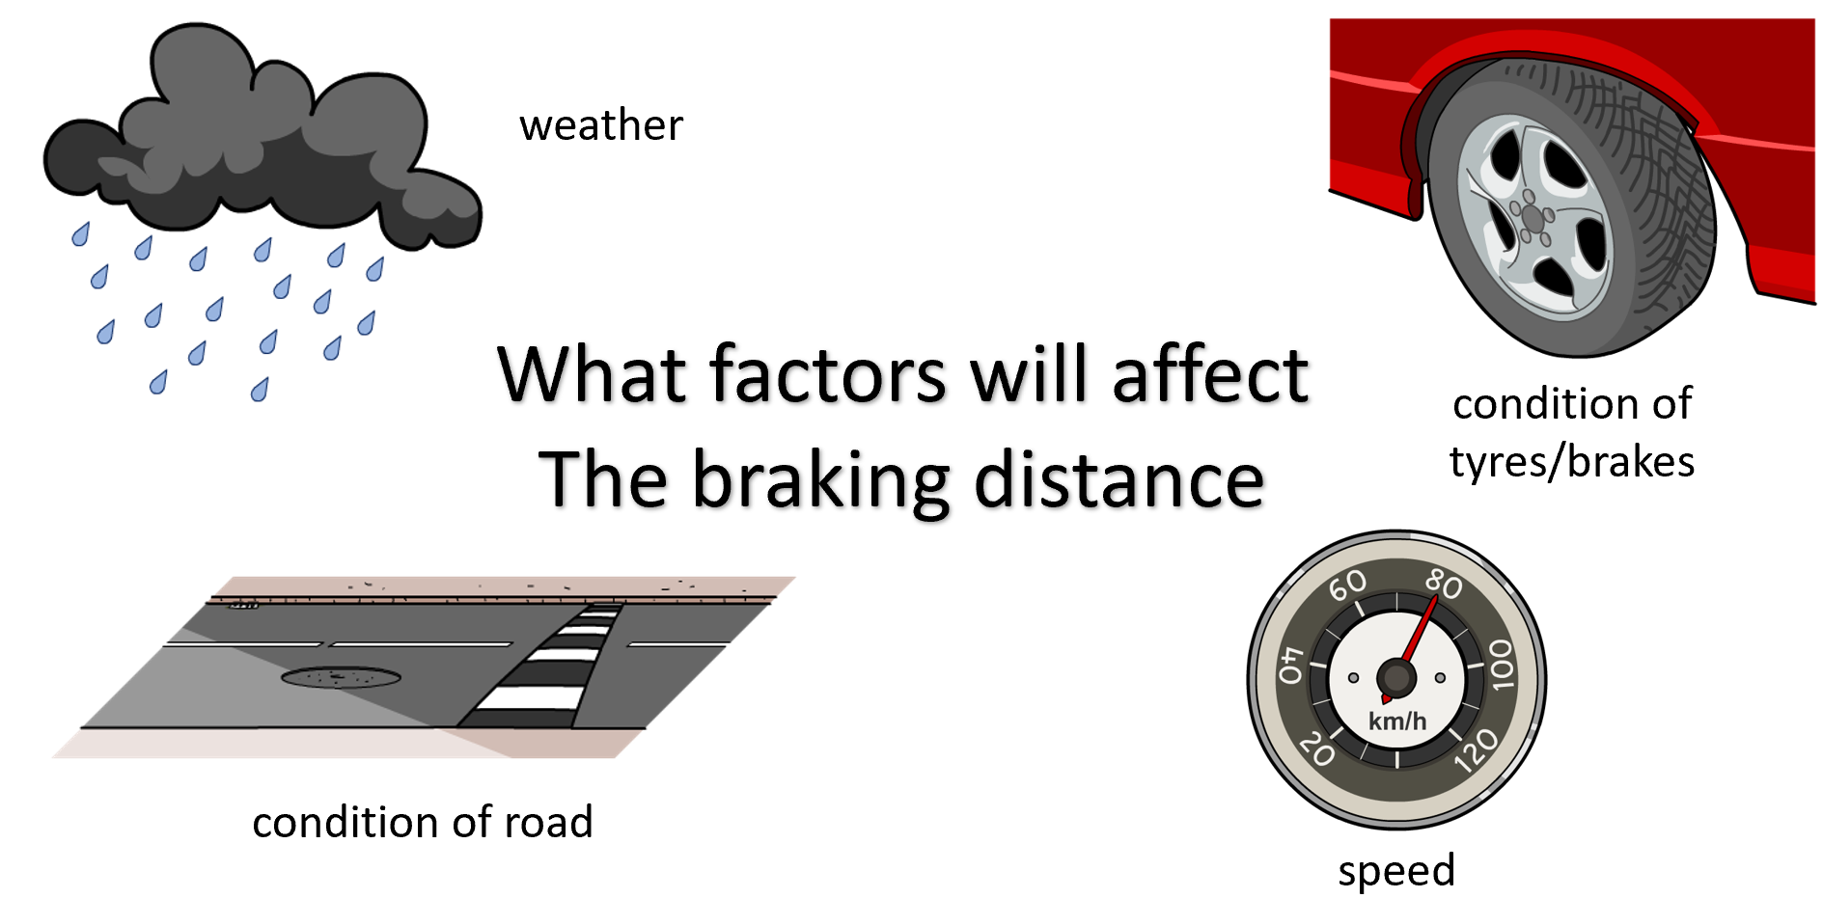
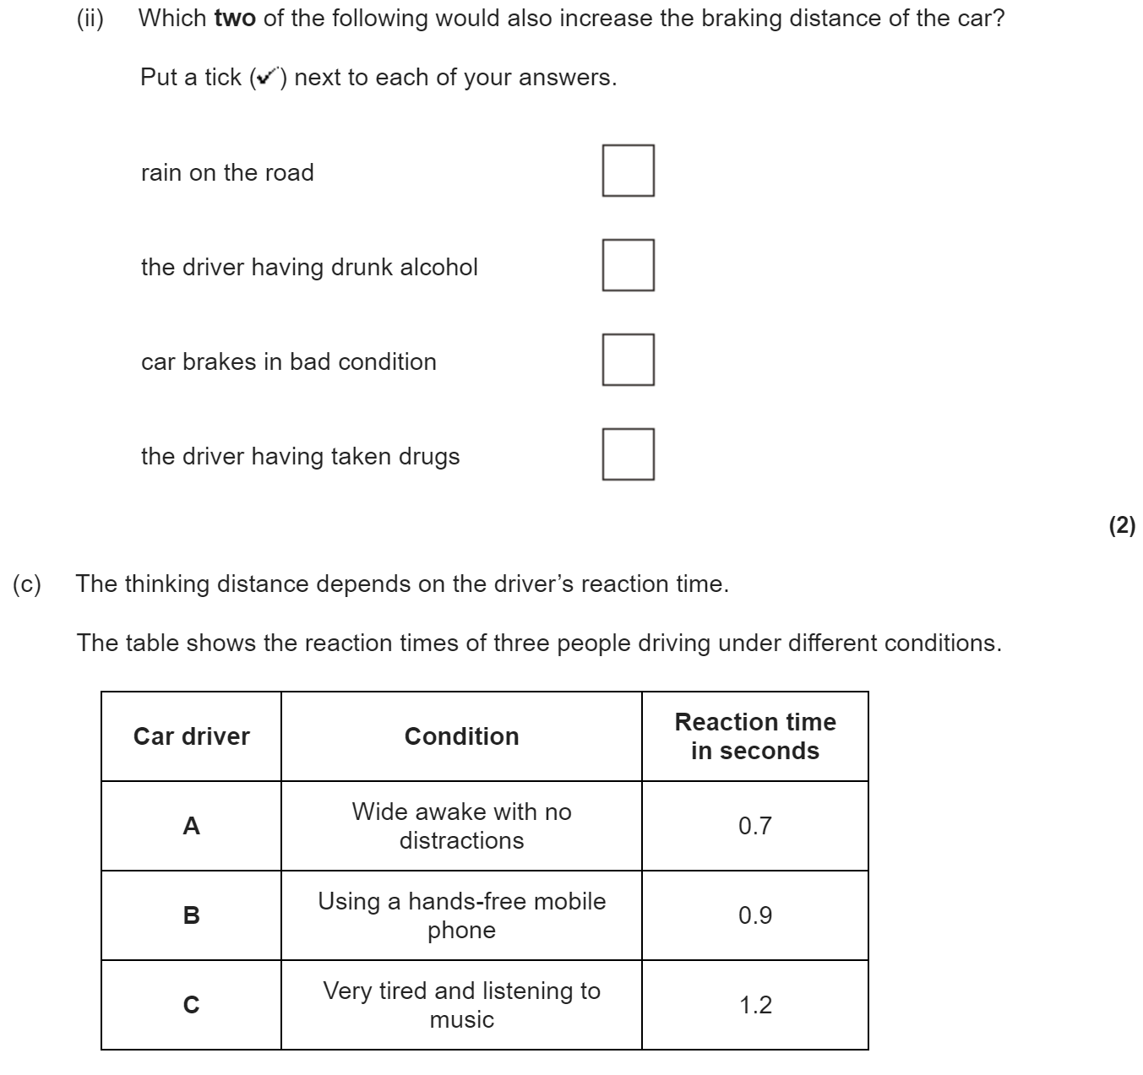
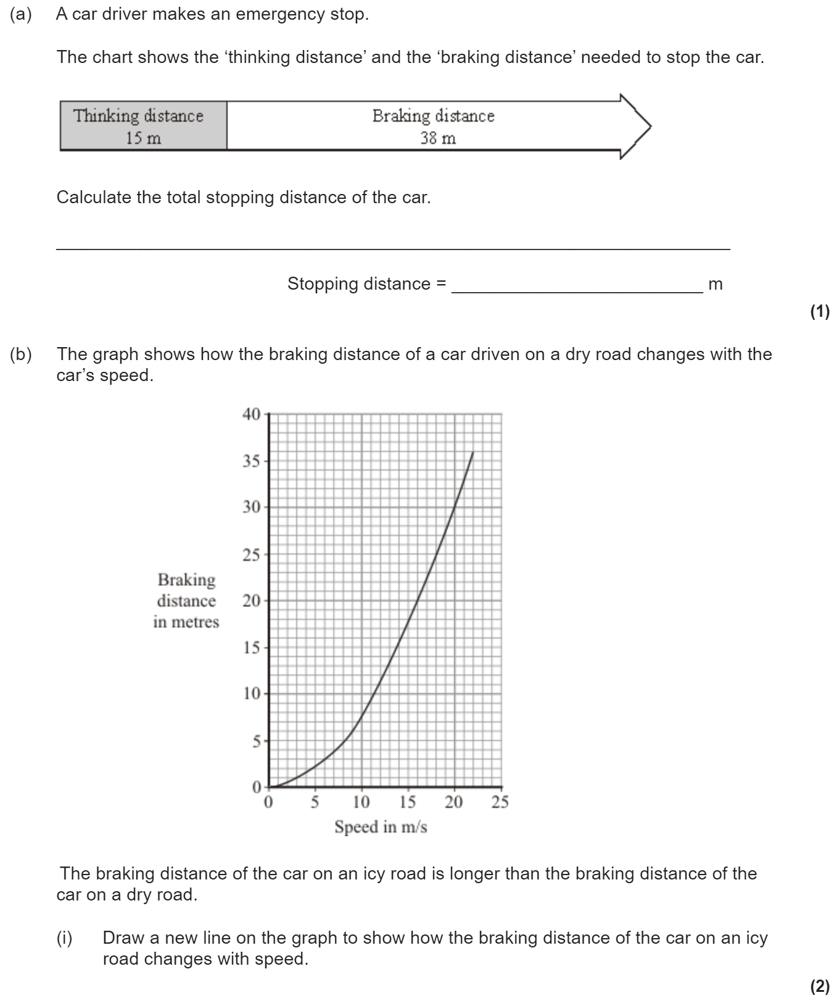
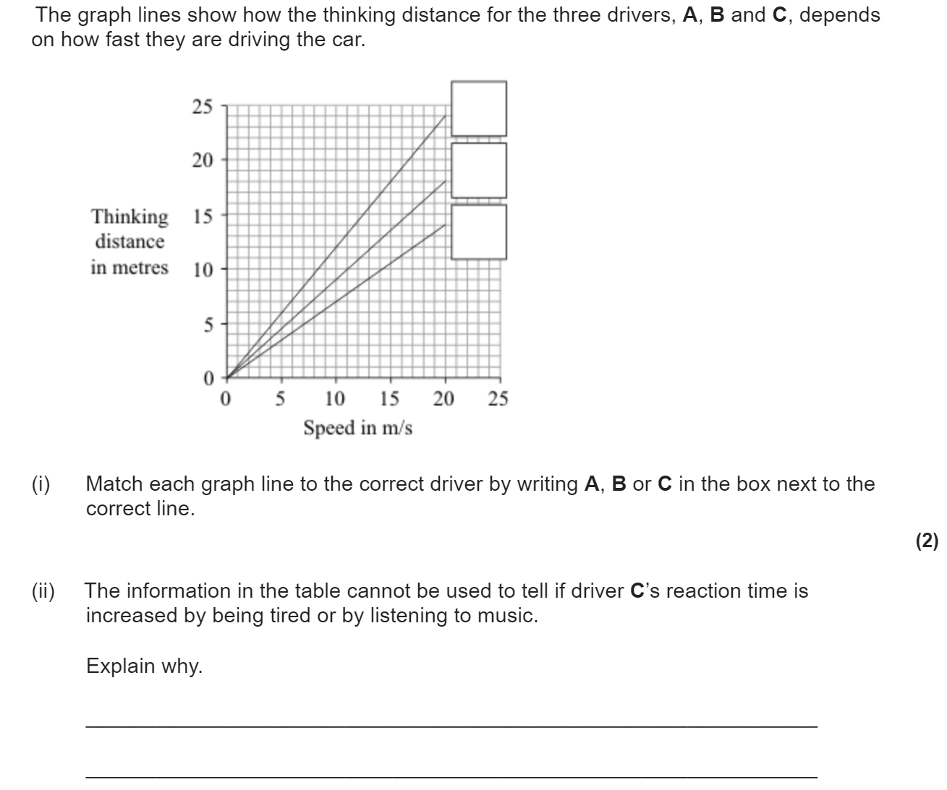
Forces and braking
The stopping distance of a car is the minimum distance that a car can safely stop in. It is made up of the thinking distance and the braking distance.
Stopping distance = thinking distance + braking distance
The thinking distance is the distance travelled by the vehicle in the time it takes for the driver to react
The breaking distance is the distance travelled by the vehicle during the time the braking force acts
Reaction times vary from person to person. Typical values range from 0.2s to 0.9s.
When a force is applied to the brakes of a vehicle, work done by the friction force between the brakes and the wheel reduces the kinetic energy of the vehicle and the temperature of the brakes increases.
The greater the speed of a vehicle the greater the braking force needed to stop the vehicle in a certain distance.

Slide 13
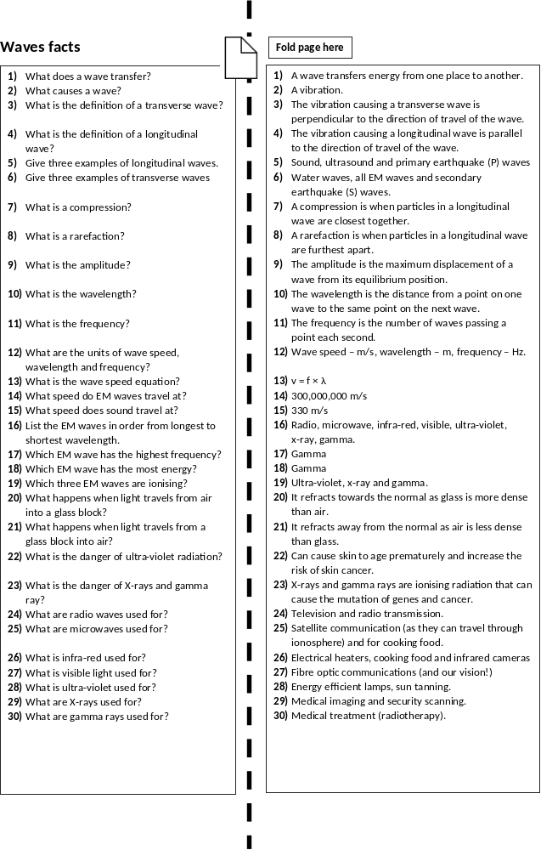

Slide 14
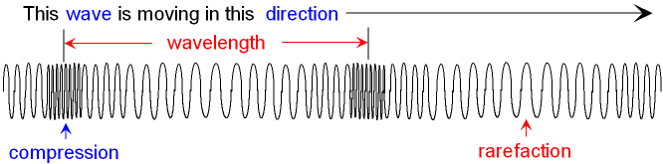
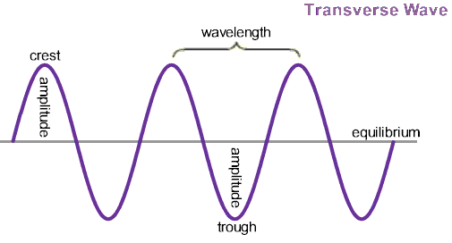
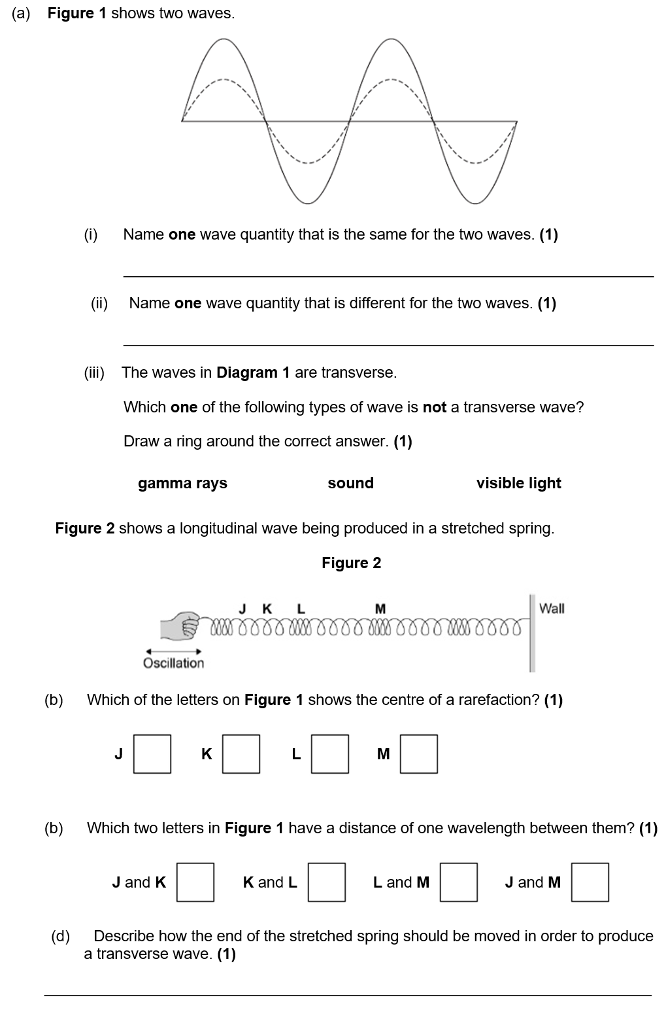
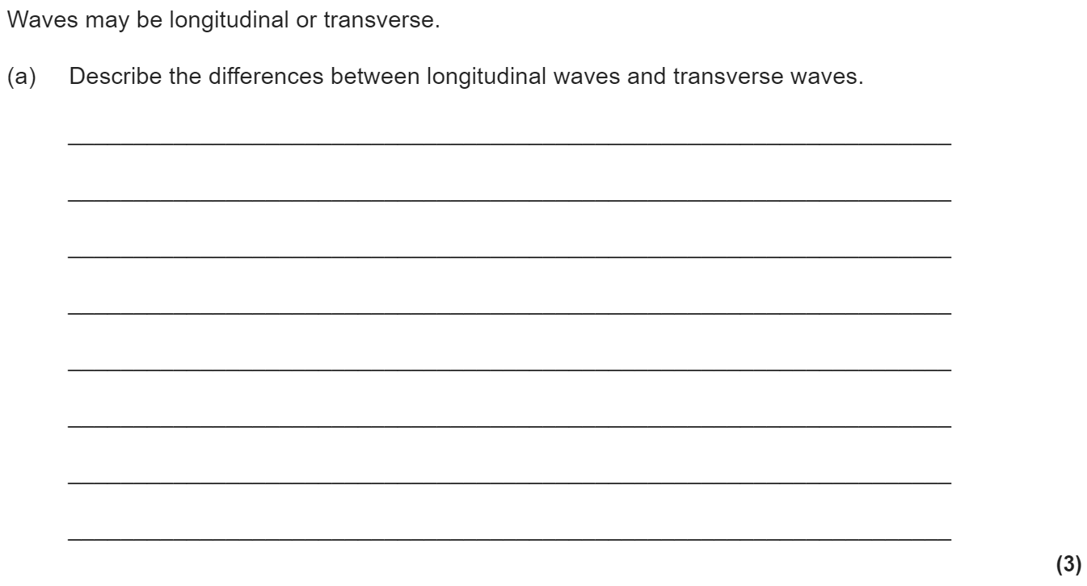
Waves revision
Keywords: Transverse, longitudinal, vibration, frequency, wavelength, amplitude, electromagnetic
Do Now: What are the units of
-Frequency
-Wavelength
-Speed
-Time period
Transverse and longitudinal waves
Waves transfer energy from one place to another.
There are two types of wave; longitudinal and transverse.
In longitudinal waves, the vibrations are parallel to the direction of wave travel. Examples of longitudinal waves include sound and ultrasound.
In transverse waves, the vibrations are at right angles to the direction of wave travel. Examples of transverse waves include all EM waves and water waves.

Slide 15
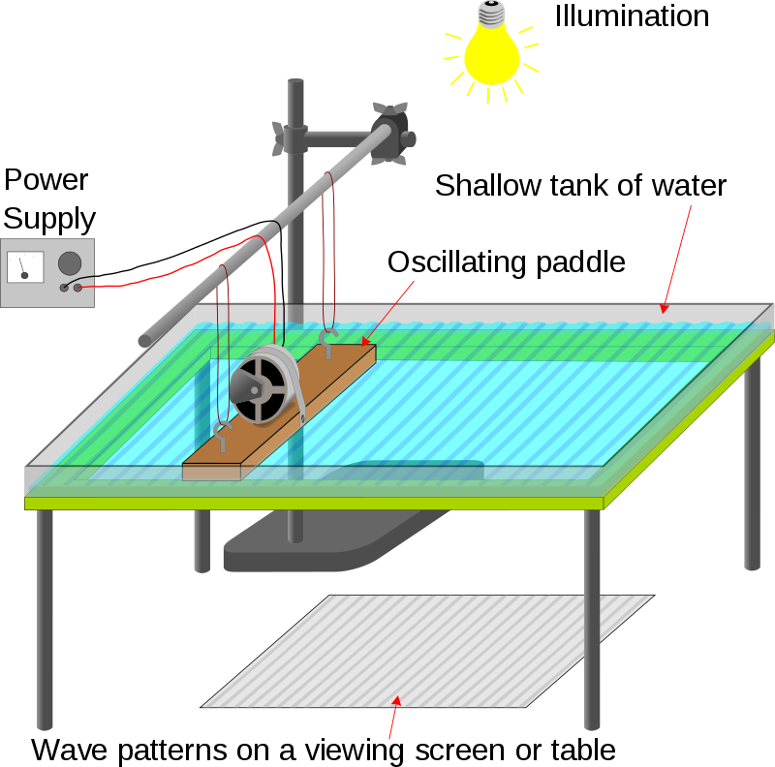
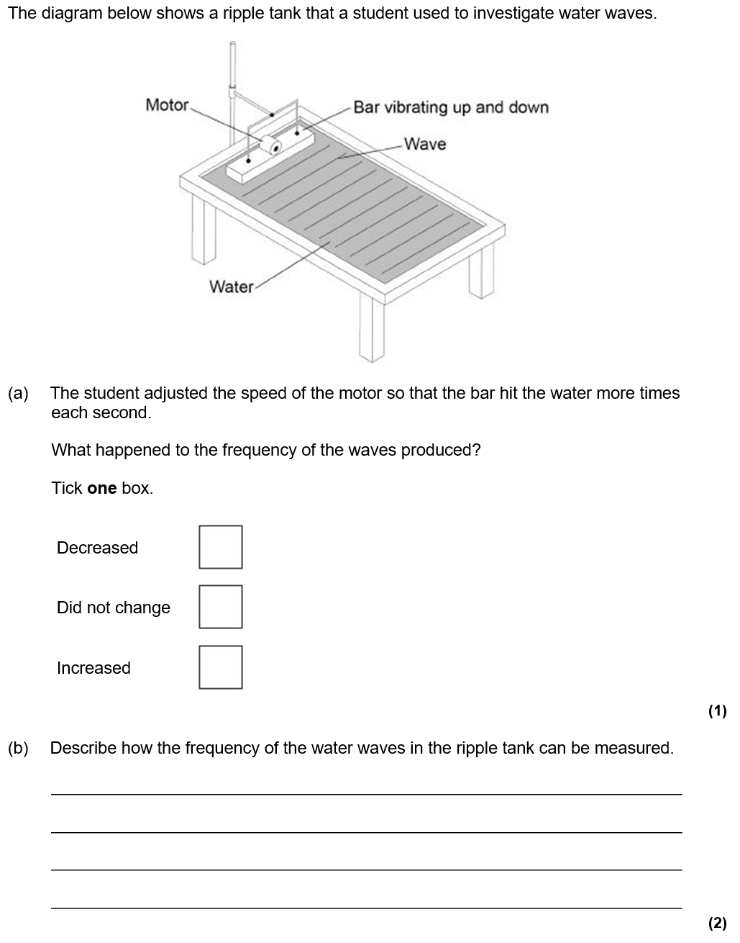
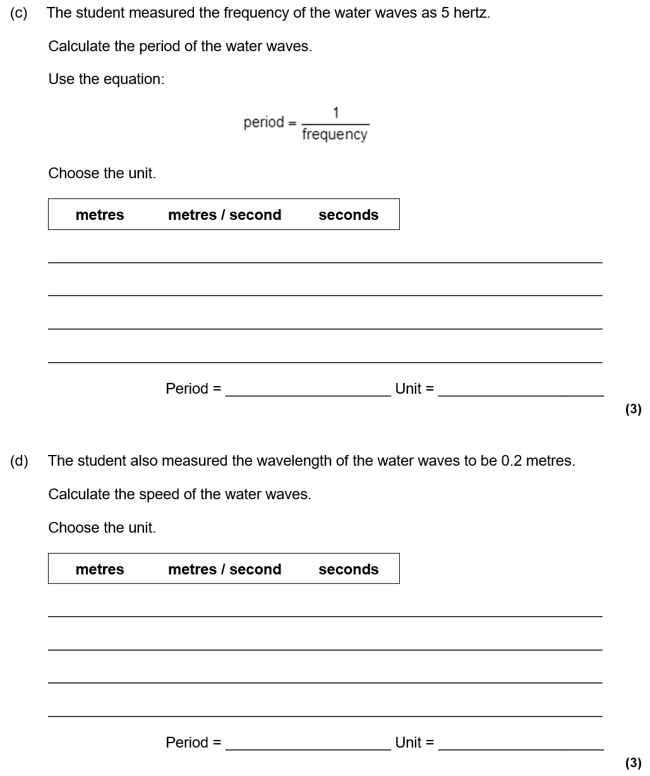
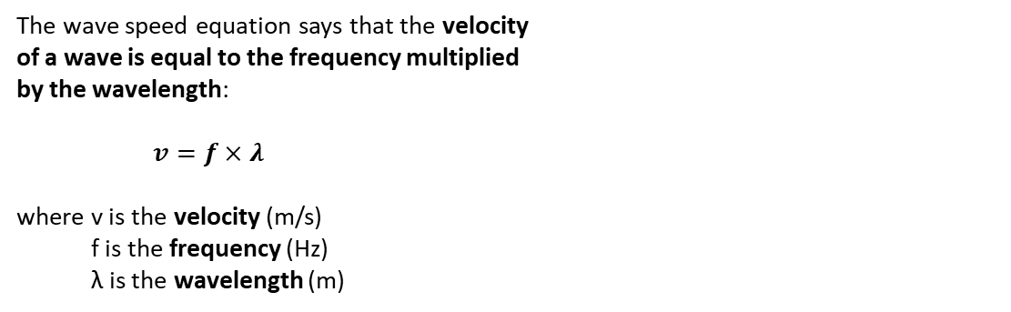
Equations
The frequency measures how many waves travel past a point every second. The equation that links time period and frequency is:
T = 1 ÷ f
where T is the time period (in seconds)
f is the frequency (in Hertz)
The wave speed equation says that the velocity
of a wave is equal to the frequency multiplied
by the wavelength:
$v=f×λ$
where v is the velocity (m/s)
f is the frequency (Hz)
λ is the wavelength (m)
The wave speed equation can be used to calculate the speed of a water wave in a ripple tank. To measure the wavelength of a wave in a ripple tank, use a ruler and take a picture with a camera. To measure the frequency count the number of waves that pass a point in 10 seconds and divide by 10. We can record it and play back in slow motion.

Slide 16






Reflection and refraction
All EM waves reflect if they hit a reflective surface. Light is the most common example of this and it’s how we can see ourselves in a mirror.
Law of Reflection
The law of reflection is true for any type of wave being reflected from a surface.
angle of incidence (°) = angle of reflection (°)
When an EM wave (like light) travels into a material that is more dense (for example from air into a glass block), it refracts towards the normal.
Refraction can also be shown with wavefronts.
In a more dense material (like glass) the wave travels more slowly. The wavelength therefore decreases.

Slide 17




Electromagnetic waves
The electro-magnetic (EM) spectrum is a family of 7 waves.
They are all transverse and travel at the speed of light.
The three EM waves with the most energy are ionising:
UV
X-rays
Gamma rays
We use a mnemonic to remember the order of the 7 EM waves (from longest wavelength to shortest) remember my instructions visible under x-ray glasses.
The order of visible light is ROY G BIV.

Slide 18


Slide 19




Magnetism revision
Keywords: Non-contact, permanent, induced, poles, field, attract, repel, compass, electromagnet, solenoid
Do Now:
What are the units of a force?
What do we use to measure a force?
3. What is a contact force?
4. What is a non-contact force?
5. Is force a scalar or a vector? Why?
Magnetism
Bar magnets have a north and a south pole. Like poles repel, unlike poles attract.
Magnets can also attract (but not repel) certain metals (iron, cobalt, nickel and steel but no others).
A permanent magnet produces its own magnetic field.
An induced magnet is a material that becomes a magnet when it is placed in a magnetic field.

Slide 20




Magnetic Fields
The region around a magnet where a force acts on another magnet or on a magnetic material (iron, steel, cobalt and nickel) is called the magnetic field.
The magnetic field flows from the North Pole to the South Pole. It is strongest neat the poles.
A compass contains a small bar magnet. It always points towards the south pole of a magnet.
The Earth has a magnetic field caused by molten (liquid) iron in the Earth’s outer core. The Earth is like a big bar magnet.
The north pole of the Earth is actually magnetic south. Compasses point north.

Slide 21






Electromagnetism
Any current flowing through a wire creates a magnetic field. This is called an electro-magnet. Grip the wire with your right hand; thumb gives direction of the current.
Your fingers curled around the wire will point in the direction of the magnetic field.
A solenoid creates a field like a bar magnet.
The field is strongest inside the solenoid.
You can also use the right hand grip rule for a solenoid.
To increase strength of electromagnet:
Wind the wire so it has more loops.
Increase the current in the wire.
Add an “iron core” to the centre of the loops of wire.

Slide 22




Answer this question in your book!

Slide 23





Slide 24





Slide 25





Slide 26





Slide 27




