Slide 1

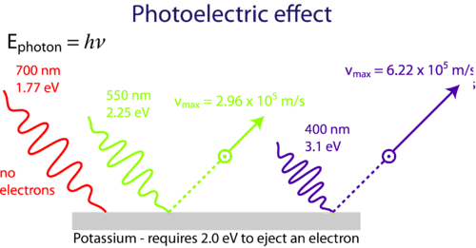
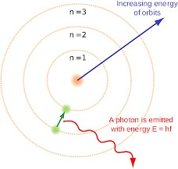


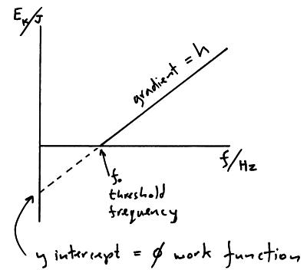
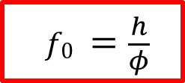
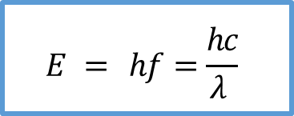
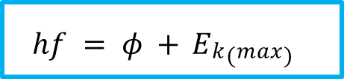
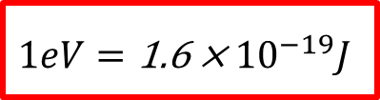


$$E = hf=\frac{hc}{\text{λ} }$$
$$hf = φ + Ek(max)$$
Photons are absorbed by electrons on a one to one basis
Some electrons are deeper in the metal than others
This means that they require more energy than the work function to be released, so their kinetic energy will be lower than those from the surface
The energy of a photon of EM radiation is directly proportional to its frequency
Planck’s constant
ℎ = 6.63 × 10⁻³⁴ 𝐽𝑠
$$eVs=Ek(max)$$
Stopping potential, 𝑉_{𝑠} is the potential difference needed to stop the fastest moving electron in a photocell experiment
$$1eV=\text{1}\text{.}\text{6 }\text{× }{10}^{−19}J$$
Work done on an electron in accelerating it through a potential difference of 1 Volt. It is a convenient unit for energy where
$f0 =\frac{h}{φ}$
The threshold frequency, 𝑓₀ is the minimum frequency of EM radiation needed to release an electron from the surface of a metal
Work function, 𝜙 (phi) is the minimum amount of energy needed to release an electron from the surface of a metal
$$φ = hf0$$
Key
Blue equation– Given formulae
Red equation – Not given formulae

Slide 2
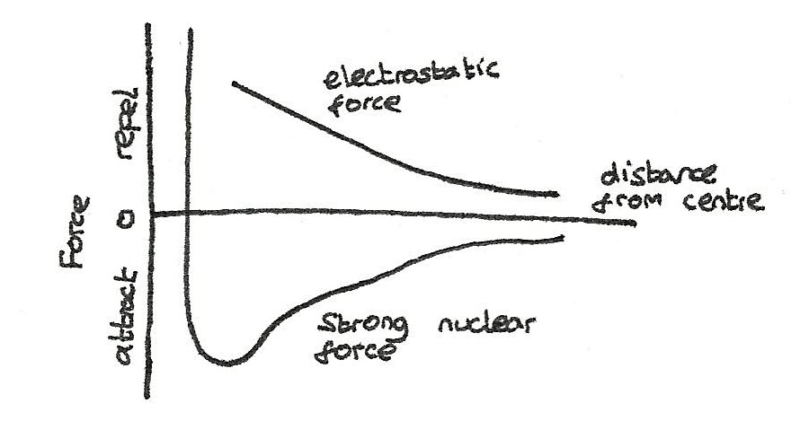
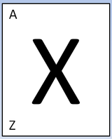
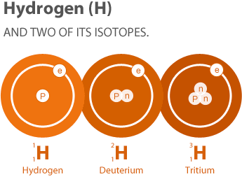
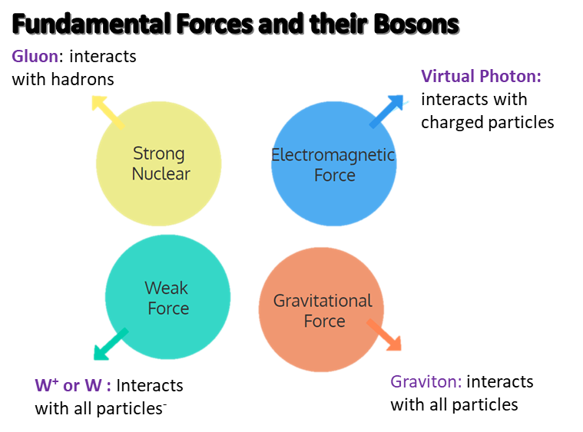
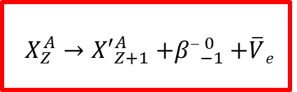
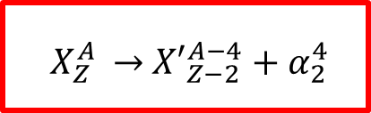
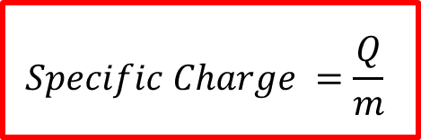
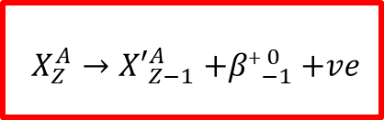
​A = the 'nucleon' number = p + n
Z = the Proton number = p
X = symbol for a particular element
$$Specific Charge =\frac{Q}{m}$$
Specific charge is the charge to mass ratio for a particle/nucleus/ion. (𝐶𝑘𝑔⁻¹)
Strong Nuclear Force: It's range is approx. 3 femtometres (1fm = 10⁻¹⁵m).
It has the same effect between protons and neutrons.
From 0.5-3fm it is an attractive force.
Below 0.5fm it becomes repulsive
ISOTOPES: Atoms with the same number of protons but different number of neutrons.
Alpha Decay, 𝛼
Nucleon number decreases by 4
Proton number decreases by 2
Beta minus decay, 𝛽⁻
Nucleon number stays the same
Proton number increases by 1
Beta plus decay, 𝛽⁺
Nucleon number stays the same
Proton number decreases by 1
$$X_{Z}^{A }→{ X′}_{Z−2}^{A−4}{ + \text{α}}_{2}^{4}$$
$$X_{Z}^{A}→{X′}_{Z+1}^{A}{+\text{β}\text{−}}_{−1}^{ 0}+\overline{V}e$$
$$X_{Z}^{A}→{X′}_{Z−1}^{A}{+\text{β}\text{+}}_{−1}^{ 0}+ve$$
Key
Blue equation– Given formulae
Red equation – Not given formulae

Slide 3
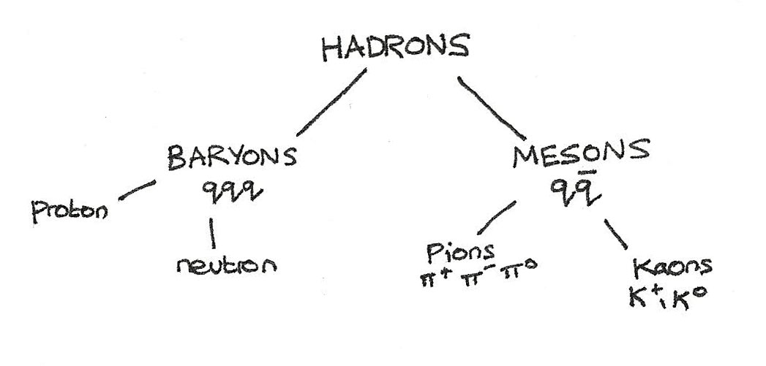
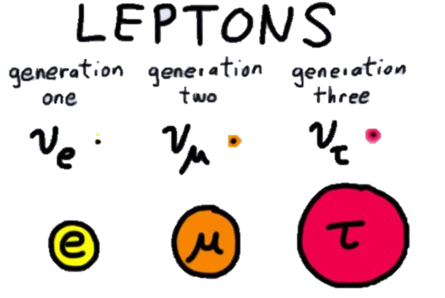
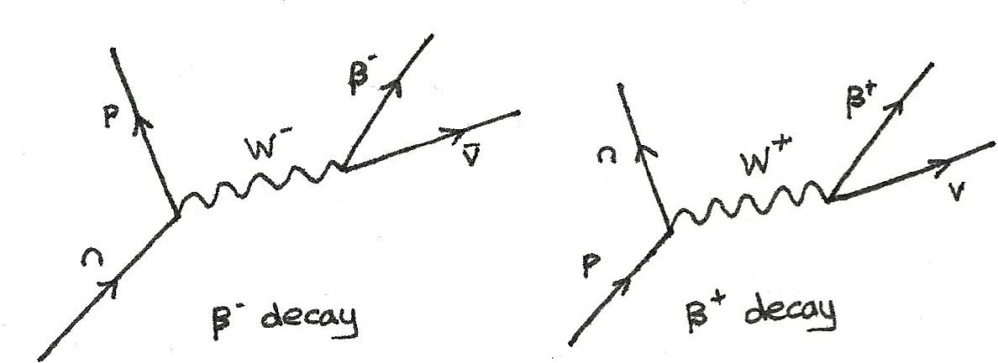
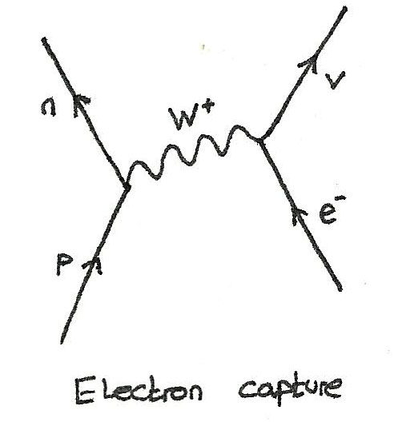
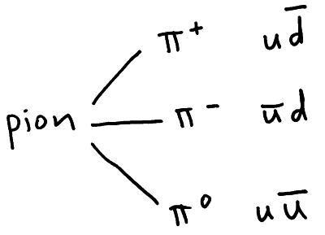
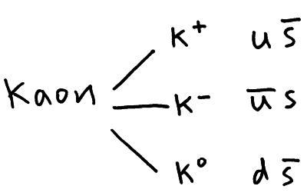
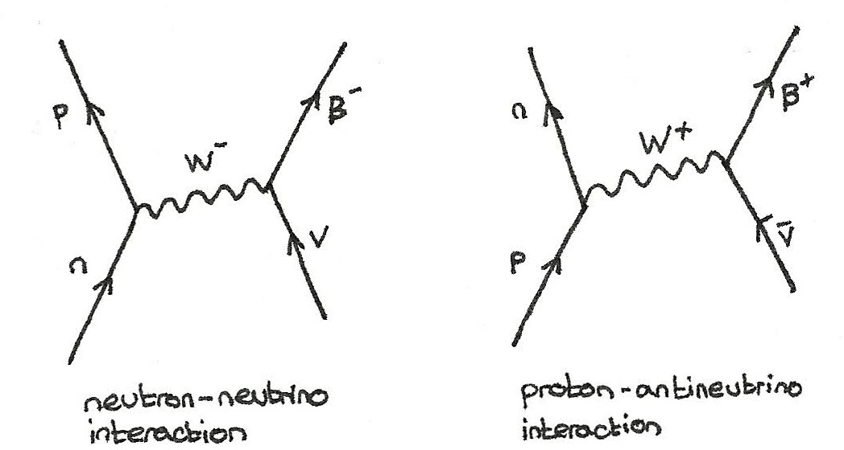
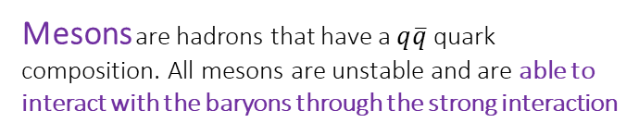
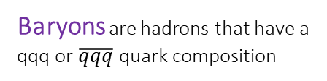
Hadrons are particles that experience the strong nuclear force
Leptons are fundamental particles that don't feel the strong nuclear force.
Examples of leptons include the stable electron (e−) and unstable muon (μ−) and tau (τ−) which both decay into electrons.
Neutrinos are also leptons, with a different neutrino for electrons (ν_{e}), muons (ν_{μ}) and tau leptons (ν_{τ}).
Neutrinos have negligible mass, no charge and only interact through the weak interaction.
Baryons are hadrons that have a qqq or $\overline{qqq}$ quark composition
Mesons are hadrons that have a $q\overline{q}$ quark composition. All mesons are unstable and are able to interact with the baryons through the strong interaction
FEYNMAN DIAGRAMS
CONSERVATION LAWS
Charge must always be conserved.
Baryon number must always be conserved.
For strong interactions, strangeness is always conserved. However with the weak interaction, strangeness is not conserved.
must also be conserved. This means that the individual e.g. lepton numbers: L_{e}, L_{μ} must individually be conserved.
Key
Blue equation– Given formulae
Red equation – Not given formulae

Slide 4
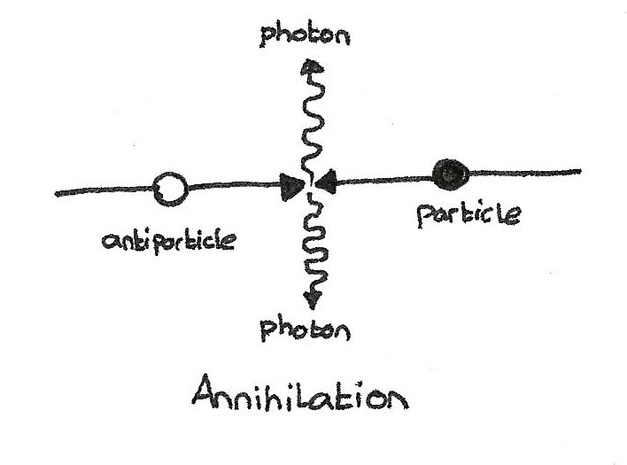
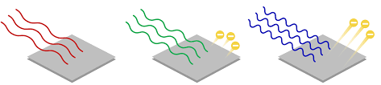
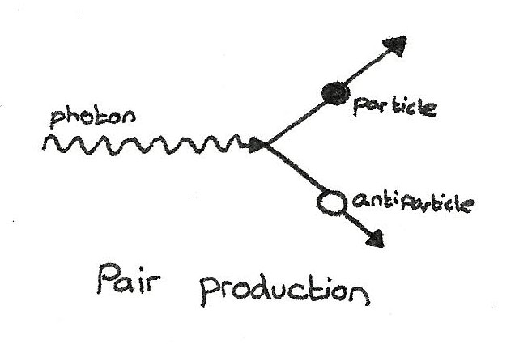
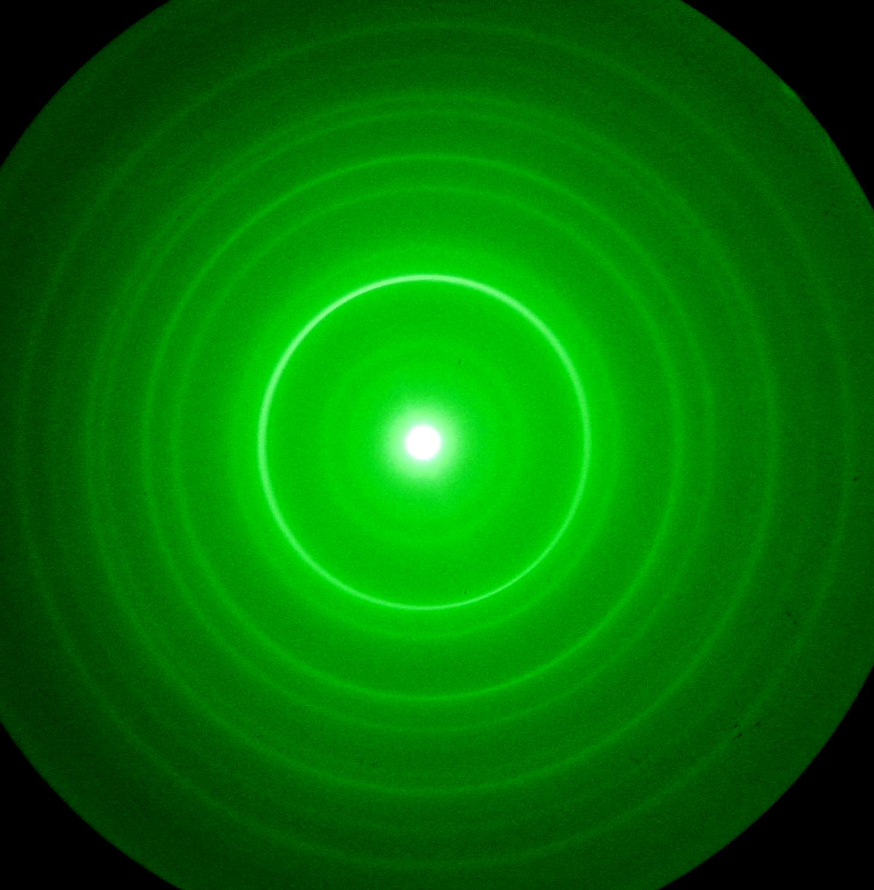
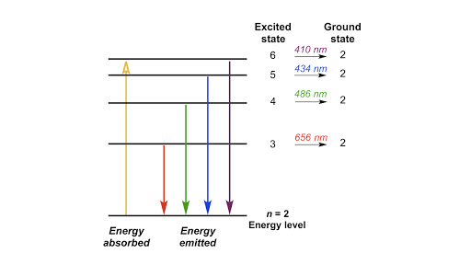
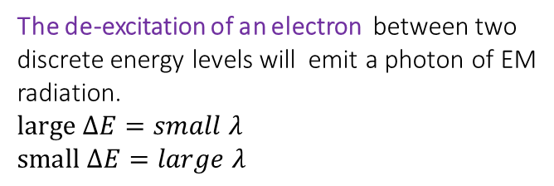

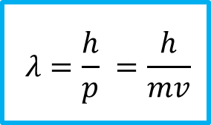

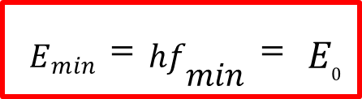
Annihilation
WAVE PARTICLE DUALITY
The minimum energy of one photon produced is equal to the rest energy of one of the particles which have been annihilated
The photoelectric effect gives evidence for light as a particle as the kinetic energy depends on the frequency of the light not the intensity.
$$Emin =hfmin= E0$$
Pair Production:
The minimum energy needed for pair production is equal to double the rest energy of one particle produced
The wave nature of electrons was shown through the production of diffraction patterns, when accelerated electrons in a vacuum interact with the spaces in a graphite crystal.
$$Emin = 2E0$$
An electron must gain a specific amount of energy in order to be excited to a higher energy level. These are known as discrete energy levels.
DE BROGLIE WAVELENGTH
Particles with a larger momentum will have a smaller de Broglie wavelength.
$$λ=\frac{h}{p} =\frac{h}{mv}$$
The de-excitation of an electron between two discrete energy levels will emit a photon of EM radiation.
$$large ∆E=small λ$$
$$small ∆E=large λ$$
$$hf = E1 − E2$$
Key
Blue equation– Given formulae
Red equation – Not given formulae

Slide 5
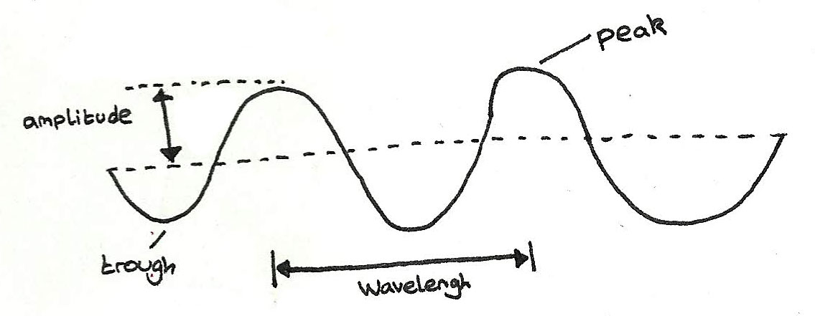
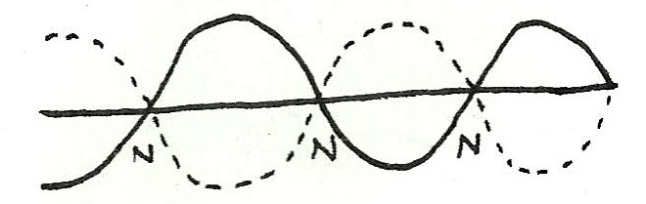
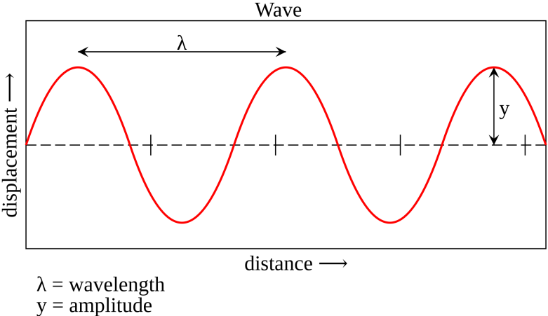
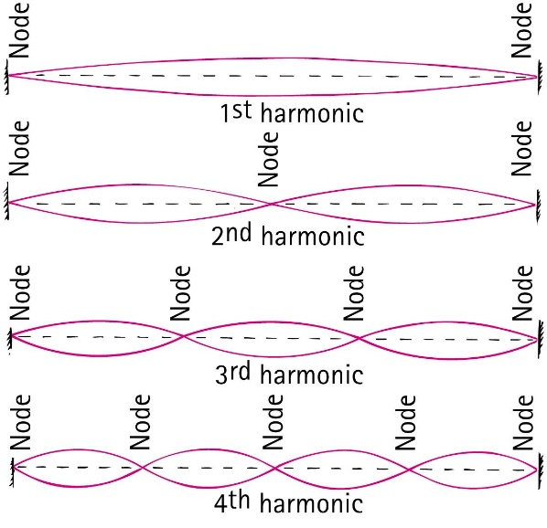

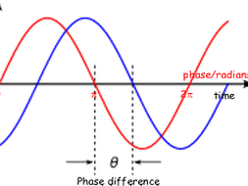

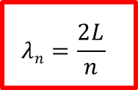
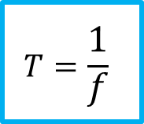
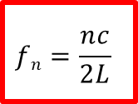

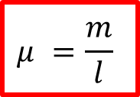
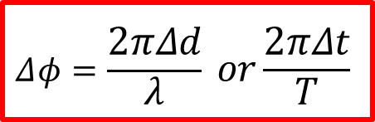
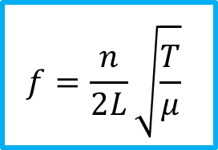
TRANSVERSE WAVES
Transverse waves are waves in which the direction of oscillations are perpendicular to the direction of wave travel.
STATIONARY WAVES
Stationary waves are formed when two progressive waves, travelling in opposite directions are in phase which results in destructive interference at nodes
Longitudinal waves are waves in which the direction of oscillations of are parallel to the direction of wave travel.
$$f=\frac{1}{T}$$
Frequency is the number of complete cycles of wave passing a fixed point per second. The unit for frequency is hertz (Hz)
FUNDAMENTAL FREQUENCY
$$fn=\frac{nc}{2L}$$
$$λn=\frac{2L}{n}$$
The period of a wave is the time taken for one complete cycle to pass a fixed point. Measured in seconds, s
$$T=\frac{1}{f}$$
𝑐
The fundamental frequency/harmonic of vibration consists of a single loop with a node at each end. Where n is the n-th harmonic
$$c=fλ$$
The speed, frequency or wavelength of a wave can be calculated by using the following equation:
The phase difference between two vibrating particles is the fraction of a cycle between the vibrations of two particles.
$$f=\frac{n}{2L}\sqrt{\frac{T}{μ}}$$
Where 𝜇 is the total mass of the string divided by its total length (mass per unit length, 𝑘𝑔𝑚⁻¹).
$$μ =\frac{m}{l}$$
$$Δφ=\frac{2πΔd}{λ} or\frac{2πΔt}{T}$$
Key
Blue equation– Given formulae
Red equation – Not given formulae

Slide 6
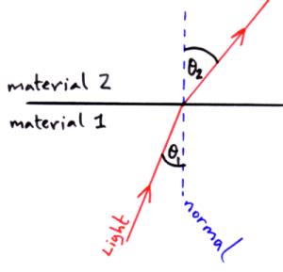
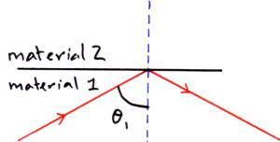
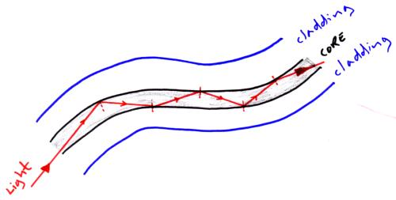
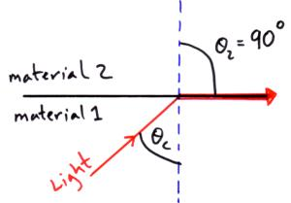
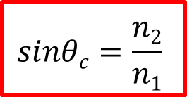

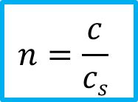
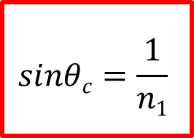
REFRACTIVE INDEX
TOTAL INTERNAL REFLECTION
$$n1 sin⁡θ1 = n2 sin⁡θ2$$
If the incident angle is greater than the critical angle then light reflects at the boundary between the two material and this is called Total Internal Reflection.
Snell’s law
𝜃₁ is the angle of incidence
𝜃₂ is the angle of refraction
step-index optical fibre
$$n=\frac{c}{cs}$$
The refractive index, n, must always be higher than 1! The higher the number, the more optically dense the medium is.
CRITICAL ANGLE
𝑐
The critical angle can only occurs when light goes from a more dense to a less dense medium.
How they work:
Core is transmission medium for EM waves to progress by total internal reflection.
Cladding provides lower refractive index so that total internal reflection takes place
Offers protection to the core, also prevents crossover of signal.
Small diameter core so less light is lost, less multipath dispersion
If the second material is air then n₂ = 1
$$sinθc=\frac{n2}{n1}$$
𝑛₂ is the more dense medium in this case
$$sinθc=\frac{1}{n1}$$
Key
Blue equation– Given formulae
Red equation – Not given formulae

Slide 7









REFRACTIVE INDEX
TOTAL INTERNAL REFLECTION
$$n1 sin⁡θ1 = n2 sin⁡θ2$$
If the incident angle is greater than the critical angle then light reflects at the boundary between the two material and this is called Total Internal Reflection.
Snell’s law
𝜃₁ is the angle of incidence
𝜃₂ is the angle of refraction
SINGLE SLIT Diffraction
To increase the amount of ‘spread’:
• Decrease size of gap
• Increase wavelength
Single Slit Diffraction produces wide central bright fringe. The other bright fringes get dimmer as you move away from the centre.
$$n=\frac{c}{cs}$$
The refractive index, n, must always be higher than 1! The higher the number, the more optically dense the medium is.
$$w=\frac{nλD}{s}$$
CRITICAL ANGLE
The critical angle can only occurs when light goes from a more dense to a less dense medium.
DifFRACTION GRATING
​A diffraction grating is a large number of regularly spaced, narrow slits.
$$sinθc=\frac{1}{n1}$$
$$d\sin{θ}=nλ$$
$$sinθc=\frac{n2}{n1}$$
𝑛₂ is the more dense medium in this case
$$λ=\frac{d\sin{θ}}{n}$$
$$d=\frac{1}{N}$$
N lines per metre on a diffraction grating
If the second material is air then n₂ = 1
Key
Blue equation– Given formulae
Red equation – Not given formulae

Slide 8















FORCES IN EQULIBRIUM
MOMENTS
A moment is the force multiplied by the distance perpendicular from the line of action of the force to the pivot. Measured in 𝑁𝑚.
An object is in equilibrium if ;
The resultant force acting on the object is zero.
The sum of the moments acting on an object must be zero.
$$Moment=Fd$$
If the forces are in equilibrium the head of the last forces will meet the tail of the first forming a closed triangle, see the example to the bottom right
COUPLE
PRINCIPLE OF MOMENTS
When an object is in equilibrium the sum of the anticlockwise moments about a turning point must be equal to the sum of the clockwise moments.
A couple is two equal forces which act in opposite directions on an object
$$Moment of a couple=Fs$$
$$∑clockwise moment=∑anticlockwise moment$$
Force not perpendicular?
Turns out that L is the shortest distance along line of force to the axis. So it turns out that:
$$F1d1=\left(F2d2\right)+(F3d3)$$
$$l=r\sin{θ}$$
l= perpendicular distance
r = distance from pivot to force
$θ$= angle between r and F
Key
Blue equation– Given formulae
Red equation – Not given formulae

Slide 9










SUVAT EQUATIONS
Assumptions made when using SUVAT:
  No air resistance acting
  Object is moving uniformly so the
  acceleration is constant
MOTION GRAPHS
V = 0ms⁻¹
$$v=\frac{Δs}{Δt}$$
For an object thrown up into the air. Motion graphs have been drawn below.
V = max
$$a=\frac{Δv}{Δt}$$
$$v=u+at$$
Gradient = velocity
$$s=\left(\frac{u+v}{2}\right)t$$
area = displacement
$$v2=u2+2as$$
PROJECTILE MOTION
Max height
The vertical and horizontal components of the object are independent and do not impact each other.
The vertical acceleration = g
The horizontal velocity of the object is constant
Vertical = $s=ut+\frac{1}{2}at2$
Horizontal = $s=vt$
area = velocity
$$s=ut+\frac{1}{2}at2$$
Gradient = acceleration
Key
Blue equation– Given formulae
Red equation – Not given formulae

Slide 10














NEWTON’S SECOND LAW
ENERGY
Energy cannot be created or destroyed. Instead it is converted between different forms. It is ONLY conserved during ELASTIC collisions
$$∑F=\frac{Δ(mv) }{Δt}$$
The RESULTANT FORCE, 𝐹, is directly proportional to the rate of change of an object’s momentum
Work done is the transfer of energy from one form to another when a force is moved through a distance. Measured in joules, 𝐽
cos 𝜃 indicates the force must be Resolved in the direction of motion
Most commonly known as:
$$W=Fs\cos{θ}$$
$$ΔEp=mgΔh$$
$$Ek=\frac{1}{2}mv2$$
$$F=ma$$
$$FΔt=Δ(mv)$$
Remember to consider which forms energy is transferred into before making equations equal!
Impulse is the resultant force on an object multiplied by the length of time it acts for. It can be measured in 𝑁𝑠 or 𝑘𝑔𝑚𝑠⁻¹. Vector quantity.
CONSERVATION OF MOMENTUM
$$P=\frac{ΔW }{Δt}=\frac{Fd}{Δt}=Fv$$
In 𝑃 = 𝐹𝑣, F is the force causing the motion. 𝑣 is the velocity in that direction
$$momentum before=momentum after$$
MOMENTUM
$$Δp=mΔv$$
$$(m1v1)+(m2v2)=(m1+m2)v3$$
Power is the energy transferred per second or the rate at which work is done. It is measured in Watts, 𝑊 or Js⁻¹
Momentum is an object’s mass multiplied by velocity. It is measured in 𝑘𝑔𝑚𝑠⁻¹ Vector quantity
If objects ‘stick’ together it is an inelastic collision.
P conserved
E is not conserved
$$efficiency=\frac{useful power}{total power}$$
If objects ‘rebound’ it is an elastic collision – both
E and P conserved
Weight is the force of an object under gravity. It is equal to
$$W=mg$$

Slide 11
















HOOKE’S LAW
DENSITY
The force applied in stretching/compressing a material is directly proportional to its extension until the limit of proportionality.
Density is the mass per unit volume of a material, a measure of how much mass each cubic metre of volume contains. It is measured in 𝑘𝑔𝑚⁻³
$$\text{ρ}=\frac{m}{V}$$
$$F=kΔL$$
An alloy is a solid mixture of two or more metals. The density of the alloy can be found by dividing the mass of both metals by the volume.
The gradient of this graph is equal to the spring constant k.
$$\text{ρ}=\frac{\text{ρ}\text{1}\text{V}\text{1 }\text{+} \text{ρ}\text{2}\text{V}\text{2} }{V1+V2}$$
Energy stored by a stretched/compressed
material (obeying Hooke’s Law) is the area under the graph.
SPRINGS IN SERIES
For springs in series, the extension of the springs is doubled (if they are identical). This then means the equivalent spring constant is:
$$Ep=\frac{1}{2}FΔL$$
SPRINGS IN PARALLEL
In Parallel the weight is supported by both of the springs,
$$Ep=\frac{1}{2}kΔL2$$
$$\frac{1}{keq}=\frac{1}{k1}+\frac{1}{k2}$$
$$keq=k1+k2$$
Key
Blue equation– Given formulae
Red equation – Not given formulae

Slide 12








𝑆𝑡𝑟𝑒𝑠𝑠
𝑌𝑜𝑢𝑛𝑔 𝑚𝑜𝑑𝑢𝑙𝑢𝑠 =
𝑆𝑡𝑟𝑎𝑖𝑛
𝐹 × 𝐿
𝑌𝑜𝑢𝑛𝑔 𝑚𝑜𝑑𝑢𝑙𝑢𝑠 =
𝐴 × Δ𝐿
STRETCHING RUBBER
STRESS VS STRAIN: BRITTLE
YOUNG MODULUS
When rubber is stretched and released energy is lost as heat and this is called hysteresis. The area between the two lines is the energy lost per unit volume.
$$\text{Young} \text{Modulus}=\frac{Stress}{Strain}$$
Gradient = Young Modulus
The Young Modulus of a material is a measure of how difficult it is to change the shape of a material. The higher the value, the stiffer the material. It is measured in 𝑃𝑎.
$$\text{Energy} lost per unit volume=\frac{1}{2}x Stress x Strain$$
$$\text{Tensile} \text{Stre}ss=\frac{F}{A}$$
This is the force applied in deforming a material divided by its cross-sectional area. Measured in 𝑁𝑚⁻² or 𝑃𝑎
STRESS VS STRAIN: DUCTILE
L = the limit of proportionality, Hooke’s law applies up to this point.
E = elastic limit, beyond this point the material is permanently stretch and it will not go back to its original length.
Y = yield point, beyond this point small increases in force give much big increases in length.
B = breaking point / breaking stress, the material breaks at this point.
$$\text{Tensile} Strain=\frac{\text{Δ}L}{L}$$
Strain is the extension of a material divided by its original length. It has no units as it is a ratio
Young Modulus then, can be expressed by:
$$\text{Young} \text{Modulus}=\frac{\text{FL} }{\text{A}\text{Δ}L}$$
Key
Blue equation– Given formulae
Red equation – Not given formulae

Slide 13















POWER AND ENERGY IN CIRCUITS
$$\text{I}=\frac{Q}{∆t}$$
Current is the rate of flow of charge
passing a point per second. Measured in amps, A or 𝐶𝑠⁻¹
$$\text{P}=IV=I2R=\frac{V2}{R}$$
Electrical Power is the rate of energy
transfer from an electrical component.
Doubling the current through a component will quadruple the power losses of a component.
$$\text{V}=\frac{W}{Q}$$
Potential difference is the work done per coulomb of charge passing between two points in a circuit. It is measured in volts, V or 𝐽𝐶⁻¹
$$\text{E}=VQ=ItV$$
Total energy transferred by a component in a given time
$$\text{R}=\frac{V}{I}$$
Resistance is the ratio of the potential difference across a component to the current passing through it. It is measured in Ω
CELLS IN SERIES
When cells are positioned in series, the total emf is equal to the sum of all the potential differences.
Resistivity is a property specific to a material which measures the resistance to the flow of current when taking into account the cross sectional area and its length. It is measured in Ωm.
$$\text{ρ}=\frac{RA}{L}$$
$$\text{V}\text{T}=V1+V2+V3…$$
CELLS IN PARALLEL
RESISTORS IN SERIES
RESISTORS IN PARALLEL
When cells are in parallel, the total potential difference supplied is equal to the pd of one of the cell
Resistors are in series with each other there total resistance is just there individual resistance added together.
Resistors are in parallel with each other there total resistance is lower than in series
$$\text{R}\text{T}=R1+R2+R3…$$
$$\frac{1}{RT} =\frac{1}{R1}+\frac{1}{R2}+\frac{1}{R3}…$$
$$\text{V}\text{T}=V1=V2=V3$$
Key
Blue equation– Given formulae
Red equation – Not given formulae

Slide 14








DIODE (FORWARD BIASED)
OHMIC CONDUCTOR
Diodes are designed to only allow current to flow in one direction. The forward bias of a diode is the direction in which the current is allowed to flow. Most diodes have a threshold of around 0.6V-0.7V before they will conduct.
Ohms Law: The electrical current in a conductor is directly proportional to the potential difference applied to it provided the temperature remains constant.
THERMISTOR
FILAMENT LAMP
A NTC (negative temperature coefficient) thermistor is a resistor where the resistance decreases as the temperature increases.
I and V start off directly proportional but the graph curves because as the filament heats it’s resistance goes up.
LDR
SUPERCONDUCTORS
Light dependent resistors are resistors where the resistance decreases as the light intensity increases.
When some materials are cooled to a critical temperature (TC) the resistance of the material falls to ZERO. This state of zero resistance is when the materials become superconducting.
Key
Blue equation– Given formulae
Red equation – Not given formulae

Slide 15









KIRCHOFF’S FIRST LAW
EMF and Internal Resistance
$$\text{ε}=\frac{E}{Q}$$
Electromotive force (e.m.f), 𝜀 is the amount of electrical energy supplied per coulomb of charge from a source. It is measured in volts, V
Kirchoff’s First law states that the current entering a junction is equal to the current leaving it.
Conservation of charge : the total charge flowing into a junction of wires must equal the total charge flowing out of the junction”.
If a power supply has internal resistance, some energy is wasted per coulomb of charge. This is referred to as lost volts (v) . The useful energy transferred per coulomb of charge to the rest of the circuit is called the terminal p.d. (V)
$$\text{I}\text{1}=I2+I3+I4$$
𝜀 = 𝑉 + v
𝜀 = IR + Ir
KIRCHOFF’S SECOND LAW
𝜀 = 𝐼(𝑅 + 𝑟)
Kirchoff’s Second law states the sum of the Emf’s in any closed loop in a circuit must be equal to the sum of the potential differences in the closed loop in the circuit.
POTENTIAL DIVIDERS
Potential dividers are 2 or more resistors connected in series. They are used to divide the potential difference supplied by a source to different components
$$V0=V1+V2+V3$$
$$Vout=\frac{VinR1}{R1+R2}$$
Key
Blue equation– Given formulae
Red equation – Not given formulae

