Slide 1
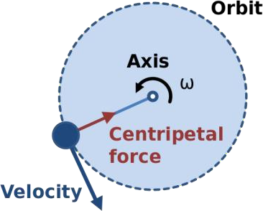
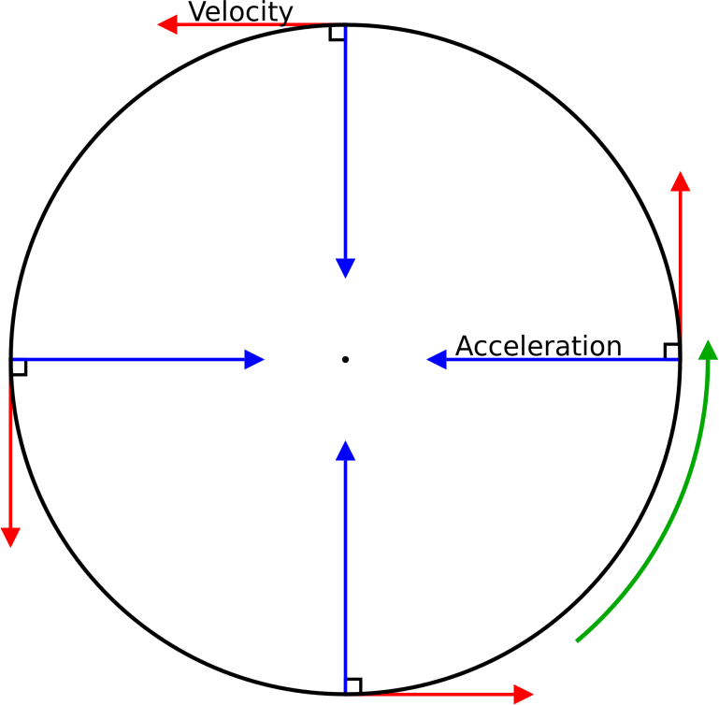
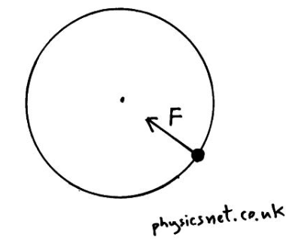
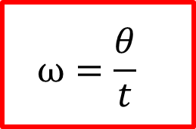
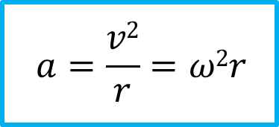
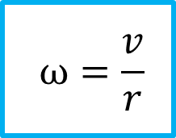
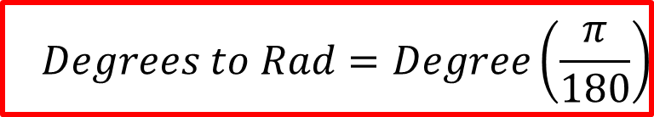
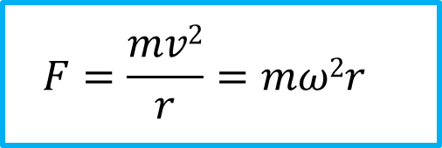
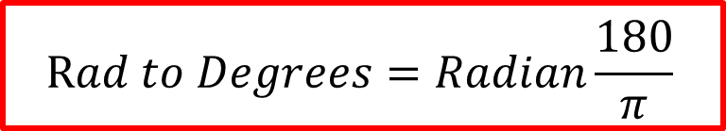
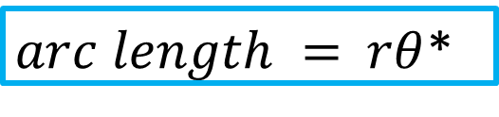
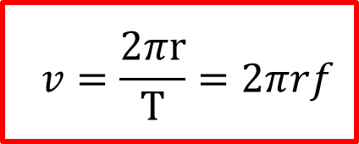
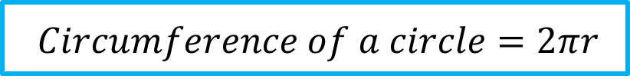
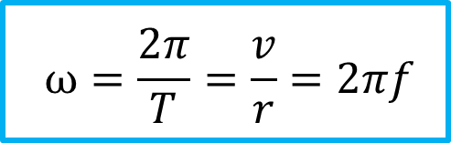
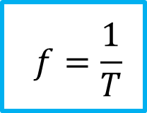
$$ω=\frac{θ}{t}$$
Anglular speed is the angle an object rotates through per second. It is measured in radians per second (𝑟𝑎𝑑𝑠⁻¹)
$arc length = rθ$*
*𝜃 must be in
radians!
$$Circumference of a circle=2πr$$
$$ω=\frac{v}{r}$$
v= Linear velocity: is always at a tangent to the circle
The further a point is from the centre of a uniformly rotating object, the faster its linear velocity.
$$Rad to Degrees=Radian\frac{180}{π}$$
$$Degrees to Rad=Degree\left(\frac{π}{180}\right)$$
$$ω=\frac{2π}{T}=\frac{v}{r}=2πf$$
The frequency of a rotating object is the number of complete revolutions per second (𝑟𝑒𝑣𝑠⁻¹ 𝑜𝑟 𝐻𝑧)
Angular velocity defined as the angular displacement per second.
$$f=\frac{1}{T}$$
$$v=\frac{2πr}{T}=2πrf$$
Centripetal Force and Acceleration
For an object swinging on the end of a string, the tension acts as the centripetal force.
For a satellite orbiting around the Earth, the gravitational force acts as the centripetal force.
If an object’s direction is constantly changing, its velocity is changing. If its velocity is changing over time, then it is accelerating. (𝑚𝑠⁻²)
$$a=\frac{v2}{r}=ω2r$$
$$F=\frac{mv2}{r}=mω2r$$
The resultant force which causes an object to undergo circular motion is called the centripetal force.
Key
Blue equation– Given formulae
Red equation – Not given formulae

Slide 2
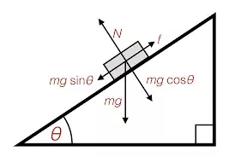
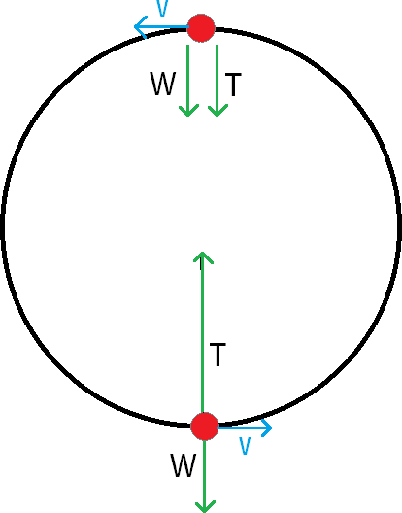
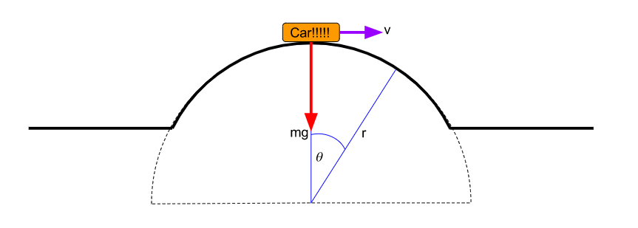

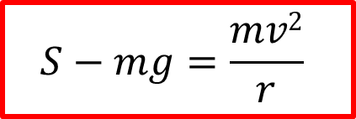
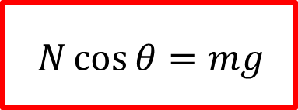
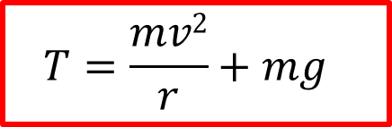
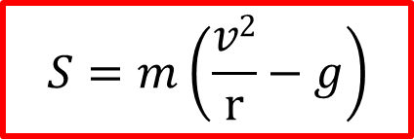
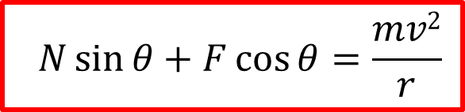

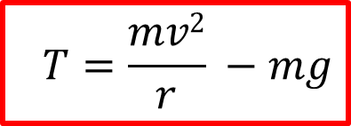
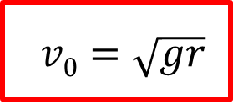
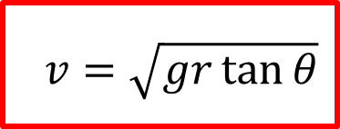
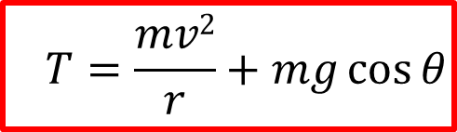
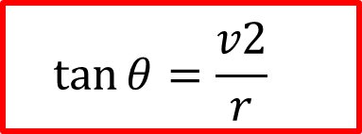
Vertical Circles
Resolving horizontally, the centripetal force acting on the car.
Banked Turns
$$N\sin{θ}+F\cos{θ}=\frac{mv2}{r}$$
$$T=\frac{mv2}{r} −mg$$
Tension at the top of a vertical circle:
Resolving vertically
$$N\cos{θ}=mg$$
At the middle T= F_{c}
$$T=\frac{mv2}{r}$$
At a certain speed the bike could travel around the track with no friction
$$\tan{θ}=\frac{v2}{r}$$
The speed the bike would need to be travelling at for there to be no sideways friction
$$v=\sqrt{gr\tan{θ}}$$
$$T=\frac{mv2}{r}+mg$$
Cars Going Over Hills
At the bottom T is greatest due to the added weight component
At some angle theta, Tension can be calculated by:
a bridge, with a radius of r the maximum speed the car would be able to go before it became airborne would be:
$$S−mg=\frac{mv2}{r}$$
Which tells us that the centripetal force which causes the car to travel in a circular path is the difference between the weight and the support force.
$$T=\frac{mv2}{r}+mg\cos{θ}$$
$$v0=\sqrt{gr}$$
$$S=m\left(\frac{v2}{r}−g\right)$$
Key
Blue equation– Given formulae
Red equation – Not given formulae

Slide 3
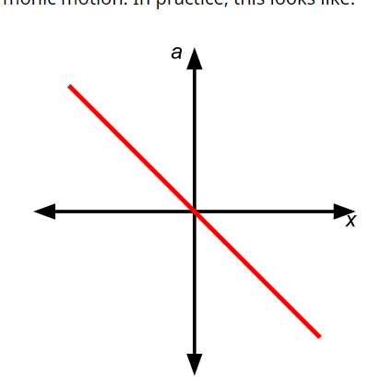
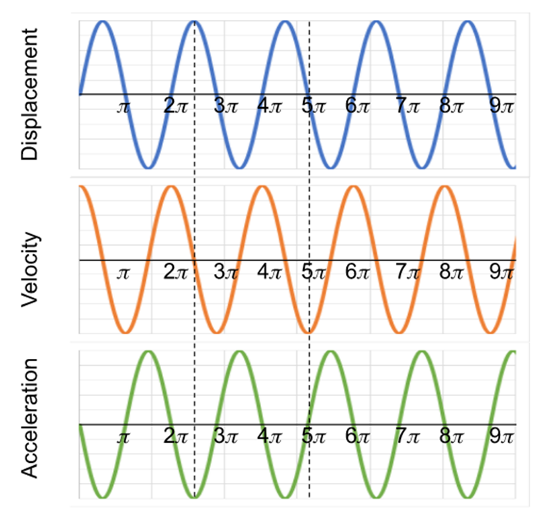
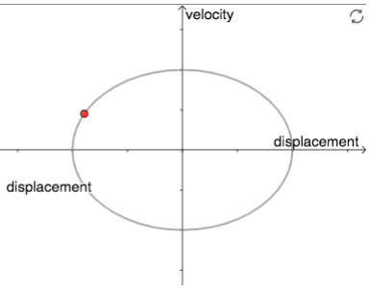
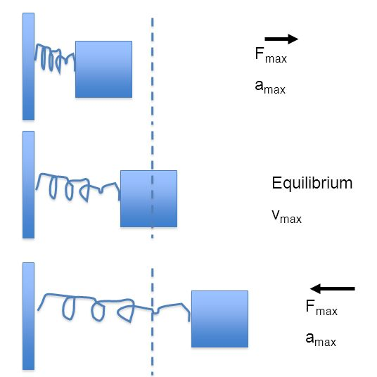
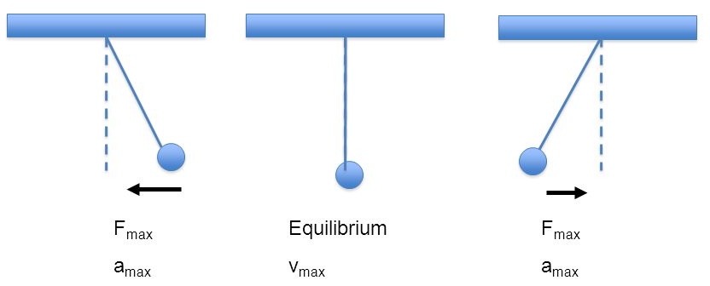
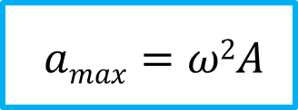
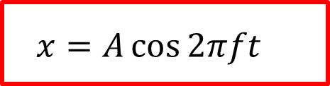
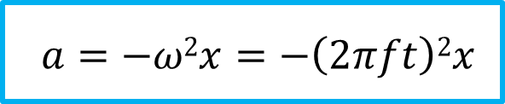
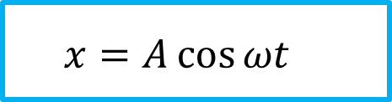
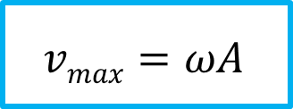
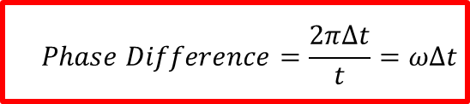
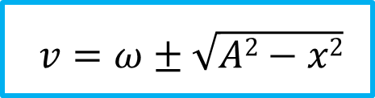
$$a=−ω2x=−\left(2πft\right)2x$$
For an object to undergo SHM, its acceleration must be directly proportional to its displacement from the equilibrium position in the opposite direction.
$$Phase Difference=\frac{2πΔt}{t}=ωΔt$$
$$amax=ω2A$$
Velocity vs displacement graph
The acceleration of the object will be at a maximum when it is at its maximum amplitude
$$v=ω±\sqrt{A2−x2}$$
The velocity of the object will be at a maximum when it is passing through the equilibrium position
The gradient of the displacement graph will give you the velocity at any point.
$$vmax=ωA$$
$$x=A\cos{ωt}$$
The variation of the displacement is sinusoidal and is given by the following expression.
$$x=A\cos{2πft}$$
At 𝑡 = 0, the object is at maximum displacement.
This is equal to the amplitude, 𝐴
Key
Blue equation– Given formulae
Red equation – Not given formulae

Slide 4
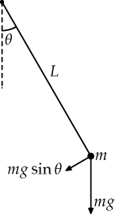
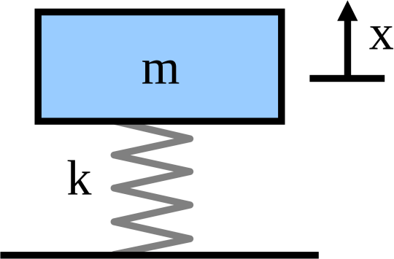
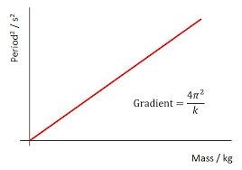
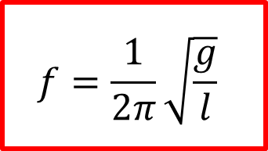
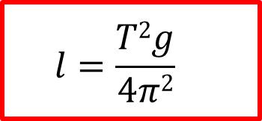
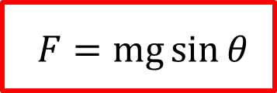
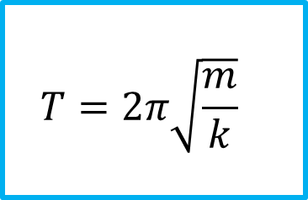
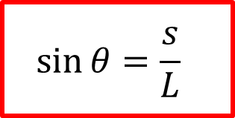
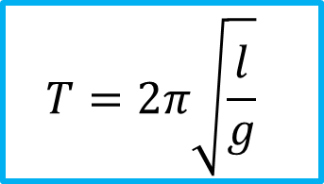
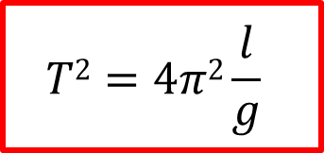
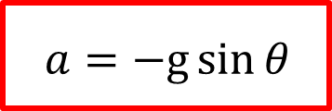

For a simple pendulum, the time period is only affected by the length of the pendulum and the gravitational field strength
$$f=\frac{1}{2π}\sqrt{\frac{g}{l}}$$
$$T=2π\sqrt{\frac{l}{g}}$$
Rearranged for length
$$l=\frac{T2g}{4π2}$$
$$T2=4π2\frac{l}{g}$$
For a mass-spring system, the time period is only affected by the object’s mass and the spring constant of the spring
$$f=\frac{1}{2π}\sqrt{\frac{k}{m}}$$
$$T=2π\sqrt{\frac{m}{k}}$$
The force on a pendulum is the component of gravity acting in the direction that the pendulum is moving in.
$$F=mg\sin{θ}$$
Using Newton’s second law, we can express the acceleration of a pendulum
These equations shows you that the higher value for k the quicker it will oscillate. The more massive the spring the slower it will oscillate.
$$a=−g\sin{θ}$$
This equation only works values under 10 degrees. Sinθ can be written as follows:
$$\sin{θ}=\frac{s}{L}$$
Key
Blue equation– Given formulae
Red equation – Not given formulae

Slide 5







Energy in an Oscillator
maximum displacement
maximum displacement
E_{p} is at a maximum
E_{p} is at a maximum
E_{k} is at a zero
E_{k} is at a zero
E_{p} is at a zero
Light damping: oscillations of constant time period continue with the amplitudes gradually decreasing over time.
Critical damping: the object returns to equilibrium in the shortest possible time without passing through to negative displacement.
Heavy damping: This results in the displaced object returning to equilibrium more slowly than if the system was critically damped.
E_{k} is at a maximum
$$Total Energy=Ek+Ep$$
Kinetic energy is given by
$$ETotal=\frac{1}{2}kA2$$
$$Ek=\frac{1}{2}k(A−x)2$$
At the maximum displacement, the total energy of the system is
$$Ep=\frac{1}{2}kx2$$
Key
Blue equation– Given formulae
Red equation – Not given formulae
The potential energy in a spring is

Slide 6










$$K=C+273$$
$$\text{Δ}U=\text{Δ}Q−\text{Δ}W$$
Internal Energy
Absolute zero is the point at which all molecules have zero kinetic energy
First law = The change in internal energy, ΔU, of a system is equal to the heat, ΔQ, added to the system minus the work done, ΔW, by the system.
$$U=Ek−Epot$$
A change of 1𝐾 equals a change of 1°𝐶
Specific heat capacity is the energy needed to raise the temperature of 1kg of a substance by 1𝐾 (or 1°𝐶).
Specific latent heat is the energy needed per kg to be gained or lost in order to change state. It is measured in 𝐽𝑘𝑔⁻¹.
$$\text{Q}\text{ = }\text{mc}\text{Δ}\text{θ}$$
A method of determining the specific heat capacity of a liquid is by using a calorimeter and a heater.
$$\text{Q}\text{ = }\text{mL}$$
A method used to determine the specific heat capacity of a substance is the inversion tube experiment.
$$c=\frac{gLn}{ΔT}$$
some energy is used to heat the liquid and some to heat the calorimeter
𝒍_{𝒇} means the latent heat of fusion (solid to liquid)
𝒍_{𝒗} means the latent heat of vaporisation (liquid to gas)
$$IVΔt=m1c1ΔT+mcalccalΔT$$
Key
Blue equation– Given formulae
Red equation – Not given formulae

Slide 7













Boyle's Law states that for a gas of fixed mass at a constant temperature, the pressure (p) and volume (V) are inversely proportional:
Charles's Law states that for a gas of fixed mass at constant pressure, the volume, V is directly proportional to its absolute temperature, T.
The pressure law states that for a gas of fixed mass at constant volume, the pressure, p is directly proportional to its absolute temperature, T.
$$PiVi=PfVf$$
$$\frac{Vi}{Ti}=\frac{Vf}{Tf}$$
$$\frac{Pi}{Ti}=\frac{Pf}{Tf}$$
T is always in Kelvin
$$P ∝\frac{1}{V}$$
$$P ∝ T$$
$$V ∝ T$$
$$N=nNA$$
𝑁_{𝐴} is Avogadro’s number, the number of molecules present in 1
mole. 𝑁 is the number of molecules and n is the number of moles
Area under the graph is equal to the work done.
Δ𝑊 = 𝑝Δ𝑉
(Relative) Molecular mass, 𝑀_{𝑟} is the sum of the atomic masses which make up a molecule (measured in grams)
The molar mass, 𝑀_{𝑢}, is the mass of one mol of a substance
(usually measured in 𝒌𝒈𝒎𝒐𝒍^{−𝟏} , but check units in questions!)
$$n=\frac{m}{Mr}$$
$$\frac{PV}{T}=constant$$
$$k=\frac{R}{NA}$$
K is the Boltzmann constant
Ideal gas
𝑝𝑉 = 𝑁𝑘𝑇
𝑝𝑉 = 𝑛𝑅𝑇
Key
Blue equation– Given formulae
Red equation – Not given formulae

Slide 8








Kinetic Theory and Molecular Speeds
$$crms={\left[\frac{\left(C12+c22+c32…\right)}{N}\right]}^{1/2}$$
T always in Kelvin
Distribution of speed remains the same provided the temperature is constant.
The rms speed of molecules in an ideal gas, this gives a mean of the magnitude of the speeds:
$$pV=\frac{1}{3}Nm\left(Crms\right)2$$
Mass of ONE MOLECULE
The kinetic theory equation demonstrates that that for 𝑁 molecules of gas at a given volume, the mass and the r.m.s. speed affect the pressure
Ideal Gas Assumptions
R – The motion of all molecules is random.
A – No attraction between molecules
V - Molecules take up negligible volume.
E - All collisions between molecules and the walls of the container are completely elastic.
D – The duration of the collision is negligible in comparison to the duration between collisions
$$EKin=\frac{3}{2}KT$$
microscopic
macroscopic
Mean kinetic energy of one molecule
The total energy for n moles of an ideal gas
$$EK =\frac{1}{2}m\left(crms\right)2$$
$$EK Total=\frac{3}{2}NKT$$
$$EK =\frac{3}{2}nRT$$
Key
Blue equation– Given formulae
Red equation – Not given formulae

Slide 9













$$Fg=\frac{Gm1m2}{r2}$$
Coulombs Law: Force between two masses is directly proportional to the product of their masses and inversely proportional to the distance between them squared. Vector quantity
$\text{Δ}Epot=mg$Δh
$$g=\frac{GM}{r2}$$
Gravitational field strength is the force per unit mass (𝑁𝑘𝑔⁻¹) Vector quantity
$$g=\frac{F}{m}$$
$$M=\frac{4}{3}πr3ρ$$
Calculating the mass of a planet with its density
Subbing this into
$g=\frac{GMM}{r2}$you get :
The gradient of a graph showing distance against gravitational potential gives you the gravitational field strength.
$$g=\frac{4}{3}Gπrρ$$
Key
Blue equation– Given formulae
Red equation – Not given formulae

Slide 10









Gravitational Potential is:
the work done per unit mass in bringing a point mass from infinity to a point in a gravitational field (𝐽𝑘𝑔⁻¹)
Scalar quantity
$$V=\frac{W}{m}$$
Δ E_{pot}=Δ𝑊 = 𝑚Δ𝑉
Gravitational Potential is always negative as by convention, zero potential is at a point which is an infinite distance away from a gravitational field
Gravitational potential gradient: the change of potential per metre at that point ($\frac{ΔV}{ΔR}$).
$$V=−\frac{GM}{r}$$
Δ $V=\left(−GM(\frac{1}{r1}−\frac{1}{r2})\right)$
$$g=\frac{ΔV}{ΔR}$$
E$pot=\frac{Gm1m2}{r}$
Gravitational Potential Energy in a radial field
Key
Blue equation– Given formulae
Red equation – Not given formulae

Slide 11












Total energy INPUT required to put a satellite into an orbit of radius r around a planet of mass M and radius R is therefore the sum of the gravitational potential energy and the kinetic energy of the satellite
$$Centripetal Force=Gravitational Force$$
$$E=\frac{Gm1m2}{2r}$$
$$\frac{mv2}{r}=\frac{Gm1m2}{r2}$$
The orbital speed of a satellite is inversely proportional to the square root of the radius of its orbit
$$mr {\left(\frac{2\text{π}}{T}\right)}^{2}=\frac{Gm1m2}{r2}$$
$$v=\sqrt{\frac{GM}{r}}$$
The time period of a satellite’s orbit around a planet squared is directly to proportional to the radius of its orbit cubed (Circular motion applies)
T$2=\left(\frac{\text{4}\text{π}\text{2} }{\text{G}\text{M} }\right)r3$
$$v=\sqrt{\frac{2GM}{r}}$$
The escape velocity of an object is the velocity needed for an object to be completely free of a gravitational field from a planet
r$3=\left(\frac{\text{G}\text{M} }{\text{4}\text{π}\text{2}}\right)T2$
r$3\text{∝} T2$
Key
Blue equation– Given formulae
Red equation – Not given formulae

Slide 12


















$$F=\text{±}\frac{kQ1Q2}{r2}$$
Coulombs Law: Force between two charges is directly proportional to the product of their charges and inversely proportional to the distance between them squared. Vector quantity,
1
∗ 𝑘 = _{4𝜋𝜀}
0
$$E=\frac{kQ}{r2}$$
+ + + + + + + + +
- +
$$E=\frac{F}{Q}$$
- - - - -
Electric field strength in a radial field is inversely proportional to the distance from the charge squared
Electric field strength is the force per unit charge (𝑁𝐶⁻¹) Vector quantity
$$\text{Δ}\text{W} \text{= }\text{Q}\text{Δ}\text{V}$$
The electric field strength, E, is equal to the negative of the potential gradient
$$\text{E}\text{= }\frac{\text{Δ}\text{V}}{\text{Δ}\text{r}}$$
Electric Potential is the work done per unit charge in bringing a positive charge to infinity from a point in an electric field (𝐽𝐶⁻¹ 𝑜𝑟 𝑉) Scalar quantity
+ +
Electric fields when there is more than one charge
+ +
$$V=±\frac{kQ}{r}$$
$$E1−E2=k\left(\frac{Q1}{r12}−\frac{Q2}{r22}\right)$$
+ -
Depending on the charge, electric potential may be positive or negative as it is the work done in bringing a positive point charge to a point in a field
$$E1−E2=k\left(\frac{Q1}{x2}−\frac{Q2}{(D−x)2}\right)$$
Key
Blue equation– Given formulae
Red equation – Not given formulae

Slide 13
















$$C=\frac{Q}{V}$$
Capacitance is the charge stored per unit potential difference by a capacitor (𝐹𝑎𝑟𝑎𝑑𝑠, 𝐹 𝑜𝑟 𝐶𝑉⁻¹)
The Gradient is equal to the Capacitance
Relative permittivity is the ratio between the permittivity of a material and the permittivity of free space (𝐹𝑚⁻¹)
$$\text{ε}r=\frac{\text{ε}1}{\text{ε}o}$$
$$\text{ε}r=\frac{Q}{\text{Q}o}$$
$$\text{ε}r=\frac{C}{\text{C}o}$$
The energy stored is equal to the work done to force extra charge
E$=\frac{1}{2}QV$
E$=\frac{1}{2}CV2$
E$=\frac{1}{2}\frac{Q2}{C}$
Area under the graph is equal to the energy stored
$$C=\frac{A\text{ε}0\text{ε}r}{d}$$
Capacitance is directly proportional to the area of the plates, and inversely proportional to the distance between them
𝑡
$$Time to ≈ 100\% charge =5(RC)$$
The greater the relative permittivity of a material, the higher the capacitance
$$time constant = RC= 0.37Q0$$
The time constant is the time taken for the
voltage/current/charge of a capacitor to ≈ 37%
$$CTotal=\frac{1}{C1}+\frac{1}{C2}+…$$
$$CTotal=C1+C2+…$$
Key
Blue equation– Given formulae
Red equation – Not given formulae

Slide 14








$$t_{1/2}=ln2RC$$
The half life of a capacitor is the time taken for the voltage/current/charge of a capacitor reaches half of its original value
𝑡
V$=Voe^{− \frac{t}{RC}}$
The equation for capacitor charge is:
$$V=Vo\left({1−e}^{−\frac{t}{RC}}\right)$$
$$I=Ioe^{− \frac{t}{RC}}$$
Q$=Qoe^{− \frac{t}{RC}}$
$$Q=Qo\left({1−e}^{−\frac{t}{RC}}\right)$$
For a discharging capacitor, the rate at which charge and voltage change over time obey an exponential decay relationship
Key
Blue equation– Given formulae
Red equation – Not given formulae

Slide 15












𝐹 = 𝐵𝐼𝑙
$$F=\left(BIl\right)n$$
The force on a charge in a magnetic field is affected by the magnetic flux density, the size of the charge and the velocity of its motion perpendicular to the field.
$$F=Bev$$
The force on a current carrying wire is directly proportional to the magnetic flux density (field strength), the current in the wire and the length of the wire.
Φ = 𝐵𝐴
Magnetic Flux Density is measured in
𝑇𝑒𝑠𝑙𝑎𝑠, 𝑇 𝑜𝑟 𝑁𝐴⁻¹𝑚⁻¹ Vector quantity
$$v=velocity$$
$$V=Voltage$$
Magnetic Flux is the total magnetic flux passing through a given area. It is measured in 𝑊𝑒𝑏𝑒𝑟𝑠, 𝑊𝑏 𝑜𝑟 𝑇𝑚⁻² Scalar quantity
$$N\text{Φ}\text{=}\text{BAN}\cos{\text{θ} }$$
$$\frac{1}{f}=T=\frac{2\text{π}m}{BQ}$$
$$\text{ε}\text{=}\text{BAN}\text{ω}\sin{\text{θω}t}$$
The emf of a coil rotating uniformly in a magnetic field is dependant on the flux linkage and the angular speed.
Fleming's left hand rule
Applied for charges moving through conventional current
+ve → -ve
The time period of a charged particle moving through a magnetic field is independent of its velocity.
Key
Blue equation– Given formulae
Red equation – Not given formulae

Slide 16










$$v=velocity$$
$$V=Voltage$$
$$r=\frac{mv}{BQ}$$
Current going into Page
Current coming out of Page
$$\text{ε}=−\frac{N\text{Δ}\text{Φ}}{\text{Δ}t}$$
The induced emf across a conductor is directly proportional to the rate of change of flux linkage in a magnetic field
The radius of a charged particle moving through a magnetic field is directly proportional to its momentum and inversely proportional to the magnetic flux density and its charge.
Lenz’s Law
AC Generator
Flux linkage through the coil is
$$N\text{Φ}\text{=}\text{BAN}\sin{\text{θ} }$$
Key
Blue equation– Given formulae
Red equation – Not given formulae

Slide 17












Effective voltage, V_{rms}.
From Faraday's law the induced emf in the primary and secondary coils are:
$$Vp=Np\frac{∆\text{Φ}}{∆t}$$
Peak voltage is V₀
$$Vs=Ns\frac{∆\text{Φ}}{∆t}$$
The r.m.s. current/voltage of an A.C supply can be directly compared to its DC equivalent
Assuming that a transformer is 100% efficient, the ratio of the number of turns on the primary and secondary coil is equal to the ratio of their voltages
$$Irms=\frac{I\text{0}}{\sqrt{2}}$$
$$Vrms=\frac{V\text{0}}{\sqrt{2}}$$
$$\frac{Ns}{Np}=\frac{Vs}{Vp}$$
$$\frac{Ns}{Np}=\frac{Vs}{Vp}$$
We use the rms value because its use allows us to do electrical calculations as if they were direct currents.
$$P=IrmsVrms$$
Using a CRO (Oscilloscope)
$$Efficiency=\frac{IsVs}{IpVp}x100$$
$$IpVp=IsVs$$
Key
Blue equation– Given formulae
Red equation – Not given formulae

Slide 18















$$ρ=\frac{3m}{4πro}$$
The nuclear density of a nucleus is approx 1.8 x 10¹⁷ kgm⁻³
$$R=roA^{\frac{1}{3}}$$
$V=\frac{4}{3}$ $πro$A
$$ro=1.5fm$$
The radius of a nucleus is directly proportional to the cube root of an atoms nucleon number
RUTHERFORD’S SCATTERING EXPERIMENT
Deflected >90$°$
(1 in 10,000)
= concentrated mass & +ve
Deflected <90$°$ = +ve nucleus
CLOSEST APPROACH OF α PARTICLES
$$Initial Ek=\frac{kQ1Q2}{r}$$
1
∗ 𝑘 = _{4𝜋𝜀}
0
Pass through
(1 in 2000)
= empty space
Due to the conservation of energy, assuming no energy loss, the electrostatic potential energy will be equal to its initial kinetic energy.
ELECTRON DIFFRACTION
$$r=\frac{kQ1Q2}{Ek}$$
$$r=\frac{0.61\sin{θmin}}{λ}$$
When determining the radius of a nucleus through electron diffraction, the minimum angle of diffraction is given as follows
Key
Blue equation– Given formulae
Red equation – Not given formulae

Slide 19






Alpha Decay, 𝛼
Nucleon number decreases by 4
Proton number decreases by 2
Beta minus decay, 𝛽⁻
Nucleon number stays the same
Proton number increases by 1
Beta plus decay, 𝛽⁺
Nucleon number stays the same
Proton number decreases by 1
$$X_{Z}^{A }→{ X′}_{Z−2}^{A−4}{ + \text{α}}_{2}^{4}$$
$$X_{Z}^{A}→{X′}_{Z+1}^{A}{+\text{β}\text{−}}_{−1}^{ 0}+\overline{V}e$$
$$X_{Z}^{A}→{X′}_{Z−1}^{A}{+\text{β}\text{+}}_{−1}^{ 0}+ve$$
𝛼 emitters
Key
Blue equation– Given formulae
Red equation – Not given formulae

Slide 20















$$I=\frac{k}{x2}$$
The intensity of radiation is inversely proportional to the distance from the source squared
Nuclear decay is random and spontaneous. The decay constant, 𝜆 is the probability of a nucleus decaying in a given time.
1𝑢 = 931.5𝑀𝑒𝑉 = 1.661 × 10⁻²⁷ 𝑘𝑔
1 atomic mass unit has a binding energy of 931.5𝑀𝑒𝑉
$$Ebind=mc2$$
$$A=Nλ$$
The activity, 𝐴 of a radioactive sample is directly proportional to the number of nuclei present. It is measured in becquerels, 𝐵𝑞
$$\frac{ΔN}{Δt}=−λN$$
The binding energy of a nucleus is the work that must be done to separate a nucleus into its constituent neutrons and protons.
The number of nuclei and activity of radioactive substance follow an exponential decay relationship over time
$$Δm=ZmP+\left(A−Z\right)mN−mnucleus$$
Mass defect of nucleus, the difference between the mass of separated nucleons and the mass of the nucleus
$$N=N0e^{−λt}$$
$$ln⁡(N)=ln⁡(N0)−λt$$
$$Ebind in Mev=Δm in u x 931.5Mev$$
$$m=m0e^{−λt}$$
$$gradient=−λ$$
$$E in Joules=\frac{EbindMev}{1.6x{10}^{−13}}$$
$$A=A0e^{−λt}$$
$$t_{1/2}=\frac{ln2}{λ}$$
The half life of a radioactive substance is the time taken for the activity/ number of radioactive nuclei present to half
Key
Blue equation– Given formulae
Red equation – Not given formulae

Slide 21


Nucleons with a mass number greater than the peak release energy (Fe-56) through nuclear fission.
Nucleons with a mass number less than the peak (Fe-56) release energy through nuclear fusion
Fission: In this process, a large unstable nucleus is split into two lighter, more stable nuclei.
Fusion: two light nuclei fuse together to form a larger, more stable nucleus
$$Ebind per N=\frac{mc2}{A}$$
Oxygen-16, Carbon -12 and He-4 are very stable isotopes
The binding energy per nucleon is the average work done per nucleon to remove all the nucleons from a nucleus. It is a measure of the stability of a nucleus.
Neutrons have ZERO binding energy
Key
Blue equation– Given formulae
Red equation – Not given formulae

Slide 22












$$\frac{1}{f}=\frac{1}{u}+\frac{1}{V}$$
The lens equation
𝑓 is the focal length
𝑢 is the object distance from the lens
𝑣 is the image distance from the lens
$$P=\frac{1}{f}$$
Diverging lenses have a negative power
Converging lenses have a positive power
$$\frac{Ir}{Ii}={\left(\frac{Z2−Z1}{Z2+Z1}\right)}^{2}$$
$$Z=pc$$
$$m=\frac{v}{u}$$
Magnification
of a lens
$$I=\frac{P}{A}$$
The intensity of a sound wave is the energy transferred per second per metre squared perpendicular to the direction of wave travel. Measured in 𝑊𝑚⁻²
The larger the difference in acoustic impedance between two materials, the higher the intensity of the reflected ultrasound wave, 𝐼_{𝑟}
𝐼₀ = 1.0 × 10⁻¹²𝑊𝑚⁻²
The threshold of hearing is the lowest intensity sound which the human ear can hear at a frequency 1kHz
𝐼 = 𝐼₀𝑒^{−𝜇𝑥}
The intensity of X-rays through a material follows an exponential decay relationship
𝐼
𝑖𝑛𝑡𝑒𝑛𝑠𝑖𝑡𝑦 𝑙𝑒𝑣𝑒𝑙 = 10 log
𝐼₀
The half value thickness is the thickness of a material needed to reduce the intensity of an X-ray beam to half its original value
The intensity of sound can also be measured in decibels (dB). The intensity level follows a logarithmic scale. This is for going from intensity in 𝑊𝑚⁻² to decibels
$$x_{1/2}=\frac{Ln2}{\text{μ} }$$
$$\text{μ}m=\frac{\text{μ}}{ ρ}$$
$$I=I0 x 10^{0.1(dB)}$$
The mass attenuation coefficient is a measure of how much radiation is absorbed per unit mass of a material
Converting decibels back to 𝑊𝑚⁻²
The effective half life of a radioactive tracer depends on the physical half life of the substance and the biological half life which is how long the body’s biological processes take to remove the substance
$$ΔL∝\log\left(\frac{I2}{I1}\right)$$
Perceived loudness in decibels is proportional logarithmically to the ratio of intensity before and after
$$\frac{1}{TE}=\frac{\text{1}}{ TB}+\frac{\text{1}}{ TP}$$
Key
Blue equation– Given formulae
Red equation – Not given formulae

