Slide 1
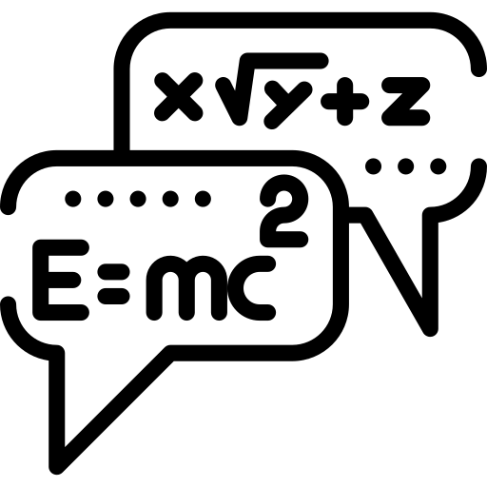








Physics Paper 1 revision booklet
Exam date: 18th May 2020 (pm)
Contents:
Measurements spec points and exam questions.
Particles spec points and exam questions.
Waves spec points and exam questions.
Mechanics spec points and exam questions.
Electricity spec points and exam questions.
Periodic motion spec points and exam questions
How to use:
Quiz yourself on the questions on the fact sheets (or get a family member/friend) to quiz you.
Answer the questions on the exam questions. Once answered, cover up the answers & check that you can do again.
Revising effectively does not simply involve reading over notes or making new notes – you have to practice answering questions & practice remembering information. To learn physics you have to do physics.
Good luck – although if you revise hard you won’t need it!
Dr. Edmunds

Slide 2
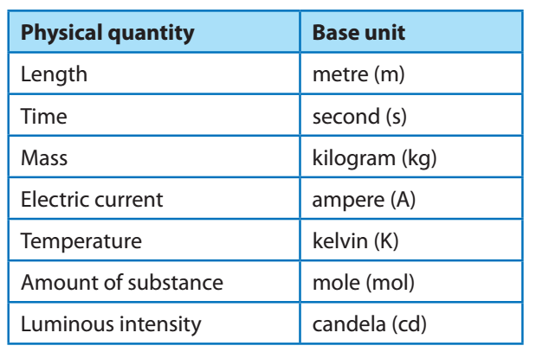
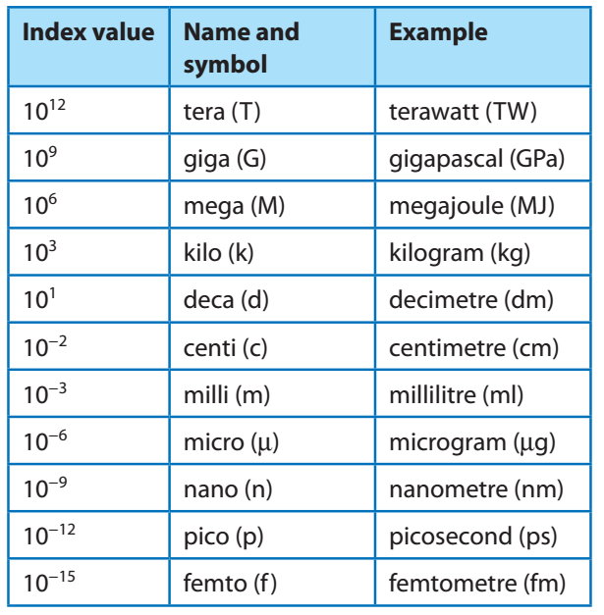
3.1.1 Uses of SI units and their prefixes
Fundamental (base) units.
Use of mass, length, time, amount of substance, temperature, electric current and their associated SI units.
SI units derived.
Knowledge and use of the SI prefixes, values and standard form.
Students should be able to use the prefixes: T, G, M, k, c, m, μ, n, p, f,
Students should be able to convert between different units of the same quantity, eg. J and eV, J and kWh.
A beam of electrons is accelerated through a potential difference of 5 kV. The kinetic energy gained by one electron is given by the equation E_{k} = qV, where q is the charge on one electron and V is the potential difference.
Calculate the kinetic energy gained by one electron in:
joules
(ii) electronvolts.
b) If 3 × 10¹² electrons are used in the beam, estimate the total energy gained by all of the electrons in the beam and give your answer in terms of mJ.
c) 20% of the electron beam is absorbed before reaching the detector. Calculate the amount of energy reaching the detector. Give your answer to 3 s.f. [2 marks]

Slide 3
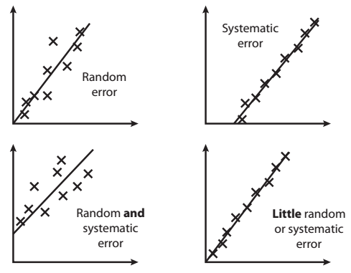
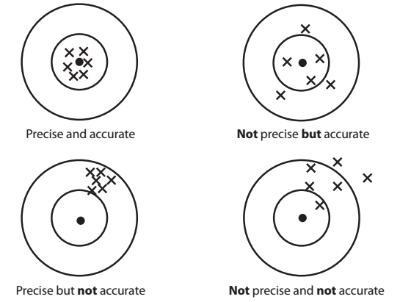
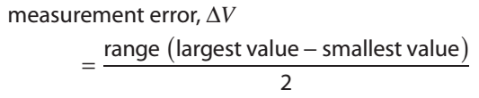

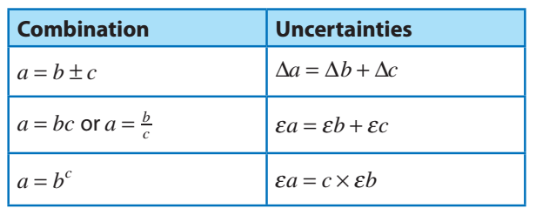
3.1.2 Limitation of physical measurements.
Random and systematic errors.
Precision, repeatability, reproducibility, resolution and accuracy.
Uncertainty:
Absolute, fractional and percentage uncertainties represent uncertainty in the final answer for a quantity.
Combination of absolute and percentage uncertainties.
Represent uncertainty in a data point on a graph using error bars.
Determine the uncertainties in the gradient and intercept of a straight-line graph.
Individual points on the graph may or may not have associated error bars.
3.1.3 Estimation of physical measurements.
Orders of magnitude.
Estimation of approximate values of physical quantities.

Slide 4
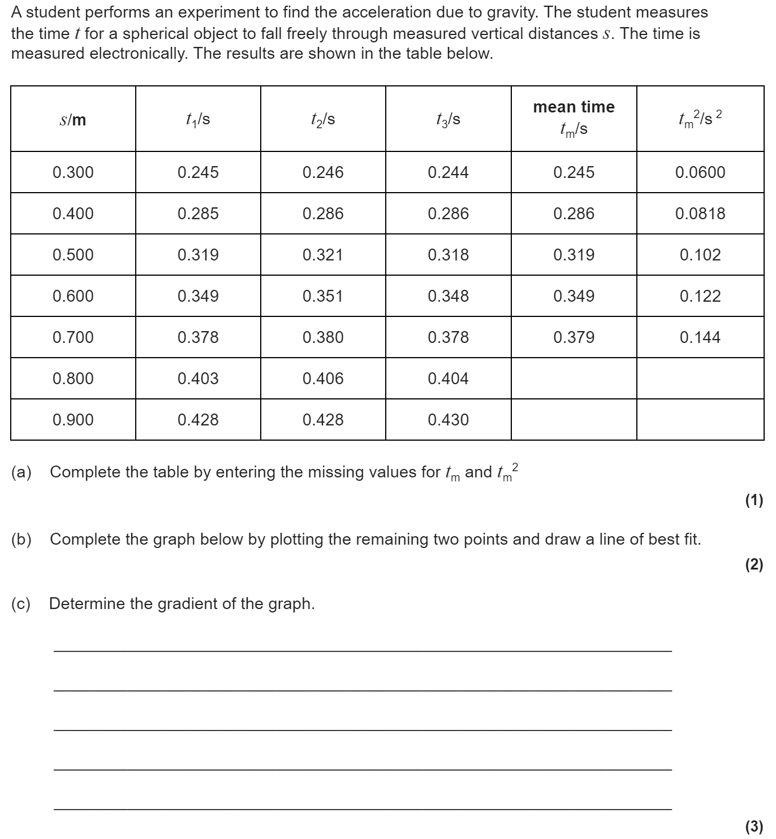
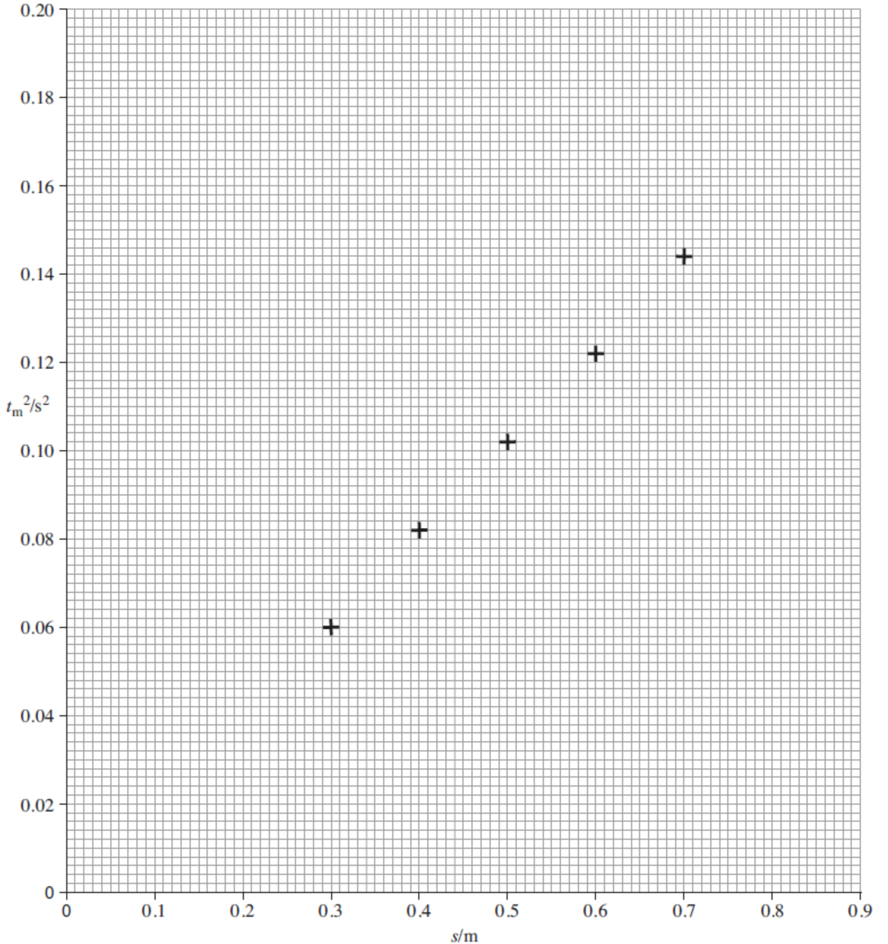

Slide 5
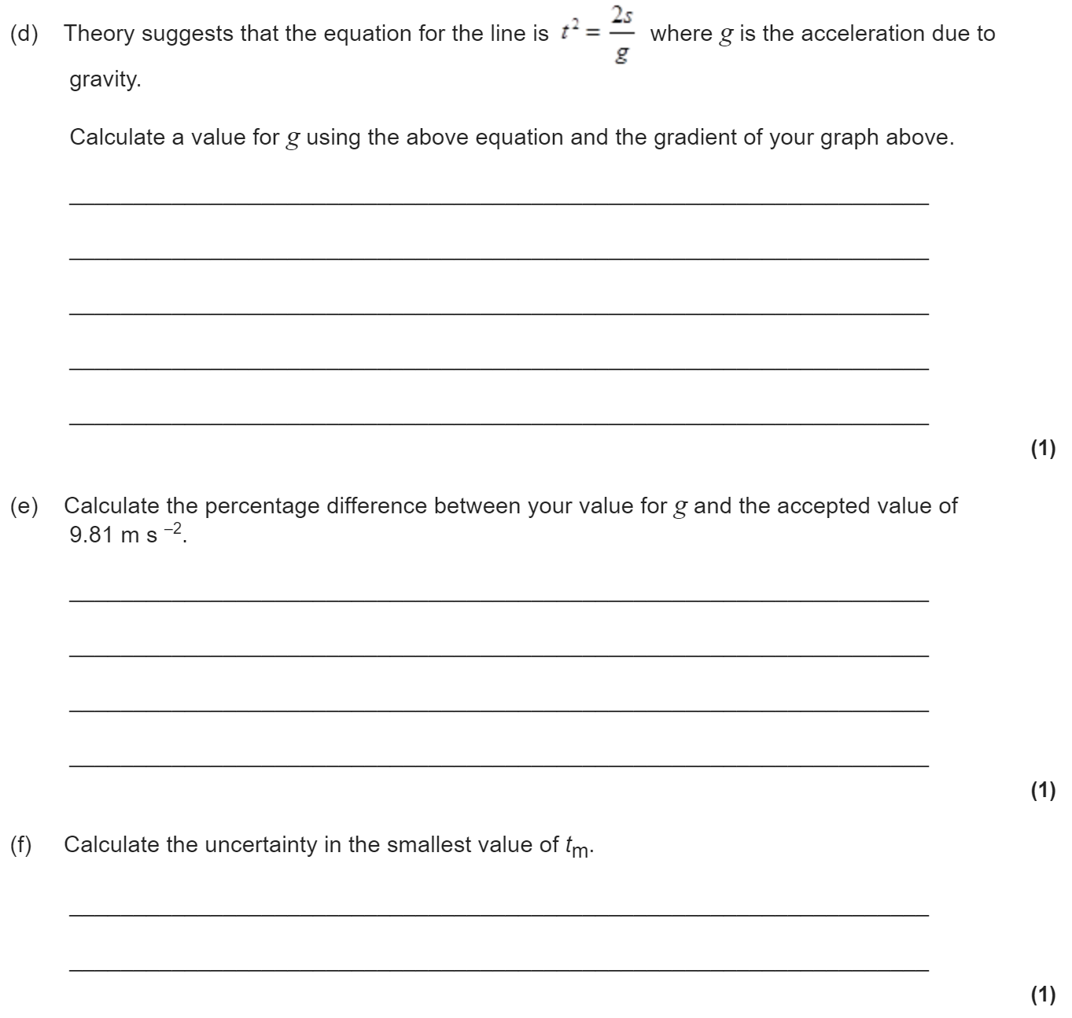

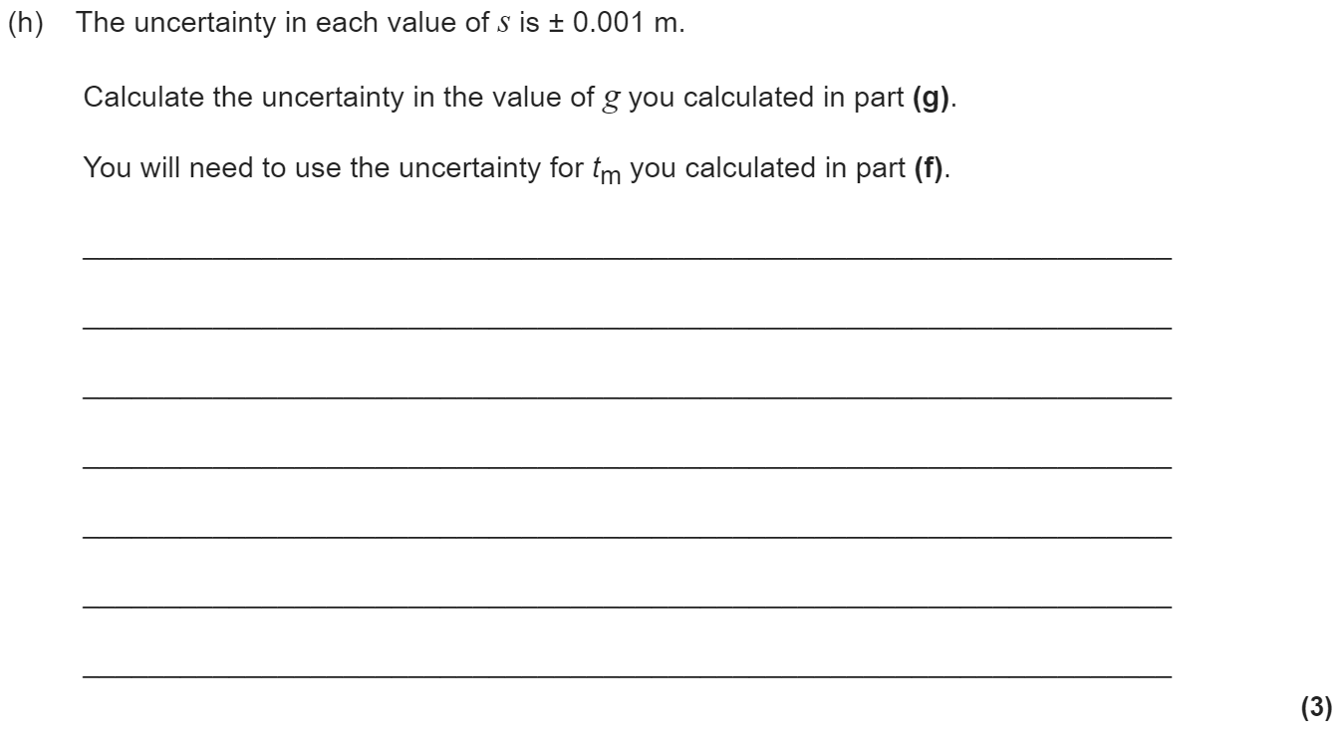


Slide 6
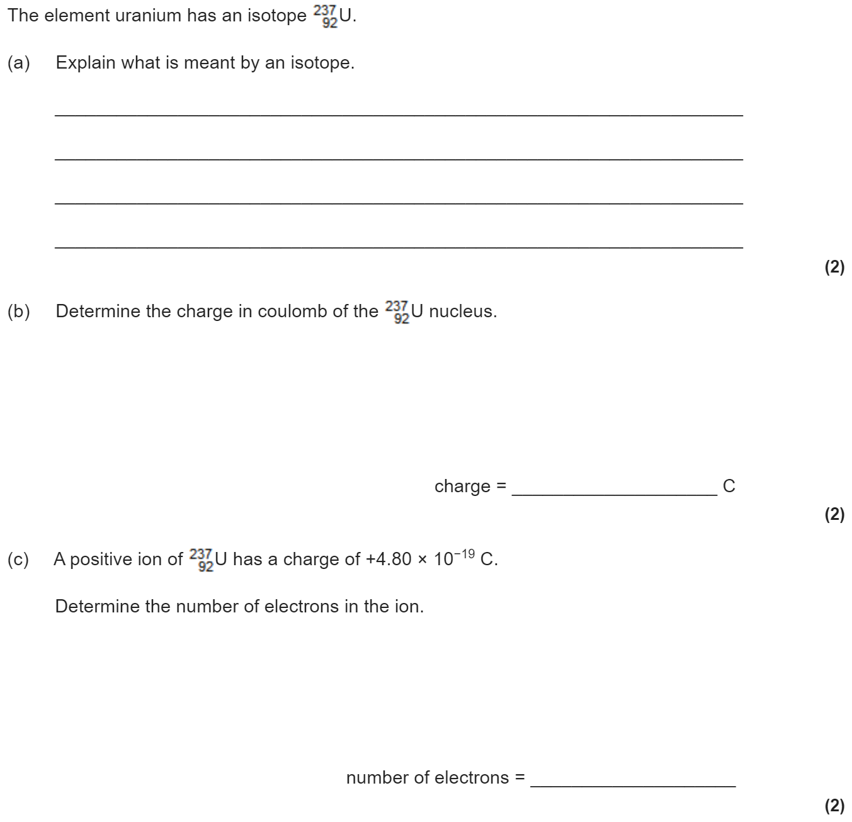
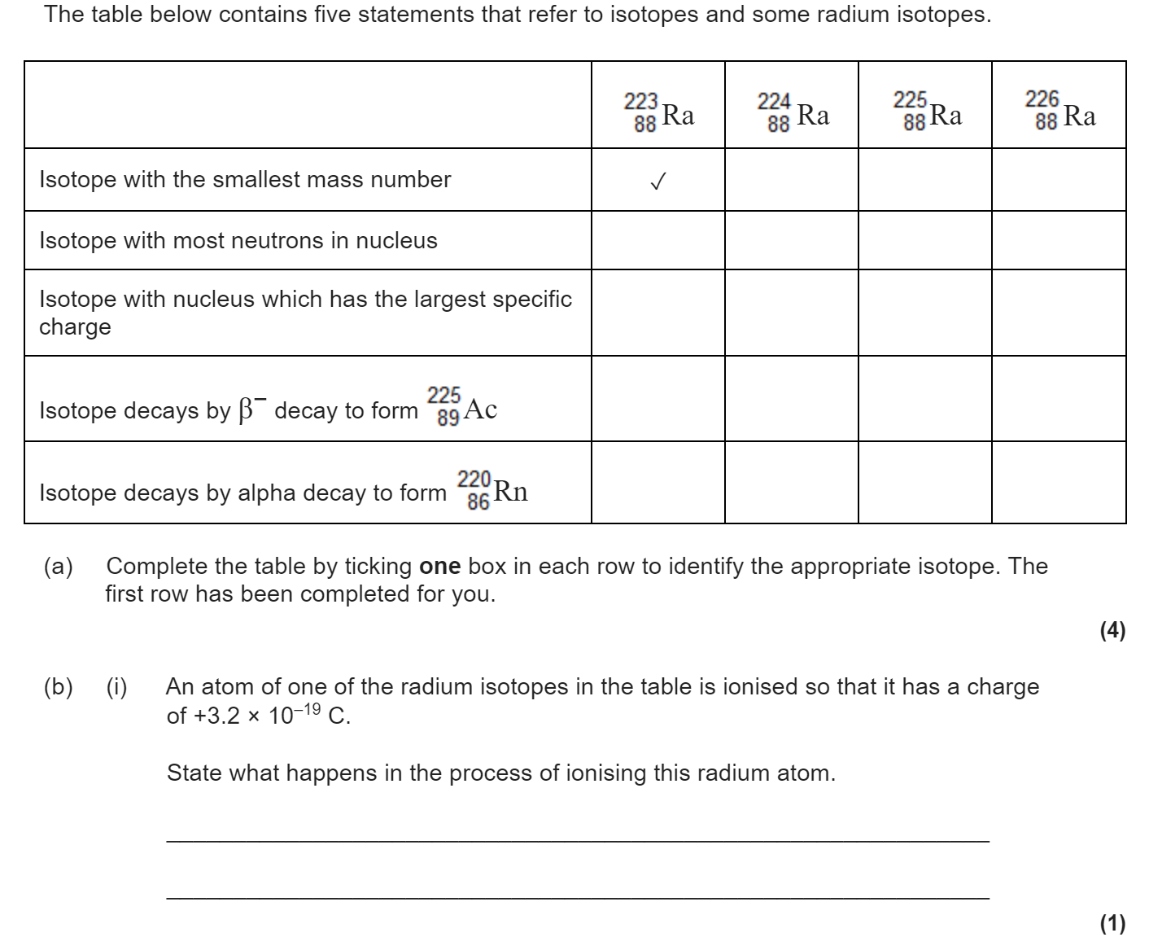
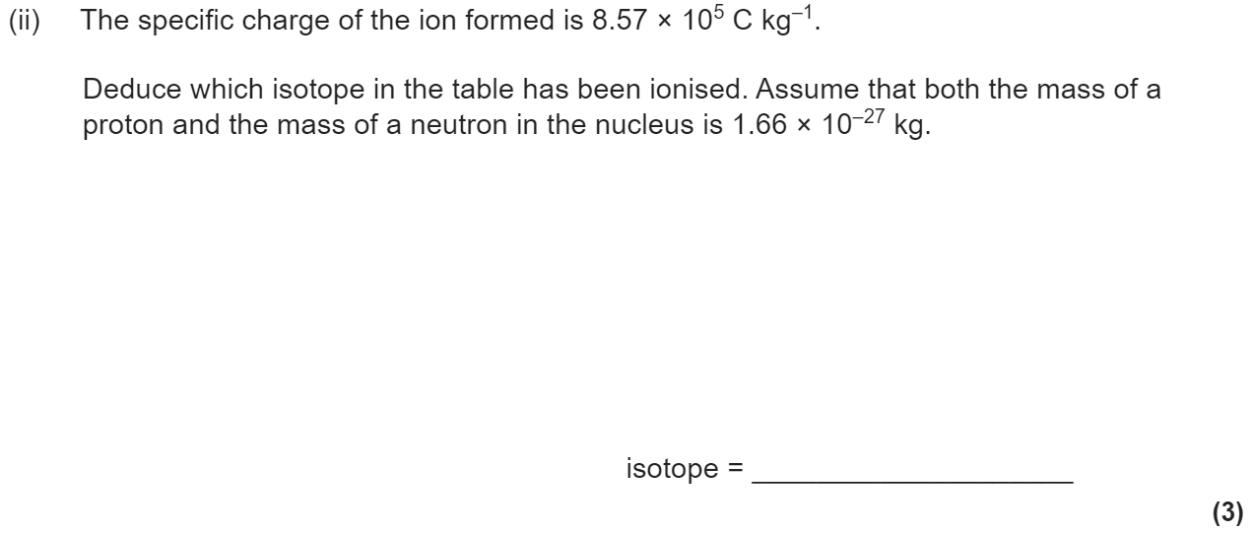
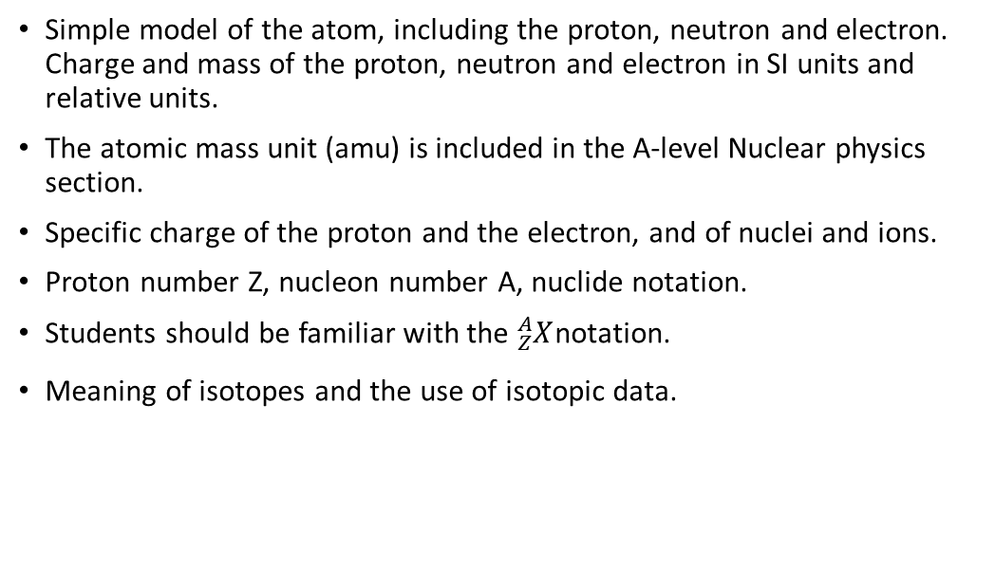
3.2.1.1 Constituents of the atom
Simple model of the atom, including the proton, neutron and electron. Charge and mass of the proton, neutron and electron in SI units and relative units.
The atomic mass unit (amu) is included in the A-level Nuclear physics section.
Specific charge of the proton and the electron, and of nuclei and ions.
Proton number Z, nucleon number A, nuclide notation.
Students should be familiar with the ${}_{Z}^{A}X$notation.
Meaning of isotopes and the use of isotopic data.

Slide 7
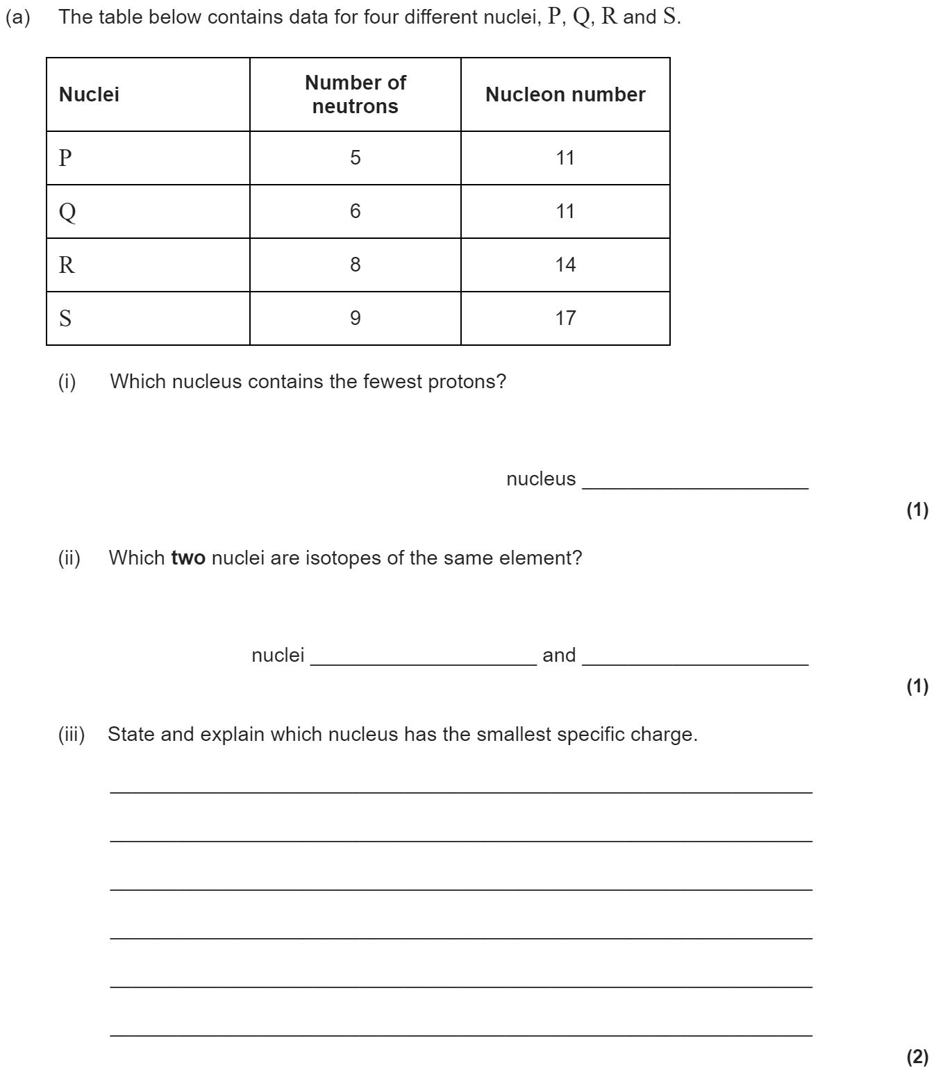
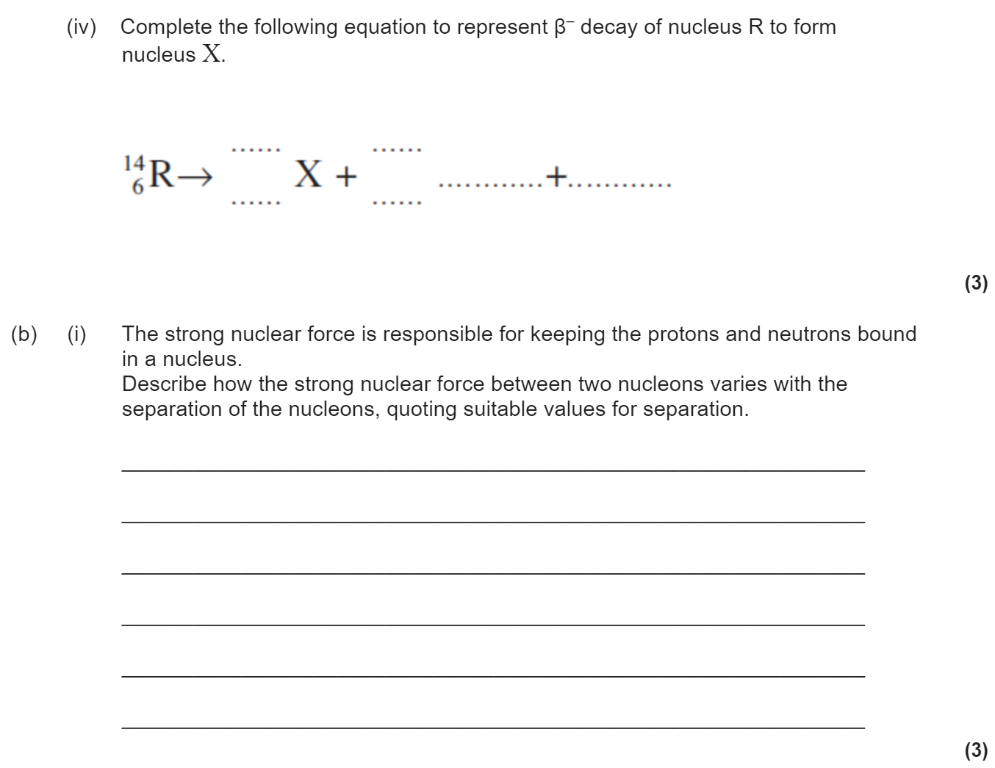
3.2.1.2 Stable and unstable nuclei
The strong nuclear force; its role in keeping the nucleus stable; short-range attraction up to approximately 3 fm, very-short range repulsion closer than approximately 0.5 fm.
Unstable nuclei; alpha and beta decay.
Equations for alpha decay, β− decay including the need for the neutrino.
The existence of the neutrino was hypothesised to account for conservation of energy in beta decay.

Slide 8
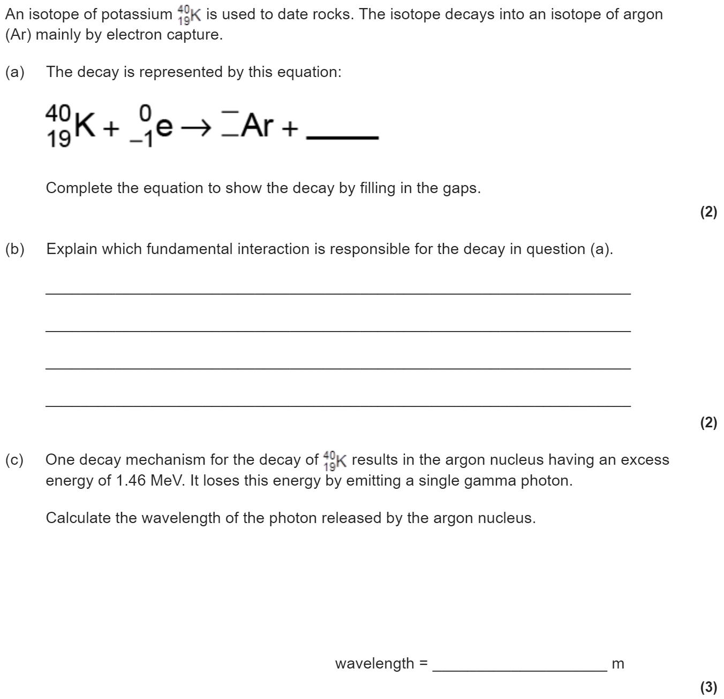
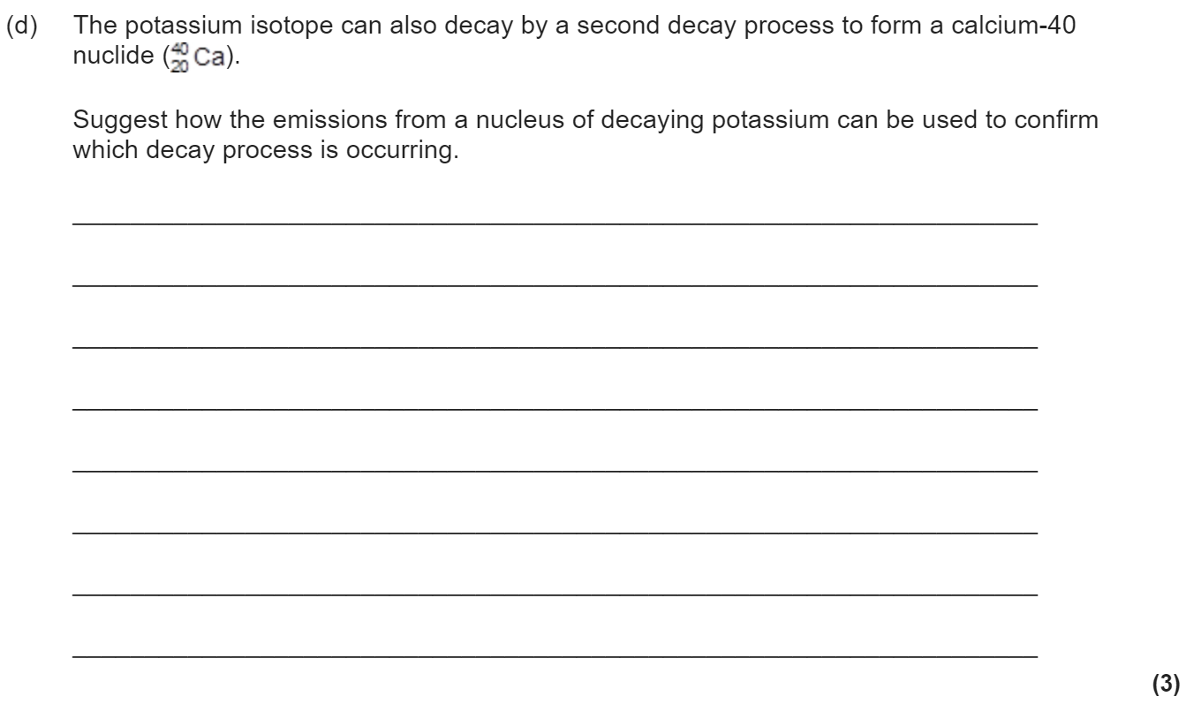
3.2.1.3 Particles, antiparticles and photons
For every type of particle, there is a corresponding antiparticle.
Comparison of particle and antiparticle masses, charge and rest energy in MeV.
Students should know that the positron, antiproton, antineutron and antineutrino are the antiparticles of the electron, proton, neutron and neutrino respectively.
Photon model of electromagnetic radiation, the Planck constant.
E = hf = hc/λ
Knowledge of annihilation and pair production and the energies involved.

Slide 9
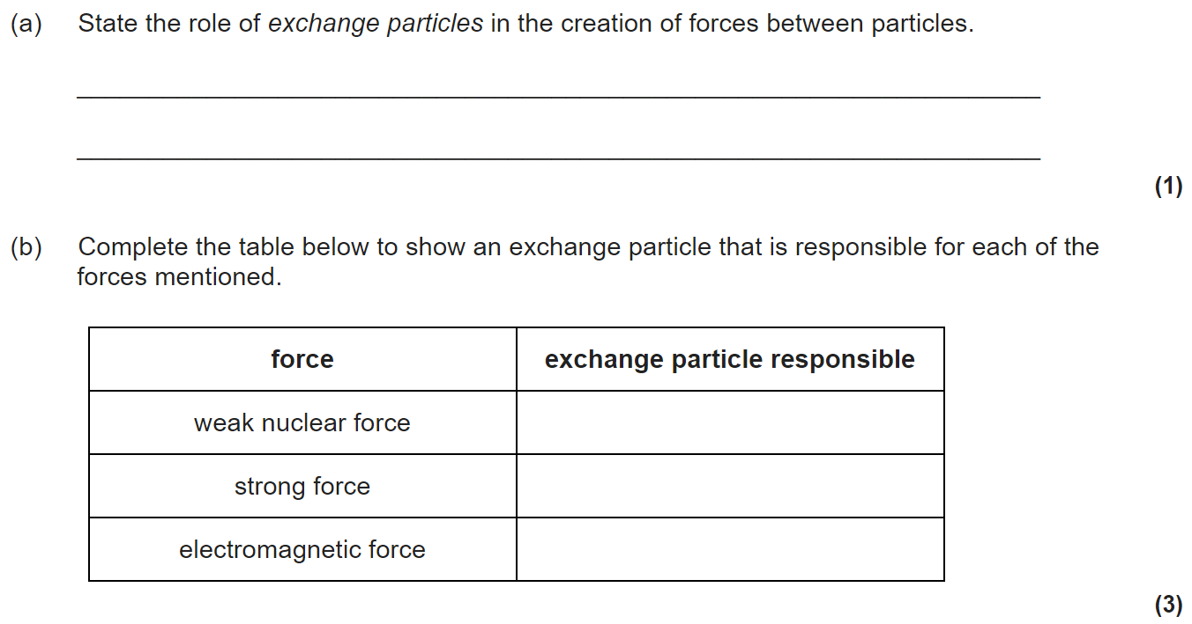
3.2.1.4 Particle interactions
Four fundamental interactions: gravity, electromagnetic, weak nuclear, strong nuclear. (The strong nuclear force may be referred to as the strong interaction.)
The concept of exchange particles to explain forces between elementary particles.
The electromagnetic force; virtual photons as the exchange particle.
The weak interaction limited to β⁻ and β⁺ decay, electron capture and electron–proton collisions; W⁺ and W⁻ as the exchange particles.
Simple diagrams to represent the above reactions or interactions in terms of incoming and outgoing particles and exchange particles.

Slide 10
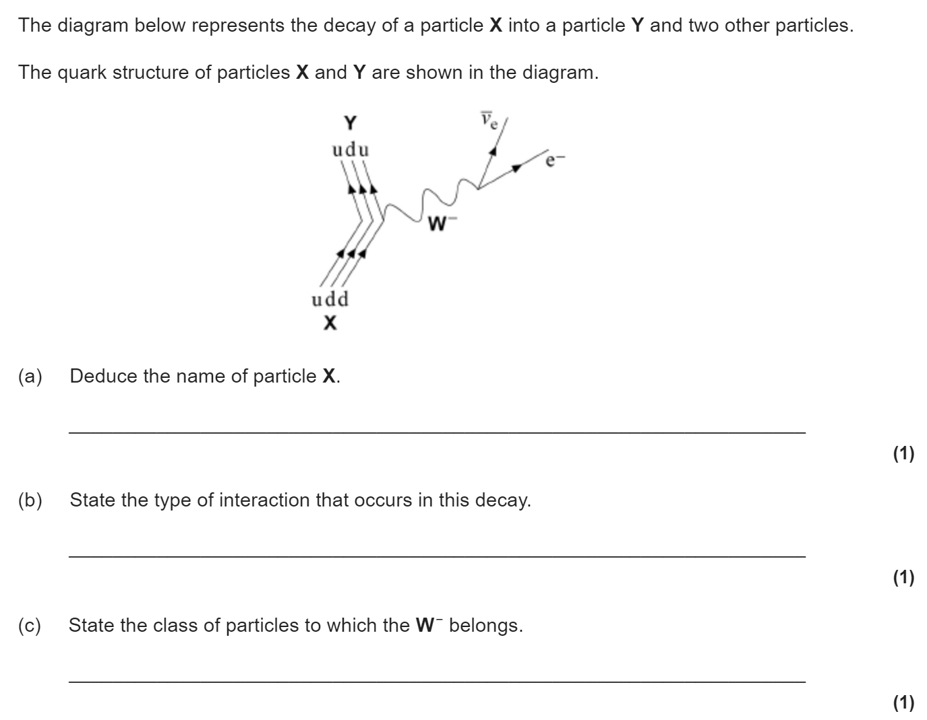
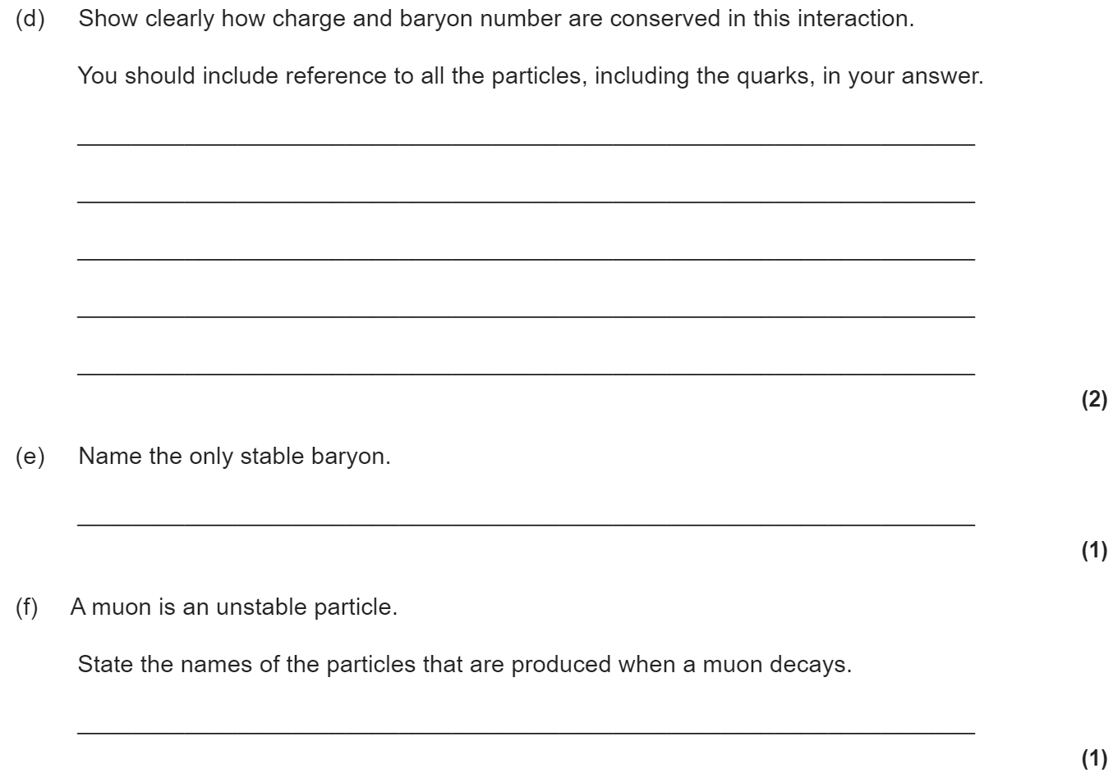
3.2.1.5 Classification of particles
Hadrons are subject to the strong interaction.
The two classes of hadrons:
baryons (proton, neutron) and antibaryons (antiproton and antineutron)
mesons (pion, kaon).
Baryon number as a quantum number.
Conservation of baryon number.
The proton is the only stable baryon into which other baryons eventually decay.
The pion as the exchange particle of the strong nuclear force.
The kaon as a particle that can decay into pions.
Leptons: electron, muon, neutrino (electron and muon types only) and their antiparticles.
Lepton number as a quantum number; conservation of lepton number for muon leptons and for electron leptons.
The muon as a particle that decays into an electron.
Strange particles
Strange particles as particles that are produced through the strong interaction and decay through the weak interaction (eg kaons).
Strangeness (symbol s) as a quantum number to reflect the fact that strange particles are always created in pairs.
Conservation of strangeness in strong interactions.
Strangeness can change by 0, +1 or -1 in weak interactions.
Appreciation that particle physics relies on the collaborative efforts of large teams of scientists and engineers to validate new knowledge.

Slide 11
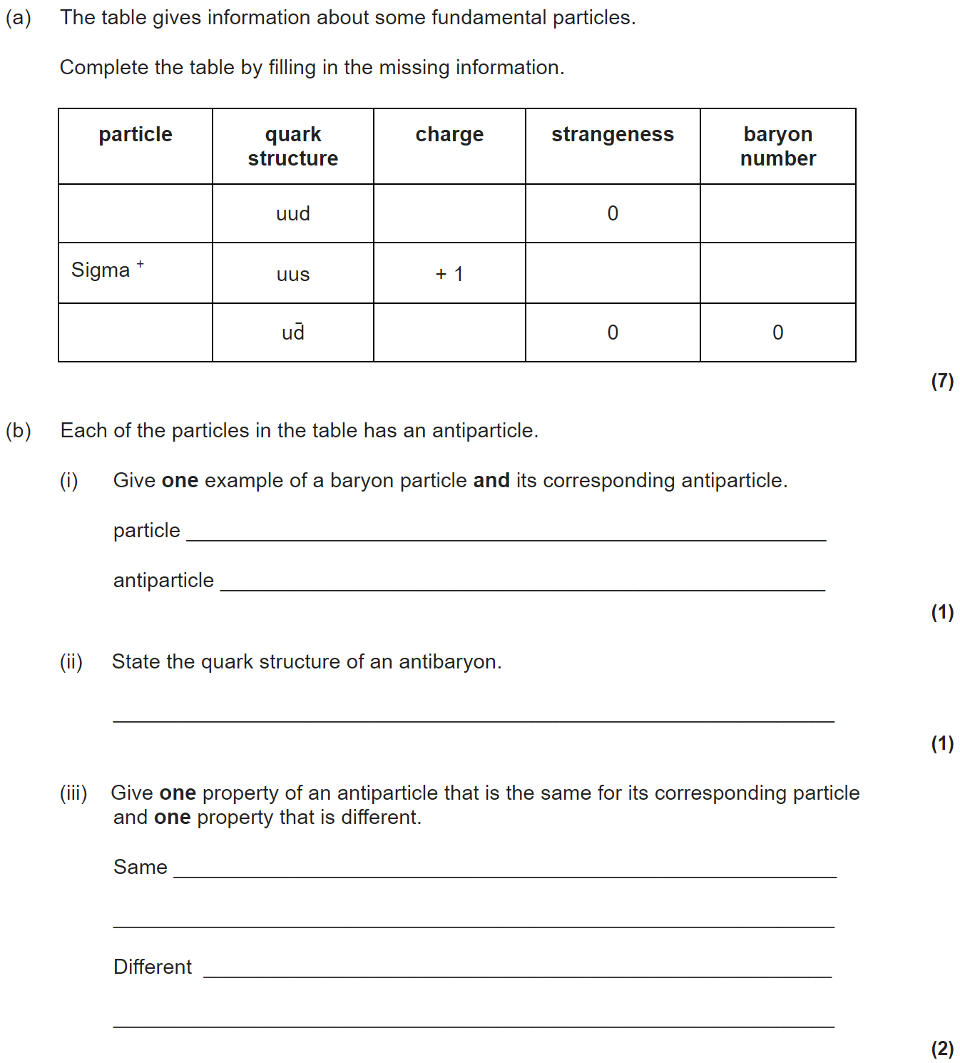
3.2.1.6 Quarks and anti-quarks
Properties of quarks and antiquarks: charge, baryon number and strangeness.
Combinations of quarks and antiquarks required for baryons (proton and neutron only), antibaryons (antiproton and antineutron only) and mesons (pion and kaon only).
Only knowledge of up (u), down (d) and strange (s) quarks and their antiquarks will be tested.
The decay of the neutron should be known.

Slide 12
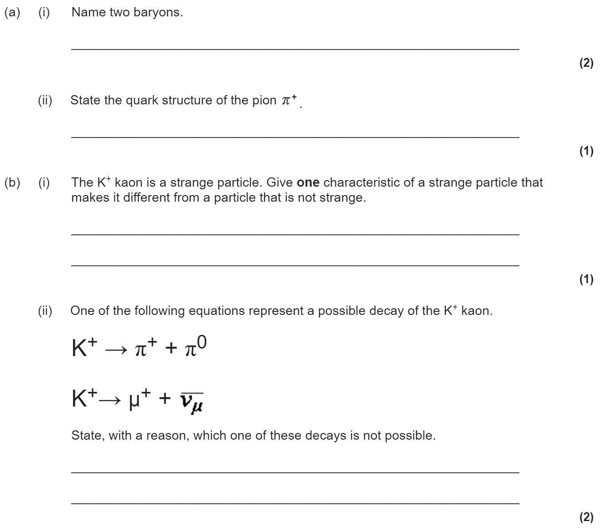
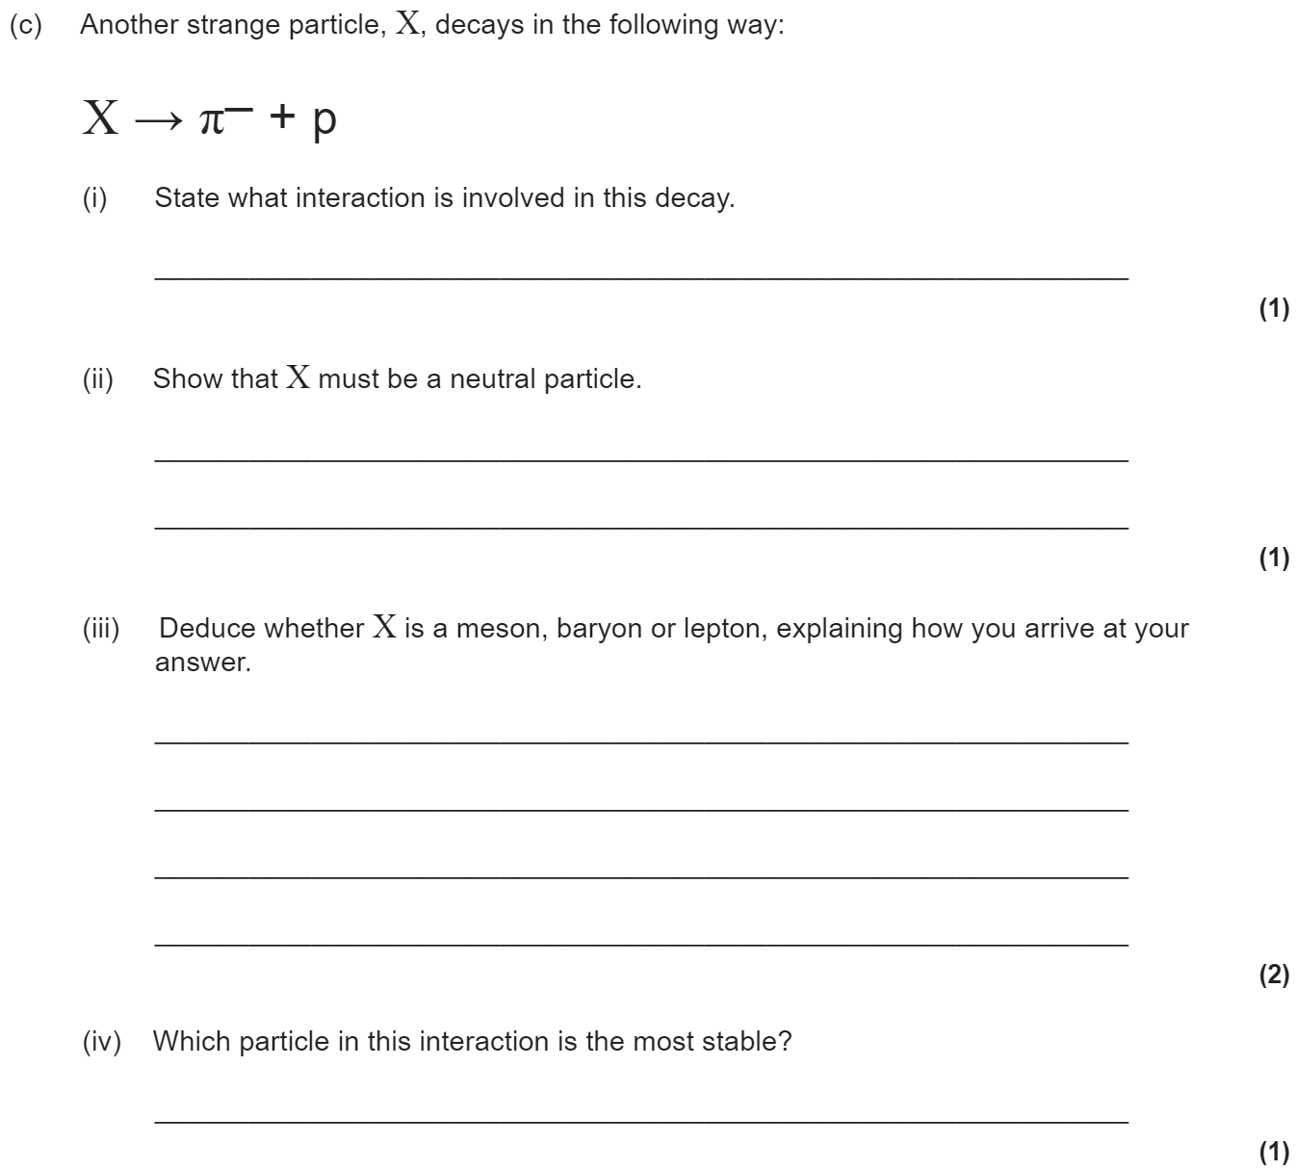
3.2.1.7 Applications of conservation laws
Change of quark character in β− and in β+ decay.
Application of the conservation laws for charge, baryon number, lepton number and strangeness to particle interactions. The necessary data will be provided in questions for particles outside those specified.
Students should recognise that energy and momentum are conserved in interactions.

Slide 13
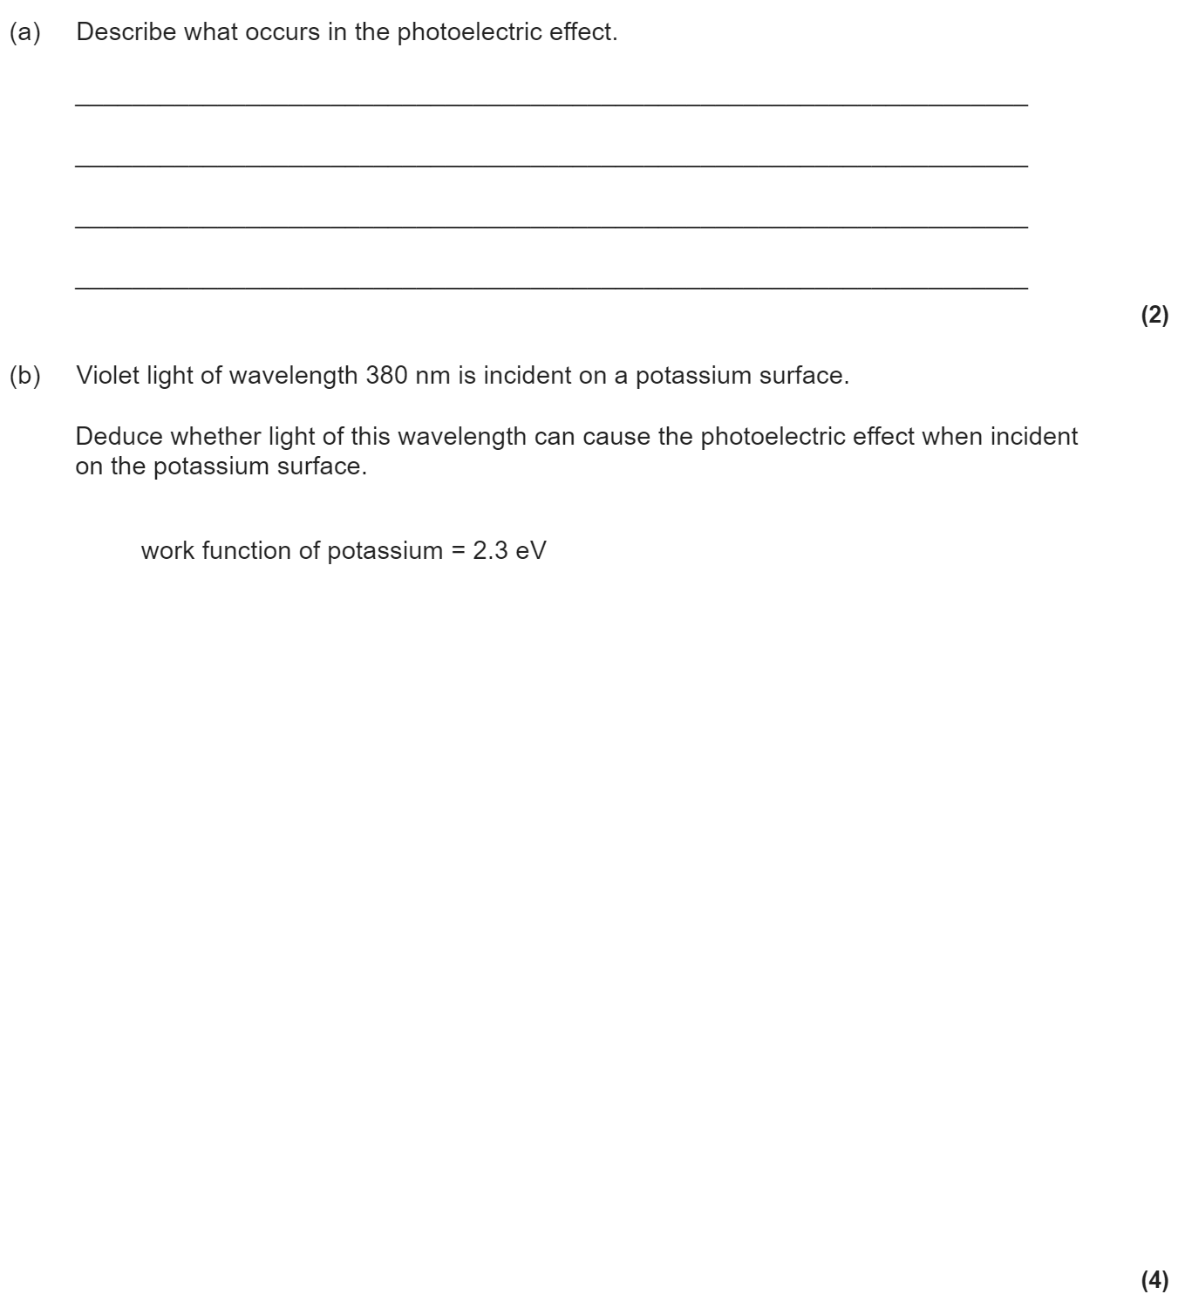
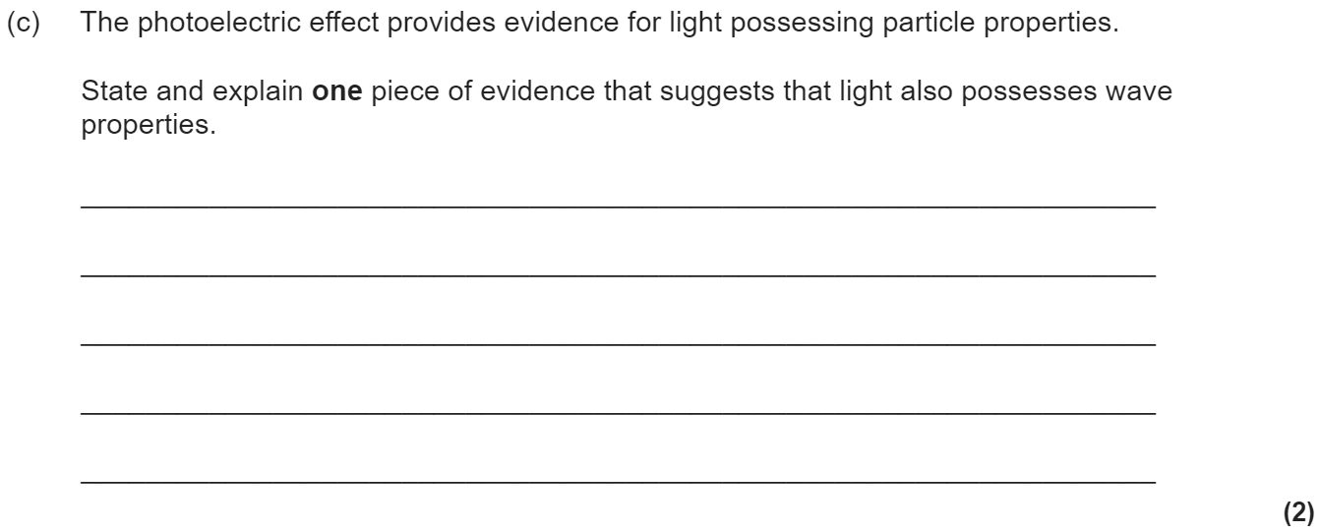
3.2.2.1 The photoelectric effect
Threshold frequency; photon explanation of threshold frequency.
Work function φ, stopping potential.
Photoelectric equation: hf = φ + E_{k(max)}
E_{k(max)} is the maximum kinetic energy of the photoelectrons.

Slide 14
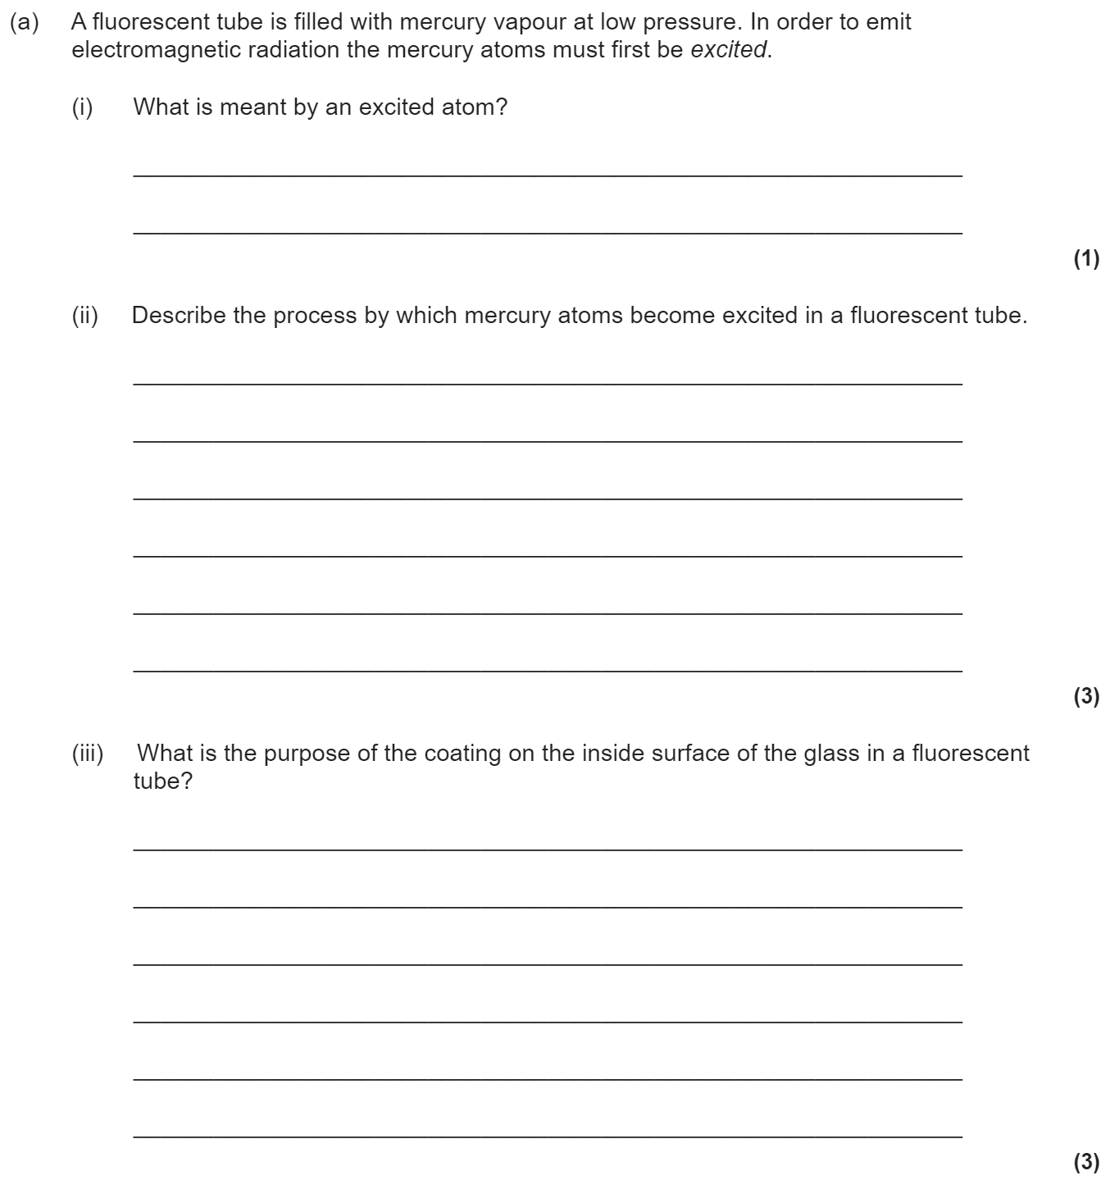
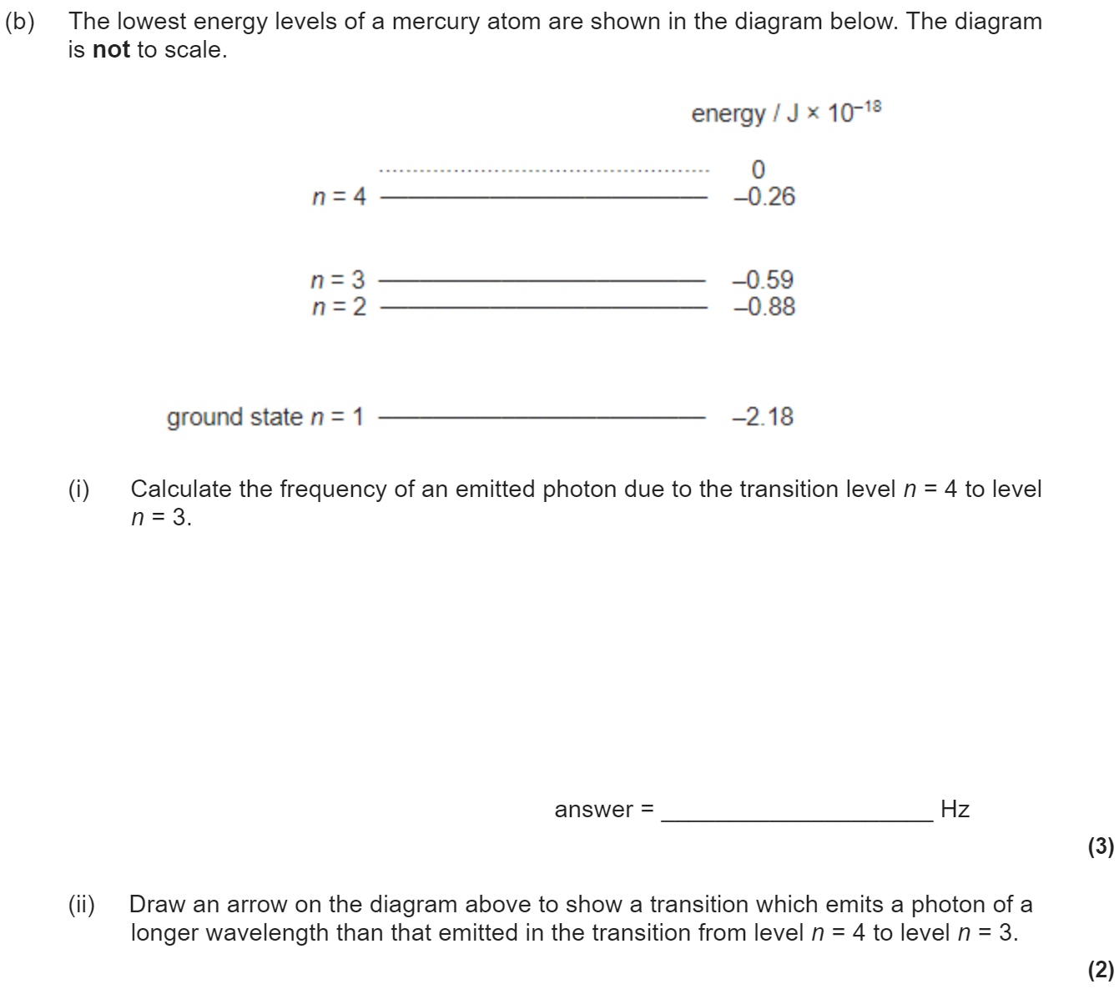
3.2.2.2 Collisions of electrons with atoms
Ionisation and excitation; understanding of ionisation and excitation in the fluorescent tube.
The electron volt.
Students will be expected to be able to convert eV into J and vice versa.

Slide 15
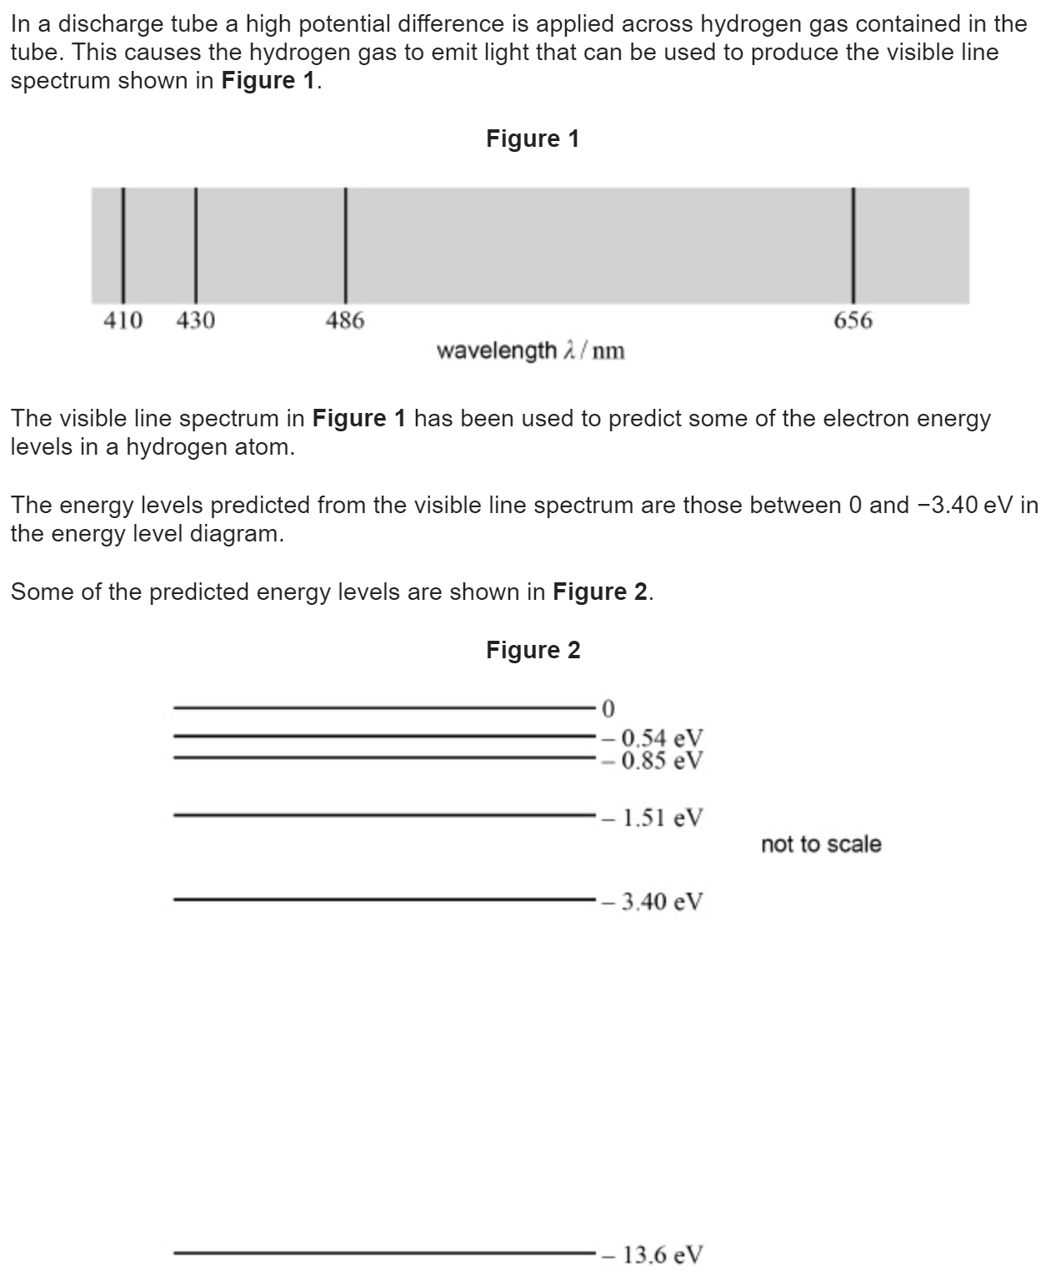
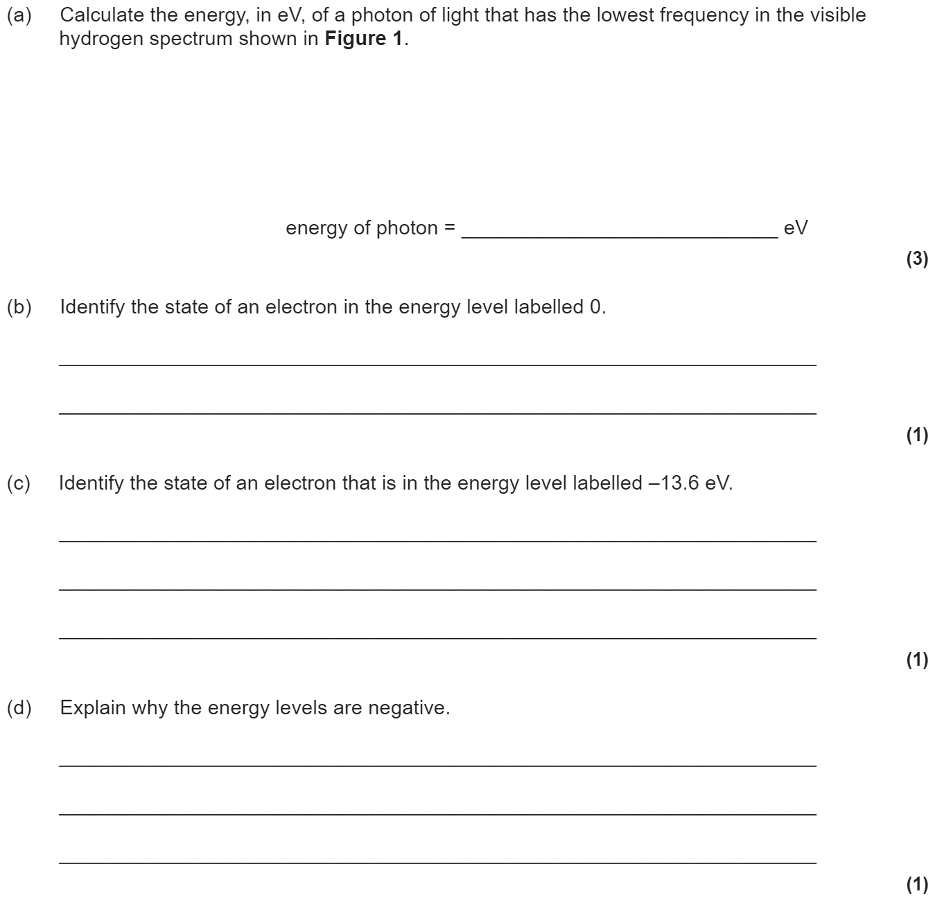
3.2.2.3 Energy levels and photon emission
Line spectra (e.g. of atomic hydrogen) as evidence for transitions between discrete energy levels in atoms.
hf = E₁ − E₂
In questions, energy levels may be quoted in J or eV.

Slide 16
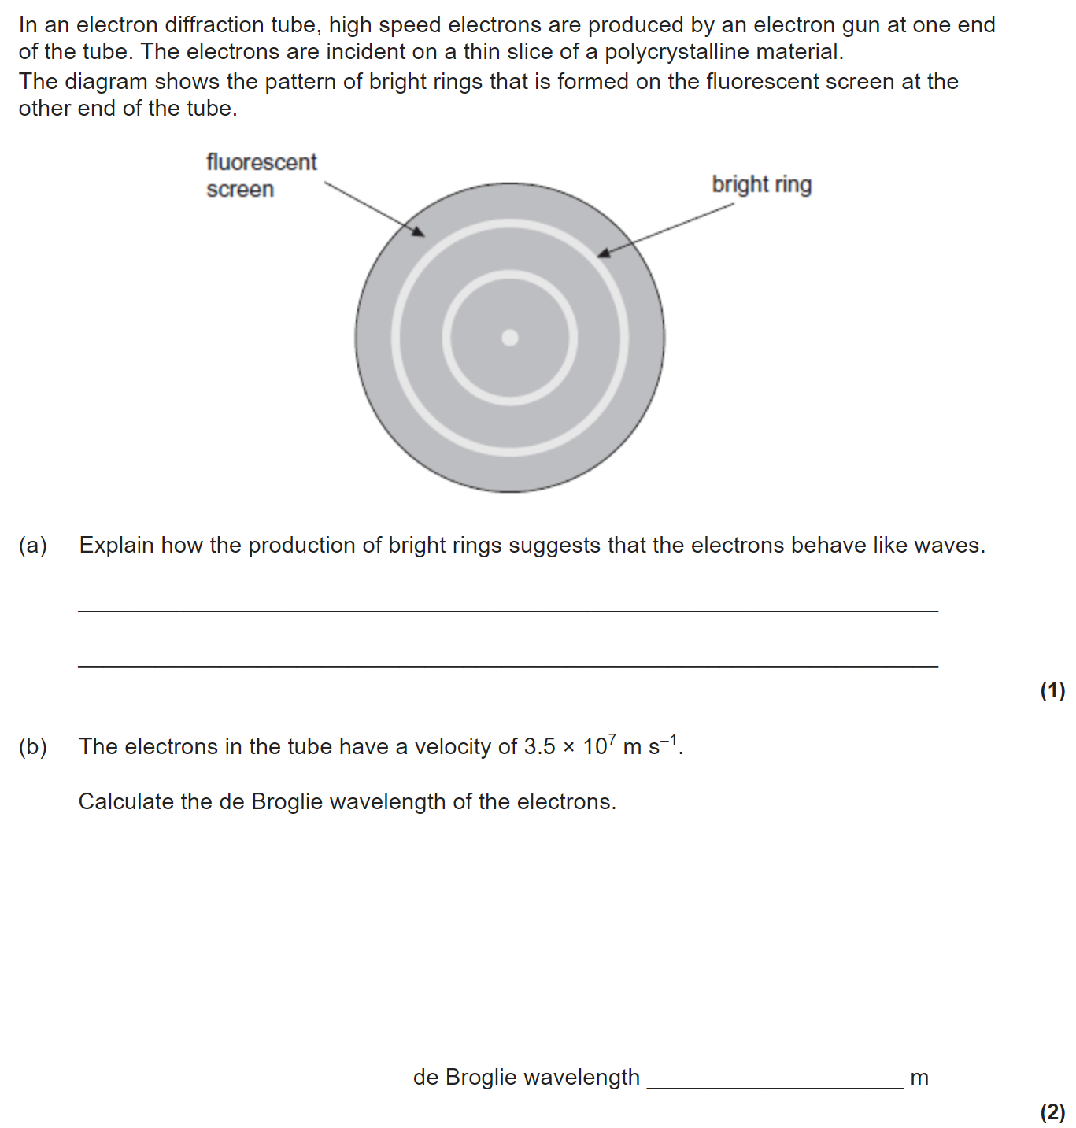
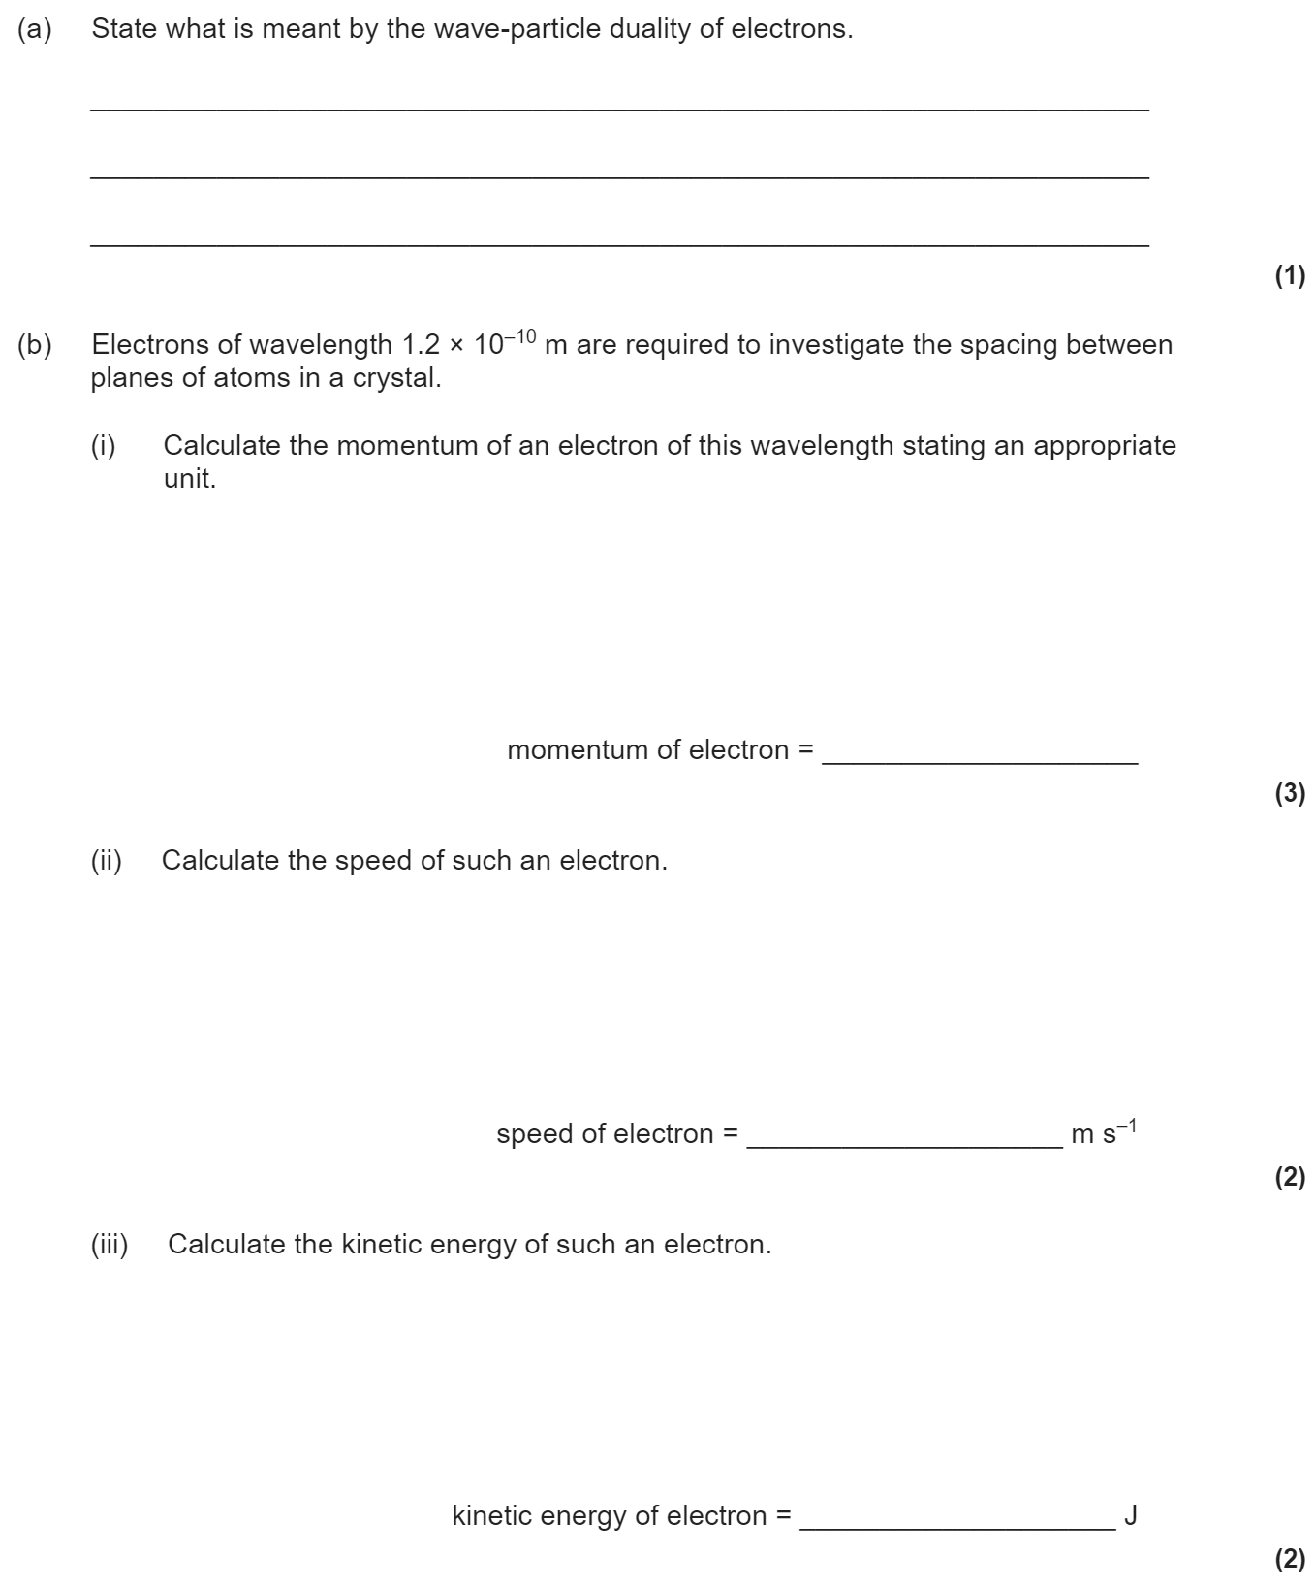
3.2.2.4 Wave-particle duality
Students should know that electron diffraction suggests that particles possess wave properties and the photoelectric effect suggests that electromagnetic waves have a particulate nature.
Details of particular methods of particle diffraction are not expected.
de Broglie wavelength λ = h/mv where mv is the momentum.
Students should be able to explain how and why the amount of diffraction changes when the momentum of the particle is changed.
Appreciation of how knowledge and understanding of the nature of matter changes over time.
Appreciation that such changes need to be evaluated through peer review and validated by the scientific community.

Slide 17
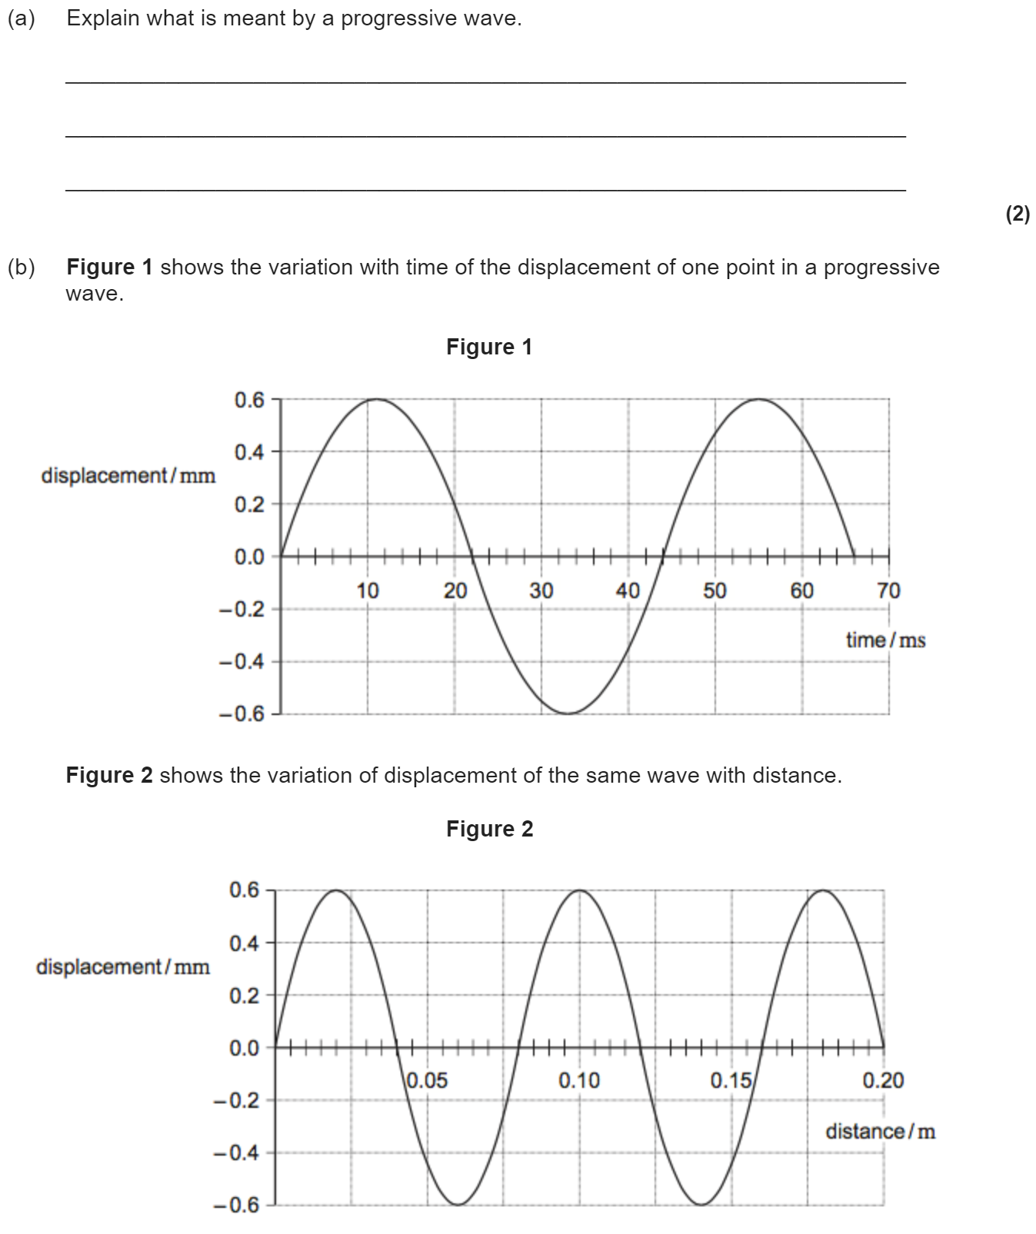
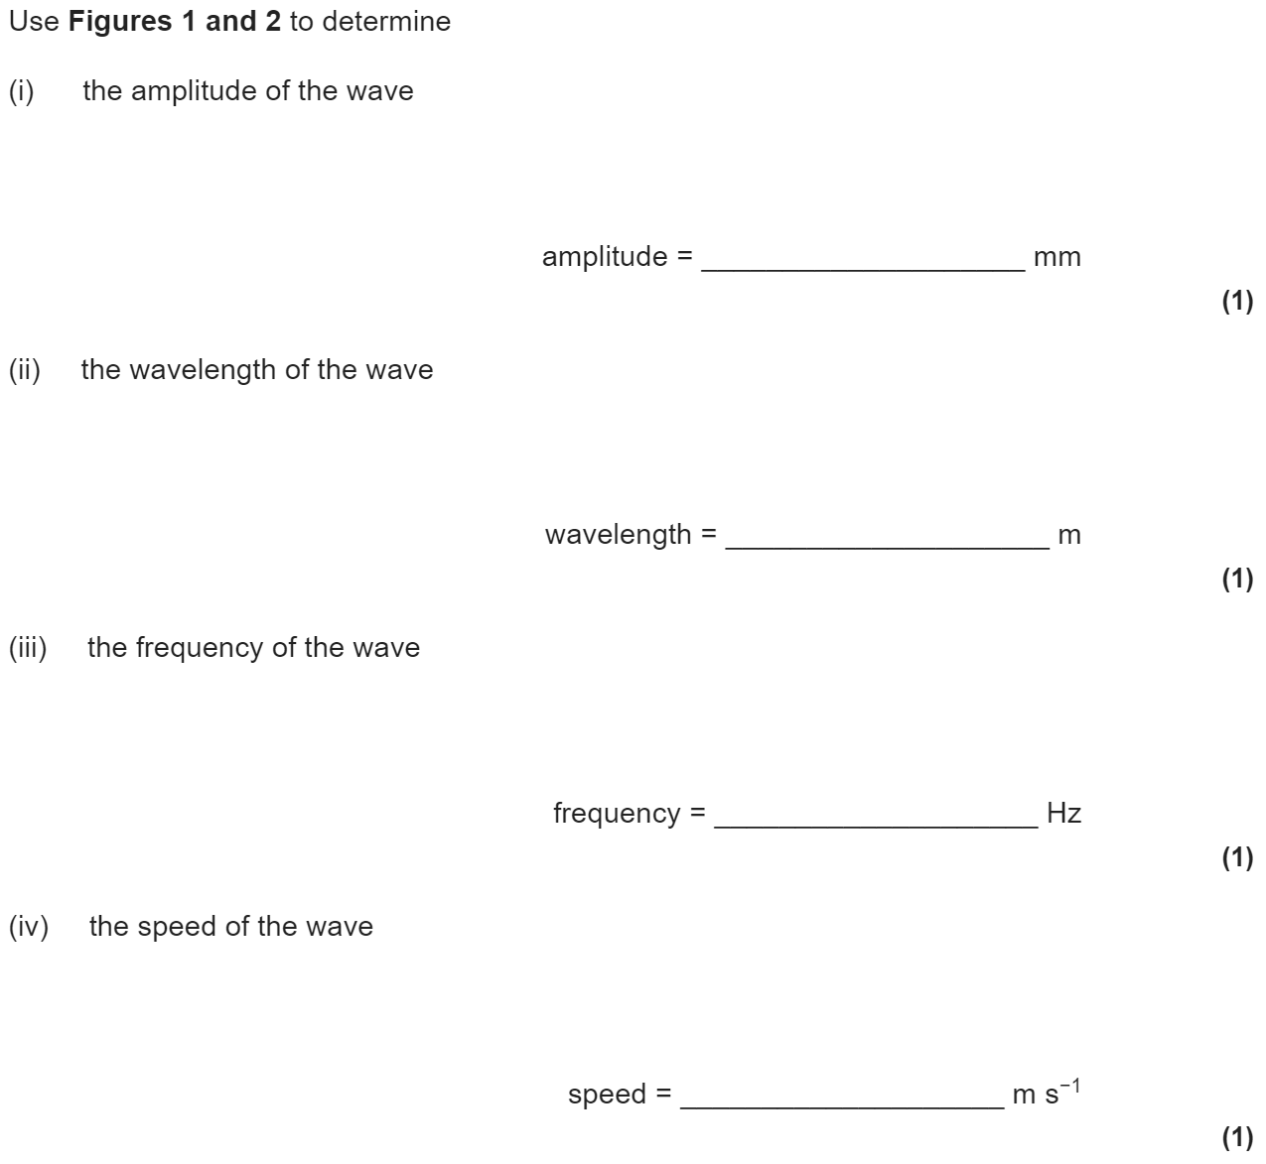
3.3.1.1 Progressive waves
Oscillation of the particles of the medium;
amplitude, frequency, wavelength, speed, phase, phase difference, c = f λ f = 1/T
Phase difference may be measured as angles (radians and degrees) or as fractions of a cycle.

Slide 18
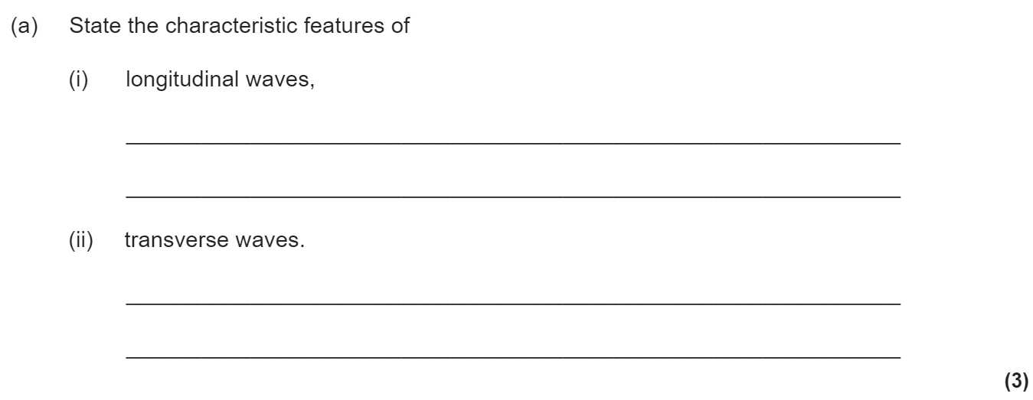
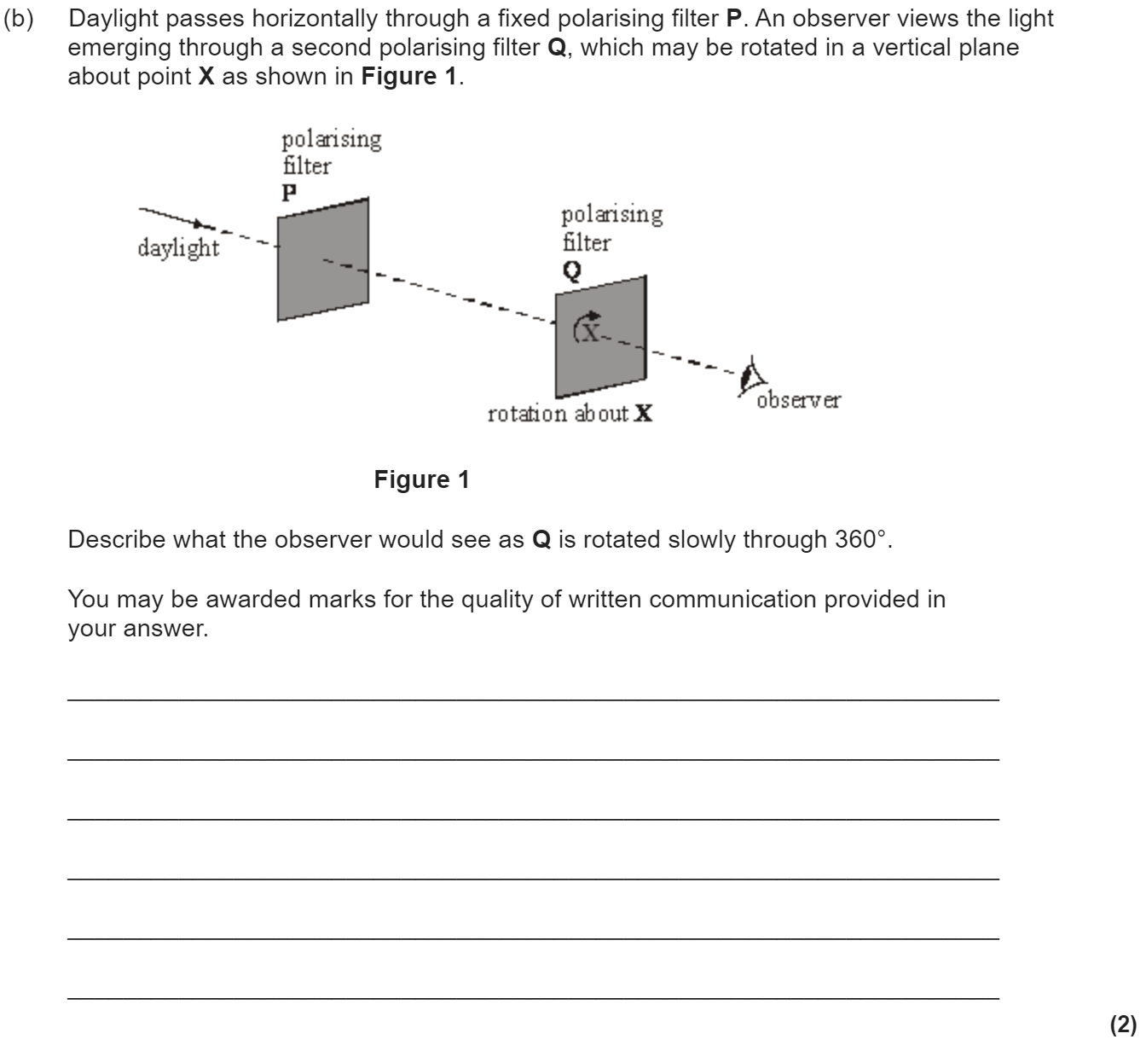
3.3.1.2 Longitudinal and transverse waves
Nature of longitudinal and transverse waves.
Examples to include: sound, electromagnetic waves, and waves on a string.
Students will be expected to know the direction of displacement of particles/fields relative to the direction of energy propagation and that all electromagnetic waves travel at the same speed in a vacuum.
Polarisation as evidence for the nature of transverse waves.
Applications of polarisers to include Polaroid material and the alignment of aerials for transmission and reception.

Slide 19
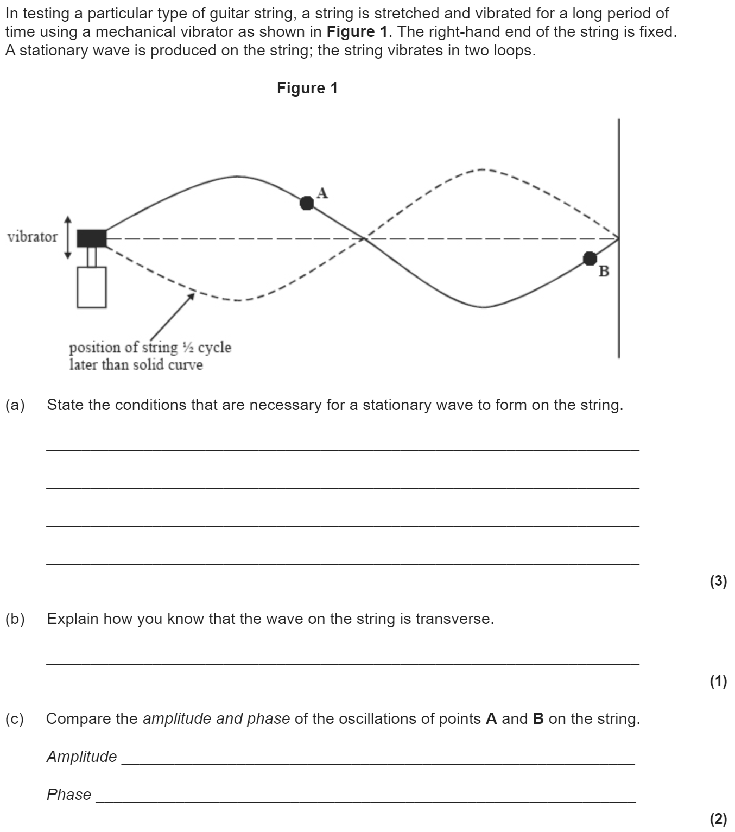
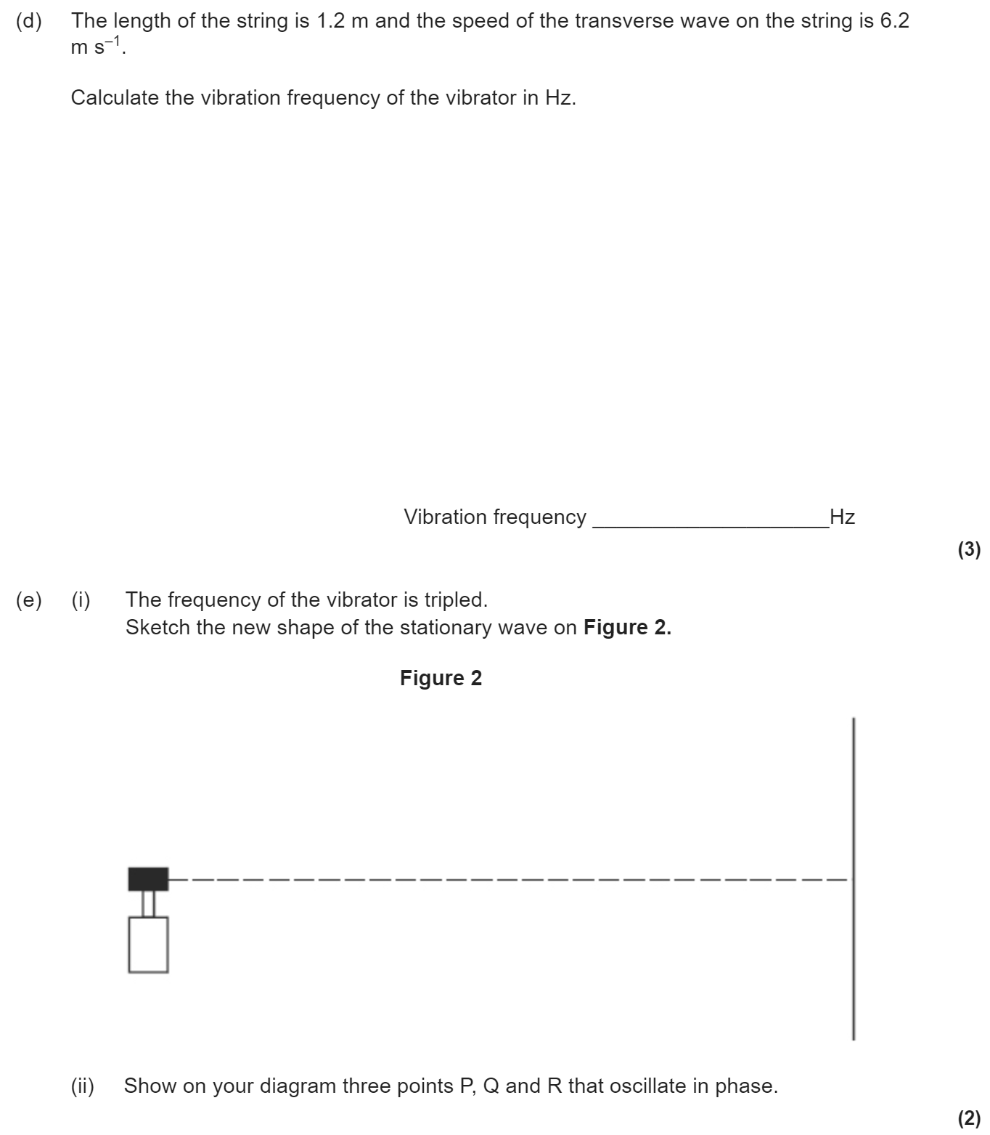
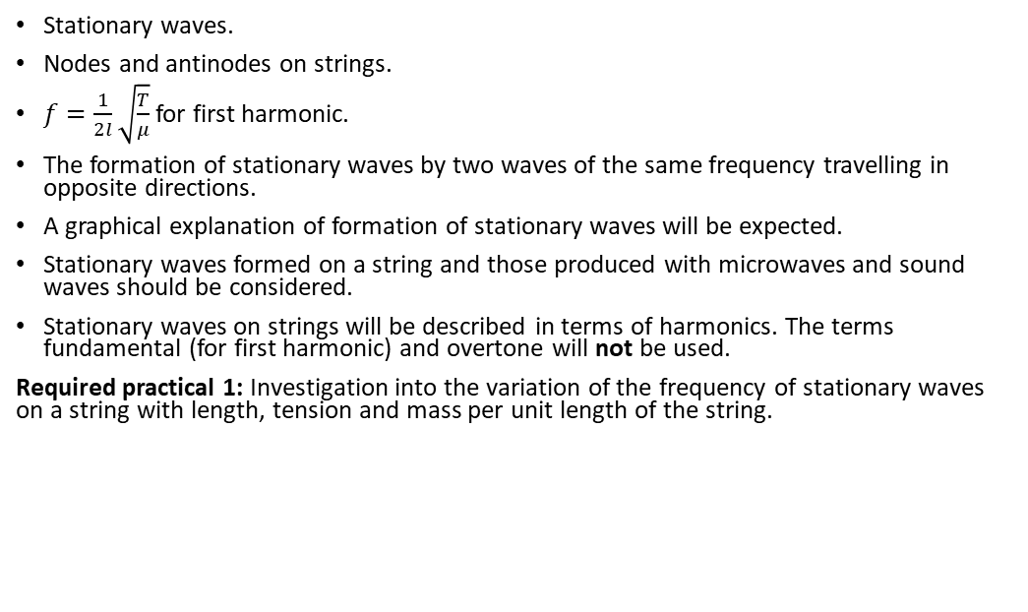
3.3.1.3 Principle of superposition of waves and formation of stationary waves
Stationary waves.
Nodes and antinodes on strings.
$f=\frac{1}{2l}\sqrt{\frac{T}{μ}}$ for first harmonic.
The formation of stationary waves by two waves of the same frequency travelling in opposite directions.
A graphical explanation of formation of stationary waves will be expected.
Stationary waves formed on a string and those produced with microwaves and sound waves should be considered.
Stationary waves on strings will be described in terms of harmonics. The terms fundamental (for first harmonic) and overtone will not be used.
Required practical 1: Investigation into the variation of the frequency of stationary waves on a string with length, tension and mass per unit length of the string.

Slide 20
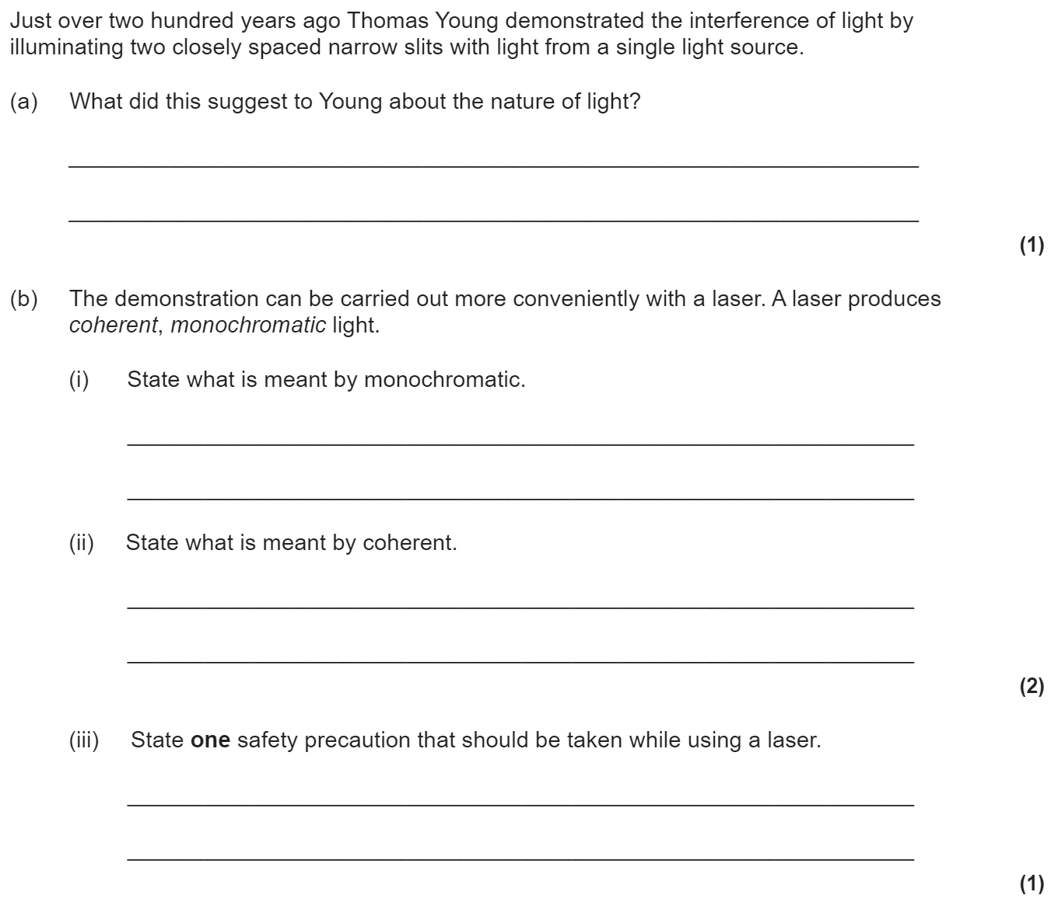
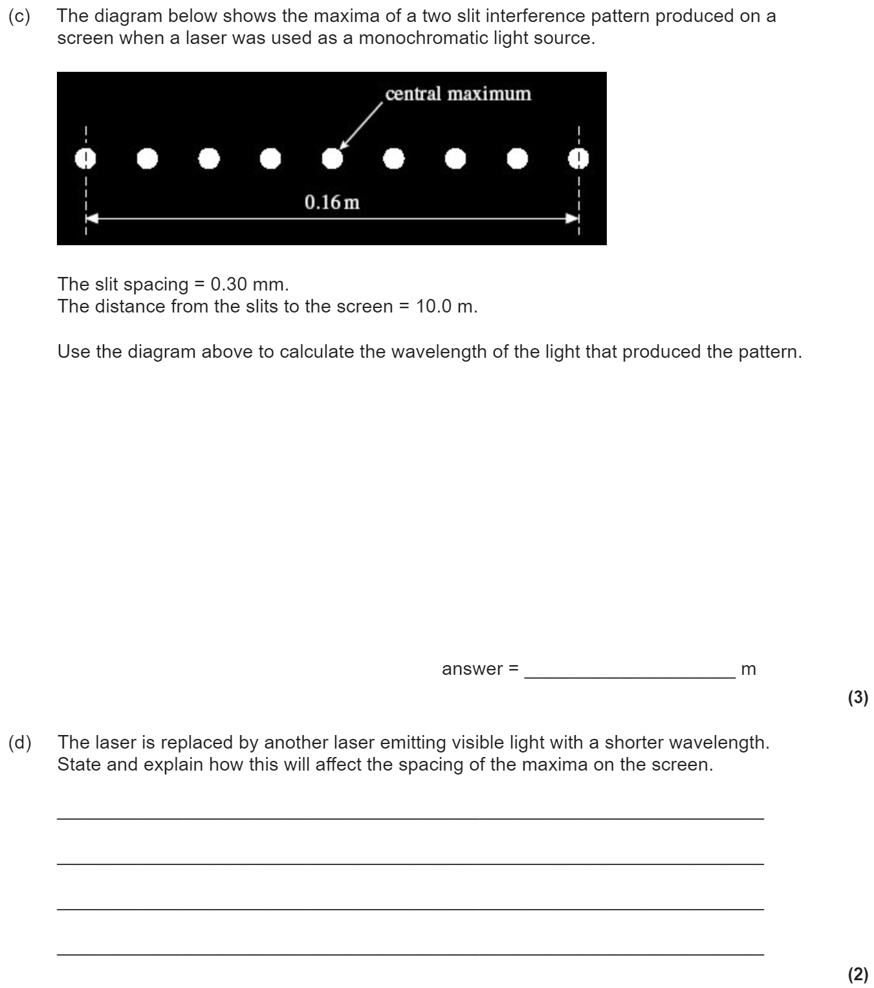
3.3.2.1 Interference
Path difference. Coherence.
Interference and diffraction using a laser as a source of monochromatic light.
Young’s double-slit experiment: the use of two coherent sources or the use of a single source with double slits to produce an interference pattern.
Fringe spacing, w = λD/s
Production of interference pattern using white light.
Students are expected to show awareness of safety issues associated with using lasers.
Students will not be required to describe how a laser works.
Students will be expected to describe and explain interference produced with sound and electromagnetic waves.
Appreciation of how knowledge and understanding of nature of electromagnetic radiation has changed over time.
Required practical 2: Investigation of interference effects to include the Young’s slit experiment and interference by a diffraction grating.

Slide 21
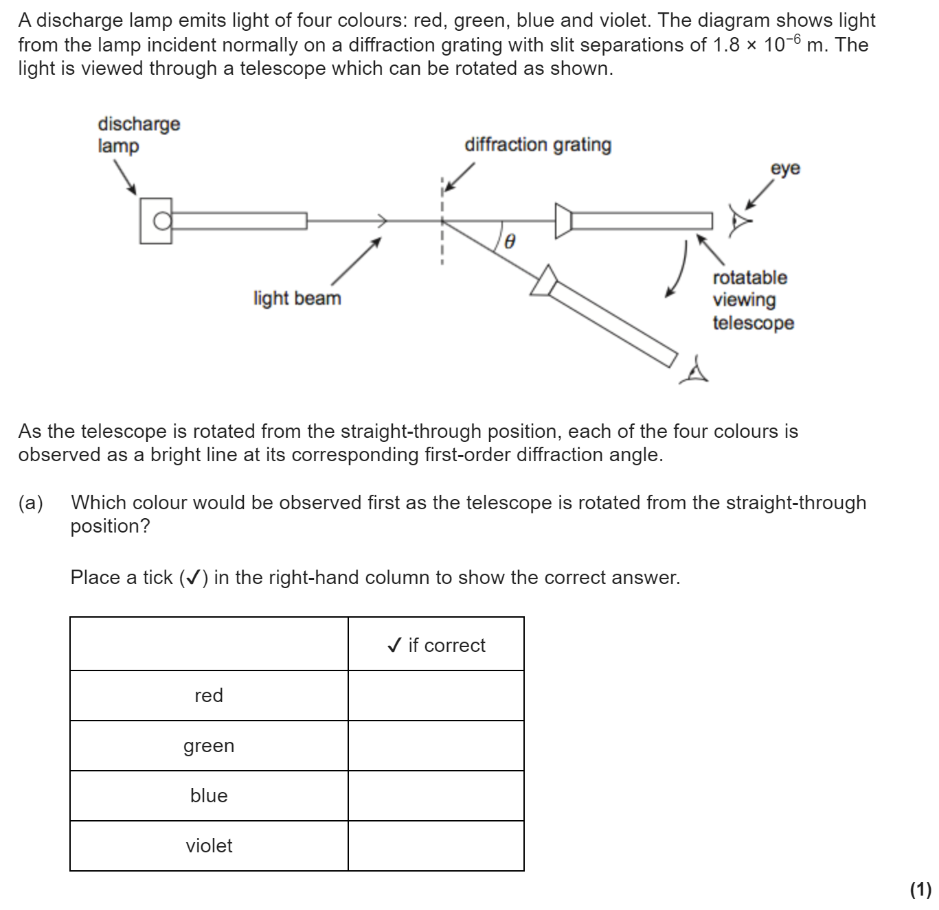
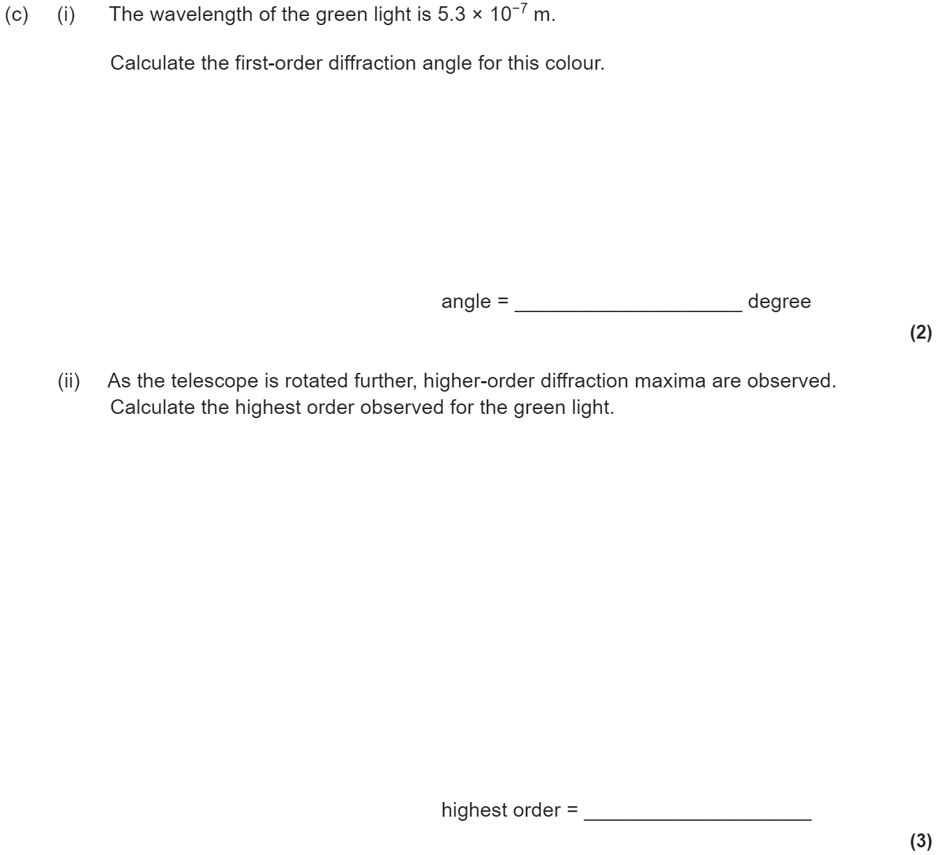
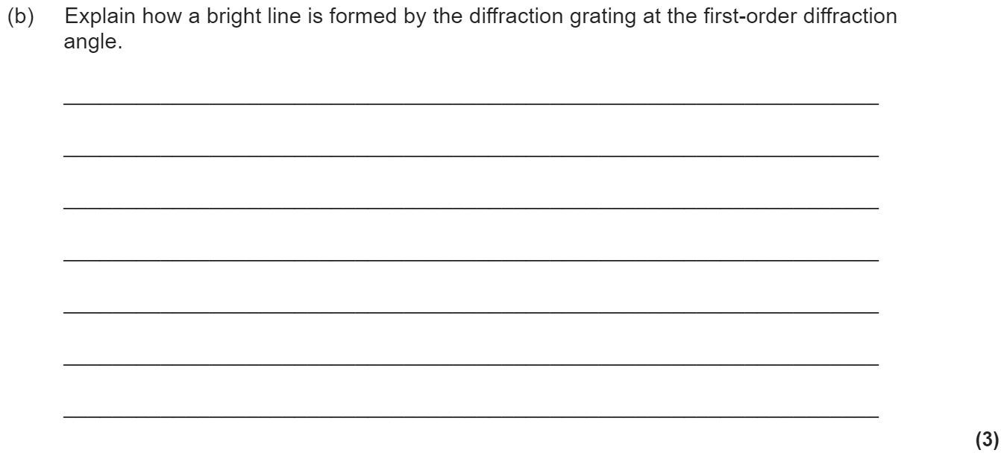
3.3.2.2 Diffraction
Appearance of the diffraction pattern from a single slit using monochromatic and white light.
Qualitative treatment of the variation of the width of the central diffraction maximum with wavelength and slit width. The graph of intensity against angular separation is not required.
Plane transmission diffraction grating at normal incidence.
Derivation of dsinθ = nλ
Use of the spectrometer will not be tested.
Applications of diffraction gratings.

Slide 22
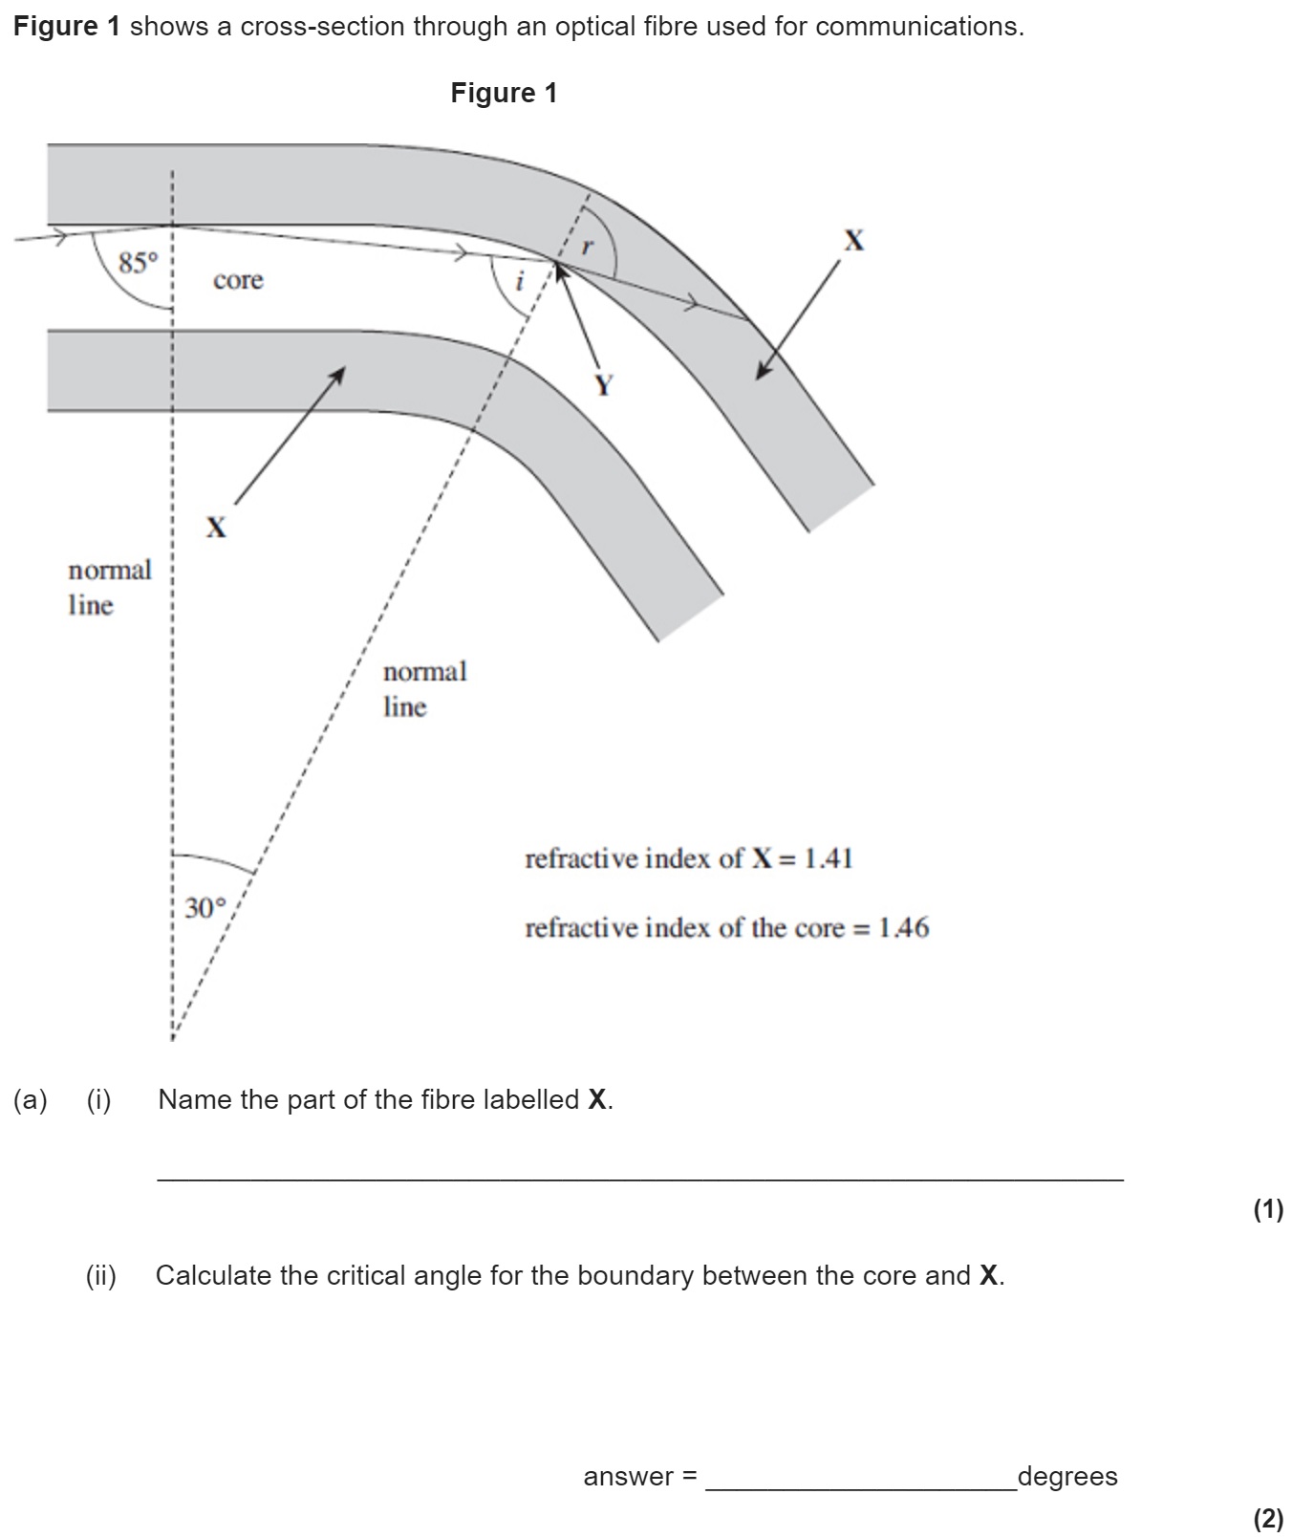
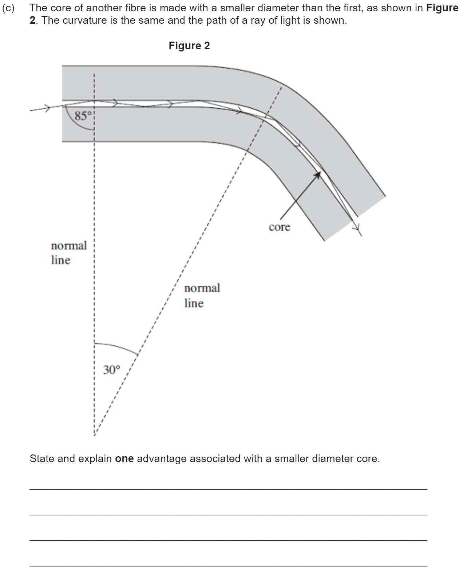
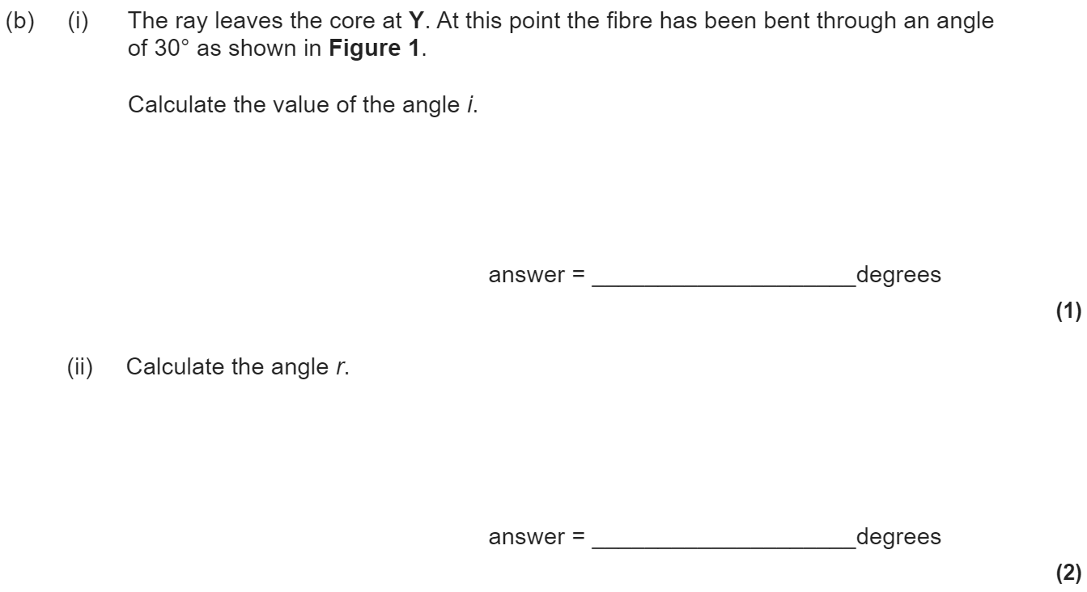
3.3.2.3 Refraction at a plane surface
Refractive index of a substance, n = c/c_{s}
Students should recall that the refractive index of air is approximately 1.
Snell’s law of refraction for a boundary n₁sinθ₁ = n₂sinθ₂
Total internal reflection sinθ_{c} = n₂/n₁
Simple treatment of fibre optics including the function of the cladding.
Optical fibres will be limited to step index only.
Material and modal dispersion.
Students are expected to understand the principles and consequences of pulse broadening and absorption.

Slide 23
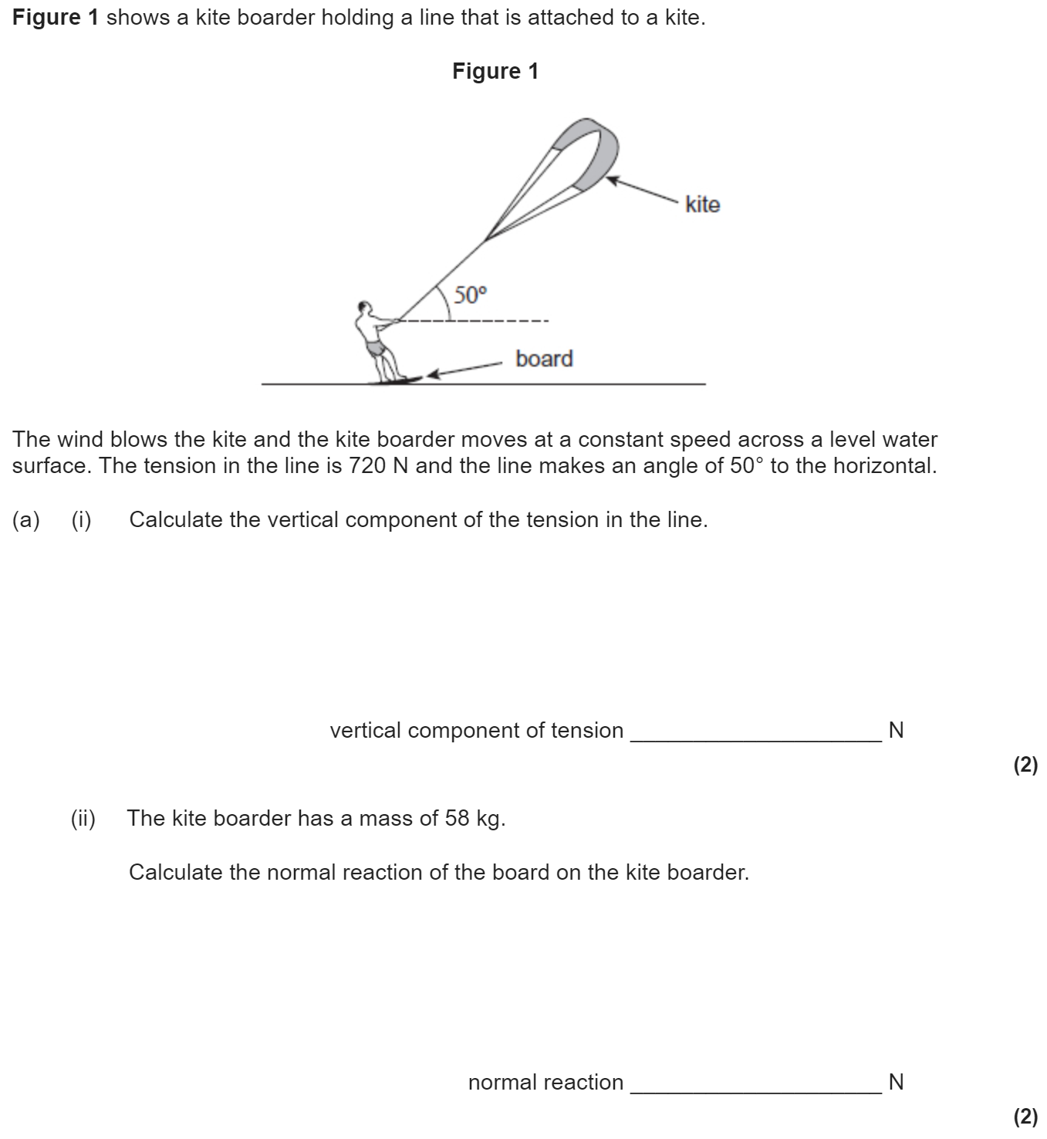
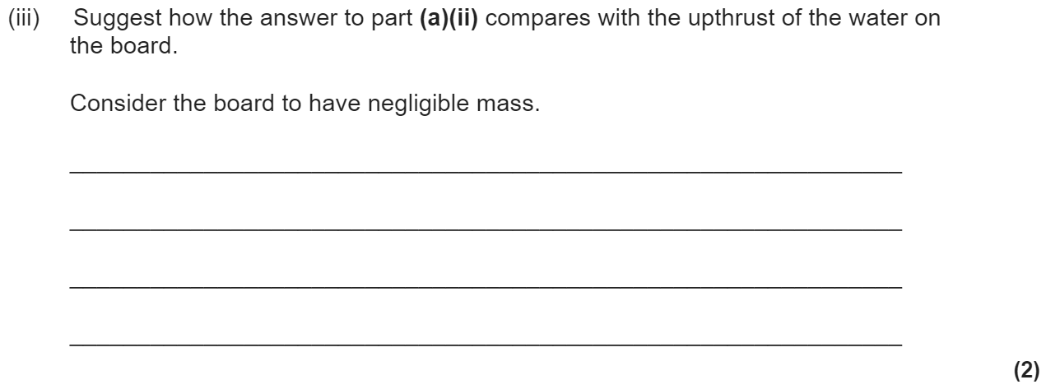
3.4.1.1 Scalars and vectors
Nature of scalars and vectors.
Examples should include:
velocity/speed, mass, force/weight, acceleration, displacement/distance.
Addition of vectors by calculation or scale drawing.
Calculations will be limited to two vectors at right angles. Scale drawings may involve vectors at angles other than 90 °.
Resolution of vectors into two components at right angles to each other.
Examples should include components of forces along and perpendicular to an inclined plane.
Problems may be solved either by the use of resolved forces or the use of a closed triangle.
Conditions for equilibrium for two or three coplanar forces acting at a point. Appreciation of the meaning of equilibrium in the context of an object at rest or moving with constant velocity.

Slide 24

3.4.1.2 Moments
Moment of a force about a point.
Moment defined as force × perpendicular distance from the point to the line of action of the force.
Couple as a pair of equal and opposite coplanar forces.
Moment of couple defined as force × perpendicular distance between the lines of action of the forces.
Principle of moments.
Centre of mass.
Knowledge that the position of the centre of mass of uniform regular solid is at its centre.

Slide 25


3.4.1.3 Motion along a straight line
Displacement, speed, velocity, acceleration. v = Δs/Δt a = Δv/Δt
Calculations may include average and instantaneous speeds and velocities.
Representation by graphical methods of uniform and non-uniform acceleration.
Significance of areas of velocity–time and acceleration–time graphs and gradients of displacement–time and velocity–time graphs for uniform and non-uniform acceleration eg graphs for motion of bouncing ball.
Equations for uniform acceleration:
v = u + at
s = (u + v/2)t
s = ut + at²
v² = u² + 2as
Acceleration due to gravity, g.
Required practical 3: Determination of g by a freefall method.

Slide 26



3.4.1.4 Projectile motion
Independent effect of motion in horizontal and vertical directions of a uniform gravitational field. Problems will be solvable using the equations of uniform acceleration.
Qualitative treatment of friction.
Distinctions between static and dynamic friction will not be tested.
Qualitative treatment of lift and drag forces.
Terminal speed.
Knowledge that air resistance increases with speed.
Qualitative understanding of the effect of air resistance on the trajectory of a projectile and on the factors that affect the maximum speed of a vehicle.

Slide 27




3.4.1.5 Newton’s laws of motion
Knowledge and application of the three laws of motion in appropriate situations.
F = ma for situations where the mass is constant.

Slide 28


3.4.1.6 Momentum
momentum = mass × velocity
Conservation of linear momentum.
Principle applied quantitatively to problems in one dimension.
Force as the rate of change of momentum, F = Δmv/Δt
Impulse = change in momentum
FΔt = Δmv , where F is constant.
Significance of the area under a force–time graph.
Quantitative questions may be set on forces that vary with time. Impact forces are related to contact times (eg kicking a football, crumple zones, packaging).
Elastic and inelastic collisions; explosions.
Appreciation of momentum conservation issues in the context of ethical transport design.

Slide 29


3.4.1.7 Work, energy & power
Energy transferred, W = Fscosθ
rate of doing work = rate of energy transfer, P = ΔW/Δ t = Fv
Quantitative questions may be set on variable forces.
Significance of the area under a force–displacement graph.
efficiency = useful output power input power
Efficiency can be expressed as a percentage.

Slide 30



3.4.1.8 Conservation of energy
Principle of conservation of energy.
ΔE_{p} = mgΔh and E_{k} = 0.5mv²
Quantitative and qualitative application of energy conservation to examples involving gravitational potential energy, kinetic energy, and work done against resistive forces.

Slide 31


3.4.2.1 Bulk properties of solids
Density, ρ = m/V
Hooke’s law, elastic limit,
F = kΔL , k as stiffness and spring constant.
Tensile strain and tensile stress.
Elastic strain energy, breaking stress.
energy stored = 0.5FΔL = area under force−extension graph
Description of plastic behaviour, fracture and brittle behaviour linked to force–extension graphs.
Quantitative and qualitative application of energy conservation to examples involving elastic strain energy and energy to deform.
Spring energy transformed to kinetic and gravitational potential energy.
Interpretation of simple stress–strain curves.
Appreciation of energy conservation issues in the context of ethical transport design.

Slide 32



3.4.2.2 The Young Modulus
Young modulus = tensile stress/tensile strain = FL/AΔL
Use of stress–strain graphs to find the Young modulus.
(One simple method of measurement is required.)
Required practical 4: Determination of the Young modulus by a simple method.

Slide 33


3.5.1.1 Basics of electricity
Electric current as the rate of flow of charge; potential difference as work done per unit charge.
I = ΔQ/Δ t , V = W/Q
Resistance defined as R = V/I
3.5.1.2 Current-voltage characteristics
For an ohmic conductor, semiconductor diode, and filament lamp.
Ohm’s law as a special case where I ∝ V under constant physical conditions.
Unless specifically stated in questions, ammeters and voltmeters should be treated as ideal (having zero and infinite resistance respectively).
Questions can be set where either I or V is on the horizontal axis of the characteristic graph.

Slide 34

3.5.1.3 Resistivity
Resistivity, ρ = RA/L
Description of the qualitative effect of temperature on the resistance of metal conductors and thermistors.
Only negative temperature coefficient (ntc) thermistors will be considered.
Applications of thermistors to include temperature sensors and resistance–temperature graphs.
Superconductivity as a property of certain materials which have zero resistivity at and below a critical temperature which depends on the material.
Applications of superconductors to include the production of strong magnetic fields and the reduction of energy loss in transmission of electric power.
Critical field will not be assessed.
Required practical 5: Determination of resistivity of a wire using a micrometer, ammeter and voltmeter.

Slide 35



Slide 36



Slide 37

3.5.1.4 Circuits
Resistors:
in series, R_{T} = R₁ + R₂ + R₃ + …
in parallel, 1/R_{T} = 1/R₁ + 1/R₂ + 1/R₃ + …
Energy and power equations: E = IVt;
P = IV = I²R = V²/R
The relationships between currents, voltages and resistances in series and parallel circuits, including cells in series and identical cells in parallel.
Conservation of charge and conservation of energy in dc circuits.

Slide 38
3.5.1.4 Circuits
Resistors:
in series, R_{T} = R₁ + R₂ + R₃ + …
in parallel, 1/R_{T} = 1/R₁ + 1/R₂ + 1/R₃ + …
Energy and power equations: E = IVt;
P = IV = I²R = V²/R
The relationships between currents, voltages and resistances in series and parallel circuits, including cells in series and identical cells in parallel.
Conservation of charge and conservation of energy in dc circuits.

Slide 39



3.5.1.5 Potential divider
The potential divider used to supply constant or variable potential difference from a power supply.
The use of the potentiometer as a measuring instrument is not required.
Examples should include the use of variable resistors, thermistors, and light dependent resistors (LDR) in the potential divider.

Slide 40


3.5.1.6 Electromotive force and internal resistance
ϵ = E/Q , ϵ = I(R + r)
Terminal pd; emf
Students will be expected to understand and perform calculations for circuits in which the internal resistance of the supply is not negligible.
Required practical 6: Investigation of the emf and internal resistance of electric cells and batteries by measuring the variation of the terminal pd of the cell with current in it.

Slide 41


3.6.1.1 Circular motion
Motion in a circular path at constant speed implies there is an acceleration and requires a centripetal force.
Magnitude of angular speed ω = v/r = 2πf
Radian measure of angle.
Direction of angular velocity will not be considered.
Centripetal acceleration a = v²/r = ω²r
The derivation of the centripetal acceleration formula will not be examined.
Centripetal force F = mv²/r = mω²r

Slide 42


3.6.1.2 Simple harmonic motion
Analysis of characteristics of simple harmonic motion (SHM).
Condition for SHM: a ∝ − x
Defining equation: a = − ω²x
x = Acosωt and v = ±ω√(A² − x²)
Graphical representations linking the variations of x, v and a with time.
Appreciation that the v − t graph is derived from the gradient of the x − t graph and that the a − t graph is derived from the gradient of the v − t graph.
Maximum speed = ωA
Maximum acceleration = ω²A

Slide 43

3.6.1.3 Simple harmonic systems
Study of mass-spring system: T = 2π√(m/k)
Study of simple pendulum: T = 2π√(l/g)
Questions may involve other harmonic oscillators (eg liquid in U-tube) but full information will be provided in questions where necessary.
Variation of E_{k}, E_{p}, and total energy with both displacement and time.
Effects of damping on oscillations.

Slide 44



Slide 45



3.6.1.4 Forced vibrations and resonance
Qualitative treatment of free and forced vibrations.
Resonance and the effects of damping on the sharpness of resonance.
Examples of these effects in mechanical systems and situations involving stationary waves.

