Slide 1
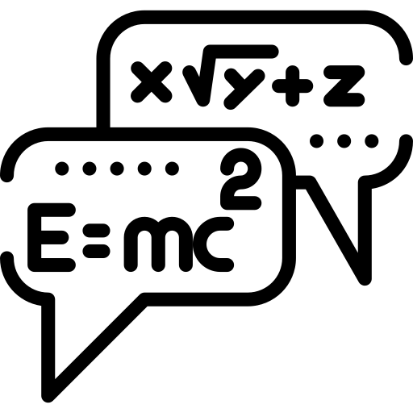







Physics Paper 1 revision booklet (separate)
Exam date: 20th May 2020 (pm)
Contents:
Equations fact sheet.
Energy fact sheet.
Energy notes and exam questions.
Electricity fact sheet.
Electricity notes and exam questions.
Particle model fact sheet.
Particle model notes and exam questions.
Atomic structure fact sheet.
Atomic structure notes and exam questions.
Paper 1 knowledge assessment.
Specification.
How to use:
Quiz yourself on the questions on the fact sheets (or get a family member/friend) to quiz you.
Answer the questions on the exam questions. Once answered, cover up the answers & check that you can do again.
Revising effectively does not simply involve reading over notes or making new notes – you have to practice answering questions & practice remembering information. To learn physics you have to do physics.
Good luck – although if you revise hard you won’t need it!
Dr. Edmunds

Slide 2
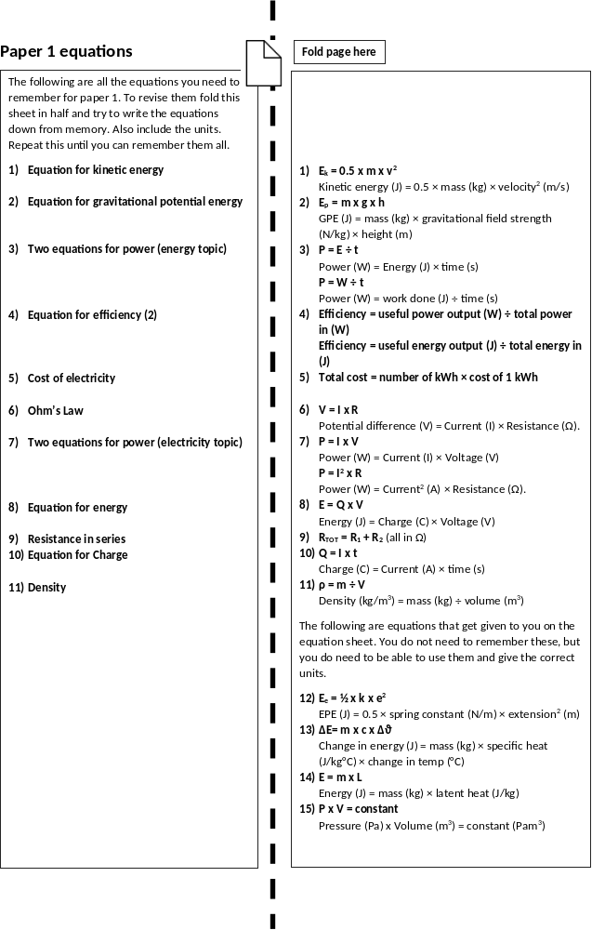

Slide 3
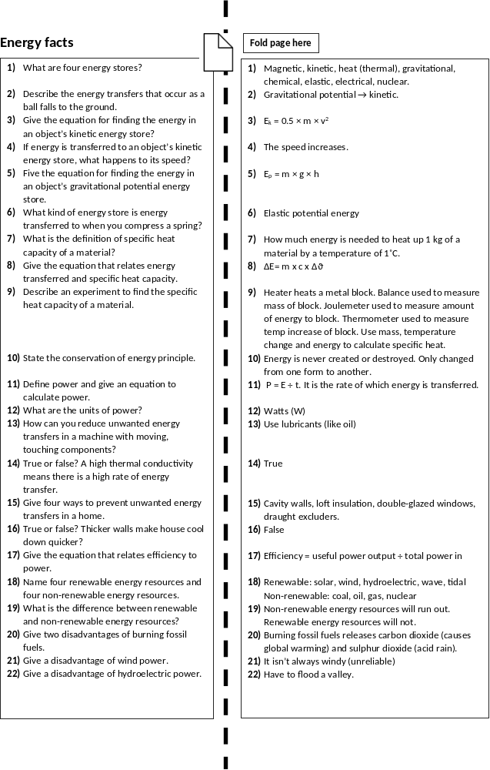

Slide 4
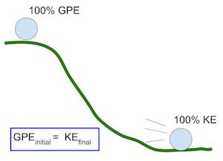
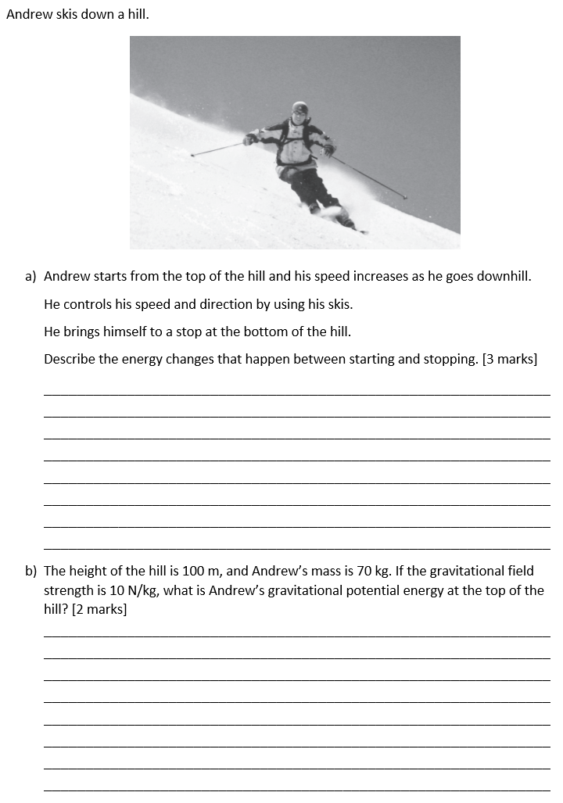
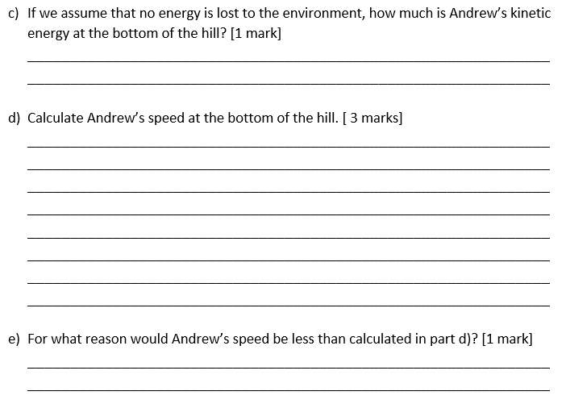
Energy revision
Keywords: Store, system, kinetic, gravitational, kinetic, elastic, heat capacity
Do Now: What are the units of
-Gravitational field strength?
-Velocity
-Spring constant
-Mass
-Power
-Efficiency
-Energy
-Height
Energy
There are ten different types of energy, and eight energy stores (the underlined energies): “Most Kids Hate Learning GCSE Energy Names”. The first letters stand for Magnetic, Kinetic, Heat (thermal), Light, Gravitational, Chemical, Sound, Electrical, Elastic, Nuclear.
A system is an object or a group of objects. When a system changes, energy is transferred.
The principle of conservation of energy says that energy is never created or destroyed, only changed from one form to another.
You have to remember the equations for gravitational potential and kinetic energy, but get given the equation for elastic potential energy.
E_{k} = 0.5 x m x v²
Kinetic energy (J) = 0.5 × mass (kg) × velocity² (m/s)
E_{p} = m x g x h
GPE (J) = mass (kg) × gravitational field strength (N/kg) × height (m)
E_{e} = ½ x k x e²
EPE (J) = 0.5 × spring constant (N/m) × extension² (m)

Slide 5
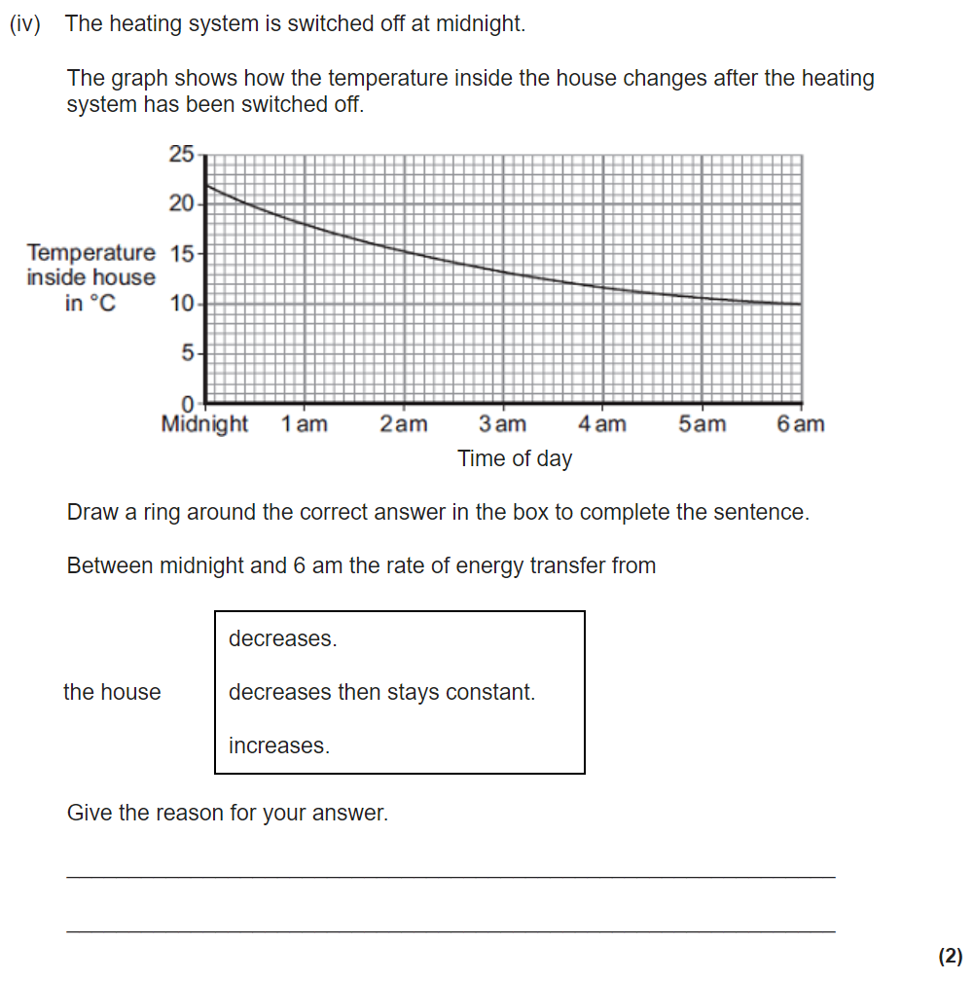
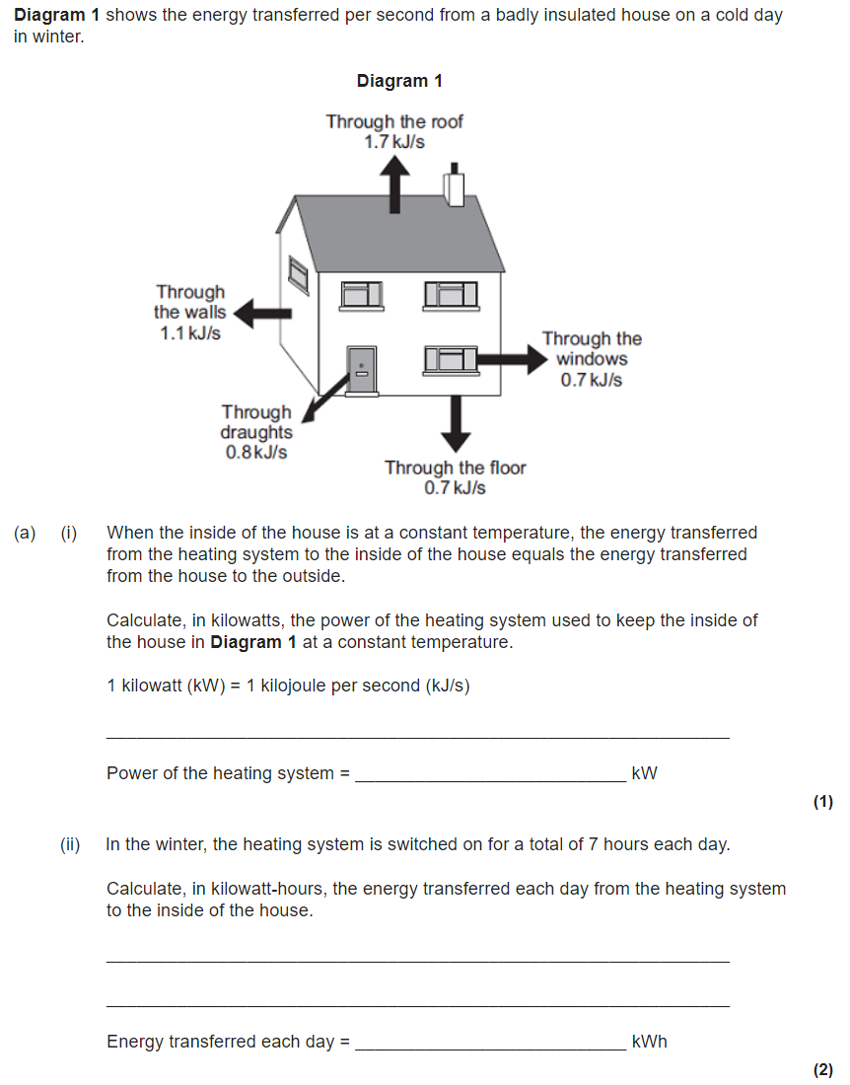
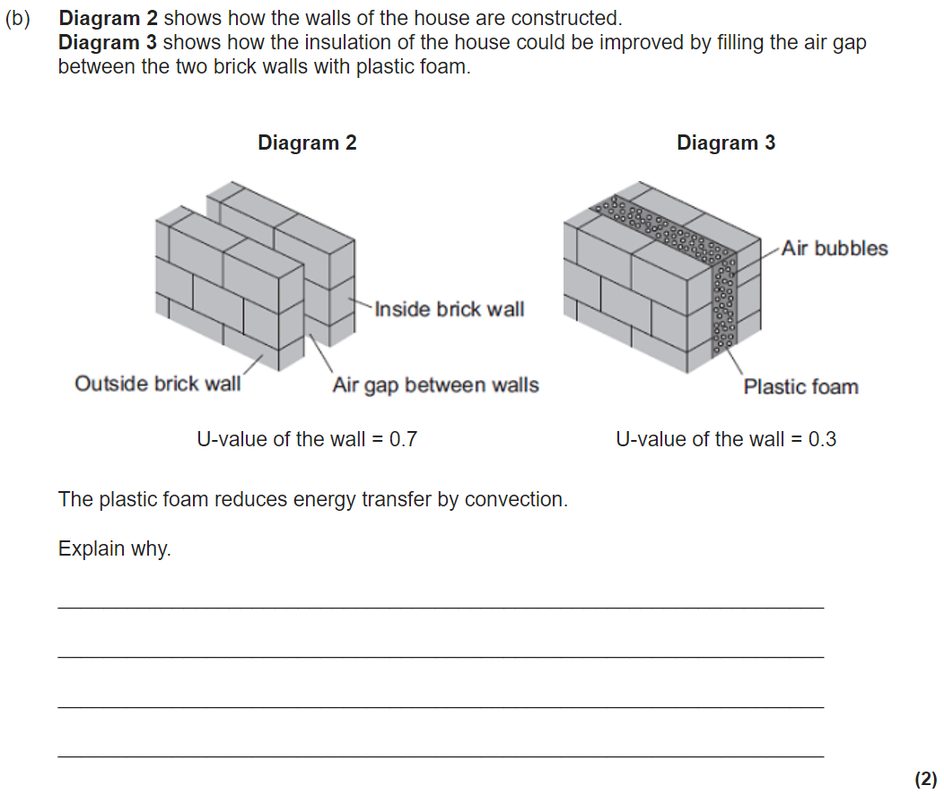
Power and efficiency
Power is a measured of how much energy is being used/work done is transferred per second.
P = E ÷ t
Power (W) = Energy (J) ÷ time (s)
P = W ÷ t
Power (W) = work done (J) ÷ time (s)
During the process of an energy transfer, energy is usually lost (mostly in the form of thermal and sound energy). Efficiency is a measure of how usefully the energy/power is transferred.
Efficiency = useful power output (W) ÷ total power in (W)
Efficiency = useful energy output (J) ÷ total energy in (J)
We want to reduce energy unwanted energy transfers. We can do this by lubrication (for example on the wheels of a bike), or reduce energy loss in the home by:
Installing double glazing.
Installing cavity wall insulation (which decreases the thermal conductivity of the wall and reduces convection also).
Using loft insulation and draught excluders.

Slide 6
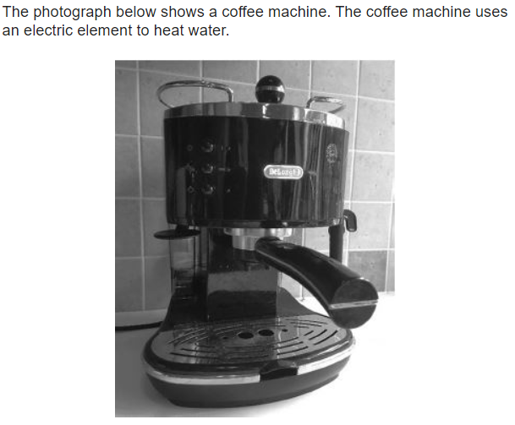
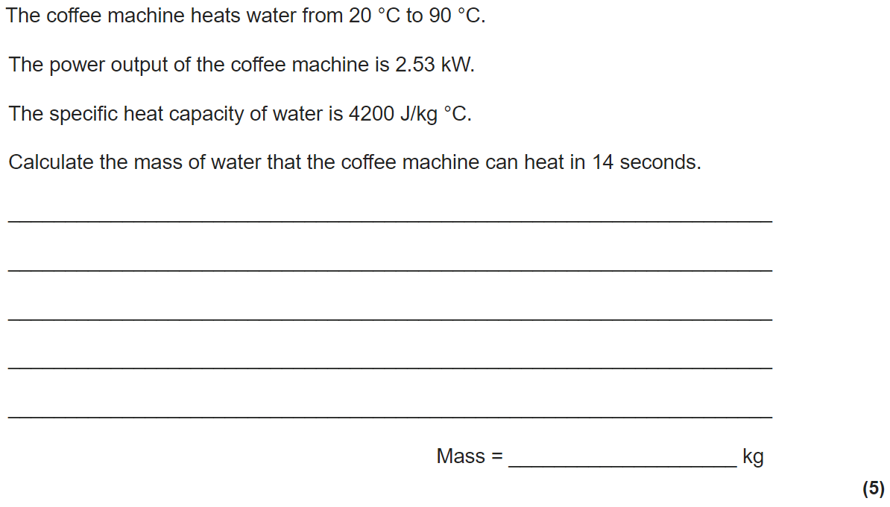
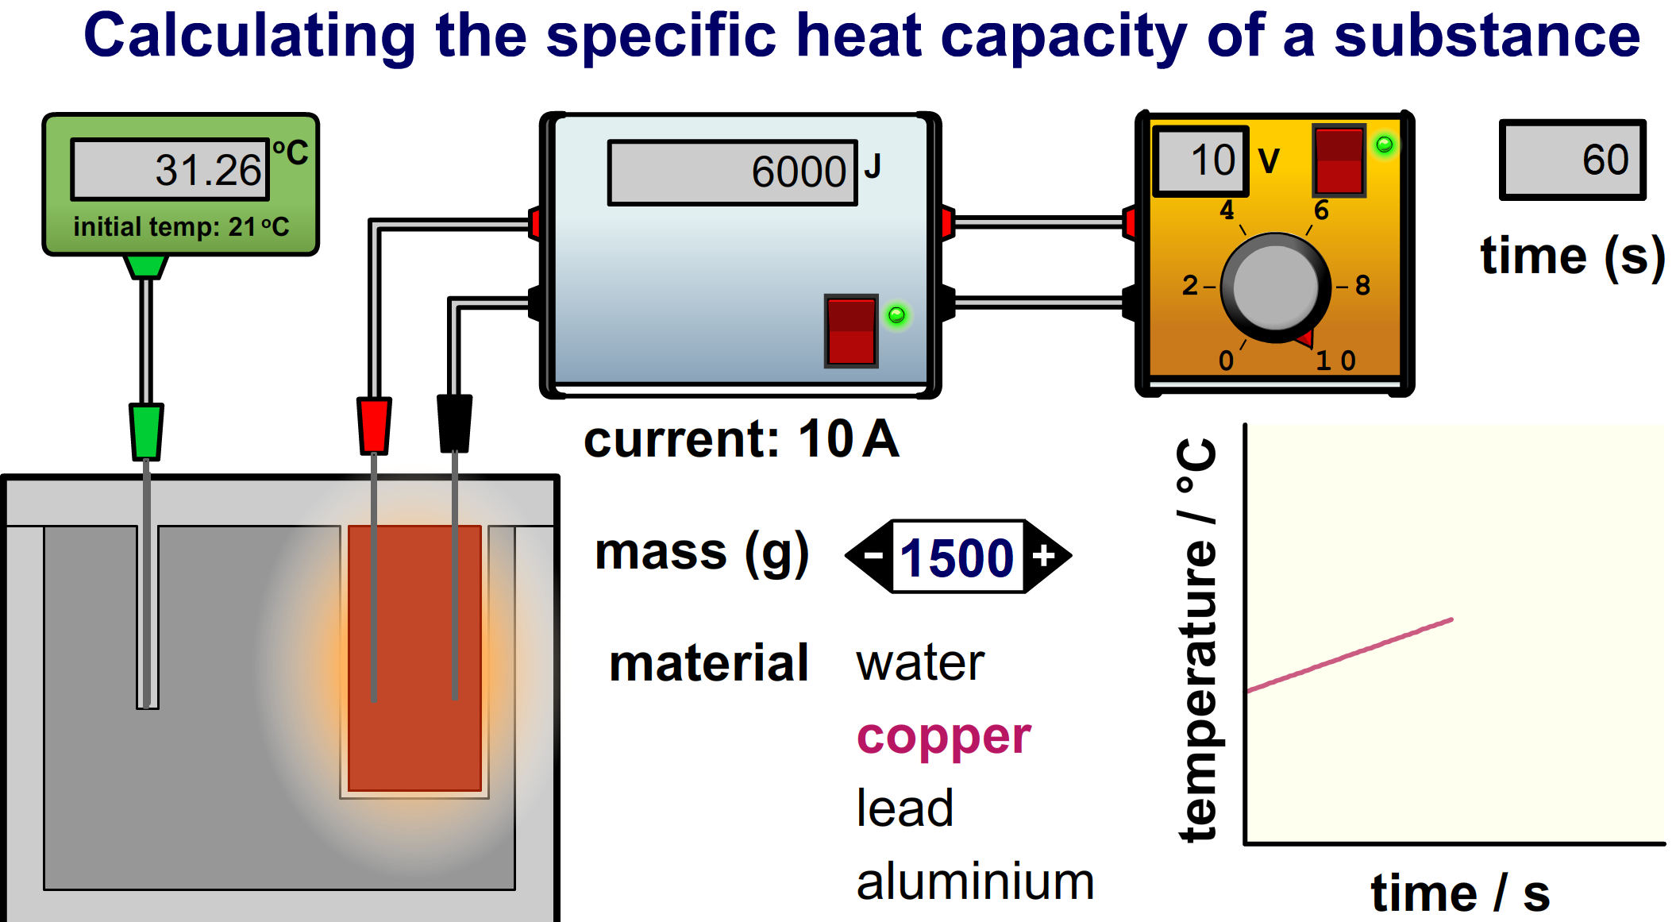
Specific heat capacity
When a substance is changing temperature, the energy change can be calculated by using ΔE= m x c x Δϑ.
The specific heat capacity is the energy needed to heat up 1 kg of a substance by 1 degree.
Required practical 1 gets us to measure the specific heat capacity of a material. To do this we:
-Use a metal block with two holes in it (one for heater and one for thermometer to measure the temperature.
-Use a balance to measure the mass of the metal block.
-Use a power pack to supply energy to the metal block, a Joulemeter can be used to measure the thermal energy going into the block. (Note: you can use an ammeter, voltmeter and stopwatch instead of a Joulemeter).
-If we have measured the mass, energy change, and temperature change then we can use ΔE= m x c x Δϑ to calculate the specific heat capacity.
Stretch: Calculate the specific heat capacity of the copper block from the information in the diagram.

Slide 7



Energy Resources
Renewable energy resources are renewed. They do not run out. Examples include; tidal, wave, geothermal, wind and solar.
Non-renewable energy resources do run out. They are fossil fuels (coal, oil and gas) and nuclear. Non-renewables generally work by heating water in a boiler until it turns to steam. This steam is highly pressurised and turns the blades of a turbine. This turbine then turns a generator which converts kinetic energy into electrical energy.
Each method of generating electricity has advantages and disadvantages. Burning fossil fuels creates carbon dioxide which leads to global warming; but they generate electricity reliably. Wind and solar power are unreliable but do not generate carbon dioxide and once built are cheap to run.

Slide 8
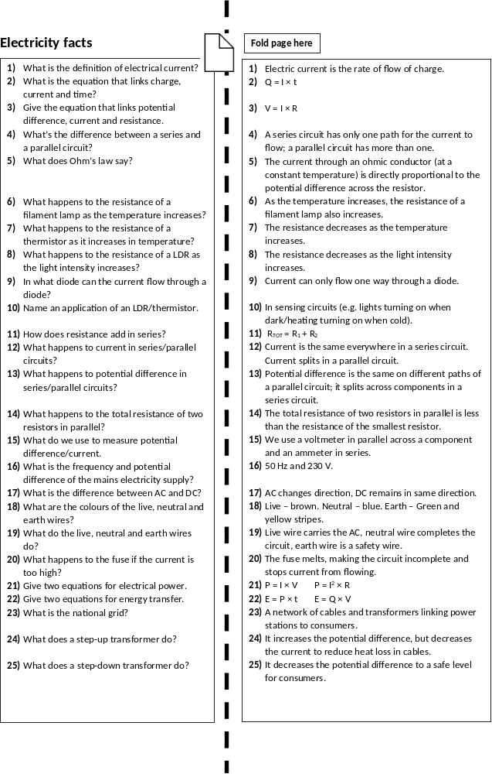

Slide 9

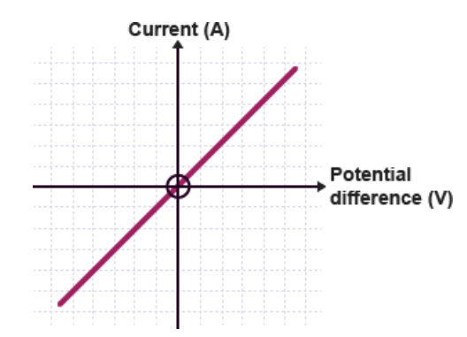

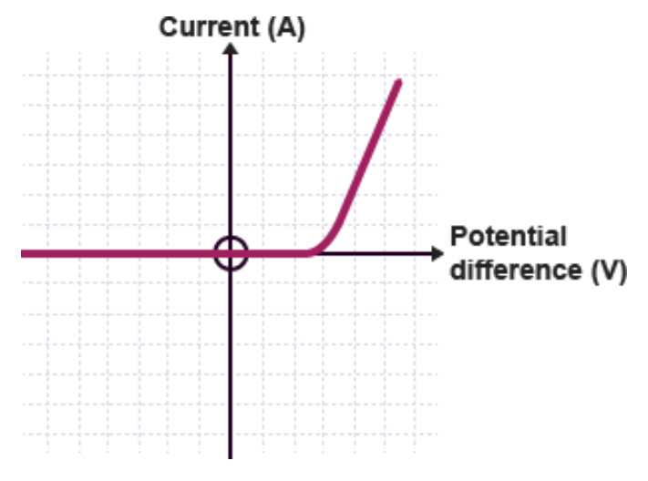
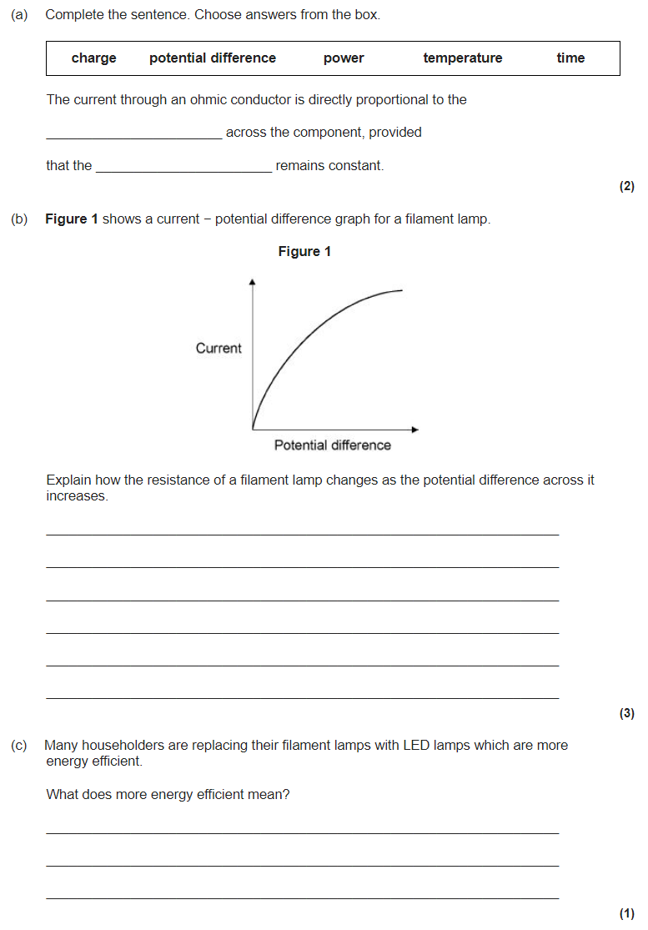
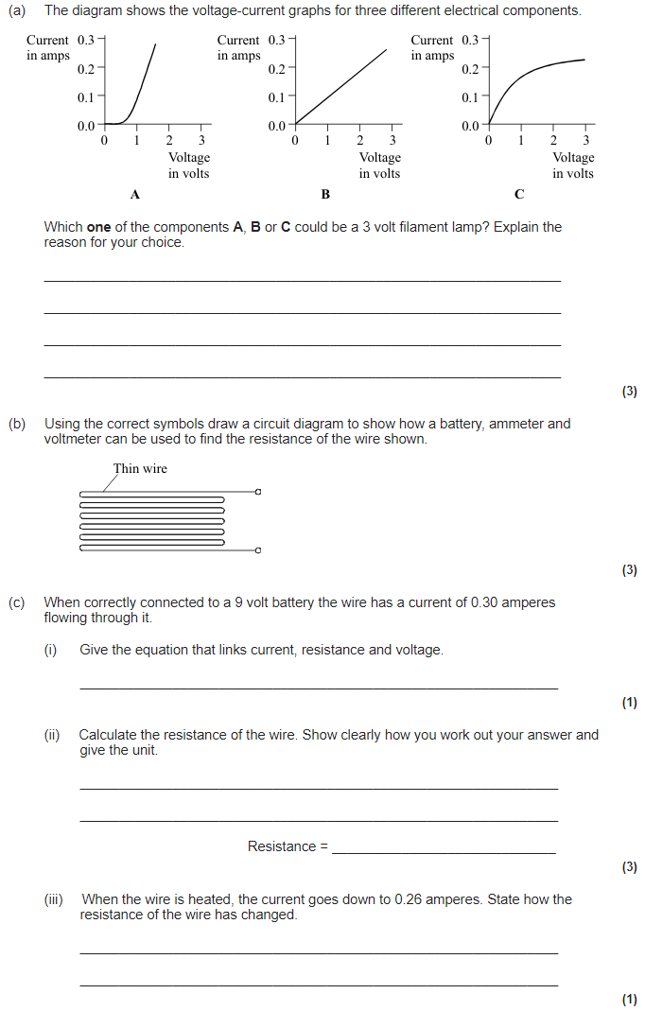
Energy revision
Keywords: Store, system, kinetic, gravitational, kinetic, elastic, heat capacity
Do Now: What are the units of
-Resistance
-Charge
-Time
-Energy
-Power
-Voltage
-Current
Symbols, charge, current and Ohm’s law
Current is the flow of charged particles (electrons). The equation that links charge, current and time is:
Q = I x t
Charge (C) = Current (A) × time (s)
Ohm’s law says that for an Ohmic conductor, the potential difference is directly proportional to the current.
V = I x R
Potential difference (V) = Current (I) × Resistance (Ω).
I-V graph for a resistor. A resistor is Ohmic
I-V graph for a lamp. A lamp is non-Ohmic (resistance increases as it heats)
I-V graph for a diode. A diode is non-Ohmic (only lets current flow one way)

Slide 10

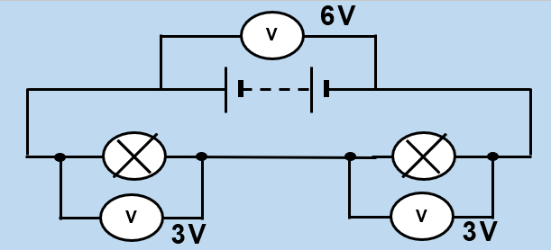
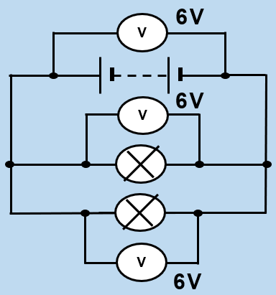

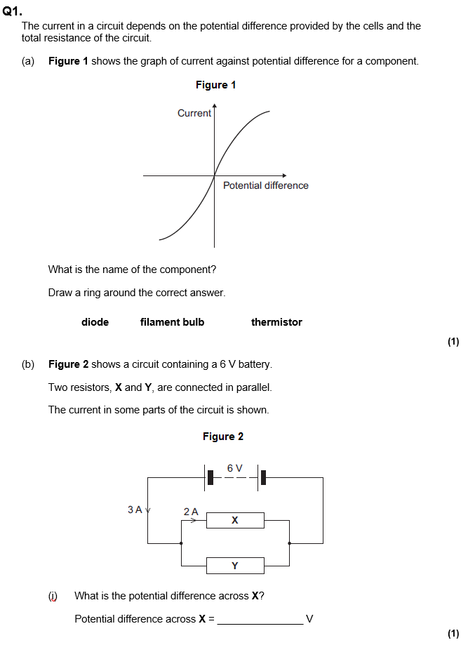
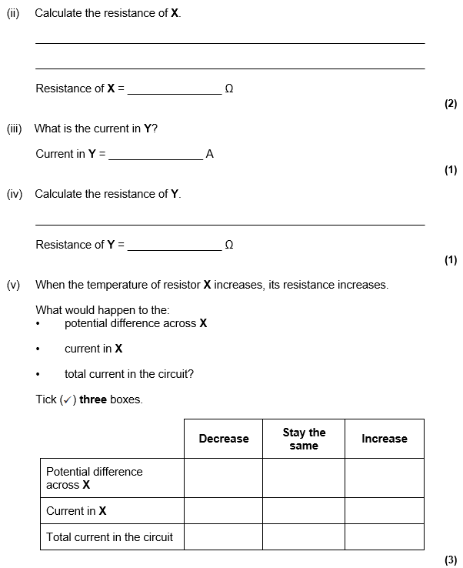
Series and parallel circuits
A series circuit only has one path, a parallel circuit has more than one path.
Current is the same everywhere in a series circuit, but splits on each path of a parallel circuit. Voltage is the same on each path of a parallel circuit, but splits across components in a series circuit.
Ammeters are used to measure current and go in series. Voltmeters are used to measure potential difference and go in parallel across the component you want the voltage across.
Resistance is added together when two resistors are in series:
R_{TOT} = R₁ + R₂ (all in Ω)

Slide 11




Mains electricity and the National Grid
AC current (eg. mains electricity) changes direction, but DC does not (eg. batteries). Mains electricity has a voltage of 230V and a frequency of 50 Hz.
Plugs have three wires. The live wire carries the AC and is brown. The neutral wire completes the circuit and is blue. The earth wire is for safety and is green/yellow.
The national grid is made up of transformers and transmission cables. Directly after a power station is a step-up transformer. This increases the voltage but decreases the current. This reduces the energy lost to heating in the cables.
The cables are also low resistance to reduce energy lost to heating. Before electricity is delivered to consumers it goes to a step down transformer which reduces the voltage to a safe level for consumers.
The fuse is also for safety and melts if the current is too large. The cable grip prevents the cables from coming out of the plug.
Potential difference is how much energy each charge has:
E = Q x V
Energy (J) = Charge (C) × Voltage (V)
Two equations for power:
P = I x V
Power (W) = Current (I) × Voltage (V)
P = I² x R
Power (W) = Current² (A) × Resistance (Ω).

Slide 12
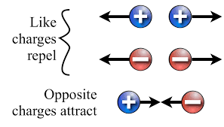
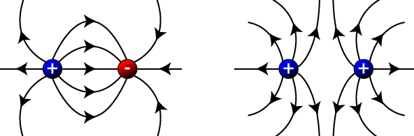
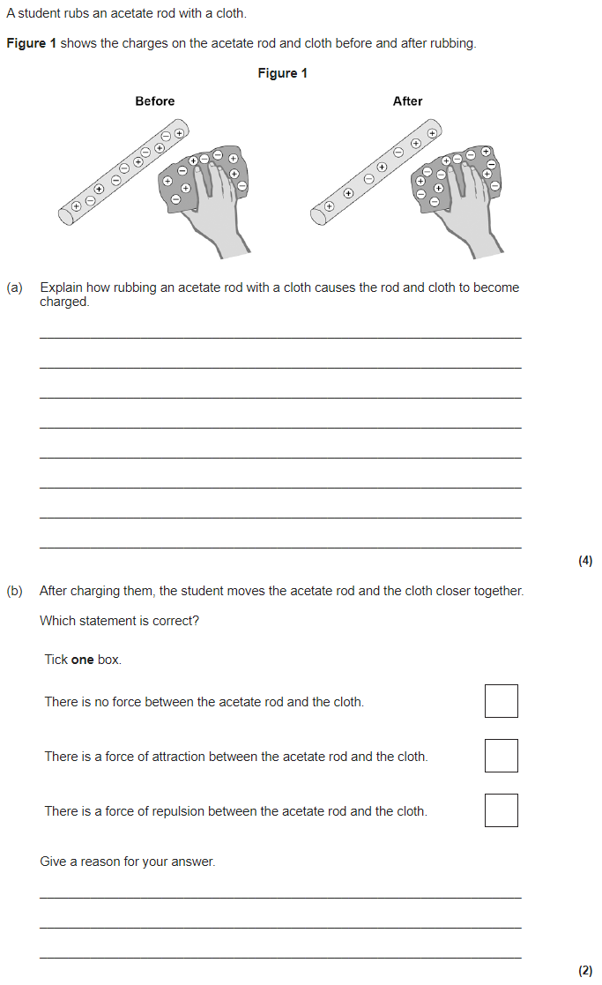
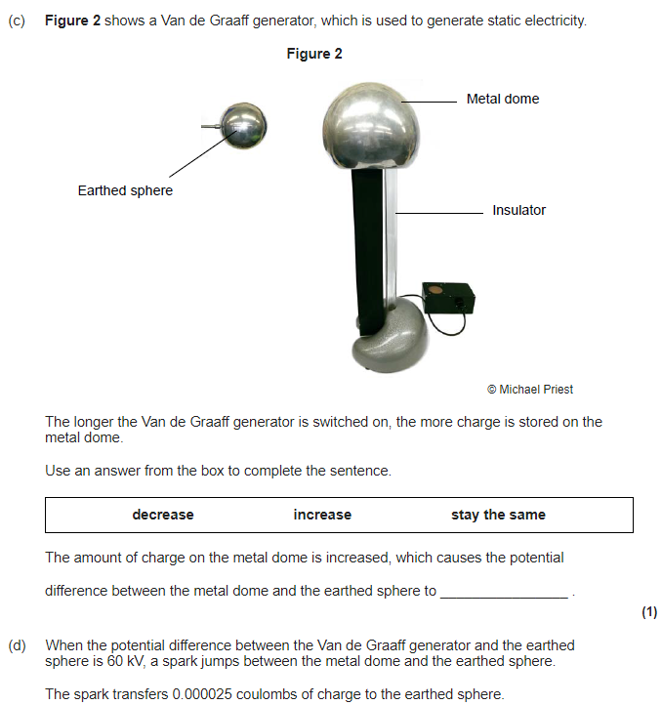
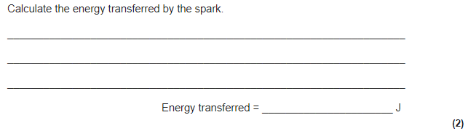
Static electricity
Friction causes static charge. If you rub a balloon (very attractive to other atoms’ electrons) together with a woollen jumper. It will remove some of the electrons and leave the jumper positively charged. The balloon will then become negatively charged.
Two static electricity rules:
Opposite charges attract.
Like charges repel.
A force field is caused by non-contact forces. These forces do not need to be in physical contact (touching) for an interaction of forces to take place. Attraction/repulsion of static charges is an example of a non-contact forces.
Electric field lines flow away from positive charges and towards negative charges. The arrows show the direction a positive charge would move in the field.
The closer together the field lines are, the stronger the field. The strength of the field depends on two things:
The size of the charge.
The distance away from the charge.

Slide 13
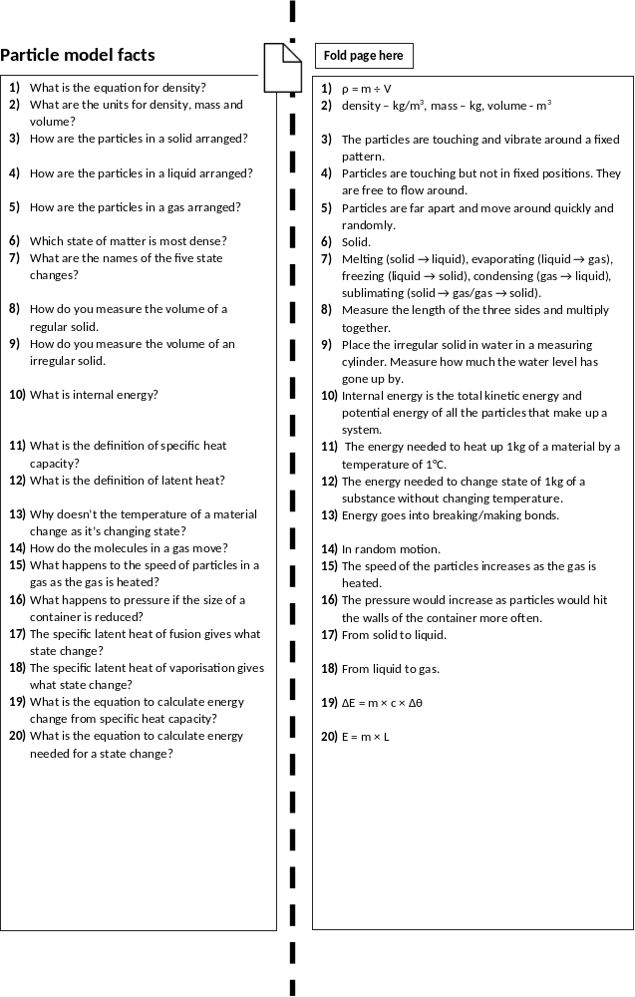

Slide 14

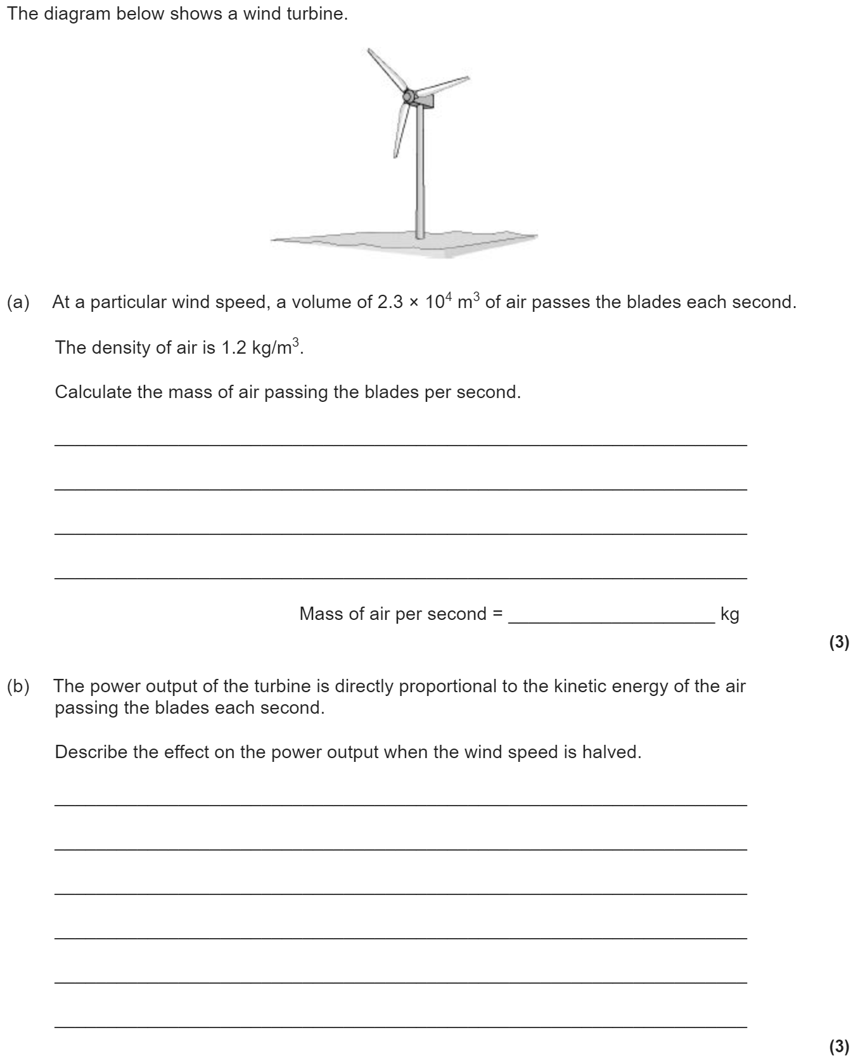
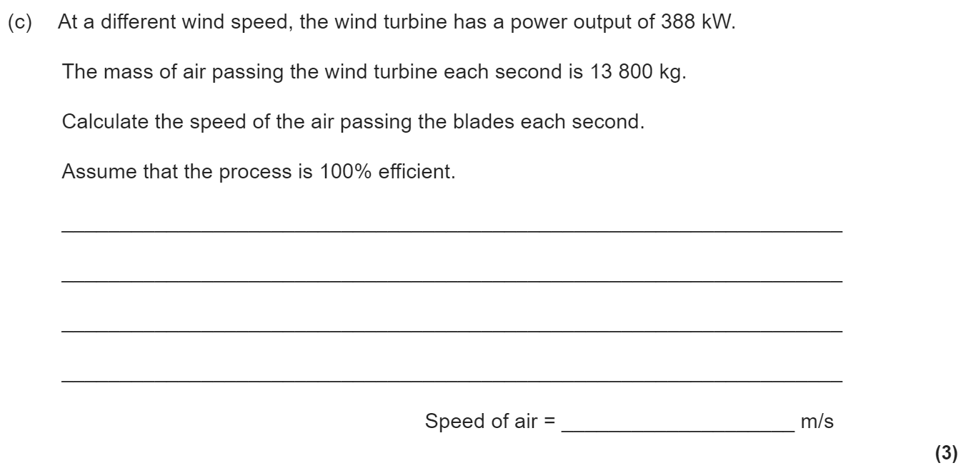
Particle model of matter revision
Keywords: States, solid, liquid, gas, density, internal energy, heat capacity, latent heat
Do Now: What are the units of
-Volume
-Density
-Specific Heat capacity
-Latent Heat
-Mass
-Energy
States of matter
State changes:
Melting: Solid → Liquid
Evaporation: Liquid → Gas
Condensation: Gas → Liquid
Freezing: Liquid → Solid
Sublimation: Solid → Gas
or Gas → Solid
The amount of mass per unit volume is called the density:
ρ = m ÷ V
Density (kg/m³) = mass (kg) ÷ volume (m³)

Slide 15
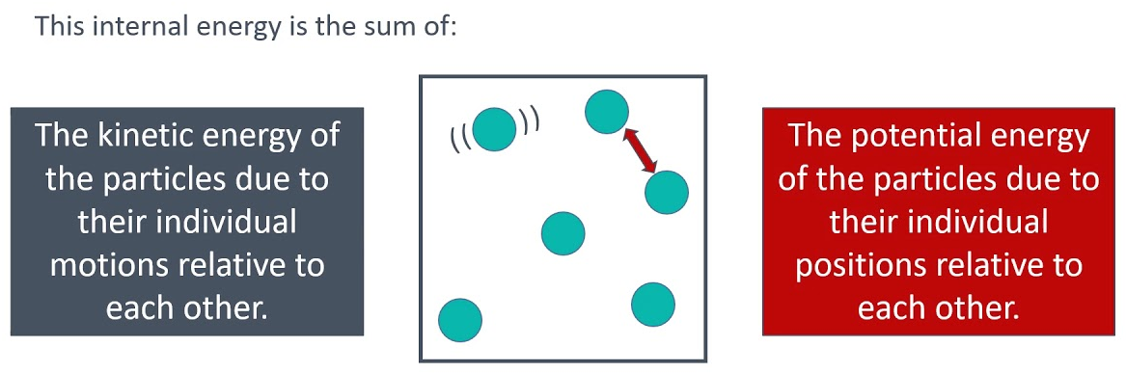

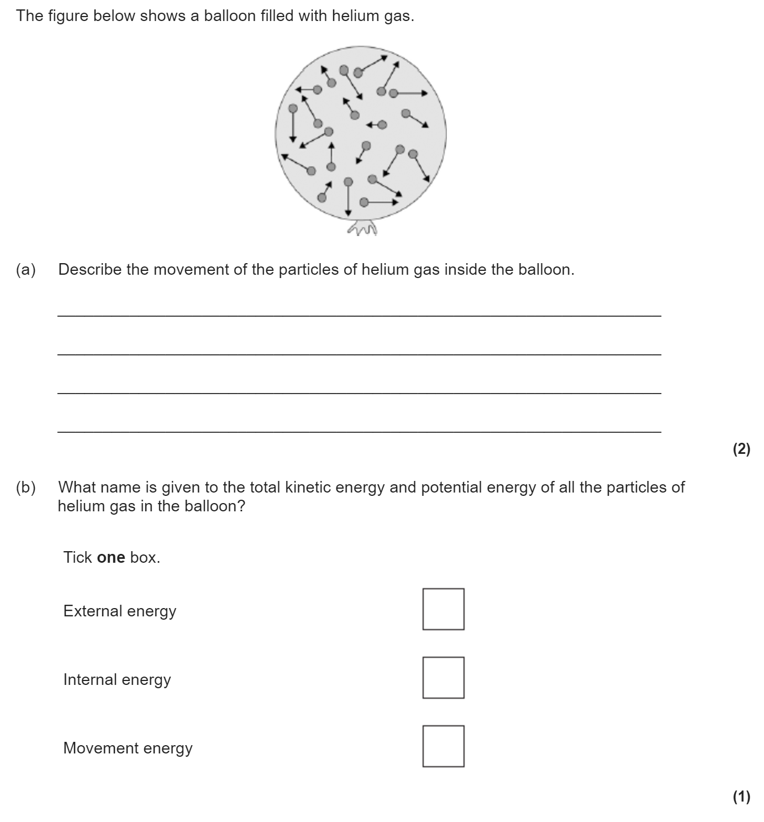
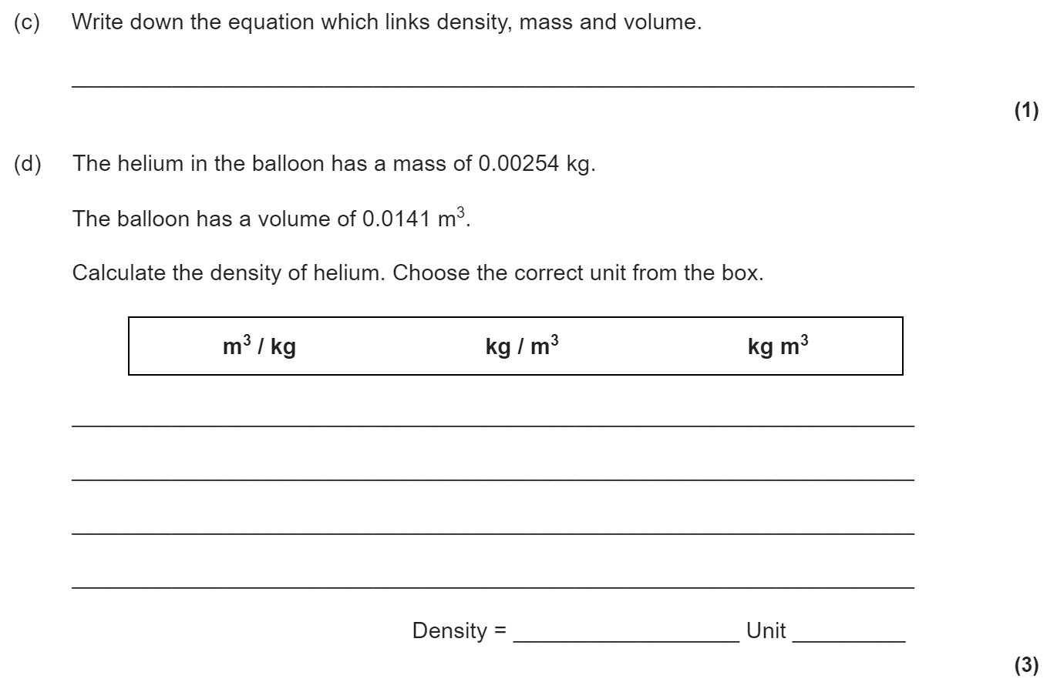
Internal energy & particle motion
Internal energy is the total kinetic energy and potential energy of all the
particles (atoms and molecules) that make up a system.
Heating a system increases the energy of the particles. This either raises the
temperature of the system or produces a change of state.
Gas particles move randomly in all directions at different speeds. As a gas heats, it gains energy and the speed of the particles increases.
The reason balloons get bigger when you blow them us is because more air means more particles. More particles means more collisions and a larger force on the walls of the balloon. This means a higher pressure.
Similarly, if we heat the gas inside a balloon the particles move more quickly. This means more collisions with the wall of the balloon and therefore a higher force on the walls. This leads again to a higher pressure.

Slide 16

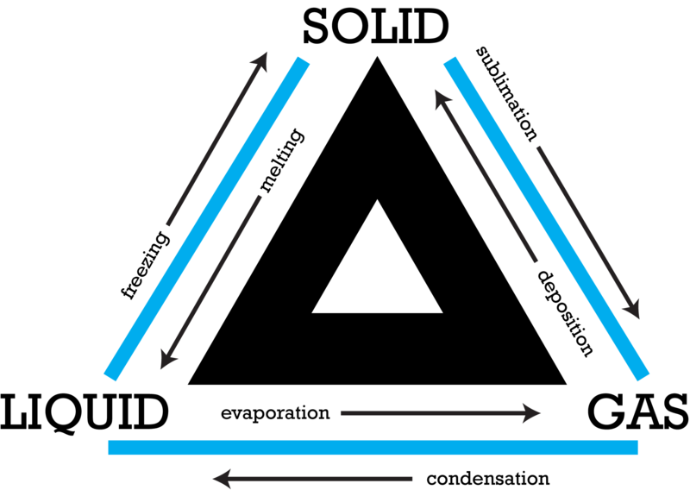
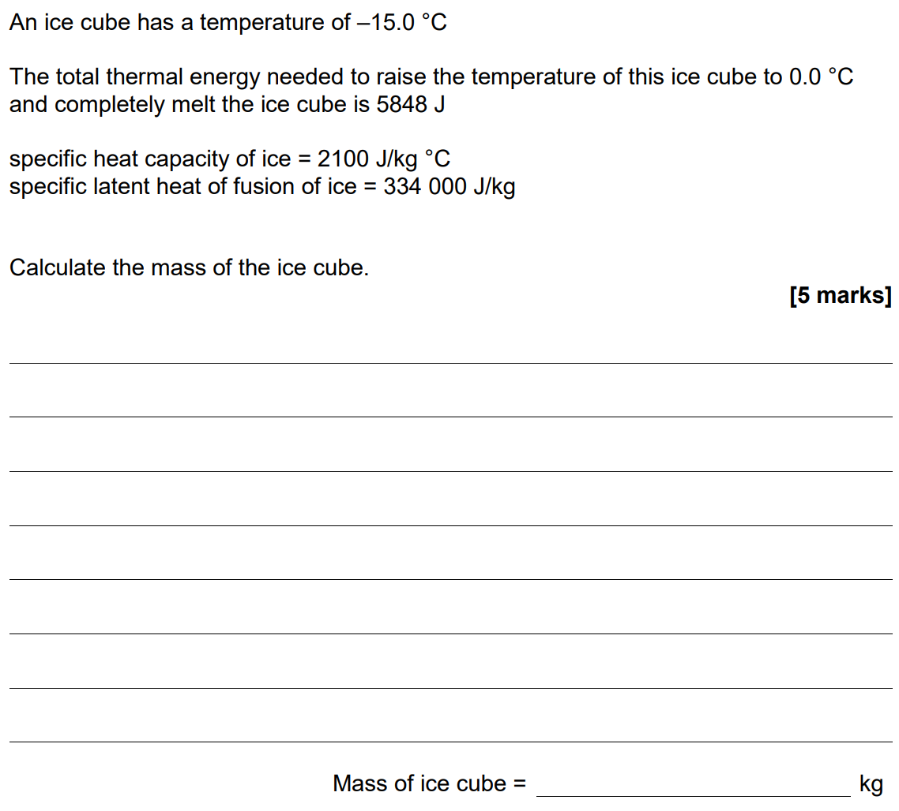
Specific and latent heat
When a substance is changing temperature, the energy change can be calculated by using ΔE= m x c x Δϑ. The specific heat capacity is the energy needed to heat up 1 kg of a substance by 1 degree.
ΔE= m x c x Δϑ
Change in energy (J) = mass (kg) × specific heat (J/kg°C) × change in temp (°C)
When a substance is changing state, energy goes into breaking the bonds instead of increasing the temperature of the substance. The energy needed to change state can be calculated by E = m x L. The latent heat is the energy needed to change state of 1 kg of a substance.
E = m x L
Energy (J) = mass (kg) × latent heat (J/kg)

Slide 17
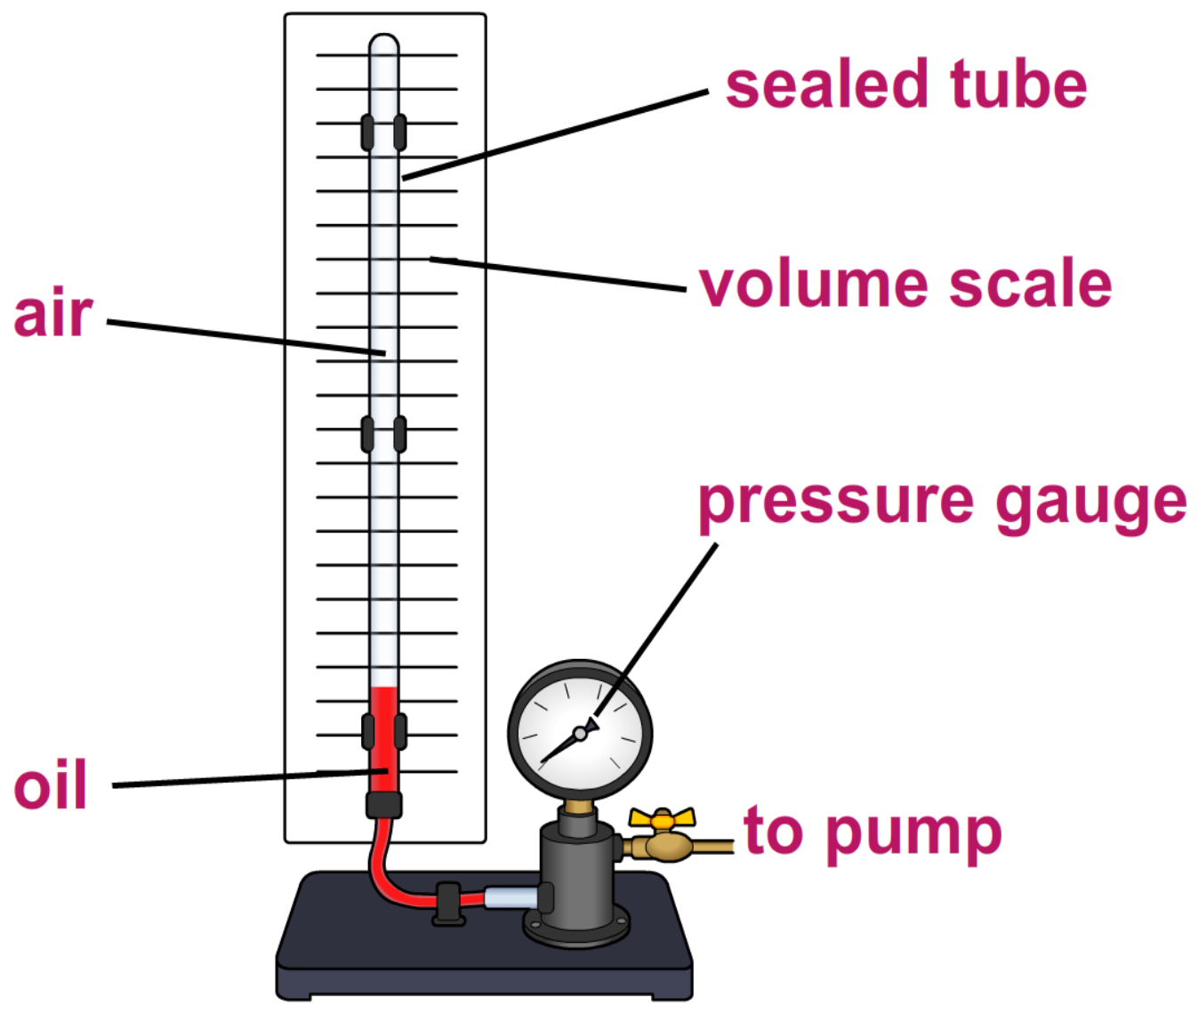
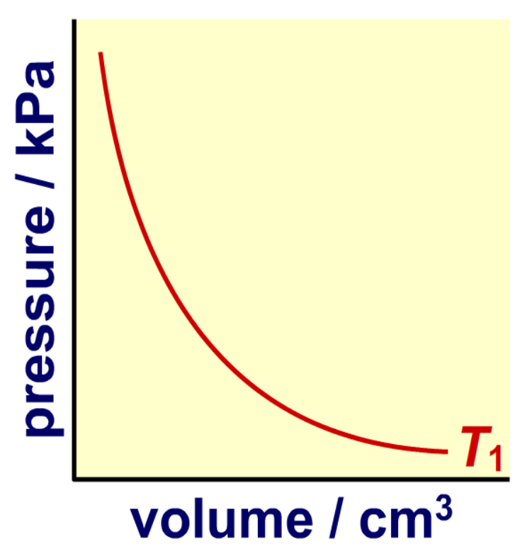
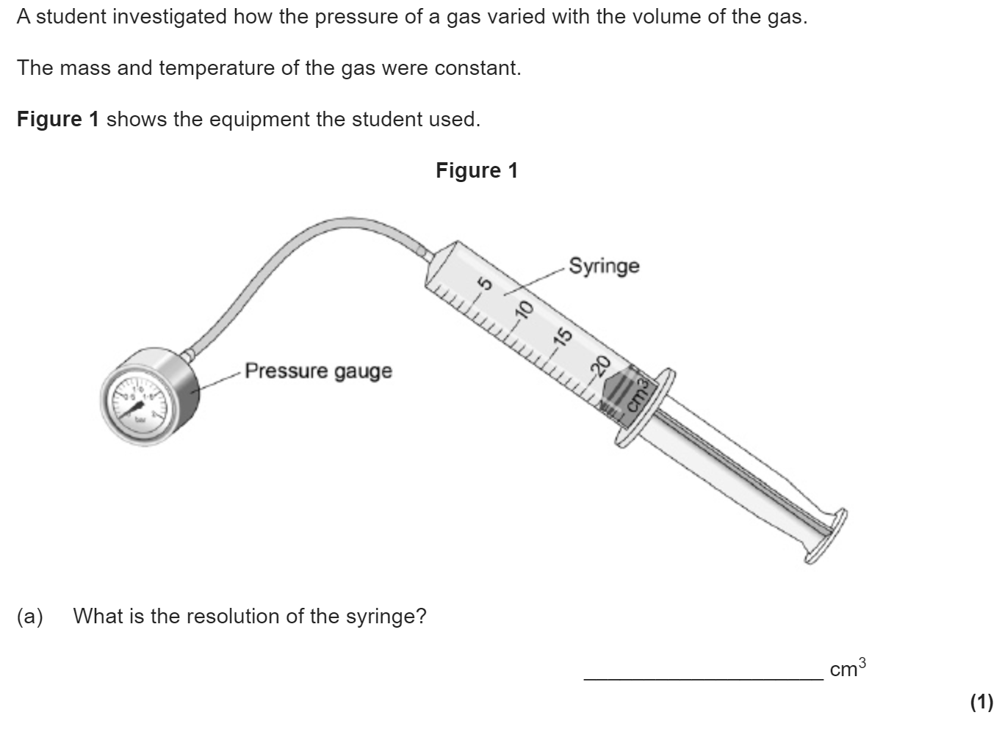
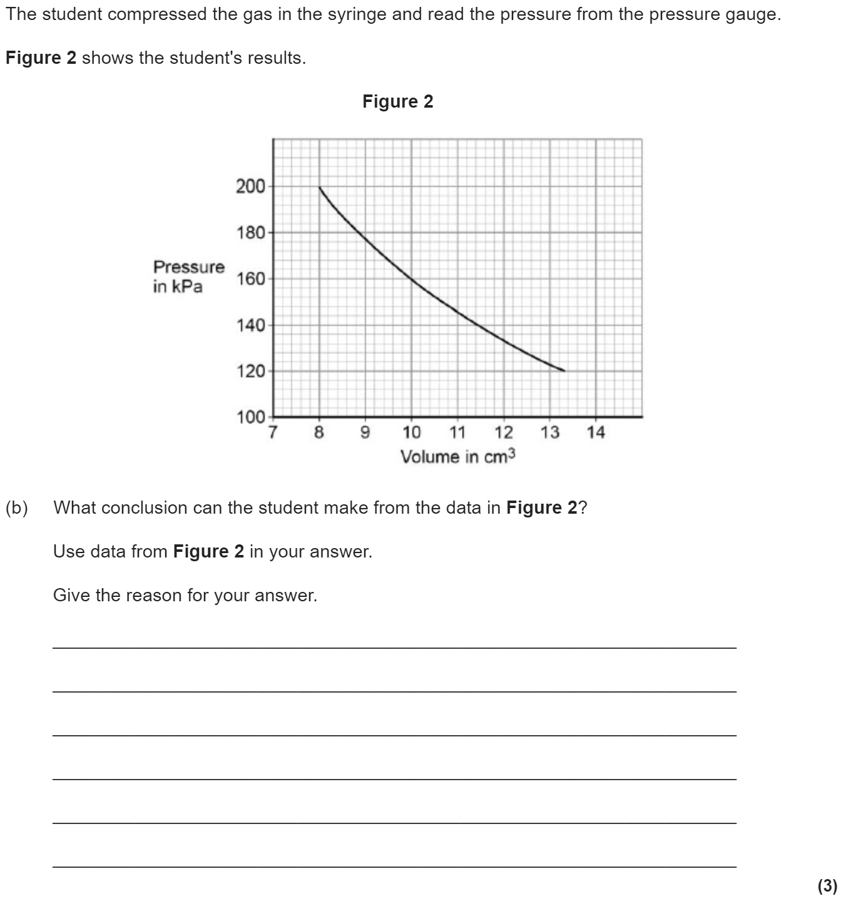
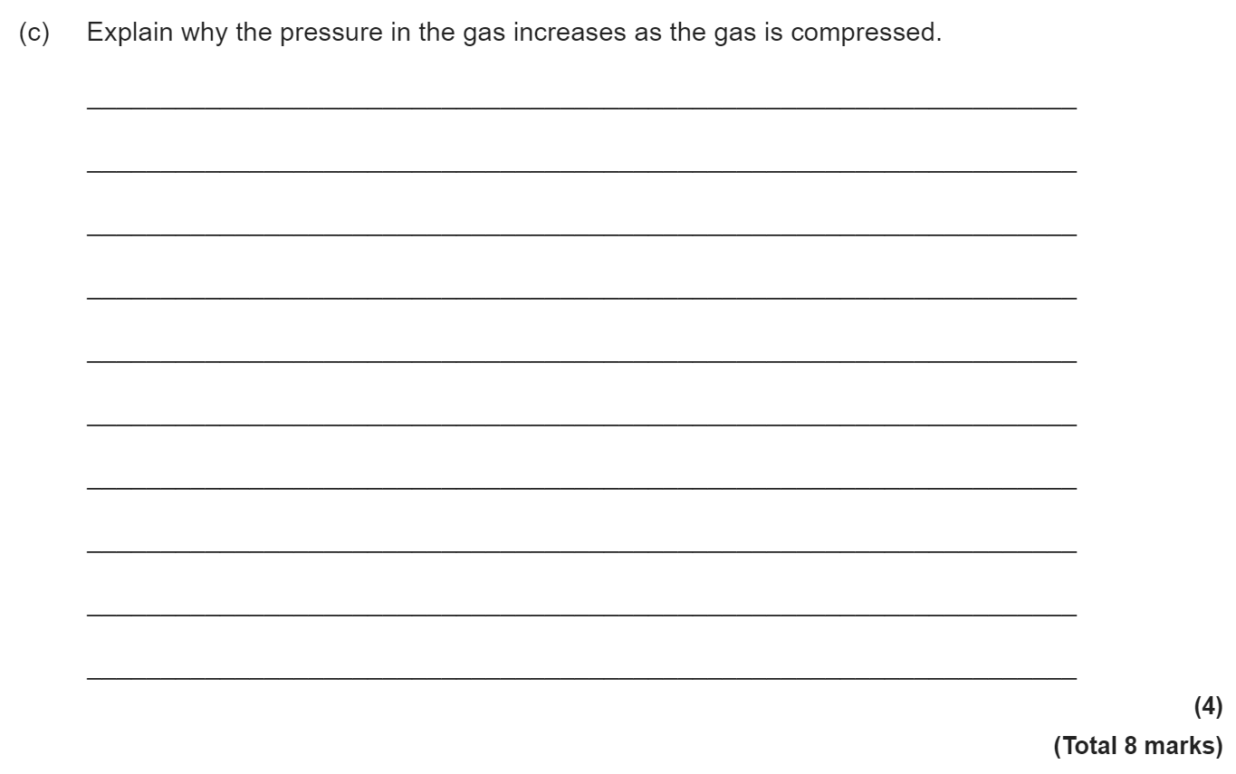
Pressure in gases
Provided that the number of particles and the temperature of a gas are kept constant, then:
P x V = constant
Where:
P is pressure in pascals (Pa)
V is volume in metres cubed (m³)
constant is a number in Pa m³
The graph of pressure against volume is inversely proportional.

Slide 18
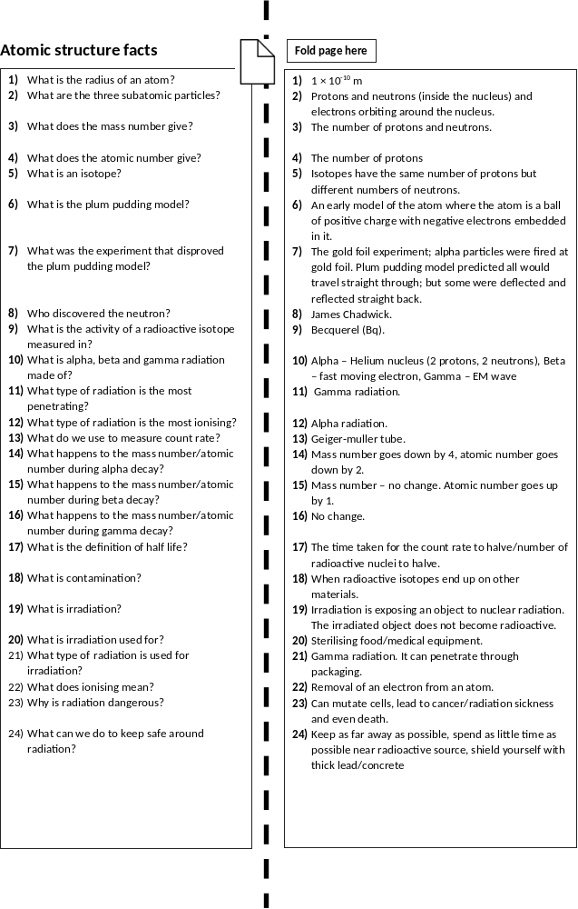

Slide 19
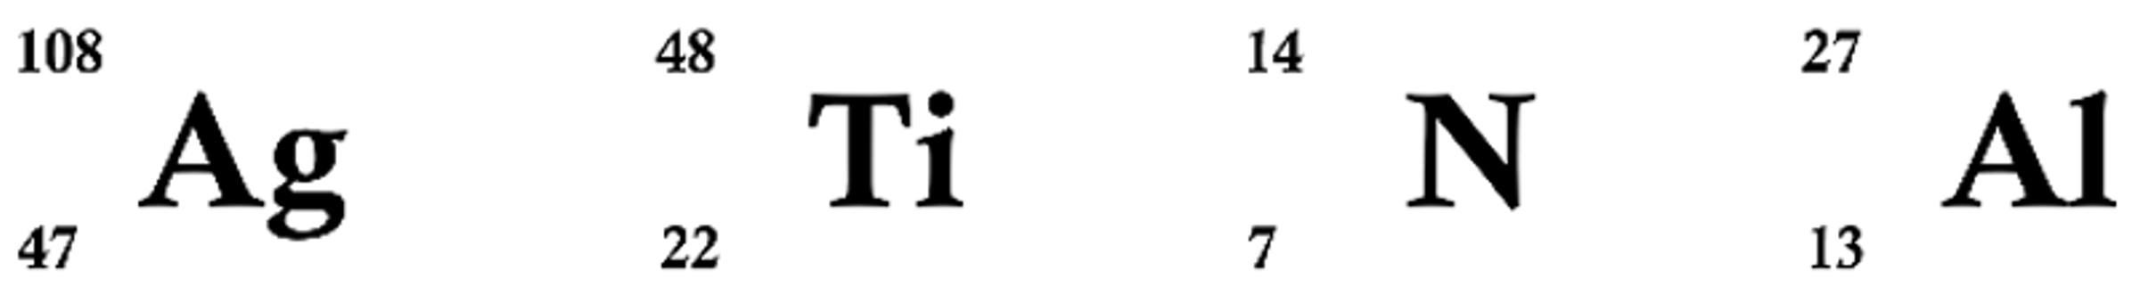
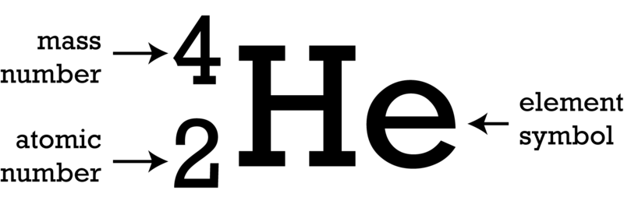

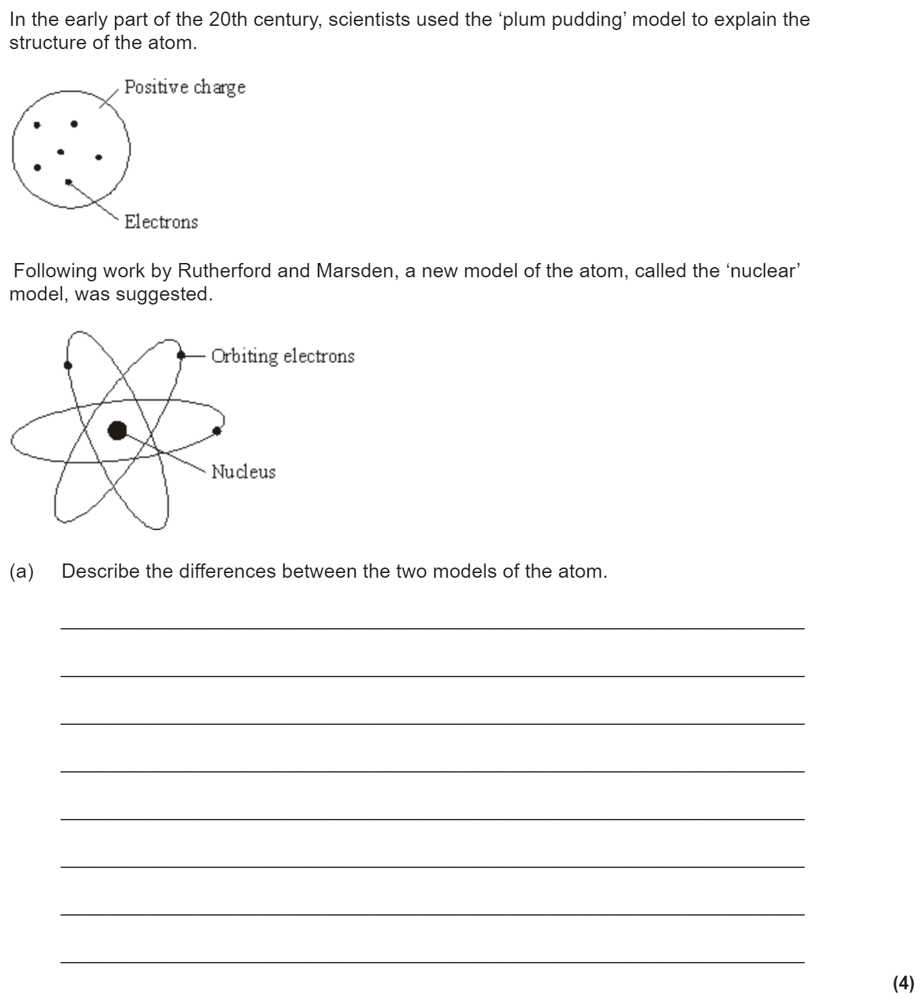
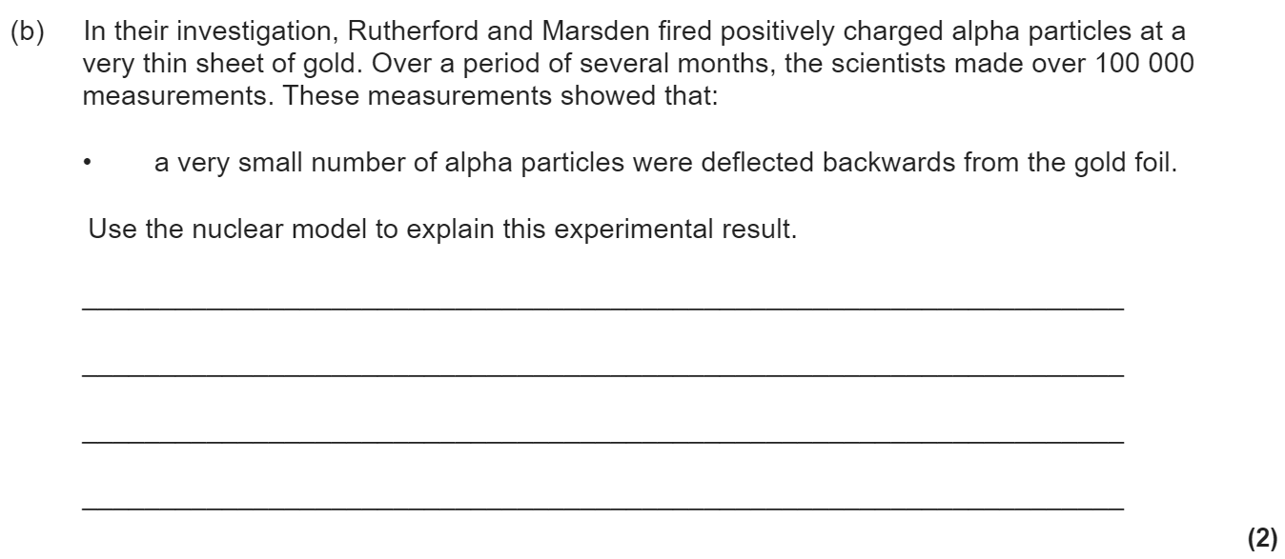
Atomic structure revision
Keywords: Nucleus, electron, proton, neutron, alpha, beta, gamma, radiation, half life, ionising, penetrating
Do Now: How many protons, neutrons and electrons are there in
Atomic structure & development of the model of the atom.
Isotopes are elements with the same atomic number (no. of protons) and different mass numbers (no of protons + neutrons). This means they have different numbers of neutrons.
Before the discovery of the electron, atoms were thought to be tiny spheres that could not be divided. The discovery of the electron led to the plum pudding model of the atom. The plum pudding model suggested that the atom is a ball of positive charge with negative electrons embedded in it.
The results from the alpha particle scattering experiment led to the conclusion that the mass of an atom was concentrated at the centre (nucleus) and that the nucleus was charged. This nuclear model replaced the plum pudding model.

Slide 20


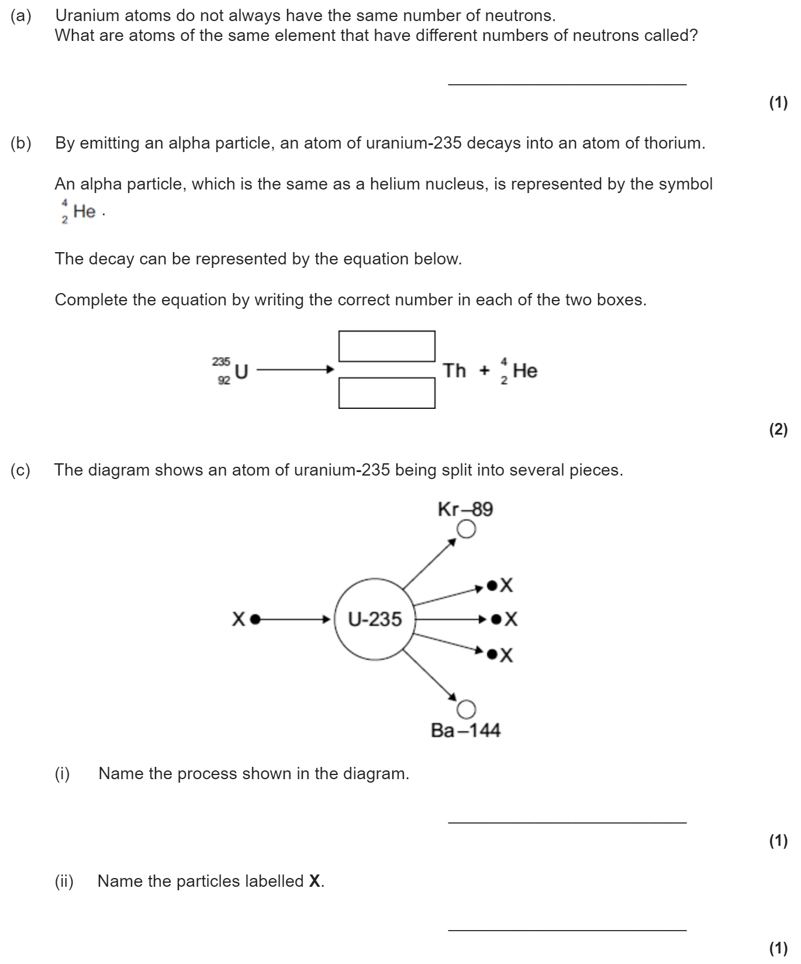
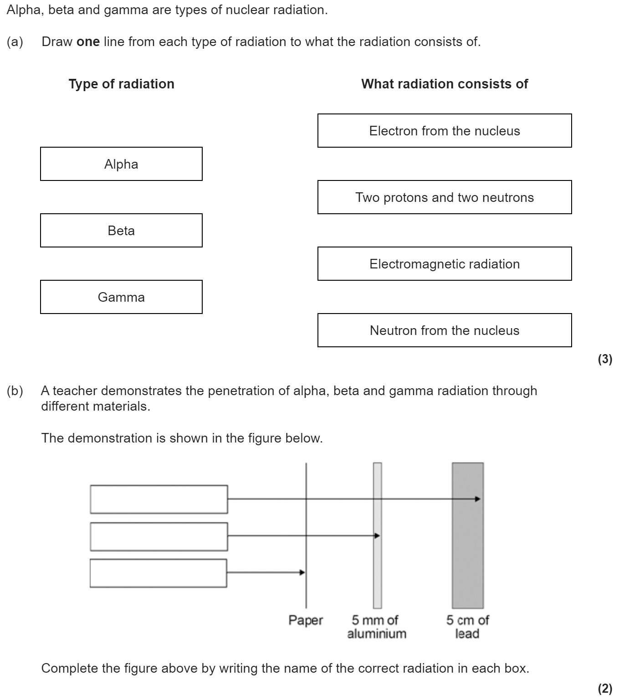
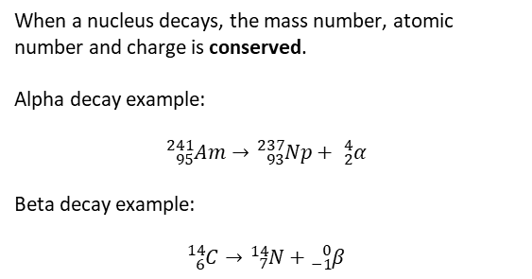
Types of radiation
Alpha particles are the most massive (as they are made of 2 protons and 2 neutrons) and so they bump into other matter more often. When they do this they ionise matter (making it lose an electron). Alpha radiation is the most ionising but the least penetrating (it can be stopped by paper). Gamma radiation is the least ionising but the most penetrating (taking thick lead to stop it).
When a nucleus decays, the mass number, atomic number and charge is conserved.
Alpha decay example:
$${}_{95}^{241}{Am}→{}_{93}^{237}{Np}+ {}_{2}^{4}α$$
Beta decay example:
$${}_{6}^{14}{C→}{}_{7}^{14}N+{}_{−1}^{0}β$$
When alpha/beta decay happens, the nucleus transmutes into another element. When gamma decay happens the nucleus emits some energy but keeps the same atomic and mass numbers.

Slide 21

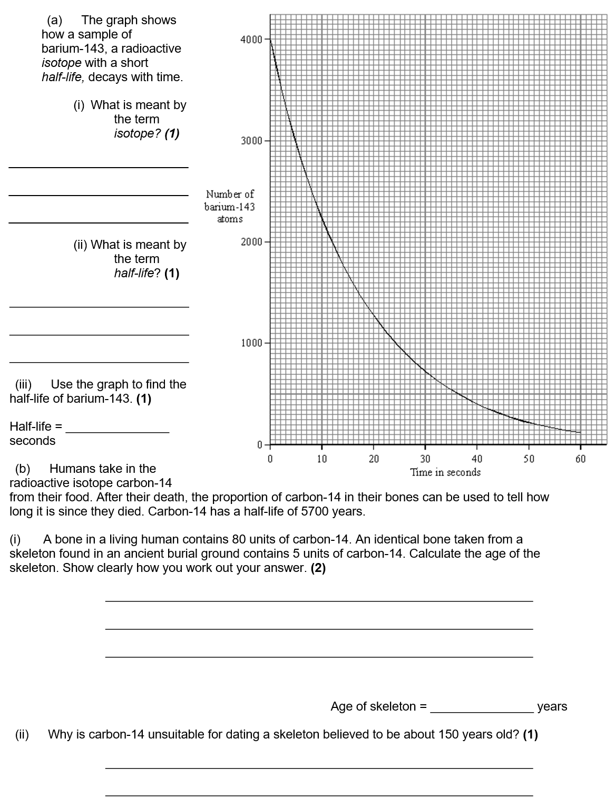
Half life
Half-life is the time taken for the count rate (measured in Becquerel) to halve. We can calculate this using the tree method or from a graph.
Radioactivity is dangerous because our cells can be ionised. This can kill cells or lead to mutations and potentially cancer. If some radioactive particles are in contact with an object, we say the object is contaminated.
All types of radiation are dangerous but alpha particles are most dangerous inside the body as they are most ionising and can’t escape the body. Beta particles are dangerous up to the mid-range and gamma radiation is dangerous up to the long-range.

Slide 22
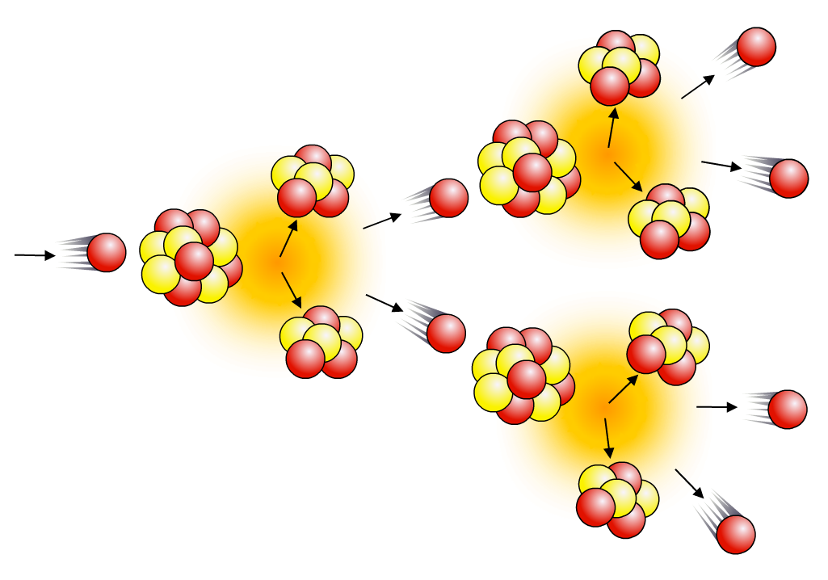
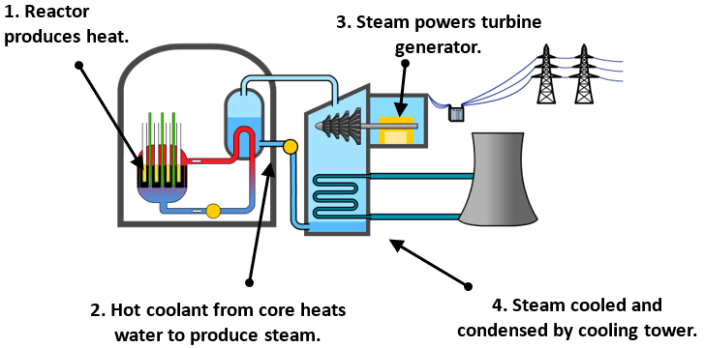




Nuclear fission & fusion
The energy released in nuclear power plants comes from nuclear fission. Large, unstable nuclei such as uranium-235 or plutonium-239 break into smaller fragments, releasing energy as they do so:
²³⁵U + neutron → fission fragments + neutrons + energy
When a uranium-235 nucleus undergoes induced fission after
collision with a neutron, it breaks up into two smaller nuclei and
two/three neutrons. These are called fission neutrons.
The fission neutrons can go on to cause further fission events, which will produce further neutrons, and so on, causing a chain reaction.
Uncontrolled chain reactions are used in atomic bombs.
A nuclear reactor uses a controlled chain reaction to produce heat to produce steam for a generator. Apart from the source of heat, it works in the same way as a coal-fired power station. The reactor itself consists of fuel rods, control rods, coolant and a moderator.
Whereas nuclear fission involves very large nuclei splitting into smaller nuclei, fusion involves small nuclei joining together to form larger ones. The energy emitted by a star, such as the Sun, comes from nuclear fusion. In order for this to happen, the core temperature has to be extremely high – in excess of 10 million degrees. Nuclear fusion in a star like the Sun involves the combination of lighter isotopes of hydrogen to form helium, and the release of energy.

Slide 23


Slide 24


Slide 25


Slide 26


Slide 27


Check answers with the fold-able fact sheet.
How did you do?
Which topics do you need to revise more?

Slide 28





Slide 29





Slide 30





Slide 31






Slide 32





Slide 33





Slide 34



