Slide 1
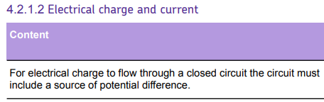
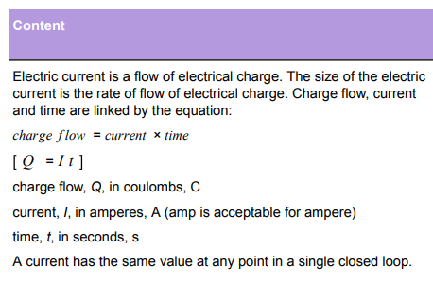
L1 Circuit symbols
L2 Current & charge
L3 Potential difference
L4 Resistance & Ohm’s Law
L5 Power & energy
L6 Electrical power
L7 Current in series & parallel
L8 Potential difference in series & parallel
L9 Sensing circuits
L10 Three pin plug
L11 National Grid
Basics of electricity in KS2/3, and most recently have been taught common circuit symbols. In particular, the ammeter can be revisited here.
These ideas will be constantly be revisited (in particular in the ohm’s law, kirchoff’s law and sensing circuits lessons).

Slide 2
Charge & current

Slide 3
Charge
Coulomb
Electron
Current
Ampere
Ammeter
Recall what the charges particles flowing through a metal wire are.
Recall the definition of current.
Apply an equation to calculate charge, current and time in common circuits.

Slide 4
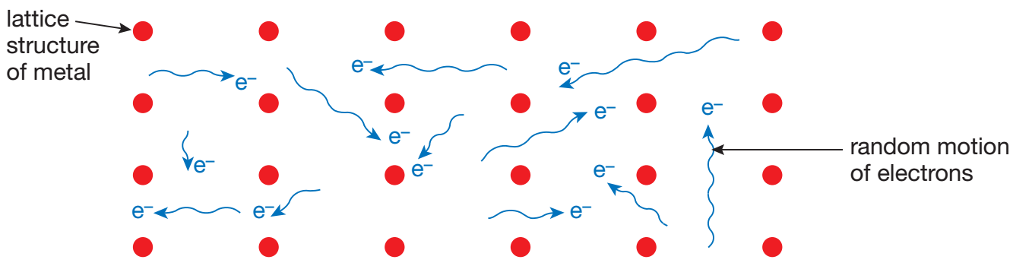
Charged particles (electrons) flow through metal wires.
Charge has units of Coulombs (C) and each electron carries a charge of -1.6 × 10⁻¹⁹ C.
Stretch: If each electron has a charge of -1.6 × 10⁻¹⁹ C, how many electrons are there in one coulomb?

Slide 5
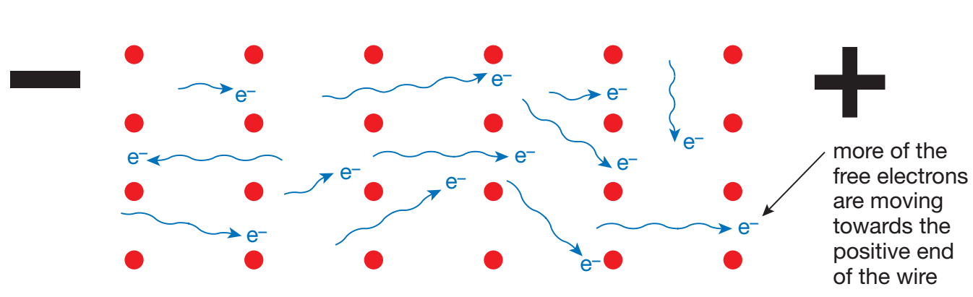
Current is the rate of flow of charge (i.e. how much charge is flowing every second).
Current has units of Amps (A) and is measured by an ammeter (which goes in series).
Stretch: A circuit contains a battery and a thermistor. Draw a circuit that could measure the current flowing in the circuit.

Slide 6
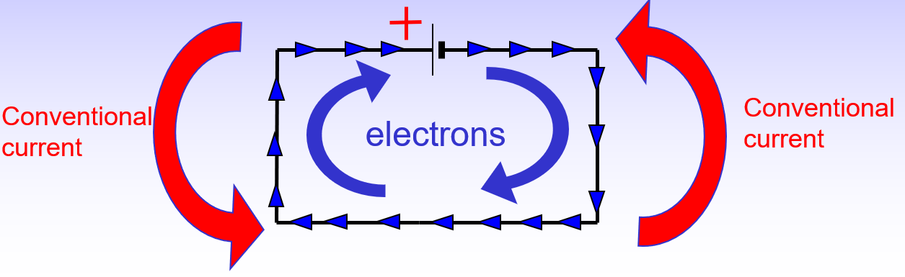
Conventional current vs electron flow
We say that conventional current flows from positive to negative.
However like charges ________. So electrons are repelled by the negative terminal and move from negative to positive.

Slide 7
T/N: Charge & current
Charge, current and time are linked by the equation:
Stretch: Re-arrange to give equations for I and t.
From one of the equations, why do you think current is defined how much charge is flowing each second?
Q = I × t
I = Current (Amps, A)
Q = Charge (Coulombs, C)
t = Time (s)

Slide 8
Example question 1
Calculate the charge when 10 Amps passes a point in 8 seconds.
Write the formula: Q = I x t
Write the variables
Q =
I = 10
t = 8
Write the equation Q = 10 x 8, which is Q = 80 C

Slide 9
Example question 2
Calculate the current when 4 C of charge passes a point in 8 seconds.
Write the formula: Q = I x t
Write the variables
Q = 4
I =
t = 8
Rearrange the formula Q/t = I
Put the numbers in 4/8 = Q which means Q = 0.5C

Slide 10
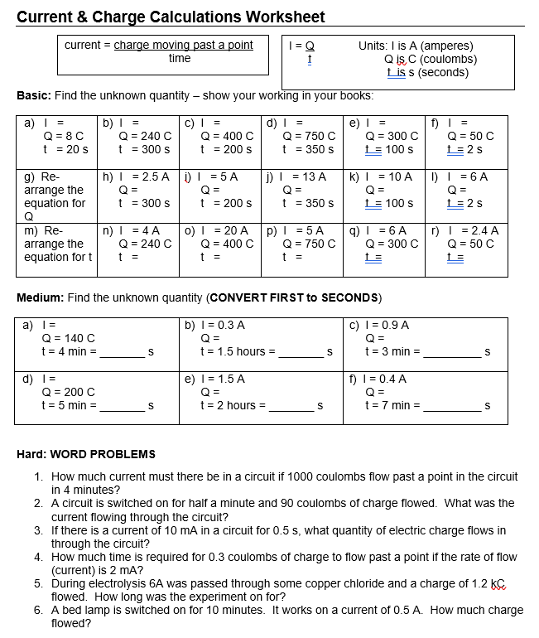
Worksheet
Complete the worksheet!

Slide 11

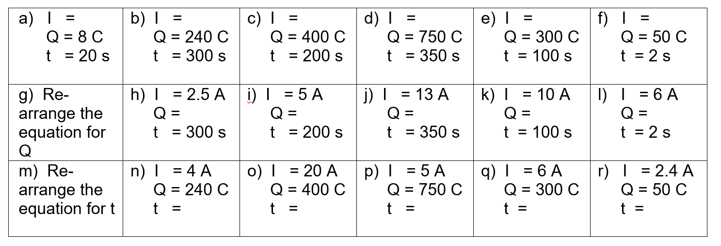
Basic answers
0.4A
0.8A
2A
2.14A
3A
25A
750C
1000C
4550C
1000C
12 C
Q = I × t
60s
20s
150s
50s
20.8s
t = Q ÷ I

Slide 12
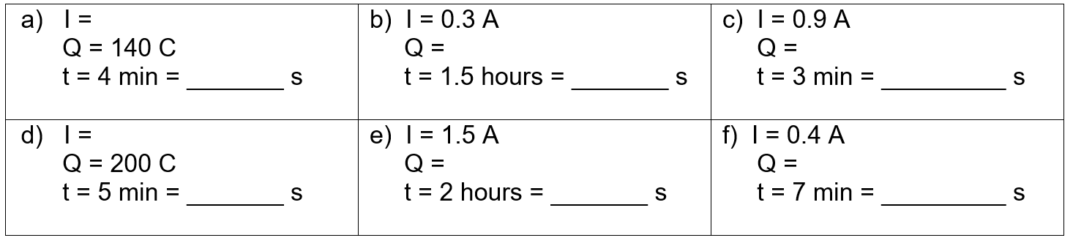
Medium answers
0.58 A
1620 C
162 C
240
5400
180
0.67 A
10800 C
168 C
300
7200
420

Slide 13
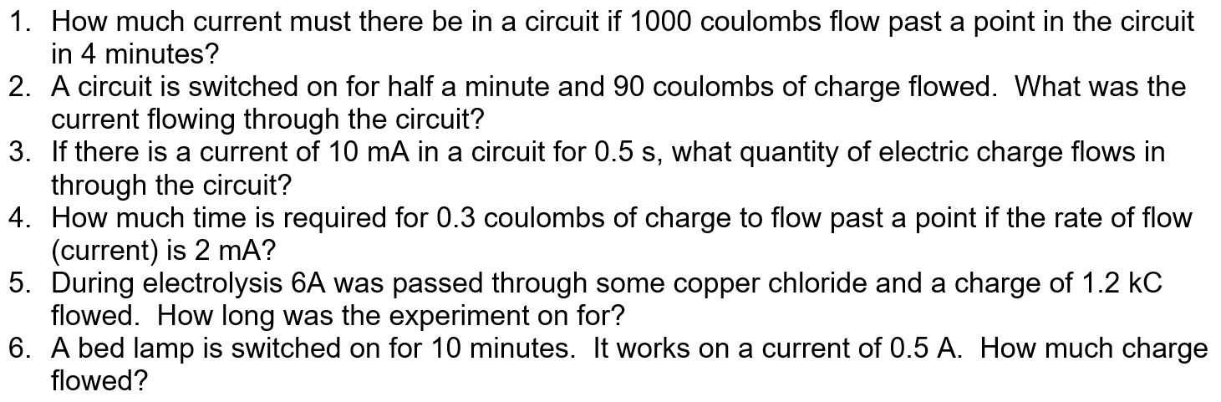
Hard answers
I = Q ÷ t = 1000 ÷ 240 = 0.42 A
Q = I × t = 0.01 × 0.5 = 0.005 A
t = Q ÷ I = 0.3 ÷ 0.002 = 150 s
Q = I × t = 0.5 × 600 = 300 C

Slide 14
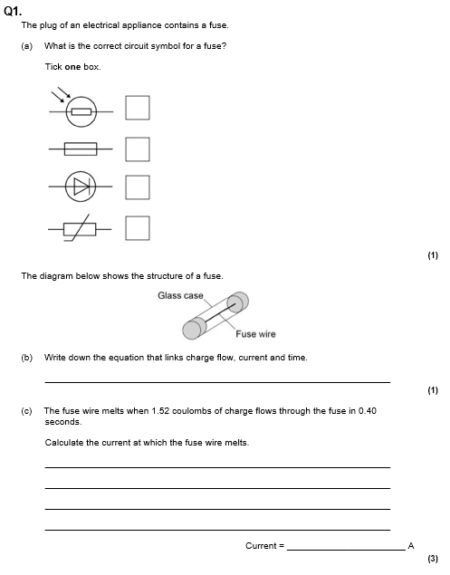
Struggle time!
Exam question so exam conditions!
You have 8 minutes.

Slide 15
