Slide 1
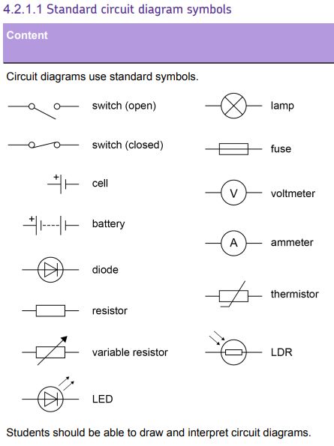
L1 Circuit symbols
L2 Current & charge
L3 Potential difference
L4 Resistance & Ohm’s Law
L5 Power & energy
L6 Electrical power
L7 Current in series & parallel
L8 Potential difference in series & parallel
L9 Sensing circuits
L10 Three pin plug
L11 National Grid
First lesson on electricity, but students will have encountered most of this content in previous key stages.
Circuit symbols will be cyclically revisited in many of the future lessons in this topic.

Slide 2
Circuits & circuit symbols

Slide 3
Cell
Lamp
Voltmeter
Ammeter
Fuse
LED
LDR
Thermistor
Recall circuit symbols & describe their uses.
Describe the difference between series and parallel circuits.
Describe the difference between a complete and incomplete circuit.

Slide 4
We use circuit symbols to show different components (parts) of an electrical circuit.
Circuit diagrams are drawn in pencil and a ruler used to draw the connecting wires.
Stretch: Draw any circuit symbols that you can remember from previous years.

Slide 5
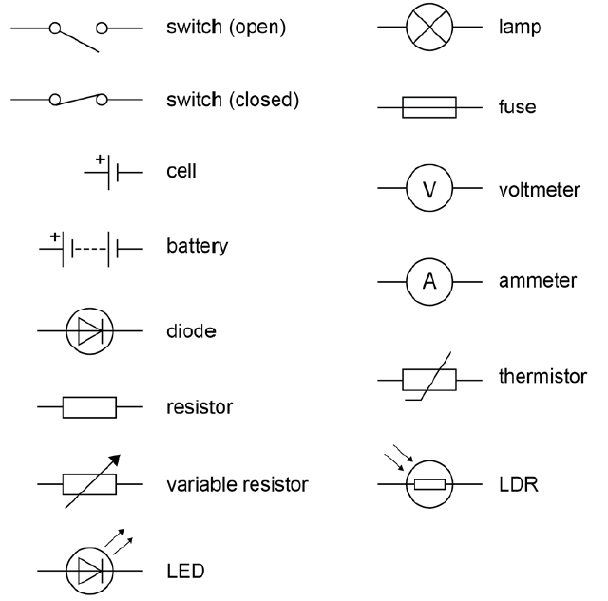
Stick the handout into your book.

Slide 6
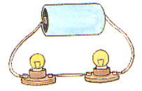
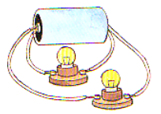
Series circuits follow one single loop.
Parallel circuits contain more than one loop.
Stretch: Draw circuit diagrams with:
-A cell and two bulbs in series with the cell.
-A cell and two bulbs in parallel with the cell.

Slide 7
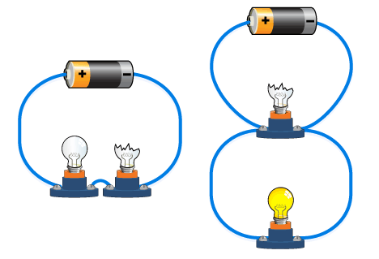
T/N: Complete and incomplete circuits
Parts of a circuit will only work if there is a complete circuit. If there is a break in the circuit then it’s incomplete.
Stretch: Why is it a benefit to put lamps in a parallel circuit?

Slide 8
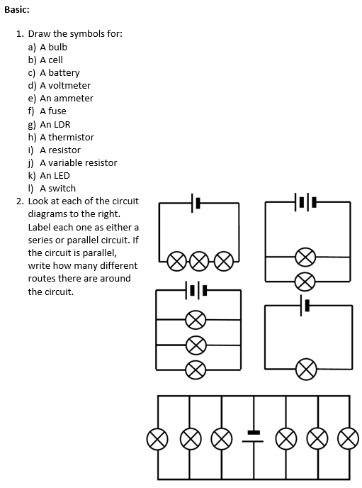
Worksheet
Complete the worksheet!

Slide 9

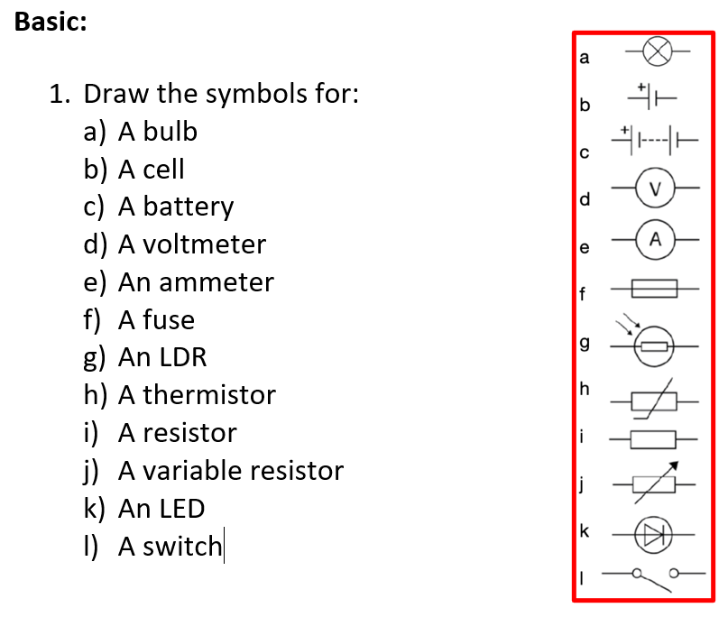
Basic answers

Slide 10
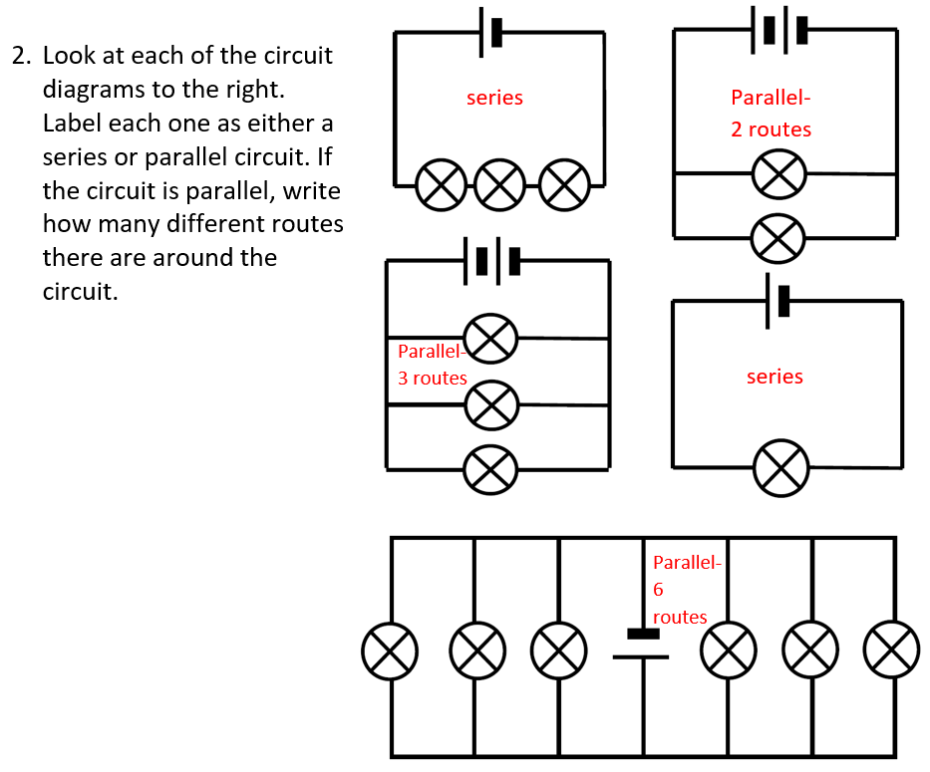
Basic answers

Slide 11
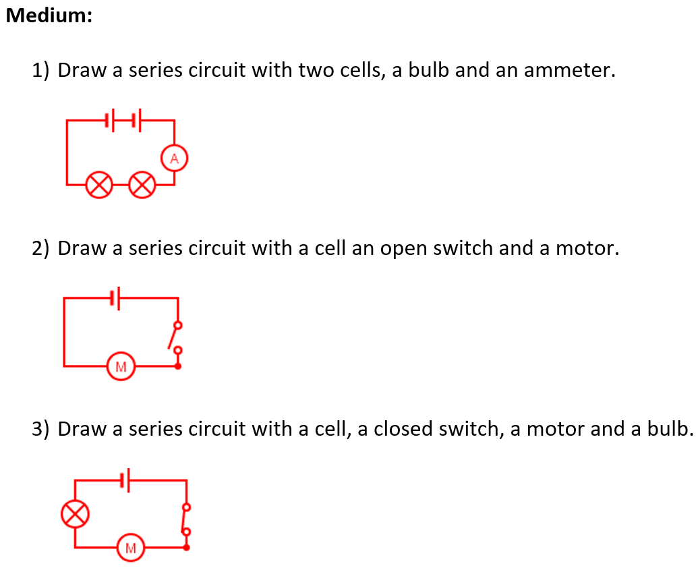
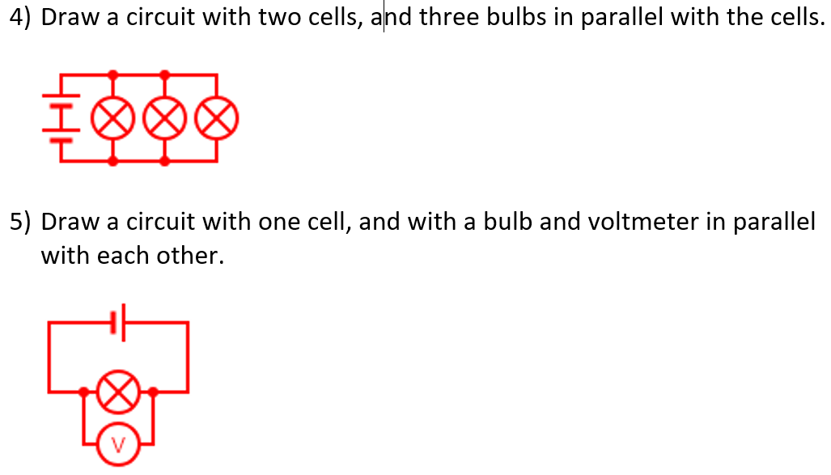
Medium answers

Slide 12
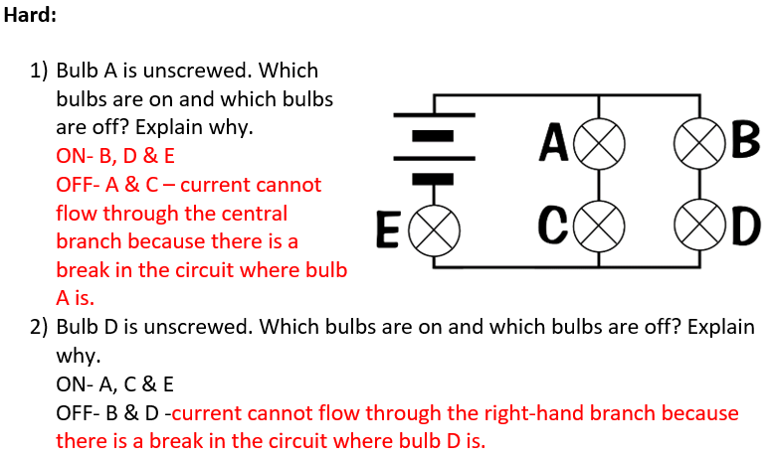
Hard answers

Slide 13
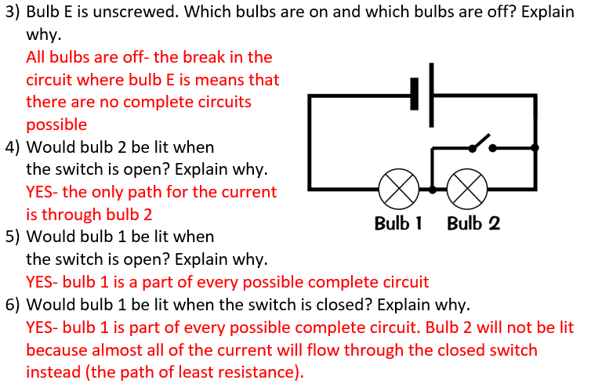
Hard answers

Slide 14
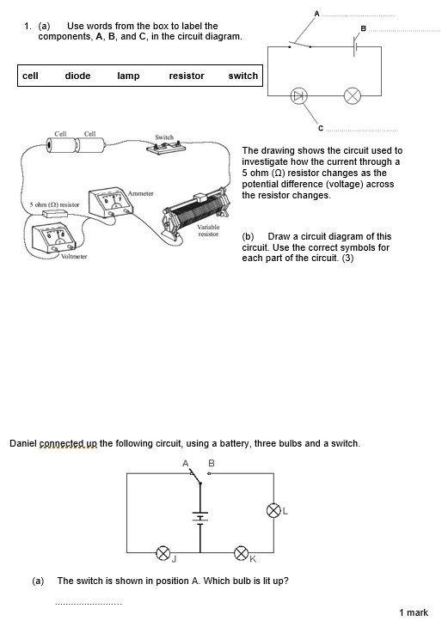
Struggle time!
Exam question so exam conditions!
You have 8 minutes.

Slide 15
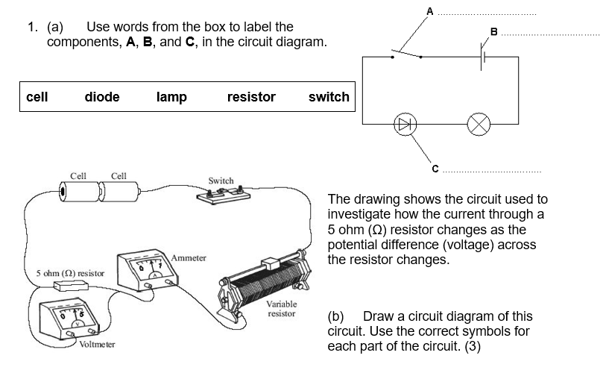

Slide 16
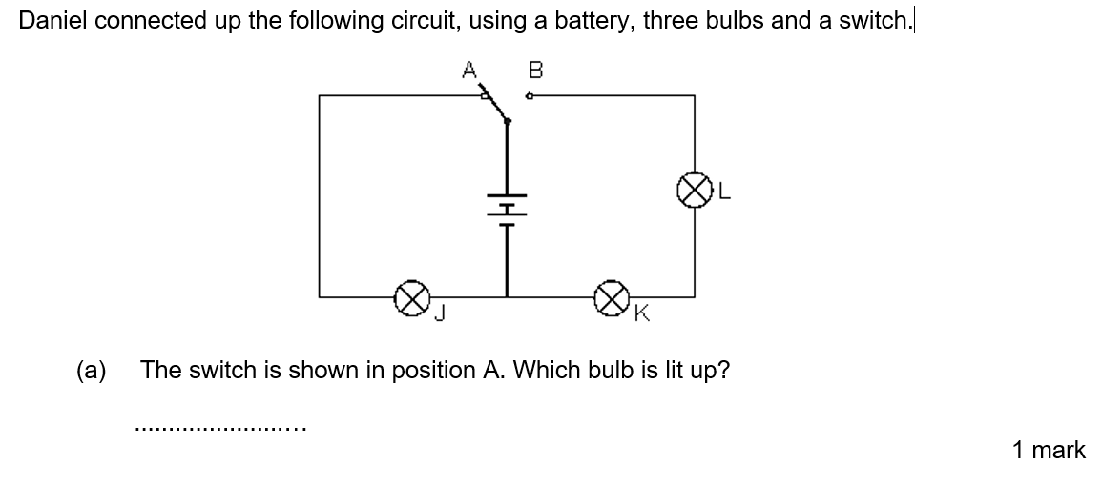
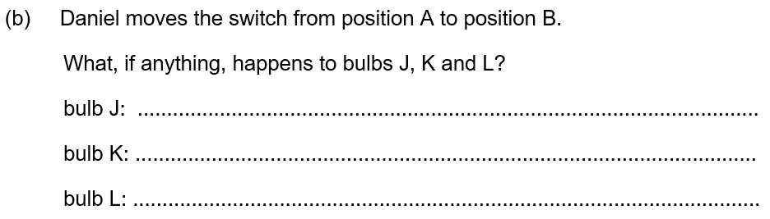

Slide 17
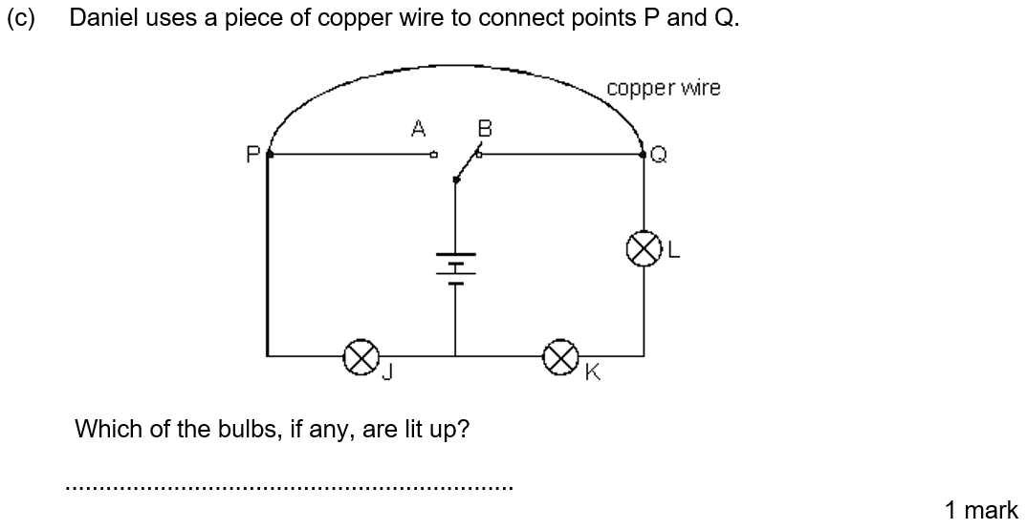

Slide 18
Plenary
Draw a series circuit with 2 lightbulbs, a battery and a resistor.
Draw a series circuit with a battery, 2 lightbulbs, a switch, an ammeter and a variable resistor.
Draw a parallel circuit with 1 battery and 2 lightbulbs (each parallel to the battery).
Draw a series circuit with 1 battery, 1 diode, 1 variable resistor and a lightbulb.
Draw a series circuit with a battery, 1 resistor, 1 thermistor, 1 diode and a switch.
Draw a parallel circuit with 1 battery, 3 lightbulbs (each parallel to the battery) and a switch that would allow 1 lightbulb to shine even if it opened. (Hard)

