Slide 1
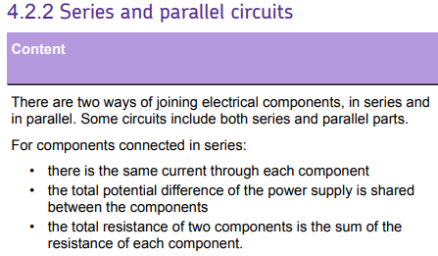
L1 Circuit symbols
L2 Current & charge
L3 Potential difference
L4 Resistance & Ohm’s Law
L5 Power & energy
L6 Electrical power
L7 Current in series & parallel
L8 Potential difference in series & parallel
L9 Sensing circuits
L10 Three pin plug
L11 National Grid
Students know the definition of current & how to calculate currents in simple examples.
The ideas taught in this lesson will expanded upon in the lesson on potential difference in series & parallel

Slide 2
Current in series & parallel

Slide 3
Current
Amps
Series
Parallel
Junction
Recall that current is the same everywhere in a series circuit.
Recall that current splits in a parallel circuit.
Calculate currents in series and parallel circuits.

Slide 4

In a series circuit the current flow through one continuous path. This means that the current must be the same at all parts in a series circuit.
Stretch
Both of the lamps above have a resistance of 3 Ω. Calculate the potential difference supply of the battery.

Slide 5

In a parallel circuit, there are different paths for the current to take.
Current splits in a parallel circuit.
Stretch: Say we have a circuit as above, but one of the bulbs has more resistance than the other? What happens to the current?
What if the resistance of one bulb is three times the other?

Slide 6
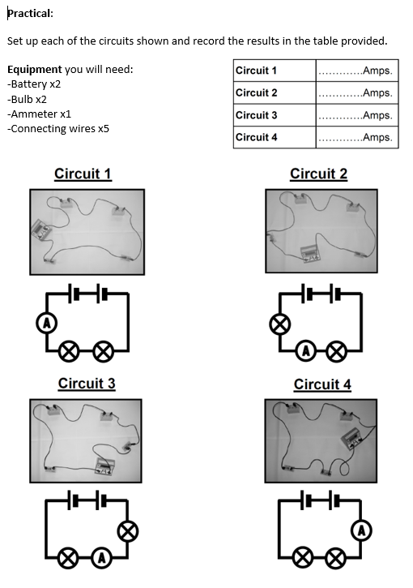
Practical
Equipment you will need:
-Battery x2
-Bulb x2
-Ammeter x1
-Connecting wires x5

Slide 7
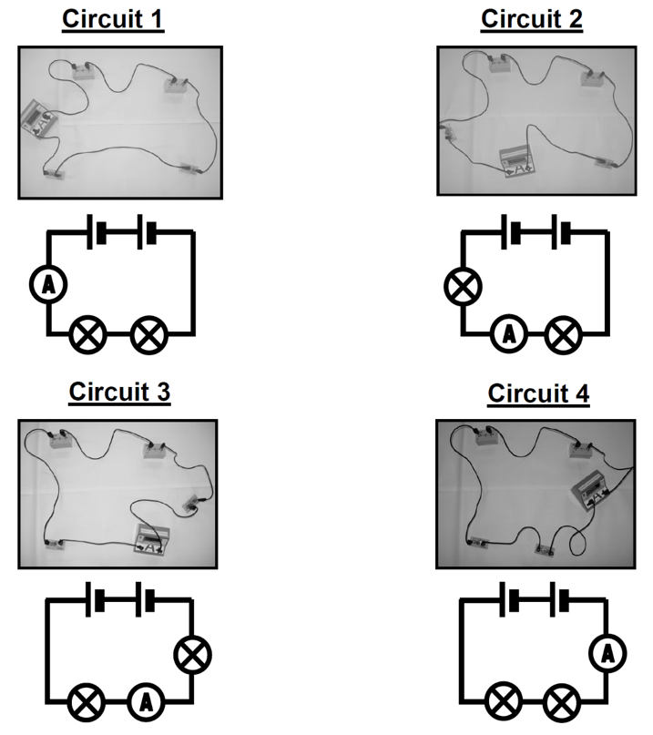
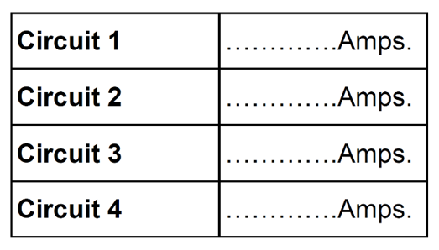

Slide 8


Slide 9
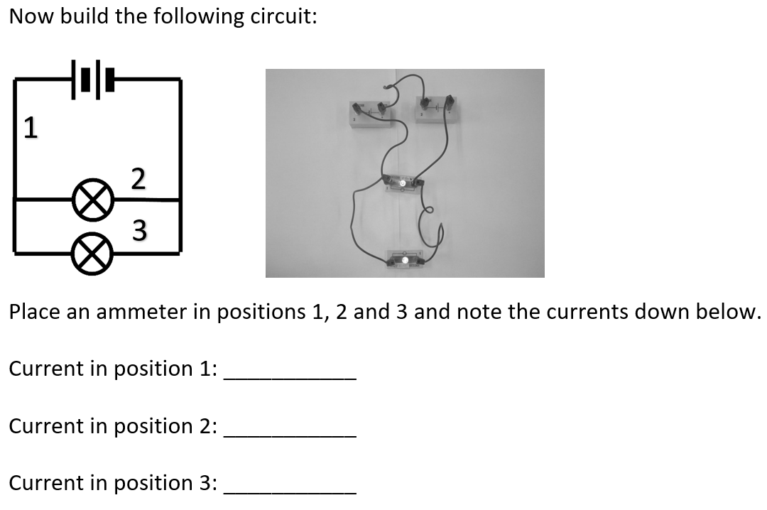


Slide 10
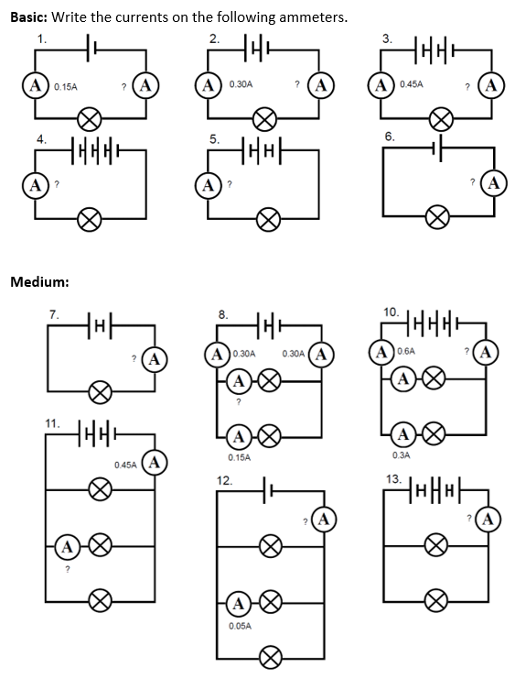
Worksheet
Complete the worksheet!

Slide 11

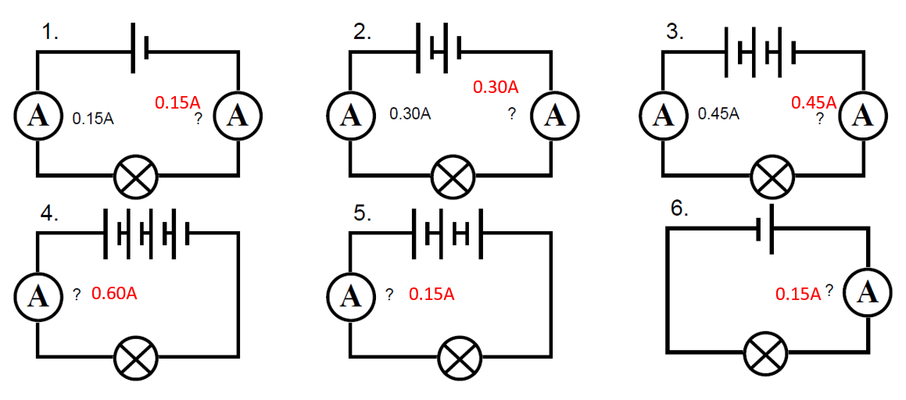
Basic answers

Slide 12
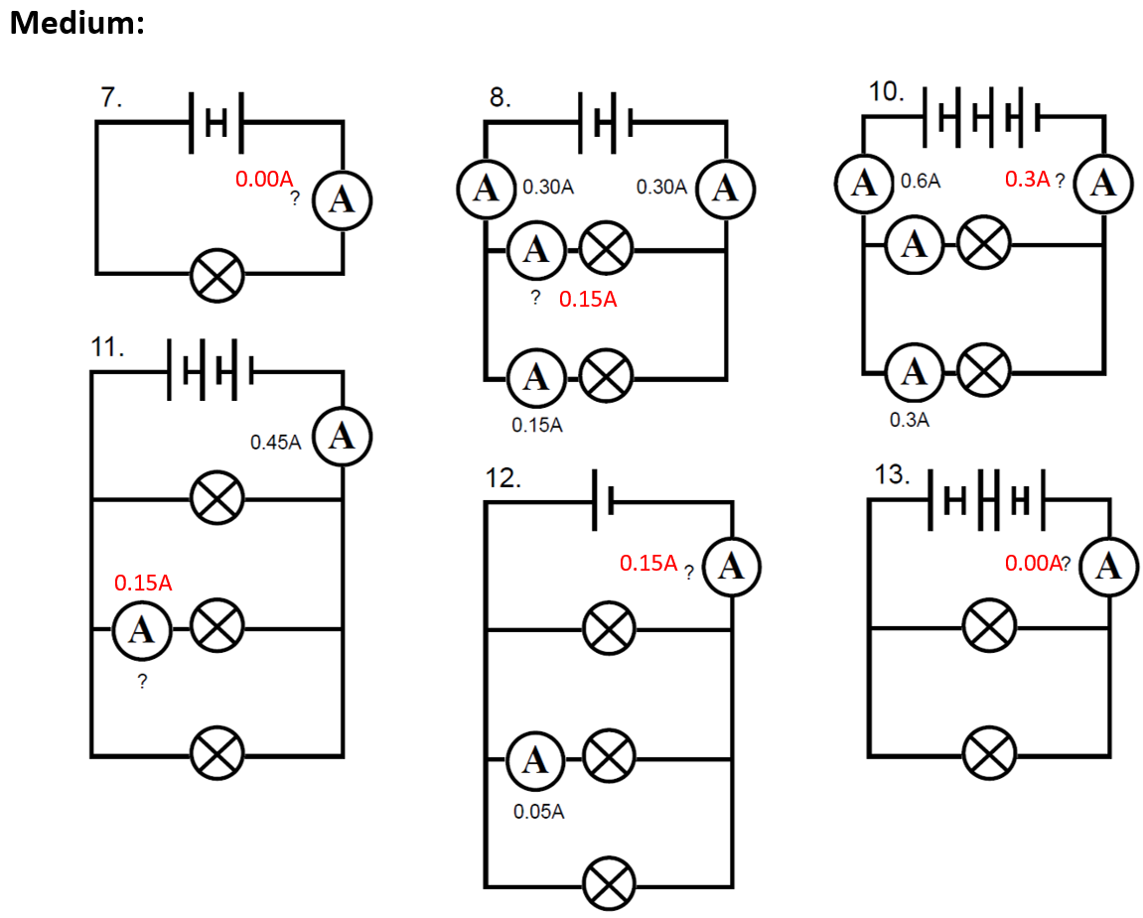
Medium answers

Slide 13
Hard answers
Both 6A- current in the parallel branches add together when the branches join.
1A- the 3A is split between the two branches, the current through X plus the current through Y must add up to 3A
26/4=6.5A
0.20+0.10=0.30A

Slide 14
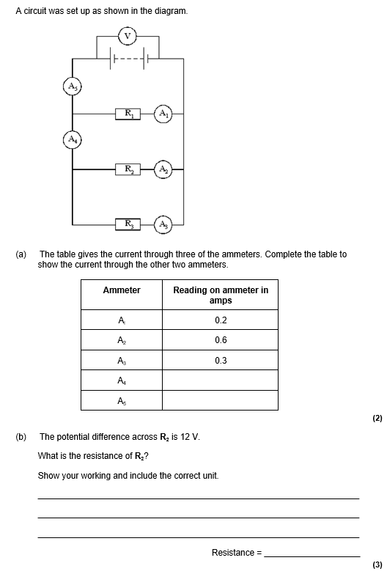
Struggle time!
Exam question so exam conditions!
You have 6 minutes.

Slide 15
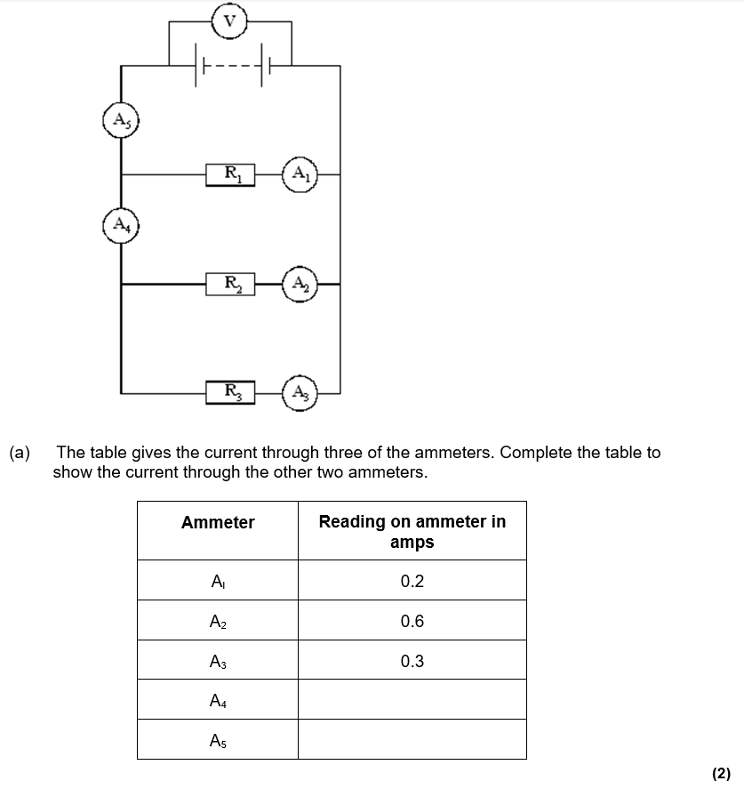
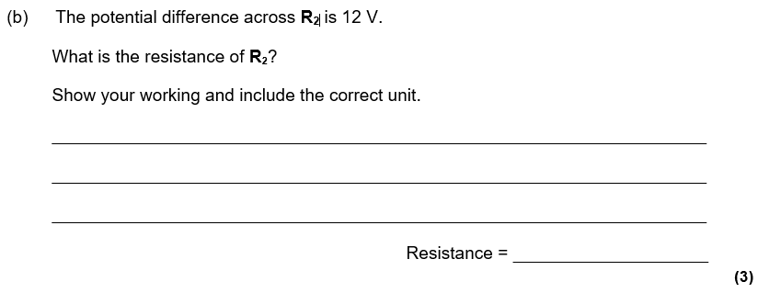

Slide 16
