Slide 1
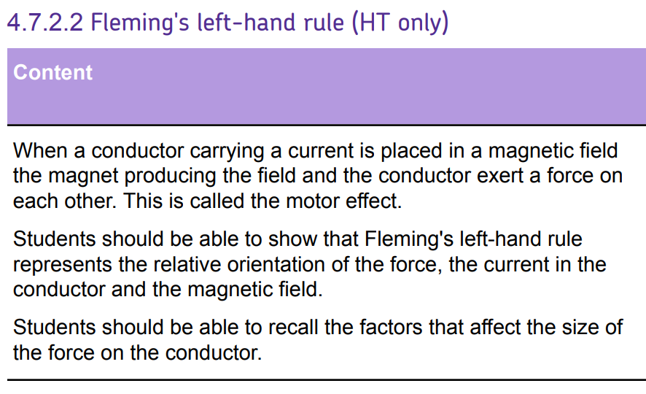
L1 Introduction to magnetism
L2 Compasses
L3 EM practical
L4 Solenoid
L5 Force on a current carrying wire
L6 Fleming LHR
L7 Motors
L8 Induced potential
L9 Generator effect
L10 Loudspeakers & Microphones
L11 Transformers
Students should have been taught how that a current carrying wire within a magnetic field should experience a force.
To apply this knowledge & apply it to motors & other electromagnetic devices.

Slide 2
Fleming’s left hand rule

Slide 3
Fleming’s left hand rule
Current
Flux density
Force
Recall what each finger in Fleming’s left hand rule means.
Recall what direction current flows in.
Apply Fleming’s LHR to a variety of different scenarios.

Slide 4
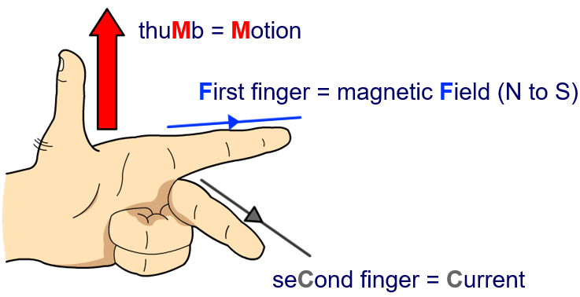


The direction of the force acting on a current carrying wire can be predicted using Fleming’s left-hand rule.
FBI!
$B$ = 0.25T
Stretch: Work our the direction in which the wire will move, and calculate the force exerted on the wire.
S
0.15m
N
$I$ = 2A

Slide 5
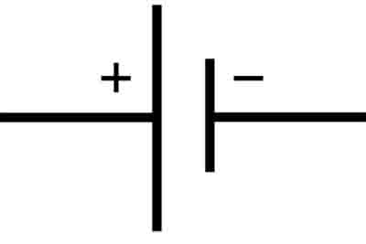
Stretch: What directions do electrons flow in a circuit?
Magnetic field lines flow from North to South.
Current flows from positive to negative.

Slide 6
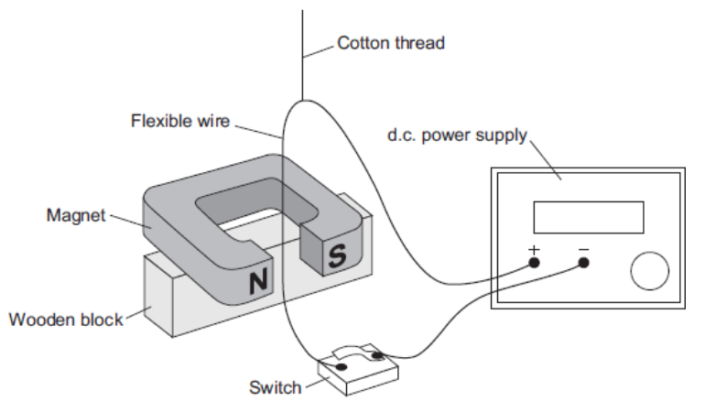
Questions:
What direction does the current flow through the wire?
What direction does the magnetic field go?
Therefore what direction is the force on the wire?

Slide 7
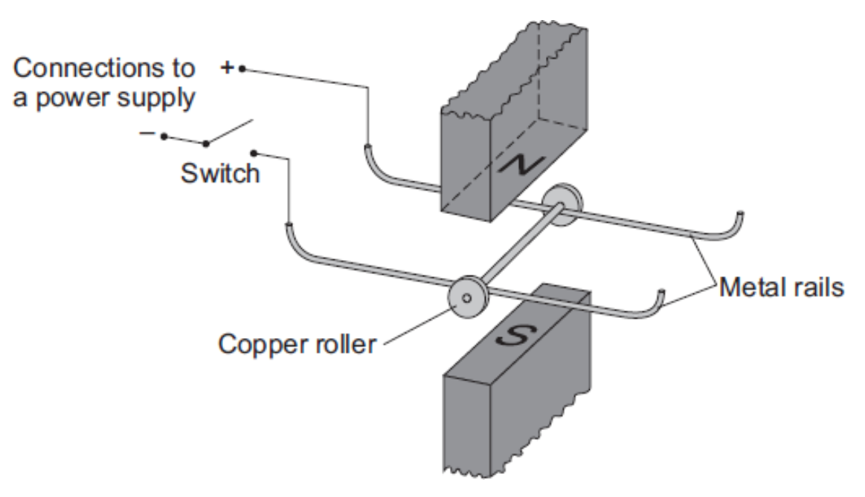
Questions:
What direction does the current flow through the wire?
What direction does the magnetic field go?
Therefore what direction is the force on the wire?

Slide 8
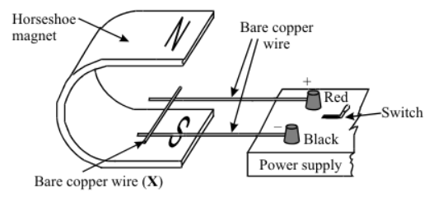
Questions:
What direction does the current flow through the wire?
What direction does the magnetic field go?
Therefore what direction is the force on the wire?

Slide 9
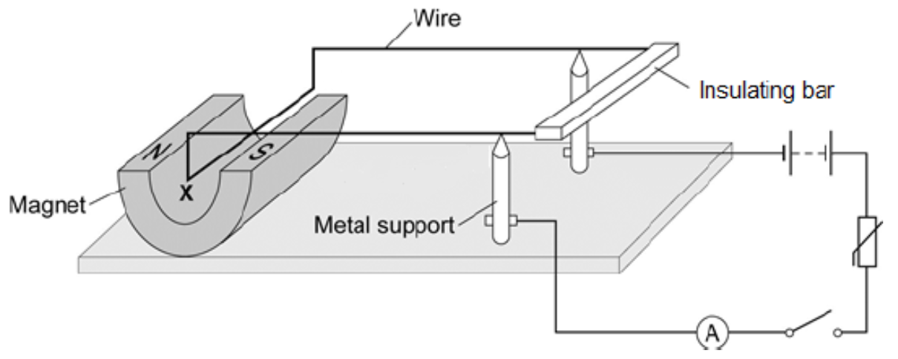
Questions:
What direction does the current flow through the wire?
What direction does the magnetic field go?
Therefore what direction is the force on the wire?

Slide 10
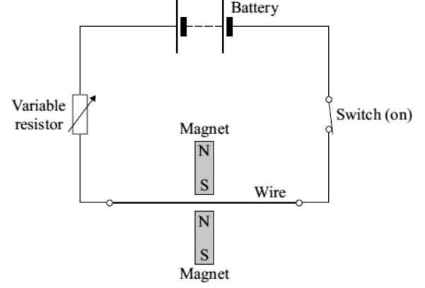
Questions:
What direction does the current flow through the wire?
What direction does the magnetic field go?
Therefore what direction is the force on the wire?

Slide 11
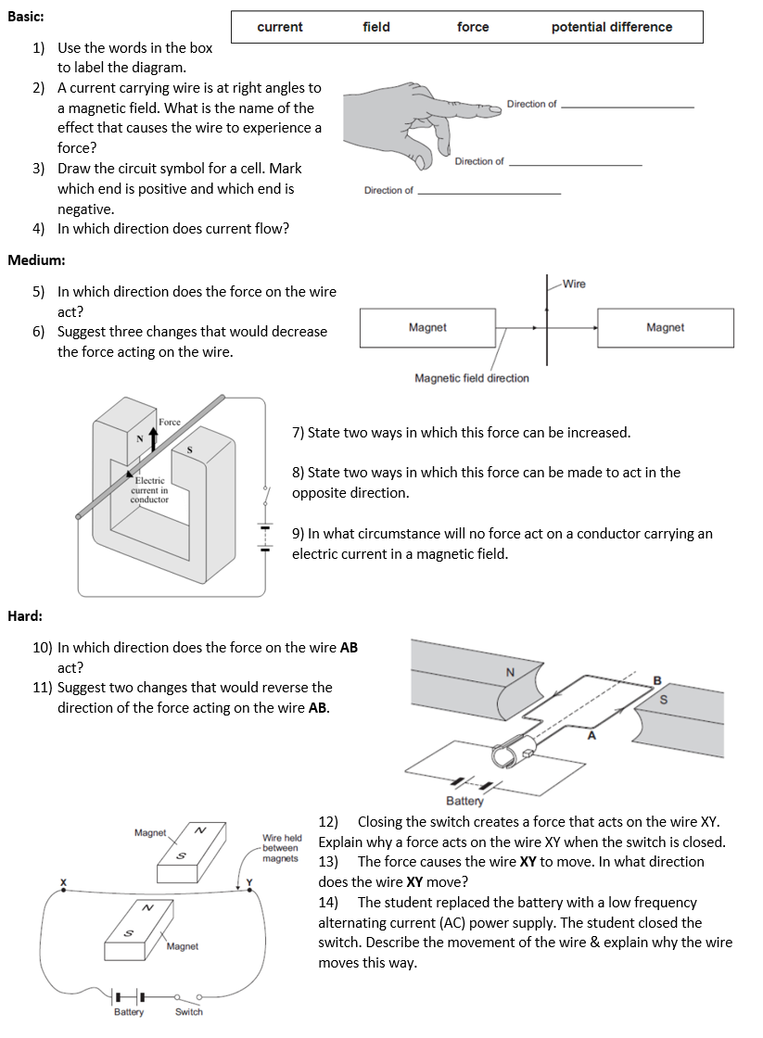
Task
Complete the worksheet.

Slide 12
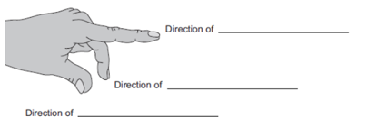

Basic/medium answers
current
field
force
2. Motor effect.
3.
4. From positive to negative

Slide 13
Medium answers
5. Into the page.
6. Decrease current, decrease strength of magnetic field, decrease length of wire in wire, rotate wire to same direction as field.
7. Increase current, increase strength of magnetic field.
8. Reverse the current, turn magnet so North and South poles are in opposite directions.
9. When the current goes parallel to magnetic field.

Slide 14
Hard answers
10. Down
11. Reverse direction of battery/current, reverse direction of magnetic field.
12. Closing switch makes a current flow.
This creates a magnetic field.
This field interacts with the permanent magnetic field.
13. Upwards
14. The wire vibrates up and down, because the forces continually changes direction.

Slide 15
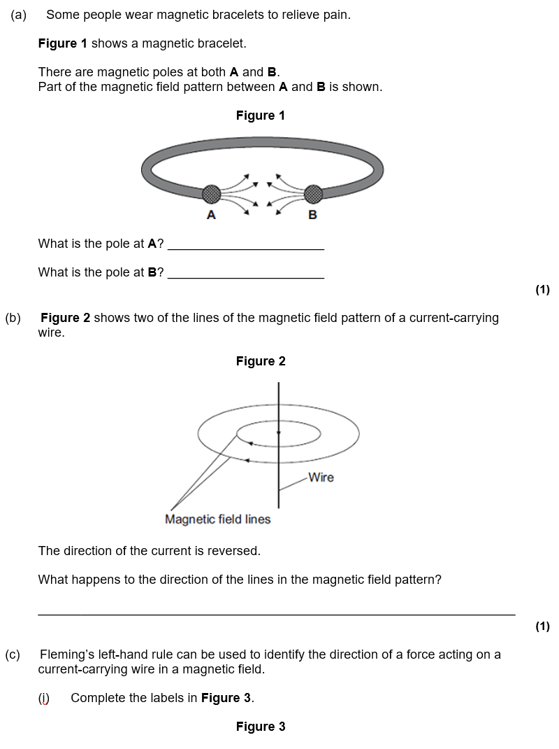
Struggle time!
Exam question so exam conditions!
You have 8 minutes.

Slide 18
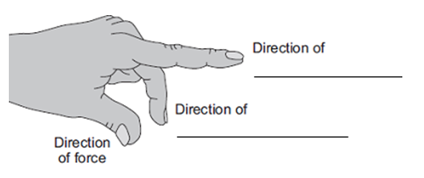

Slide 19
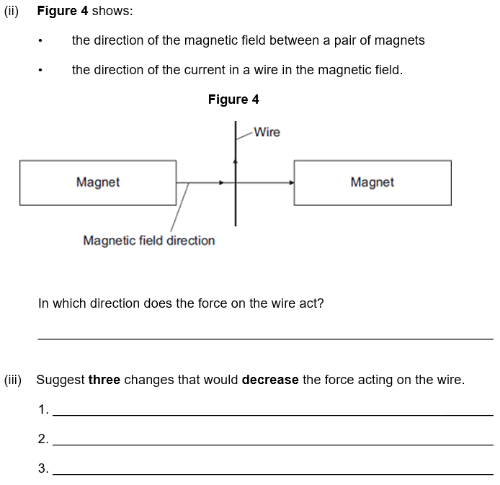

Slide 20
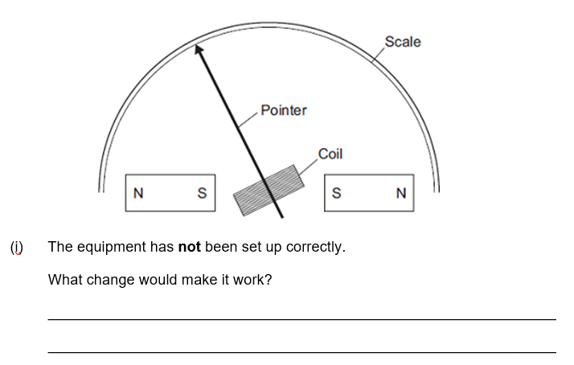

Slide 21
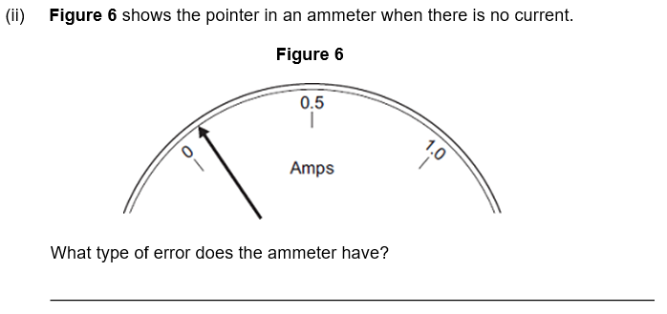

Slide 22
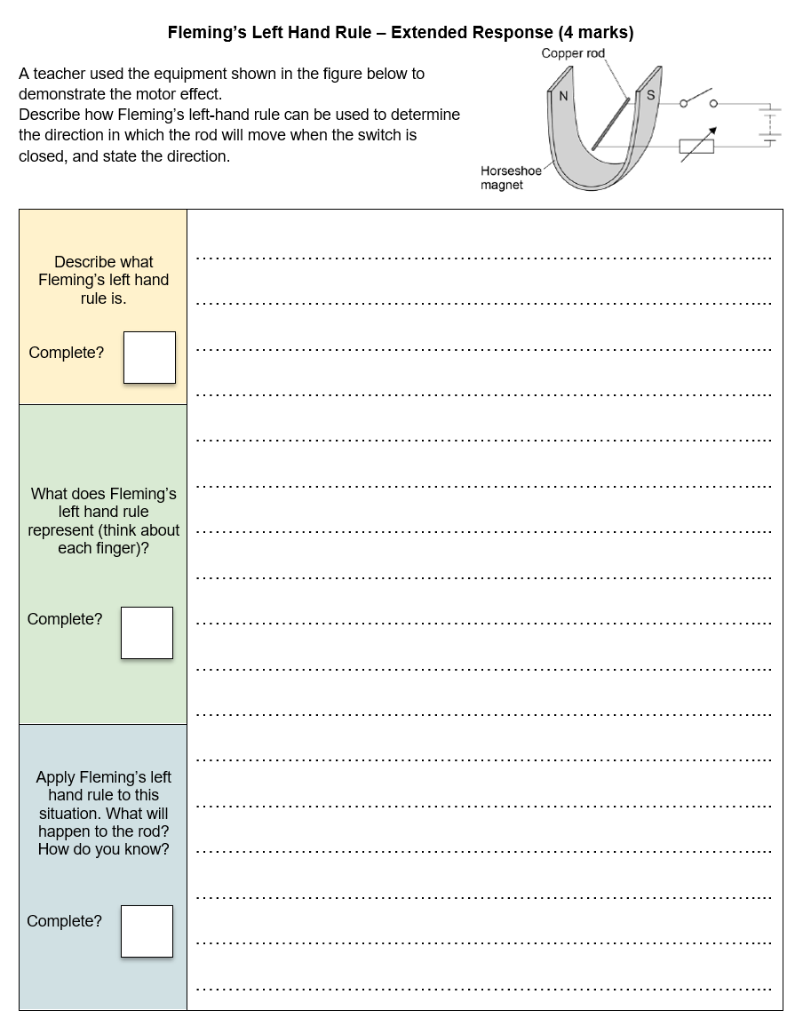
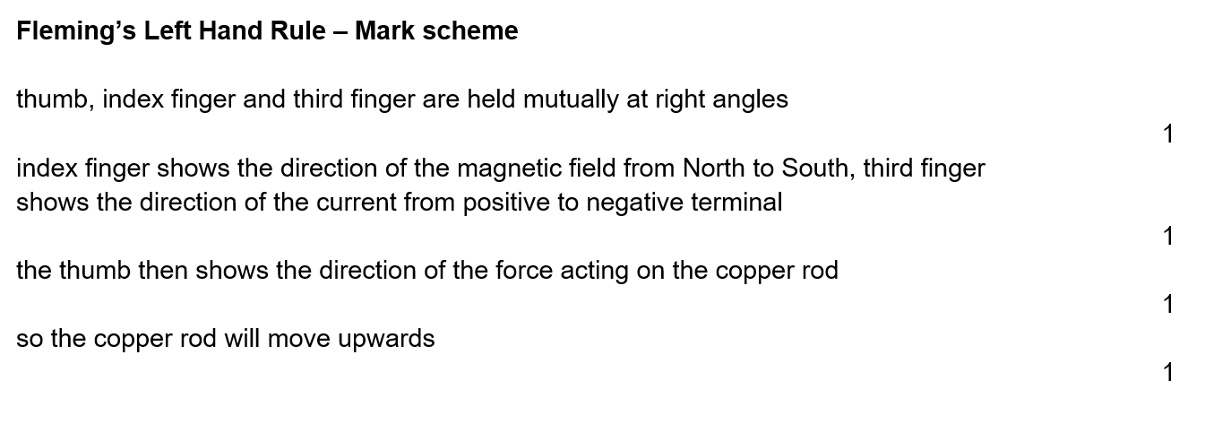
Plenary
Complete the question (4 minutes).

