Slide 1
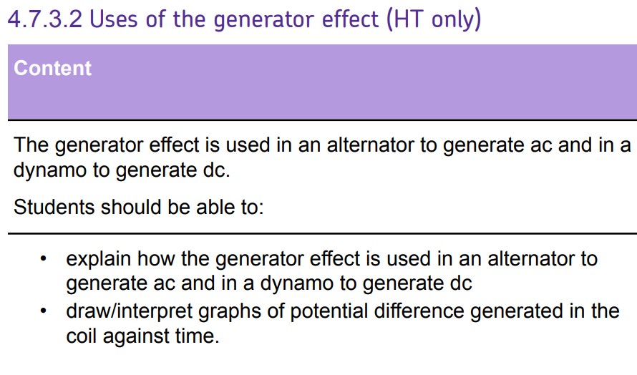
L1 Introduction to magnetism
L2 Compasses
L3 EM practical
L4 Solenoid
L5 Force on a current carrying wire
L6 Fleming LHR
L7 Motors
L8 Induced potential
L9 Generator effect
L10 Loudspeakers & Microphones
L11 Transformers
Students have learnt induced potential and AC and DC. These ideas should be retrieved and built upon during this lesson.
This learning will be consolidated in lessons on transformers.

Slide 2
Alternators and dynamos
15/07/2020

Slide 3
Alternators and dynamos
Current
Commutator
Flux density
Alternator
Dynamo
Generator
AC
DC
Describe what a dynamo is.
Describe what an alternator is.
Explain the difference between alternators and dynamos.

Slide 4
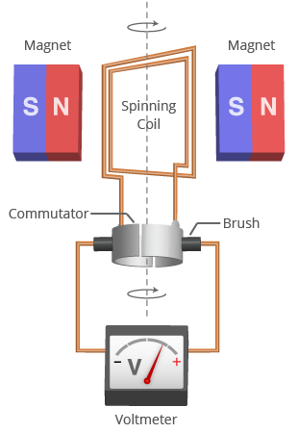
A dynamo is a DC generator. It is a DC motor in reverse. The direction of current does not change.
Stretch: How could we induce a larger voltage?
In what devices might these be used?

Slide 5
When the coil is moving parallel to the direction of the magnetic field, no potential difference is induced.
Stretch: When is a maximum potential difference induced?

Slide 6
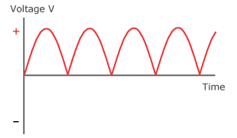
Dynamo graph
Stretch: What would happen if we span the dynamo twice as fast?

Slide 7
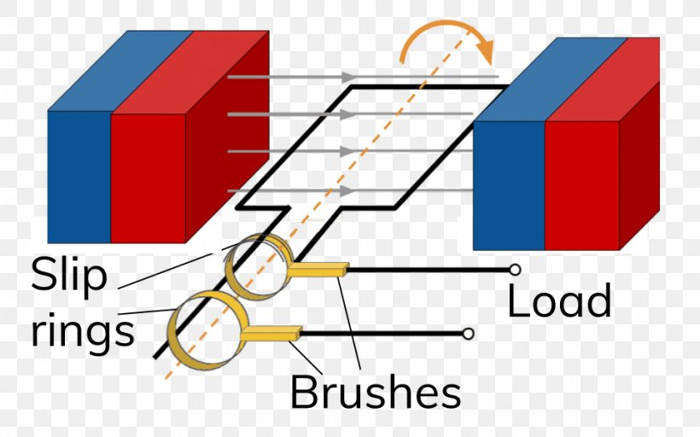
A alternator is an AC generator. It does not contain a split ring commutator.
Stretch: A current of 200mA is induced in a circuit. If the power in the circuit is 2W, calculate the resistance of the circuit.

Slide 8
What are the differences?
What are the differences between alternators and dynamos?
1. _____________________
2. _____________________
Alternator is AC, dynamo is DC
Dynamo has no split ring commutator

Slide 9
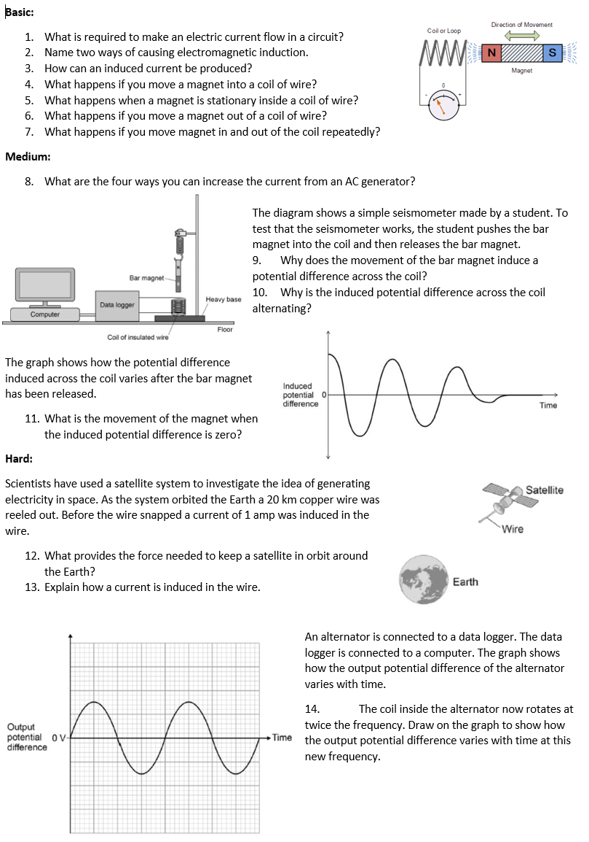
Worksheet
Complete the worksheet

Slide 10

Basic answers
An alternator.
Alternating current.
Generator effect.
Alternating current.
Voltmeter.
Potential difference (y axis) vs time (x axis).
Graph opposite way up.
Dynamo
Alternator is AC, dynamo is DC.

Slide 11
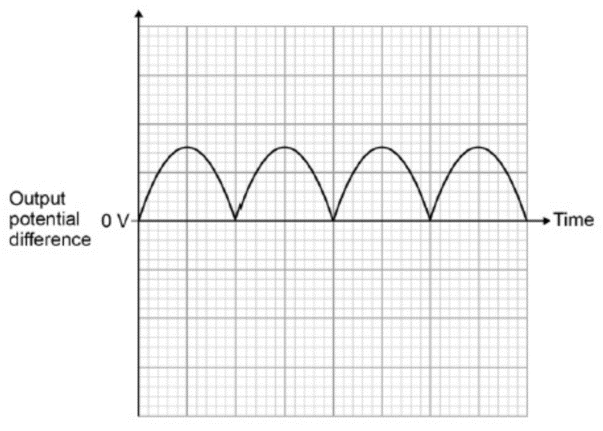
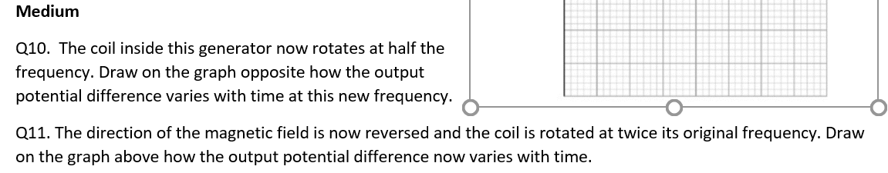
Medium answers
Q12. Wind turbines/steam turbines/dynamo on a bike. Rotation causes coil to turn in a magnetic field inducing a voltage.

Slide 12
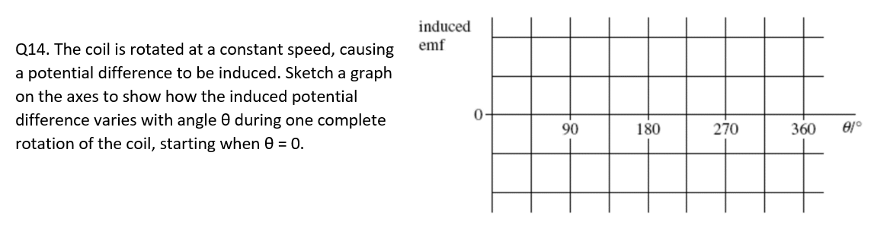
Hard answers
13. Zero at 0 degrees, maximum at 90 degrees.

Slide 13
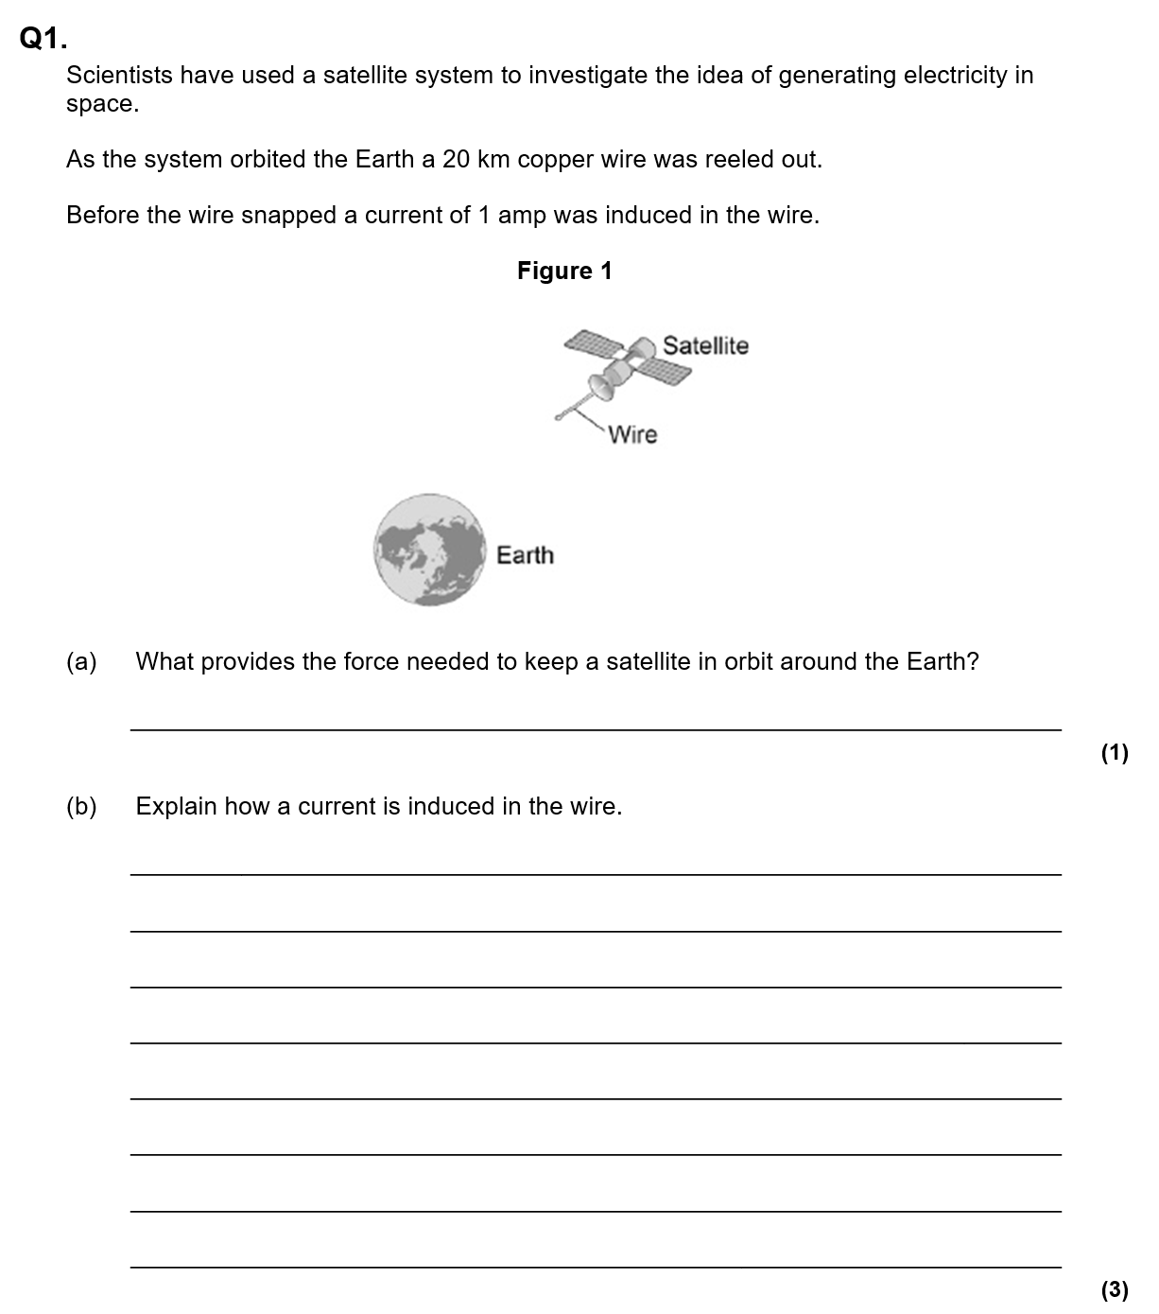
Struggle time!
Exam question so exam conditions!
You have 10 minutes!

Slide 14
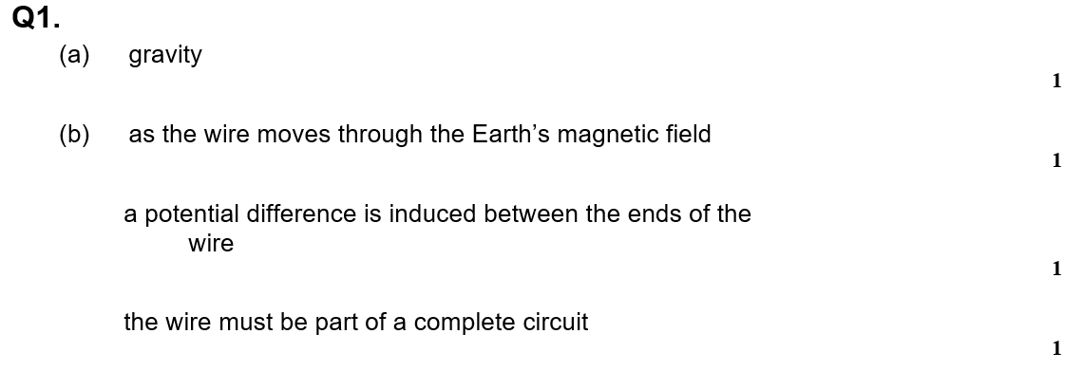

Slide 15
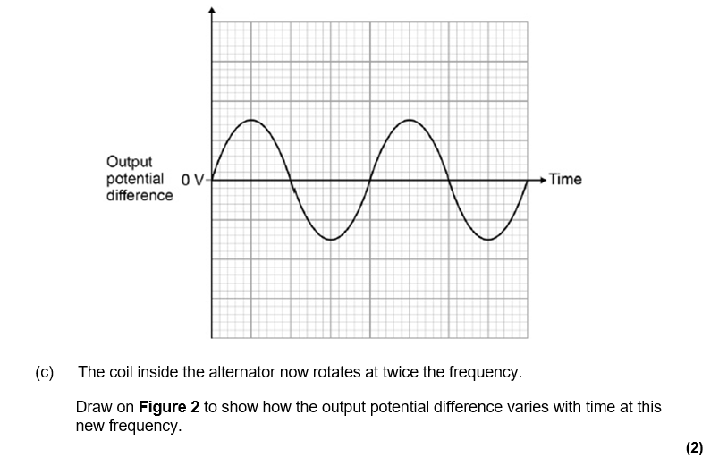

Slide 16
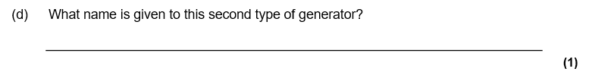
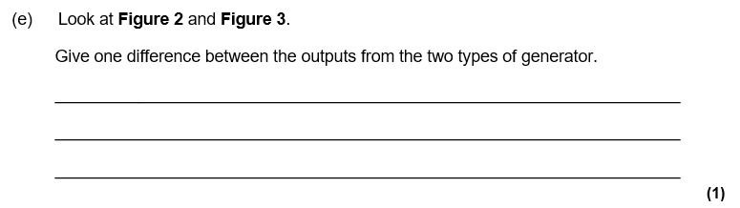

Slide 17
