Slide 1
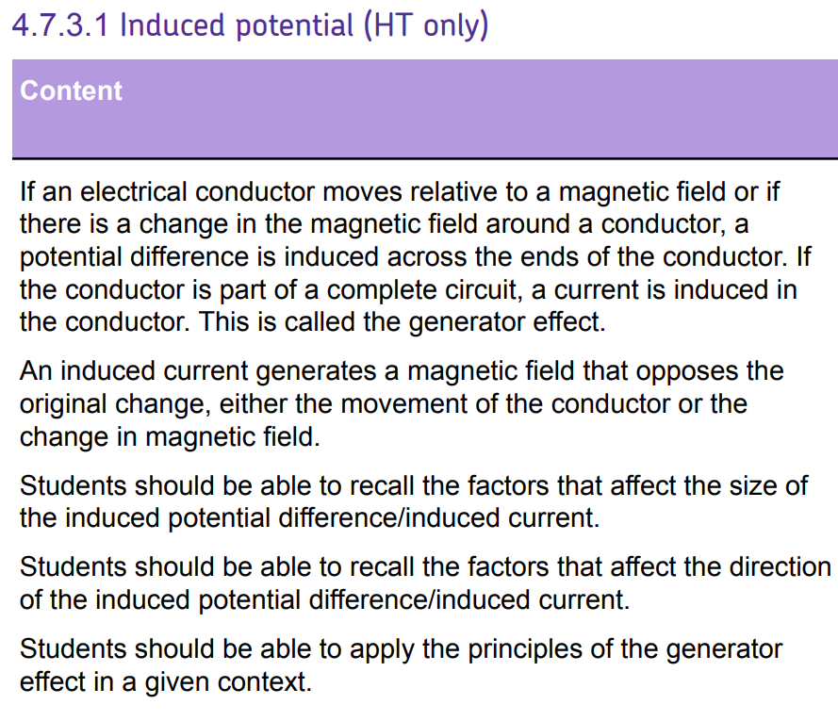
L1 Introduction to magnetism
L2 Compasses
L3 EM practical
L4 Solenoid
L5 Force on a current carrying wire
L6 Fleming LHR
L7 Motors
L8 Induced potential
L9 Generator effect
L10 Loudspeakers & Microphones
L11 Transformers
Students have learnt F-BIL, Fleming’s LHR and motors. Emphasis should be that inducing potential is really the reverse of what they’ve learnt previously.
This learning will be consolidated in lessons on the generator effect, microphones & transformers.

Slide 2
Induced potential
15/07/2020

Slide 3
Current
Commutator
Flux density
Motor
Carbon brush
Describe what causes electromagnetic induction.
Explain how a current is induced.
Describe the four ways you can increase the current from an AC generator.

Slide 4
Electromagnetic induction
A potential difference or voltage is needed to make an electric current flow in a circuit:
a coil of wire is moved in a magnetic field
a magnet is moved into a coil of wire
This is called electromagnetic induction and is often referred to as the generator effect.
Stretch: How could we make the cone vibrate more strongly?

Slide 5
Induced current
The induced voltage produces an induced current if the conductor is connected in a complete circuit.
Stretch: A current of 2A is induced in a circuit. If the power in the circuit is 150 mW, calculate the resistance of the circuit.

Slide 6
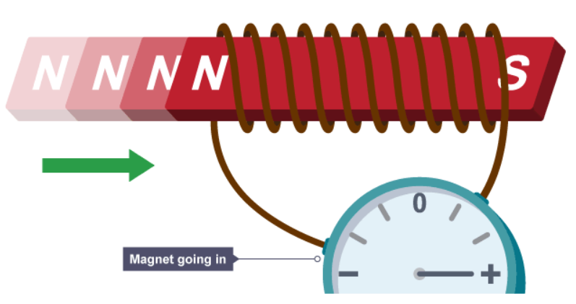
Induced current
What will happen if you move a magnet into a coil of wire?
A current is induced in the coil.
Only when the magnet is moving.

Slide 7
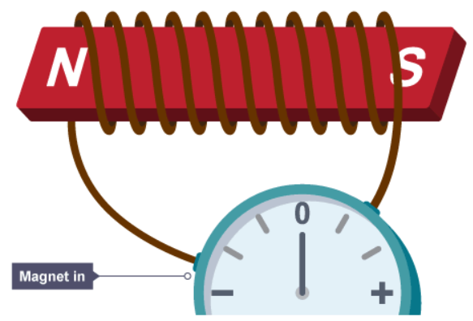
Induced current
What happens when the magnet is in the coil?
Nothing!!
A current is only induced when the magnet is moving.

Slide 8
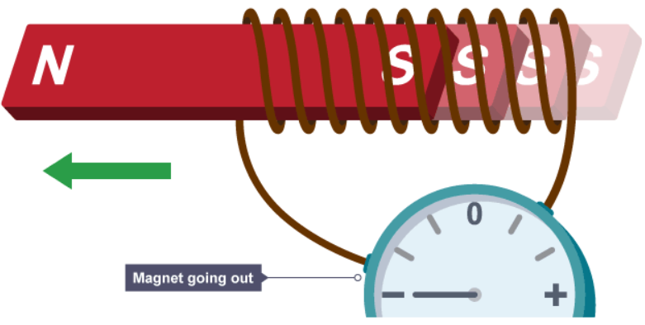
Induced current
What will happen if you move the magnet out of the coil of wire?
A current is induced in the coil.
This time in the opposite direction.
If you reverse the direction of the movement, then you reverse the direction of the current.

Slide 9
AC or DC?
What will happen if you move a magnet in and out of the coil repeatedly?
A current will be induced in the coil, the current will flow in one direction and then reverse and flow in the opposite direction.
What type of current is this?
Alternating current

Slide 10
AC generator
What are the four ways you can increase the current from an AC generator?
1. _____________________
2. _____________________
3. _____________________
4. _____________________
Faster movement
Stronger magnetic field
More coils
Larger area of coils

Slide 11
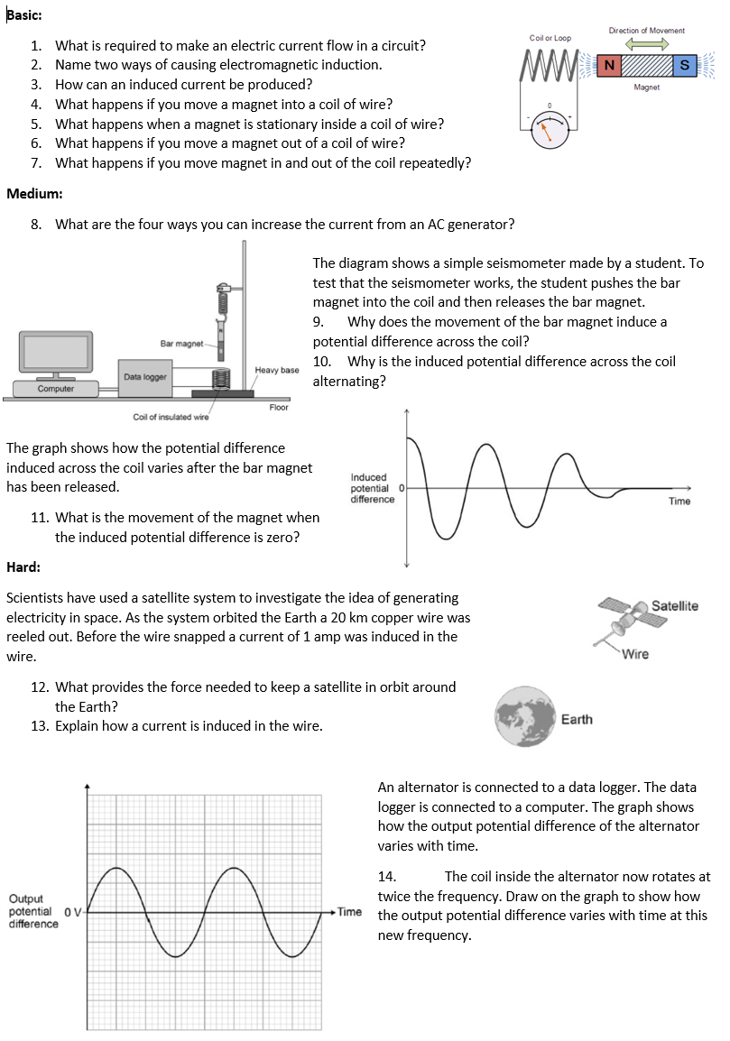
Worksheet
Complete the worksheet

Slide 12

Basic answers
A potential difference/voltage.
A coil of wire is moved in a magnetic field/a magnet is moved into a coil of wire.
If the conductor is connected in a complete circuit.
A current is induced.
No current is induced.
A current is induced is the opposite direction.
An AC current will be induced.

Slide 13
Medium answers
8. Faster movement/stronger magnetic field/more coils/larger area of coils.
9. Magnetic field around the coil changes.
10. Because the magnet changes direction.
11. It is stationary.

Slide 14
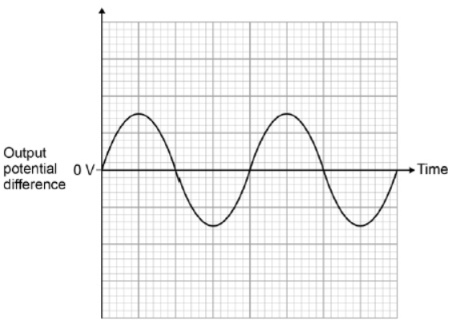
Hard answers
12. Gravity.
13. As the wire moves through the Earth’s magnetic field [1] a potential difference is induced between the ends of the wire [1] the wire must be part of a complete circuit [1]
14.Twice the amplitude and twice the frequency

Slide 15
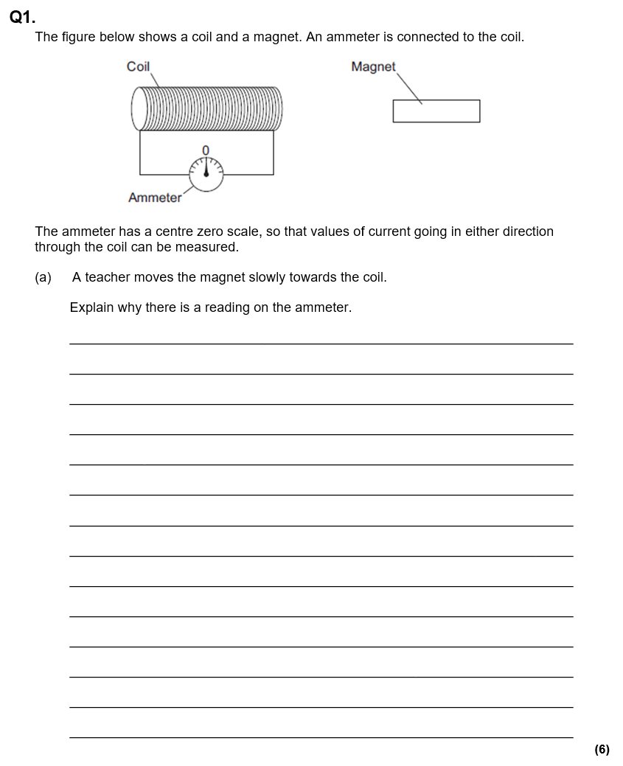
Struggle time!
Exam question so exam conditions!
You have 10 minutes!

Slide 16
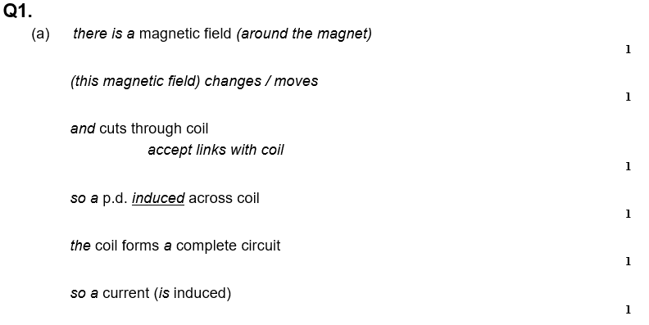

Slide 17
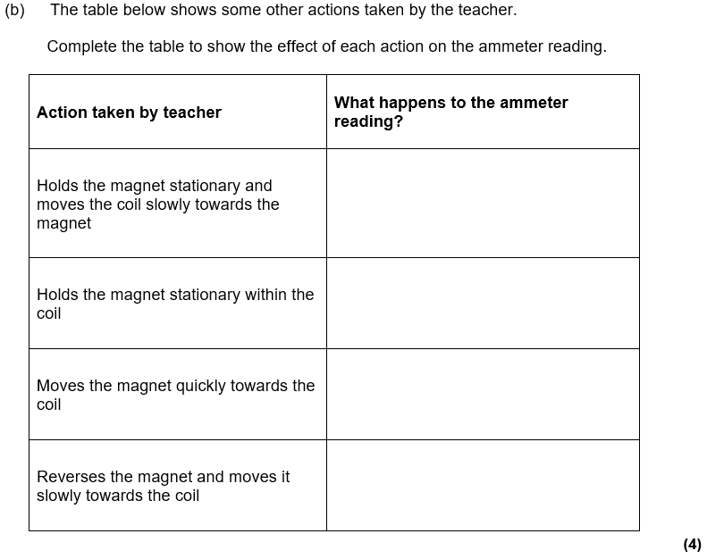
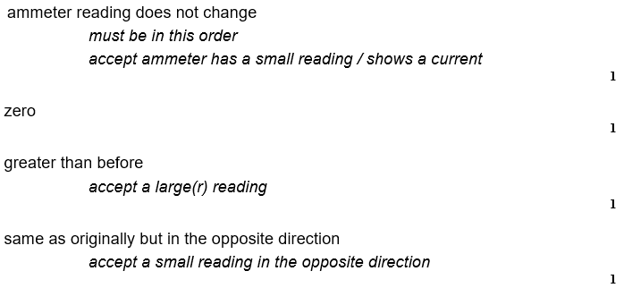

Slide 18
