Slide 1
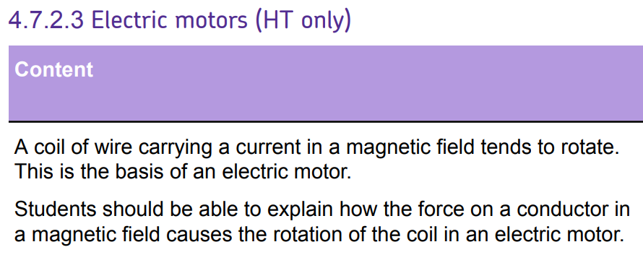
L1 Introduction to magnetism
L2 Compasses
L3 EM practical
L4 Solenoid
L5 Force on a current carrying wire
L6 Fleming LHR
L7 Motors
L8 Induced potential
L9 Generator effect
L10 Loudspeakers & Microphones
L11 Transformers
Students have learnt F-BIL, and Fleming’s LHR. The electric motor is really an application of these two lessons. Therefore there is plenty of opportunity for consolidation of prior lessons.
Students will cover loudspeakers, generator effect, microphones and transformers.

Slide 2
DC motors
16/07/2020

Slide 3
Current
Commutator
Flux density
Motor
Carbon brush
Describe the structure of a DC motor.
Explain the role of a split ring commutator.
Describe how to make a DC motor stronger/spin the other way.

Slide 4
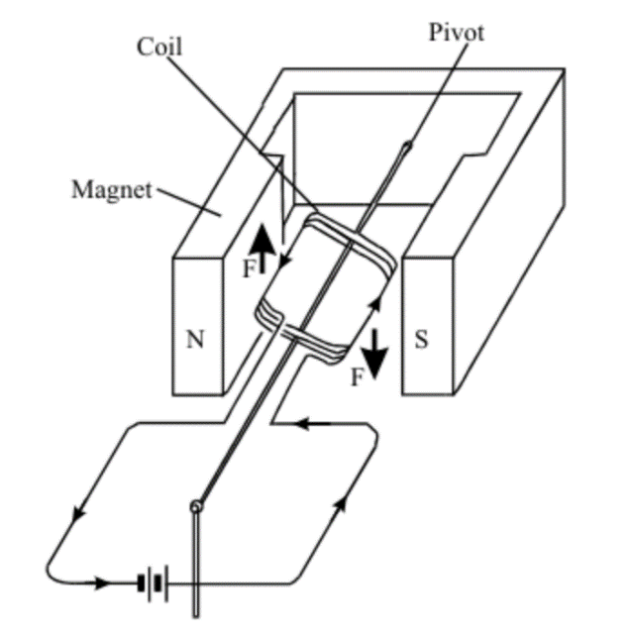
DC Motor
A DC motor is made out of a coil of wire within a magnetic field.
There is an equal and opposite force on each side of the coil.
Stretch: What happens to the direction of the force when the coil rotates 180 degrees?

Slide 5
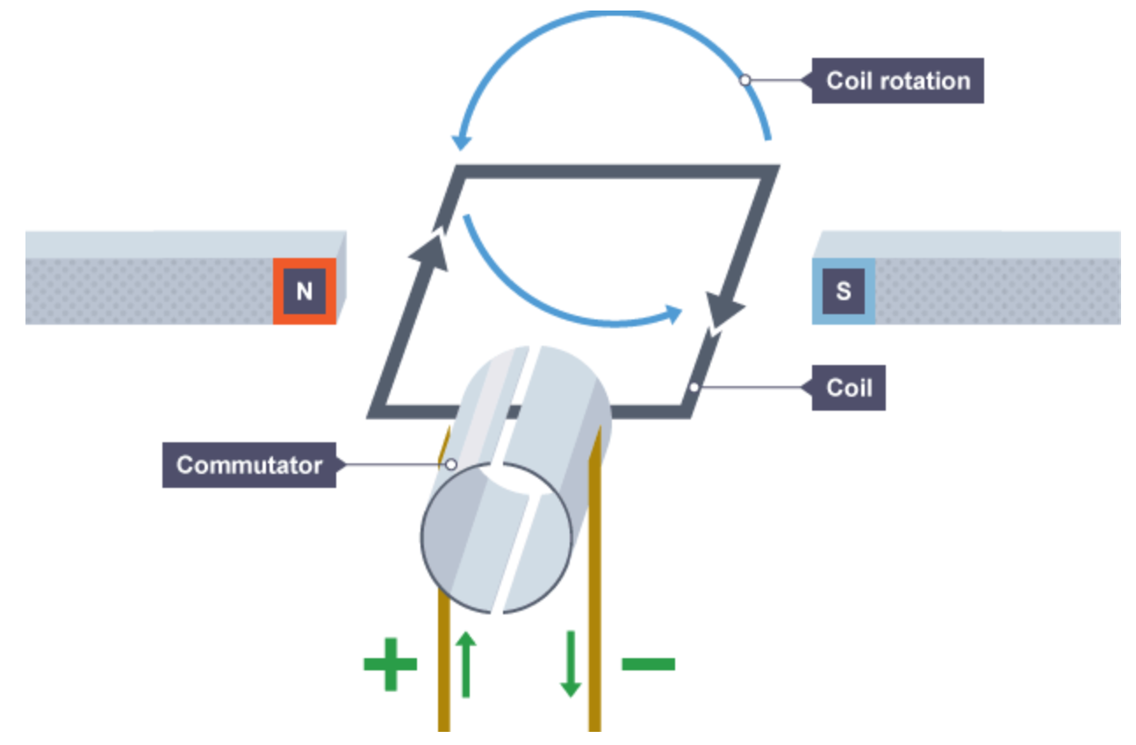
Commutator
A split ring commutator changes the direction of current every half turn.
This is due to two halves swapping from one carbon brush to another.
Stretch: The commutator disconnects the current every half turn. Why doesn’t the motor stop?

Slide 6

DC Motor
How could we:
Make the motor spin in the opposite direction?
Make the motor spin faster?

Slide 7
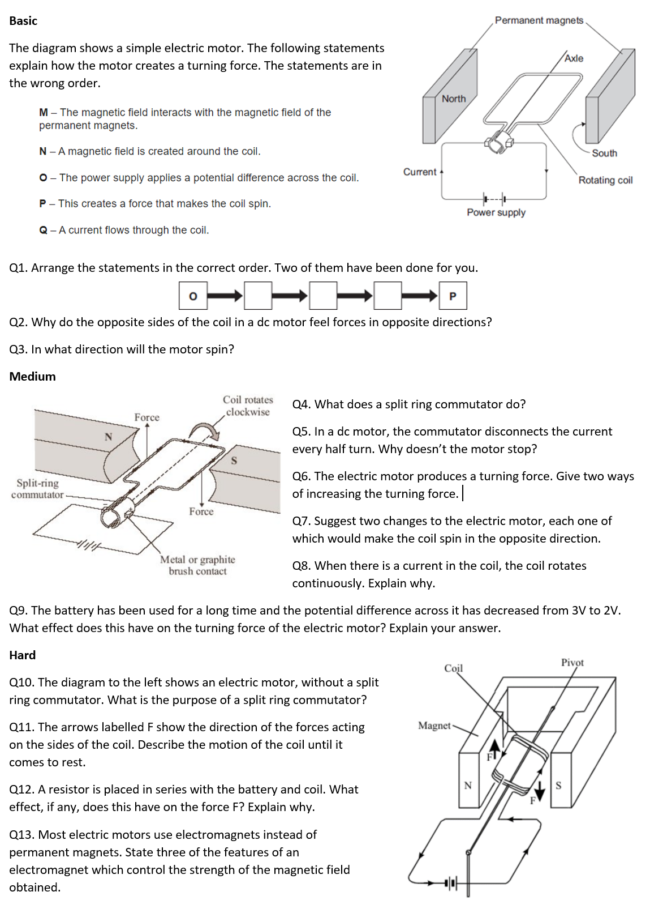
Worksheet
Complete the worksheet

Slide 8

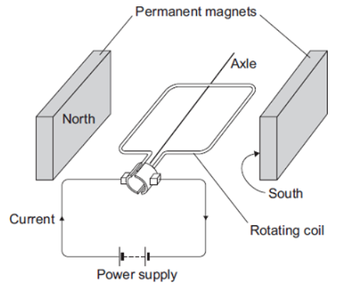
Basic answers
Q1.
Q2. Because the direction of the current is going in the opposite direction.
Q3. Anti-clockwise.
A
N
M

Slide 9
Medium answers
Q4. Reverses the direction of current every half turn.
Q5. Because the momentum of the coil keeps the motor spinning.
Q6. Increasing the current in the coil, increasing the magnetic flux density of the magnets.
Q7. Reversing direction of the current, reversing direction of the magnetic field.
Q8. The current creates a magnetic field [1]
This magnetic field interacts with the magnetic field of the magnets [1]
Which creates a force, and causes the coil to rotate [1]
When the coil has rotated half a turn, the split ring commutator reverses the current direction [1]
So that the coil continues rotating in the same direction [1]
Q9. Potential difference has decreased, so current decreases. This reduces the force of the motor.

Slide 10
Hard answers
Q10. The split ring commutator reverses the direction of the current every half turn [1]
This keeps the turning force in the same direction [1]
Q11. It will rotate a half turn, and then experience a force in the opposite direction.
It will come to rest in a vertical position.
Q12. The resistor decreases the current in the circuit [1]
This reduces the force on the coil [1]
Q13. The size of the current, iron core, number of turns in the coil.

Slide 11
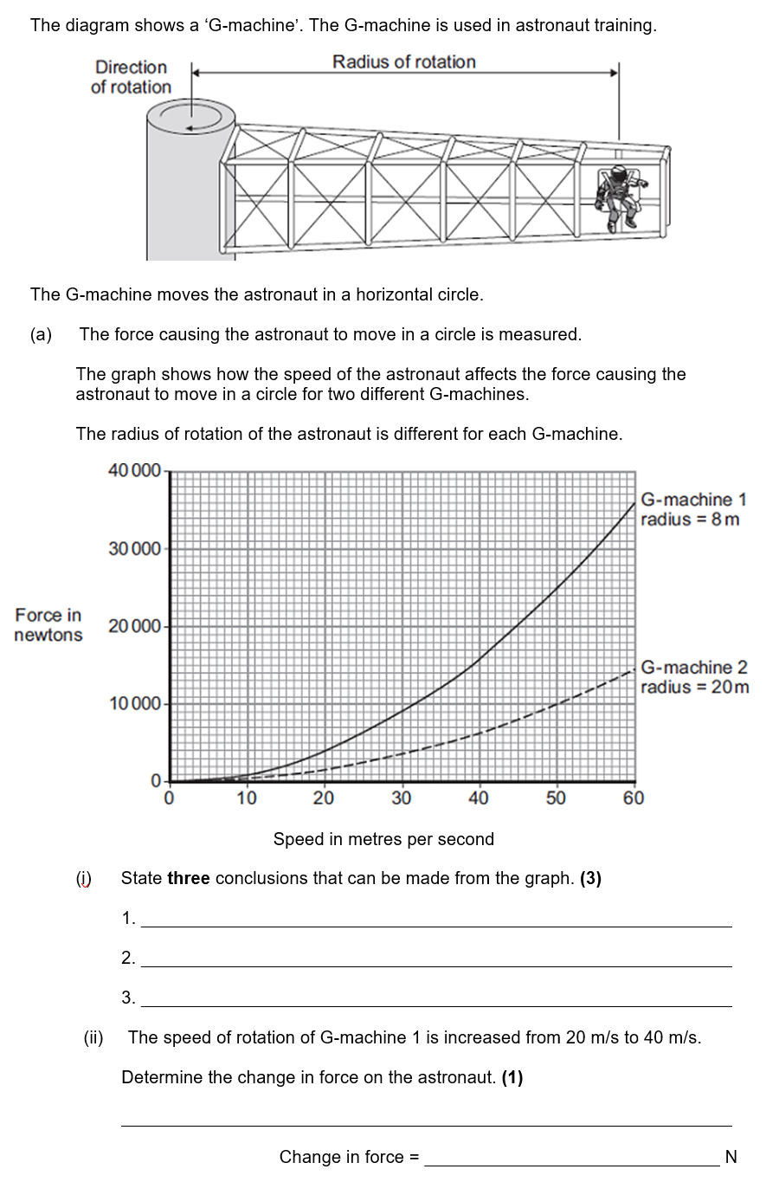
Struggle time!
Exam question so exam conditions!
You have 8 minutes!

Slide 12
Greater the speed, the greater the force
Smaller the radius, the greater the force
Doubling the speed quadruples the force
12,000N

Slide 13
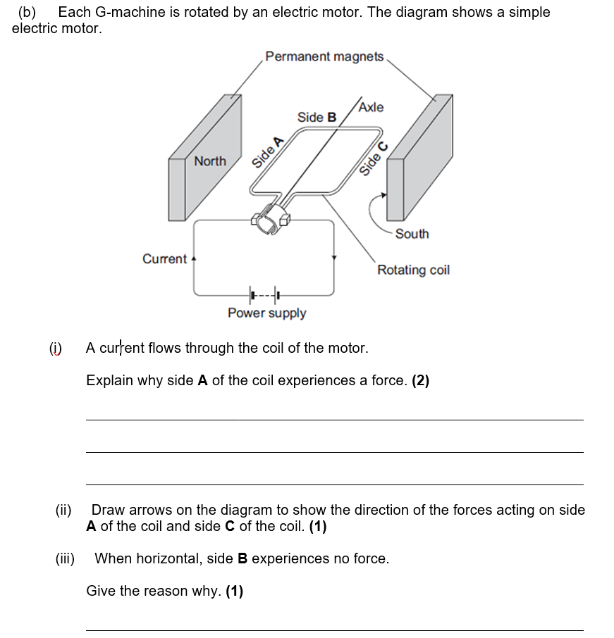
Current creates a magnetic field
This interacts with the permanent magnetic field and produces a force.
Because side B is parallel to the magnetic field lines

Slide 14
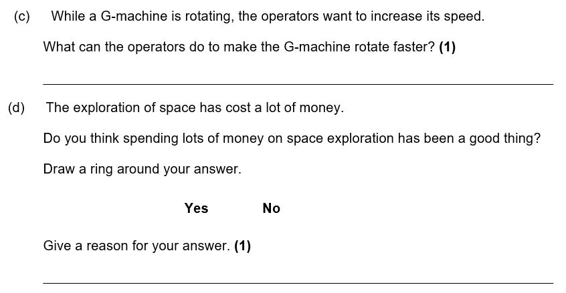
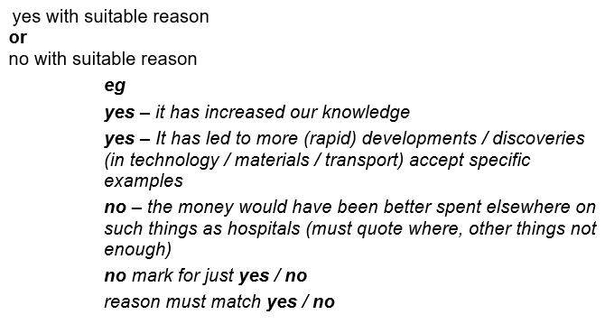
Increase current/strength of magnetic field

