Slide 1
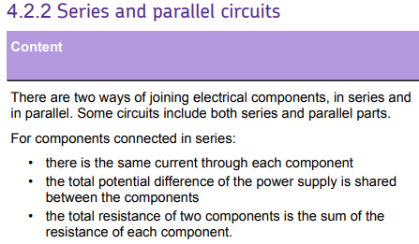
L1 Circuit symbols
L2 Current & charge
L3 Potential difference
L4 Resistance & Ohm’s Law
L5 Power & energy
L6 Electrical power
L7 Current in series & parallel
L8 Potential difference in series & parallel
L9 Sensing circuits
L10 Three pin plug
L11 National Grid
Students know the definition of potential difference & the difference between series and parallel circuits.
The ideas taught in this lesson will expanded upon in the lesson on sensing circuits.

Slide 2
Potential difference in series & parallel

Slide 3
Voltage
Potential
Difference
Series
Parallel
Recall that voltage is shared across components in a series circuit.
Recall that voltage is equal in each path of a parallel circuit.
Calculate voltage in series and parallel circuits.

Slide 4
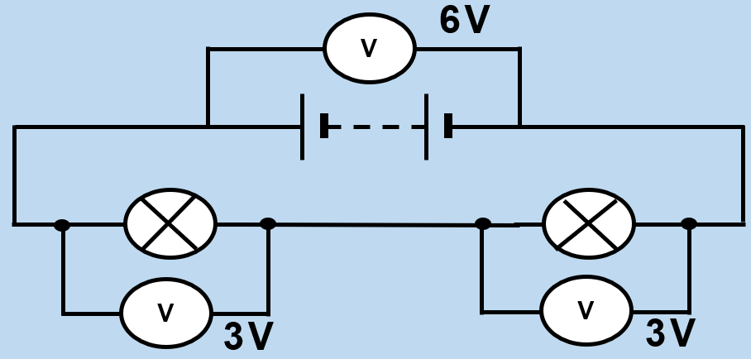
In a series circuit, the voltage supplied by the battery is shared by the components. So, the sum of the potential difference across the components equals the battery voltage.
Stretch
Both of the lamps above have a resistance of 12 Ω. Calculate the current in the circuit.

Slide 5
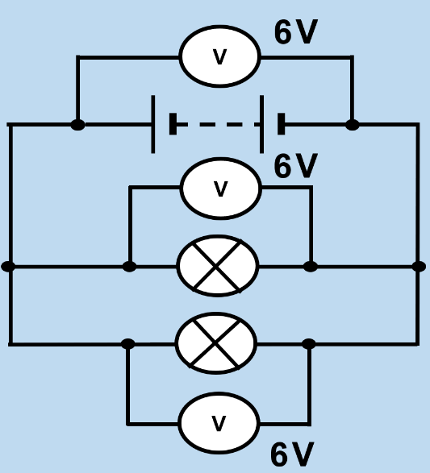
In a parallel circuit, the potential difference across each bulb is the same as the potential difference across the battery.
This means that all the bulbs have the same brightness, and they are brighter than the same number of bulbs in a series circuit. However, this also means that the battery will run down faster in a parallel circuit.
Stretch: The current flowing through the battery is 0.2 A. Calculate the resistance of each of the bulbs.

Slide 6
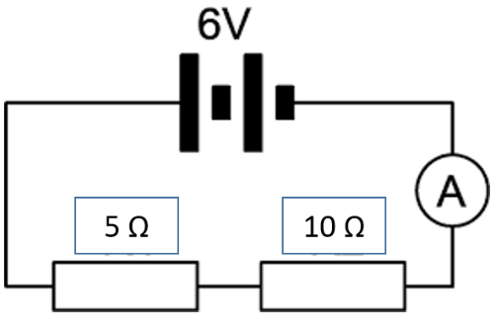
Example question. What is the potential difference across each of these resistors?
STEP 1: Calculate the total resistance
R_{TOT} = R₁ + R₂ = 5 + 10 = 15 Ω
STEP 2: Calculate the total current in the circuit
I = V ÷ R = 6 ÷ 15 = 0.4 A
STEP 3: Calculate the potential difference across both of the resistors
5 Ohm resistor: V = I × R = 0.4 × 5 = 2V
10 Ohm resistor: V = I × R = 0.4 × 10 = 4V
Note that these potential differences add up to give the total potential difference across the battery (6V).

Slide 7
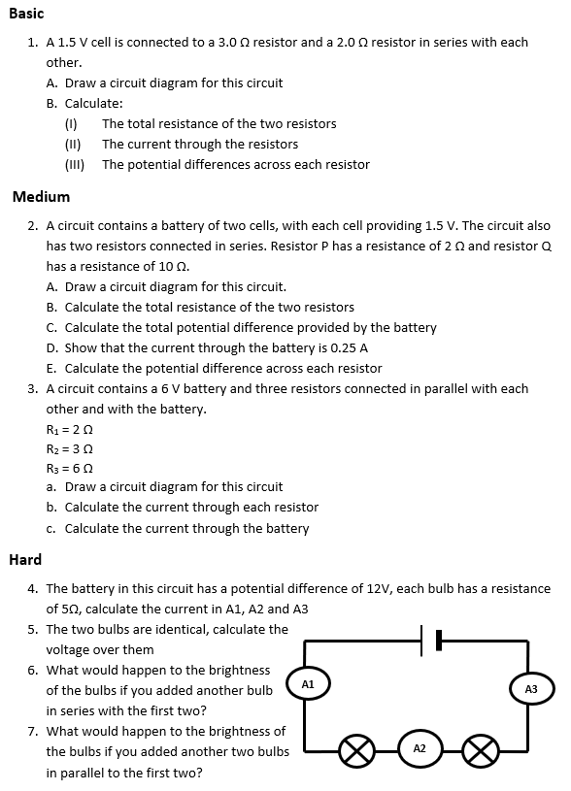
Worksheet
Complete the worksheet!

Slide 8

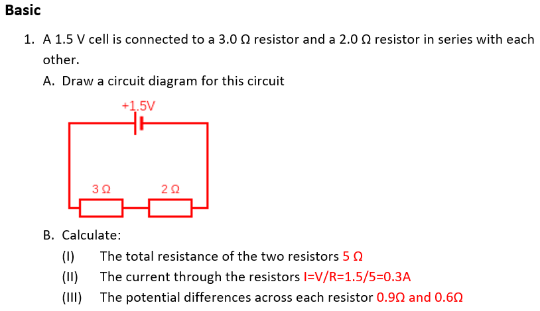
Basic answers

Slide 9
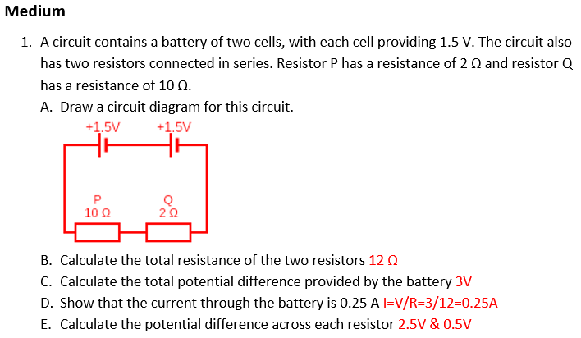
Medium answers

Slide 10
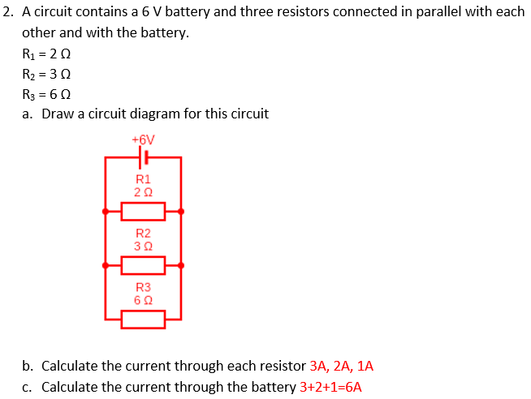
Medium answers

Slide 11
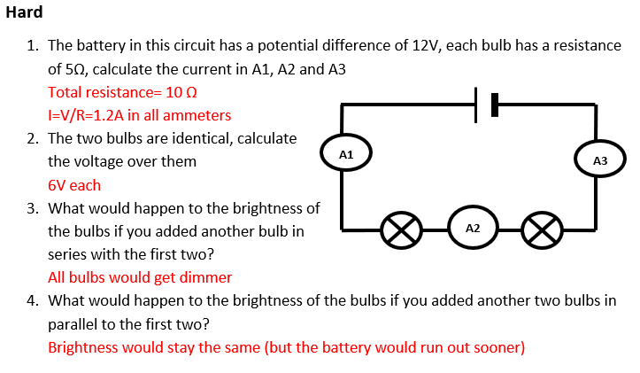
Hard answers

Slide 12
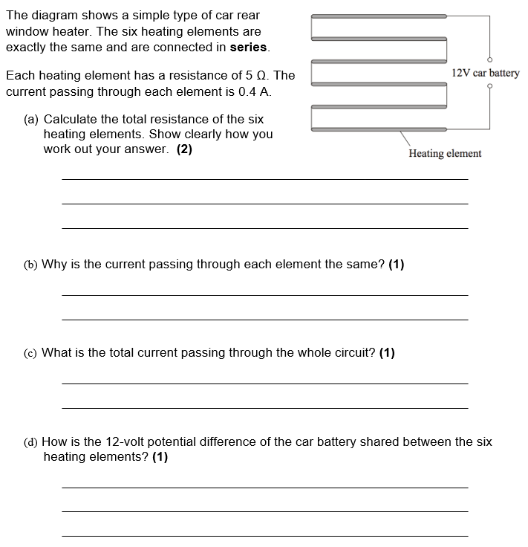
Struggle time!
Exam question so exam conditions!
You have 6 minutes.

Slide 13
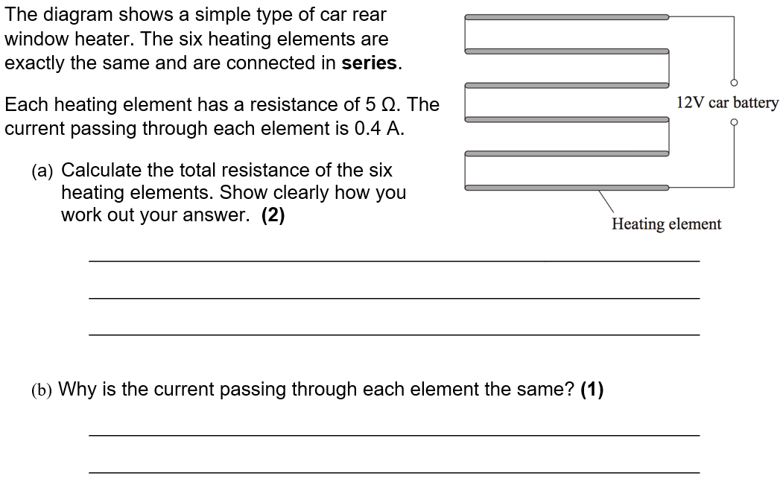

Slide 14
