Slide 1
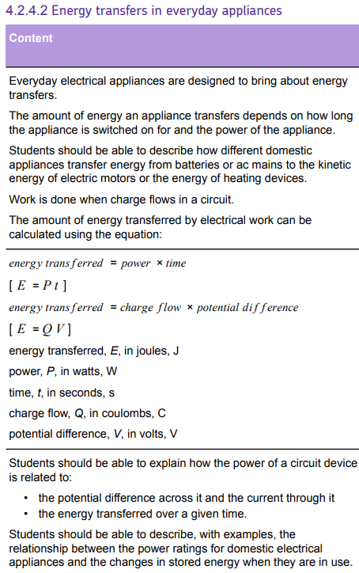
L1 Circuit symbols
L2 Current & charge
L3 Potential difference
L4 Resistance & Ohm’s Law
L5 Power & energy
L6 Electrical power
L7 Current in series & parallel
L8 Potential difference in series & parallel
L8 Sensing circuits
L10 Three pin plug
L11 National Grid
Students have been taught definitions & equations potential difference. These concepts will be built on during the course of this lesson.
Power will be revisited in the “electrical power” lesson.

Slide 2
Power & energy

Slide 3
Power
Watts
Energy
Joules
Recall the definition of power.
Recall the equation for power.
Calculate power, energy and time.

Slide 4
The electrical power supplied to an appliance is the energy transferred to the appliance each second.
Power has units of Watts.
Stretch: What is the equation that links energy transferred, charge and potential difference? Give all units.

Slide 5
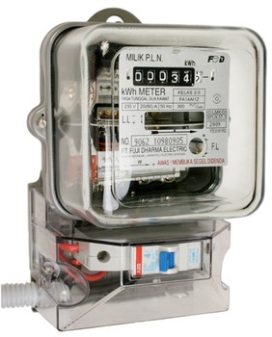
P = E ÷ t → you must remember this equation!
Where:
P → power in watts (W)
E → energy in Joules (J)
t → time in seconds (s)
Stretch: Sometimes you might see units for power being kWh. This means that a power of 1 kiloWatt is used for 1 hour.
How many Joules are there in 1 kWh?

Slide 6

Worked example
PROBLEM
Calculate the energy transferred from
the mains when the TV has 3000 kW
of power and is turned on for 3 hours.
SOLUTION
E = P x t
P = 3000 kW
t = 3 h
E = P x t = 3000 x 3 = 9000 kWh
The energy transferred from the mains to the TV is 9000 kWh.

Slide 7
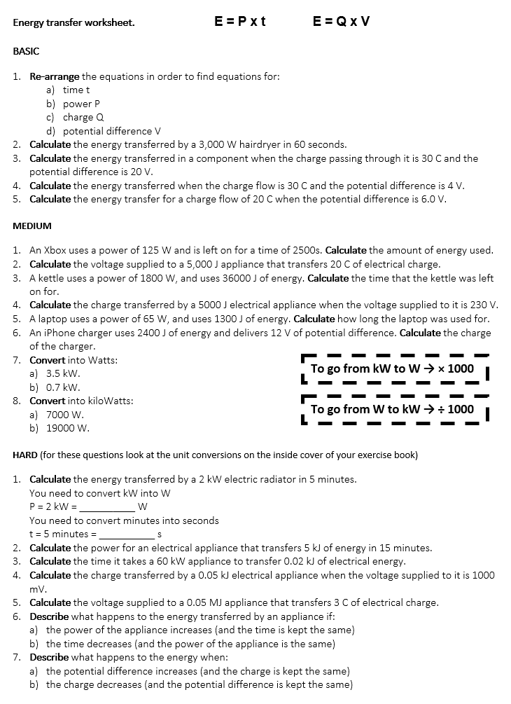
Worksheet
Complete the worksheet!
This is also recapping & retrieving the equation E = Q × V
All energy units in Joules, not kWh.

Slide 8

Basic answers
a) t = E ÷ p
b) P = E ÷ t
c) Q = E ÷ V
d) V = E ÷ Q

Slide 9
Basic answers
2. E = P × t = 3000 × 60 = 180,000 J
3. E = Q × V = 30 × 20 = 600 J
4. E = Q × V = 30 × 4 = 120 J
5. E = Q × V = 20 × 6 = 120 J

Slide 10
Medium answers
E = P × t = 125 × 2500 = 312,500 J
V = E ÷ Q = 5000 ÷ 20 = 250 V
t = E ÷ P = 36,000 ÷ 1800 = 20 s
Q = E ÷ V = 5,000 ÷ 230 = 21.7 C
t = E ÷ P = 1300 ÷ 65 = 20 s
Q = E ÷ V = 2400 ÷ 12 = 200 C
a) 3500 W b) 700 W
a) 7 kW b) 19 kW

Slide 11
Hard answers
P = 2000 W, t = 300 s → E = P × t = 2000 × 300 = 600,000 J
P = E ÷ t = 5000 ÷ 900 = 5.6 W
t = E ÷ P = 20 ÷ 60,000 = 0.0003 s
Q = E ÷ V = 50 ÷ 1 = 50 C
V = E ÷ Q = 50,000 ÷ 3 = 16700 V
a) It increases b) It increases
a) It increases b) It decreases

Slide 12
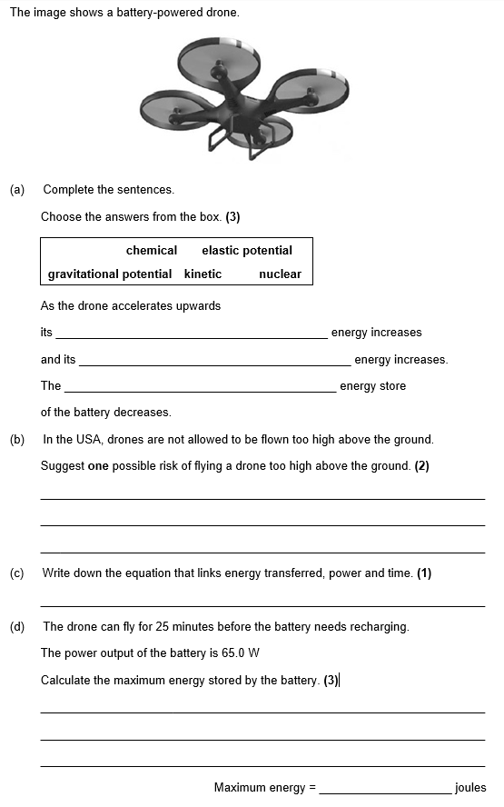
Struggle time!
Exam question so exam conditions.
You have 6 minutes.

Slide 13
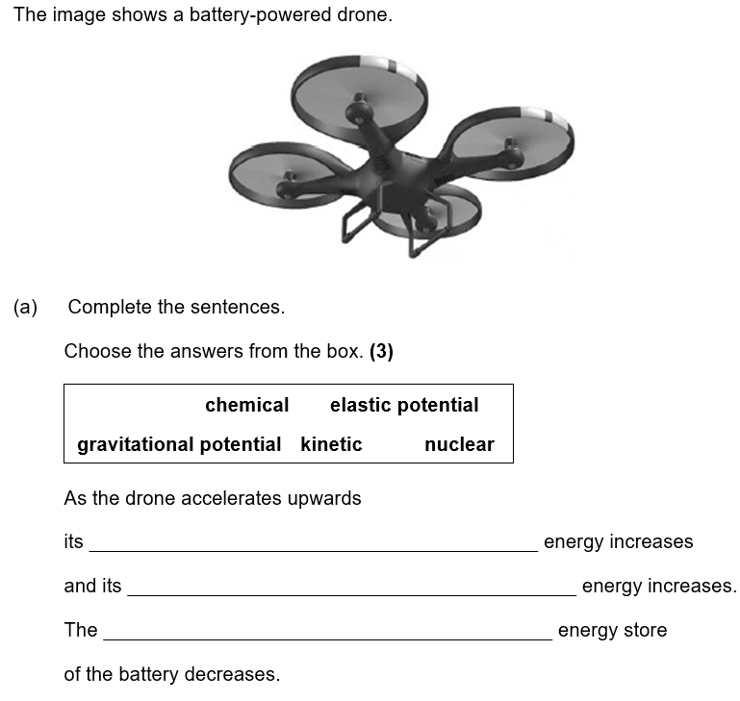

Slide 14
