Slide 1
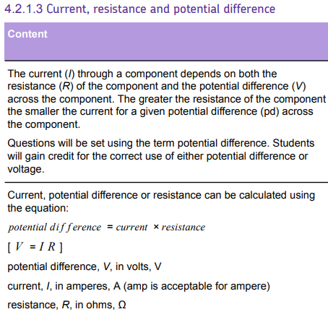
L1 Circuit symbols
L2 Current & charge
L3 Potential difference
L4 Resistance & Ohm’s Law
L5 Power & energy
L6 Electrical power
L7 Current in series & parallel
L8 Potential difference in series & parallel
L8 Sensing circuits
L10 Three pin plug
L11 Double insulation & fuses
L12 National Grid
Students have been taught definitions & equations for current & potential difference. These concepts will be built on during the course of this lesson.
This knowledge can be recapped during the electricity required practicals & during lessons on series/parallel & sensing circuits.

Slide 2
Resistance

Slide 3
Resistance
Current
Potential
Difference
Ohms
Recall common prefixes.
Recall what causes resistance & the definition of Ohm’s law.
Calculate resistance, current and potential difference.

Slide 4
Prefixes: Stick the following on the inside cover of your book.
Prefix | Symbol | Value | Expanded value
Giga | G | 10⁹ | 1 000 000 000
Mega | M | 10⁶ | 1 000 000
Kilo | k | 10³ | 1 000
Centi | c | 10⁻² | 0.01
Milli | m | 10⁻³ | 0.001
Micro | μ | 10⁻⁶ | 0.000 001
Nano | n | 10⁻⁹ | 0.000 000 001

Slide 5
Questions (5 mins)
Convert 0.7 kV to V.
Convert 5 MV to V.
Convert 0.1 mV to V.
Convert 1,500 V to kV.
Convert 2,700,000 to MV
Convert 700,000,000 to GV.

Slide 6
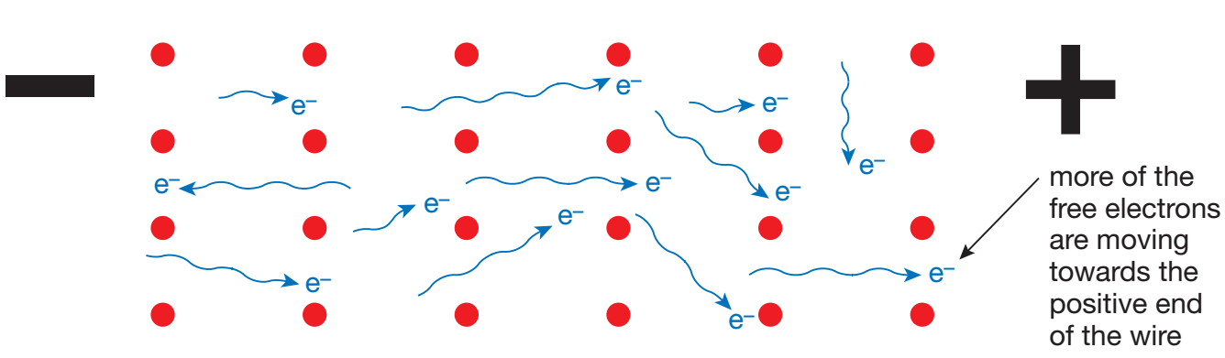
Resistance is a measure of how hard it is for the current to pass through a component in a circuit.
The higher the resistance of a component the harder it is for the current to pass through that component.
Stretch: What causes resistance in a conductor?
Moving electrons can collide with the ions in the metal. This makes it more difficult for the current to flow, and causes resistance.

Slide 7

Ohm’s law states that the current through a resistor is proportional to the potential difference provided that the temperature is constant.
Stretch: The graph opposite is for a filament lamp. Is it Ohmic (following Ohm’s law) or non-Ohmic?
What happens to the resistance of the filament lamp as the current increases? Why?

Slide 8
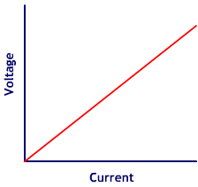
V = I x R → you must remember this equation!
Where:
I → current in amps (A)
V → voltage in volts (V)
R → resistance in ohms (Ω)
Stretch
Re-arrange the equation above to get equations for I and R.

Slide 9
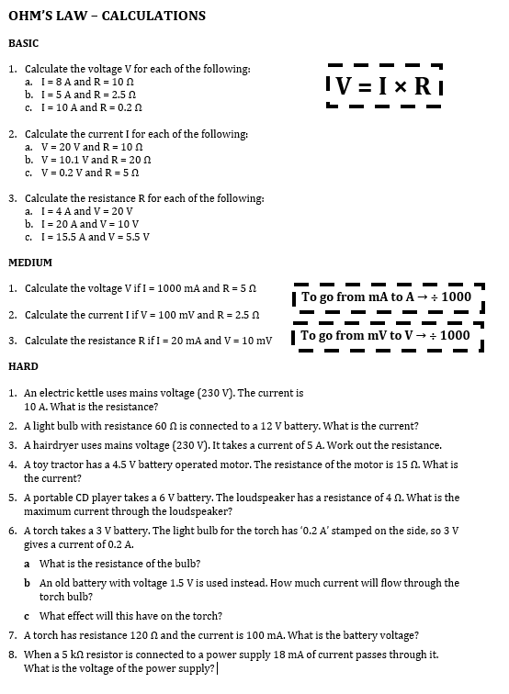
Worksheet
Complete the worksheet!

Slide 10

Basic answers
BASIC:
a) V = I × R = 8 × 10 = 80 V
b) V = I × R = 5 × 2.5 = 12.5 V
c) V = I × R = 10 × 0.2 = 2 V
a) I = V ÷ R = 20 ÷ 10 = 2 A
b) I = V ÷ R = 10 ÷ 20 = 0.5 A
c) I = V ÷ R = 0.2 ÷ 5 = 0.04 A
a) R = V ÷ I = 20 ÷ 4 = 5 Ω
b) R = V ÷ I = 10 ÷ 20 = 0.5 Ω
c) R = V ÷ I = 5.5 ÷ 15.5 = 0.35 Ω

Slide 11
Medium answers
MEDIUM:
I = 1000 mA = 1 A
V = I × R = 1 × 5 = 5 V
V = 100 mV = 0.1 V
I = V ÷ R = 0.1 ÷ 2.5 = 0.04 A
I = 20 mA = 0.02 A
V = 10 mV = 0.01 A
R = V ÷ I = 0.01 ÷ 0.02 = 0.5 Ω

Slide 12
Hard answers
HARD:
R = V ÷ I = 230 ÷ 10 = 23 Ω
I = V ÷ R = 12 ÷ 60 = 0.2 A
R = V ÷ I = 230 ÷ 5 = 46 Ω
I = V ÷ R = 4.5 ÷ 15 = 0.3 A
I = V ÷ R = 6 ÷ 4 = 1.5 A
a) R = V ÷ I = 3 ÷ 0.2 = 15 Ω
b) I = V ÷ R = 1.5 ÷ 15 = 0.1 A
c) Torch will have less current therefore less bright.
7. I = 100 mA = 0.1 A → V = I × R = 0.1 × 120 = 12 Ω
8. R = 5 kΩ = 5,000 Ω, I = 18 mA = 0.018 A → V = I × R = 0.018 × 5,000 = 90 V

Slide 13
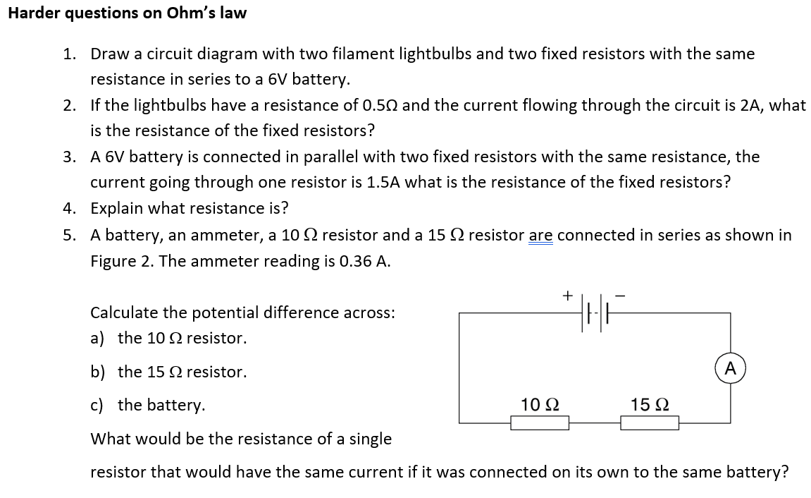
Stretch questions
Complete the harder questions!

Slide 14
Stretch Answers
2. Calculate total resistance first → R = V ÷ I = 6 ÷ 2 = 3 Ω
3 – 1 = 2 Ω for the two resistors → each resistor has 1 Ω resistance
3. R = V ÷ I = 6 ÷ 1.5 = 4 Ω
4. Resistance is a measure of how hard it is for the current to pass through a component in a circuit.
5. a) V = I × R = 0.36 × 10 = 3.6 V
b) V = I × R = 0.36 × 15 = 5.4 V
c) Total voltage = 3.6 + 5.4 = 9.0 V
R = V ÷ I = 9 ÷ 0.36 = 25 Ω

Slide 15
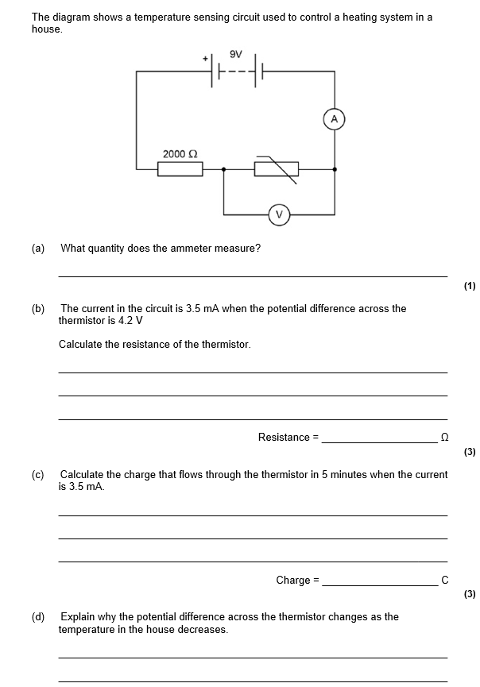
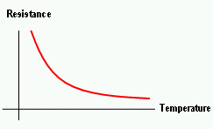
Struggle time! (8 mins)
The graph below shows how the resistance of a thermistor varies with temperature. Use this to help answer part d).

Slide 16
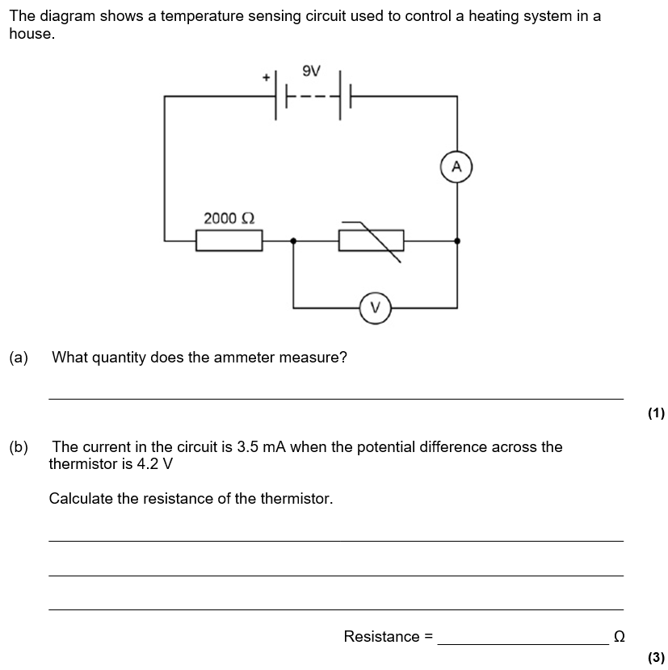
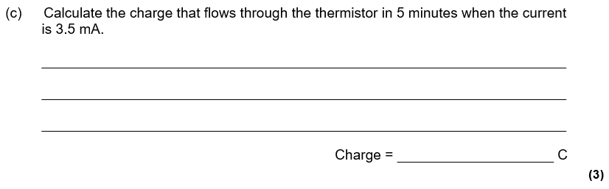

Slide 17
