Slide 1
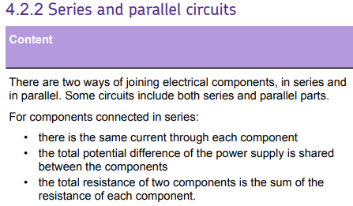
L1 Circuit symbols
L2 Current & charge
L3 Potential difference
L4 Resistance & Ohm’s Law
L5 Power & energy
L6 Electrical power
L7 Current in series & parallel
L8 Potential difference in series & parallel
L9 Sensing circuits
L10 Three pin plug
L11 National Grid
Students know the definition of potential difference & the difference between series and parallel circuits. This lesson will recap current & potential difference in series & parallel.
The ideas taught in this lesson will expanded upon in practical lessons.

Slide 2
Sensing circuits

Slide 3
Sensing
Thermistor
LDR
Resistance
Voltage
Current
Recall what happens to resistance of a thermistor/LDR as the temperature/light intensity increases.
Recall how sensing circuits can be used.
Calculate resistances, voltages and currents in sensing circuits.

Slide 4
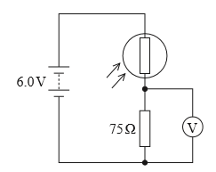
As the temperature increases, the resistance of a thermistor decreases.
As the light intensity increases, the resistance of an LDR decrease.
Stretch: How will the following vary if the light level increases:
Resistance of the LDR.
Voltage across the LDR.
Voltage across the resistor.
Overall current in the circuit.

Slide 5
If the light level increases:
Resistance of LDR will decrease.
Voltage across the LDR will decrease.
Voltage across the resistor will increase.
Overall current in the circuit will increase.
Stretch: If the resistance of the LDR is 150Ω, what is the:
Current in the circuit.
Voltage across the resistor.

Slide 6
Sensing circuits are used in:
Central heating that turns on automatically when it’s cold.
Lighting circuits that turn on when it’s dark.
Stretch: If the resistance of the LDR is 150Ω, what is the:
Current in the circuit.
Voltage across the resistor.

Slide 7
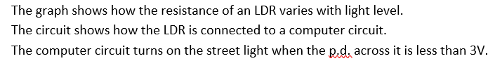
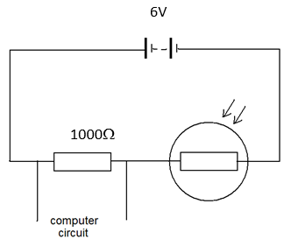
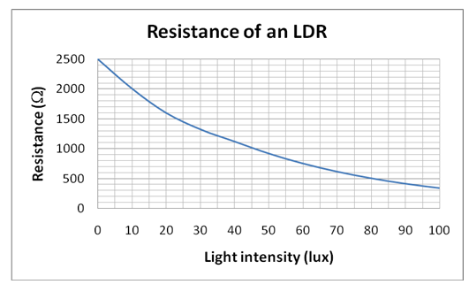
When light intensity is 45 lux:
What is the resistance of the LDR?
What is the total resistance of the circuit?
What is the current in the circuit?
What is the p.d. across the fixed resistor?
Will the street lights be on or off?

Slide 8
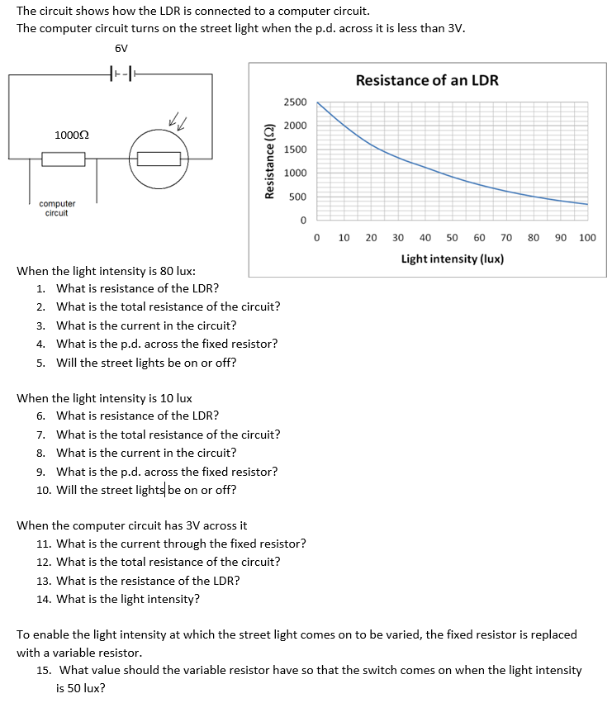
Worksheet
Complete the worksheet!

Slide 9
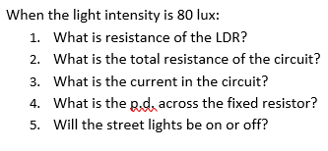
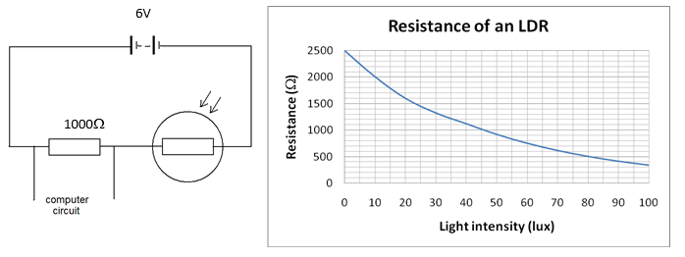

Basic answers
From graph; R = 500 Ω
1000 + 500 = 1500 Ω
V = I x R
→ I = V ÷ R = 6 ÷ 1500 = 0.004 A
4. V = I x R = 0.004 x 1000 = 4 V
5. Over 3 volts, so street lamps off.

Slide 10
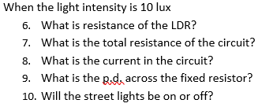
6. From graph; R = 2000 Ω
7. 1000 + 2000 = 3000 Ω
8. V = I x R
→ I = V ÷ R = 6 ÷ 3000 = 0.002 A
9. V = I x R = 0.004 x 1000 = 2 V
10. Under 3 volts, so street lamps on.

Slide 11
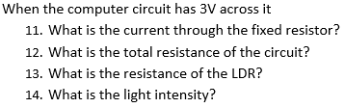
11. Total resistance = 2000 Ω
I = V ÷ R = 6 ÷ 2000 = 0.003 A
12. 2000 Ω
13. 1000 Ω
14. 45 lux

Slide 12

Resistance of LDR is 900 Ω at 50 lux.
Therefore variable resistor needs resistance of 900 Ω to split voltage with LDR.

Slide 13
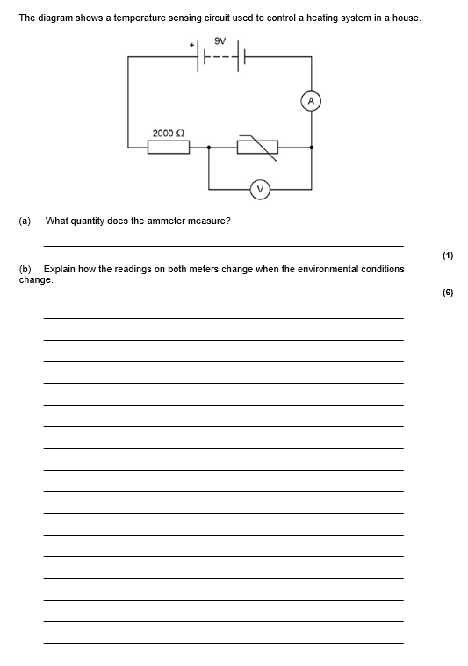
Struggle time!
Exam question so exam conditions!
You have 10 minutes.

Slide 14
Current

Slide 15
As temperature increases, resistance of thermistor decreases. [1]
This decreases overall resistance in circuit. [1]
So (due to V = I x R), current on ammeter decreases. [1]
Reading on voltmeter across thermistor would decrease. [1]
Due to voltage splitting in series. [1]
Vice versa if temperature decreases. [1]

Slide 16
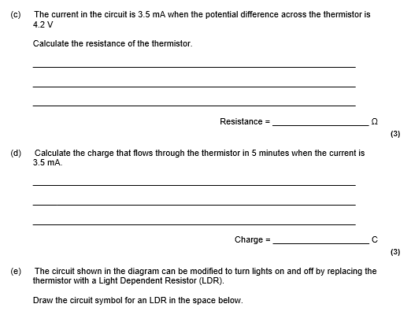
R = V ÷ I [1]
I = 3.5 mA = 0.0035 A [1]
R = 4.2 ÷ 0.0035 A = 1200 Ω [1]
Q = I x t [1]
t = 5 mins = 300 s [1]
Q = 0.0035 × 300 = 1.05 C [1]

