Slide 1
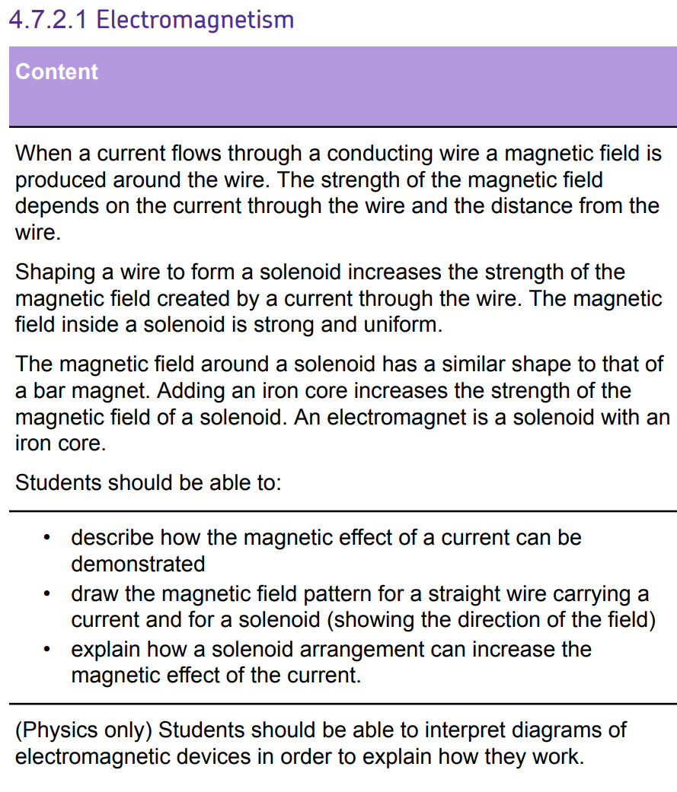
L1 Introduction to magnetism
L2 Compasses
L3 EM practical
L4 Solenoid
L5 Force on a current carrying wire
L6 Fleming LHR
L7 Motors
L8 Induced potential
L9 Generator effect
L10 Loudspeakers & Microphones
L11 Transformers
The basics of magnetism & of electromagnetism. Students should know that a current carrying wire produces a magnetic field.
This knowledge will be directly revisited in the Fleming’s LHR & force on a current carrying wire lesson.

Slide 2
Solenoids & uses

Slide 3
Solenoids & uses
Solenoid
Coil
Current
Non-contact
Circuit
Complete
Describe what a solenoid is.
Recall how to use the right hand rule.
Describe how electromagnets are used in common devices.

Slide 4
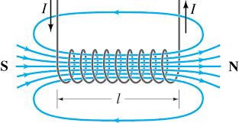
T/N: Solenoids
A current flowing through a wire produces a magnetic field.
This effect can be increased by having a coil of wire (called a solenoid).
Stretch: What else could we do to increase the strength of the magnetic field?

Slide 5
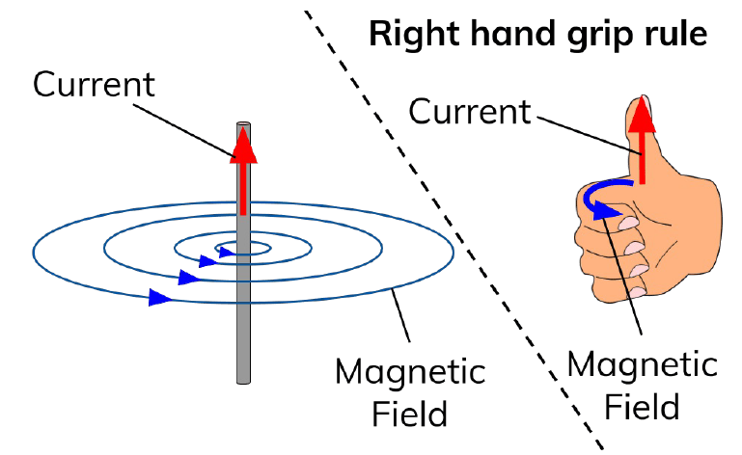
T/N: Right hand rule
Stretch: Where is the magnetic field strongest?
Grip the wire with your right hand; thumb gives direction of the current.
Your fingers curled around the wire will point in the direction of the magnetic field.

Slide 6
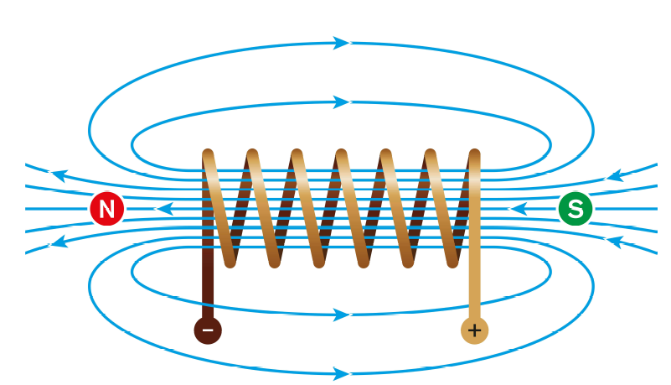
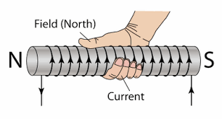
A solenoid creates a field like a bar magnet.
The field is strongest inside the solenoid.
You can also use the right hand grip rule for a solenoid.
Stretch: How could we plot the direction of the magnetic field?

Slide 7
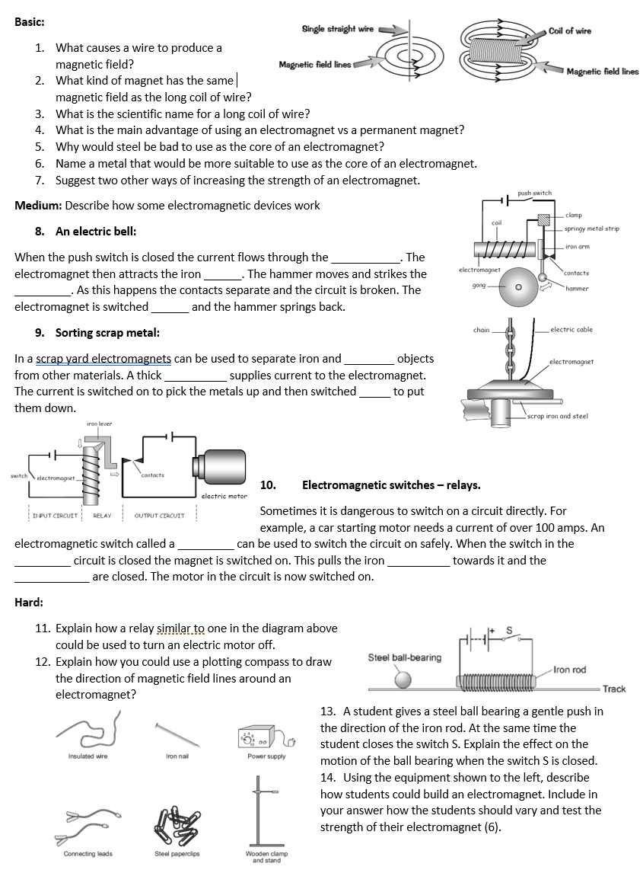
Task
Complete the worksheet.

Slide 8

Basic/medium answers
A current flowing through it.
Bar magnet.
Solenoid.
Electromagnet can be switched off.
Steel becomes permanently magnetised.
Soft iron.
Increase the current, increase the number of turns in the coil.
Coil, arm, gong, off.
Steel, cable, off.
Relay, input, level, contacts.

Slide 9
Hard answers
11. Switch in input circuit is opened, this breaks the
circuit so current can no longer flow. This turns the electromagnet off and the iron lever releases the contacts. The breaks the circuit with the electric motor so that it also turns off.
12. Place plotting compass near the magnet on a piece of paper. Mark the direction the compass needle points. Move the plotting compass to many different positions in the magnetic field, marking the needle direction each time. Join the points to show the field lines.
13. Complete answer on other whiteboard.

Slide 10
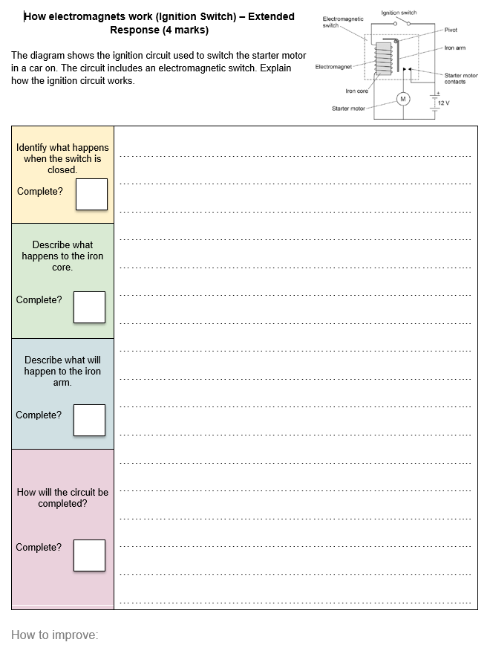
Complete the task.
You have 6 minutes.

Slide 11
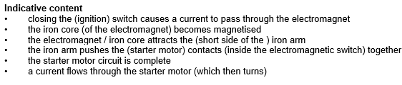

Slide 12
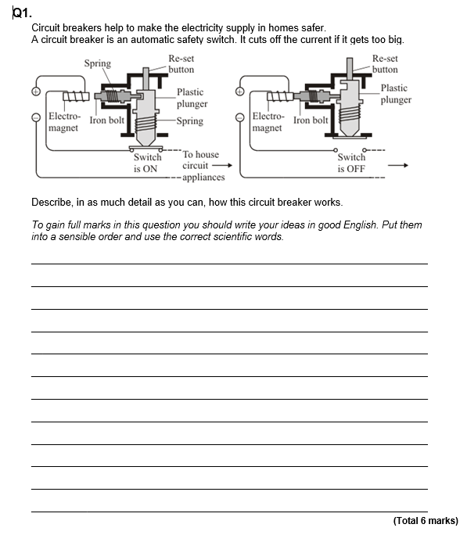
Struggle time!
Exam question so exam conditions!
You have 6 minutes!

Slide 13
