Slide 1
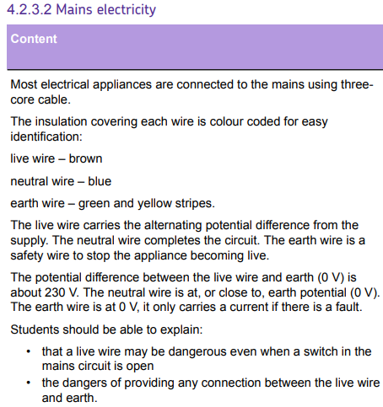
L1 Circuit symbols
L2 Current & charge
L3 Potential difference
L4 Resistance & Ohm’s Law
L5 Power & energy
L6 Electrical power
L7 Current in series & parallel
L8 Potential difference in series & parallel
L9 Sensing circuits
L10 Three pin plug
L12 National Grid
Understand definitions of current, potential difference & resistance. These ideas are revisited in this lesson.
The ideas taught in this lesson will expanded upon the lesson on national grid

Slide 2
Three pin plug

Slide 3
AC
DC
Voltage
Frequency
Earth
Live
Neutral
Describe the difference between AC and DC.
Recall the voltage and frequency of the mains supply.
Recall the purpose & colour of the three mains wires.

Slide 4
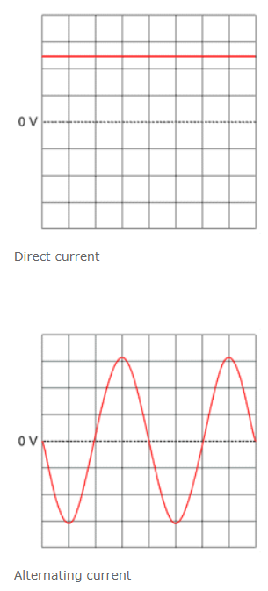
Direct current (d.c.) only flows in one direction.
Alternating current (a.c.) constantly changes direction.
Mains electricity:
230V AC with a frequency of 50 Hz?
e.g. batteries
e.g. anything plugged into a socket.
Stretch: What is the definition of current?

Slide 5
Answer questions verbally
one
Direct current is where the electrons move in _____ direction.
It is produced by ___________________.
In an _____________ current, the electrons rapidly change ______________.
____________________ has an alternating current.
The mains voltage is _________ and has a _______________ of 50Hz.
This means that the ____________ change direction 50 times every _________.
batteries
alternating
direction
Mains electricity
230V
frequency
electrons
second

Slide 6

Plugs
Most electrical appliances are connected to the mains using a cable and a three-pin plug.
Three pins stick out through the
plug case the live pin, the neutral
pin and the earth pin.
The pins are made of brass
The plug contains a fuse between
the live pin and the live wire.
Stretch
Why are the pins made of brass?
What is the function of the fuse?

Slide 7
T/N: Plugs
The live wire (brown) carries the a.c.
The neutral wire (blue) completes the circuit.
The Earth wire (green and yellow) is a safety wire.
Stretch: Metal appliances have an Earth pin, but Plastic ones do not. Why do you think that is?

Slide 8
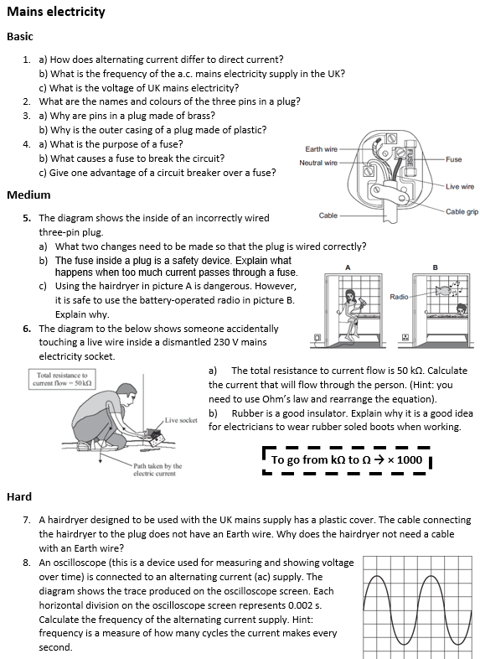
Worksheet
Complete the worksheet!

Slide 9

Basic answers
a) Alternating current constantly changes direction, whereas direct current only flows in one direction.
b) 50 Hz c) 230 V
2. Earth: Yellow and Green Neutral: Blue Live: Brown
3. a) Brass is hard and a good conductor.
b) Plastic is a good insulator.
4. a) For safety. If there’s a fault in the circuit and the current is too high then the fuse melts and breaks the circuit.
b) The current being too high (for example from live wire touching metal case)
c) It is resettable by a switch.

Slide 10
Medium answers
5. a) The Earth wire needs to be connected to the pin, and the cable grip needs to be connected properly.
b) The fuse gets hot, melts and this breaks the circuit.
c) Hairdryer plugged into mains (using 230 V). Water conducts electricity. Radio is low voltage and current, therefore much lower risk of electrocution.
6. a) I = V ÷ R = 230 ÷ 50,000 = 0.0046 A
b) Rubber increases resistance. Therefore if a shock is given it will be of a lower current.

Slide 11
Hard answers
7. It has a plastic case and is therefore an insulator.
8. Time is 0.002 × 4 = 0.008 for one cycle.
Frequency = 1 ÷ 0.008 = 125 Hertz

Slide 12
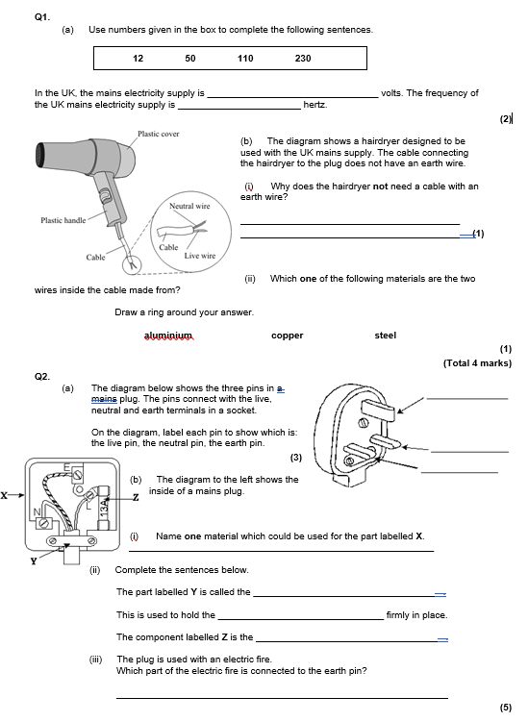
Struggle time!
Exam question so exam conditions!
You have 8 minutes.

Slide 13
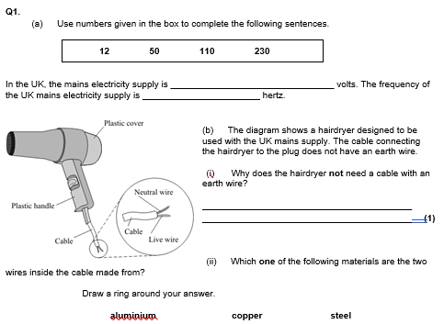
230
50
Because it has a plastic casing

Slide 14
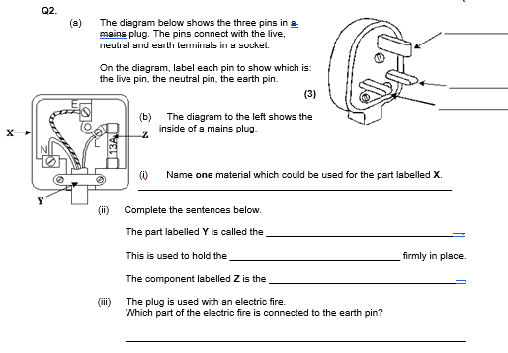
Earth
Neutral
Live
Plastic
Cable grip
Cable
Fuse
The casing

