Slide 1
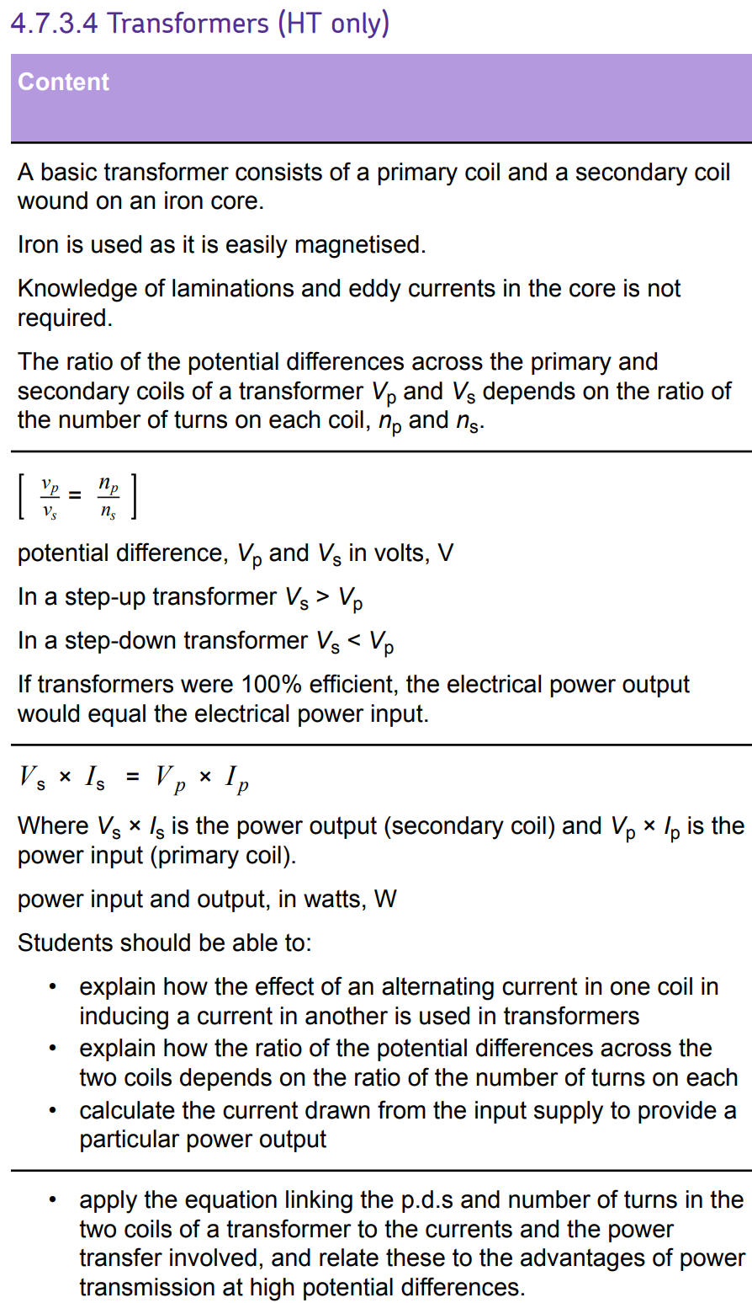
L1 Introduction to magnetism
L2 Compasses
L3 EM practical
L4 Solenoid
L5 Force on a current carrying wire
L6 Fleming LHR
L7 Motors
L8 Induced potential
L9 Generator effect
L10 Loudspeakers & Microphones
L11 Transformers
Students have learn induction & this knowledge should be retrieved & relied upon to fully understand transformers.
Final lesson of topic.

Slide 2
Transformers
16/07/2020

Slide 3
Transformer
Primary
Secondary
Coil
Current
Potential difference
Describe the structure of a transformer.
Recall two transformer equations.
Calculate current and potential difference using the transformer equations.

Slide 4
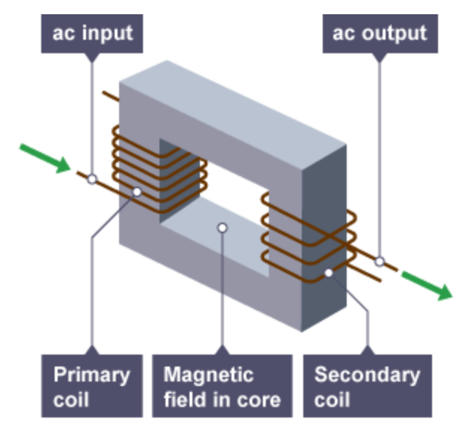
Transformers
A basic transformer consists of a primary coil and a secondary coil wound on an iron core.
Iron is used as it is easily magnetised.
Stretch: What is the equation that relates power, current and potential difference?

Slide 5
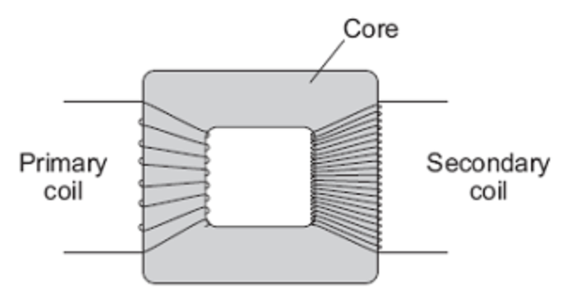
Power conservation
V_{s} × I_{s} = V_{p} × I_{p}
Where V_{s} is the potential difference (V) in secondary coil, and I_{s} is the current (A) in secondary coil.
Stretch: V_{s} = 230 V, I_{s} = 13A & V_{p} = 400,000 V.
What is I_{p}?

Slide 6
Step-up & step-down transformers
V_{p} ÷ V_{s} = N_{p} ÷ N_{s}
If there are more turns on the secondary coil (N_{s}) than the primary coil (N_{p}) then the voltage is stepped up (and vice versa if other way around).
Stretch: Is the transformer below step-up or step-down?

Slide 7
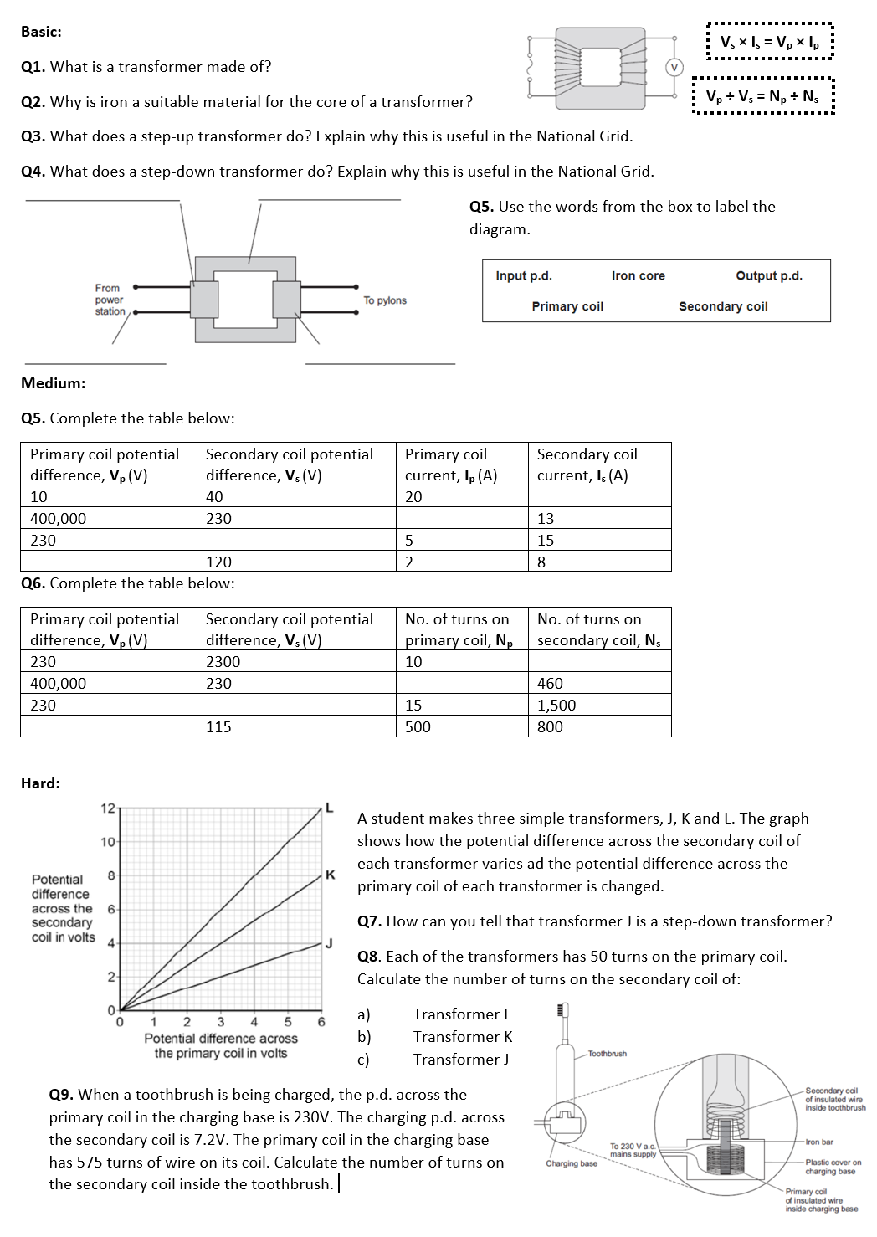
Worksheet
Complete the worksheet

Slide 8

Basic answers
A primary coil and a secondary coil wound on an iron core
It is easily magnetisable.
It increase the potential difference/reduces the current. This helps to reduce power loss in transmission cables.
It decreases the potential difference to a safe level for consumers.

Slide 9
Medium answers
5
0.007
76.7
480
100
800,000
23,000
71.9

Slide 10
Hard answers
7. Because the p.d. across secondary coil is less than across primary coil.
8. a) 150 turns.
b) 66.7 turns.
c) 33.3 turns.
9. 18 turns

Slide 11
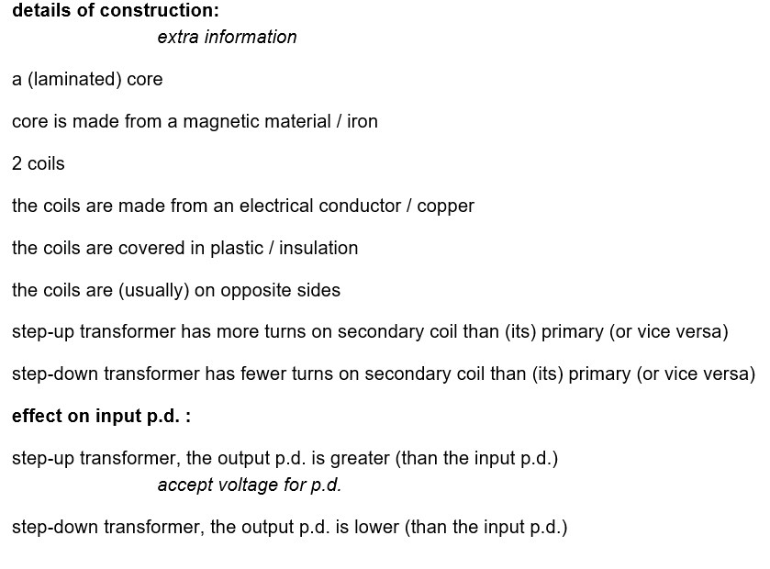
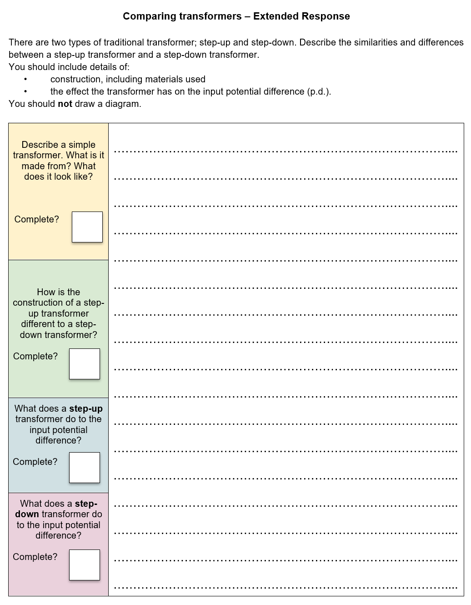
Complete the task
(6 minutes)

Slide 12
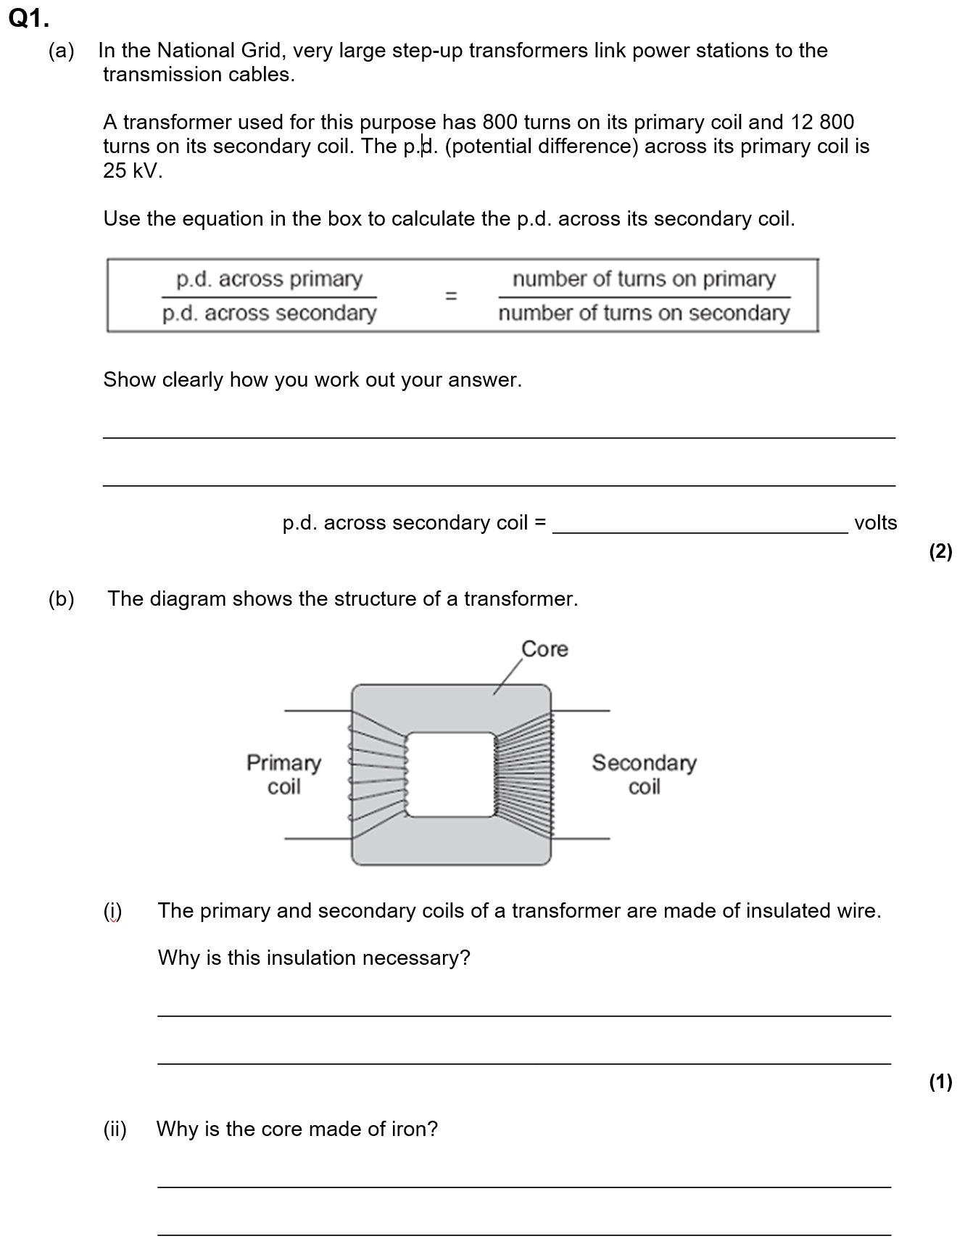
Struggle time!
Exam question so exam conditions!
You have 8 minutes!

Slide 13
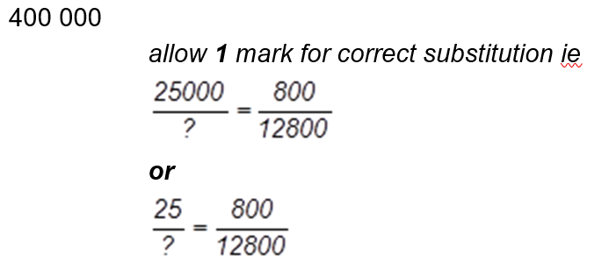

Slide 14
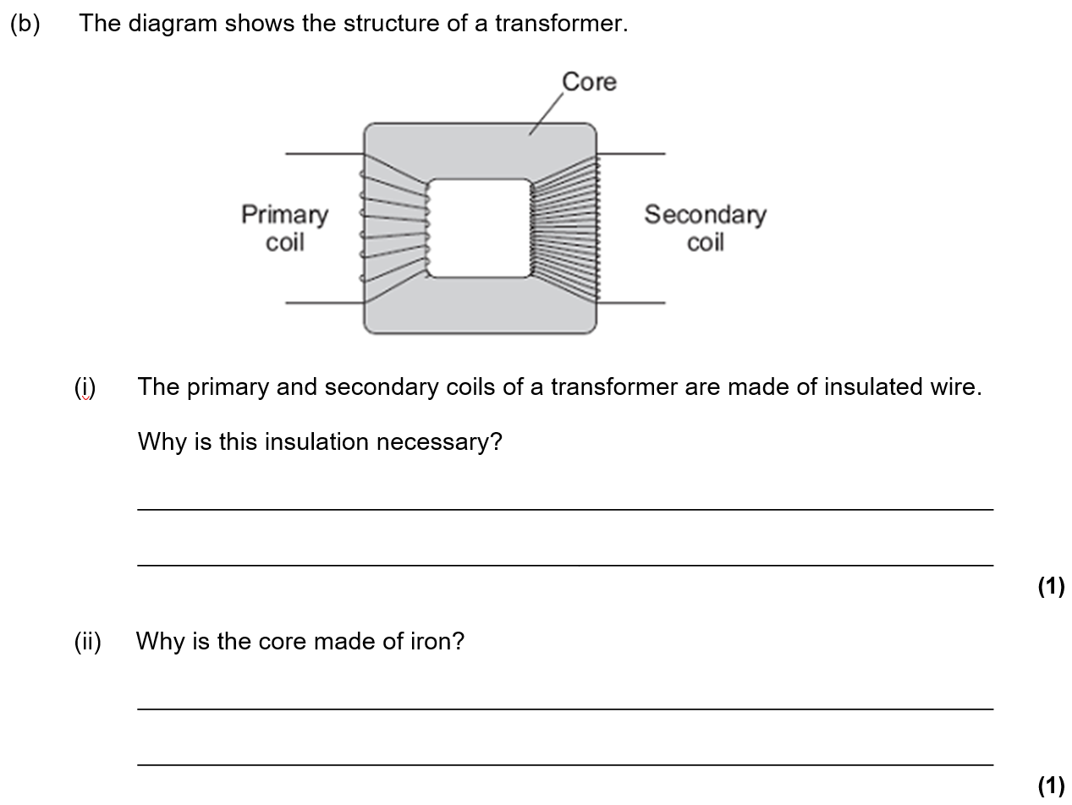
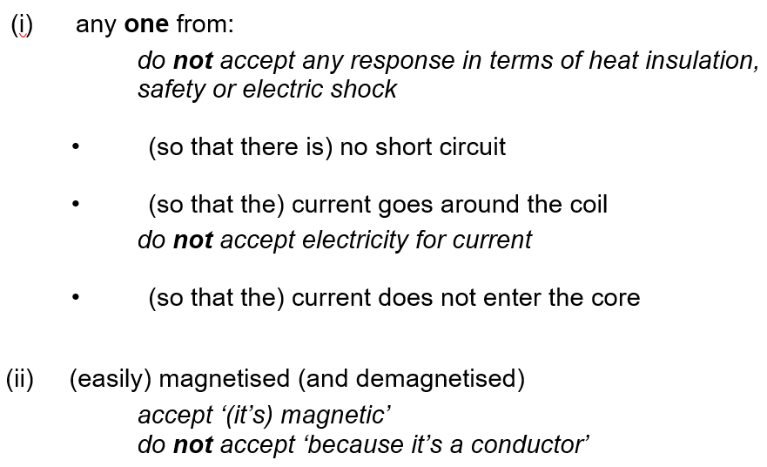

Slide 15
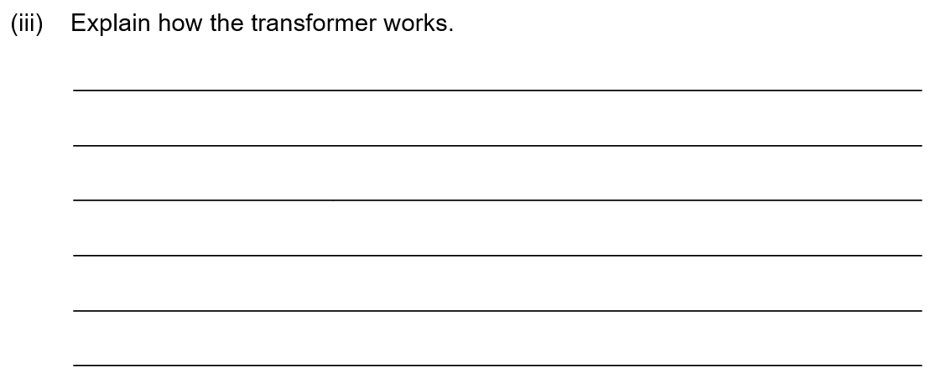
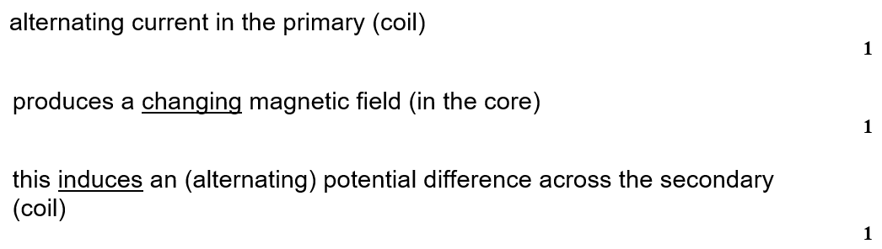

Slide 16
