Slide 1
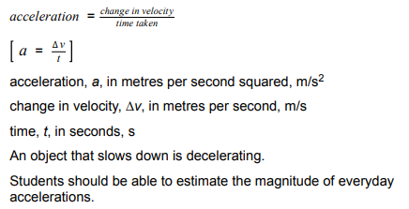
L1 Speed
L2 Distance-time graphs
L3 Speed practical
L4 Acceleration
L5 Velocity time graphs
L6 Equation of motion
The definition of speed & mathematical skills in (for example) rearranging of an equation.
How to obtain acceleration from a velocity time graph.

Slide 2
Acceleration
29/08/2020

Slide 3
Acceleration
Acceleration
Speed
Velocity
Time
Recall the definition of acceleration.
Recall the equation for acceleration
Calculate acceleration using the equation.

Slide 4
Acceleration
Acceleration is a measure of how much the velocity changes by in a given time.
Stretch: What are the units of velocity and time?

Slide 5
Equation for acceleration
Stretch: Rearrange the equation to give equations for Δv and t.
Acceleration = Change in velocity ÷ Time taken
a = Δv ÷ t
Acceleration has units of m/s²
Change in velocity has units of m/s
Time has units of seconds

Slide 6
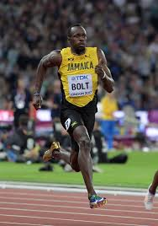
Practice question
Usain Bolt accelerates from a speed of 5 m/s to 10 m/s in a time of 0.8 seconds. Calculate his acceleration.
Write down the teacher’s notes on the whiteboard.

Slide 7
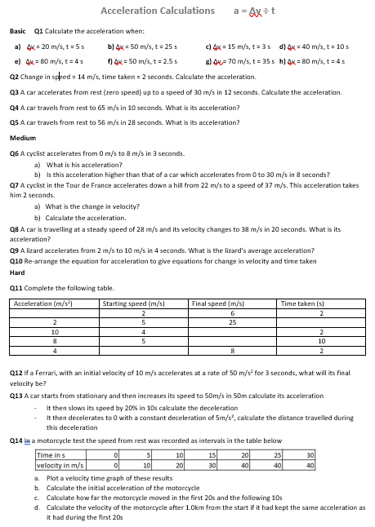
Worksheet
Complete the worksheet

Slide 8

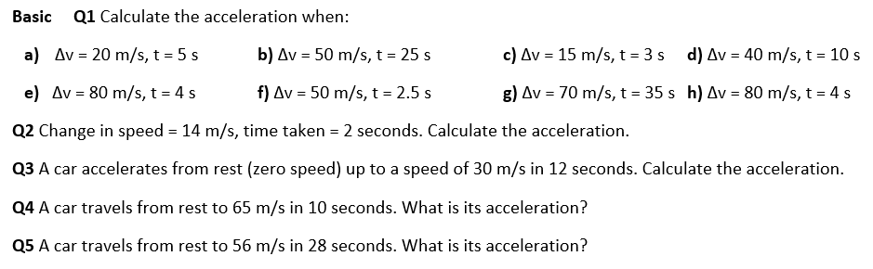
Basic answers
4 m/s²
2 m/s²
5 m/s²
4 m/s²
20 m/s²
20 m/s²
2 m/s²
20 m/s²
7 m/s²
6.5 m/s²
2 m/s²

Slide 9
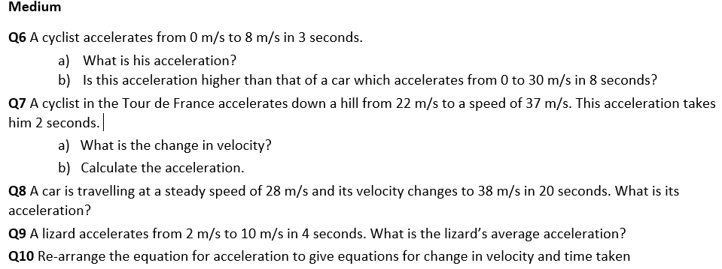
Medium answers
2.7 m/s²
lower
15 m/s
7.5 m/s²
0.5 m/s²
2 m/s²
^{Δv = a ⨯ t t = Δv ÷ a}

Slide 10
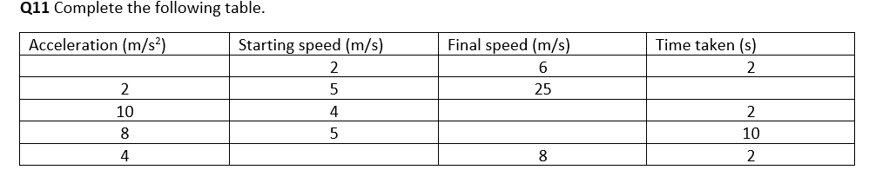
Hard answers
2
10
24
85
0

Slide 11
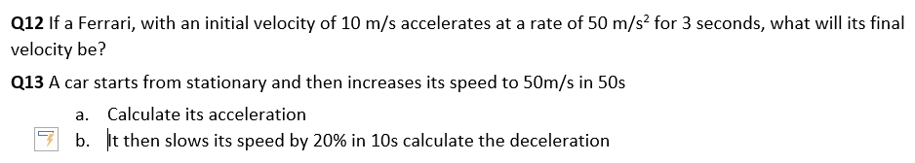
Hard answers
160 m/s
1 m/s²
1 m/s²

Slide 12
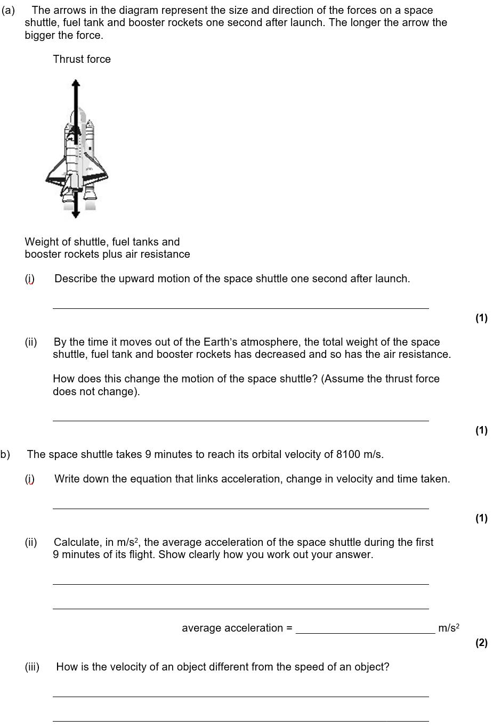
Struggle time!
Exam questions so exam conditions!
You have 5 minutes!

Slide 13
It accelerates
It accelerates faster

Slide 14
Acceleration = Change in velocity ÷ Time taken
9 minutes = 9 × 60 = 540 seconds
Acceleration = 8100 ÷ 540 = 15 m/s²
Velocity is speed with direction/it is a vector

Slide 15
Multi-step calculations
A multi-step calculation is when you can be expected to use more than one equation.
Stretch: An F1 car has a start velocity of 20 m/s and after 10 seconds has a kinetic energy of 1,250,000 J. If the F1 car has a mass of 1000kg, what is its acceleration?

Slide 16

Stretch review
An F1 car has a start velocity of 20 m/s and after 10 seconds has a kinetic energy of 1,250,000 J. If the F1 car has a mass of 1000kg, what is its acceleration?

Slide 17
Multi-step calculations
A horse has a start velocity of 2m/s and after 15 seconds has a kinetic energy of 40,000 J. If the horse has a mass of 800kg, what is its acceleration?
A cat has a start velocity of 0.5 m/s and after 5 seconds has a kinetic energy of 32J. If the cat has a mass of 4kg, what is its acceleration?
An aeroplane has a start velocity of 100 m/s and after 4 minutes has a kinetic energy of 1.6 GJ. If the aeroplane has a mass of 80,000 kg, what is its acceleration?

Slide 18
  final velocity = 10 m/s
acceleration = 0.67 m/s²
2. final velocity = 4 m/s
acceleration = 0.8 m/s²
3. final velocity = 200 m/s
acceleration = 0.41 m/s²

