Slide 1
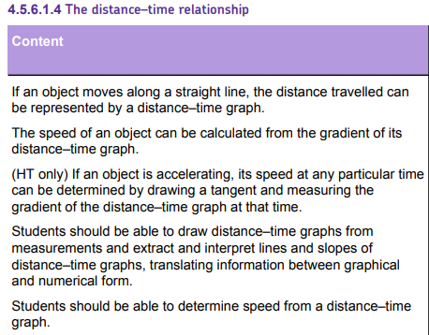
L1 Speed
L2 Distance-time graphs
L3 Speed practical
L4 Acceleration
L5 Velocity time graphs
L6 Equation of motion
Students have just been taught the speed equation & this knowledge should be retrieved & directly relied upon during this lesson.
Similar skills (e.g. gradients of a line) will be revisited during velocity time graphs.

Slide 2
Distance-time graphs
29/08/2020

Slide 3
Distance-time graphs
Distance
Time
Speed
Velocity
Gradient
Describe what the gradient of a distance-time graph gives.
Explain the different types of distance-time graphs.
Calculate speeds from distance-time graphs.

Slide 4
Distance-time graphs
A distance-time graph can be used to see when an object is stationary or travelling at a constant speed.
The steeper the slope, the faster the speed. The gradient (slope) of a distance-time graph shows the speed.
Stretch: How can we calculate the gradient of a straight line?

Slide 5
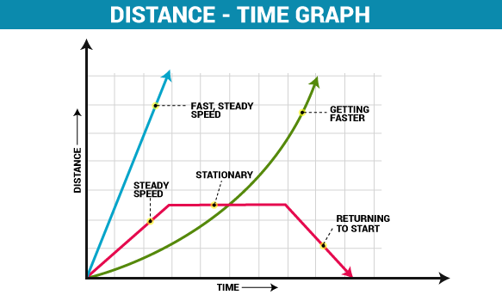
Copy distance-time graphs from other whiteboard.

Slide 6
Speed from a distance-time graph
You can calculate the speed from the gradient of a distance-time graph. This is because of the equation for speed:
v = s ÷ t
Stretch: What is the speed between A and B
Distance (km)
50
D
40
30
B
C
20
10
1
2
3
4
5
6
Time (h)

Slide 7
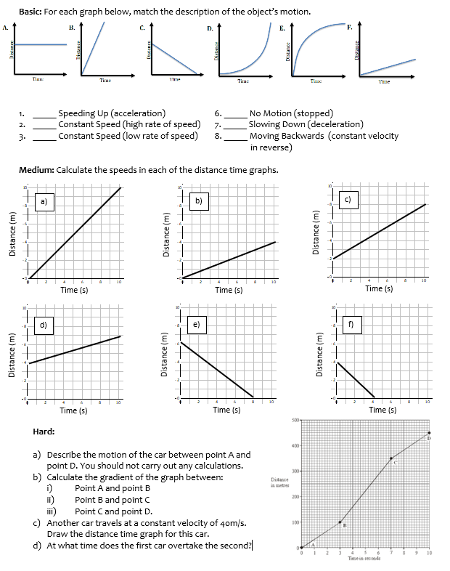
Worksheet
Complete the worksheet

Slide 8

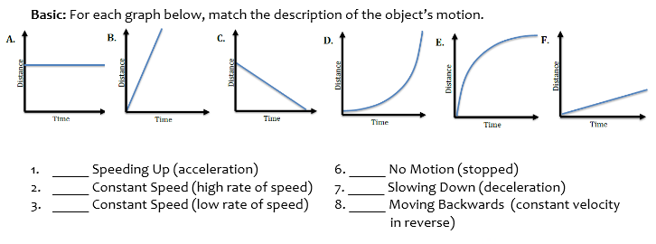
Basic answers

Slide 9
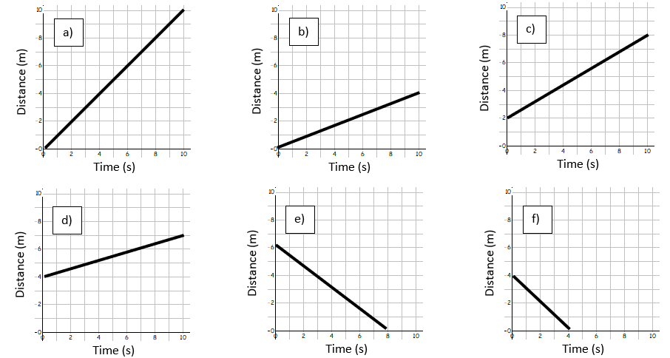
Medium answers

Slide 10
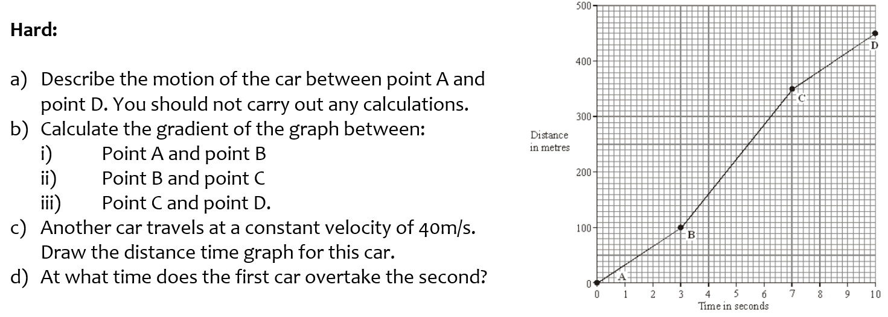
Hard answers

Slide 11
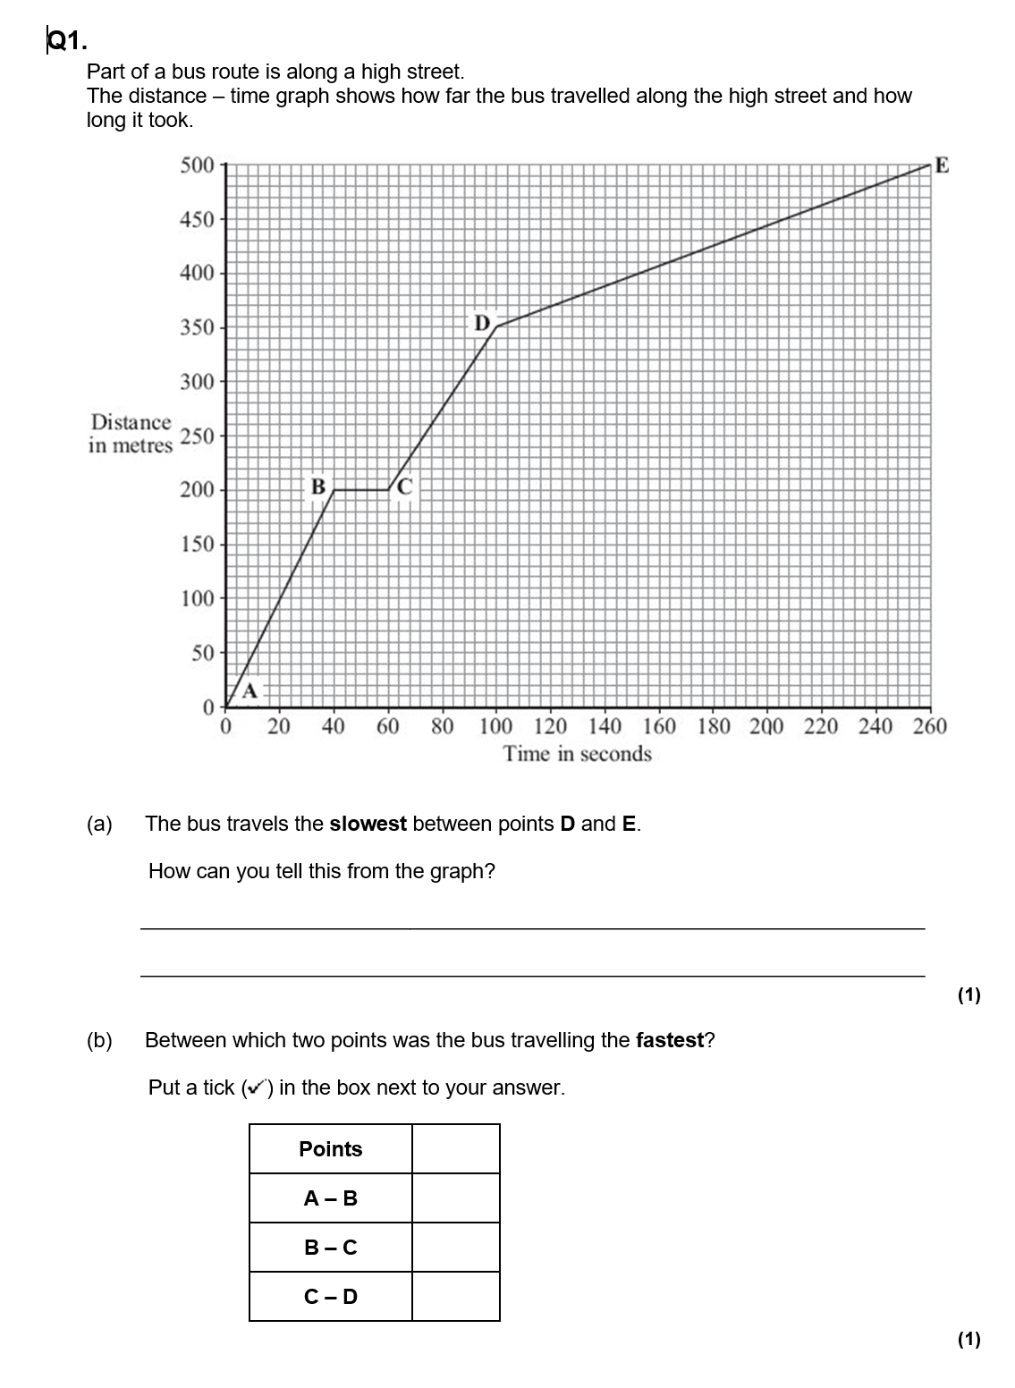
Struggle time!
Exam questions so exam conditions!
You have 12 minutes!

Slide 12
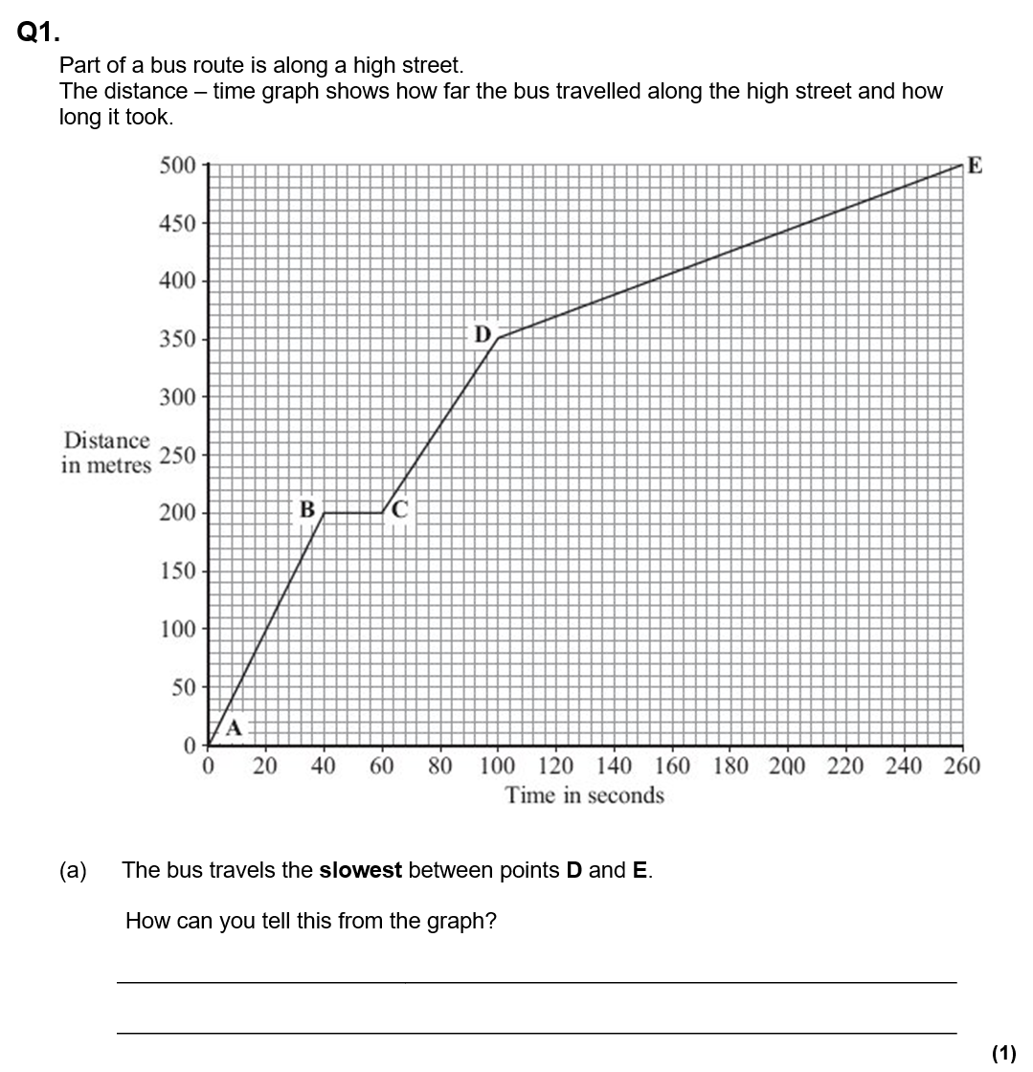
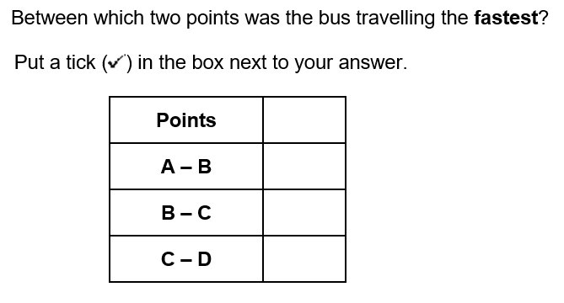
✓
The slope/gradient is the shallowest/least

Slide 13
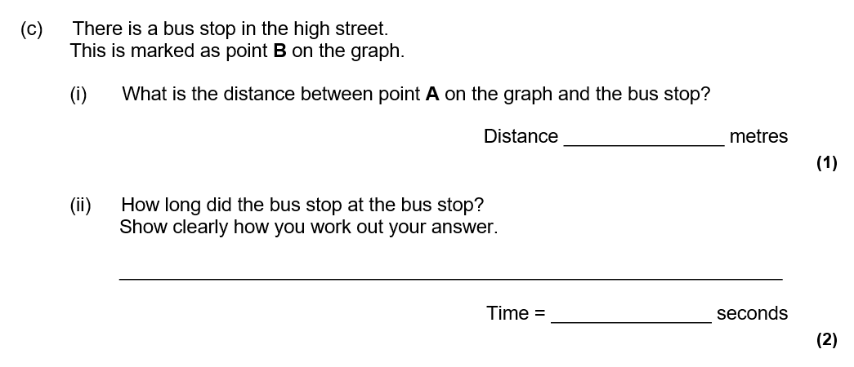
200
60 – 40 = 20 seconds

Slide 14
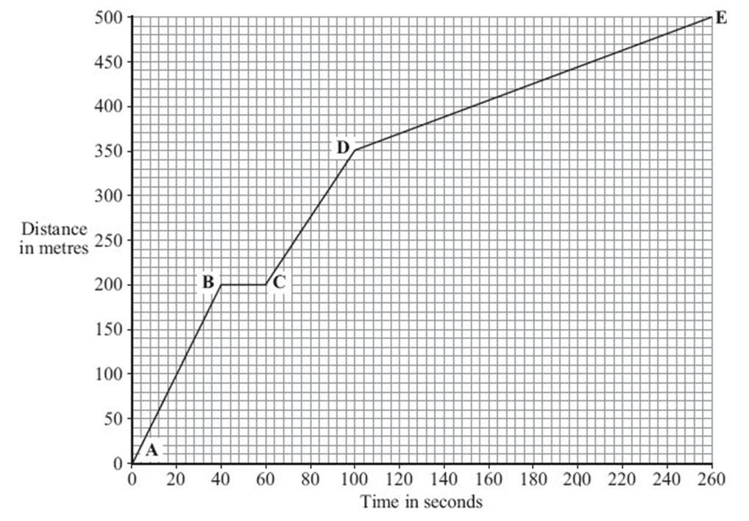
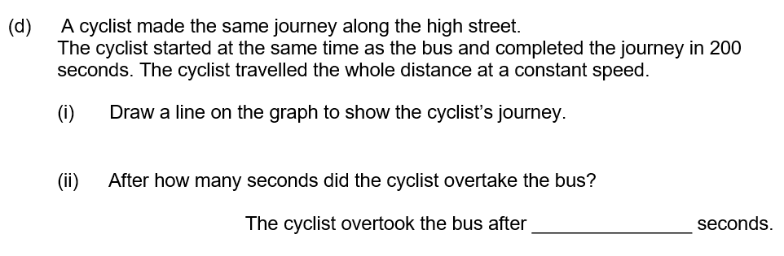
162-168

Slide 15
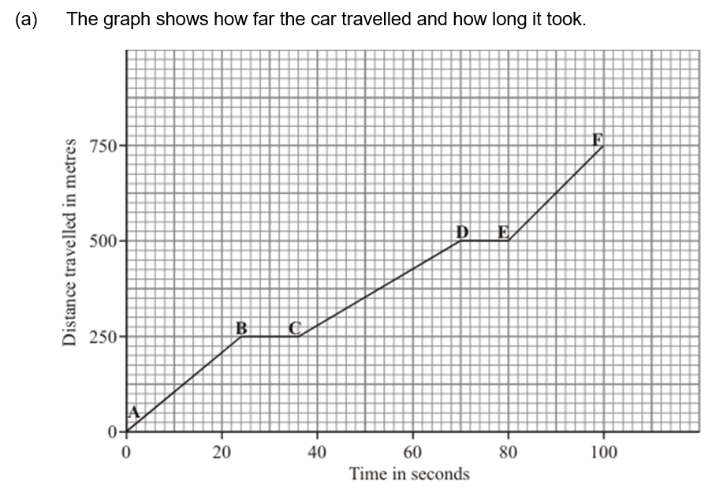
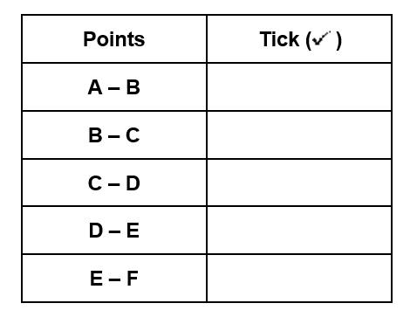
✓

Slide 16
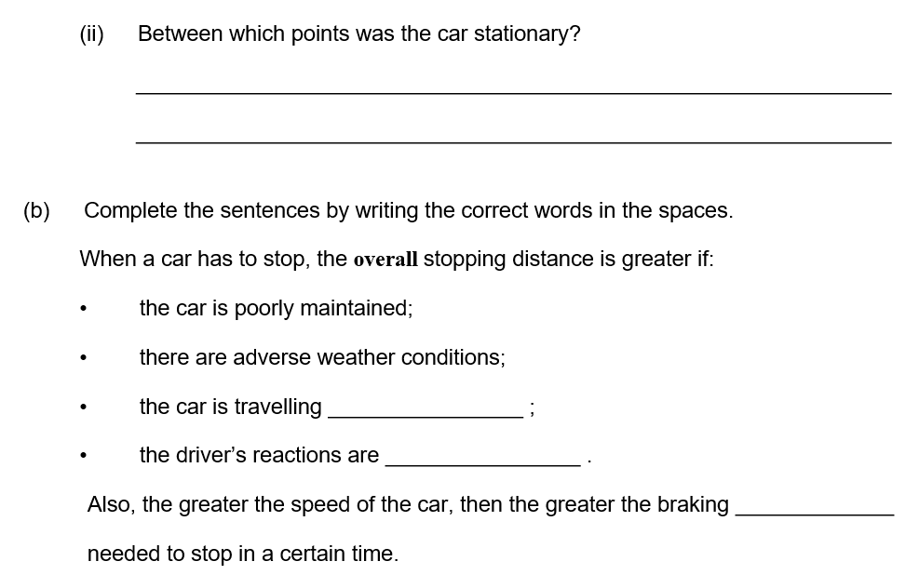
Between B-C or D-E
faster
slower
force

Slide 17
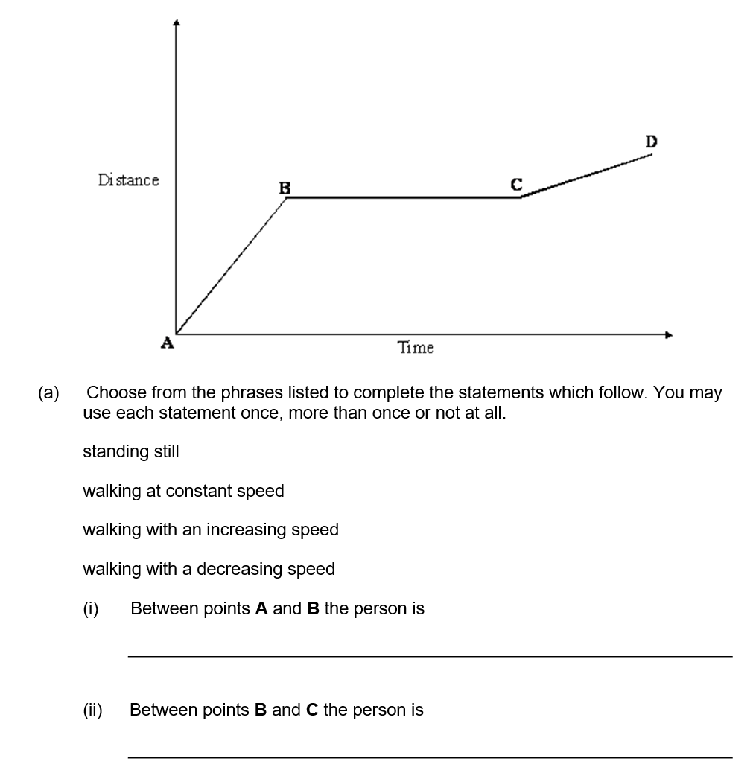
Walking at a constant speed
Standing still

Slide 18
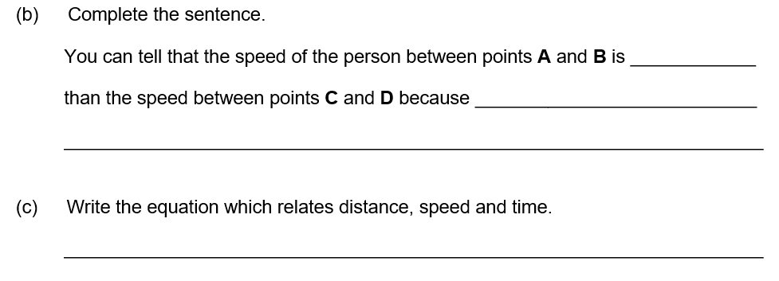
faster
the gradient of the line is steeper
Speed = distance ÷ time

