Slide 1

Graphs
17/08/2020
A voltmeter gives readings of 6.02 V, 5.83 V, 6.12 V, 6.54 V and 5.79V. Give the mean voltage and the measurement error.
What is the equation for fractional uncertainty? Calculate the fractional uncertainty of the voltmeter in Q1.
What is the equation for percentage uncertainty? Calculate the percentage uncertainty of the voltmeter in Q1.
Current in a circuit is 2.2 ± 0.2 A, while the resistance of a component is 4.6 ± 0.1 Ω. Calculate the potential difference across the component.

Slide 2
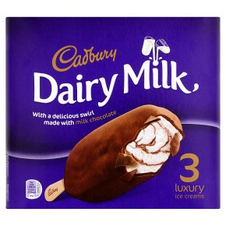
Usually (but not always!) independent variable goes on the x-axis and dependent variable goes on the y axis.
Stretch: I put magnesium powder into a beaker of hydrochloric acid. I measured how the temperature changes over time. What are the dependent and independent variables?

Slide 3
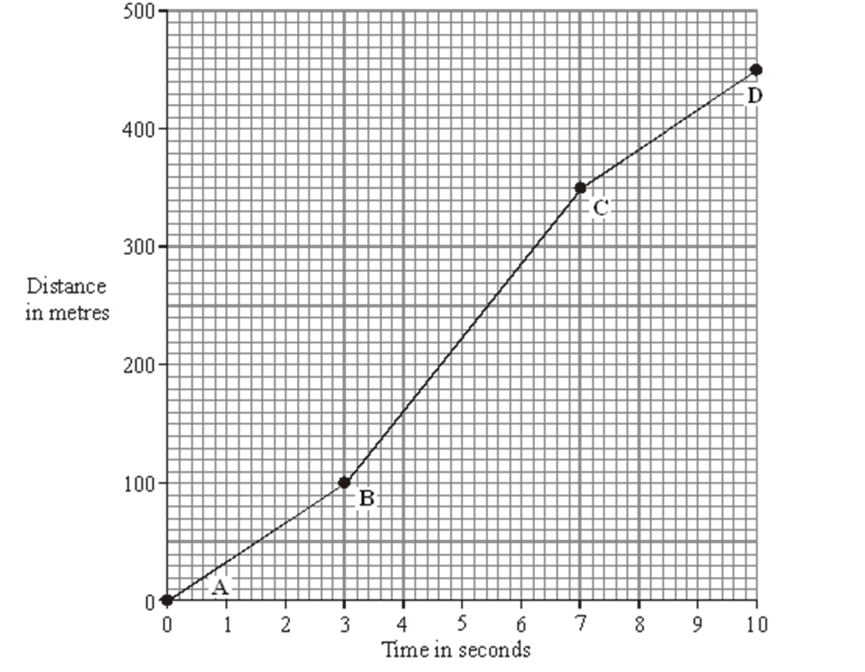
Equation of a straight line graph: y = mx + c
Stretch: What is the speed of the car between:
A – B
B – C
C – D

Slide 4
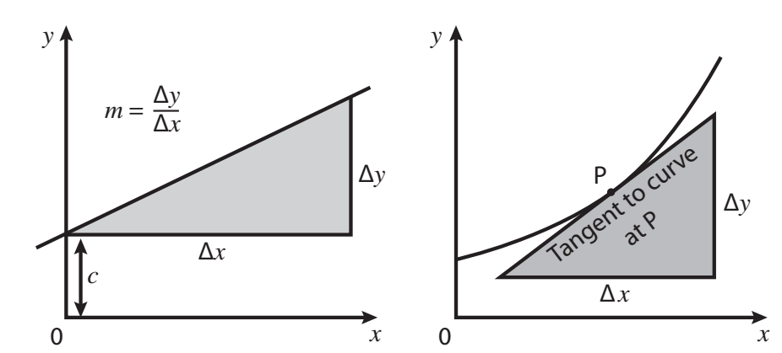
m = Δy ÷ Δx
For gradient on a curve, you need to draw a tangent.
Stretch: What does a graph of y = kx² look like?

Slide 5
Example questions
V = IR. V is plotted on the y axis, I is plotted on the x axis. What is the gradient & y intercept?
v = u + at. v is plotted on the y axis, t is plotted on the x axis. What is the gradient & y intercept?
E_{p} = mgh. E_{p} is plotted on the y axis, h is plotted on the x axis. What is the gradient & y intercept?
c = fλ. 1/λ is plotted on the y axis, f is plotted on the x axis. What is the gradient & y intercept?

Slide 6
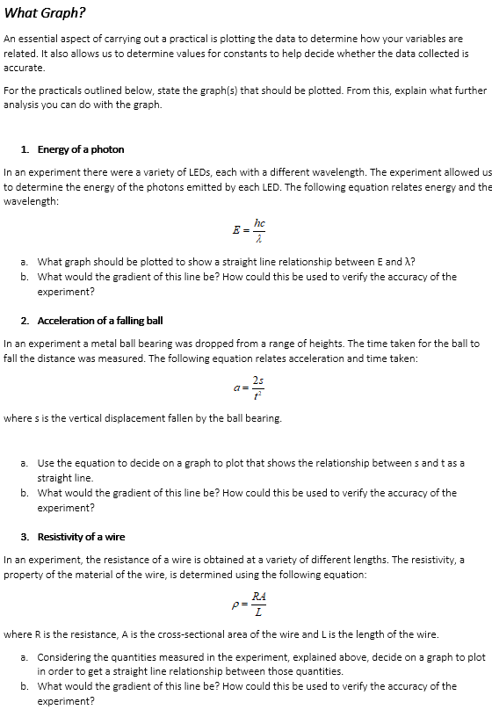
Task
Complete questions 1-3.

Slide 7

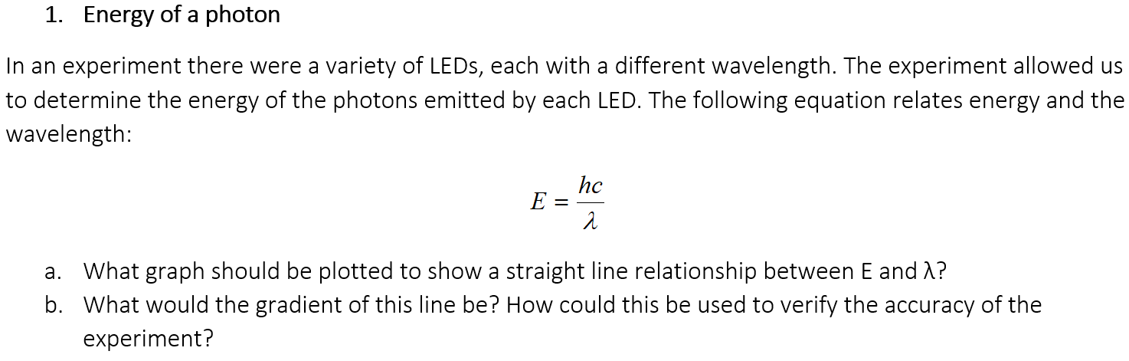
Task review

Slide 8
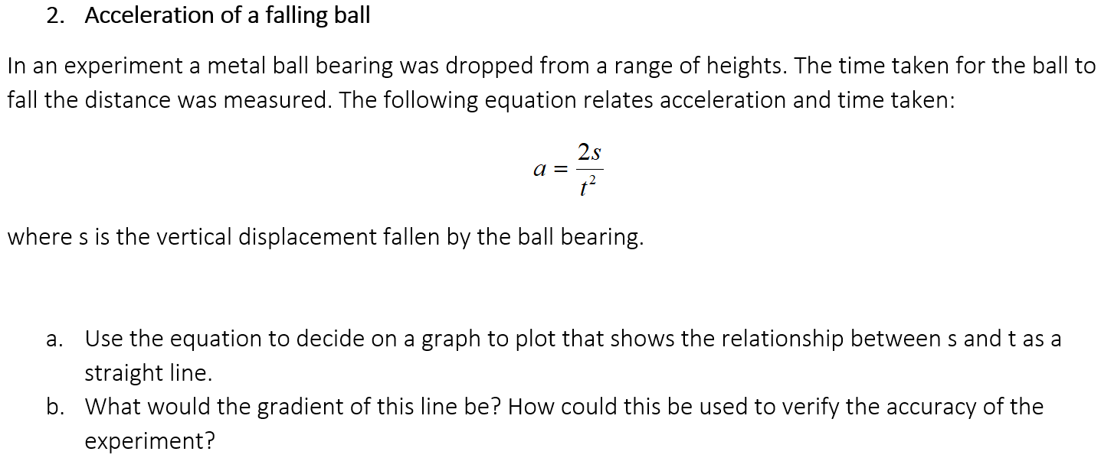
Task review

Slide 9
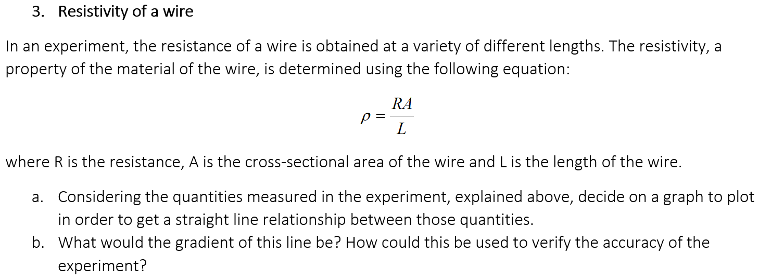
Task review

Slide 10
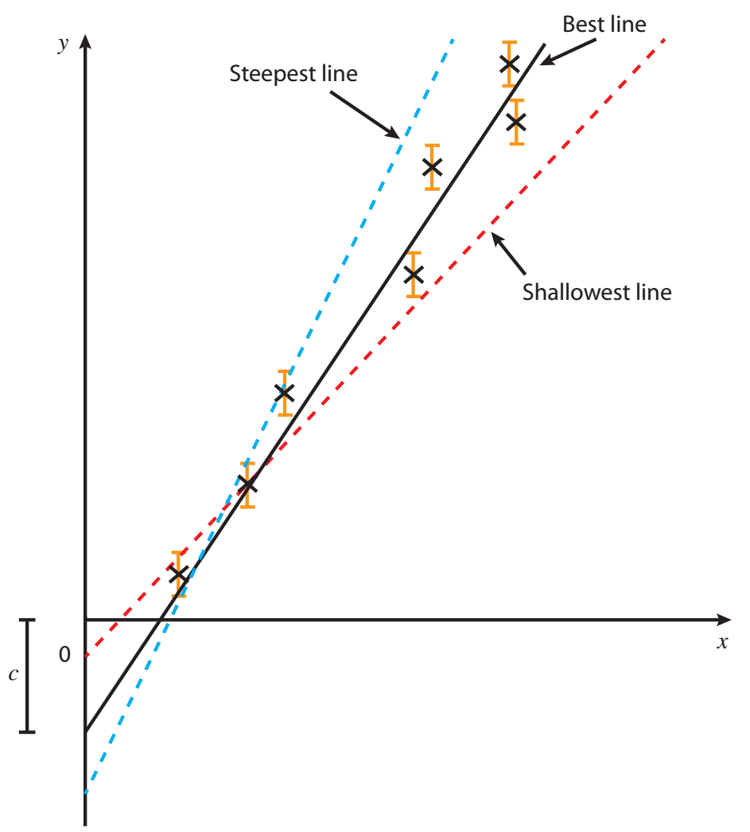
Errors can be show by error bars on a graph. Absolute uncertainties of a gradient can be calculated from worst case lines of best fit.

Slide 11
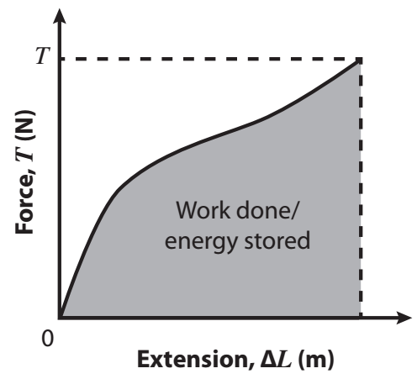
Can work out some other quantities from area under the graph.
E.g. area under a force vs extension graph gives work done.
Stretch: What does the area under a velocity-time graph give?

Slide 12
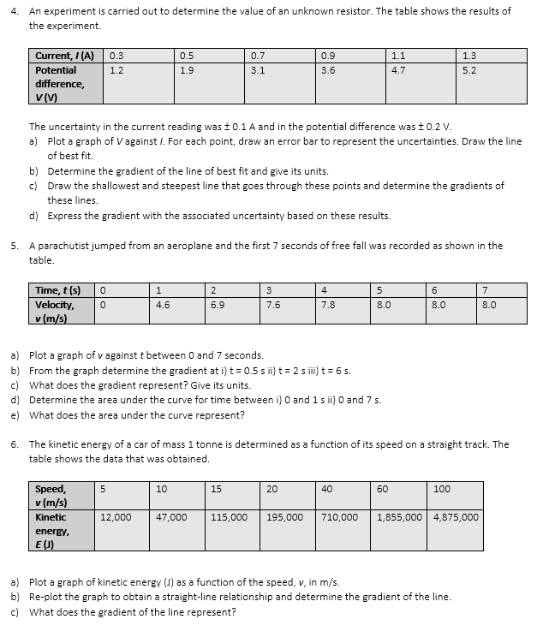
Task
Complete questions 4-6.

Slide 13
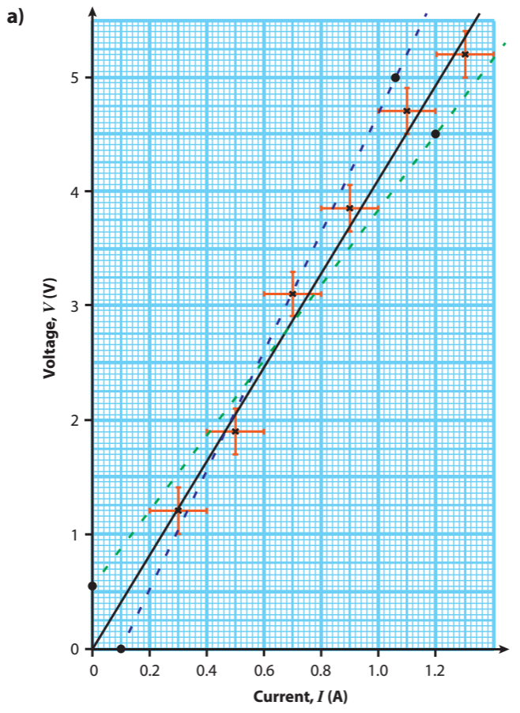
Answers
b) Gradient = 4.1 V/A
c) Shallowest gradient = 3.3 V/A
Steepest gradient = 5.2 V/A
d) Gradient = 4.1 ± 1.1 V/A

Slide 14
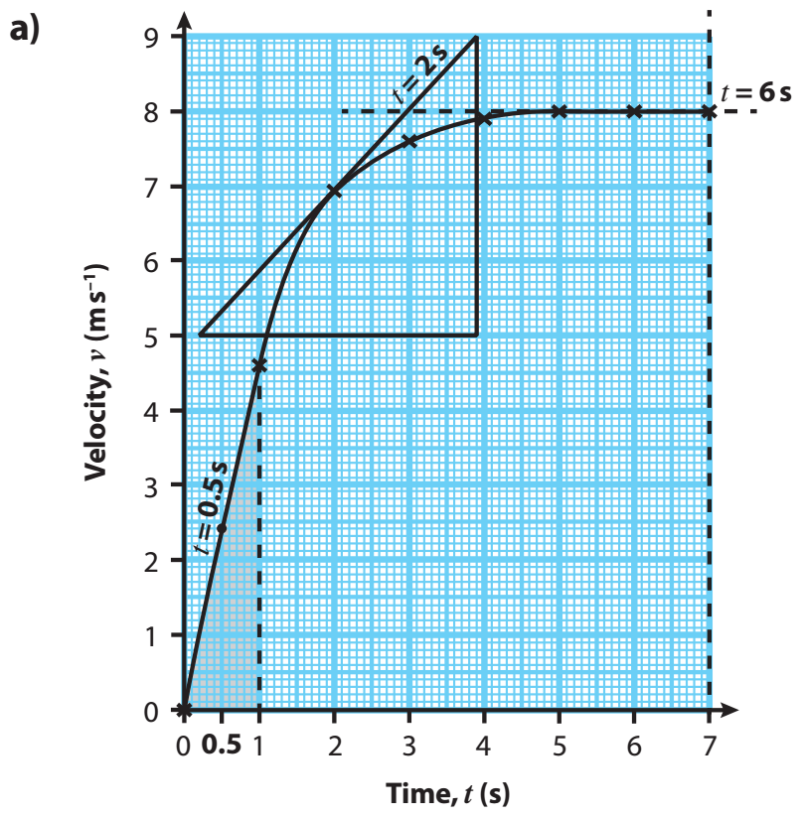
Answers
b) i) 4.7 m/s²
ii) 1.1 m/s²
iii) 0 m/s²
c) Gradient gives acceleration (units of m/s²)
d) i) 2.3 m
ii) 47 m
e) Area under curve gives displacement

Slide 15
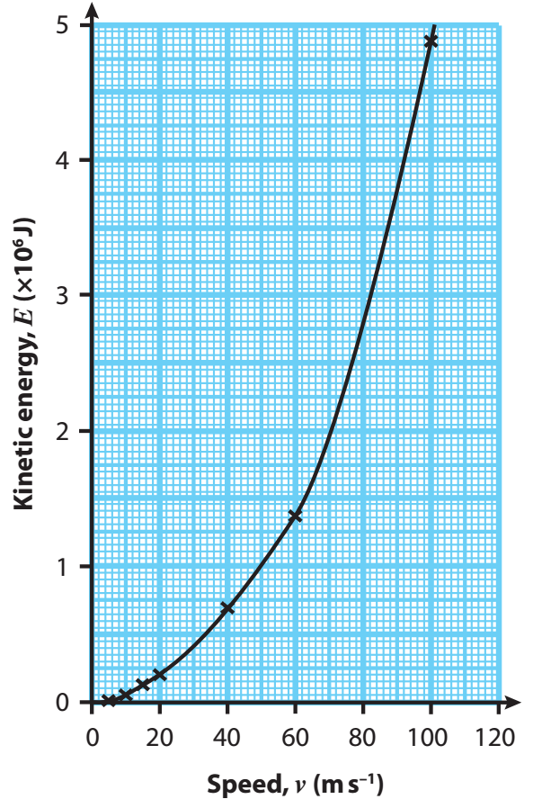
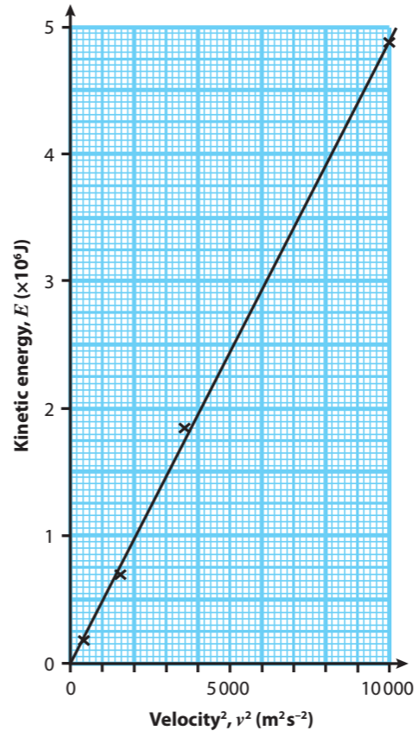
Answers
Gradient gives mass = 500 kg

