Slide 1
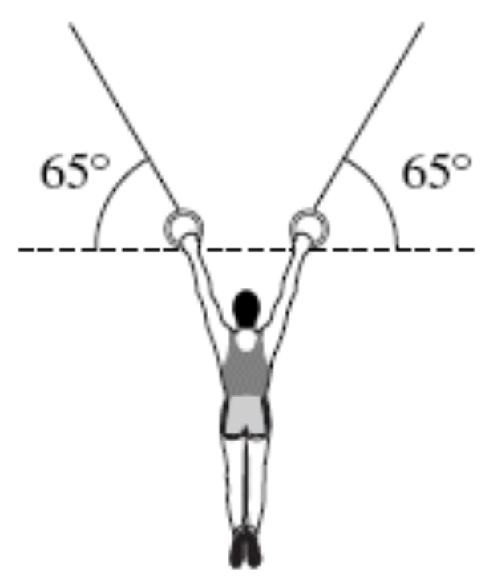

Gravitational fields
18/08/2020
The figure shows a stationary gymnast suspended by his arms at the end of two ropes.
The tension in each rope is 4.1 × 10² N. The angle between each of the ropes and the horizontal is 65°.
Calculate the weight of the gymnast.
Give your answer to an appropriate number of significant figures.

Slide 2
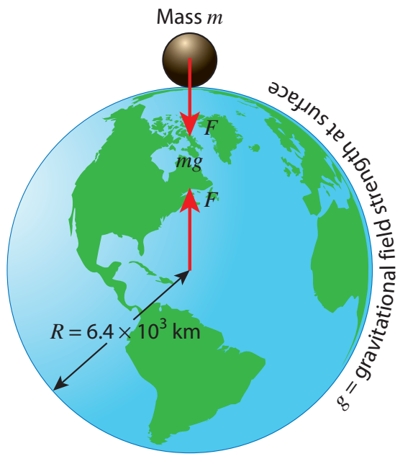
Weight
From GCSE & mechanics, we know that force due to gravity (weight) is:
W = m × g
But does this apply if we move something far away from Earth?
No! If we move something far away, then the gravitational field strength is weaker. This only apply for distances that are small compared to the Earth’s radius.

Slide 3
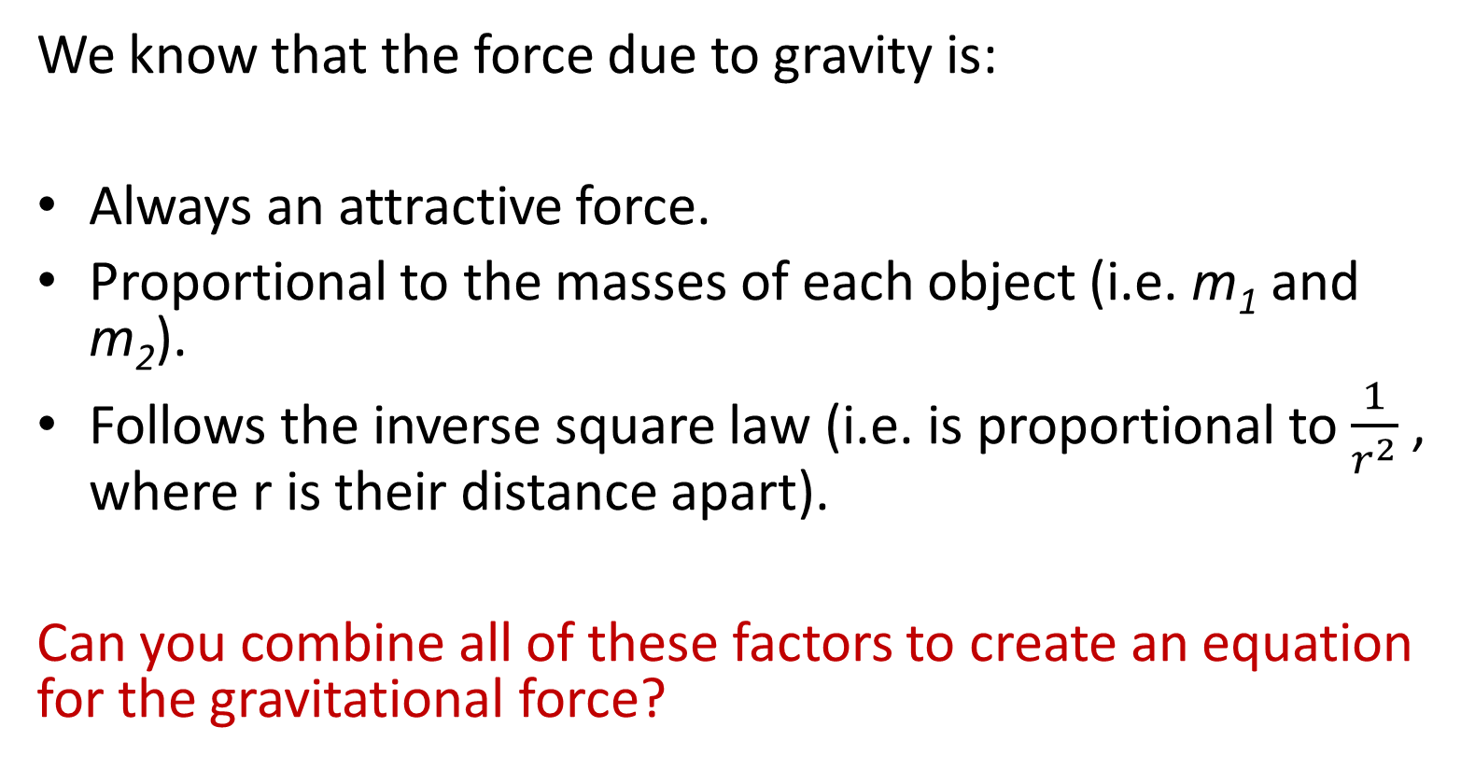
Newton’s law of gravitation
We know that the force due to gravity is:
Always an attractive force.
Proportional to the masses of each object (i.e. m₁ and m₂).
Follows the inverse square law (i.e. is proportional to $\frac{1}{r^{2}}$ , where r is their distance apart).
Can you combine all of these factors to create an equation for the gravitational force?

Slide 4
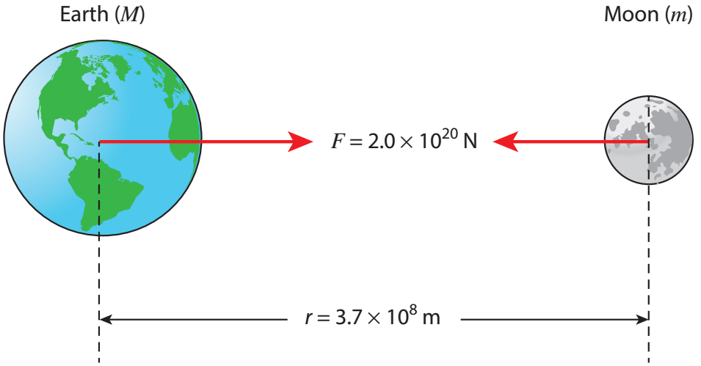
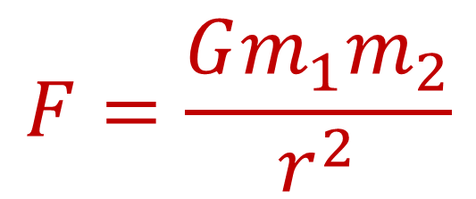
T/N: Newton’s law of gravitation
Newton’s law of gravitation says that the force of gravity between two objects is the product of their masses (m₁ and m₂) and the gravitational constant (G), divided by the square of their distance apart (r):
Stretch: Re-arrange the equation to give an equation for the gravitational constant.
What are the units for the gravitational constant?
$$F=\frac{Gm_{1}m_{2}}{r^{2}}$$

Slide 5
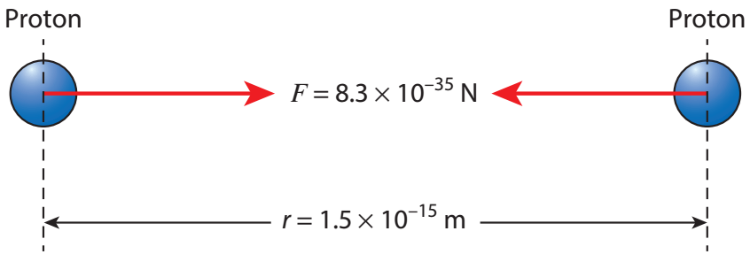
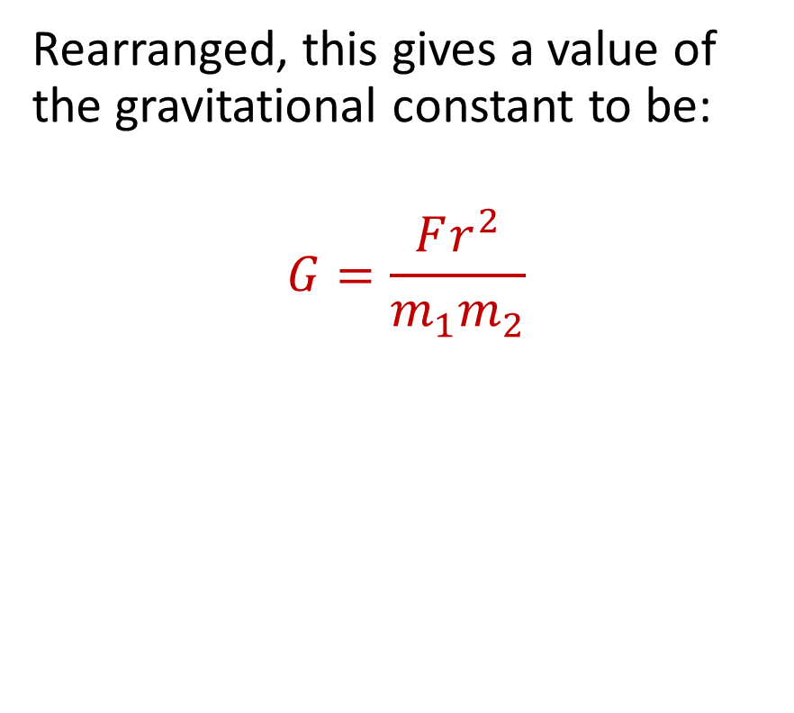
Newton’s law of gravitation
Rearranged, this gives a value of the gravitational constant to be:
$$G=\frac{Fr^{2}}{m_{1}m_{2}}$$
Stretch: Using the numbers in the diagram, calculate the value for the gravitational constant.
G = 6.67408 × 10⁻¹¹ m³ kg⁻¹ s⁻²

Slide 6
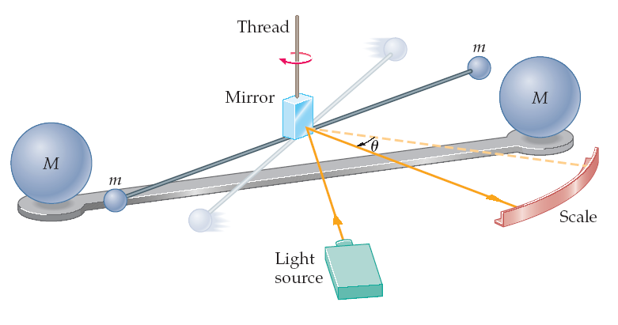
Cavendish experiment

Slide 7
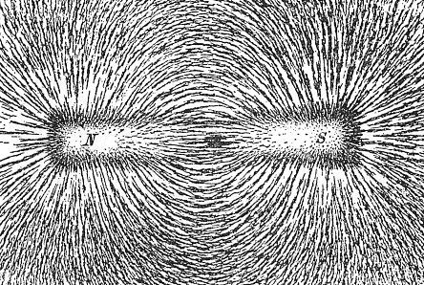
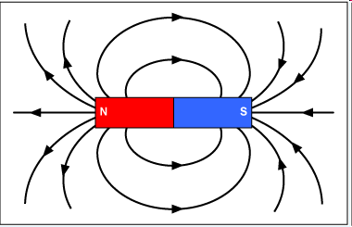
Field lines

Slide 8
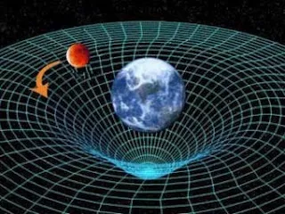
T/N: Gravity
The force of gravity is carried by “force field” lines, and is a non-contact force. As with all forces, it is a vector and it’s direction points towards anything with mass.
Stretch: An object is in between two planets of equal mass. What force does it feel and why?

Slide 9
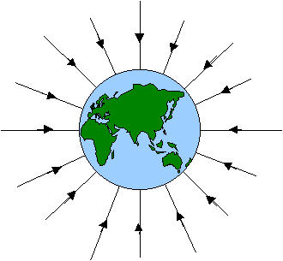
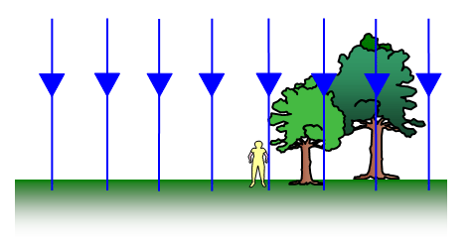
Gravitational fields
Radial field on a large scale.
Uniform field on a small scale.
Note: if a small mass is attracted to a large mass, then the field lines are the path that the smaller mass would follow.

Slide 10
T/N: Field lines
The closer together the field lines, the larger the gravitational field strength. The reason the gravitational force decreases as you go away from a planet is because the field lines become more spread out.
Radial field on a large scale.
Stretch: Draw field lines for both planet Earth and Jupiter.

Slide 11
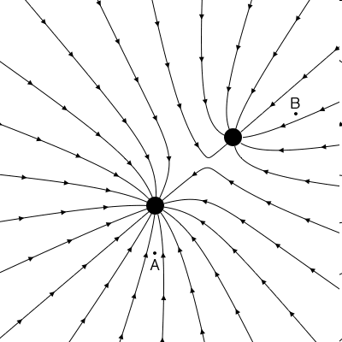
Question
Which of the two masses is heavier?
Draw arrows showing the direction of the field at each of the positions A and B.
At which point, A or B, is the field stronger?
Mark an X at the point where an object could sit and not feel any force.
Notes:
1. A 3. A

Slide 12
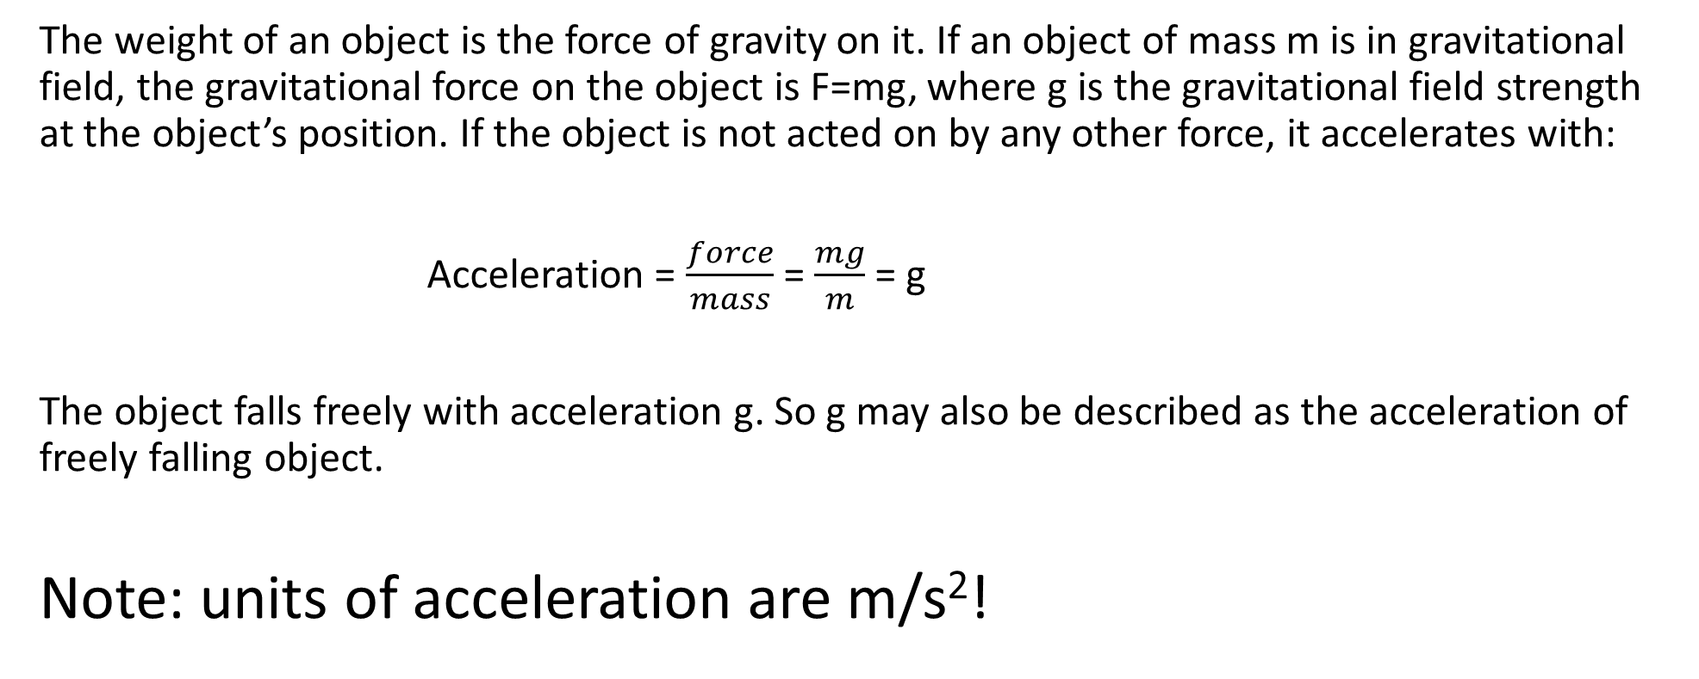
Free fall in gravitational field
The weight of an object is the force of gravity on it. If an object of mass m is in gravitational field, the gravitational force on the object is F=mg, where g is the gravitational field strength at the object’s position. If the object is not acted on by any other force, it accelerates with:
Acceleration = $\frac{force}{mass}$ = $\frac{mg}{m}$ = g
The object falls freely with acceleration g. So g may also be described as the acceleration of freely falling object.
Note: units of acceleration are m/s²!

Slide 13
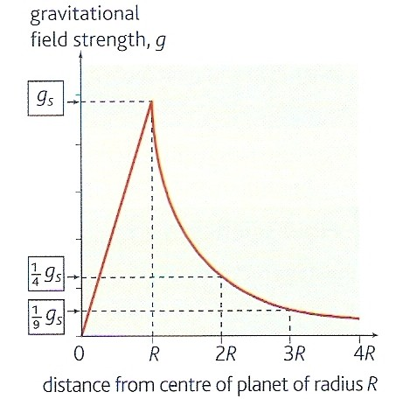
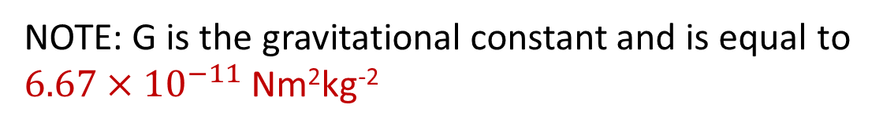
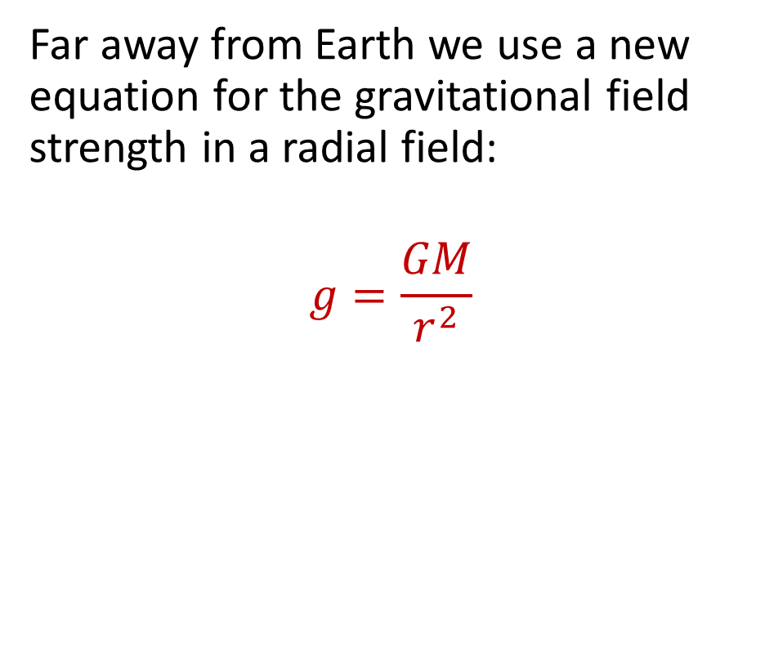
Gravitational field strength
Stretch: Can you derive this equation from F = m × g and Newton’s law of gravitation?
Far away from Earth we use a new equation for the gravitational field strength in a radial field:
$$g=\frac{GM}{r^{2}}$$
Inside planet
g α r
Outside planet
g α 1/r²
NOTE: G is the gravitational constant and is equal to $6.67×{10}^{−11}$ Nm²kg⁻²

Slide 14
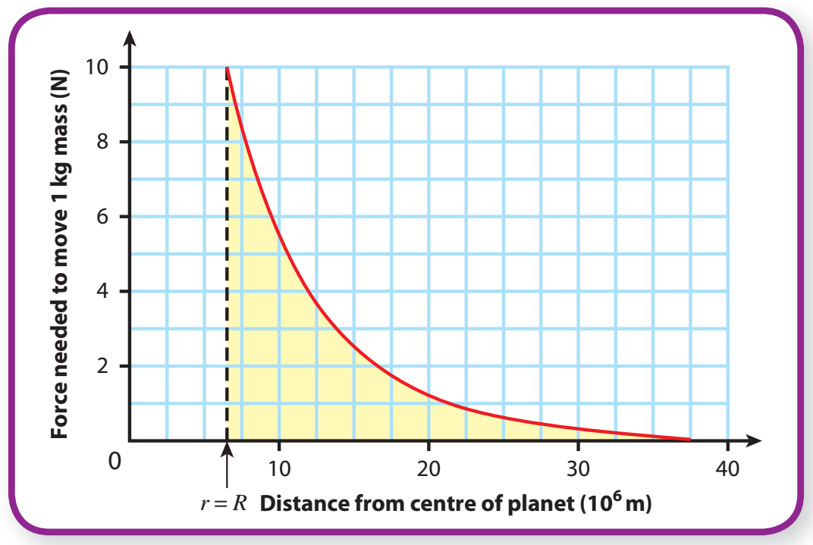
Change in GPE can be obtained for area under the graph:
W = E_{p} = FΔr

Slide 15
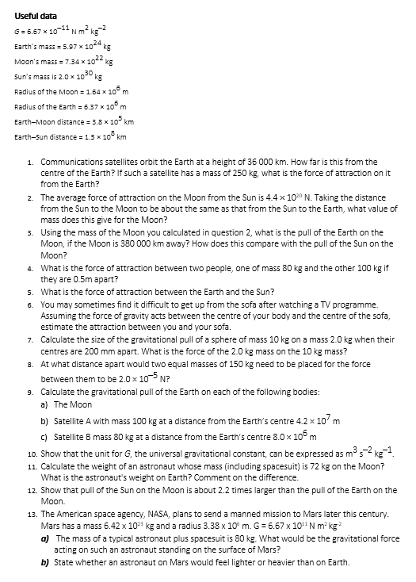
Task
Complete the questions.

Slide 16

Answers
56 N
7.4 x 10²² kg
2.1 x 10²⁰ N
2.14 x 10⁻⁶ N
6.7 x 10¹¹ N
1.6 x 10⁻⁶ N
3.3 x 10⁻⁹ N
8. 0.27 m
9 a) 2.0 x 10²⁰ N
b) 23 N
c) 5.0 x 10² N
10. N kg⁻² m² = kg m s⁻² m² = m³ s⁻² kg⁻¹
11. Moon 1.3 x 10² N
Earth 7.1 x 10² N
12. Sun-Moon 4.4 x 10²⁰ N
Earth-Moon 2.0 x 10²⁰ N
ratio of attractions = 2.2
13. a) 330 N
b) Would feel lighter.

Slide 17
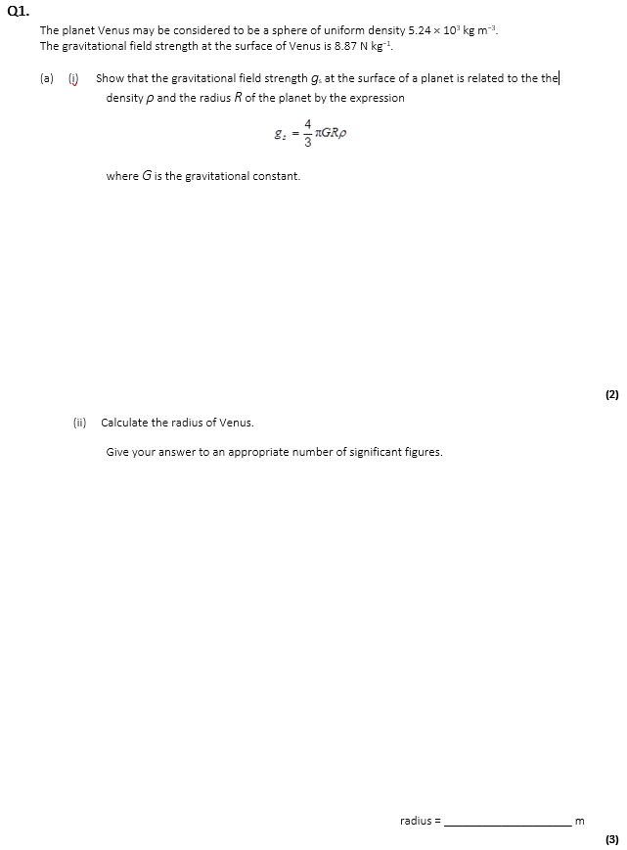
Exam question
Complete the exam question.

Slide 18
