Slide 1

Gravitational potential
17/08/2020
What is the equation we already know for gravitational potential energy?
A weight of mass 20kg is 10m above the surface of the Earth. How much GPE does it have?
If that mass was dropped from that height, with what speed would it hit the floor?
How does the gravitational field strength on the surface of the Earth compare to at the top of Mt. Everest?
Why do we think that the equation for GPE doesn’t work
at distances far from Earth?

Slide 2
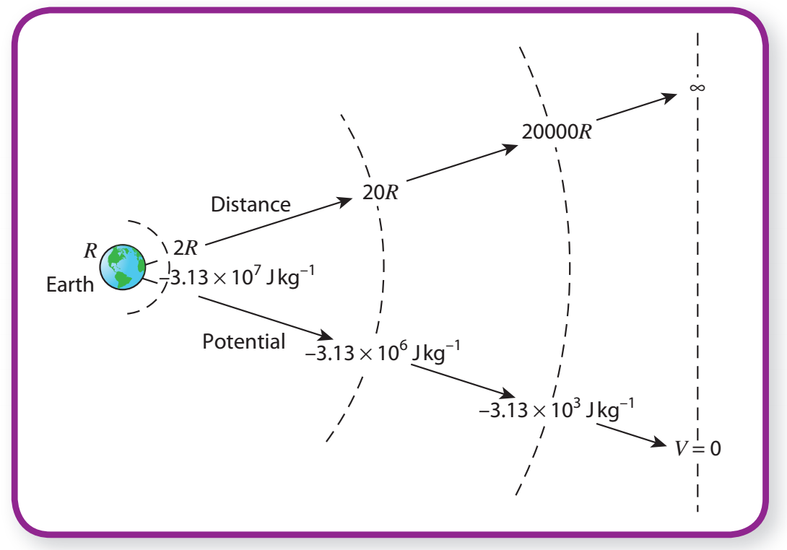
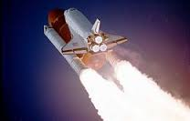
Gravitational potential energy
Gravitational potential energy is the energy of any object due to its position in a gravitational field.
The position for zero GPE is at infinity (object is so far away that gravitational force on it is negligible).

Slide 3
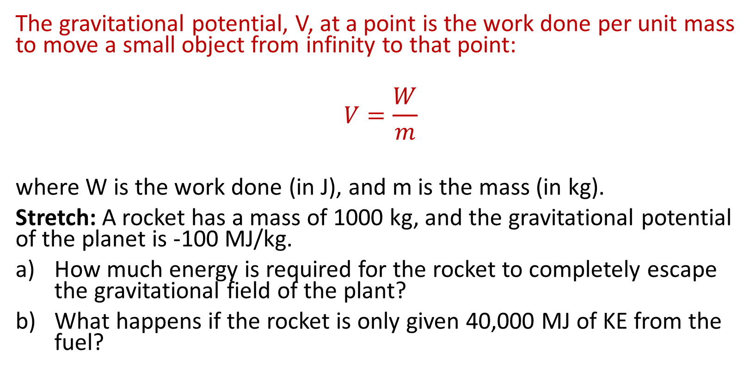
T/N: Gravitational Potential
The gravitational potential, V, at a point is the work done per unit mass to move a small object from infinity to that point:
$$V=\frac{W}{m}$$
where W is the work done (in J), and m is the mass (in kg).
Stretch: A rocket has a mass of 1000 kg, and the gravitational potential of the planet is -100 MJ/kg.
How much energy is required for the rocket to completely escape the gravitational field of the plant?
What happens if the rocket is only given 40,000 MJ of KE from the fuel?

Slide 4
Why is gravitational potential negative?
The gravitational potential is negative because a negative amount of work is done to bring an object closer to the Earth.
Stretch: What on Earth is a negative amount of work? We can’t have a negative energy right?

Slide 5
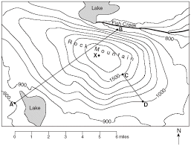
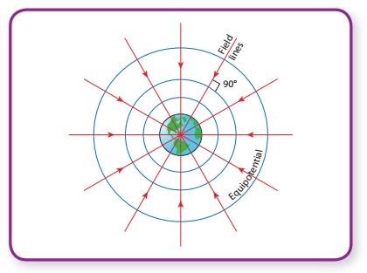
Equipotentials
Equipotentials are surfaces of constant potential. No work needs to be done to move along an equipotential surface.

Slide 6
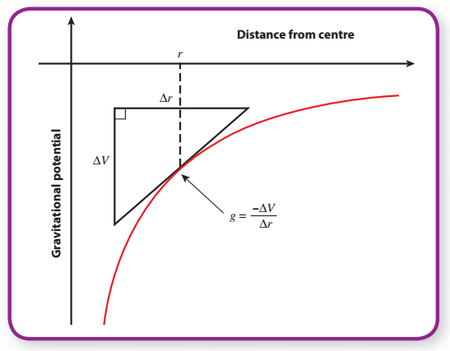
Potential gradient
The potential gradient at a point in a gravitational field is the change of potential per metre at that point.
Near the Earth’s surface the potential changes by 9.8 Jkg⁻¹ for every metre of height gained. So the potential gradient near the surface of the Earth is constant and equal to 9.8 Jkg⁻¹m⁻¹. However, further from the Earth’s surface, the potential gradient becomes less and less.
Stretch: What therefore is the equation for potential gradient?

Slide 7
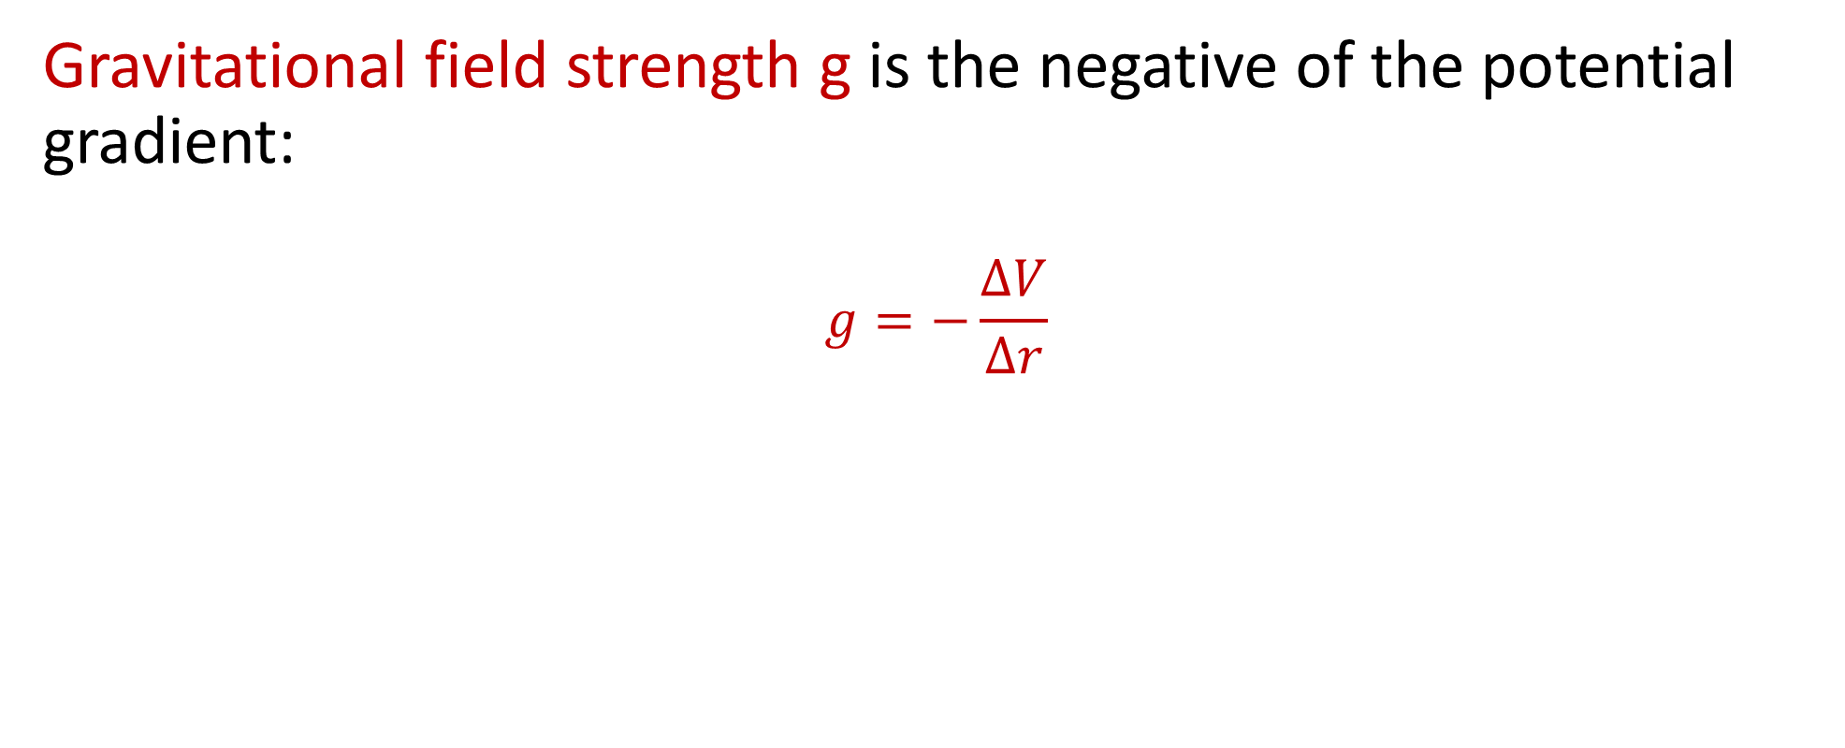
Gravitational field strength
Gravitational field strength g is the negative of the potential gradient:
$$g=−\frac{∆V}{∆r}$$
Here, the minus sign shows you that g acts in the opposite direction to the potential gradient.

Slide 8
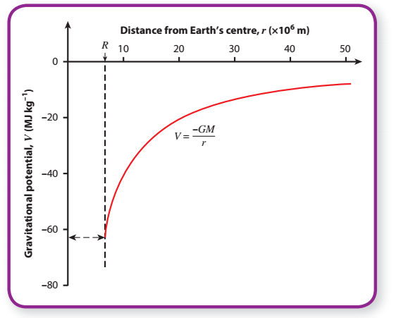
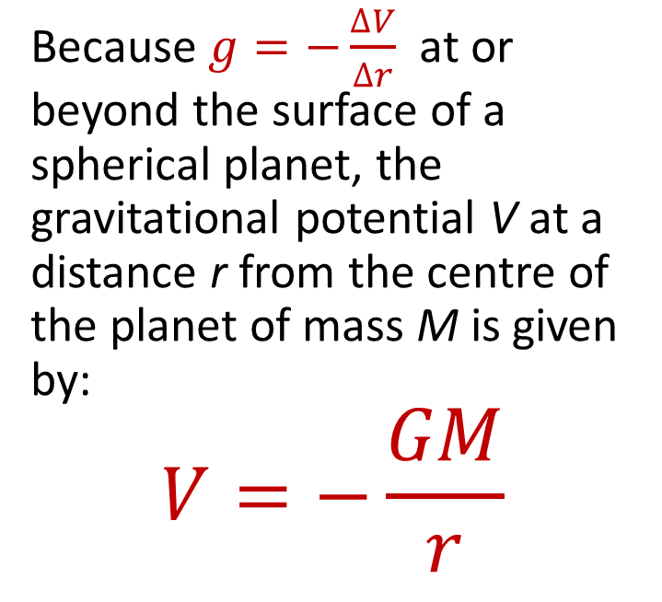
Gravitational potential
Because $g=−\frac{∆V}{∆r}$ at or beyond the surface of a spherical planet, the gravitational potential V at a distance r from the centre of the planet of mass M is given by:
$$V=−\frac{GM}{r}$$
Stretch: Derive this equation from Newton’s law of gravitation.

Slide 9

Moving an object
Moving an object from one position to another requires work to be done against the force of gravity. The amount of energy required depends on the mass of the object being moved and the gravitational potential difference that the mass moves through:

Slide 10
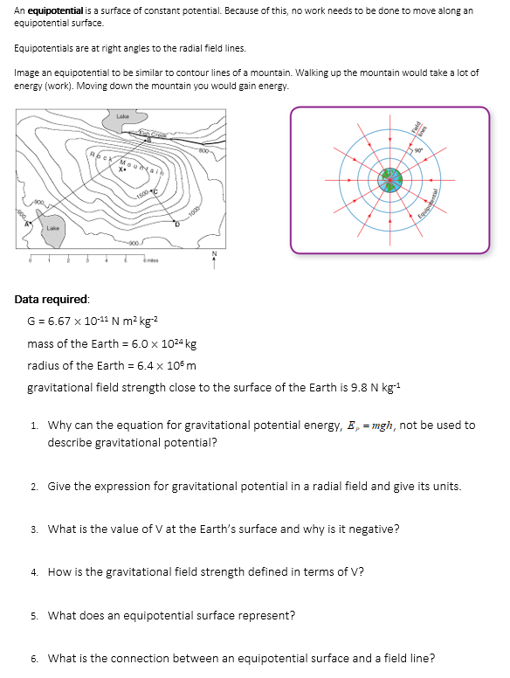
Task
Complete the questions.

Slide 11

Answers
The value for ‘g’ is not constant for large changes in h; the Earth’s field is a radial field and so for only small changes of h (or r) can the field be considered uniform
V = − GM/R; J kg⁻¹
− 63MJkg⁻¹; the potential is defined as zero at infinity and therefore becomes increasingly negative as it approaches Earth; work
It is the gradient of a V – r graph at the point r, i.e. g = − ΔV/ Δr
lines along which a mass experiences no change in gravitational potential
They are always perpendicular
7. Zero
8. ΔE= m(V₂ – V₁)
9. -3.8 × 10⁹ J/kg
10. 1.9 × 10²⁷ kg
11. 25.7 N/kg
12. The satellite moves along an equipotential and there is thus no change in potential energy; as total energy is conserved, there is no change in kinetic energy, so speed remains constant
13. GPE = -GMm/r = (- 6.67 x 10⁻¹¹ x 6.0 x 10²⁴ x 60) / 6.4 x 10⁶ = - 3.8 x 10⁹ J
14. V = -GM/r = (-6.67 x 10⁻¹¹ x 6.0 x 10²⁴) / 6.4 x 10⁶ = - 6.3 x 10⁷ J kg⁻¹ or - 63 MJ kg⁻¹

Slide 12
Answers
15. V = -GM/r = (-6.67 x 10⁻¹¹ x 6.0 x 10²⁴) / (6.4 x 10⁶ + 3.6 x 10⁷)
= -9.4 x 10⁶ J kg⁻¹ or -9.4 MJ kg⁻¹
The potential difference is then - 9.4 – (- 63) = 53 MJ kg⁻¹ (or 5.3 x 10⁷ J kg⁻¹).
16. Well, we now know that the potential difference between the Earth’s surface and the geostationary orbit height is + 5.3 x 10⁷ J kg⁻¹. In other words, for each kg of mass lifted from Earth to geostationary orbit, 5.3 x 10⁷ J of energy is required. Therefore, for a satellite of mass 150 kg, energy required = 150 x 5.3 x 10⁷= 8.0 x 10⁹ J or (or 8.0 GJ).
Actually, much more energy is required because there is drag with the Earth’s atmosphere to overcome on the way up, and also the rocket itself (and its fuel) have mass that needs to be lifted into orbit too! The answer we’ve arrived at is only the energy required to lift the satellite against the gravitational pull of the Earth.
16. For a uniform field, change in potential = gh = 9.8 x 50 = 490 J kg⁻¹

Slide 13
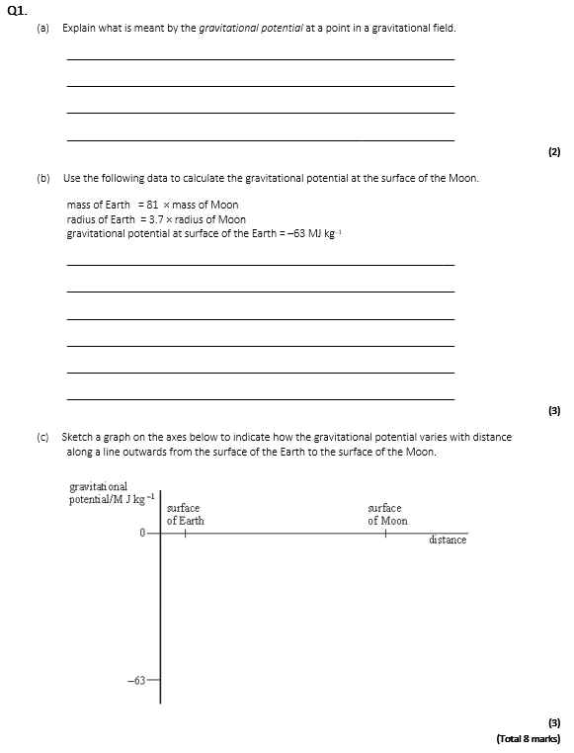
Exam question
Complete the exam question.

Slide 14
