Slide 1

Kepler’s third law
17/08/2020
Calculate the minimum work required to lift an astronaut of mass 80kg from the Earth’s surface to the height of the ISS (300 km).
What work would be needed to remove the astronaut completely from the Earth’s gravitational field?
If this work came from a conversion of initial kinetic energy (the astronaut is projected from the Earth’s surface), what would be the astronaut’s initial speed?
Earth radius, r = 6400 km
Earth mass, M = 6.0 x 10 ²⁴ kg
G = 6.672 x 10 ⁻¹¹ N m ² kg ⁻ ²

Slide 2

Question 1 review
V = - G M / r
V at Earth surface: r = 6.4 x 10 ⁶ m
= - (6.672 x 10 ⁻¹¹) x (6.0 x 10 ²⁴ ) / 6.4 x 10 ⁶
= - 6.26 x 10 ⁷ Jkg ⁻¹
V at ISS: r = 6.7 x 10 ⁶ m
= - 5.97 x 10 ⁷ Jkg ⁻¹
ΔV = (6.26 – 5.97) x 10 ⁷ Jkg ⁻¹ = 2.9 x 10 ⁶ Jkg ⁻¹
ΔW = m x ΔV
= 80 kg x 2.9 x 10 ⁶ Jkg ⁻¹
Work = 2.32 x 10 ⁸ J = 232 MJ

Slide 3
Question 2/3 review
2. ΔV = (6.26 – 0) x 10 ⁷ Jkg⁻¹ = 6.26 x 10 ⁷ Jkg⁻¹
ΔW = m x ΔV
= 80 kg x 6.26 x 10 ⁷ Jkg⁻¹
Work = 5.01 x 10 ⁹ J = 5 010 MJ
3. ½ m v ² = ΔW = 5.01 x 10 ⁹ J
v² = (2 x 5.01 x 10 ⁹ J) / 80 kg
v² = (10.02 x 10 ⁹ J) / 80 kg
v² = 1.25 x 10 ⁸
speed, v = 1.12 x 10⁴ ms⁻¹ (11 kms⁻¹)
This is called the escape speed.

Slide 4
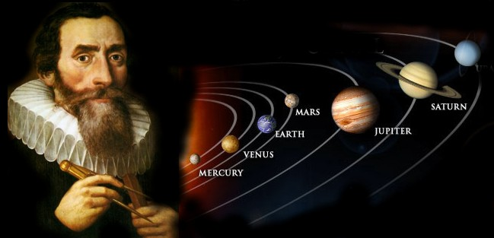
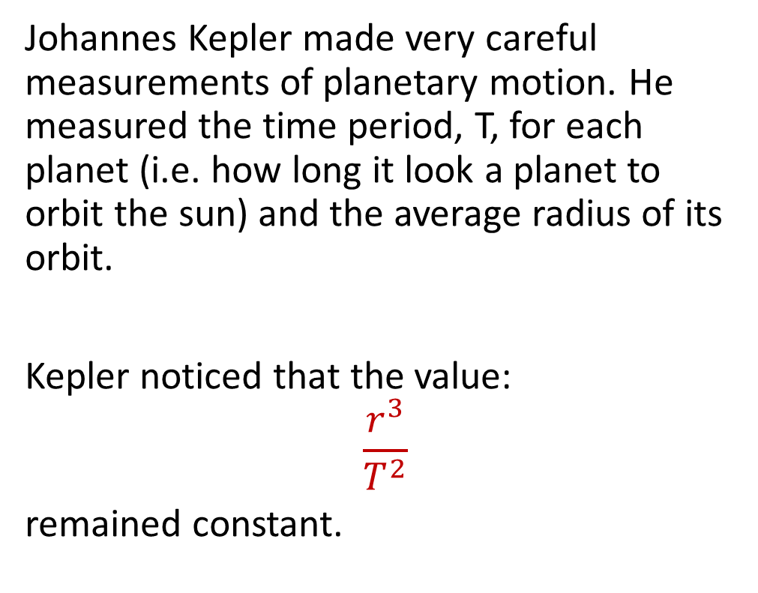
Kepler’s third law
Johannes Kepler made very careful measurements of planetary motion. He measured the time period, T, for each planet (i.e. how long it look a planet to orbit the sun) and the average radius of its orbit.
Kepler noticed that the value:
$$\frac{r^{3}}{T^{2}}$$
remained constant.
Stretch: If the radius is doubled, what happens to the time period?

Slide 5
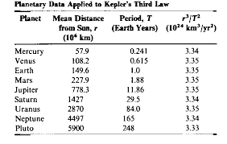
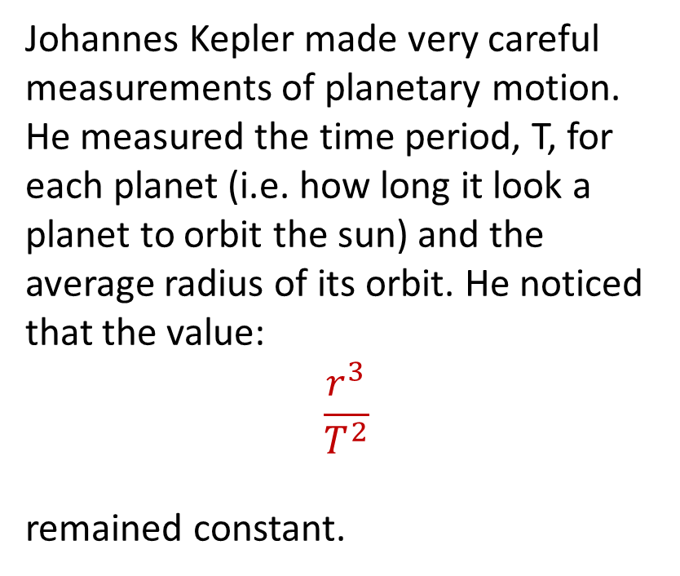
Kepler’s third law
Johannes Kepler made very careful measurements of planetary motion. He measured the time period, T, for each planet (i.e. how long it look a planet to orbit the sun) and the average radius of its orbit. He noticed that the value:
$$\frac{r^{3}}{T^{2}}$$
remained constant.

Slide 6
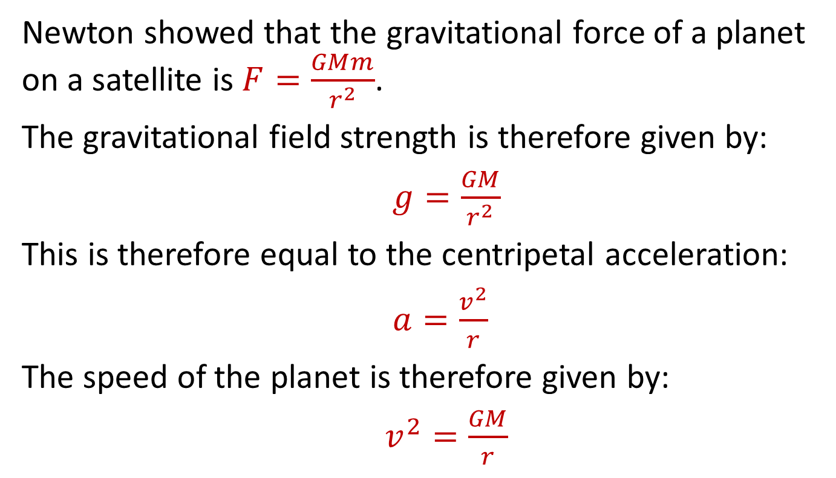
T/N: Satellite motion
Newton showed that the gravitational force of a planet on a satellite is $F=\frac{GMm}{r^{2}}$.
The gravitational field strength is therefore given by:
$g=\frac{GM}{r^{2}}$
This is therefore equal to the centripetal acceleration:
$a=\frac{v^{2}}{r}$
The speed of the planet is therefore given by:
$v^{2}=\frac{GM}{r}$

Slide 7
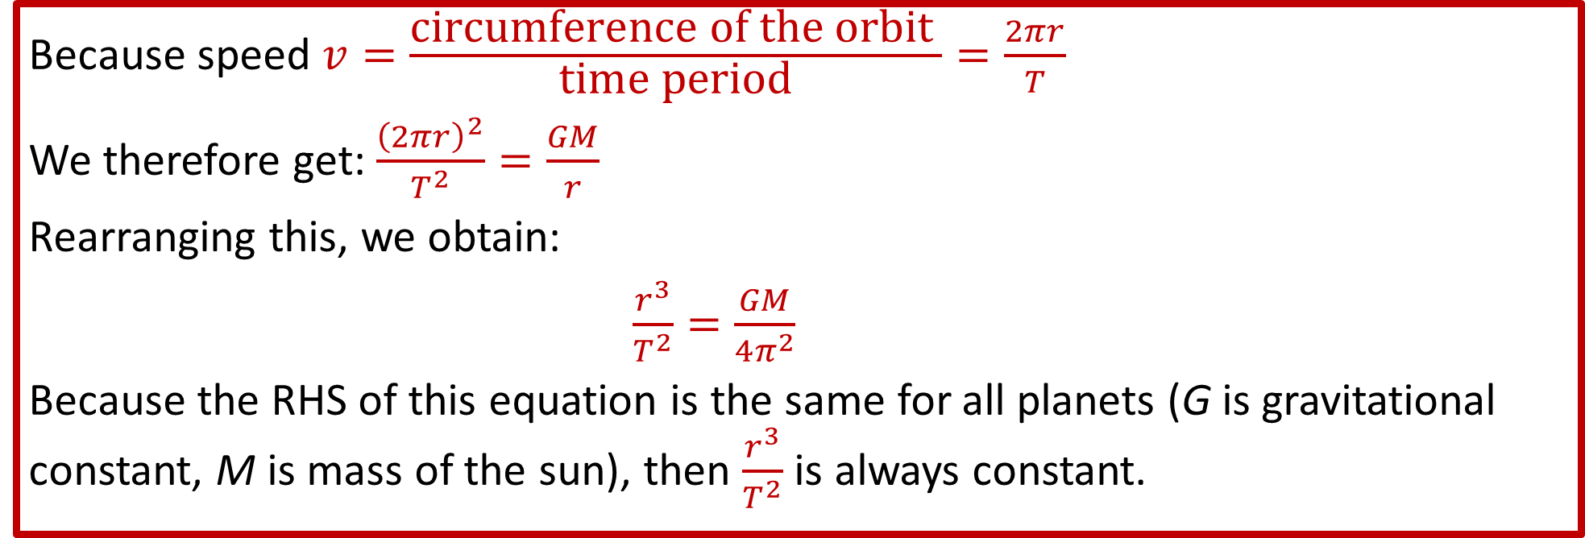
T/N: Satellite motion
Because speed $v=\frac{\text{circumference} \text{of} \text{the} \text{orbit} }{\text{time} \text{period}}=\frac{2πr}{T}$
We therefore get: $\frac{{\left(2πr\right)}^{2}}{T^{2}}=\frac{GM}{r}$
Rearranging this, we obtain:
$\frac{r^{3}}{T^{2}}=\frac{GM}{4π^{2}}$
Because the RHS of this equation is the same for all planets (G is gravitational constant, M is mass of the sun), then $\frac{r^{3}}{T^{2}}$ is always constant.

Slide 8
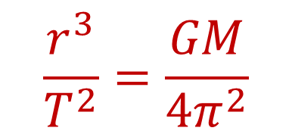
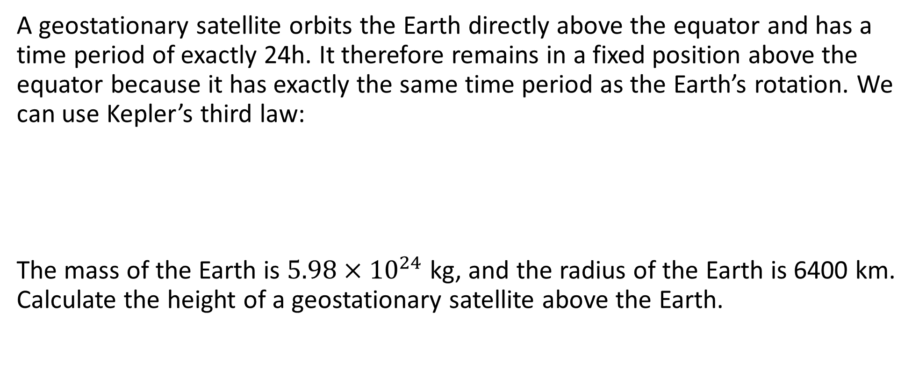
Geostationary satellites
A geostationary satellite orbits the Earth directly above the equator and has a time period of exactly 24h. It therefore remains in a fixed position above the equator because it has exactly the same time period as the Earth’s rotation. We can use Kepler’s third law:
The mass of the Earth is $5.98×{10}^{24}$ kg, and the radius of the Earth is 6400 km. Calculate the height of a geostationary satellite above the Earth.
$$\frac{r^{3}}{T^{2}}=\frac{GM}{4π^{2}}$$

Slide 9
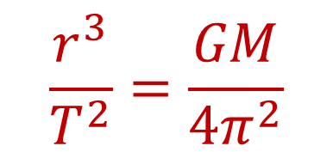
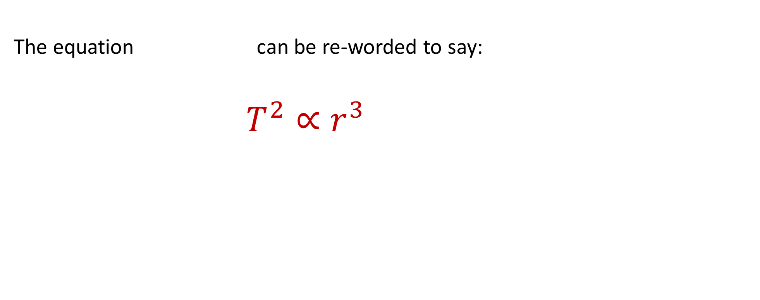
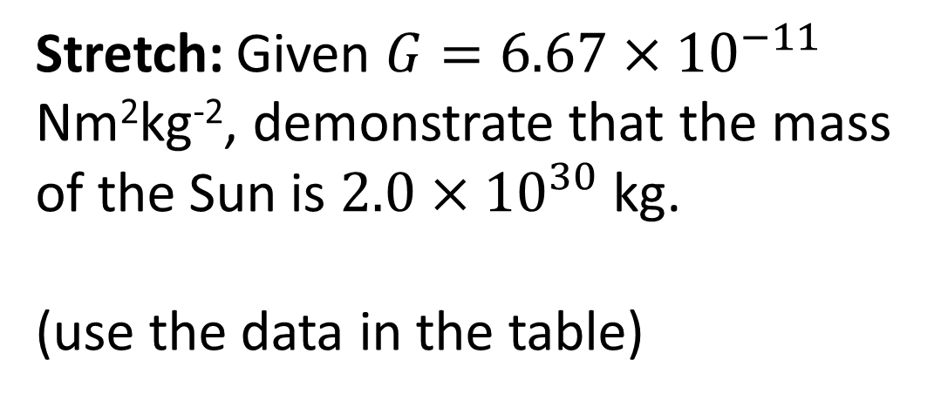
Satellite motion
The equation can be re-worded to say:
$T^{2}∝r^{3}$
$$\frac{r^{3}}{T^{2}}=\frac{GM}{4π^{2}}$$
Stretch: Given $G=6.67×{10}^{−11 }$ Nm²kg⁻², demonstrate that the mass of the Sun is $2.0×{10}^{30}$ kg.
(use the data in the table)

Slide 10
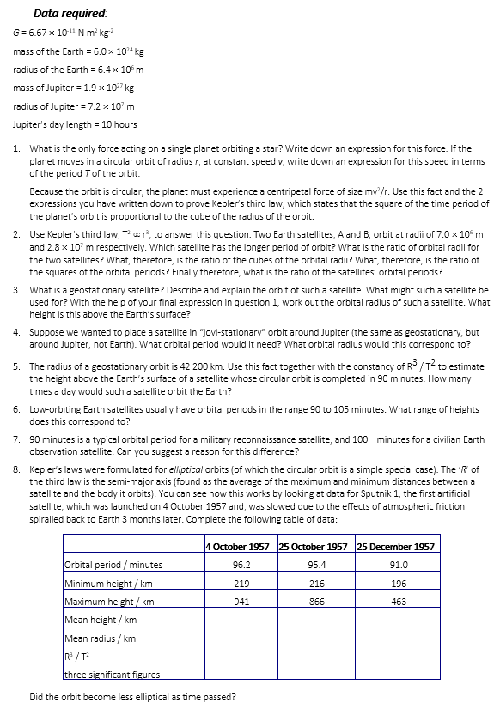
Task
Complete the questions.

Slide 11
Answers
1. Gravitational attraction GMm/r².
v = 2πr/T
GMm/r² = mv²/r
GM/r = m (2πr/T)²
GM/r = 4π²r²m/T²
T² = (4π²/GM) r³
2. By Kepler’s third law, orbital period increases with orbital radius. Thus B has the longer orbital period.
r_{B}/r_{A} = 2.8 x 10⁷/ 7.0 x 10⁶ = 4
(r_{B}/r_{A})³ = 4³ = 64
By Kepler’s third law, (T_{B}/T_{A})² = (r_{B}/r_{A})³ = 64
Thus T_{B}/T_{A} = square root of 64 = 8
3. A satellite that appears to be stationary over a point on the Earth’s equator. The orbit of such a satellite is circular and over the Earth’s equator as the satellite’s orbital centre is the centre of the Earth, and the only points on Earth that orbit its centre are those on the equator.
Such a satellite might be used for communications, e.g. satellite broadcasting.
T² = (4π²/GM) r³
r³ = (GM/4π²) T²
= (6.67 x 10⁻¹¹ x 6.0 x 10²⁴ / 4π²) x (24 x 60 x 60)²
= 7.567 x 10²² m³ (4sf)
Therefore, r = 4.23 x 10⁷ m (3sf)
Height above Earth’s surface is 4.23 x 10⁷ – 6.4 x 10⁶ = 3.59 x 10⁷ m or 36,000 km.

Slide 12
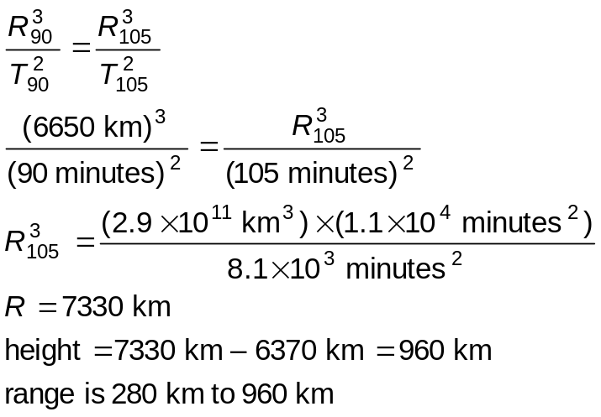

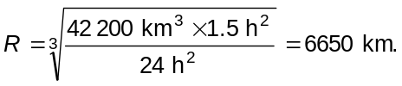


Answers
4. 10 hours
r³ = (GM/4p²) T² = (6.67 x 10⁻¹¹ x 1.9 x 10²⁷ / 4p²) x (10 x 60 x 60)²
= 4.160 x 10²⁴ m³ (4sf)
Therefore, r = 1.61 x 10⁸ m (3sf)
5.
6.
7. Low orbits give smaller image detail; higher orbits give greater coverage and endurance (because there is less atmospheric friction).
8.
so
 | 4 October 1957 | 25 October 1957 | 25 December 1957
Orbital period / minutes | 96.2 | 95.4 | 91.0
Minimum height / km | 219 | 216 | 196
Maximum height / km | 941 | 866 | 463
Mean height / km | 580 | 541 | 330
Mean radius / km | 6950 | 6911 | 6700
R3 / T2 three significant figures | 36 x 106 | 36 x 106 | 36 x 106
Therefore
The Kepler ratio for each case is the same; the deviation from the mean height decreases, so the orbit becomes more like a circle.
Average orbit time was 93.6 minutes. In 3 months (90 days) it made approximately

Slide 13
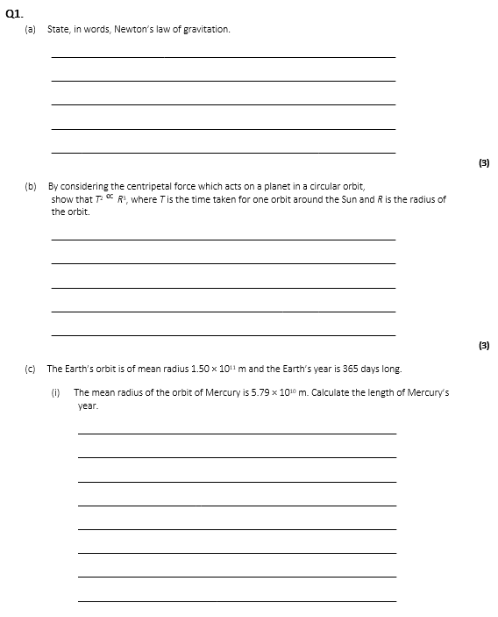
Exam question
Complete the exam question.

Slide 14
