Slide 1
Boyle’s Law
30/10/2020

Slide 2
Boyle’s law
Pressure
Pascal
Volume
Inversely
Proportional
Describe as basic experiment that shows the relationship between pressure and volume.
Recall the equation for Boyle’s law
Predict what will happen to the pressure inside an object under different volumes.

Slide 3
Provided that the number of particles and the temperature of a gas are kept constant, then:
P₁ x V₁ = P₂ x V₂
Where:
P is pressure in pascals (Pa)
V is volume in metres cubed (m³)
Stretch:
Re-arrange the equation.
You might sometimes see this equation written as P x V = constant

Slide 4
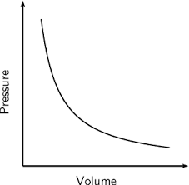
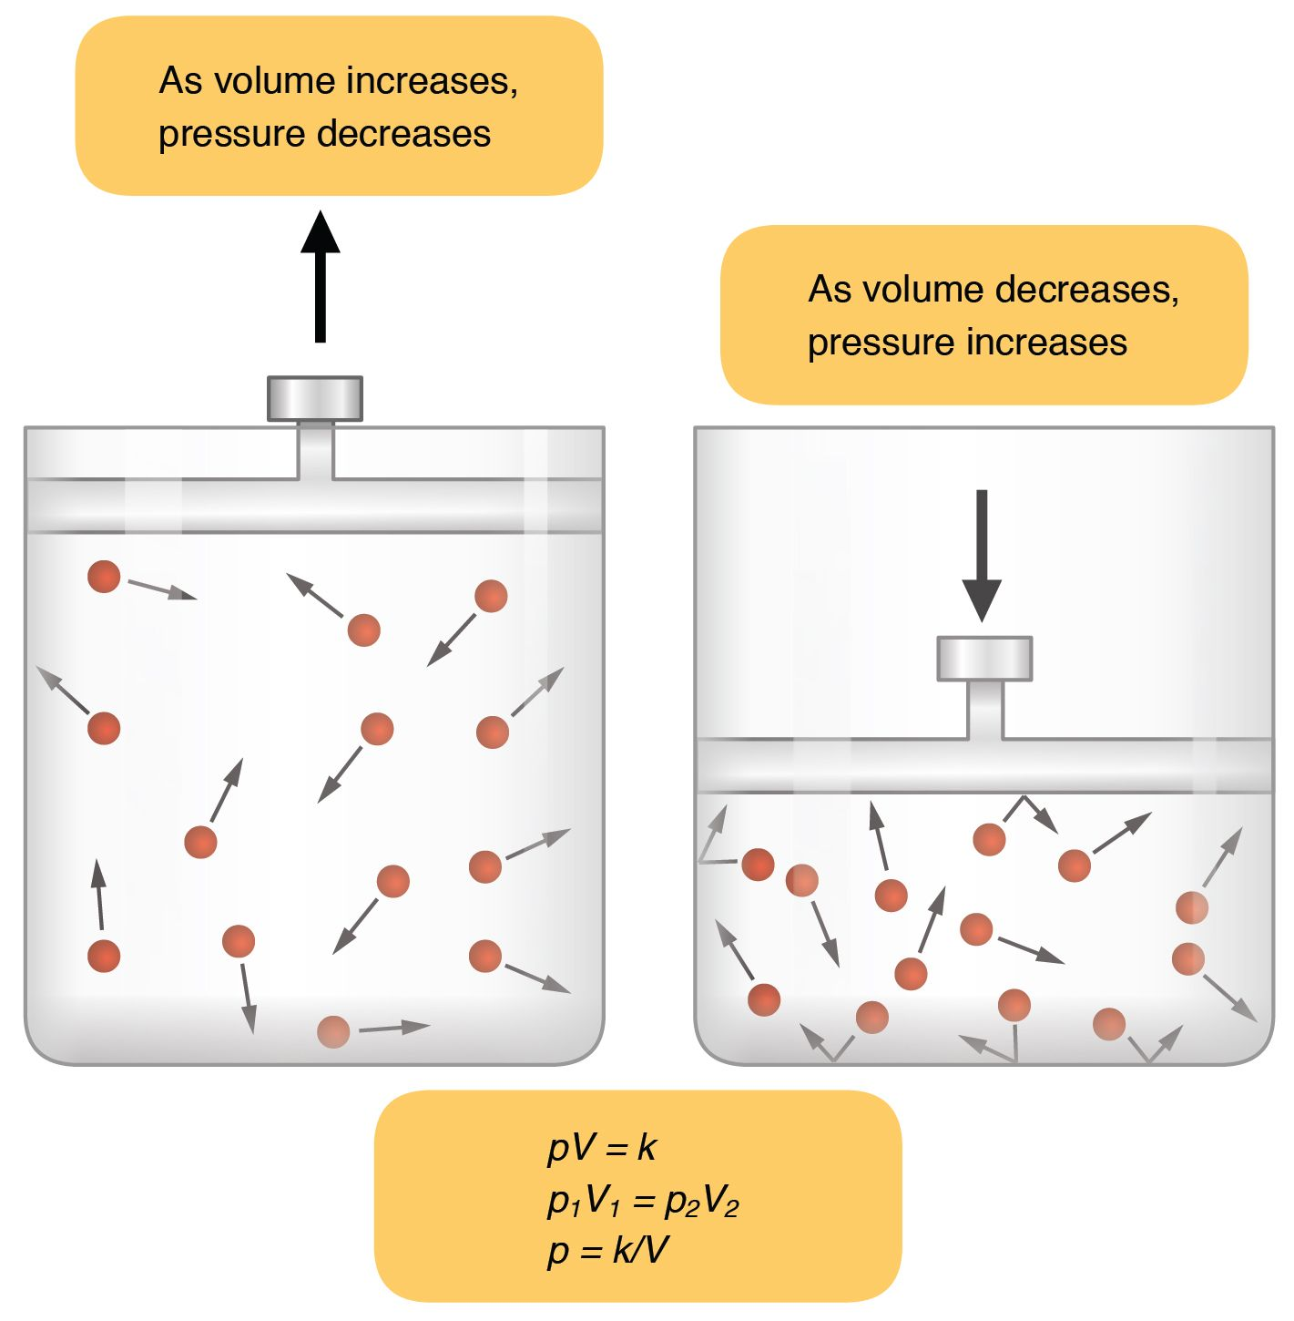
T/N: The graph of pressure against volume is inversely proportional.
20 kPa
10 kPa
8 m³
4 m³
Stretch: You can use the equation P x V = constant to show that they are inversely proportional. Do this for the graph above.

Slide 5
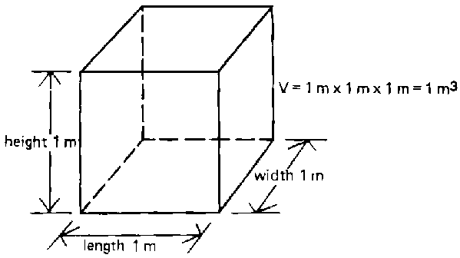
Conversion from cm³ to m³

Slide 6
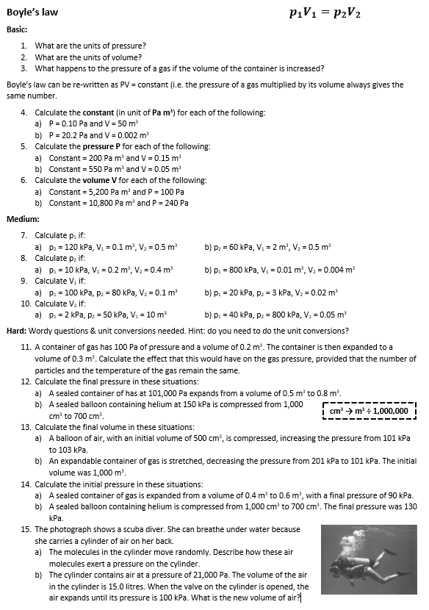
Worksheet
Complete the worksheet.

Slide 7

Basic answers
Pascal
metres cubed
It decreases
a) constant = P x V = 0.1 x 50 = 5 Pa m³
b) constant = P x V = 20.2 x 0.002 = 0.0404 Pa m³
5.a) P = constant ÷ V = 200 ÷ 0.15 = 1,333.3 Pa
b) P = constant ÷ V = 550 ÷ 0.05 = 11,000 Pa
6.a) V = constant ÷ P = 5,200 ÷ 100 = 52 m³
b) V = constant ÷ P = 10,800 ÷ 240 = 45 m³

Slide 8
Medium/Hard answers
7. a) 600 kPa b) 15 kPa
8. a) 5 kPa b) 2000 kPa
9. a) 0.08 m³ b) 0.003 m³
10. a) 0.4 m³ b) 0.0025 m³
11. 66.7 Pa
12. a) 63,125 Pa b) 214.2 kPa
13. a) 490.3 cm³ b) 502.5 cm³
14. a) 135 kPa b) 91 kPa
15. a) They collide with the walls of the cylinder. Each collision exerts a force and therefore a pressure. b) 3,150 litres

Slide 9
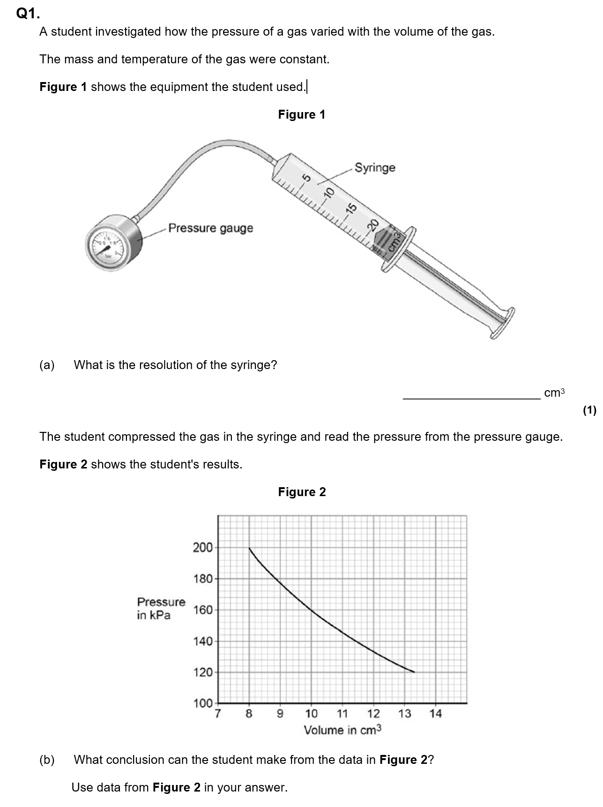
Struggle time!
Exam question so exam conditions!
You have 8 minutes!

Slide 10
Struggle time review

Slide 11
Pressure is inversely proportional to volume/PV = constant
Two calculations to prove this:
Eg. 200 × 8 = 1600 kPacm³
160 × 10 = 1600 kPacm³

Slide 12
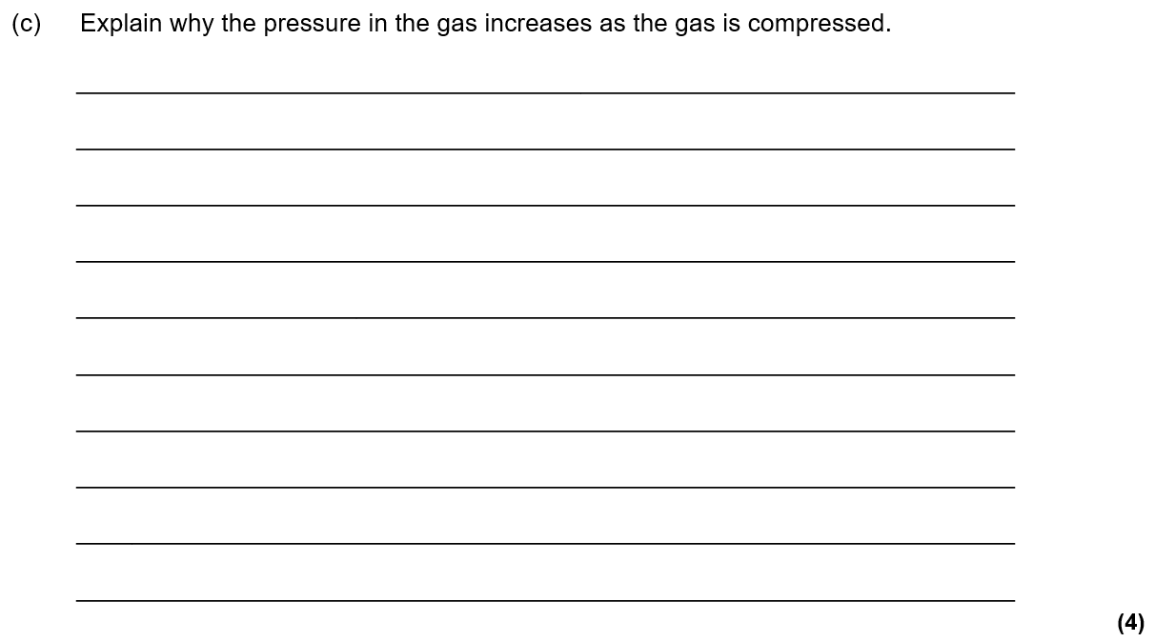
Compressed means volume of gas decreases [1]
So there are more frequent collisions of gas particles with container walls [1]
Each collision with the wall causes a force [1]
So there is a greater force on walls [1]

Slide 13
Plenary
In a chemistry experiment, 45 cm³ of a gas is collected in a syringe at a pressure of 160 kPa.
Calculate the volume of this amount of gas if its pressure changed to 200 kPa without changing its temperature.
If the gas in a. was then cooled without changing its volume, write and explain how its pressure would change.

