Slide 1
Changes of state
30/10/2020

Slide 2
Changes of state
Solid
Liquid
Gas
Particle
State
Energy
Inter-molecular
Recall the arrangement and motion of particles in solids, liquids and gases.
Describe the changes that occur when a solid melts to form a liquid, and when a liquid evaporates to form a gas.
Explain the temperature-time graph for a material changing state.

Slide 3
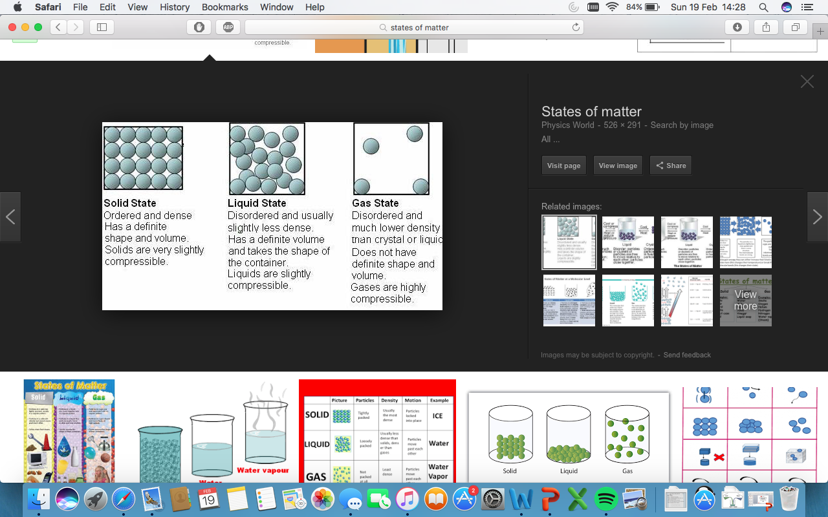
Questions:
Which state has the highest energy?
Which state of matter can be compressed?
Solids: Particles are tightly packed and vibrate in a fixed position.
Liquids: Not ordered (but still touching) and can flow.
Gases: Spread out and can move freely.
Stretch:
Explain the differences between the states of matter in terms of inter-molecular forces.

Slide 4
Melting
Evaporating
Which state changes require an input of energy?
Which state changes output energy to the surroundings?
Freezing
Condensing

Slide 5

Describe the particle arrangement of a liquid.

Slide 6
Which state of matter is compressible? Why?

Slide 7
Describe the particle arrangement of a gas.

Slide 8
What is the state change called when going from a gas to a liquid?

Slide 9
Describe the particle arrangement of a solid.

Slide 10
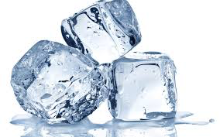
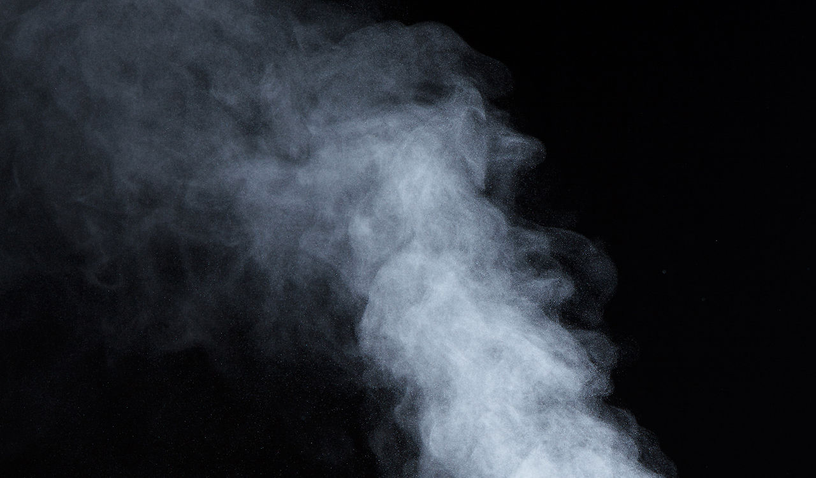

Describe what happens to the particle arrangement when going from ice → water vapour
Describe what happens to the particle arrangement when you going from water vapour → ice
Keywords
Solid, liquid, gas, evaporation, condensation, freezing, melting, energy
5 minutes
Stretch: Which state of matter is used in hydraulics? Why?

Slide 11
State change temperatures
Stretch: Why is the temperature of a material constant during a state change?
Where does the heating energy go?
Before a state change, energy raises the temperature of a material.
During a state change, the temperature stays constant.

Slide 12
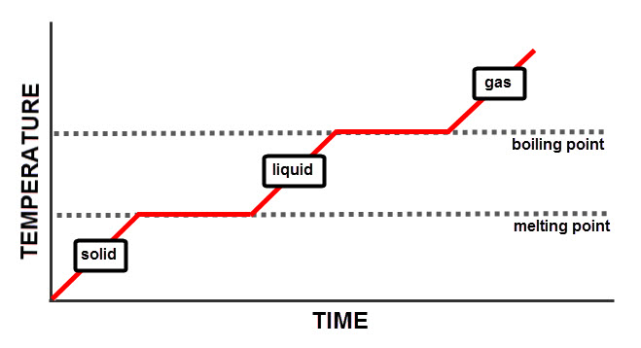

Slide 13
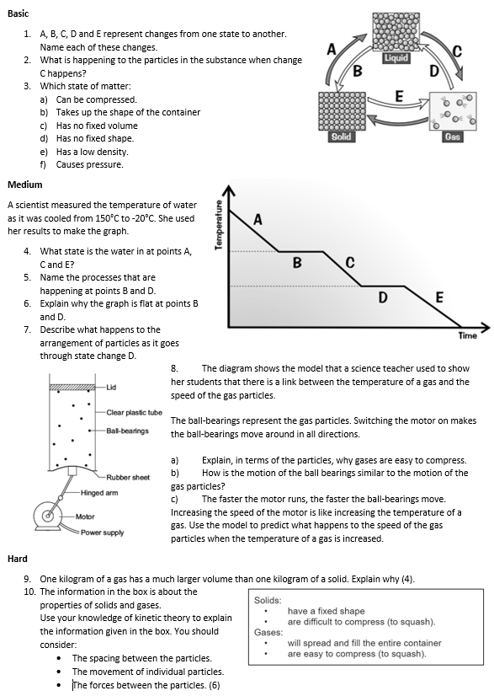
Task
Complete the worksheet

Slide 14

Basic/Medium answers
A – Melting, B – Freezing, C – Evaporation, D – Condensation
E – Sublimation.
The bonds are breaking, particles moving more quickly & eventually separating from each other to form a gas.
a) Gas, b) Liquid, c) Gas, d) Gas/Liquid, e) Gas, f) Gas.
A – Gas, C – Liquid, E – Solid
B – Condensation, D – Freezing.
Energy is going into making bonds (instead of changing temperature).
Bonds of particles are strengthening, larger inter-molecular forces & particles arranging in a fixed pattern (vibrating around their fixed positions).

Slide 15
Medium/Hard answers
8. a) Particles are very far apart, large spaces in between them.
b) Moving at a range of different speeds & moving in different directions.
c) It increases.
9. In gas, particles are further apart (much less dense) moving in random directions
In solid, particles are much closer together (much more dense) and in a regular arrangement
Particles themselves are the same size for the same material
The same mass has the same number of particles for the same material.
Thus gas requires a much larger volume.

Slide 16
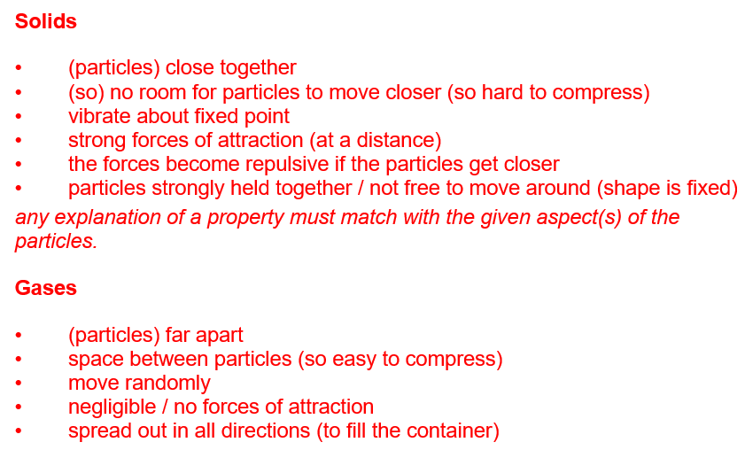
Hard answers

Slide 17
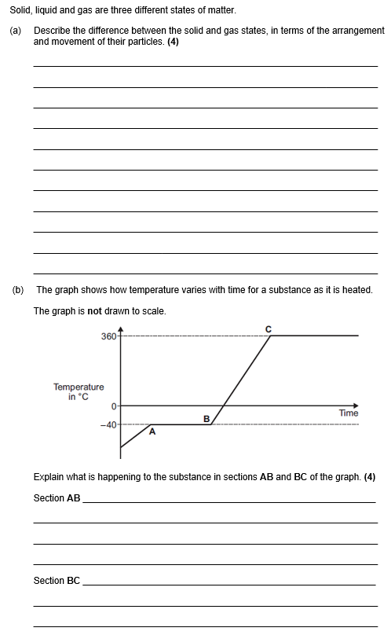
Struggle time!
Exam question so exam conditions!
You have 6 minutes.

Slide 18
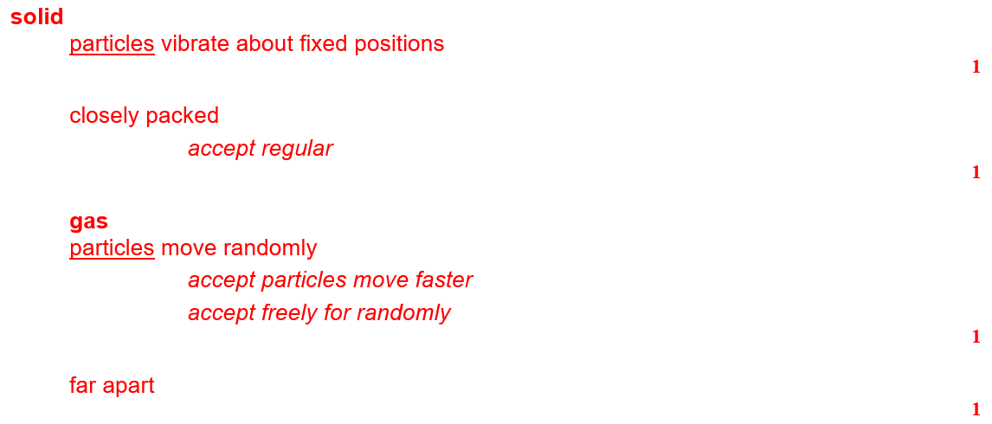
Self correct answers

Slide 19
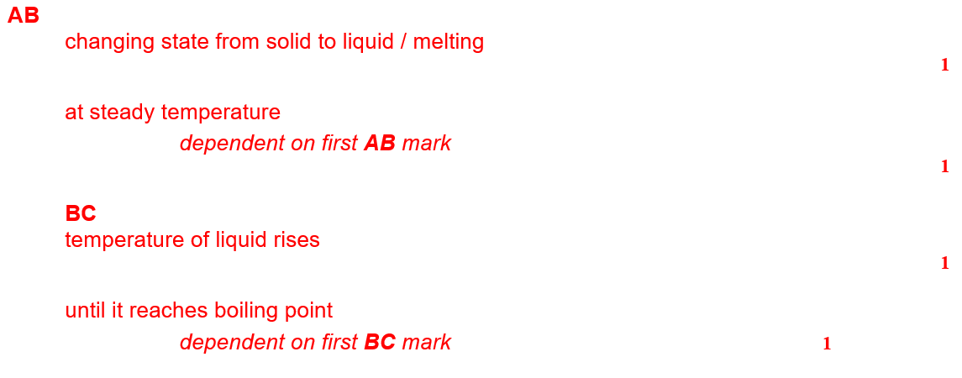
Self correct answers

