Slide 1
Cooling curve practical
30/10/2020
Sketch a diagram of a solid, liquid and gas.
Describe the particle arrangement of a solid.

Slide 2
Solid
Liquid
Gas
Particle
State
Energy
Inter-molecular
Describe an experiment to measure the temperature of a material over time.
Obtain a temperature-time graph to show the constant temperature during a change of state.
Obtain the melting point of stearic acid.

Slide 3
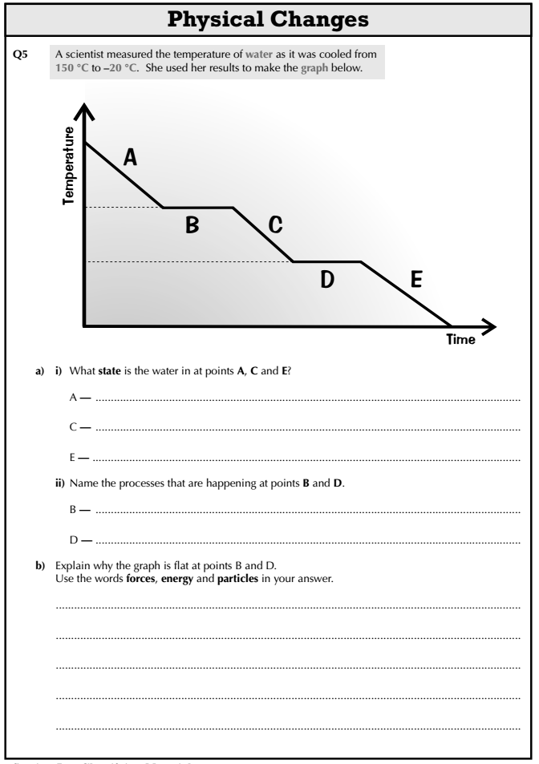

Slide 4
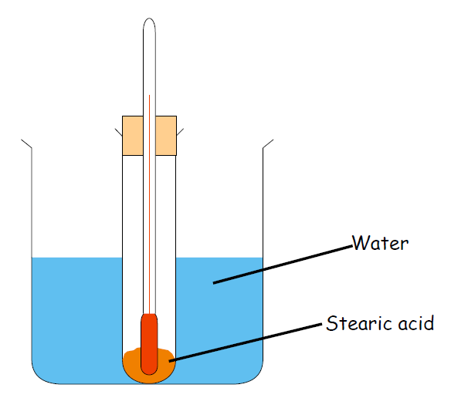
Aim of practical
AIM:
To heat and melt stearic acid, and then to obtain a cooling curve as it cools down.
Stretch: What are the possible dangers of this practical?
What will we do to minimise the risk of these dangers happening?

Slide 5
Time (mins) | Temperature (°C)
0
1
2
3
4
5
6
7
8
Stretch: How many seconds are there in a minute?
How many seconds are there in 5 minutes?
How many seconds are there in 1 hour?

Slide 6
Cooling of stearic acid
Put a boiling tube with 3cm³ of Stearic Acid into a beaker half full of water.
Heat this on a Bunsen burner until the stearic acid has melted.
Turn the Bunsen burner off and put thermometer into stearic acid.
Use the tongs to put boiling tube into rack.
Record the temperature immediately and then after every 1 minute until the stearic acid has been a solid again for 2 minutes.

Slide 7

Graph
Time (mins) | Temperature (°C)
0 | 80
1 | 75
2 | 70
3 | 70
4 | 70
5 | 70
6 | 65
7 | 60
8 | 55
Temperature (˚C)
0 10 20 30 40 50 60 70 80 90 100
Don’t draw a line of best fit.
0 1 2 3 4 5 6 7 8
Time (mins)

Slide 8
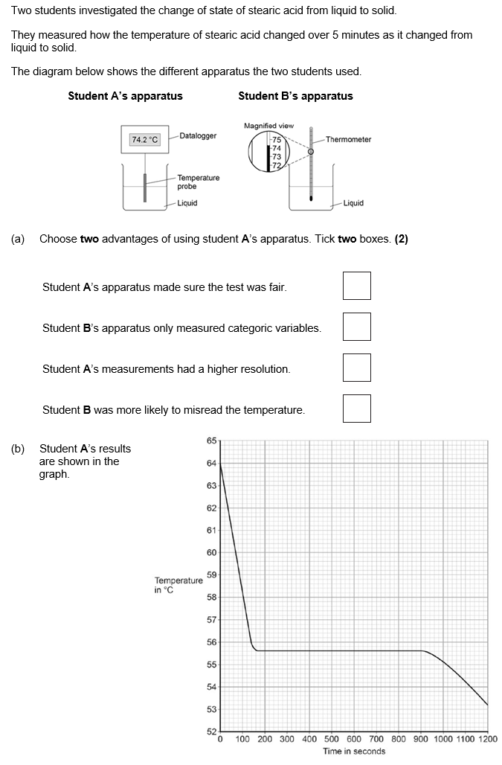
Struggle time!
Exam question so exam conditions!
You have 6 minutes!

