Slide 1
Efficiency
What energy store do the following have:
Battery b) Stretched rubber band
c) A uranium nucleus

Slide 2
Efficiency
Energy
Power
Joules
Watts
Percentage
Recall what efficiency is.
Recall the equation for efficiency.
Calculate efficiencies of various devices.

Slide 3
System
The more energy something wastes, the less efficient it is.
Energy is dissipated to the thermal energy store of the surroundings.
Stretch: Name three different ways transferring energy.

Slide 4
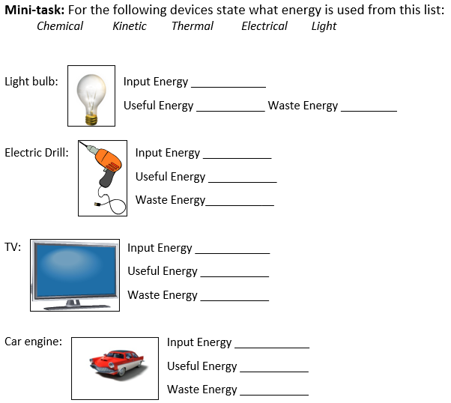
Complete the task!

Slide 5
Efficiency is a measure of how good a device is at changing energy from one form to another. Efficiency can be calculated using the formula:
Efficiency = Useful energy out x 100%
Total energy in
Stretch: A car uses a total of 2,000 J of chemical energy and turns it into 1,500 J of useful kinetic energy. What is its efficiency?
Note: You can also see this equation as
Efficiency = Useful power out x 100%
Total power in

Slide 6
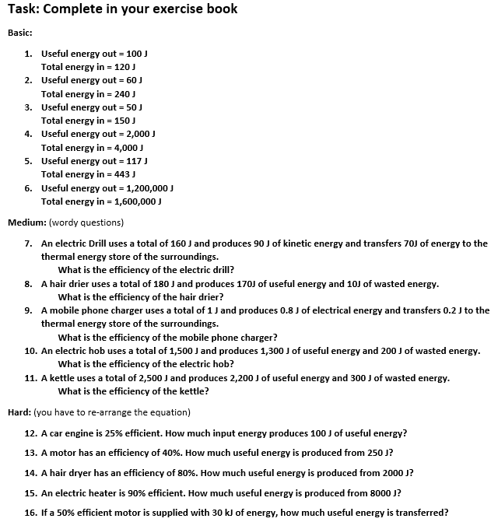
Worksheet
Complete the worksheet

Slide 7

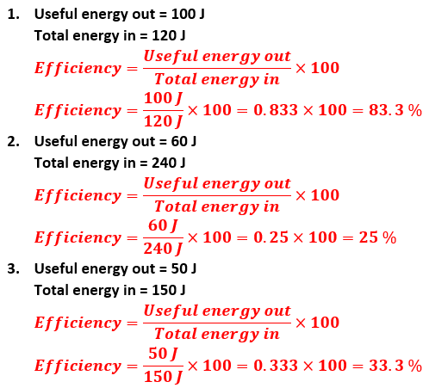
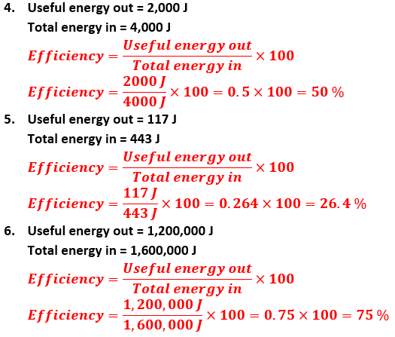
Basic answers

Slide 8
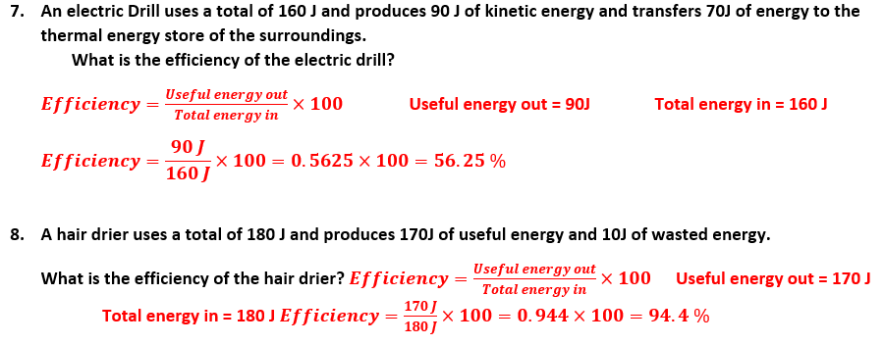
Medium answers

Slide 9
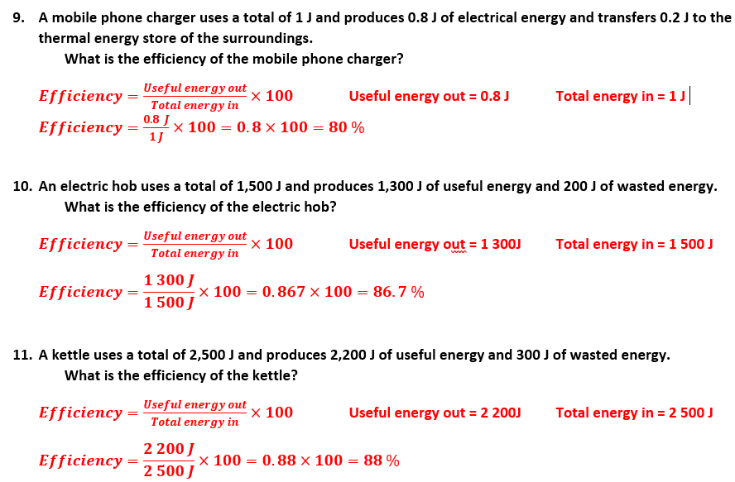
Medium answers

Slide 10
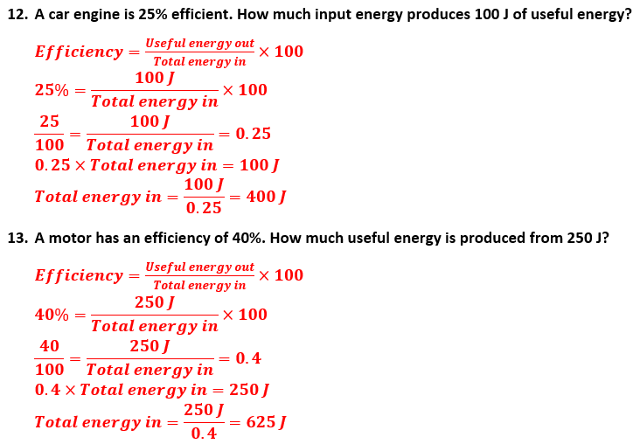
Hard answers

Slide 11
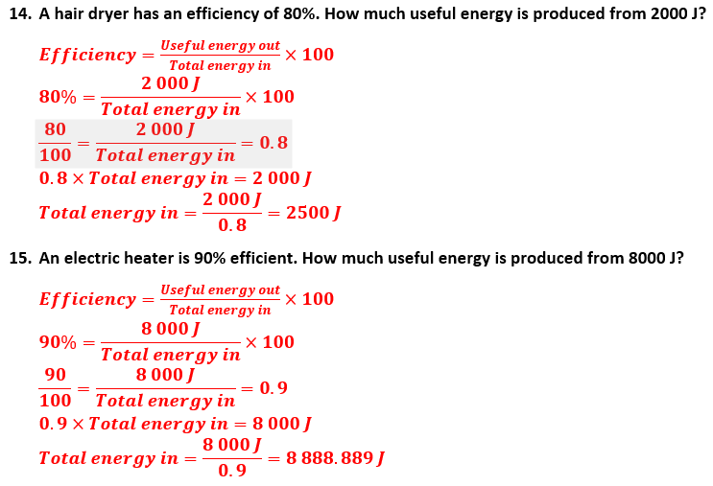
Hard answers

Slide 12
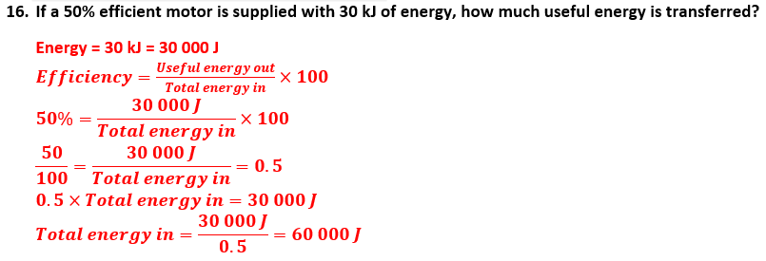
Hard answers

Slide 13
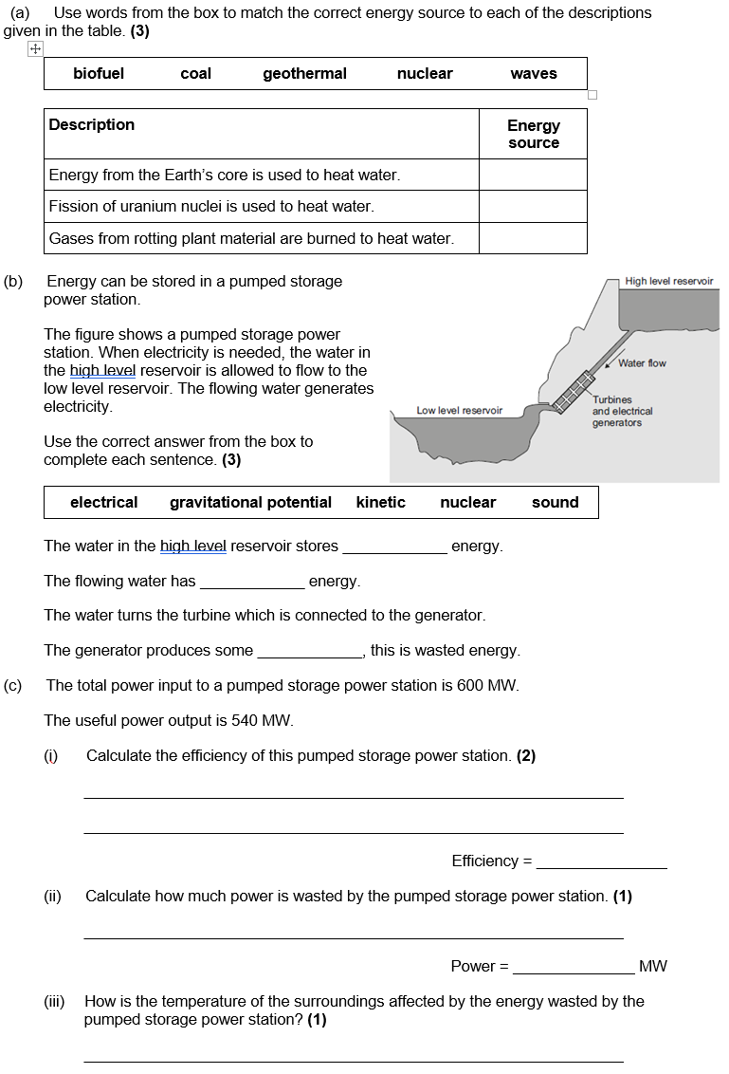
Struggle time
Exam question so exam conditions!
You have 8 minutes.

Slide 14
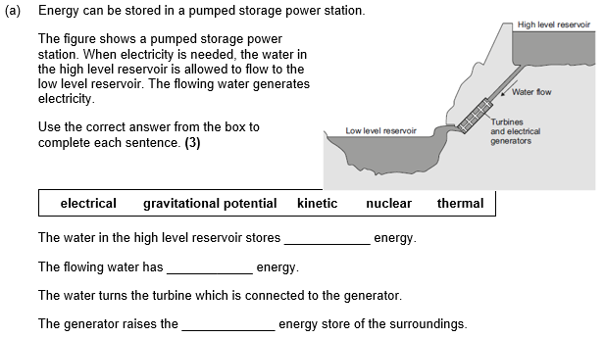

Slide 15
