Slide 1
Energy stores

Slide 2
Energy
Store
Transfer
Joule
Recall the different energy stores.
Recall common energy transfers.
Draw energy flow diagrams to show energy transfers.

Slide 3
Potential energies
gravitational potential – objects above the ground
elastic potential – objects that are stretched or squashed
magnetic – magnets
electrostatic – due to electric charges repelling or attracting
Stretch: Give an example of an object storing elastic potential energy.

Slide 4
chemical – fuels, food, batteries
kinetic – moving objects
nuclear – when nuclei inside atoms join or separate
thermal energy – due to temperature
Stretch: Describe the energy transfers that occur as a battery powered remote control car starts moving, then goes up a hill & comes to a stop.

Slide 5
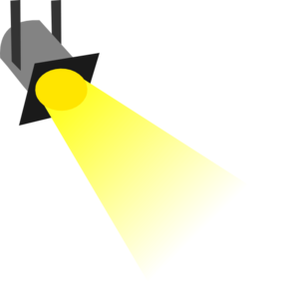








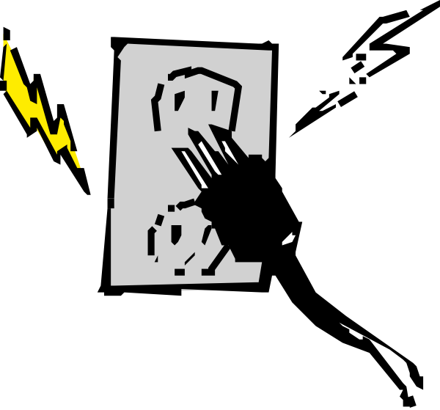

ENERGY STORES
TASK – Identify the energy stores in the pictures below. Be careful, not all are stores.
2 minutes

Slide 6
Energy transfers: mechanically, electrically, by heating, by radiation (light and sound)
Stretch
TASK – Create a flow diagram to show the energy transfers when an electric kettle is used to boil water.
You can show the energy transfers by using a flow diagram.

Slide 7
Energy transfers
10 minutes
INDEPENDENT WORK
TASK 1 – Create flow diagrams to show the energy transfers taking place when:
a ball falls in air
an electric heater is switched on
a car is accelerated by the thrust from its petrol engine
a stone is thrown upwards
a car hits a wall
TASK 2 – List two different objects you could use to light a room if you have a power cut. Then, for each object, create a flow diagram to show the energy transfers that occur when it lights up the room.

Slide 8
Joules
2 minutes
Energy is measured in joules (J).
INDEPENDENT WORK
TASK – Look carefully at the amount of joules
needed for each of the following actions:
Picking an apple up – 2 J needed
Light bulb in a room for one hour – 3,000 J
Heating water for a cup of tea – 180,000 J
Calculate the amount of apples you can pick up if you eat a Mars bar with 180 000 J.
Calculate the amount of cups of tea you can make with 720,000 J worth of energy.
Calculate the number of hours you can light your light bulb if you have 21,000 J of energy.

Slide 9
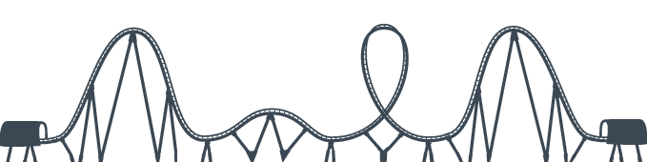
Plenary
TASK – When a roller coaster gets to the bottom of a descent, describe the energy transfers and changes to energy stored that happen if:
the breaks are applied to stop it
it goes up and over a second hill

