Slide 1
Energy stores and systems
What energy store do the following have:
Petrol b) A book on a high shelf
c) A moving car

Slide 2
Energy
Store
Transfer
Joule
Conservation
Recall the what a system is.
Recall the principle of conservation of energy
Recall what wasted energy is.

Slide 3
System
A system is an object or a group of objects.
When a system changes, the energy stored in that system changes as well, as it is transferred from one store to another.
Stretch: Name three different ways transferring energy.

Slide 4
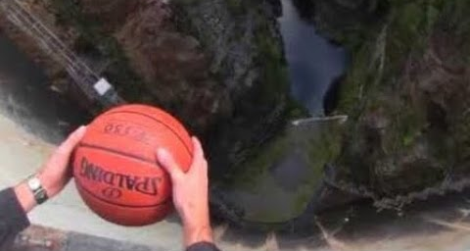
The principle of conservation of energy says that energy cannot be created or destroyed. It can only be transferred from one store to another.
Stretch: A ball is dropped from a height. The energy is transferred from the________________ store to the ______________ store.

Slide 5
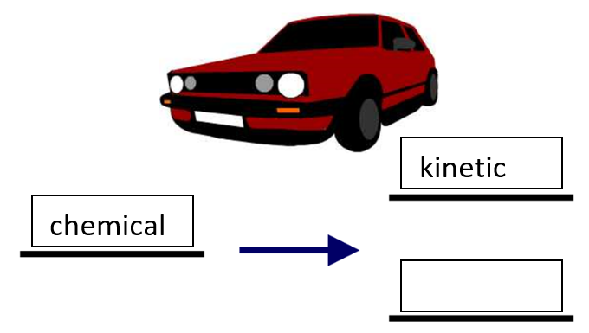
Energy that is transferred to unwanted forms of energy is wasted.
Stretch: Wasted energy is transferred to which store of energy?

Slide 6
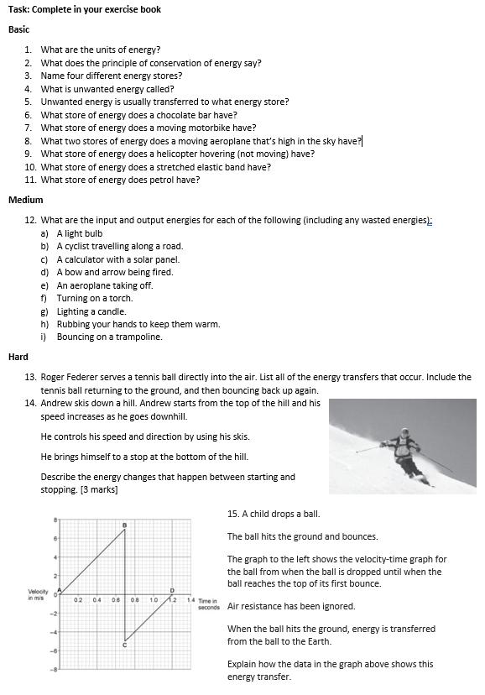
Worksheet
Complete the worksheet

Slide 7

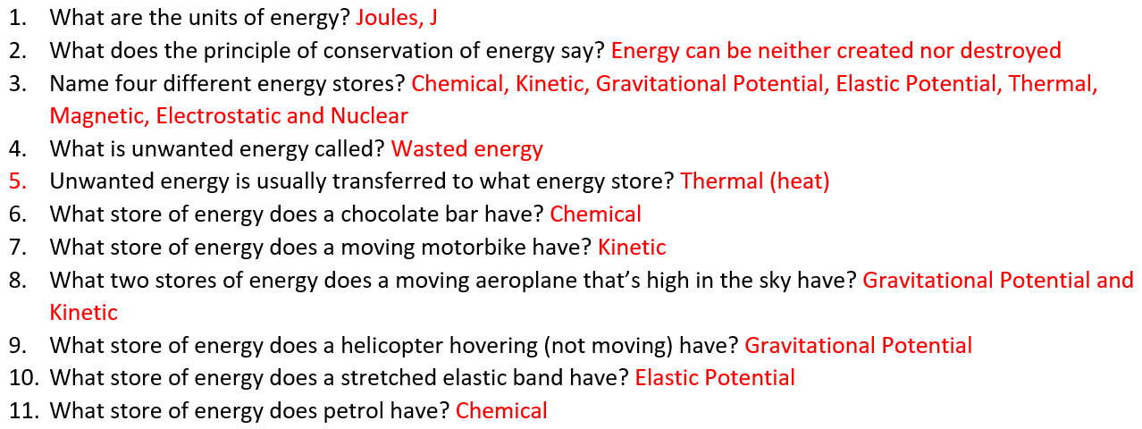
Basic answers

Slide 8
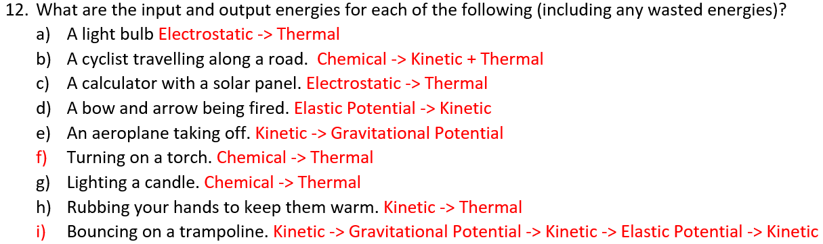
Medium answers

Slide 9
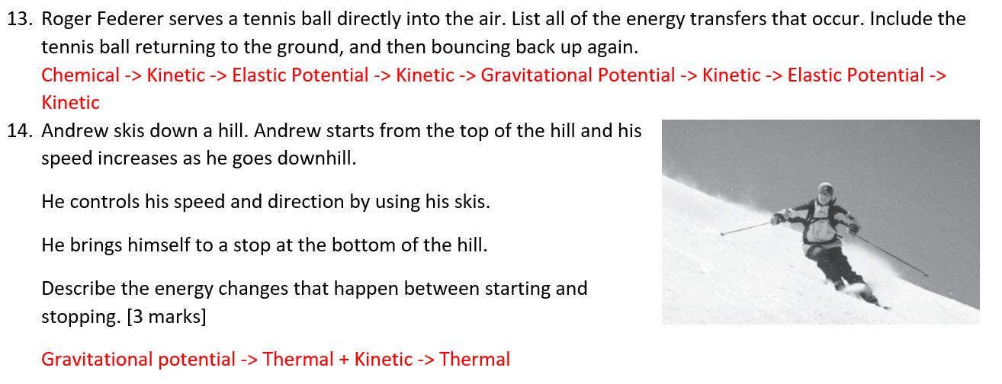
Hard answers

Slide 10
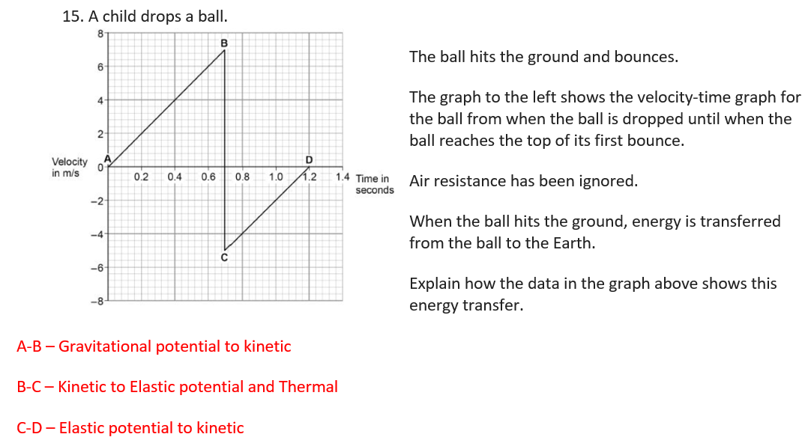
Hard answers

Slide 11
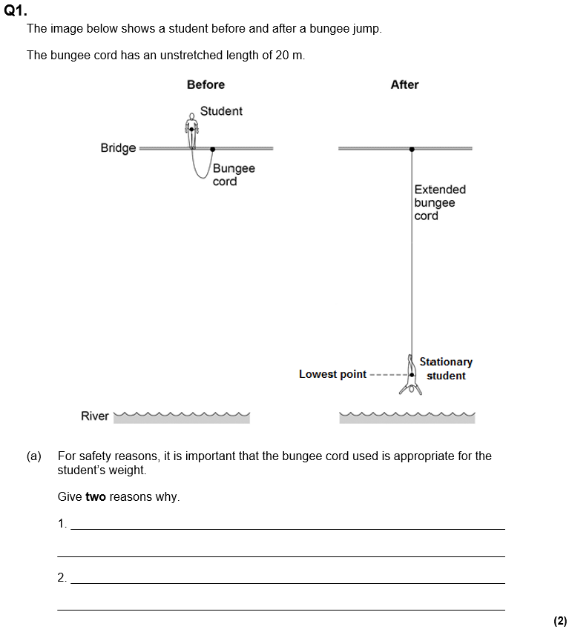
Struggle time
Exam question so exam conditions!
You have 5 minutes.

Slide 13
