Slide 1
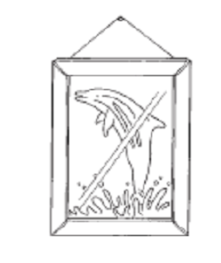
GPE – KE conversions
What is the equation for gravitational potential energy?
If an object is dropped from a height the gravitational store converts into what store?

Slide 2
Gravitational
Potential
Energy
Height
Metres
Joules
Mass
State energy transfers that occur for a falling objects
Recall the principle of conservation of energy.
Calculate final velocities from drop heights.

Slide 3
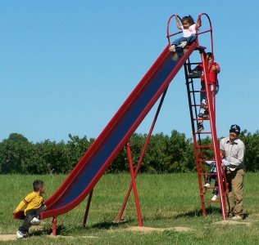
Energy conversions
An object at height initially has gravitational potential energy. If it falls, this energy is converted into kinetic energy. As the book reaches the ground its final KE will be equal to its initial GPE.
Stretch: Kris is at the top of a 5 m high slide. Assuming that all of her GPE is converted to KE, what will be her maximum speed when she reaches the bottom? Kris has a mass of 55 kg.

Slide 4
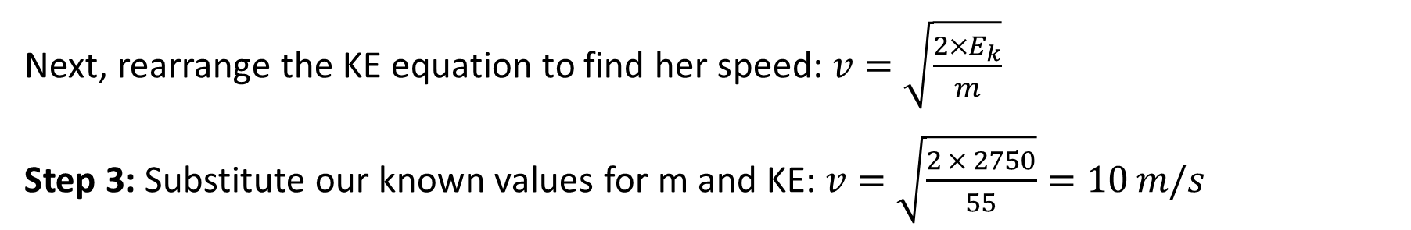

Worked example 1
Worked example 1: Kris is at the top of a 5 m high slide. Assuming that all of her GPE is converted to KE, what will be her maximum speed when she reaches the bottom? Kris has a mass of 55 kg.
Step 1: Calculate Kris’s GPE at the top of the slide:
$$E_{p}=m×g×h=55 × 10 × 5=2750 J$$
Step 2: As Kris slides down, her GPE is converted to KE. At the bottom of the slide, all her GPE will have been converted to KE, i.e. her KE equals 2750 J.
Next, rearrange the KE equation to find her speed: $v=\sqrt{\frac{{2×E}_{k}}{m}}$
Step 3: Substitute our known values for m and KE: $v=\sqrt{\frac{2 × 2750}{55}}=10 m/s$

Slide 5
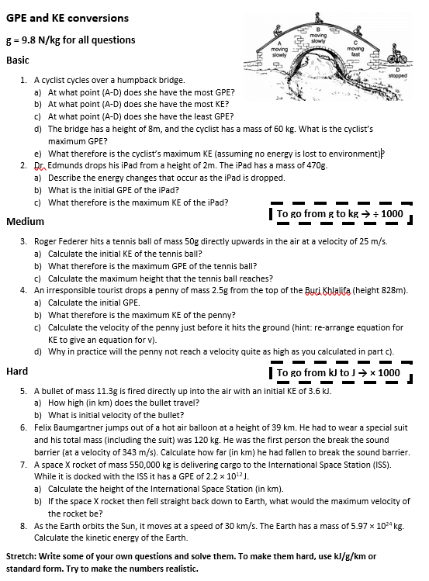
Worksheet
Complete the worksheet!

Slide 6

Basic/medium answers
a) B b) C c) D
d) E_{p} = m × g × h = 60 × 9.8 × 8 = 4704 J
e) 4704 J
2. a) Starts with maximum KE. This reduces as the iPad falls and turns into KE. The iPad has max KE and min GPE just before it hits the floor.
b) E_{p} = m × g × h = 0.47 × 9.8 × 2 = 9.2 J
c) 9.2 J
3. a) E_{k} = 0.5 × m × v² = 0.5 × 0.005 × 25² = 15.6 J
b) 15.6 J
c) E_{p} = m × g × h
15.6 = 0.05 × 9.8 × h → h = 31.8 m
4. a) E_{p} = m × g × h = 0.0025 × 9.8 × 828 = 20.3 J
b) 20.3 J
c) E_{k} = 0.5 × m × v² → 20.3 = 0.5 × 0.0025 × v²
v = √16240 = 127.4 m/s

Slide 7
Hard answers
5. a) E_{p} = m × g × h → 3600 = 0.0113 × 9.8 × h
→ h = 32,500 m = 32.5 km
b) E_{k} = 0.5 × m × v² → 3600 = 0.5 × 0.0113 × v²
v = √637168 = 798 m/s
6. E_{k} = 0.5 × m × v² = 0.5 × 120 × 343² = 7,058,940 J
E_{p} = m × g × h → 7,058,940 = 120 × 9.8 × h
h = 6002.5 m = 6 km
7. a) E_{p} = m × g × h → 2.2 × 10¹² = 550,000 × 9.8 × h
→ h = 408,163 m = 408 km
b) E_{k} = 0.5 × m × v² → 2.2 × 10¹² = 0.5 × 550,000 × v²
→ v = √8,000,000 = 2830 m/s
8. E_{k} = 0.5 × m × v² = 0.5 × 5.97 × 10²⁴ × (30,000)² = 2.69 × 10³³ J

Slide 8
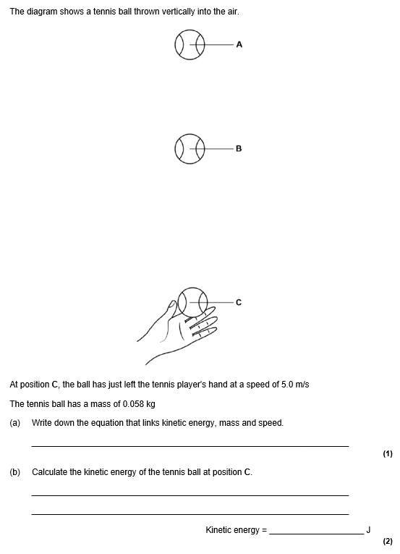
Struggle time
Exam questions so exam conditions!
You have 8 minutes.

Slide 9
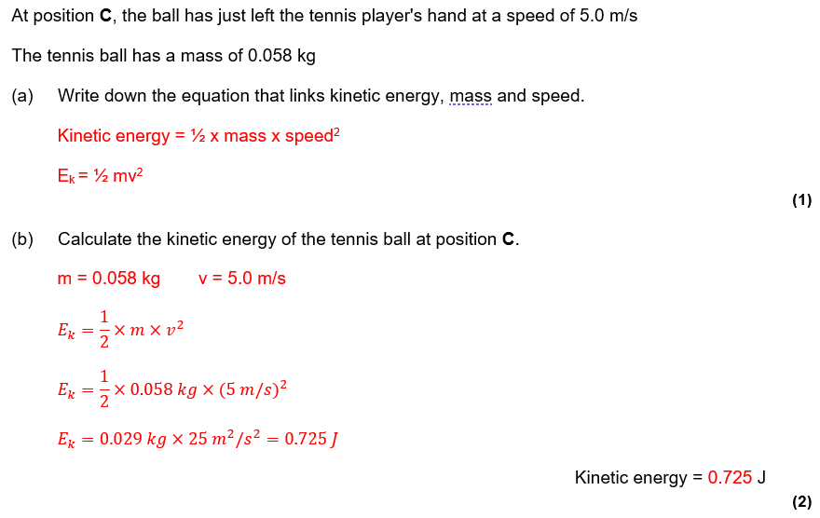
Struggle time review

Slide 10
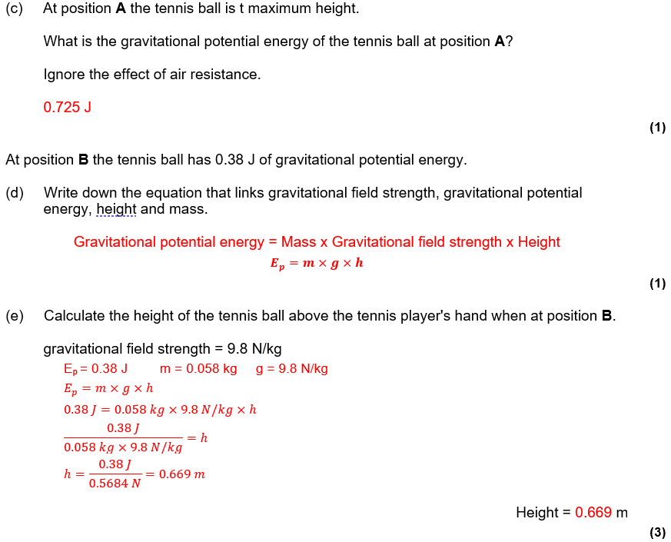
Struggle time review

