Slide 1
Gravitational potential energy
What type of objects store kinetic energy?
A moving van has a kinetic energy of 800,000 and a velocity of 20 m/s. What is the mass of the van?

Slide 2
Gravitational
Potential
Energy
Height
Metres
Joules
Mass
State the types of object that have gravitational potential energy.
Recall the equation for GPE.
Calculate gravitational potential energies using the equation.

Slide 3
Gravitational field strength
The greater the height on an object above the ground, the greater the GPE it will have. The stronger the gravitational field strength, again the greater the GPE. On Earth, the gravitational field strength is 9.8 N/kg.
Stretch: What would happen to the gravitational field strength the further away we went from Earth?

Slide 4
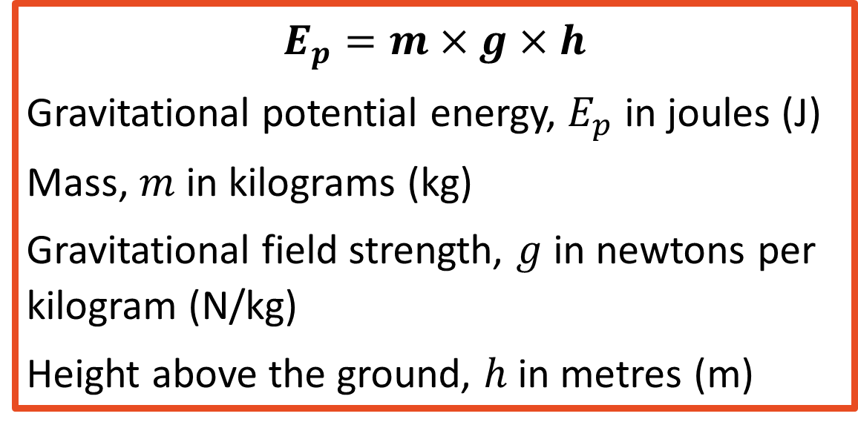
Equation for gravitational potential energy
$$E_{p}=m×g×h$$
Gravitational potential energy, $E_{p}$ in joules (J)
Mass, $m$ in kilograms (kg)
Gravitational field strength, $g$ in newtons per kilogram (N/kg)
Height above the ground, $h$in metres (m)
Stretch: Rearrange the equation to give equations for mass, gravitational field strength and height.

Slide 5

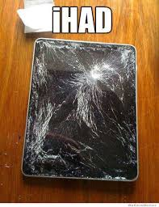
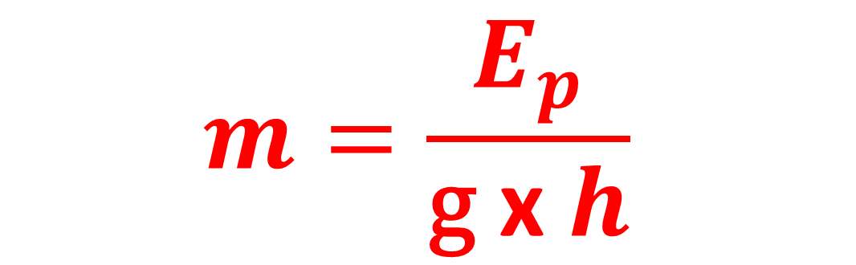

Rearranged equations
Stretch: Dr. Edmunds drops his iPad from a height of 2m. If the initial GPE is 3.92 J, what is mass of the iPad?
$$m=\frac{E_{p}}{\text{g} \text{x} h}$$
h $=\frac{E_{p}}{\text{m} \text{x} g}$

Slide 6
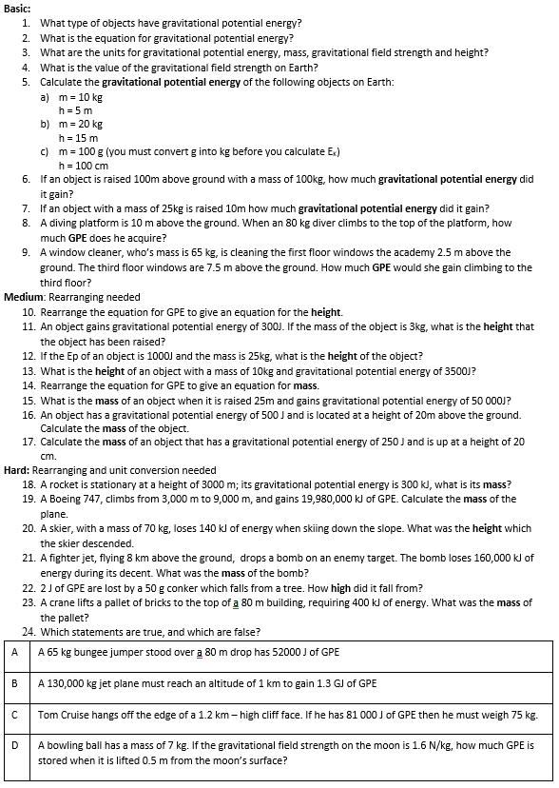
Worksheet
Complete the worksheet!

Slide 7
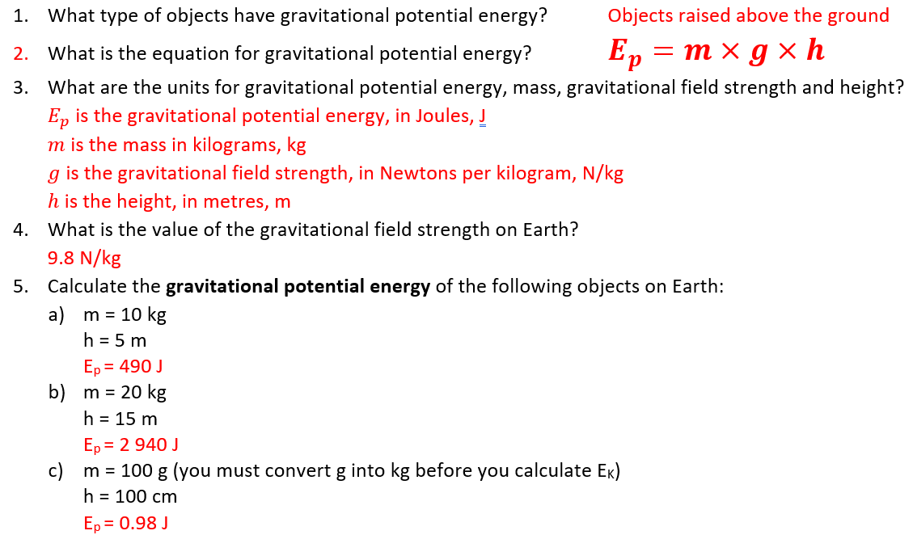

Basic answers

Slide 8
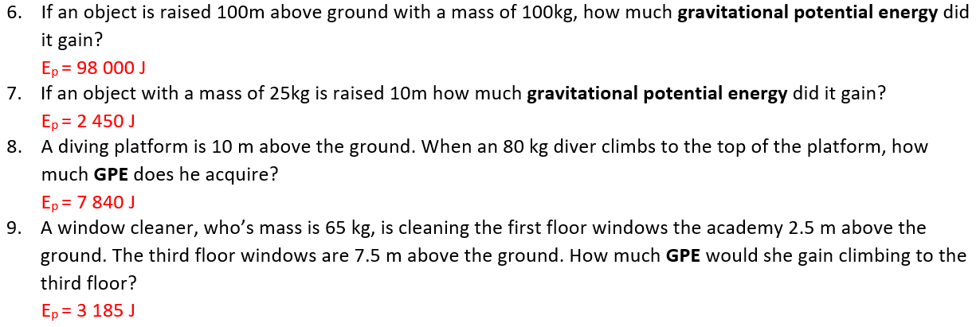
Basic answers

Slide 9
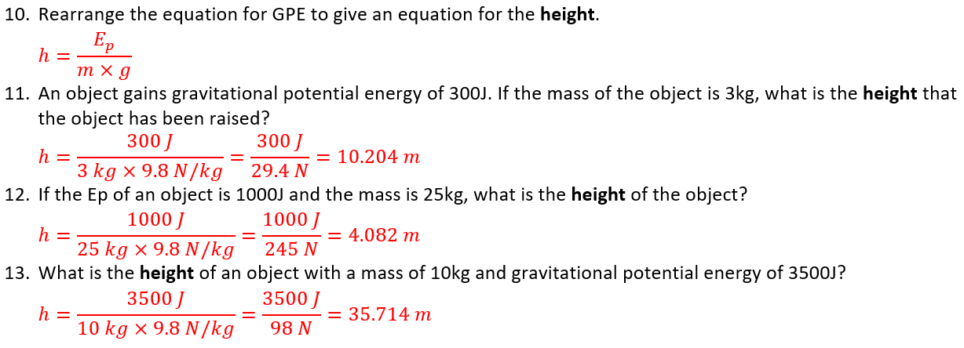
Medium answers

Slide 10
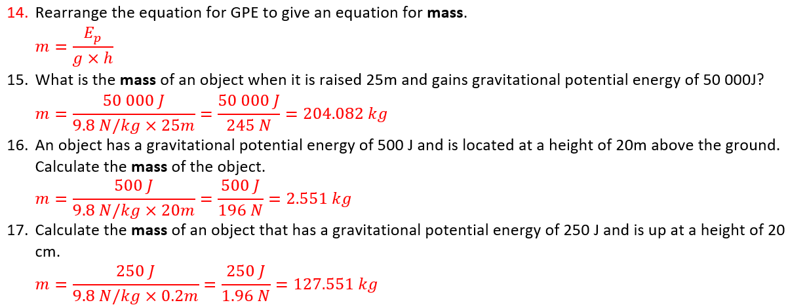
Medium answers

Slide 11
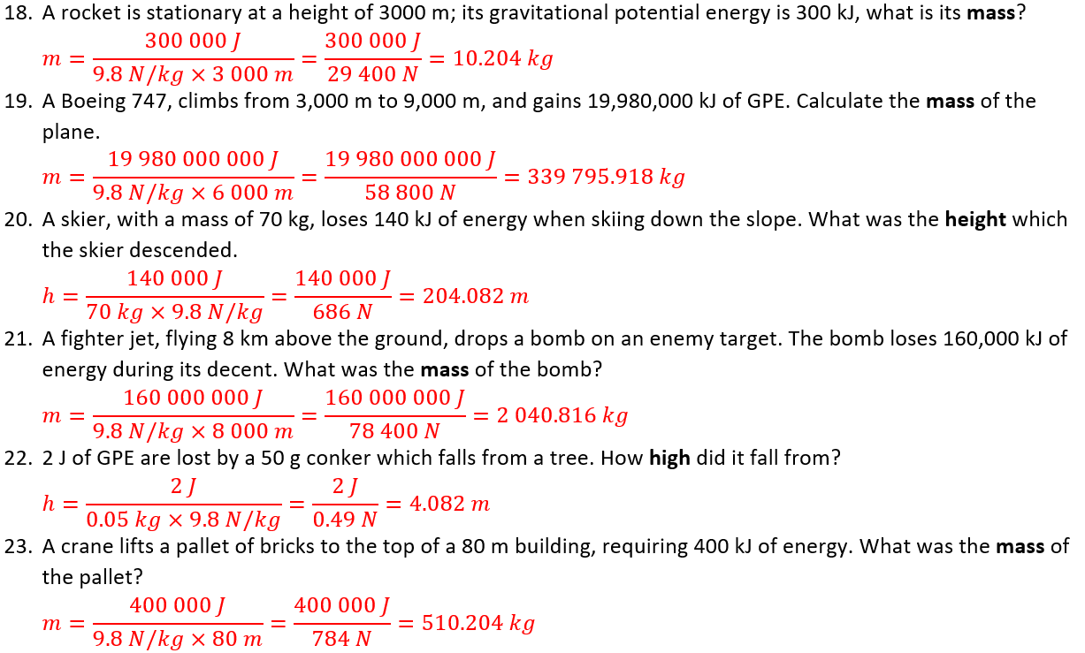
Hard answers

Slide 12
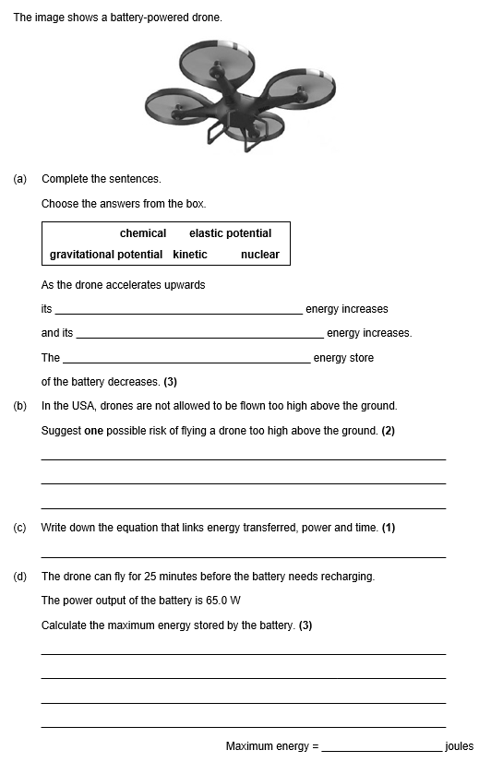
Struggle time
Exam questions so exam conditions!
You have 8 minutes.

Slide 13
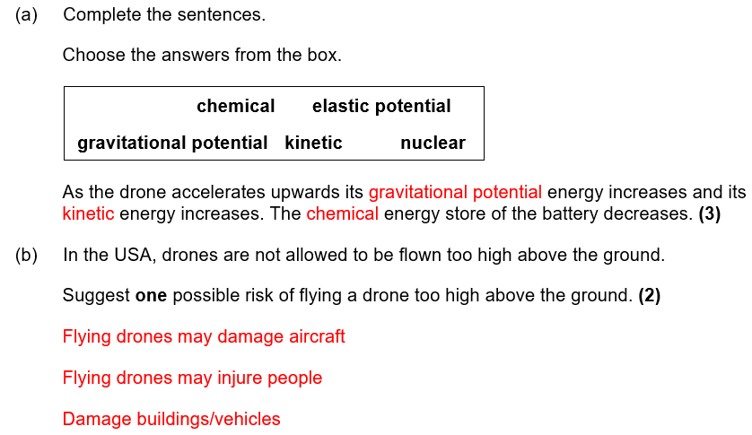
Struggle time review

Slide 14
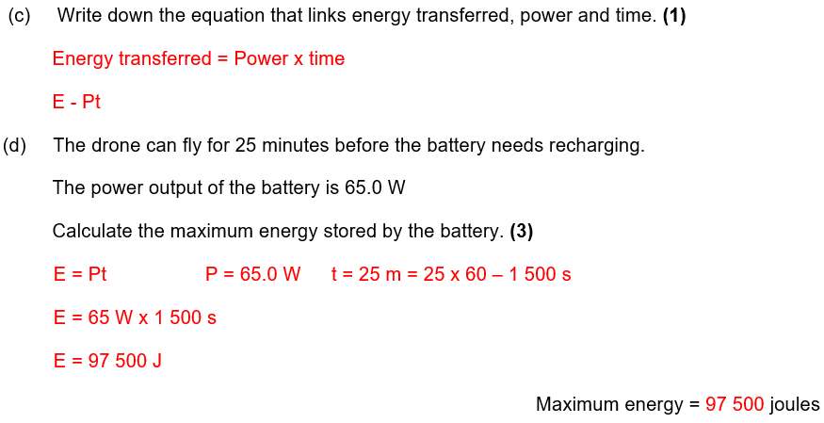
Struggle time review

