Slide 1
Kelvin scale & pressure law
30/10/2020

Slide 2
Kelvin scale & pressure law
Pressure
Pascal
Temperature
Kelvin
Absolute Zero
Describe an experiment to measure the lowest possible temperature
Recall how to convert between degrees Celsius and Kelvin.
Calculate what will happen to the pressure of gases at different temperatures.

Slide 3
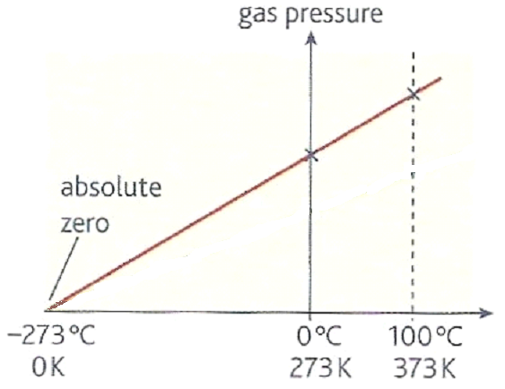
Pressure against °C temperature graph
The straight line crosses the temperature axis at absolute zero
(-273°C)

Slide 4
Absolute zero
As temperature decreases the average speed at which molecules move decreases.
Eventually at a temperature called absolute zero all molecules will cease moving.
Stretch: Describe the experiment we could do to measure absolute zero.

Slide 5
This kelvin scale starts from absolute zero:
0 kelvin (0 K) = - 273 °C
A change of one kelvin is the same as
a change of one °C.
kelvin temperature = °C temperature + 273
Task: Calculate the temperatures missing from the table below:
Situation | Celsius (ºC) | Absolute (K)
Intergalactic space | - 270 | 3
Vostok Antarctica 1983 | - 89 | 184
Average Earth Surface | 15 | 288
Gas flame | 1500 | 1773
Sun’s surface | 5727 | 6000

Slide 6
Mathematically the pressure law can be stated:
p₁ = p₂
T₁ T₂
Where:
p = pressure (in Pa)
T = temperature (in Kelvin)
Stretch: A gas has an initial pressure of 40kPa at a temperature of - 73ºC. Calculate the final pressure of this gas if its temperature is increased to 327ºC at a constant volume.

Slide 7
Pressure law question
A gas has an initial pressure of 40kPa at a temperature of - 73ºC. Calculate the final pressure of this gas if its temperature is increased to 327ºC at a constant volume.
Pressure law: p₁ / T₁ = p₂ / T₂
Temperatures must be in kelvin!
so: T₁ = 200K and T₂ = 600K
40 kPa / 200K = p₂ / 600K
p₂ = (40 000 x 600) / 200
Final pressure = 120 kPa

Slide 8
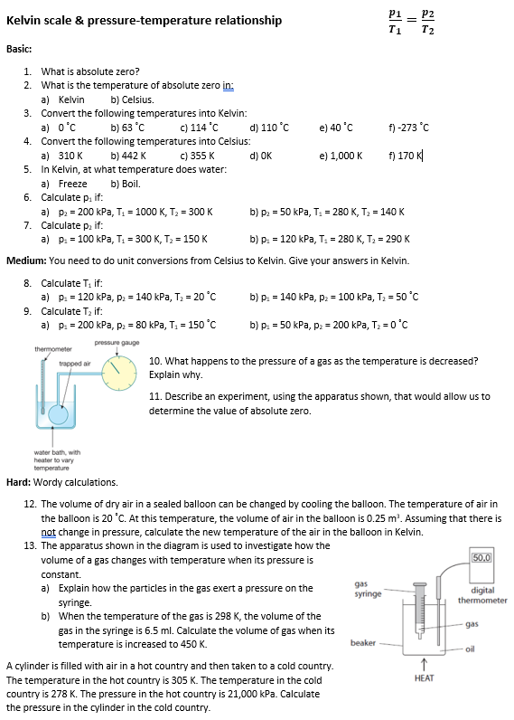
Worksheet
Complete the worksheet.

Slide 9

Basic answers
Temperature at which there is no pressure/particles are not moving
a) 0 K b) -273 °C
a) 273 K b) 336 K c) 387 K
d) 383 K e) 313 K f) 0 K
4. a) 37 °C b) 169 °C c) 82 °C
d) -273 °C e) 727 °C f) -103 °C
5. a) 273 K b) 373 K
6. a) 666.7 kPa b) 100 kPa
7. a) 50 kPa b) 124.3 kPa

Slide 10
Medium answers
8. a) 251.1 K b) 452.2 K
9. a) 169.2 K b) 1092 K
10. The pressure decreases. The particles are travelling less quickly and so collide with the walls of the container less often.
11. Vary the temperature of the water bath & measure the pressure of air trapped in a container. Extrapolate linear relationship to zero pressure. This is the temperature of absolute zero.

Slide 11
Hard answers
12. a) Particles are moving in random directions. When they collide with the walls the particles exert a force. This force causes a pressure.
b) 9.8 ml
13. 19,140 kPa

Slide 12
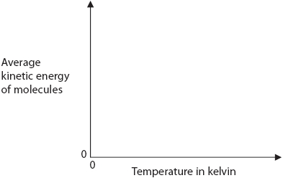
Kinetic energy
The Kelvin temperature of a gas is proportional to the average kinetic energy of its molecules.
Stretch: Sketch a graph of average kinetic energy of molecules vs temperature in Kelvin.

Slide 13
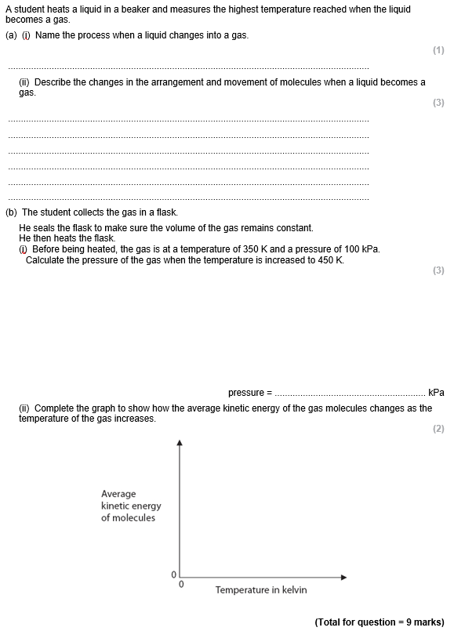
Struggle time!
Exam question so exam conditions!
You have 6 minutes!

Slide 14
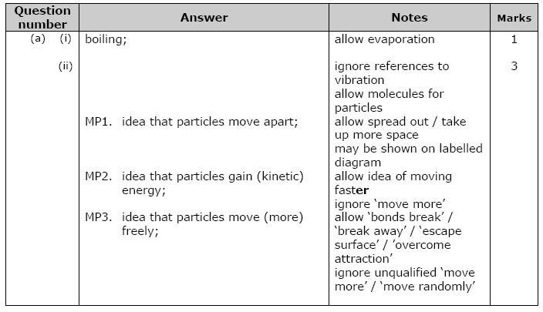
Struggle time review

Slide 15
